Slide 1
indoor localization Using fingerprinting
Dimitrios Lymberopoulos - Microsoft Research

Slide 2
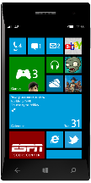
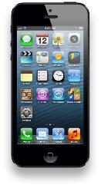
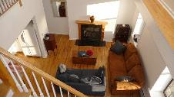




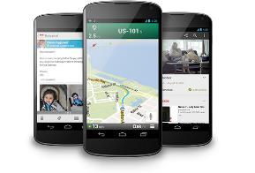
Infrastructure is already in place
Home
Mall
Restaurant
Coffee Shop

Slide 3
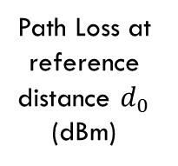
The Problem
Estimating distance from Received Signal Strength (RSSI) is hard
  Path loss propagation model
distance between TX and RX
$RSSI = {RSSI}_{0} − 10 × n × \log_{10}{\frac{d}{d_{0}}}$ + X
Flat Fading
Path Loss (dBm)
Path Loss at reference distance $d_{0}$ (dBm)
Path Loss Exponent
(2 - 4)
Reference distance between TX and RX
Realistic indoor environments introduce significant noise
  Multipath fading
  Signal occlusions due to objects/walls
  Signal diffractions depending on the object’s material

Slide 4
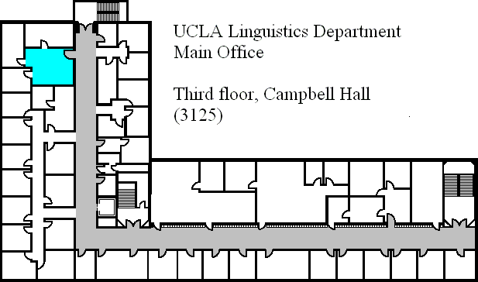
The Problem
[Bahl2000]

Slide 5
Fingerprint-based Indoor Localization
Key idea:
  Map signal strengths to physical locations (Radio Fingerprinting)
Inputs:
  Signal strength of access point beacons
  Building geometry/map
Offline phase: Construct a Radio Map
  <Location, RSSI> information
Online phase:
  Extract RSSI from base station beacons
  Find Radio Map entry that best matches the measured RSSI values

Slide 6






Outline
WiFi
FM
GSM
Magnetic Field
Sound
What’s Next?

Slide 7
WiFi Fingerprinting

Slide 8
RADAR – Offline Phase
For every location, and for every user orientation at this location:
  < <x,y,z>, <RSSI^{A}, RSSI^{B}, RSSI^{C}> >
  RSSI values averaged over multiple measurements to capture
    Stochastic variations of wireless signals
    The effect of user orientation
A
RSSI Map
  < <x,y,z>, <A:10, B:20, C:15> >
  < <x,y,z>, <A:12, B:19, C:15> >
…
C
  < <x’,y’,z’>, <A:0, B:30, C:40> >
B
[Bahl2000]

Slide 9
RADAR – Online Phase
At the unknown location, record all RSSI values:
  < RSSI^{A}, RSSI^{B}, RSSI^{C} > = < A:11, B:20, C:13 >
  The location of the closest fingerprint in the RSSI Map becomes the location of the user: <x,y,z>
$$D= \sqrt{{\left({RSSI}^{A}−{RSSI}_{MAP}^{A}\right)}^{2}+{\left({RSSI}^{B}−{RSSI}_{MAP}^{B}\right)}^{2}+{\left({RSSI}^{C}−{RSSI}_{MAP}^{C}\right)}^{2}}$$
A
RSSI Map
  < <x,y,z>, <A:10, B:20, C:15> >
  < <x,y,z>, <A:12, B:19, C:15> >
…
C
  < <x’,y’,z’>, <A:0, B:30, C:40> >
B
Closest fingerprint – User Location: <x,y,z>
[Bahl2000]

Slide 10
RADAR
DEMO

Slide 11
RADAR – Performance
3-story office building
  43.5m x 22.5m
  3 Access points
Median Error: 2.94 meters
90% Error: 10 meters
[Bahl2000]

Slide 12
RADAR – Neighbor Averaging
N₁
N₁, N₂, N₃: neighbors
T: true location of user
G: guess based on averaging
T
G
N₂
N₃
Median Error Distance when averaging over 3 neighbors: 2.13 meters
[Bahl2000]

Slide 13
Radar - Overview
Introduced WiFi fingerprinting
  Median error of 2.1 meters
  90% within 10 meters
Limitations
  Profiling effort
    For each location multiple measurements for each user orientation
  Accuracy is good, but not ideal
  Performance
    What if the RSSI map is large?

Slide 14
Probabilistic Fingerprinting
RADAR leverages deterministic fingerprinting
  Averaging RSSI values over multiple measurements at a given location to create radio map
  Fails to accurately capture wireless channel characteristics
    Temporal variations and correlations
    Spatial variations
Probabilistic Fingerprinting
  Accurately capture signal variations during the radio map creation
  Leverage probabilistic techniques (i.e., Bayesian models) for fingerprint matching

Slide 15
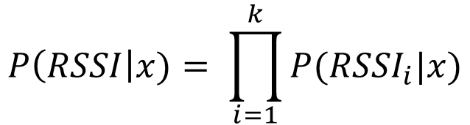
Horus: Main Idea
Offline Fingerprinting
  Store distributions of RSSI values for a given location in the RSSI map (parametric or non-parametric)
    For location x, we store: P(RSSI|x)
Online Fingerprinting
  Record a new distribution of RSSI values
  Identify location x from the RSSI map that satisfies:
  P(RSSI|x) can be calculated directly from the radio map
$${argmax}_{x}P\left(x\right|RSSI)={argmax}_{x}P\left(RSSI\right|x)$$
$$P\left(RSSI\right|x)= \prod_{i=1}^{k}{P({RSSI}_{i}|x)}$$

Slide 16
Horus: Architecture
[Youssef2005]

Slide 17
Horus: Offline
Group together all points covered by the same set of access points
Performance
  Enable faster fingerprint matching during the online phase
[Youssef2005]

Slide 18


Horus: Offline
Builds the radio map
  Distribution of RSSI values
Accounts for temporal variations of RSSI values
  Autoregressive model
$${RSSI}_{t}= α{RSSI}_{t−1}+(1−α)u_{t}$$
$$0≤ α ≤1$$
[Youssef2005]

Slide 19



Horus: Offline
Estimate the value of in the autoregressive model
Estimate the parameters of the RSSI distribution
  Gaussian distribution
$$α$$
$${RSSI}_{t}= α{RSSI}_{t−1}+(1−α)u_{t}$$
$$0≤ α ≤1$$
[Youssef2005]

Slide 20
Horus: Online
Average consecutive N RSSI values
[Youssef2005]

Slide 21
Horus: Online
Returns the radio map location closest to the recorded fingerprint
[Youssef2005]

Slide 22
Horus: Online
Perturbs the RSSI value from each access point in the online fingerprint, and then re-estimates the location
  Chooses the closest to the initially estimated location
Continuous Location Sensing
  Averaging of top candidate locations
  Time-averaging in the physical space
[Youssef2005]

Slide 23
Horus: Evaluation
110 locations along the corridor and 62 locations inside rooms.
21 access points
Fingerprinting at 1.52m resolution
[Youssef2005]

Slide 24
Horus: Evaluation
90th percentile error: 1.5 meters
[Youssef2005]

Slide 25
Horus
Probabilistic Fingerprinting
  Properly model the stochastic variation of WiFi signals at the fingerprinting stage
  Parametric or non-parametric distributions
  Clutering of locations to improve performance
90% Error
  Horus: 1.5m
  RADAR: 10m

Slide 26
What if accuracy <1m is required?
Am I looking at the toothpaste or the shampoo shelf?
RSSI only changes over several meters
  Fundamentally limits localization accuracy
Exploit the physical layer!
  Beyond RSSI values
  More fine-grain information used for fingerprinting
  Hopefully more unique, and therefore more accurate!

Slide 27
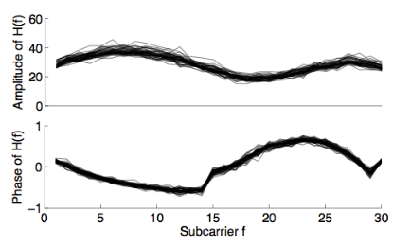
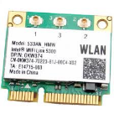
PinLoc: Fingerprinting Wireless Channel
802.11 a/g/n implements OFDM
  Wideband channel divided into subcarriers
1 2 3 4 5 6 7 8 9 10 39 48
Frequency subcarriers
Intel 5300 card exports frequency response per subcarrier
[Sen2012]

Slide 28
Two Key Hypotheses Need to Hold
Temporal
  Channel responses at a given location may vary over time
  However, variations must exhibit a pattern – a signature
1.
2.
Spatial
  Channel responses at different locations need to be different
[Sen2012]

Slide 29
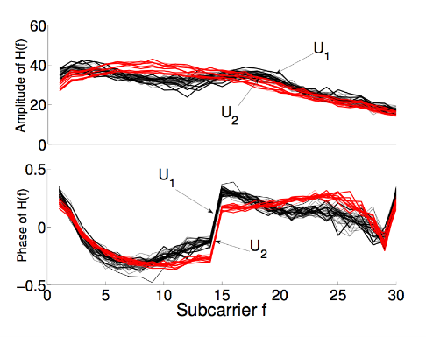
Variation over Time
Measured channel response at different times
cluster2
cluster2
[Sen2012]

Slide 30
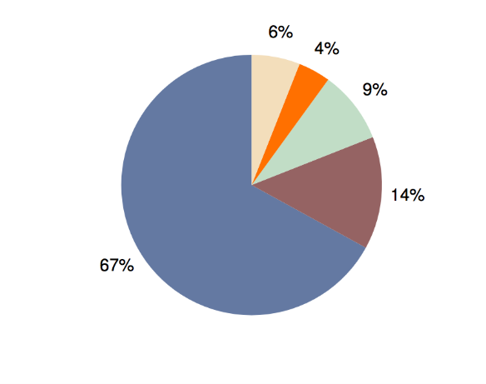
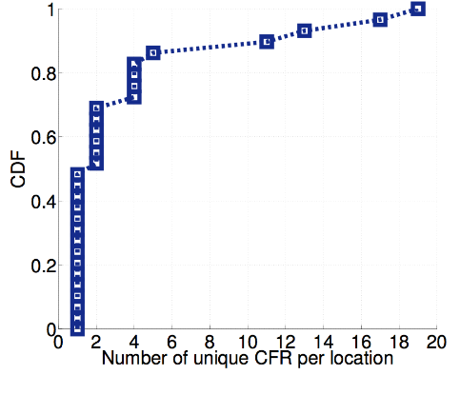
How Many Clusters per Location?
Others
4th
3rd
2nd
most
Most
frequent
cluster
Unique clusters per location
[Sen2012]

Slide 31
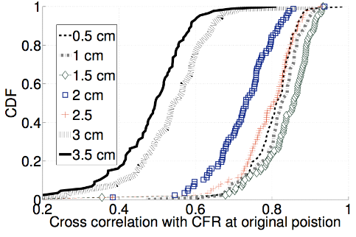

Localization Granularity
3 cm apart
2 cm apart
Cross correlation with signature at reference location
Channel response changes every 2-3cm
Define “location” as 2cm x 2cm area, call them pixels
[Sen2012]

Slide 32
Pixel Signature Variation
>
Max ( )
Self
Similarity
Cross
Similarity
Pixel 1
Pixel 2
Im (H(f))
Pixel 3
Real (H(f))
[Sen2012]

Slide 33
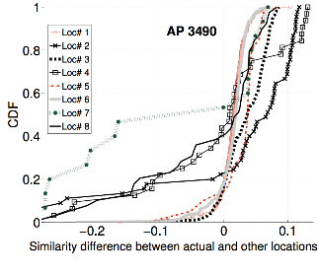
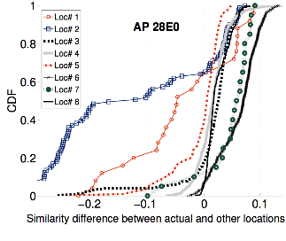
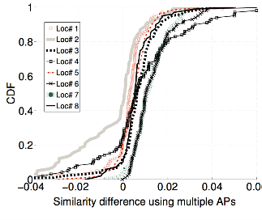
For correct pixel localization:
>
Max ( )
0
Self
Similarity
-
Cross
Similarity
AP1
AP2
AP1 and AP2
Self – Max (Cross)
Self – Max (Cross)
Self – Max (Cross)
67% pixel accuracy with multiple APs
[Sen2012]

Slide 34
Group Pixels into Spots
2cm
Pixel
Spot
Intuition: low probability that a set of pixels
will all match well with an incorrect spot
[Sen2012]

Slide 35

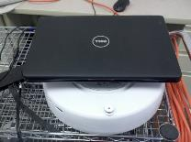
PinLoc Evaluation
Evaluated PinLoc (with existing building WiFi) at:
  Duke museum
  ECE building
  Café (during lunch)
Roomba calibrates
  4 min each spot
  Testing next day
  Compare with Horus (best RSSI based scheme)
[Sen2012]

Slide 36
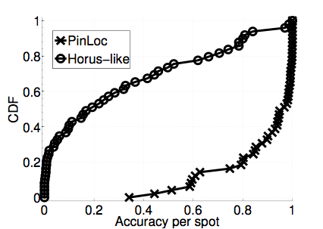
Performance
Horus
PinLoc
Accuracy per spot
90% mean accuracy, 6% false positives
WiFi RSSI is not rich enough, performs poorly - 20% accuracy
[Sen2012]

Slide 37
PinLoc: Fingerprinting Wireless Channel
Leverage physical layer information for fingerprinting
  Fine-grain fingrprinting
  Predictable temporal variations
Highly accurate localization
  <1 meters accuracy!
Extensive profiling is required!

Slide 38
Broadcasted FM signal fingerprinting

Slide 39
WiFi Limitations
Reasonable Accuracy
Low Cost
Sensitive to human presence
Commercial APs
Variation over Time
Blind Spots

Slide 40
FM Signals
Occupy 87.8-108MHz, a total of 20.2MHz and 101 channels
Low power receivers in most phones
Existing Infrastructure
(FM Radio Towers)
More robust to human presence/orientation
Excellent indoor penetration

Slide 41
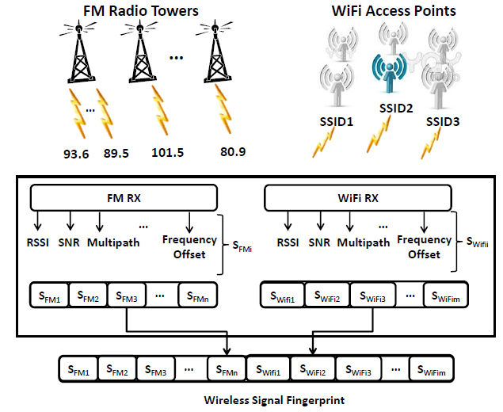
FM stations as WiFi Access Points
Use additional physical layer information to enable more robust fingerprints
  The way signals are reflected is unique to the given location, and multipath indicators can capture this.
[Chen2012]

Slide 42
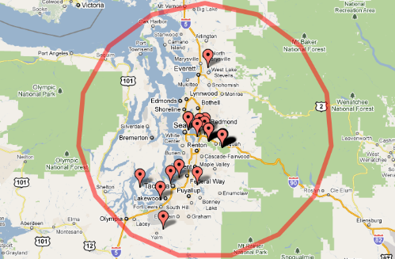
FM Towers are Sparse
[Chen2012]

Slide 43
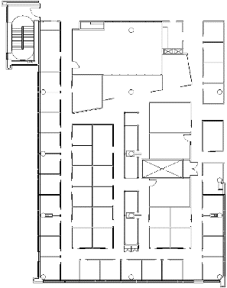
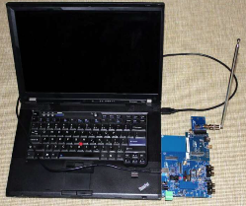
Experimental Study
Silicon Labs SI-4735 Receiver
  Leading manufacturer of FM receivers
  Access to low level physical information
    RSSI
    Signal to noise ratio indicator (SNR)
    Multipath indicator
    Frequency Offset indicator
Data Collected
  WiFi RSSI values
  32 FM radio stations
MS Office building
(3 Floors, 119 rooms)
[Chen2012]

Slide 44
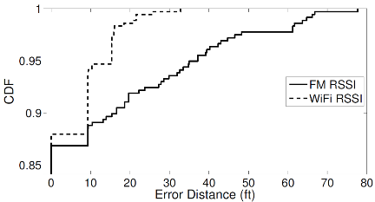
Localization Method & Accuracy
Room level localization (room size: 9ft x 9ft)
  Multiple measurements per room at different locations
  65% train, 35% test
  Localization result: the nearest neighbor (Manhattan distance) in signature space
[Chen2012]

Slide 45
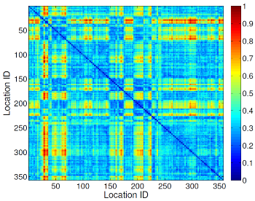
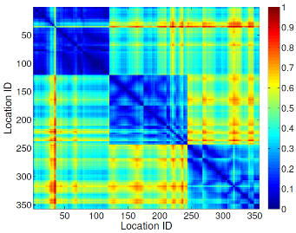
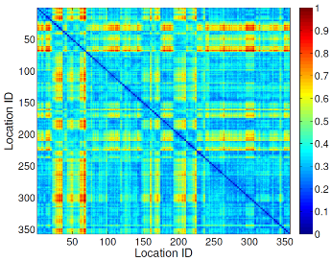
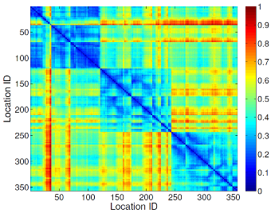
Fingerprint Distance Matrices
FM RSSI
WiFi RSSI
FM ALL
FM ALL + WiFi RSSI
[Chen2012]

Slide 46
Localization Method & Accuracy
Room level localization
  Multiple measurements per room at different locations
  65% train, 35% test
  Localization result: the nearest neighbor (Manhattan distance) in signature space
[Chen2012]

Slide 47
Localization Method & Accuracy
Temporal variation
  4 additional datasets were collected (days, weeks, months apart)
  Train:1 dataset , Test: the rest 4 datasets
  Average accuracy reported across all possible train/test combinations.
[Chen2012]

Slide 48
Localization Method & Accuracy
Temporal variation & larger training set
  Train: 4 datasets , Test: the remaining 1 dataset
  Average accuracy reported across all possible train/test combinations.
[Chen2012]

Slide 49
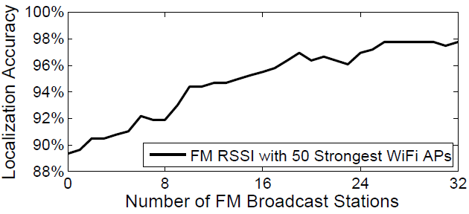
Is 32 the magic number?
Radio | Power | Scan Time
WiFi | 800mW | 1s
FM | 40mW | 1.5s
[Chen2012]

Slide 50
FM Localization
FM-based indoor localization
  Similar or better room-level accuracy compared to WiFi
  FM signals exhibit less temporal variations to WiFi signals
The use of additional signal indicators at the physical layer can improve localization accuracy by 5%.
Errors of FM and WiFi signals are independent
  Combining FM and WiFi signatures provides the highest localization accuracy
  >80% improvement when considering temporal variations

Slide 51
Fingerprint Reduction
Leverage signal propagation models to reduce fingerprinting
  Already done with WiFi, but:
    Temporal variation and sensitivity of WiFi signals to environmental changes (small objects etc.) can affect accuracy
    Hard to know signal properties (e.g., directional gain)
FM signals are a better fit for RSSI modeling

Slide 52
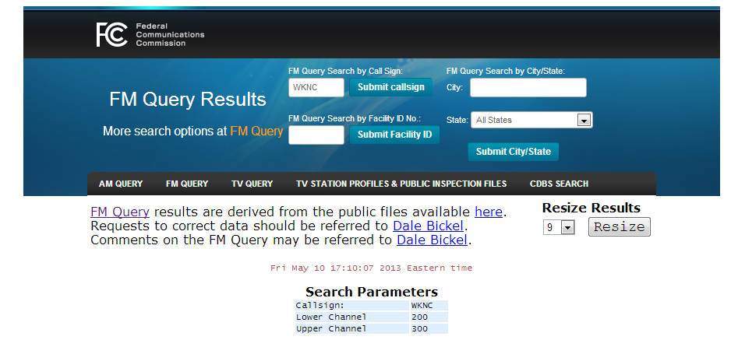
Accurate Source Information
FCC Query Database
  http://transition.fcc.gov/fcc-bin/fmq?=callsign
[Yoon2013]

Slide 53
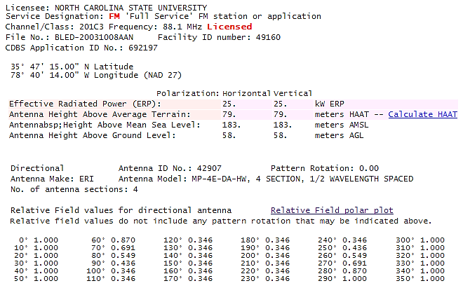
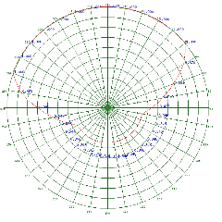
Accurate Source Information
Raw Information from the FCC database
  FM station coordinates
  Signal Strength
  Antenna direction and height
  http://transition.fcc.gov/fcc-bin/fmq?call=WKNC
[Yoon2013]

Slide 54
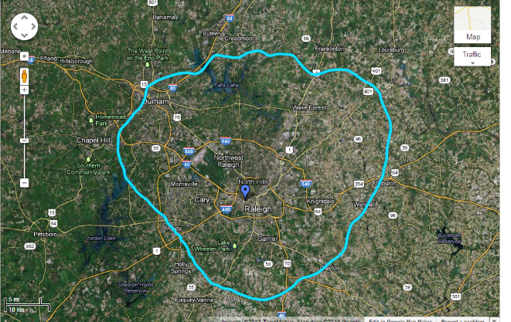
Accurate Source Information
What can we get from this?
  FM signal strengths at a local building
[Yoon2013]

Slide 55
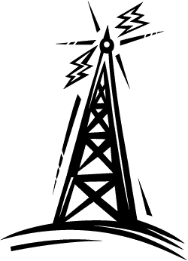
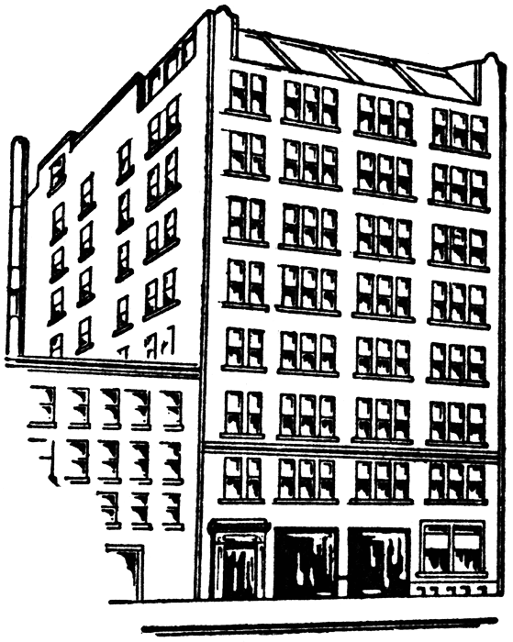
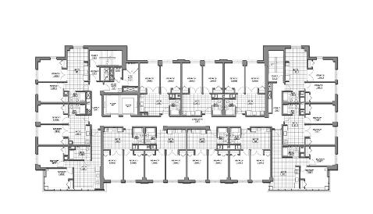
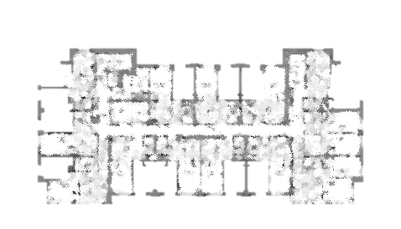
Accurate Source Information
153○
25○
Estimated RSS distribution
[Yoon2013]

Slide 56
Indoor RSSI Estimation
Process raw source information to estimate indoor RSSI
  TX power
  Distance and direction
  Antenna height and directive gain
  Building structure information (floorplan)
How?
  Existing mathematical model for outdoor path loss
  Empirical measurement study for indoor path loss
[Yoon2013]

Slide 57
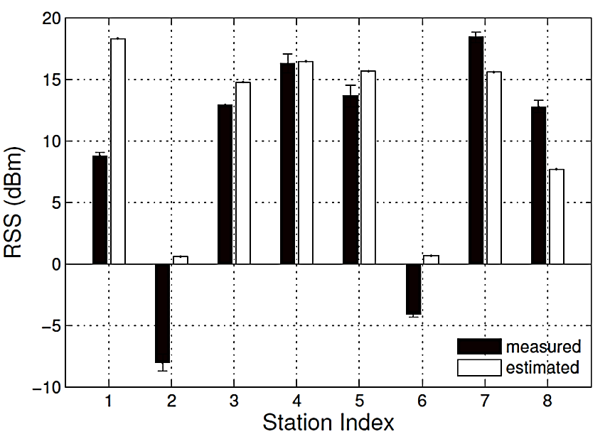
Indoor RSSI Estimation
First step: estimate RSSI at building surface
  Maximum indoor RSSI
Outdoor path model is used
  Perez-Vega et al., “Path-loss model for broadcasting applications and outdoor communication systems in the VHF and UHF bands,” IEEE Transactions on Broadcasting, 2002
  Distance, height difference, TX power
[Yoon2013]

Slide 58
Indoor RSSI Estimation
Second step: RSSI distribution over the floor
  Empirical study
[Yoon2013]

Slide 59
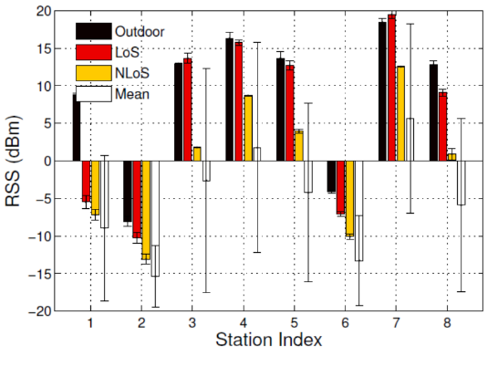
Indoor RSSI Estimation
Exterior Wall completely blocks the FM signals
  Open doors and windows are major source of signals indoors
Visibility of FM tower matters
[Yoon2013]

Slide 60
Indoor RSSI Estimation
Significant indoor path loss
  Path loss exponent: 2.2
Indoor walls significantly attenuates the signals
[Yoon2013]

Slide 61
Indoor RSSI Estimation
VHF signals diffract frequently
[Yoon2013]

Slide 62
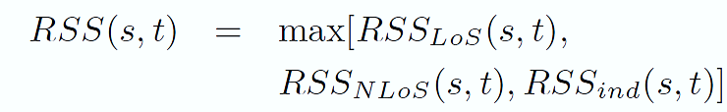


Indoor RSSI Estimation
Based on the log-distance model
[Yoon2013]

Slide 63
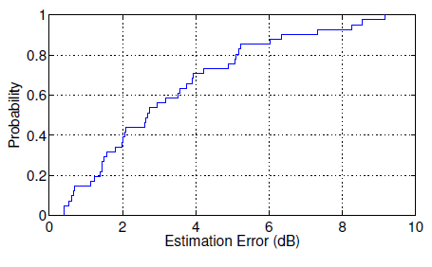
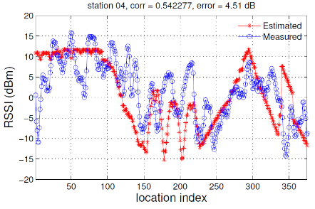
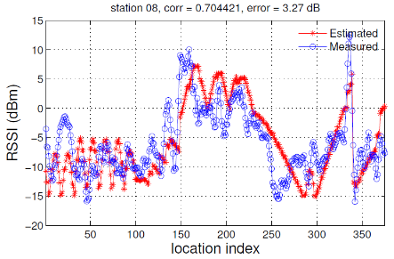
Indoor RSSI Estimation
Reasonable accuracy, but not perfect!
Average Localization Accuracy: 15m
Maximum error: 32m
[Yoon2013]

Slide 64
Mitigating Errors
Different model parameters
  Variance in building materials
  Obstacles that do not appear on the floorplan
Parameter Calibration
Online Path Matching
Calibrate the model parameters at known reference points
Search user’s location based on the multitude of RSS values
RSSs are sampled during user’s walking
[Yoon2013]

Slide 65
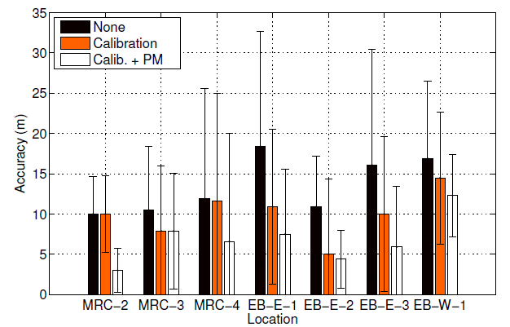
Localization Accuracy
7 different campus locations
  USRP/GNU Radio combined with FM antenna
  Tested with over 1100 indoor spots
[Yoon2013]

Slide 66
GSM Fingerprinting

Slide 67
GSM Basics
North America GSM
  850MHz and 1900MHz frequency bands
  Each band subdivided into 200KHz wide physical channels using FDMA
  Each physical channel is subdivided to 8 logical channels using TDMA
  Physical channels: 299 in 1900MHz band and 124 in the 850MHz band
Each GSM cell broadcasts control packets at the maximum power through the broadcast control channel (BCCH)

Slide 68
GSM Wide Fingerprinting
Multiple Buildings
  University (88mx113m)
  Research Lab (30mx30m)
  House (18mx6m)
[Varshavsky2007]

Slide 69
GSM Fingerprinting
within floor accuracy
across floor accuracy
[Varshavsky2007]

Slide 70
Magnetic field Fingerprinting

Slide 71

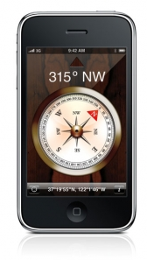
Indoor Positioning Using Geo-Magnetism
Indoor positioning system using magnetic field as location reference
?
[Chung2011]

Slide 72
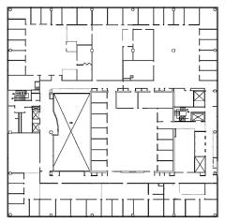
Magnetic Field Distortion
Heading Error ( in degree)
40 m
40 m
A magnitude map (in units of μT) of the magnetic field.
[Chung2011]

Slide 73
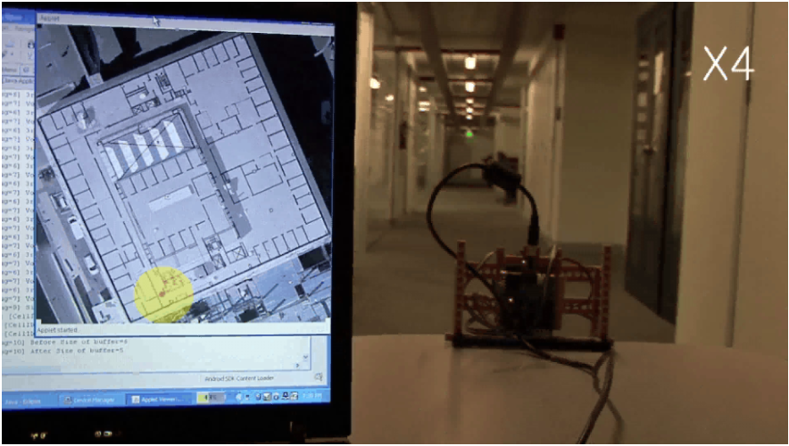
Demo
[Chung2011]

Slide 74
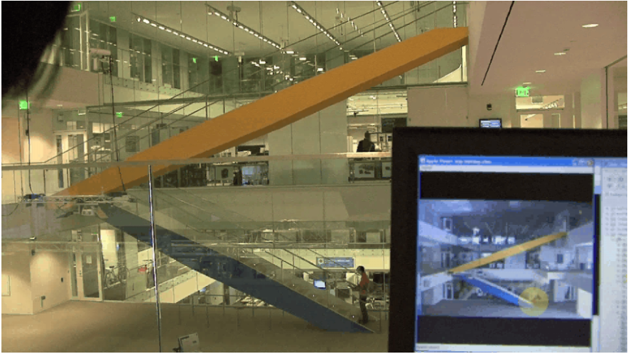
Demo
[Chung2011]

Slide 75
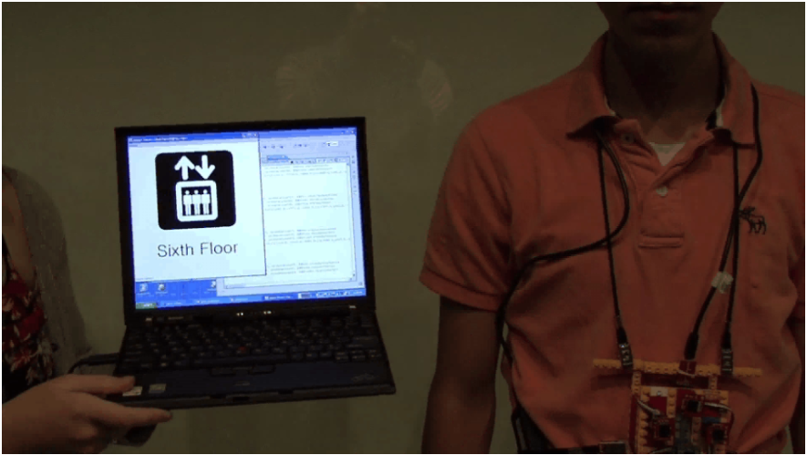
Demo
[Chung2011]

Slide 76
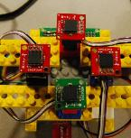
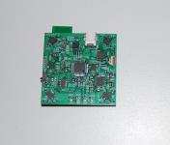


Hardware Setup
10 Hz sampling rate: 4 magnetometers, 1 Gyro, 1 Accel.
M
M
M
M
5 cm
I2C MUX
G
A
5 cm
I2C BUS
MPU
Bluetooth
SerialPort
SD card
Magnetic sensor (M): 3 axes HMC5843
Gyroscope sensor (G): 3 axes ITG-3200
Accelerometer sensor (G): 3 axes ADXL345
MPU : ATmega328
[Chung2011]

Slide 77

Fingerprint Matching Method
Data format
  At each step, 3-dimensional X4 vector d_{raw} = [m_{x1,} m_{y1,} m_{z1,} m_{x2,} m_{y2,} m_{z2,} m_{x3,} m_{y3,} m_{z3,}m_{x4,} m_{y4,} m_{z4}] is produced from a magnetic sensor badge.
  Locations and directions are indexed
    Map E = {d_{1,1} …d_{L,K}} where
      L is the location index
      K is the rotation index
Least RMS based Nearest Neighborhood:
  Given a map dataset E and target location fingerprint d, then a nearest neighbor of d, d’ is defined as
  L and K of the d’ are predicted location and direction.
[Chung2011]

Slide 78


Data Collection Process
  Map fingerprints were collected at every 2 feet (60 cm) on the floor rotating sensor attached chair at the height of 4 feet above ground.
  The test data set was collected in a similar manner, sampling one fingerprint per step (2 feet), a week later than the creation of the fingerprint map.
[Chung2011]

Slide 79


Data Collection Process
Meter
5
5
10
20
30
Corridor: 187.2m x 1.85m #fingerprints: 37200
Atrium: 13.8m x 9.9m #fingerprints: 40800
[Chung2011]

Slide 80


Accuracy
Corridor
Atrium
[Chung2011]

Slide 81
Indoor Positioning Using Geo-Magnetism
Accurate indoor localization
However
  Building needs to have metallic skeleton
  Extensive fingerprinting is needed

Slide 82
Acoustic background sound Fingerprinting

Slide 83
Acoustic Background Spectrum
Given:
  A smartphone
  A building composed of many rooms
  At least one prior visit to each room for training
Without:
  Specialized hardware
  Anything installed in the environment
  Cooperation from the building owner
Goal:
  Determine which room the smartphone is currently located in
[Tarzia2011]

Slide 84
Acoustic Background Spectrum
DEMO

Slide 85
Signal Processing
[Tarzia2011]

Slide 86
Fingerprints
[Tarzia2011]

Slide 87
Experimental Setup
To guess the current location find the “closest” fingerprint in a database of labeled fingerprints.
[Tarzia2011]

Slide 88
Localization Accuracy
[Tarzia2011]

Slide 89
Parameter Estimation
[Tarzia2011]

Slide 90
Acoustic Background Spectrum
Feasible room-level localization!
Sound limitations
  Hard to achieve higher accuracy
  High interference when multiple people are talking can significantly degrade the accuracy

Slide 91
Conclusions

Slide 92
Fingerprinting Overview
System | Wireless Technology | Positioning Algorithm | Accuracy | Precision | Cost
RADAR | WLAN RSS fingerprints | kNN, Viterbi-like algorithm | 3-5 m | 90% within 5.9 m 50% within 2.5 m | Low
Horus | WLAN RSS fingerprints | Probabilistic method | 2 m | 90% within 2.1 m | Low
PinLock | WLAN PHY | Nearest Neighborhood | <1m | 90% within 1m | High
FM | FM RSSI/PHY | Nearest Neighborhood | 3m x 3m | 90% within 3m Within 1ft possbile | Low
GSM | GSM cellular network (RSS) | Weighted kNN | 5m | 80% within 10m | High
Magnetic | Magnetic Fingerprints | Nearest Neighborhood | 4.7 m | 90% within 1.64 m 50 % within 0.71 m | High
Sound | Audio frequency spectrum | Nearest Neighborhood | Room-level | Coarse-grain localization only | Low

Slide 93
What’s Next?

Slide 94




White Space Networking
WiFi-like networking over UHF white spaces
  TV wireless bands currently- FM/AM signals in the future?
  Lower frequency, longer range networking
01/2012 : “World's First Commercial White Spaces Network Launching Today In North Carolina”
04/2012: “Cambridge becomes UK's first White Space city as trials declared a success”
MSR 2009 White Space Network

Slide 95
New Signals
Explore new signals
  Sound, magnetic, etc.
Go crazy!
  Light?
  Aviation signals?
  …?

Slide 96
Complementary Signals
Many localization studies on individual signals
  WiFi or FM or Magnetic or Sound
How do these signals complement each other?
  Can properties of each signal be combined together to achieve
    Perfect accuracy?
    Higher robustness to temporal variations?
    Higher robustness to floorplan changes?
How can we combine the physical layer of each of these signals more effectively?
  Different signals might be able to provide different information at the physical layer.

Slide 97
Fingerprint overhead
Can we reduce/minimize it?
  Combination of multiple signals?
  Combination of fingerprinting and signal propagation models?

Slide 98
REferences

Slide 99
WiFi
[Bahl2000] Bahl, P., Padmanabhan, V.N., "RADAR: an in-building RF-based user location and tracking system", Infocom 2000
[Smailagic2002] Smailagic, A., Kogan, D., "Location sensing and privacy in a context-aware computing environment", Wireless Communications, IEEE , vol.9, no.5, pp.10,17, Oct. 2002
[Youssef2005] Youssef, M., Agrawala, A., "The Horus WLAN Location Determination System", MobiSys 2005
[Castro2001] Castro, P., Chiu, P., Kremenek, T., Muntz, R. A, "Probabilistic Location Service for Wireless Network Environments", Ubiquitous Computing 2001
[Gwon2004] Gwon, Y., Jain, R., Kawahara, T., "Robust Indoor Location Estimation of Stationary and Mobile Users", Infocom 2004
[Haeberlen2004] Haeberlen, A., Flannery, E., Ladd, A., Rudys, A., Wallach, D., Kavraki, L., "Practical Robust Localization
over Large-Scale 802.11 Wireless Networks", Mobicom 2004
[Krishnan2004] Krishnan, P., Krishnakumar, A., Ju, W. H., Mallows, C., Ganu, S., "A System for LEASE: Location Estimation Assisted by Stationary Emitters for Indoor RF Wireless Networks", Infocom 2004
[Ladd2002] Ladd, A. M., Bekris, K., Rudys, A., Marceau, G., Kavraki, L. E., Wallach, D. S., "Robotics-Based Location Sensing using Wireless Ethernet", Mobicom 2002

Slide 100
WiFi
[Roos 2002a] Roos, T., Myllymaki, P., Tirri, H. A, "Statistical Modeling Approach to Location Estimation. IEEE Transactions on Mobile Computing 1, pp. 59–69, 2002
[Roos2002b] Roos, T., Myllymaki, P., Tirri, H., Misikangas, P., Sievanen, J. A, "Probabilistic Approach to WLAN User Location Estimation", International Journal of Wireless Information Networks 9, 3, 2002
[Sen2012] Sen, S., Radunovic, B., Choudhury, R. R., Minka, T., "You are facing the Mona Lisa: Spot Localization Using PHY Layer Information", MobiSys 2012
[Wang2012] Wang, H., Sen, S., Elgohary, A., Farid, M., Youssef, M., Choudhury, R. R., "No Need to War-Drive: Unsupervised Indoor Localization", Mobisys 2012
[Chintalapudi2010] Chintalapudi, K. K., Iyer, A. P., Padmanabhan, V., Indoor Localization "Without the Pain", Mobicom 2010

Slide 101
FM
[Chen2012] Chen, Y., Lymberopoulos, D., Liu, J., Priyantha, B., "FM-based indoor localization", MobiSys 2012
[Yoon2013] Yoon, S., Lee, K., Rhee, I., "FM-based Indoor Localization via Automatic Fingerprint DB Construction and Matching", MobiSys 2013
[Matic2010] Matic, A., Popleteev, A., Osmani, V., Mayora-Ibarra, O., "Fm radio for indoor localization with spontaneous recalibration", Pervasive Mob. Comput., vol. 6, 2010.
[Popleteev2012] Popleteev, A., Osmani, V., Mayora-Ibarra, O., "Investigation of indoor localization with ambient FM radio stations", PerCom, 2012.
[Moghtadaiee2011a] Moghtadaiee, V., Dempster, A. G., Lim, S. "Indoor localization using FM radio signals: A fingerprinting approach", IPIN, 2011.
[Moghtadaiee2011b] Moghtadaiee, V., Dempster, A. G., Lim, S., "Indoor positioning based on FM signals and Wi-Fi signals", IGNSS, 2011.
[Moghtadaiee2012] Moghtadaiee, V., Dempster, A. G., Li, B., "Accuracy indicator for fingerprinting localization systems", PLANS, IEEE/ION, 2012.
[Youssef2005] A. Youssef, J. Krumm, G. Cermak, and E. Horvitz, "Computing location from ambient FM radio signals commercial radio station signals", IEEE WCNC, 2005.
[Fang2009] Fang, S. H., Chen, J. C., Huang, H. R., Lin, T. N., "Is FM a RF-Based Positioning Solution in a Metropolitan-Scale Environment? A Probabilistic Approach With Radio Measurements Analysis", IEEE Transactions on Broadcasting, 2009

Slide 102
GSM
[Varshavsky2007] Alex Varshavsky, Eyal de Lara, Jeffrey Hightower, Anthony LaMarca, and Veljo Otsason, "GSM indoor localization", Pervasive Mob. Comput. 3, 6 (December 2007), 698-720.
[Otsason2005] Veljo Otsason, Alex Varshavsky, Anthony LaMarca, and Eyal de Lara, "Accurate GSM indoor localization", Ubicomp 2005
[Laitinen2001] Laitinen, H., Lahteenmaki, J., Nordstrom, T., "Database correlation method for GSM location", IEEE Vehicular Technology Conference 2001.
[LaMarca2005] LaMarca, A., Chawathe, Y., Consolvo, S., Hightower, J., Smith, I., Scott, J., Sohn, T., Howard, J., Hughes, J.
Potter, F., Tabert, J., Powledge, P., Borriello, G., Schilit, B., "Place lab: Device positioning using radio beacons
in the wild", Pervasive Computing 2005
[Laasonen2004] Laasonen, K., Raento, M., Toivonen, H., "Adaptive on-device location recognition", Pervasive Computing 2004.

Slide 103
Magnetic - Sound
[Chung2011] Chung, J., Donahoe, M., Schmandt, C., Kim, I.J., Razavai, P., Wiseman, M., "Indoor location sensing using geo-magnetism", MobiSys 2011
[Haverinen2009] Haverinen, J., Kemppainen, A., "Global indoor self-localization based on the ambient magnetic field", Robot. Auton. Syst. 57, 10, 1028-1035, 2009
[Angermann2012] Angermann, M., Frassl, M., Doniec, M., Julian, B.J., Robertson, P., "Characterization of the indoor magnetic field for applications in Localization and Mapping", Indoor Positioning and Indoor Navigation (IPIN), 2012
[Suksakulchai2000] Suksakulchai, S., Thongchai, S., Wilkes, D.M., Kawamura, K., "Mobile robot localization using an electronic compass for corridor environment", Systems, Man, and Cybernetics, 2000
[Haverinen2009] Haverinen, J., Kemppainen, A., "A global selflocalization technique utilizing local anomalies of the ambient magnetic field", ICRA 2009
[Navarro2009] Navarro, D., Benet, G., "Magnetic map building for mobile robot localization purpose," Emerging Technologies & Factory Automation, 2009
[Georgiou2010] Georgiou, E., Dai, J., "Self-localization of an autonomous maneuverable nonholonomic mobile robot using a hybrid double-compass configuration", Mechatronics and its Applications, 2010
[Tarzia2011] Tarzia, S. P., Dinda, P. A., Dick, R. P., Memik, G., "Indoor localization without infrastructure using the acoustic background spectrum", MobiSys 2011

Slide 104
Questions?
dlymper@microsoft.com

