Slide 1
Distance and Angle Measurements-based Indoor Location Estimation
Bodhi Priyantha (bodhip@microsoft.com)

Slide 2

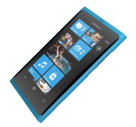
Anchor node
Distance measurement
Orientation measurement
Infrastructure based in door localization:
  “Determine mobile device location using distance and/or orientation measurements to multiple anchor nodes with known location”
Challenges:
  How to measure distances / orientations?
  How to compute location from these measurements
  How to determine (configure) anchor node locations?

Slide 3
Distance Measurement Primitives
Time Of Flight (TOF)
Time Difference Of Flight (TDOF)
Time Difference Of Arrival (TDOA)
Time
Tx
Rx
Time
Tx
Rx
Time
Tx(1)
Tx(2)
Rx

Slide 4
Orientation from Difference in Time of Arrival
Tx
d₂
d
d₁
Rx(2)
θ
L
Rx(1)
When d >> L
  Can be calculated from Time Difference Of Arrival (TDOA) of the signals

Slide 5
Location Estimation Techniques
Triangulation
  Angle and distance measurements
Trilateration
  Distances to multiple anchor nodes
Multilateration
  Distance differences to multiple anchor nodes

Slide 6


Triangulation
Sine Rule
Cosine Rule
Angle and distance measurements
Trigonometric rules determine unknown distances & angles

Slide 7
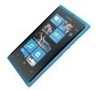
Trilateration
C
A
B
  Distances to multiple anchor nodes
  At least 3(2) distances in 3d(2d) – modulo reflection
More measurements to minimize measurement error

Slide 8
Trilateration : Problem Formulation
- estimated distance
- measured distance

Slide 9
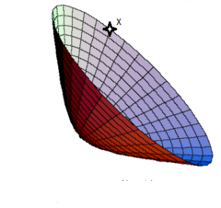
Multilateration
A
B
: defines a hyperbola with foci A and B
Distance differences to multiple anchor nodes
Location from intersecting hyperbolas
At least 4(3) anchors in 3d(2d)
More measurements to minimize measurement error

Slide 10
Multilateration : Problem Formulation
- estimated distance
- measured distance

Slide 11
Distance Measurement Techniques
Audio based: audible and ultrasound
  Advantages
    Slow speed : easy to measure propagation time
    Generation and detection using built-in speakers and mics
  Disadvantages
    Strict line of sight – blocked by most physical materials
    Lack of widely deployed infrastructure
    Interfere with hearing (audible: humans, ultrasound : pets)
RF based
  Advantages
    Widely deployed infrastructure
    Better penetration than audio
  Disadvantages
    High propagation speed: difficult to measure time-of-flight

Slide 12
Rest of the Talk
Audio-Based Distance Measurement
RF-Based Distance Measurement
Orientation Measurement

Slide 13
Audio-Based Distance Measurement
RF-Based Distance Measurement
Orientation Measurement

Slide 14
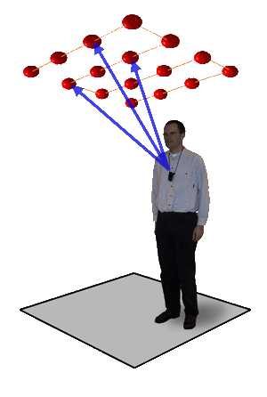
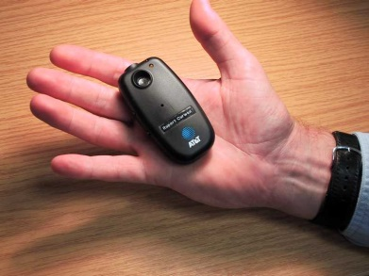
BAT Indoor Location System
First distance measurement based indoor location system: uses TOF
A 1.2m grid of US receivers are wired serially to a central controller
Central controller coordinates BAT transmissions
Mobile BAT transmits 40kHz US pulse of 50µs
The received signals are centrally processed to determine mobile location
Andy Ward, Alan Jones and Andy Hopper, “New Location Technique for the Active Office”, IEEE Personal Communications October 1997

Slide 15
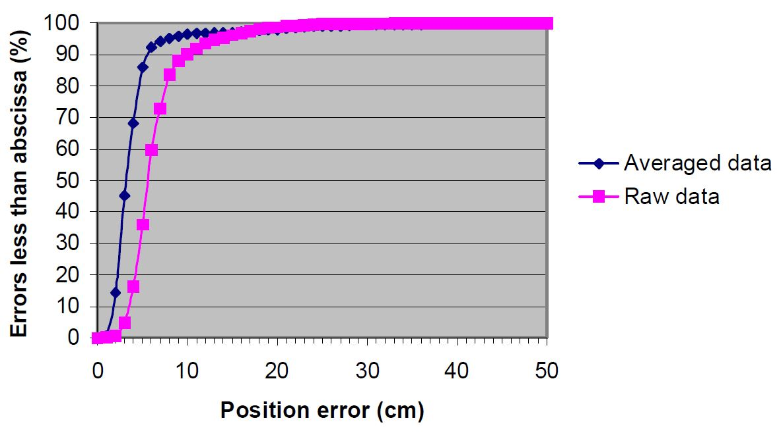
BAT System Performance
Concerns:
  Scalability – single mobile transmission at a time
  Accurately positioned wired infrastructure
  Privacy concerns due to tracking

Slide 16
Cricket Indoor Location System
Beacon
RF data
(space name)
US Reflections
Ultrasound
(pulse)
RF
US
Listener
50 ms ( T_US )
t
Cricket:
  Anchor nodes → beacons
  Mobile node → Listener
Computes distance by TDOF of RF and US
Multipath mitigation: first US pulse to measure distance
  US signals die down after 50mS
Nissanka Priyantha, Anit Chakraborty and Hari Balakrishnan, "The Cricket Location Support System”, MobiCom 2000

Slide 17
Interference Avoidance and Detection
RF1
US1
50 ms ( T_US )
RF2
US2
50 ms ( T_US )
Interference avoidance:
  Encapsulate US pulse by RF
  Beacon carrier sensing limits overlapping Tx
  Hidden terminal → RF collisions at Listener
Interference detection
  Ultrasound interference possible
  Collect multiple samples and filter outliers

Slide 18
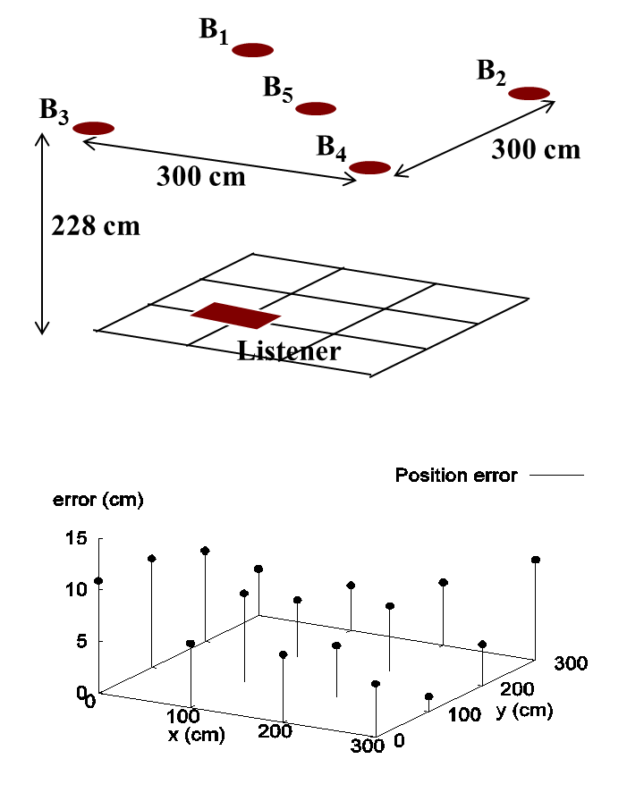
Listener Position Estimation
Uses trilateration
Deployed 5 beacons as shown
Computed listener position at 16 points on a 3m x 3m grid
Position estimation error < 11cm

Slide 19
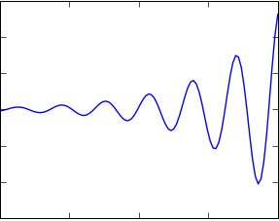
Limitations of Narrowband Ultrasonic Transducers
Previous work used narrowband piezo resonators for US Tx and Rx
  Detecting the start of Rx is hard due to “gradual signal build up”
  Cannot modulate the signals due to narrow band resonator
  Causes large measurement errors
Start ?
Beacon
θ
d
θ
Listener
US Radiation Pattern
Expt. Setup
Error increases with weaker signals

Slide 20
Improving Distance Measurements with Wideband Signals – using DSSS
Radio
Radio
CPU
CPU
Speaker
(Kingstate
KDS-27008)
Microphone
ENSBox Platform
Solution:
  Use wideband transducers
  Encode US signal with a bit sequence to generate a wideband signal (DSSS)
Lewis Girod and Deborah Estrin, “Robust range estimation using acoustic and multimodal sensing", IROS 2011
[Adapted from Girod, “A Self-Calibrating System of Distributed Acoustic Arrays – PhD Defense”]

Slide 21
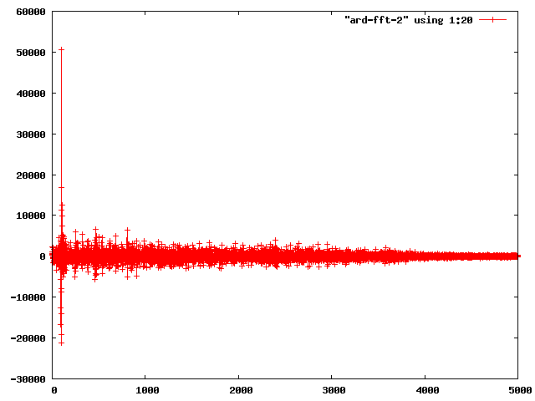
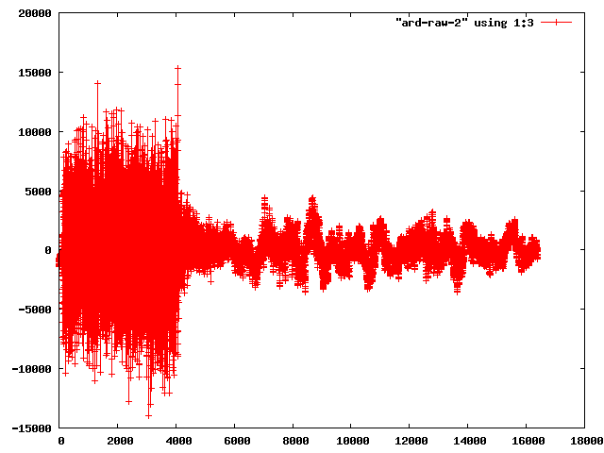
Accurate Timing from Correlation
Signal detection via “matched filter” constructed from PN code
  Observed signal S is convolved with the reference signal
  Peaks in resulting “correlation function” correspond to arrivals
  Earliest peak is most direct path
Reference
Observed
Lag = Time of Flight
[Adapted from Girod, “A Self-Calibrating System of Distributed Acoustic Arrays – PhD Defense”]

Slide 22
VoxNet Signaling and Detection
Wideband ranging signal
  511 bit “M-sequence”
  Modulated using BPSK, 12 kHz
Detected by matched filter
  Earliest “peak” in output of sliding correlator
  M-sequences’ autocorrelation properties result in good process gain
[Adapted from Girod, “A Self-Calibrating System of Distributed Acoustic Arrays – PhD Defense”]

Slide 23
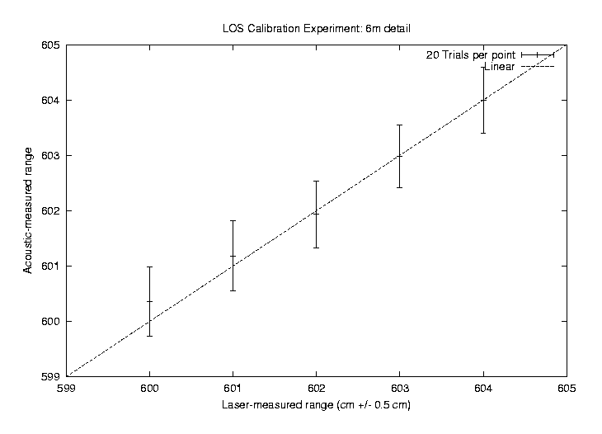
VoxNet Experimental Results
Sub-cm ranging accuracy
No significant error as a function of distance up to 10m
[Adapted from Girod, “A Self-Calibrating System of Distributed Acoustic Arrays – PhD Defense”]

Slide 24
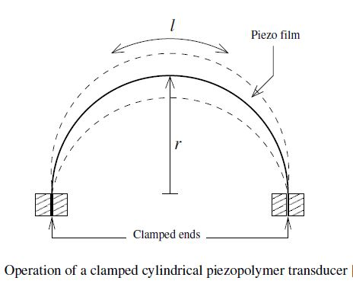
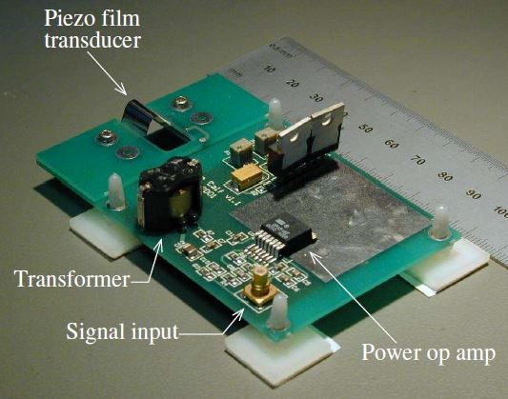
Dolphin – Wideband Ultrasonic DSSS Location System
Custom ultrasonic transmitters and receivers (clamped down piezo film)
DSSS 511 bits – 50kHz carrier 20kHz modulation (BPSK)
90th percentile error 1.75 cm
M. Hazas and A. Hopper, “Broadband Ultrasonic Location Systems for Improved Indoor Positioning,” IEEE Transactions on Mobile Computing, 2006

Slide 25
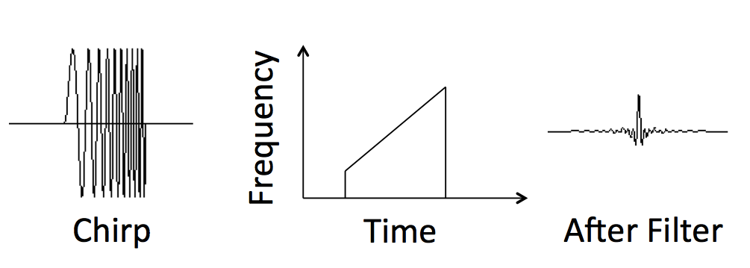
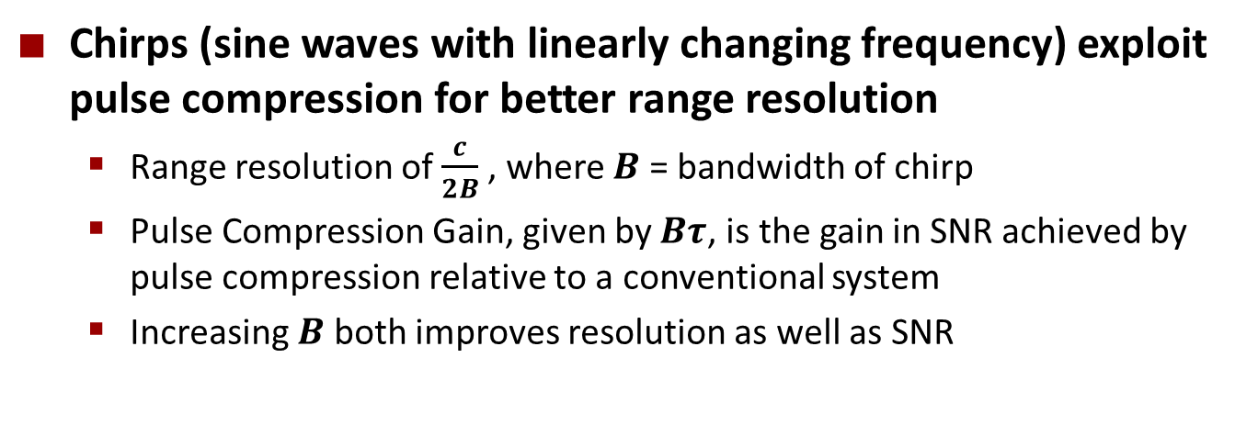
Improving Distance Measurements with Wideband Signals - Pulse Compression
Chirps (sine waves with linearly changing frequency) exploit pulse compression for better range resolution
  Range resolution of $\frac{c}{2B}$ , where $B$ = bandwidth of chirp
  Pulse Compression Gain, given by $Bτ$, is the gain in SNR achieved by pulse compression relative to a conventional system
  Increasing $B$ both improves resolution as well as SNR
[Adapted from Lazik, “Indoor Pseudo-ranging of Mobile Devices using Ultrasonic Chirps”

Slide 26
BeepBeep
Goals
  Use built in audio Tx and Rx of commodity mobile devices
  Accurate distance measurements
Challenges
  Tx and Rx timing issues due to device SW & OS induced delays
  Accurate detection of signal for timing
Chunyi Peng, Guobin Shen, Yongguang Zhang, Yanlin Li and Kun Tan “BeepBeep: A High Accuracy Acoustic Ranging System using COTS Mobile Devices ,” SenSys 2007

Slide 27



The Root Cause of Inaccuracy
– Three Uncertainties
Clock synchronization uncertainty
Sending uncertainty
Receiving uncertainty
software issuing command
software aware of arrival
...
t0 = wall_clock();
write(sound_dev, signal);
...
...
read(sound_dev, signal);
t1 = wall_clock();
...
unknown delays (software, system, driver, hardware, …) ?
sound leaves
speaker
sound
reaches mic
unknown delays (hardware, interrupt, driver, scheduling, …) ?
time
[Adapted from Peng, “BeepBeep: A High Accuracy Acoustic Ranging System using COTS Mobile Devices”

Slide 28



BeepBeep’s Basic Procedure
Device A emits a beep while both recording
Device B emits another beep while both continue recording
Both devices detect TOA of the two beeps and obtain respective ETOAs
Exchange ETOAs and calculate the distance
Device A
Device B
A’s recording
B’s recording
ETOA_{A}
ETOA_{B}
D_{AB}=|ETOA_{A}-ETOA_{B}|/2
[Adapted from Peng, “BeepBeep: A High Accuracy Acoustic Ranging System using COTS Mobile Devices”

Slide 29
Key Techniques
Eliminate the need for exact timing and time synchronization
  Use recorded audio which preserves relative occurrence of physical audio events
  Use “sample counting”- the number of audio samples to represent clock – to avoid need for system clock based timing
Accurate distance estimation (sub cm accuracy)
  Chirps for better ranging resolution
  Multipath mitigation through “first strong peak” detection

Slide 30
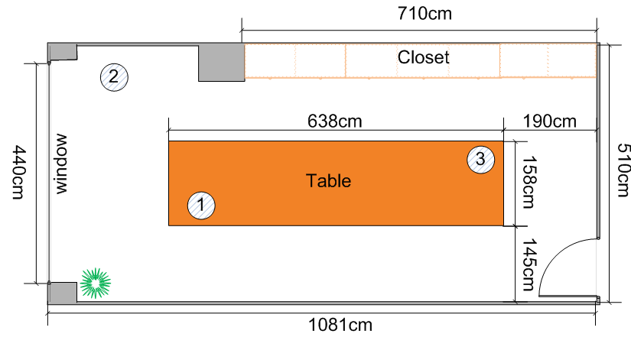
Evaluation
Case-A: Indoor, quiet
Case-B: Indoor, noisy
Case-C: Outdoor, car park entrance
Case-D: Outdoor, subway station
50 runs each setting
Expr Setting | Operation Range | Conf. Level | AA(|Err|) cm | MA(|Err|) cm | A(Std) cm | M(Std) cm
Case-A | 4.0m | 94% | 0.9 | 1.4 | 1.2 | 1.9
Case-B | 4.0m | 94% | 1.1 | 1.7 | 1.0 | 1.3
Case-C | 12m | 98% | 2.7 | 3.8 | 1.0 | 2.1
Case-D | 10m | 92% | 1.0 | 2.2 | 1.4 | 1.6
[Adapted from Peng, “BeepBeep: A High Accuracy Acoustic Ranging System using COTS Mobile Devices”

Slide 31
Indoor Pseudo-ranging of Mobile Devices using Ultrasonic Chirps
Localization indoors in 3D space with sub-meter accuracy
High refresh rate, comparable to consumer GPS receivers
Scalability with respect to simultaneous receivers
No new client-side hardware
Transmitter hardware should be cheap and easy to deploy
Patrick Lazik, Anthony Rowe, “Indoor Pseudo-ranging of Mobile Devices using Ultrasonic Pulse Compression,” SenSys 2012
[Adapted from Lazik, “Indoor Pseudo-ranging of Mobile Devices using Ultrasonic Chirps”

Slide 32
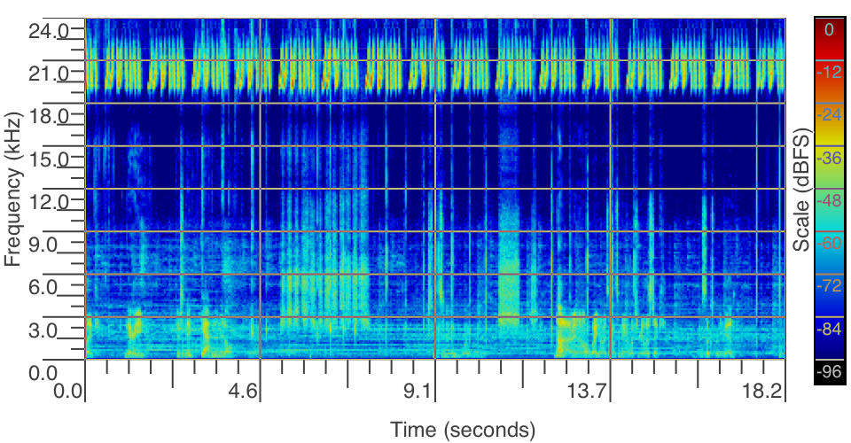
Acoustic Ranging Properties
Human hearing range is approximately 20-20,000Hz
Modern mobile devices sample audio at 48kHz
  Has almost 4kHz of bandwidth to play with
Existing audio infrastructure such as PA systems, speakers at concert venues and conference rooms can potentially be used as transmitters
[Adapted from Lazik, “Indoor Pseudo-ranging of Mobile Devices using Ultrasonic Chirps”

Slide 33
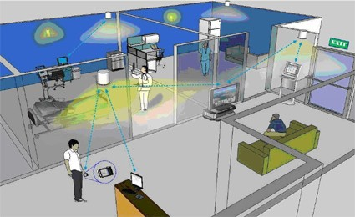
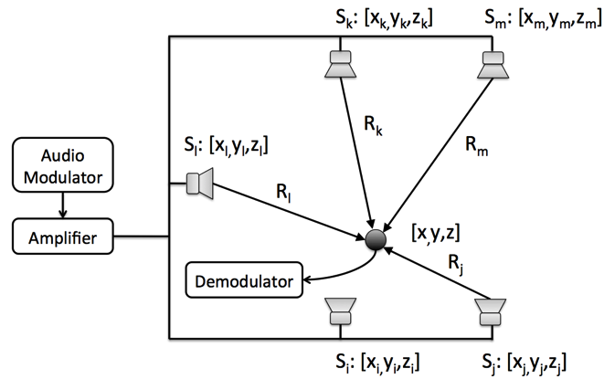
Basic System Architecture
Multiple ultrasonic transmitters deployed around an area continuously transmitting periodic ranging signals
Mobile receiver captures these signals and and compute time difference of arrival of signals
[Adapted from Lazik, “Indoor Pseudo-ranging of Mobile Devices using Ultrasonic Chirps”

Slide 34
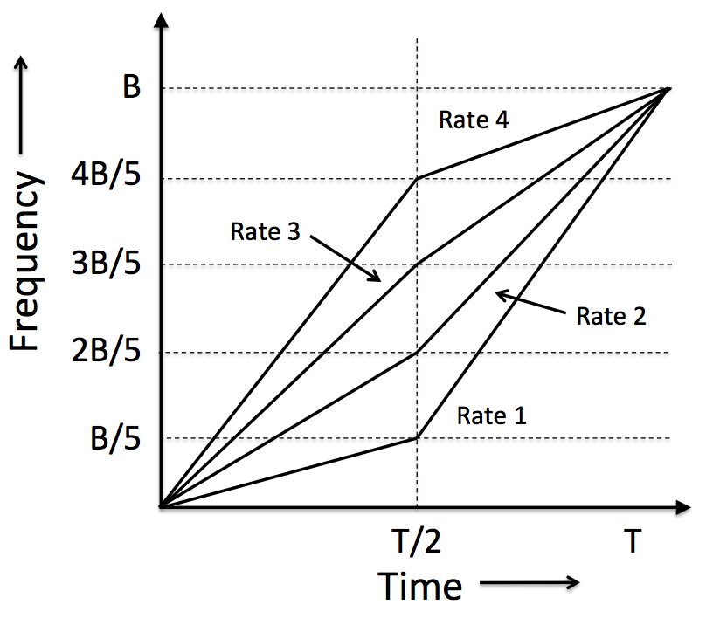
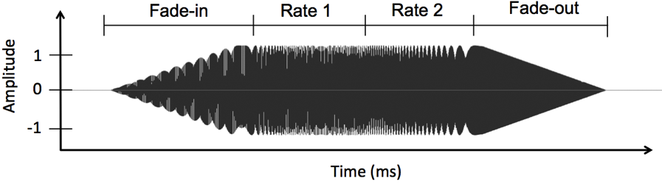
Rate Adaptive Chirp Spread Spectrum
Spread spectrum technique providing multiple access and pulse compression ranging
  RACSS assigns two different rates for the frequency changes to a single chirp.
  Different chirps (symbols) can be disaggregated by matched filtering upon reception.
[Adapted from Lazik, “Indoor Pseudo-ranging of Mobile Devices using Ultrasonic Chirps”

Slide 35
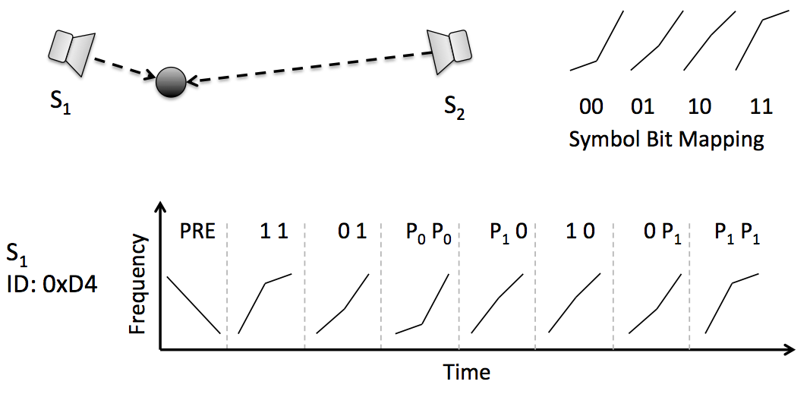
Data Transmission
Identify ID of transmitter from overlapping bit sequences
8-bit sequence (4 symbols), coded with two (7,4) Hamming codes for error correction, creating a 14-bit (7 symbol) sequence
Data sequence is prefixed with a down-chirp preamble
[Adapted from Lazik, “Indoor Pseudo-ranging of Mobile Devices using Ultrasonic Chirps”

Slide 36
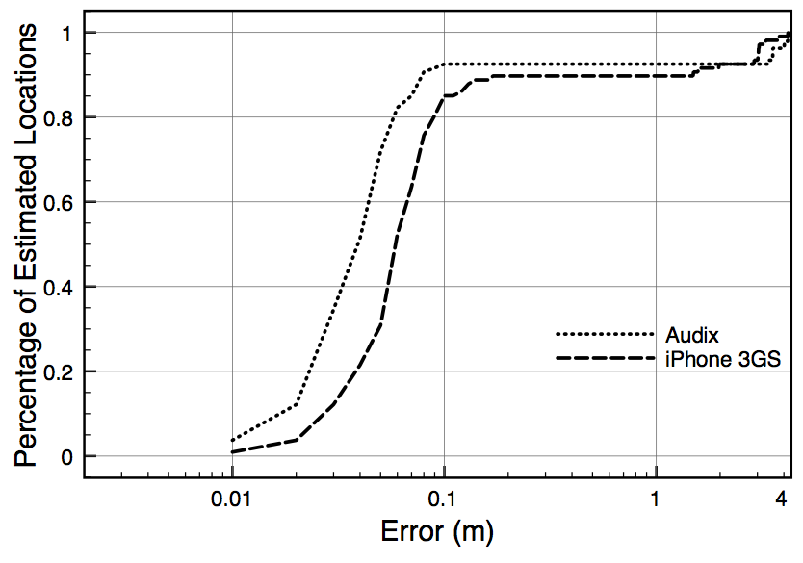
Performance - Localization
[Adapted from Lazik, “Indoor Pseudo-ranging of Mobile Devices using Ultrasonic Chirps”

Slide 37
Audio-Based Distance Measurement
RF-Based Distance Measurement
Orientation Measurement

Slide 38
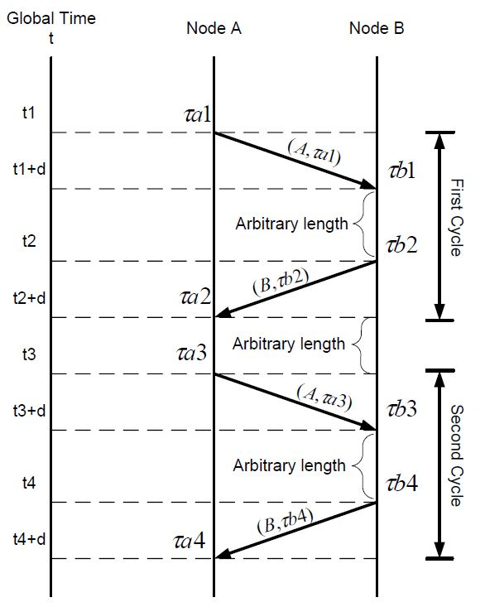
PinPoint (2006) – RF TOF Ranging from Accurate Timestamps
Radios timestamps the Tx and Rx messages
  FPGA running at 300mHz
  Timestamp resolution 3ns
Protocol
  Node A broadcasts a message to B
    Timestamped at A and B at Tx and Rx
  Node B broadcasts a message to A
    Timestamped at B and A at Tx and Rx
  A & B broadcast all the timestamps
  Enough info. To compute pairwise TOF
Protocol with O(n) messages
Moustafa Youssef and Udaya Shankar, “Pinpoint: An asynchronous time-based location determination system,” MobiSys 2006

Slide 39
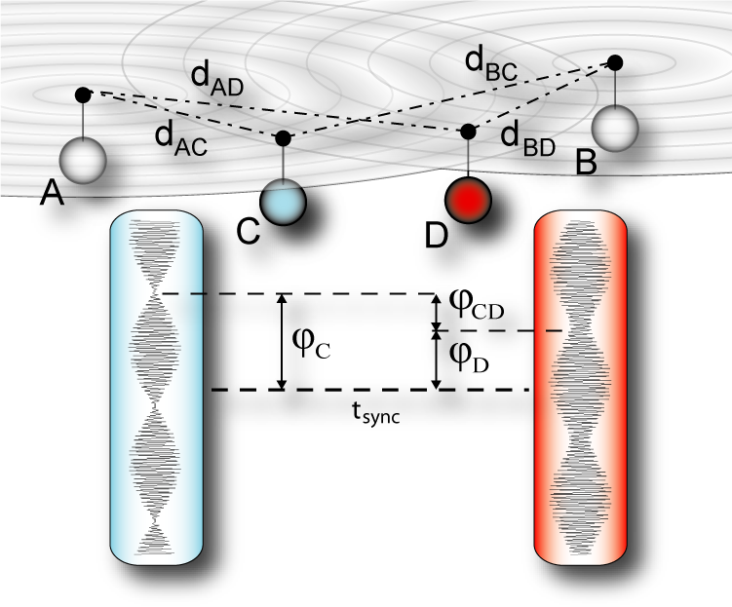
Distance Measurement by Radio Interferometry - RIPS
Nodes A & B generate RF signals with slightly different frequencies
  Composite signal has very low-frequency envelope
Relative phase shift at C & D → function of distances & carrier frequency
  Phase of low-frequency envelope can be measured by RSSI indicator
Can reconstruct relative positions of nodes in 3D by multiple measurements in an 8 (or more) node network
Maroti, M., B. Kusy, G. Balogh, P. Volgyesi, K. Molnar, A. Nadas, S. Dora, and A. Ledeczi, "Radio Interferometric Geolocation", SenSys 2005

Slide 40
RIPS Performance
Advantages
  High accuracy
    Mean error ~ 4 cm
  RSSI-based measurements
    Low clock speed requirements
    Low-power consumption
Concerns
  Impacted by multipath
    Poor indoor performance
  Impacted by radio “phase noise”

Slide 41
Audio-Based Distance Measurement
RF-Based Distance Measurement
Orientation Measurement

Slide 42
Cricket Compass: Angle Estimation
d₂
Beacon
d
d₁
θ
L
cos θ ~ (d2 - d1) / L
Can obtain θ from (d2-d1) and L
For a reasonable value of L, (d2 - d1) needs ~5 mm accuracy
  Beyond Cricket distance estimation accuracy
Solution: use phase difference
Nissanka B. Priyantha, Allen K. L. Miu, Hari Balakrishnan and Seth Teller , “The Cricket Compass for Context-Aware Mobile Applications”, MobiCom 2001

Slide 43
Differential Distance Estimation
d₁
L
θ
d₂
δφ
δφ = d₂-d₁
λ
For unique θ
  Sensor separation (L) < λ/2
  Sensor diameter ~ λ (8 mm)
  Cannot place sensors this close
Solution: Use three sensors

Slide 44
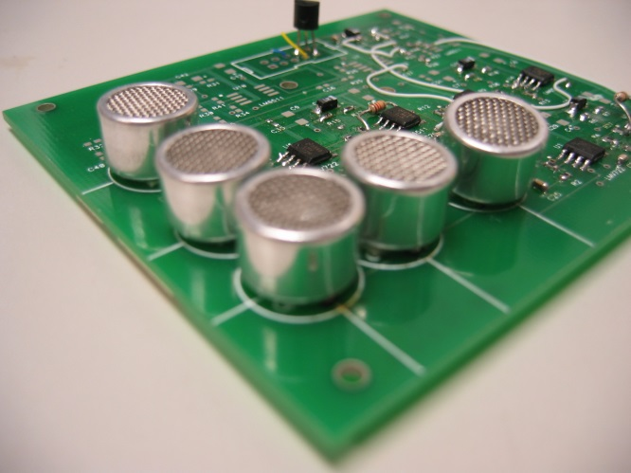
δφ1
δφ2
θ
θ
θ
1.5 λ
2.0 λ
Two sensor arrays on
the compass board
Unique combinations of ( δφ1, δφ2 ) for all θ
Need two arrays for unique solution

Slide 45
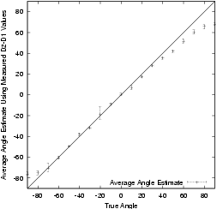
Cricket Compass Performance

Slide 46
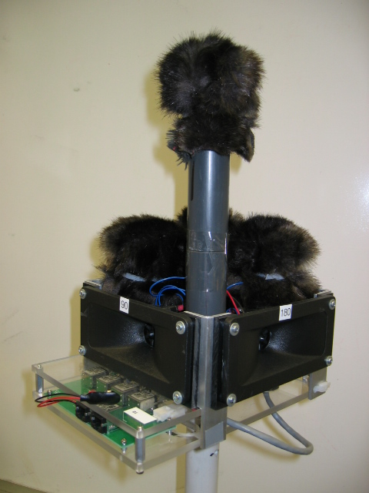
ENSBox: Acoustic Array Configuration
4 condenser microphones, arranged in a square with one raised
Coordinate system defines angles relative to array
(-4,4,14)
0°θ
0°φ
14cm
θ
φ
90°θ
(-4,-4,0)
8cm
L. Girod, M. Lukac, V. Trifa, and D. Estrin, "The Design and Implementation of a Self-calibrating Acoustic Sensing Platform", SenSys 2006
[Adapted from Girod, “A Self-Calibrating System of Distributed Acoustic Arrays – PhD Defense”]

Slide 47
Zooming in.. 8x Interpolation
Sub-sample phase comparison is critical to DOA estimation
  Otherwise, large quantization errors: 1 sample offset = 5°
Once a peak region is identified
  Zoom in by interpolating
  Use Fourier coefficients to expand the signal at higher resolution
Equivalent to phase shift in FD
  But enables direct TD processing of correlation outputs
[Adapted from Girod, “A Self-Calibrating System of Distributed Acoustic Arrays – PhD Defense”]

Slide 48
Array Track: Wireless Angle of Arrival-Based Location
AP overhears a client’s transmission
AP Leverage multiple antennas to generate angles of arrival of a client's signals:
  AoA spectrum: power versus bearing at one AP
With multiple APs, central server synthesizes AoA spectra to obtain a location estimate for the client
AP 1
Client
AP 2
Jie Xiong and Kyle Jamieson, “ArrayTrack: A Fine-Grained Indoor Location System”, NSDI 2013
[Adapted from Xiong, “Array Track: A Fine-Grained Indoor Location System”]

Slide 49
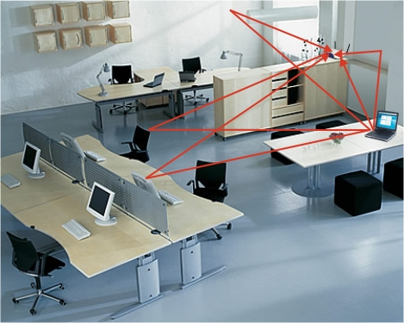
The challenge: multipath reflections
Problem #1: Strong multipath reflections indoors
Problem #2: Direct path attenuated or completely blocked
  Direct path signal may not be the strongest
Wall
AoA spectrum
array
client
AP
Furniture
[Adapted from Xiong, “Array Track: A Fine-Grained Indoor Location System”]

Slide 50
Multipath suppression: find direct path
Key observation: direct path is more stable than reflection paths when client moves slightly
array
AP
Client
[Adapted from Xiong, “Array Track: A Fine-Grained Indoor Location System”]

Slide 51
AoA spectra synthesis
N APs generate N AoA spectra
For a random position X,
the likelihood of probability
is a multiplication of
probabilities from multiple APs
P(x₁) =0.45
AP 1
P(x) = P(x₁) * P(x₂)
X
P(x₂) =0.6
AP 2
[Adapted from Xiong, “Array Track: A Fine-Grained Indoor Location System”]

Slide 52
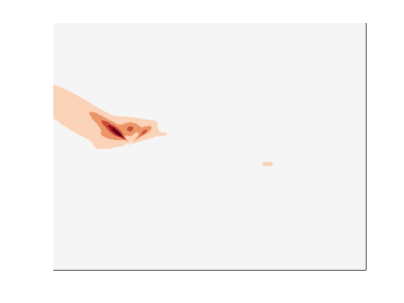
Search for highest probability position
[Adapted from Xiong, “Array Track: A Fine-Grained Indoor Location System”]
Notes:
Tradeoff between increasing parallelism and avoiding local maxima (finer sampling grid) and doing less work (coarser sampling grid)

Slide 53
Multipath suppression improves accuracy
Median: 23 cm
(ArrayTrack with 6 APs)
2.5 cm
23 cm
[Adapted from Xiong, “Array Track: A Fine-Grained Indoor Location System”]

Slide 54
Summery
Indoor distance/angle-based systems: evolved from specialized to COTS devices
Challenges:
  Deployment and maintenance of custom infrastructure
  Incremental deployment of new infrastructure features
  Propagation issues: lack of line-of-sight, multipath
Opportunities:
  HW is evolving
  New technologies (e.g. mm wave)

Slide 55
Questions?

