Slide 1
ProjecToR: Agile Reconfigurable Data Center Interconnect
Monia Ghobadi
Ratul Mahajan Amar Phanishayee Nikhil Devanur Janardhan Kulkarni Gireeja Ranade | Pierre Blanche Houman Rastegarfar Madeleine Glick Daniel Kilper

Slide 2
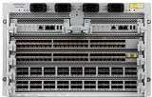
Today’s data center interconnects
A B C D
A B C D
0 | 3 | 3 | 3
3 | 0 | 3 | 3
3 | 3 | 0 | 3
3 | 3 | 3 | 0
0 | 6 | 6 | 0
0 | 0 | 0 | 0
0 | 0 | 0 | 0
0 | 0 | 0 | 0
0 | 0 | 0 | 0
0 | 0 | 0 | 7
0 | 0 | 0 | 7
0 | 0 | 0 | 0
0 | 0 | 0 | 0
0 | 0 | 0 | 0
8 | 0 | 6 | 0
0 | 0 | 0 | 0
A
B
C
D
0 | 0 | 0 | 0
0 | 0 | 0 | 0
0 | 0 | 0 | 0
0 | 12 | 8 | 0
A
B
C
D
0 | 6 | 6 | 0
0 | 0 | 0 | 0
0 | 0 | 0 | 0
0 | 0 | 0 | 0
10Gbps
10Gbps
A
B
C
D
Ideal demand matrix: uniform and static
Non-ideal demand matrix: skewed and dynamic
Static capacity between ToR pairs

Slide 3
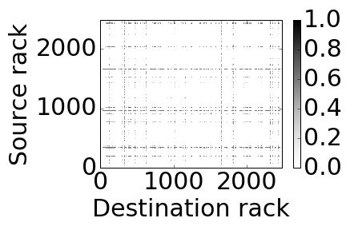
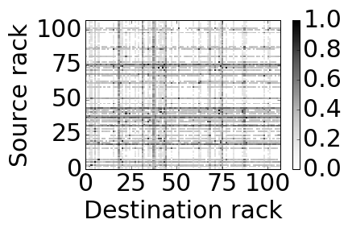
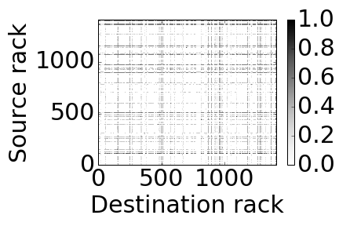
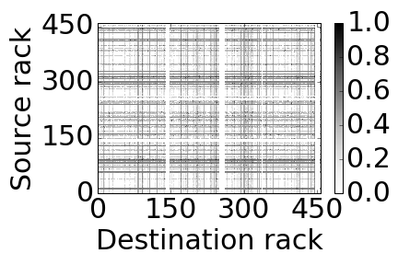
Need for a reconfigurable interconnect
Data:
200K servers across 4 production clusters
Cluster sizes: 100 -- 2500 racks
Observation:
Many rack pairs exchange little trafﬁc
Only some hot rack pairs are active
Implication:
Static topology with uniform capacity:
Over-provisioned for most rack pairs
Under-provisioned for few others
Reconﬁgurable interconnect:
To dynamically provide additional capacity between hot rack pairs

Slide 4
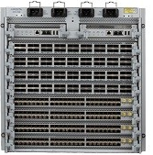
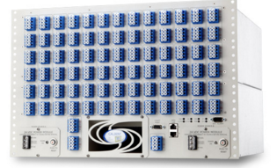
Desirable properties of a reconfigurable interconnect
Static
Reconfigurable
Optical switch
A
B
C
D
Observation:
Traffic matrices differ widely
Implication:
Difficult to determine static vs. reconfigurable divide (Seamless interconnect)

Slide 5
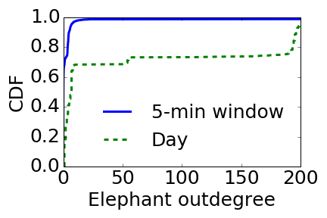
Desirable properties of a reconfigurable interconnect
Observation:
Source racks send large amounts of traffic to many other racks
Implications:
Should create direct links to lots of other racks (high fan-out)
Should switch quickly among destinations (low switching time)

Slide 6
Properties of reconfigurable interconnects
 | Enabler technology | Seamless | High Fan-out | Low switching time
Helios, Mordia [sigcomm’10, sigcomm’13] | Optical Circuit Switch
Flyways, 3D Beam forming [sigcomm’11, sigcomm’12] | 60GHz
FireFly [sigcomm’14] | Free-Space Optics
 | Enabler technology | Seamless | High Fan-out | Low switching time
Helios, Mordia [sigcomm’10, sigcomm’13] | Optical Circuit Switch
3D Beam forming, Flyways [sigcomm’12, hotnets’09] | 60GHz
FireFly [sigcomm’14] | Free-Space Optics
ProjecToR | Free-Space Optics

Slide 7
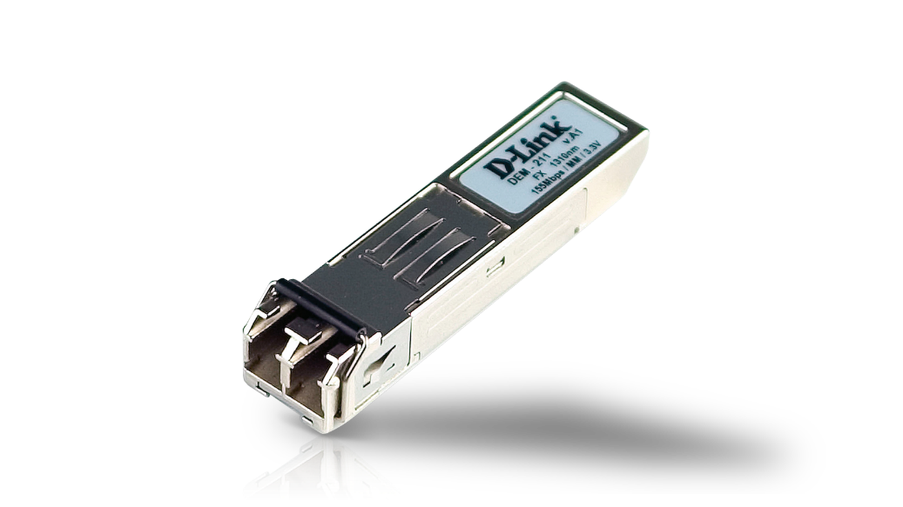
ProjecToR interconnect
Free-space topology (seamless)
18,000 fan-out (60 x more than optical circuit switches)
12 us switching time (2500 x faster than optical circuit switches)
Laser
Photodetector
7
Static topology

Slide 8
Reconfiguration in a ProjecToR interconnect
Digital micromirror device to redirect light
Mirror assembly to magnify reach
8

Slide 9
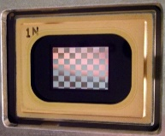
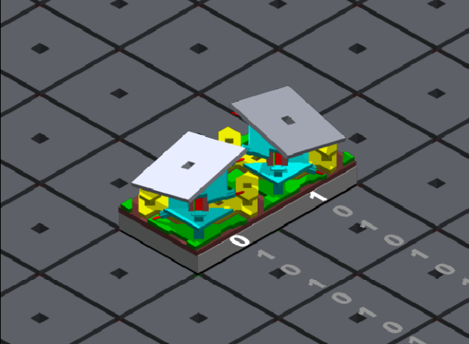
Digital Micromirror Device (DMD)
Array of micromirrors (10 um)
Memory cell

Slide 10
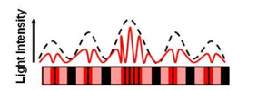
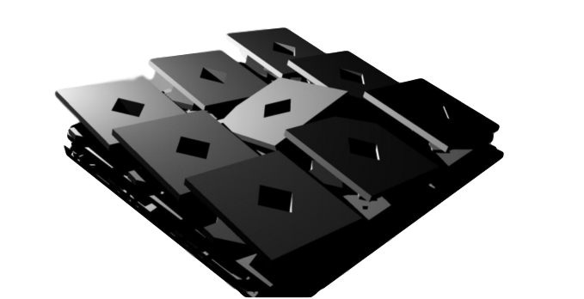
Using DMDs to redirect light
0 | 0 | 0
0 | 1 | 0
0 | 0 | 0
1 | 1 | 1
1 | 0 | 1
1 | 1 | 1
Theoretical number of accessible locations: total number of micromirrors
768x768 = 589824
Cross-talk between adjacent locations
Achievable number of accessible locations
768x768 / 32 = 18,432

Slide 11
Using mirror assemblies to magnify reach
Challenge: DMDs have a narrow angular reach
Solution: Coupling DMDs with angled mirrors
11

Slide 12
Questions to answer
How feasible is a ProjecToR interconnect?
Built and micro-benchmarked a small ProjecToR prototype
Robustness to environmental conditions
How should packets be routed in a ProjecToR interconnect?
Devised a scheduling algorithm and simulated its performance
How much does a ProjecToR interconnect cost?
Estimated cost based on cost break down of each component

Slide 13
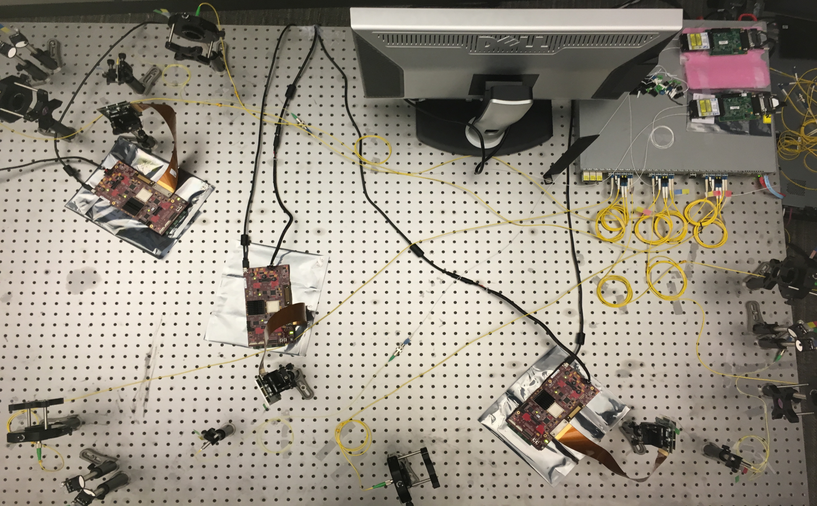
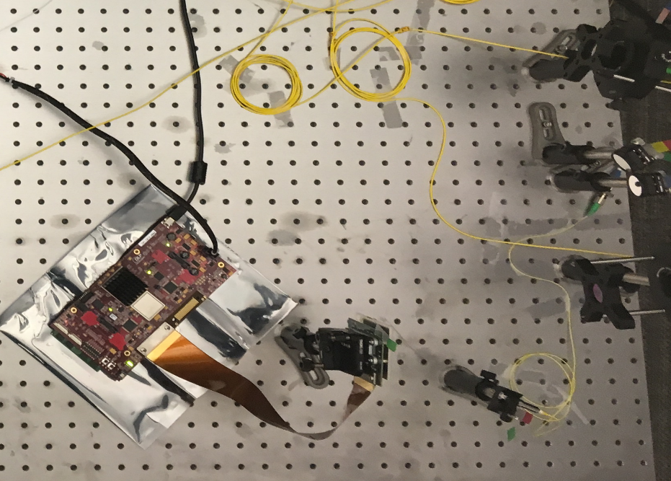
Prototype: A 3-ToR ProjecToR interconnect
ToR₃
ToR₂
ToR₁

Slide 14
Prototype: A 3-ToR ProjecToR interconnect
Mirrors reflecting to ToR₂ and ToR₃
DMD
Source laser

Slide 15
Prototype: A 3-ToR ProjecToR interconnect
ToR₃
ToR₂
ToR₁

Slide 16
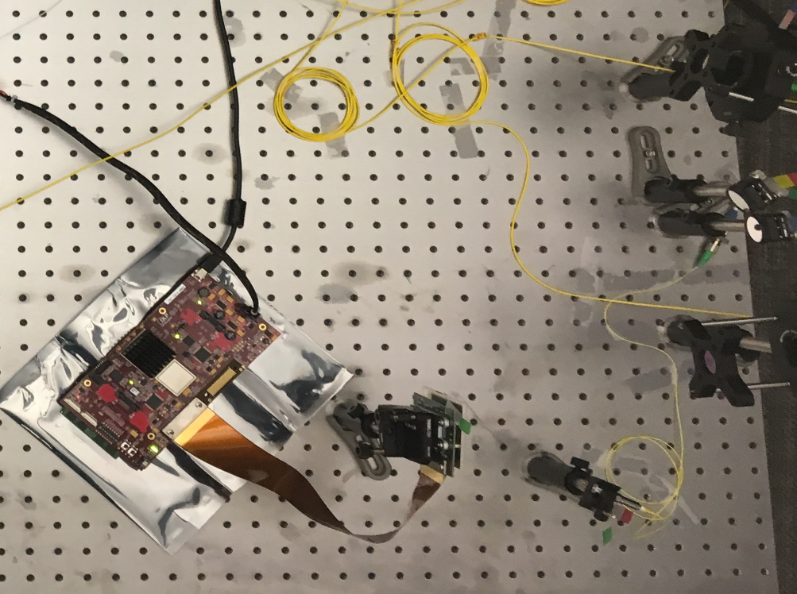
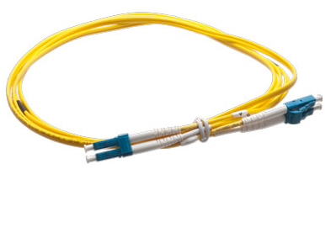
Prototype: throughput

Slide 17
Prototype: switching time
ToR₃
ToR₂
ToR₁

Slide 18
Prototype: switching time
12 us

Slide 19
Connecting lasers and photodetectors
lasers
photodetectors
ToR₁
ToR₁
ToR₁
ToR₁
ToR₁
ToR₁
ToR₂
ToR₂
ToR₂
ToR₂
ToR₂
ToR₂
ToR₃
ToR₃
ToR₃
ToR₃
ToR₃
ToR₃
dedicated topology
opportunistic links
Two topology approach
Slow switching topology or dedicated topology
Fast switching links or opportunistic links

Slide 20
Routing packets
2
2
2
2
3
3
3
2
2
ToR₁
ToR₁
2
2
Virtual output queues
ToR₂
ToR₂
opportunistic link
ToR₃
ToR₃
dedicated topology
K-shortest paths routing

Slide 21
Scheduling opportunistic links
Given a set of potential links and current traffic demand, find a set of active opportunistic links
ToR₁
ToR₁
d e s t i n a t i o n
source
$$\begin{matrix}0 & 0 & 100 \\ \begin{aligned} \\ 100\end{aligned} & \begin{aligned} \\ 0\end{aligned} & \begin{aligned} \\ 0\end{aligned} \\ \begin{aligned} \\ 0\end{aligned} & \begin{aligned} \\ 0\end{aligned} & \begin{aligned} \\ 0\end{aligned}\end{matrix}$$
ToR₂
ToR₂
ToR₃
ToR₃

Slide 22
Scheduling opportunistic links
Standard switch scheduling problem
Blossom matching
Matrix decomposition
Centralized scheduler
Single tiered matching
input
output
d e s t i n a t i o n
source
$$\begin{matrix}0 & 100 & 0 \\ \begin{aligned} \\ 0\end{aligned} & \begin{aligned} \\ 0\end{aligned} & \begin{aligned} \\ 100\end{aligned} \\ \begin{aligned} \\ 100\end{aligned} & \begin{aligned} \\ 0\end{aligned} & \begin{aligned} \\ 0\end{aligned}\end{matrix}$$

Slide 23
Scheduling opportunistic links
Standard switch scheduling problem
Blossom matching
Matrix decomposition
Centralized scheduler
Single tiered matching
Src ToRs
Dst ToRs
input
output
Decentralized
Two-tiered
Extended the Gale-Shapely algorithm for finding stable matches [GS-1962]
Constant competitive against an offline optimal allocation

Slide 24
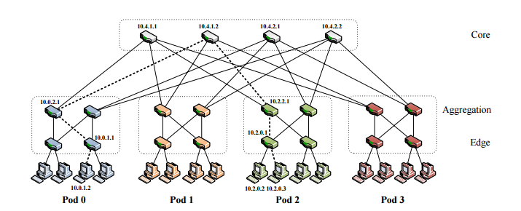
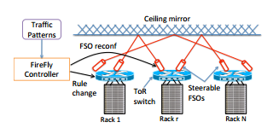
Simulations
Fat tree
FireFly
ProjecToR
128-ToR (1024 servers) with 16 lasers and photodetectors
Day-long traffic matrix: to build the dedicated topology
5-min traffic matrix: to generate probability of ToR pair communication
TCP flows arrival with poison arrival rate and realistic flow sizes

Slide 25
Simulation results
FireFly
- Slow switching time
- Low fan-out
Tail flow completion time
Different traffic matrices
Impact of fan-out
Impact of switching time
Fat tree
- No reconfigurability
95%
+ Reconfigurable
+ Switching time: 12us
+ high fan-out
ProjecToR

Slide 26
ProjecToR: A reconfigurable data center
ToR₁
ToR₁
ToR₂
ToR₂
ToR₃
ToR₃
Seamless, high fan-out, low switching time interconnect
Small prototype demonstrates feasibility
Decentralized flow scheduling algorithm

