Slide 1
DoS Threats for Cognitive Radio Wireless Networks
Carl A. Gunter
University of Illinois
With Omid Fatemieh and Ranveer Chandra

Slide 2
Environments/Applications for Cognitive Radio Communication
Emergency response networks, building automation, battlefield, advanced meter infrastructure, industrial plant monitoring, and hospitals
Hospital environment
Devices
Communication scenarios
Risks

Slide 3
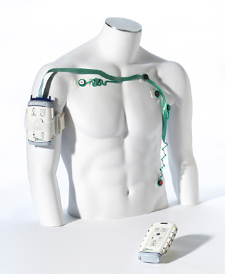
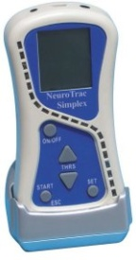
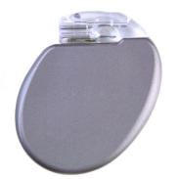
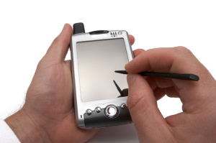
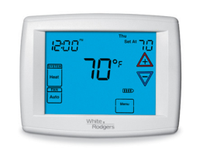
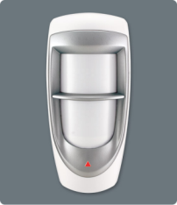
Wireless Devices in Medical / Building Automation
Medical wireless network
Medical Devices:
X-Ray, EMG
Wireless ECG, Pulse oximeter, implantable defibrillator
Wireless armband, proximity cards
Nurse / doctor hand-held devices
Hospital laptops / computers / servers
Building automation wireless network
Sensing Devices: thermostat, motion detector, camera, card reader
Back-end control system

Slide 4
DoS Threat via Control Channel Jamming
MACs that use a common control channel for coordinating access to a wider frequency spectrum (data channels)
Examples: Ad-hoc and cognitive radio MACs (HRMA [Yang et al. 99], DCA [Wu et al. 00], MMAC [So et al. 04], CMAC [Yuan et al. 07], etc.)
Problem: An attacker that jams the control channel can effectively deny access to the entire frequency spectrum
Existing solutions to the jamming problem in ad-hoc / sensor domain [Xu et al. 04 & 07]:
Coordinated Channel Switching: Entire network changes its channel to a new channel
Spectral Multiplexing: Nodes in the jammed region switch to a new channel, and boundary nodes switch back and forth between new and old channels (as relays)
Data Channels
Frequency
Control Channel

Slide 5
Problem with Existing Work
Previous work assumes a benign attacker that is:
Outsider:
A common knowledge of a secret next channel generator exists among all legitimate nodes
Attacker does not have access to this secret
Non-aggressive:
Attacker does not follow nodes to new channels quickly
Attacker does not randomly change channels quickly
A smart attacker that captures a node, or is an insider violates the assumptions and breaks the defense
Question: Is there a MAC layer defense mechanism that can withstand smart insider attacks?

Slide 6
DoS Risks in Hospitals
Examples:
ECG unable to communicate to its base
Clinician unable to take critical readings in emergency situations
Clinician unable to configure devices properly
Periodic readings of pulse oximeter cannot be stored in patient’s records
Temperature hikes due to thermostat communication problems
Authorized people locked in or out of rooms

Slide 7
The Setting
Assumptions:
Nodes can detect jamming with high probability [Xu et al. 05]
At the time of jamming, a total of K channels available for (control channel) communication
The attacker can jam at most J channels at any time (J < K): abstraction of an attacker that can capture at most J nodes
Security among nodes
No security: an entirely open network
Uniform system-wide security: key shared by all insider nodes
Multi-class system-wide security: L security classes exist. A key is associated with each class and shared by members. A node belongs to one or more classes.
Pair-wise security: Each node can authenticate, share a secret, and trust its neighbors to various degrees

Slide 8
Approach
No security / Uniform system-wide security: Use existing channel switching mechanisms. If attacker follows, switch to random channel hopping
Multi-class system-wide security:
Divide time to super-frames of L slots each
In j-th slot of each super-frame, nodes in class j hop to a channel determined by class j’s shared key
Nodes randomly hop at slots for which they don’t possess the key
Class membership criteria: criticality, compromise probability, need to communicate
Pair-wise security:
Neighbors A and B reserve their next meeting time upon each encounter
The channel for the meeting is determined by their shared key
Each node can prioritize (ignore) more (less) trustworthy neighbors in scheduling
Super Frame (L slots)
j-th slot
Notes:
Trade-offs:
Multi-class:
-Pros: -- Simple,
-- No negotiation/reservation overhead
-- Two nodes that are not in the same class, can still meet at random hop slots, but with lower probability
-Cons:
-- Needs pre-assignment of nodes to classes which is not easy: criticality, compromise probability, and need to communicate should be clear beforehand
-- If the key to a class is compromised the class is compromised
-- Wasteful if there are too many classes
-- Low throughput between two nodes that are not in the same class, but need to communicate
Reservation:
-Pros:
-- Individual nodes have more sovereignty / independence / trust / control
-- Nodes can discover and ignore rogue nodes in reservations
-Cons:
-- Complexity if nodes really want to enforce trust levels in their reservation decisions. Also some slots may remain unused.

Slide 9
Questions

Slide 10
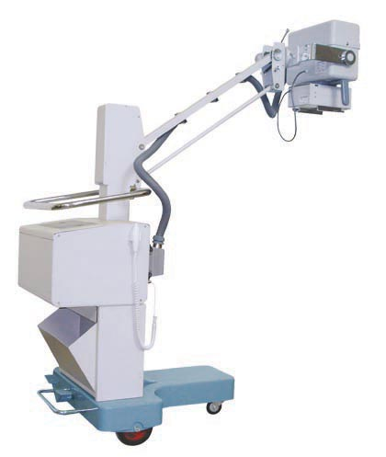
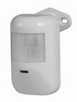
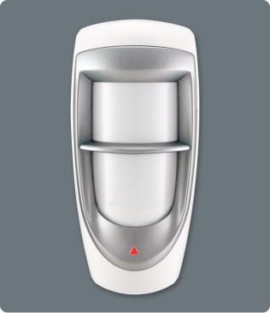
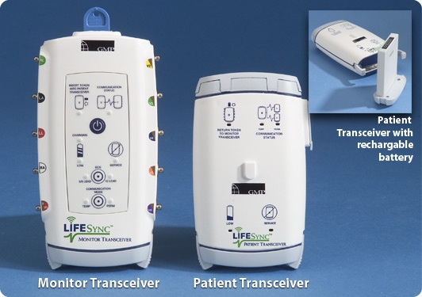
Images and Background Slides

Slide 11
Reservation Scheme

Slide 12
DoS Threat via Control Channel Jamming
MACs that use a common control channel for coordinating access to a wider frequency spectrum (data channels)
Examples: Ad-hoc and cognitive radio MACs (HRMA [Yang et al. 99], DCA [Wu et al. 00], MMAC [So et al. 04], CMAC [Yuan et al. 07], etc.)
Problem: An attacker that jams the control channel can effectively deny access to the entire frequency spectrum
Data Channels
Frequency
Control Channel

Slide 13
Related Work
Frequency hopping spread spectrum
Deployed at a lower layer with fine granularity
All nodes should use the same code for it to work in control channel MACs
Central Access Point (AP)
Without insiders: [Gummadi et al. 07, Navda et al. 07]
With insiders: [Tague et al. 07, Noubir et al. 07, Chiang et al. 08]
Ad-hoc / sensor networks [Xu et al. 04 & 07]:
Coordinated Channel Switching: Entire network changes its channel to a new channel
Spectral Multiplexing: Nodes in the jammed region switch to a new channel, and boundary nodes switch back and forth between new and old channels (as relays)

