Slide 1
How to give a great research talk
Simon Peyton Jones
Microsoft Research Cambridge
Photo © James Millar/TEDxExeter

Slide 2
Why you should listen to this talk
Research is communication
Think: how often have you said “I’m really glad I went to that talk”
Some simple, actionable ideas that can make your talks much better
You will have more fun
A research talk gives you access to the world’s most priceless commodity: the time and attention of other people. Don’t waste it!

Slide 3
Purpose

Slide 4
The purpose of your talk is not:
To impress your audience with your brainpower
To tell them everything you know about your topic
To present all the technical details

Slide 5
The purpose of your talk is:
To give your audience an intuitive feel for your idea
To make them foam at the mouth with eagerness to read your paper
To engage, excite, provoke them
To make them glad they came

Slide 6
Audience

Slide 7
Your audience…
The audience you would like
Have read all your earlier papers
Thoroughly understand all the relevant theory of cartesian closed endomorphic bifunctors
Are all agog to hear about the latest developments in your work
Are fresh, alert, and ready for action

Slide 8
Your actual audience…
The audience you get
Have never heard of you
Have heard of bifunctors, but wish they hadn’t
Have just had lunch and are ready for a doze
Your mission is to WAKE THEM UP and make them glad they did

Slide 9
What to put in

Slide 10
What to put in
1
Motivation
(20%)
2
Your key idea
(80%)
3
There is no 3

Slide 11
Motivation
They are thinking…
Why should I tune into this talk?
What is the problem?
Why is it an interesting problem?
Does this talk describe a worthwhile advance?
You have two minutes to engage your audience before they start to doze.

Slide 12
Motivation
Example: Java class files are large (brief figures), and get sent over the network. Can we use language-aware compression to shrink them? Yes, and I’m going to show you how we can do 50% better than the best generic zipping technology
Example: Synchronisation errors in concurrent programs are a nightmare to find. I’m going to show you a type system that finds many such errors at compile time.
You have 2 minutes to answer these questions.
Don’t waste those 2 minutes.

Slide 13
Your key idea
You must identify a key idea.
  ”What I did this summer” is No Good.
Be specific.
  Don’t leave your audience to figure it out for themselves.
Be absolutely specific.
  Say “If you remember nothing else, remember this.”
Organise your talk around this specific goal.
  Ruthlessly prune material that is irrelevant to this goal.
If the audience remembers only one thing from your talk, what should it be?

Slide 14

Narrow, deep beats wide, shallow
Avoid shallow overviews at all costs
Cut to the chase: the technical “meat”
It’s ok to cover only part of your paper
NO!
YES!

Slide 15
Examples are your main weapon
To motivate the work
To convey the basic intuition
To illustrate The Idea in action
To show extreme cases
To highlight shortcomings
When time is short, omit the general case, not the example.

Slide 16
Exceptions in Haskell?
Solution 1: use data values to carry exceptions
Data Maybe a = nothing
| Just a
Lookup : : Name -> Dictionary -> Maybe Address
Exceptions are to do with control flow. There is no control flow in a lazy functional program.
Often this is Just The Right Thing
[Spivey 1990, Wadler “list of successes”]

Slide 17
What to leave out

Slide 18
Outline of my talk
Background
The FLUGOL system
Shortcomings of FLUGOL
Overview of synthetic epimorphisms
π-reducible decidability of the pseudo-curried fragment under the Snezkovwski invariant in FLUGOL
Benchmark results
Related work
Conclusions and further work

Slide 19
No outline!
“Outline of my talk”: conveys near zero information at the start of your talk.
Worse, since your audience only gives you 2 minutes before dozing, you’ve just lost them
But maybe put up an outline for orientation after your motivation
…and signposts at pause points during the talk

Slide 20
Related work
[PMW83] The seminal paper
[SPZ88] First use of epimorphisms
[PN93] Application of epimorphisms to wibblification
[BXX98] Lacks full abstraction
[XXB99] Only runs on Sparc, no integration with GUI

Slide 21
Do not present related work
But…
You absolutely must know the related work; respond readily to questions
Acknowledge co-authors (title slide), and pre-cursors (as you go along)
Praise the opposition
  “X’s very interesting work does Y; I have extended it to do Z”

Slide 22
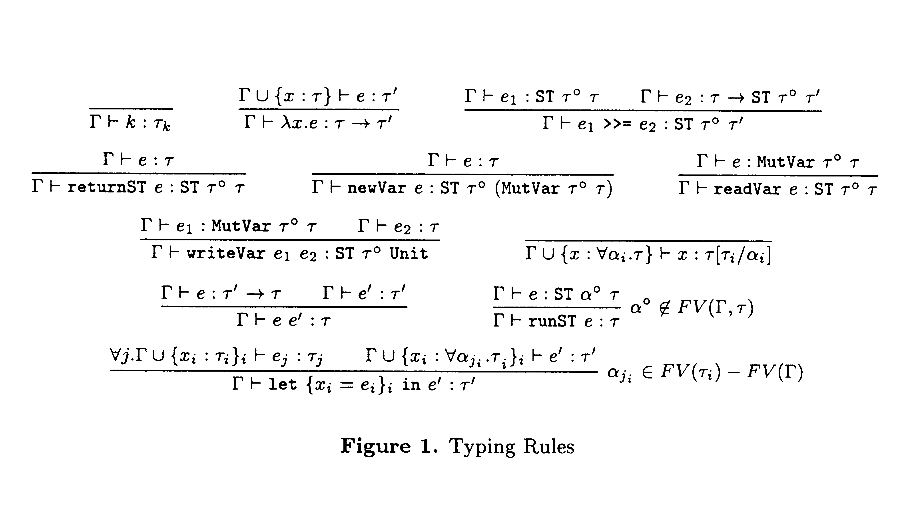
Technical detail

Slide 23
Omit technical details
Even though every line is drenched in your blood and sweat, dense clouds of notation will send your audience to sleep
Present specific aspects only; refer to the paper for the details
By all means have backup slides to use in response to questions

Slide 24
Presenting your talk

Slide 25
How to present your talk
Your most potent weapon, by far, is your
enthusiasm!

Slide 26
Enthusiasm
If you do not seem excited by your idea, why should the audience be?
Enthusiasm makes people dramatically more receptive
It gets you loosened up, breathing, moving around

Slide 27
Write your slides the night before
(…or at least, polish it then)
Your talk absolutely must be fresh in your mind
Ideas will occur to you during the conference, as you obsess on your talk during other people’s presentations

Slide 28
Do not apologise
“I didn’t have time to prepare this talk properly”
“My computer broke down, so I don’t have the results I expected”
“I don’t have time to tell you about this”
“I don’t feel qualified to address this audience”

Slide 29

The jelly effect
If you are anything like me, you will experience apparently severe pre-talk symptoms
Inability to breathe
Inability to stand up (legs give way)
Inability to operate brain

Slide 30
What to do about it
Deep breathing during previous talk
Script your first few sentences precisely
(=> no brain required)
Move around a lot, use large gestures, wave your arms, stand on chairs
Go to the loo first
You are not a wimp.
Everyone feels this way.

Slide 31
Being seen
Face the audience, not the screen
Know your material
Put your laptop in front of you, screen towards you
Don’t point much, but when you do, point at the screen, not at your laptop

Slide 32
Being heard
Speak to someone at the back of the room, even if you have a microphone on
Make eye contact; identify a nodder, and speak to him or her (better still, more than one)
Watch audience for questions…

Slide 33
Questions
Questions are not a problem.
Questions are a golden golden golden opportunity to connect with your audience.
Specifically encourage questions during your talk: pause briefly now and then, ask for questions
Be prepared to truncate your talk if you run out of time. Better to connect, and not to present all your material

Slide 34
Being a good audience member
Eye contact with speaker
Nod frequently
Ask questions.
  Don’t wait for the speaker to invite questions; ask
  Start doing so the moment you lose contact with the talk. The rest of the audience will thank you for it.
  Stop when you sense that you are beginning to de-rail the entire talk.

Slide 35
Presenting your slides
Use a wireless presenter gizmo
Test that your laptop works with the projector, in advance
Laptops break: leave a backup copy on the web; bring a backup copy on a disk or USB key

Slide 36
Presenting your slides
A very annoying technique
is to reveal
your points
one
by one
by one, unless…
there is a punch line

Slide 37
Presenting your slides
Use animation effects
very
very
very
very
very
very
very
sparingly

Slide 38
Finishing
Audiences get restive and essentially stop listening when your time is up. Continuing is very counter productive
Simply truncate and conclude
Do not say “would you like me to go on?” (it’s hard to say “no thanks”)
Absolutely without fail, finish on time.

Slide 39
Conclusion: there is hope
You will attend 50x as many talks as you give. Watch other people’s talks intelligently, and pick up ideas for what to do and what to avoid.
www.microsoft.com/research/people/simonpj
The general standard is often low.
You don’t have to be outstanding to stand out.

Slide 40
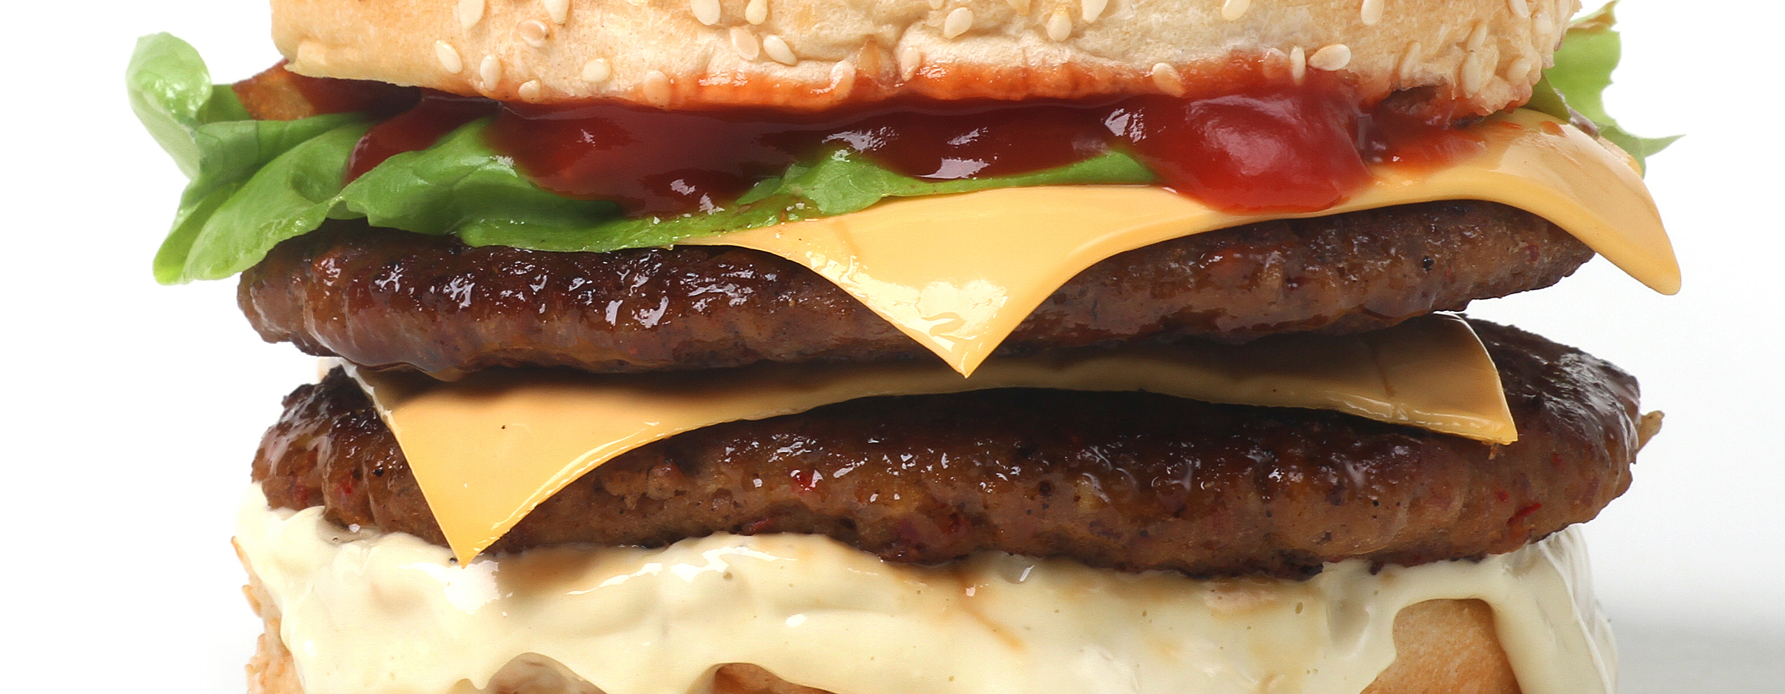

What your talk is for
Your paper
= the beef
Your talk
= the beef advertisement
Do not confuse the two.

Slide 41
Do it! Do it! Do it!
Good papers and talks are a fundamental part of research excellence
Invest time
Learn skills
Practice
Write a paper, and give a talk, about any idea, no matter how weedy and insignificant it may seem to you.

Slide 42
Research is
communication
Your papers and talks
Crystalise your ideas
Communicate them to others
Get feedback
Build relationships
(And garner research brownie points)
The greatest ideas are worthless if you keep them to yourself.

