Slide 1

Neural Approaches to Conversational AI
Jianfeng Gao, Michel Galley, Lihong Li
Microsoft Research, Google Inc.
SIGIR 2018
Ann Arbor Michigan, USA, July 8, 2018

Slide 2
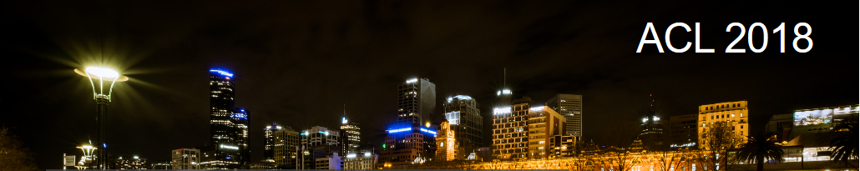
Neural Approaches to Conversational AI
Jianfeng Gao, Michel Galley, Lihong Li
Microsoft Research, Google Brain
ACL 2018
Melbourne, Australia, July 15, 2018

Slide 3
Contact Information:
Jianfeng Gao http://research.microsoft.com/~jfgao
Michel Galley http://research.microsoft.com/~mgalley
Lihong Li https://ai.google/research/people/105542
Slides:
http://microsoft.com/en-us/research/publication/neural-approaches-to-conversational-ai/
We thank Bill Dolan and Yun-Nung (Vivian) Chen for contributing slides.

Slide 4
Outline
Part 1: Introduction
  Who should attend this tutorial
  Dialogue: what kinds of problem
  A unified view: dialogue as optimal decision making
  Deep learning leads to paradigm shift in NLP and IR
Part 2: Question answering and machine reading comprehension
Part 3: Task-oriented dialogues
Part 4: Fully data-driven conversation models and chatbots

Slide 5
Who should attend this tutorial?
NLP/IR community as our primary target audience
Whoever wants to understand and create modern dialogue agents that
  Can chat like a human
  Can answer questions of various topics (movie stars, theory of relativity)
  Can fulfill tasks (whether report, travel planning)
  Can help make business decision
Focus on neural approaches, but symbolic approaches are still widely used

Slide 6
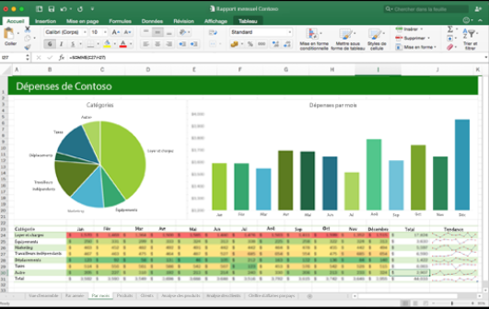
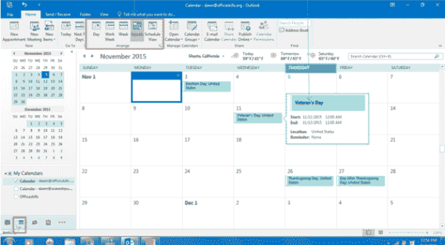
Aspirational Goal:
Enterprise Assistant
Where are sales lagging behind our forecast?
Task Completion
The worst region is [country], where sales are XX% below projections
Do you know why?
QA (decision support)
The forecast for [product] growth was overly optimistic
How can we turn this around?
Here are the 10 customers in [country] with the most growth potential, per our CRM model
Can you set up a meeting with the CTO of [company]?
Info Consumption
Yes, I’ve set up a meeting with [person name] for next month when you’re in [location]
Task Completion
Thanks

Slide 7
What kinds of problems?
“I am smart”
“I have a question”
“I need to get this done”
“What should I do?”
Turing Test (“I” talk like a human)
Information consumption
Task completion
Decision support

Slide 8
What kinds of problems?
“I am smart”
“I have a question”
“I need to get this done”
“What should I do?”
Turing Test
Information consumption
Task completion
Decision support
What is the employee review schedule?
What room is the project review meeting in?
When is the ACL 2018 conference?
What does DNN stand for?

Slide 9
What kinds of problems?
“I am smart”
“I have a question”
“I need to get this done”
“What should I do?”
Turing Test
Information consumption
Task completion
Decision support
Book me the biz trip to San Francisco
Reserve a table at Kisaku for 5 people, 7PM tonight
Brief me on people in my Thursday 9:00 am meeting
Schedule a meeting with Bill at 10:00 tomorrow.

Slide 10
What kinds of problems?
“I am smart”
“I have a question”
“I need to get this done”
“What should I do?”
Turing Test
Information consumption
Task completion
Decision support
Why are sales in China so far behind forecast?

Slide 11
What kinds of problems?
Chitchat (social bot)
“I am smart”
“I have a question”
“I need to get this done”
“What should I do?”
Turing Test (“I” talk like a human)
Information consumption
Task completion
Decision support
Goal-oriented dialogues

Slide 12
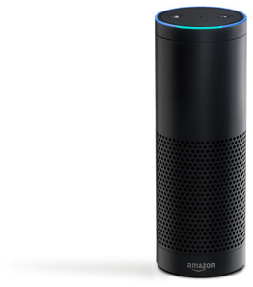


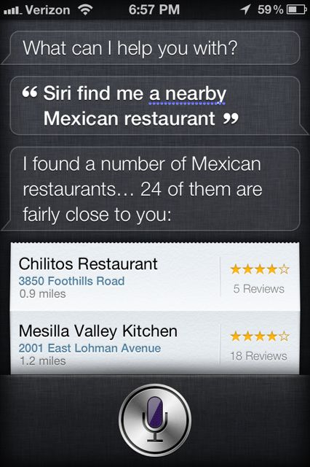
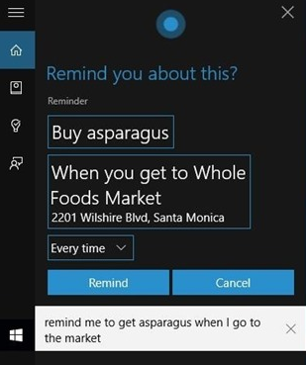
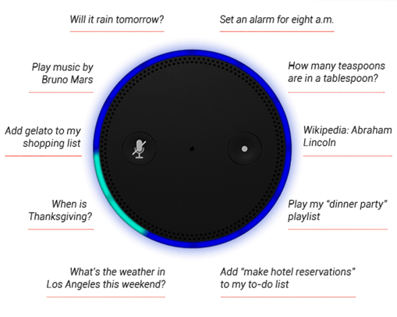
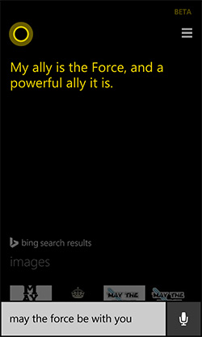
Personal assistants today
goal oriented
Engaging (social bots)

Slide 13








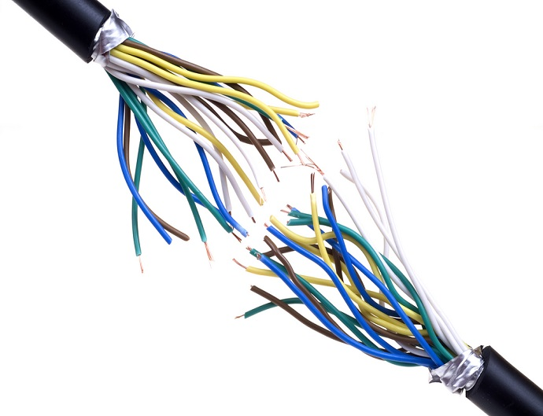
Dialog Systems
Understanding
(NLU)
State tracker
input x
Task-Oriented Dialog
DB
Database
Memory
External knowledge
Generation
(NLG)
Dialog policy
output y
Statistical model
(e.g., neural)
Understanding
(NLU)
State tracker
input x
Fully data-driven
DB
Generation
(NLG)
Dialog policy
output y
[Young+ 13; Tur & De Mori 11; Ritter+ 11; Sordoni+ 15; Vinyals & Le 15; Shang+ 15; etc.]

Slide 14

A unified view: dialogue as optimal decision making
Dialogue as a Markov Decision Process (MDP)
  Given state $s$, select action $a$ according to (hierarchical) policy $π$
  Receive reward $r$, observe new state s$′$
  Continue the cycle until the episode terminates.
Goal of dialogue learning: find optimal $π$ to maximize expected rewards
Dialogue | State (s) | Action (a) | Reward (r)
Info Bots (Q&A bot over KB, Web etc.) | Understanding of user Intent (belief state) | Clarification questions, Answers | Relevance of answer # of turns
Task Completion Bots (Movies, Restaurants, …) | Understanding of user goal (belief state) | Dialog act + slot_value | Task success rate # of turns
Social Bot (XiaoIce) | Conversation history | Response | Engagement

Slide 15
Traditional definition of NLP: the branch of AI
Understanding and generating the languages that humans use naturally (natural language)
Study knowledge of language at different levels
  Phonetics and Phonology – the study of linguistic sounds
  Morphology – the study of the meaning of components of words
  Syntax – the study of the structural relationships between words
  Semantics – the study of meaning
  Discourse – they study of linguistic units larger than a single utterance
[Jurafsky & Martin 09]

Slide 16
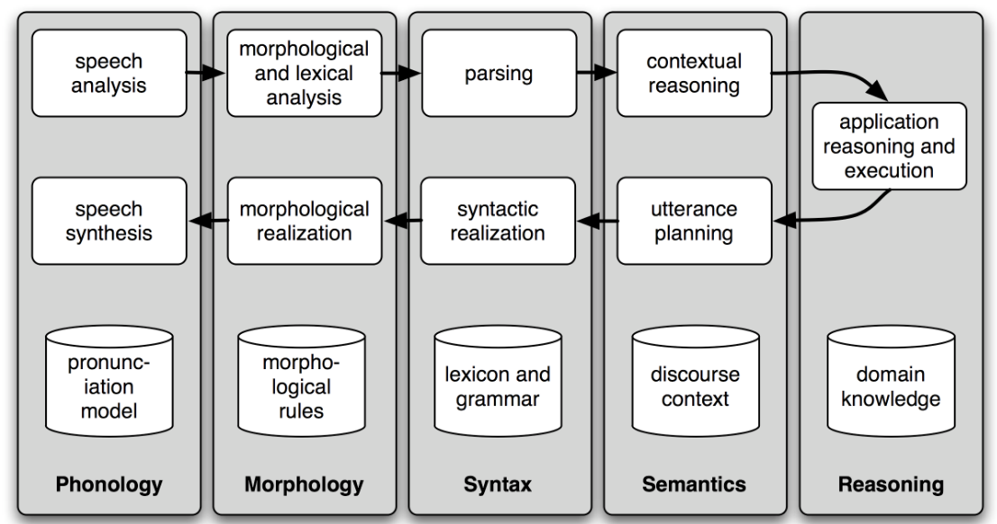
Traditional NLP component stack
Natural language understand (NLU): parsing (speech) input to semantic meaning and update the system state
Application reasoning and execution: take the next action based on state
Natural language generation (NLG): generating (speech) response from action
[Arul Menezes & Bill Dolan. 2017. The transition of natural language processing to neural methods. Unpublished report.]

Slide 17
Challenge of NLP: the diversity of natural language
Many-to-many mapping btw symbolic language and semantic meaning
Paraphrase
Example: How long is the X river?
The Mississippi River is 3,734 km (2,320 mi) long.
...is a short river, some 4.5 miles (7.2 km) in length
The total length of the river is 2,145 kilometers.
… at the estimated length of 5,464 km (3,395 mi)…
… has a meander length of 444 miles (715 km)…
… Bali’s longest river, measuring approximately 75 kilometers from source to mouth.
The … mainstem is 2.75 miles (4.43 km) long although total distance from headwater source tributaries to the sea is 14 miles (23 km).
Ambiguity
Example: I made her duck.
I cooked waterfowl for her.
I cooked waterfowl belonging to her.
I created the plaster duck she owns.
I caused her to quickly lower her head or body.
I waved my magic wand and turned her into undifferentiated waterfowl.
[Jurafsky & Martin 09; Dolan 17]

Slide 18
Pragmatic definition: building computer systems
Process large text corpora, turning information into knowledge
  Text classification
  Information retrieval and extraction
  Machine reading comprehension and question answering
  …
Enable human-computer interactions, making knowledge accessible to humans in the most natural way
  Dialogue and conversational agents
  Machine translation
  …
E2E learning of NLP systems via e.g., neural approaches

Slide 19
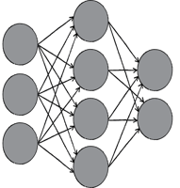


Mapping from symbolic to semantic via DNN?
Fast food
hot dog
Dog racing

Slide 20
Deep Semantic Similarity Model (DSSM)
Compute semantic similarity between two text strings X and Y
  Map X and Y to feature vectors in a latent semantic space via deep neural net
  Compute the cosine similarity between the feature vectors
Tasks | X | Y | Ref
Web search | Search query | Web document | Huang+ 13; Shen+ 14; Palangi+ 16
Entity linking | Entity mention and context | Entity and its corresponding page | Gao+ 14b
Online recommendation | Doc in reading | Interesting things / other docs | Gao+ 14b
Image captioning | Image | Text | Fang+ 15
Machine translation | Sentence in language A | Translations in language B | Gao+ 14a
Question answering | Question | Answer | Yih+ 15
    Sent2Vec (DSSM) http://aka.ms/sent2vec

Slide 21

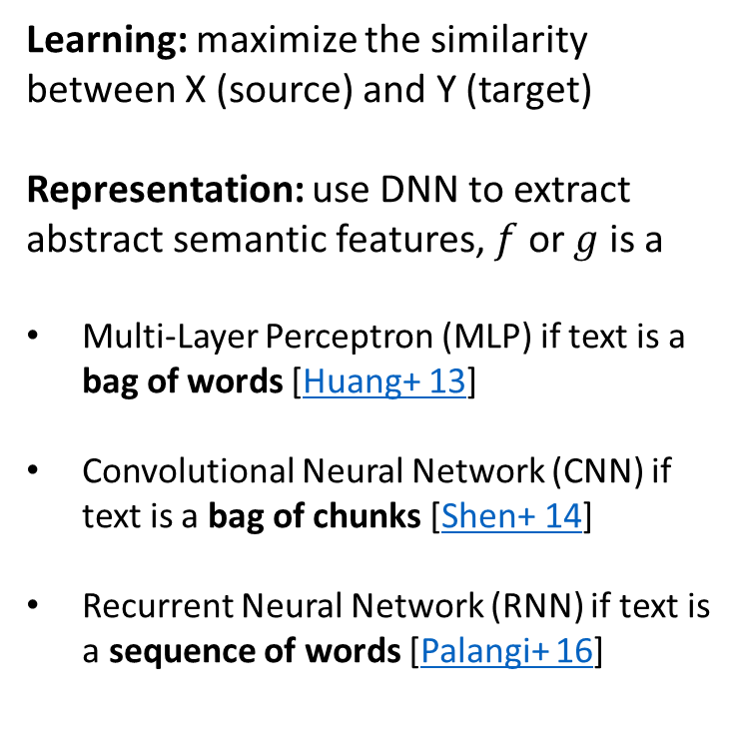

DSSM: Compute Similarity in Semantic Space
Learning: maximize the similarity between X (source) and Y (target)
Representation: use DNN to extract abstract semantic features, $f$ or $g$ is a
Multi-Layer Perceptron (MLP) if text is a bag of words [Huang+ 13]
Convolutional Neural Network (CNN) if text is a bag of chunks [Shen+ 14]
Recurrent Neural Network (RNN) if text is a sequence of words [Palangi+ 16]
$$f(.)$$
$$g(.)$$

Slide 22
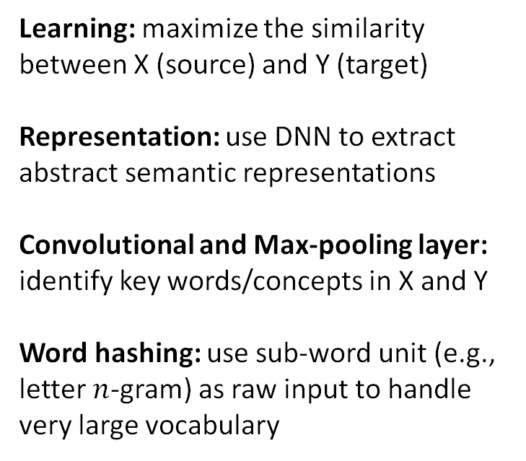
DSSM: Compute Similarity in Semantic Space
Learning: maximize the similarity between X (source) and Y (target)
Representation: use DNN to extract abstract semantic representations
Convolutional and Max-pooling layer: identify key words/concepts in X and Y
Word hashing: use sub-word unit (e.g., letter $n$-gram) as raw input to handle very large vocabulary

Slide 23
Learning DSSM from Labeled X-Y Pairs
neural (semantic) space
Y1: free online car body shop repair estimates
Y2: online body fat percentage calculator
Implicit Supervised Information
Y3: Body Language Online Courses Shop
X: auto body repair cost calculator software
Positive X-Y pairs are extracted from search click logs
Negative X-Y pairs are randomly sampled
Map X and Y into the same semantic space via deep neural net

Slide 24
Learning DSSM from Labeled X-Y Pairs
neural (semantic) space
Y1: free online car body shop repair estimates
Y2: online body fat percentage calculator
Implicit Supervised Information
Y3: Body Language Online Courses Shop
X: auto body repair cost calculator software
Positive X-Y pairs are extracted from search click logs
Negative X-Y pairs are randomly sampled
Map X and Y into the same semantic space via deep neural net
Positive Y are closer to X than negative Y in that space

Slide 25
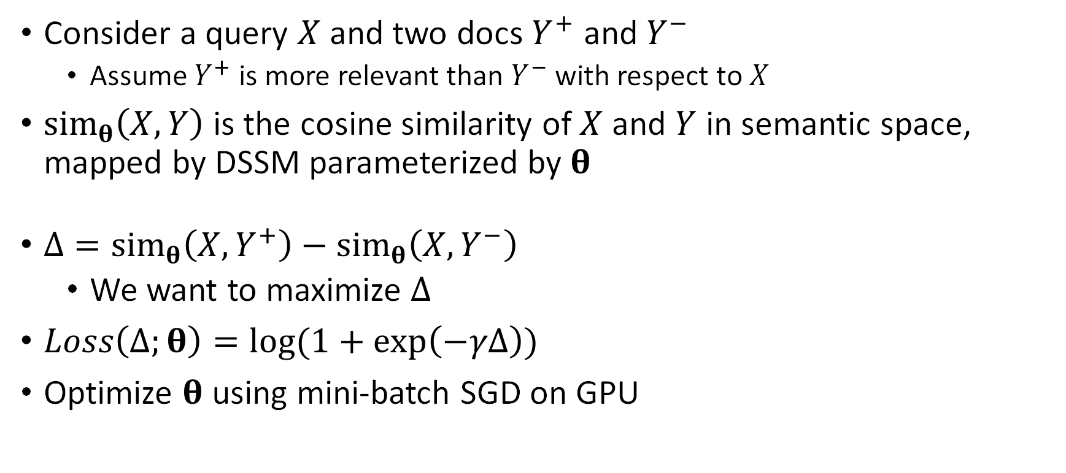
Learning DSSM from Labeled X-Y Pairs
Consider a query $X$ and two docs $Y^{+}$ and $Y^{−}$
  Assume $Y^{+}$ is more relevant than $Y^{−}$ with respect to $X$
$sim_{θ}\left(X,Y\right)$is the cosine similarity of $X$ and $Y$ in semantic space, mapped by DSSM parameterized by $θ$
$Δ=sim_{θ}\left(X,Y^{+}\right)−sim_{θ}\left(X,Y^{−}\right)$
  We want to maximize $Δ$
$Loss\left(Δ;θ\right)=\log{(1+\exp\left(−γΔ\right))}$
Optimize $θ$using mini-batch SGD on GPU

Slide 26
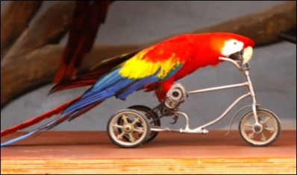
Go beyond text:
DSSM for multi-modal representation learning
Distance(s,t)
Recall DSSM for text input pairs: (X, Y)
Now: replace text X by image X
Using DNN/CNN features of image
Can rank/generate text given image or can rank images given text.
W₄
W₄
H3
… …
H3
H3
H3
W₃
W₃
H2
H2
x
W₂
W₂
Softmax layer
H1
H1
W₁
W₁
Fully connected
Input t1
Fully connected
Input s
Image features X
Text: a parrot rides a tricycle
Convolution/pooling
Convolution/pooling
Convolution/pooling
Convolution/pooling
Convolution/pooling
Raw Image pixels
[Fang+ 15]

Slide 27
Paradigm shift in NLP/IR
From symbolic to neural computation via semantic representation learning
  due to novel DNN architectures and learning algorithms;
  leads to high accuracy in many tasks
End-to-end Learning
  simplifies systems, reduces effort for feature engineering and localization
New Applications and Experience
  e.g., link language to real-world signals such as images and machine state
Deep Reinforcement Learning
  makes it possible to build intelligent agents for real-world applications such as goal-oriented dialogue
[Menezes & Dolan 17]

Slide 28
Outline
Part 1: Introduction
Part 2: Question answering (QA) and machine reading comprehension (MRC)
  Knowledge base QA tasks
  From symbolic semantic parsing to neural embedding-based approaches
  Multi-turn knowledge base QA agents
  Neural MRC models for text-based QA
Part 3: Task-oriented dialogues
Part 4: Fully data-driven conversation models and chatbots

Slide 29
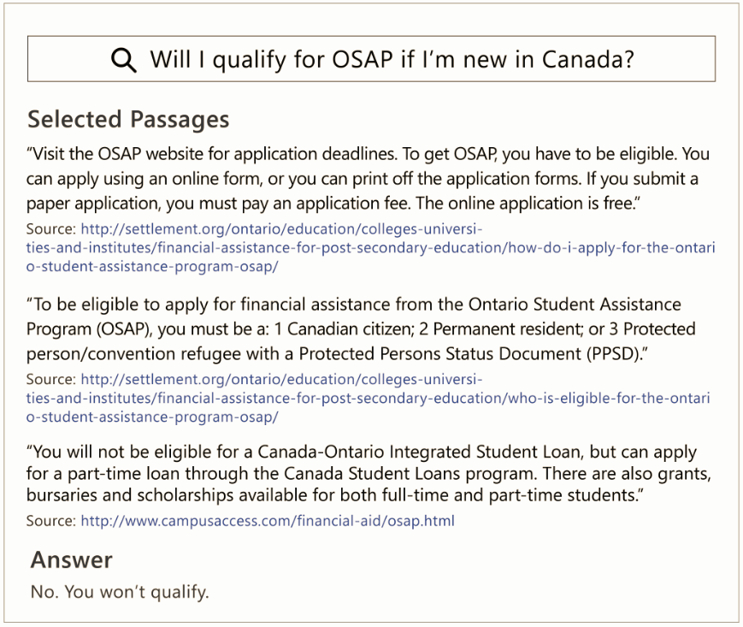

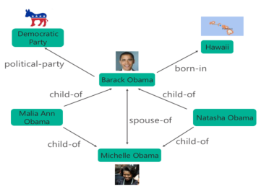
Open-Domain Question Answering (QA)
What is Obama’s citizenship?
Selected Passages from Bing
Selected subgraph from Microsoft’s Satori
Answer
USA
Text-QA
Knowledge Base (KB)-QA

Slide 30
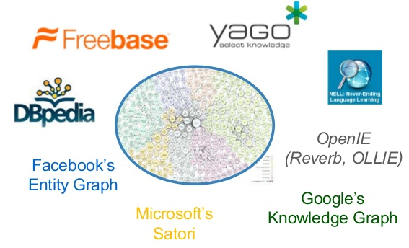
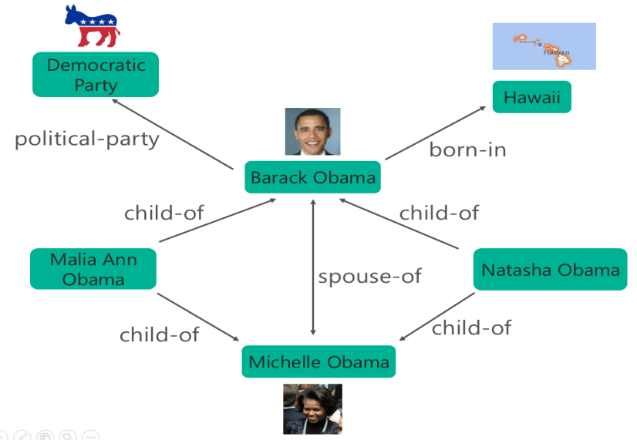
Question Answering (QA) on Knowledge Base
Large-scale knowledge graphs
Properties of billions of entities
Plus relations among them
An QA Example:
Question: what is Obama’s citizenship?
Query parsing:
  (Obama, Citizenship,?)
Identify and infer over relevant subgraphs:
  (Obama, BornIn, Hawaii)
  (Hawaii, PartOf, USA)
correlating semantically relevant relations:
  BornIn ~ Citizenship
Answer: USA

Slide 31
Symbolic approaches to QA
Understand the question via semantic parsing
  Input: what is Obama’s citizenship?
  Output (LF): (Obama, Citizenship,?)
Collect relevant information via fuzzy keyword matching
  (Obama, BornIn, Hawaii)
  (Hawaii, PartOf, USA)
  Needs to know that BornIn and Citizenship are semantically related
Generate the answer via reasoning
  (Obama, Citizenship, USA)
Challenges
  Paraphrasing in NL
  Search complexity of a big KG
[Richardson+ 98; Berant+ 13; Yao+ 15; Bao+ 14; Yih+ 15; etc.]

Slide 32
Example: “How long is the X river?”
The Mississippi River is 3,734 km (2,320 mi) long.
…is nearly 86 km long…
...is a short river, some 4.5 miles (7.2 km) in length
The total length of the river is 2,145 kilometres (1,333 mi).
… at the estimated length of 5,464 km (3,395 mi)…
…is a 25-mile (40 km) tributary of …
… has a meander length of 444 miles (715 km)…
… Bali’s longest river, measuring approximately 75 kilometers from source to mouth.
The … mainstem is 2.75 miles (4.43 km) long although total distance from headwater source tributaries to the sea is 14 miles (23 km).

Slide 33
…is 314 km long
…is nearly 86 km long…
… is a 92-mile (148 km) long tributary of the…
...is a short river, some 4.5 miles (7.2 km) in length
…flows nearly 20 miles (32 km) to the west
The [river], which is 6,853 km (4,258 miles) long…
It runs a course of about 105 kilometers
The 1,450-mile-long (2,330 km) [river] drains…
...a 234-mile (377-kilometer) man-made waterway…
… at the estimated length of 5,464 km (3,395 mi)…
... stretches for 2,639 miles (4,247 km).
…is a 25-mile (40 km) tributary of …
…starting in and flowing for nearly 160 kilometers through….
…flows almost 70 stream miles.
The river runs 184 kilometers before joining…
… Bali’s longest river, measuring approximately 75 kilometers from source to mouth.
…is reported to be anywhere from 5,499 to 6,690 kilometres (3,417 to 4,157 mi). Often it is said to be "about" 6,650 kilometres (4,130 mi) long.
...reaches a length of approximately 25 kilometres
The length of the Ouse alone is about 52 miles (84 km).
Measuring a length of 60 kilometers, the [river] flows through
It has a total length of 925 km (575 mi).
The total length of the river is 2,145 kilometres (1,333 mi).
Its length is 209 km…
…is about 1,180 miles (1,900 km) in length.
...the river flows for more than 1,200 km (750 mi)
…the river proper flows only for 113 km…
…flows slowly for 900 kilometres (560 mi)…
… has a meander length of 444 miles (715 km)…
…is a 350-kilometre (220 mi) long river in …
it …meanders slowly southwards for 2,320 miles (3,730 km) to …
The river's main stem is about 71 miles (114 km) long. Its length to its most distant headwater tributary is about 220 miles (350 km).
After approximately 30 kilometres (19 mi) of its 78-kilometre (48 mi) course, it ….
…is the longest river in the United Kingdom, at about 220 miles (354 km).
… is the second-longest river in Central and Western Europe (after the Danube), at about 1,230 km (760 mi)…
The … mainstem is 2.75 miles (4.43 km) long although total distance from headwater source tributaries to the sea is 14 miles (23 km).
At 320 kilometres (200 mi) (with some estimates ranging up to 596 kilometres (370 mi))...

Slide 34
Key Challenge in KB-QA:
Language Mismatch (Paraphrasing)
Lots of ways to ask the same question
  “What was the date that Minnesota became a state?”
  “Minnesota became a state on?”
  “When was the state Minnesota created?”
  “Minnesota's date it entered the union?”
  “When was Minnesota established as a state?”
  “What day did Minnesota officially become a state?”
Need to map them to the predicate defined in KB
  location.dated_location.date_founded

Slide 35
Scaling up semantic parsers
Paraphrasing in NL
  Introduce a paragraphing engine as pre-processor [Berant&Liang 14]
  Using semantic similarity model (e.g., DSSM) for semantic matching [Yih+ 15]
Search complexity of a big KG
  Pruning (partial) paths using domain knowledge
More details: IJCAI-2016 tutorial on “Deep Learning and Continuous Representations for Natural Language Processing” by Yih, He and Gao.

Slide 36
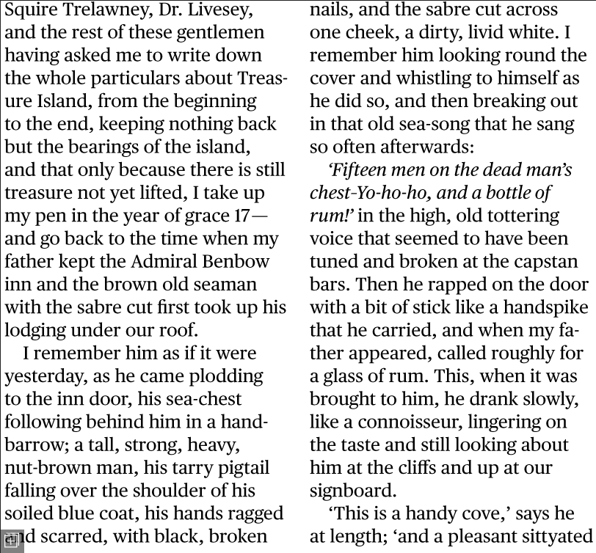
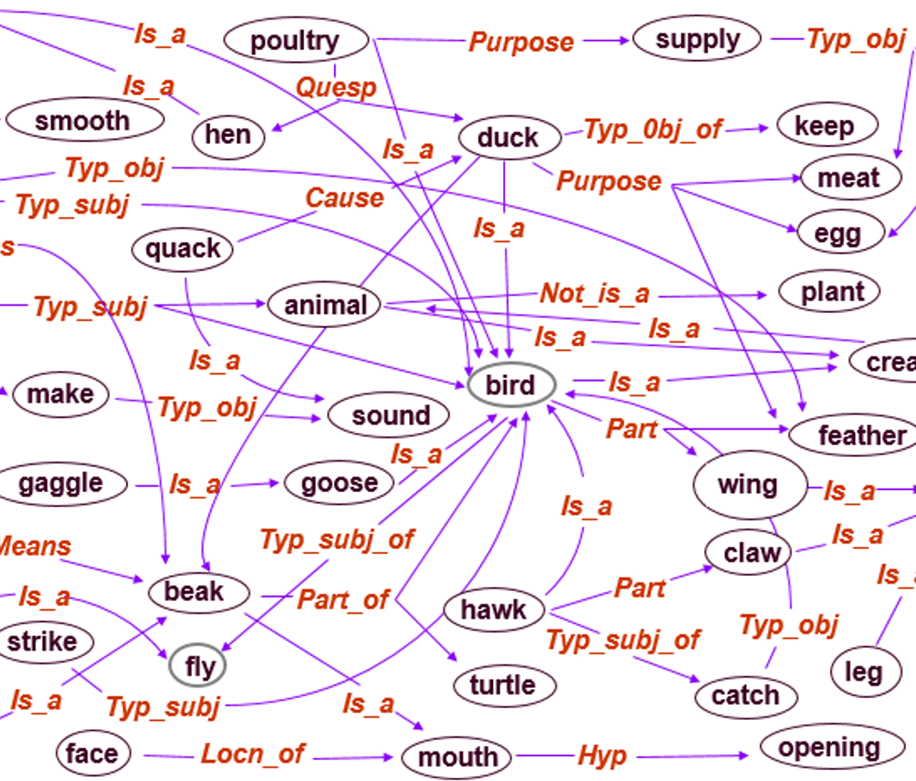
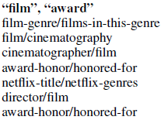
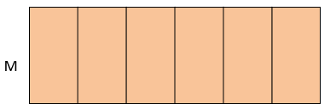
Symbolic Space
Knowledge Representation
  explicitly stored as words, relations, templates
  high-dim, discrete, sparse vectors
Inference
  slow on a big knowledge base
  keyword matching is sensitive to paraphrase alternations
Human comprehensible but not computationally efficient
Neural Space
Knowledge Representation
  Implicitly stored as semantic concepts/classes
  low-dim, cont., dense vectors
Inference
  fast on compact memory
  semantic matching is robust to paraphrase alternations
Computationally efficient but not human comprehensible yet

Slide 37
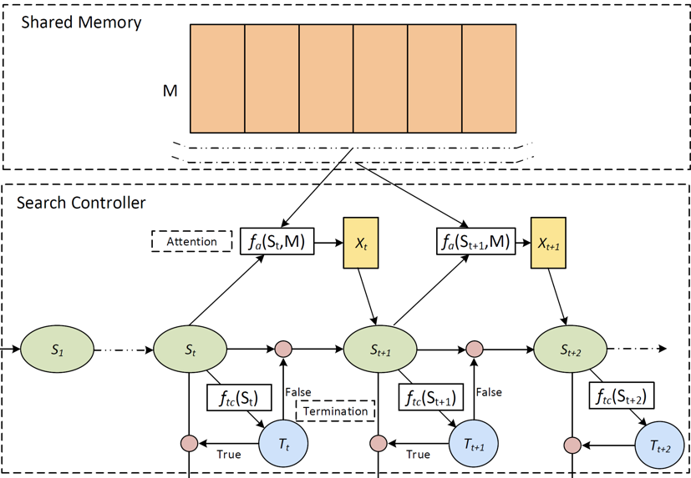
From symbolic to neural computation
Symbolic Space
human readable
Neural Space
- Computationally efficient
Input: Q
Symbolic → Neural
by Encoding (Q/D/Knowledge)
Reasoning: Question + KB → answer vector via multi-step inference, summarization, deduction etc.
Error(A, A*)
Output: A
Neural → Symbolic
by Decoding (synthesizing answer)

Slide 38
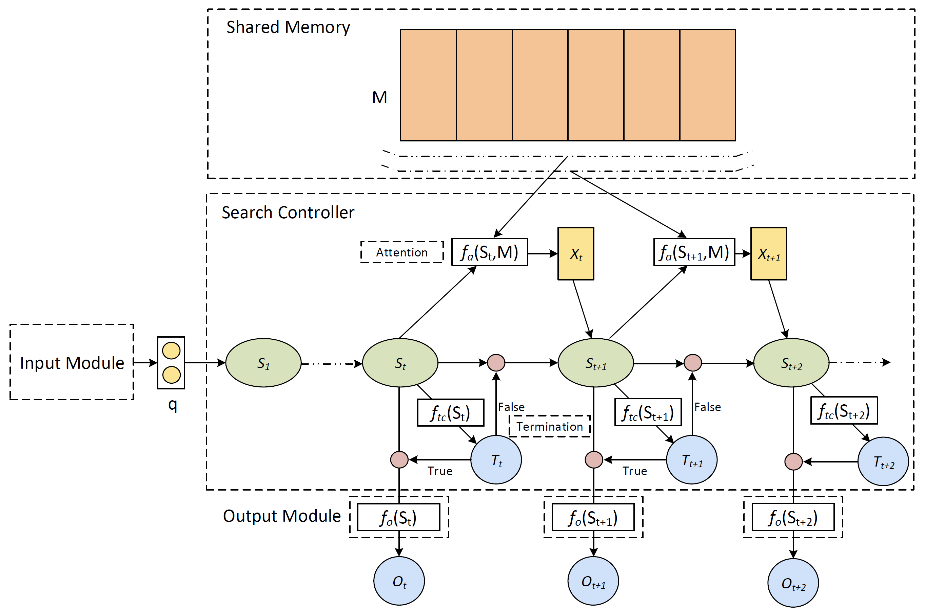
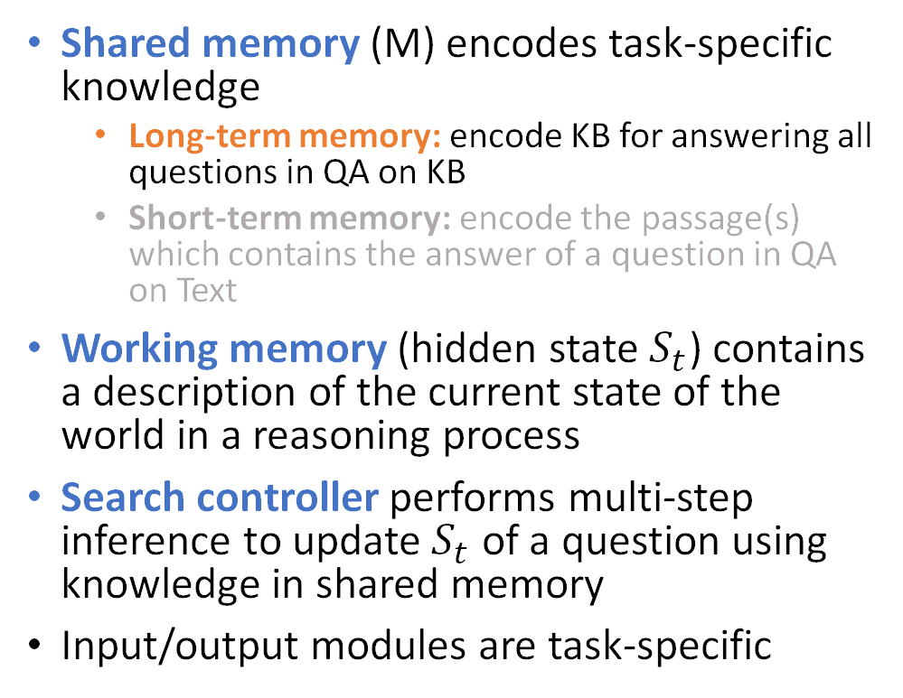
Case study: ReasoNet with Shared Memory
Shared memory (M) encodes task-specific knowledge
  Long-term memory: encode KB for answering all questions in QA on KB
  Short-term memory: encode the passage(s) which contains the answer of a question in QA on Text
Working memory (hidden state $S_{t}$) contains a description of the current state of the world in a reasoning process
Search controller performs multi-step inference to update $S_{t}$ of a question using knowledge in shared memory
Input/output modules are task-specific
[Shen+ 16; Shen+ 17]

Slide 39

Joint learning of Shared Memory and Search Controller
Embed KG to memory vectors
Citizenship
BornIn
Paths extracted from KG:
(John, BornIn, Hawaii)
(Hawaii, PartOf, USA)
(John, Citizenship, USA)
…
Training samples generated
(John, BornIn, ?)->(Hawaii)
(Hawaii, PartOf, ?)->(USA)
(John, Citizenship, ?)->(USA)
…
(John, Citizenship, ?)
(USA)

Slide 40
Joint learning of Shared Memory and Search Controller
Citizenship
BornIn
Paths extracted from KG:
(John, BornIn, Hawaii)
(Hawaii, PartOf, USA)
(John, Citizenship, USA)
…
Training samples generated
(John, BornIn, ?)->(Hawaii)
(Hawaii, PartOf, ?)->(USA)
(John, Citizenship, ?)->(USA)
…
(John, Citizenship, ?)
(USA)

Slide 41
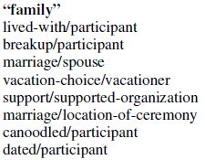
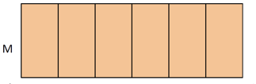
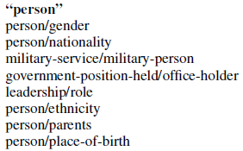
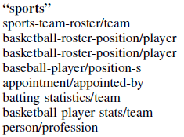
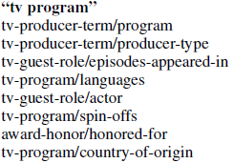
Shared Memory: long-term memory to store learned knowledge, like human brain
Knowledge is learned via performing tasks, e.g., update memory to answer new questions
New knowledge is implicitly stored in memory cells via gradient update
Semantically relevant relations/entities can be compactly represented using similar vectors.

Slide 42
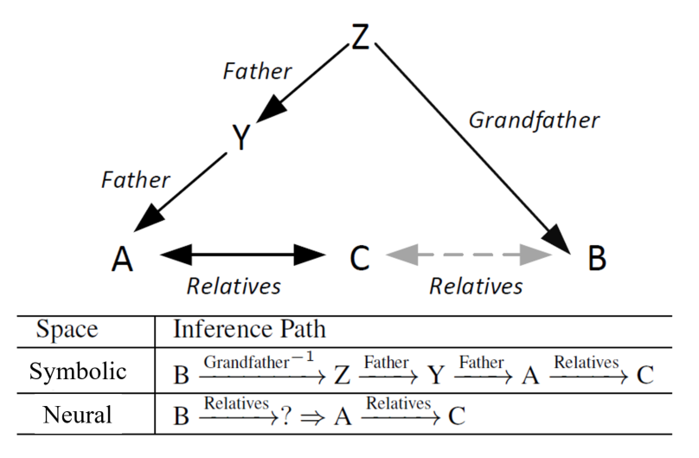
Search controller for KB QA
[Shen+ 16]

Slide 43
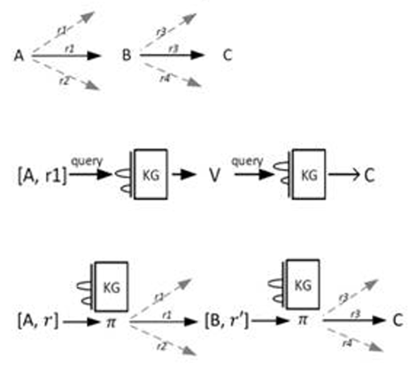
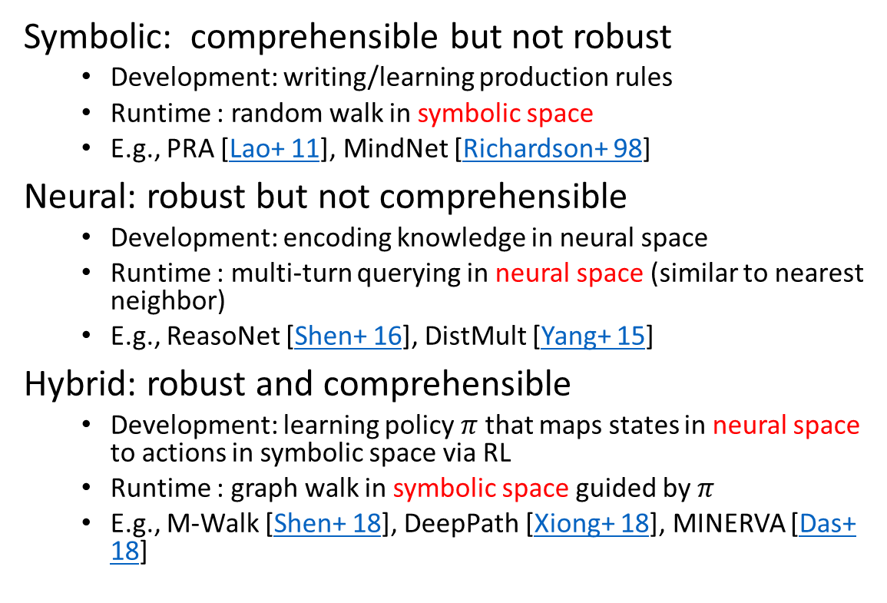
Reasoning over KG in symbolic vs neural spaces
Symbolic: comprehensible but not robust
  Development: writing/learning production rules
  Runtime : random walk in symbolic space
  E.g., PRA [Lao+ 11], MindNet [Richardson+ 98]
Neural: robust but not comprehensible
  Development: encoding knowledge in neural space
  Runtime : multi-turn querying in neural space (similar to nearest neighbor)
  E.g., ReasoNet [Shen+ 16], DistMult [Yang+ 15]
Hybrid: robust and comprehensible
  Development: learning policy $π$ that maps states in neural space to actions in symbolic space via RL
  Runtime : graph walk in symbolic space guided by $π$
  E.g., M-Walk [Shen+ 18], DeepPath [Xiong+ 18], MINERVA [Das+ 18]

Slide 44
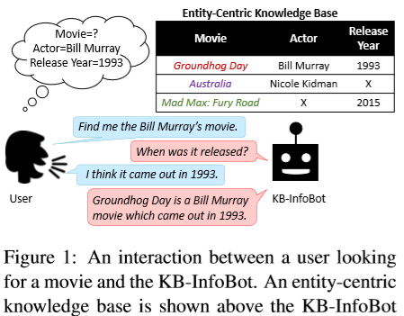


Multi-turn KB-QA: what to ask?
Allow users to query KB interactively without composing complicated queries
Dialogue policy (what to ask) can be
  Programmed [Wu+ 15]
  Trained via RL [Wen+ 16; Dhingra+ 17]

Slide 45
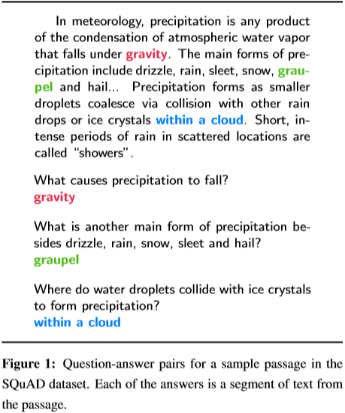
Text-QA
Selected Passages from Bing
MS MARCO [Nguyen+ 16]
SQuAD [Rajpurkar+ 16]

Slide 46

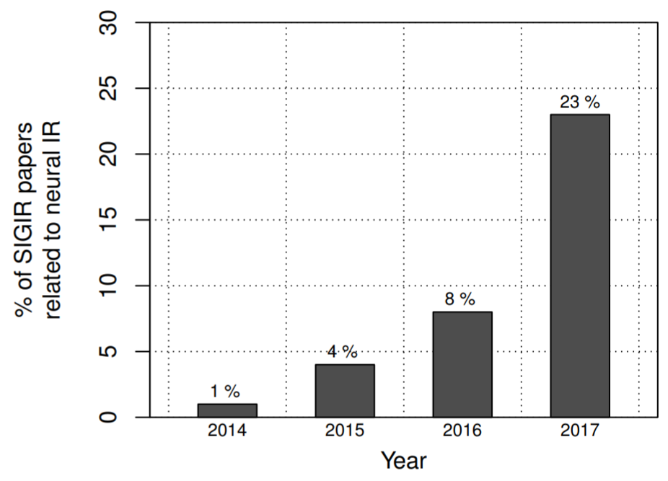
MSMARCO Passage Ranking Challenge
New passage ranking task
Collection size: 5-10M passages
# of queries: 400-500K
Manual relevance annotations for “passage contains the answer”
Two task modes:
Retrieve relevant passages from the full collection
Re-rank top 1K candidates from BM25
Releasing soon (tentatively, September 2018)
(src: http://bit.ly/fntir-neural)
Growing popularity of deep learning in IR, but lack of large training datasets
What is the “ImageNet” of ad-hoc retrieval?

Slide 47
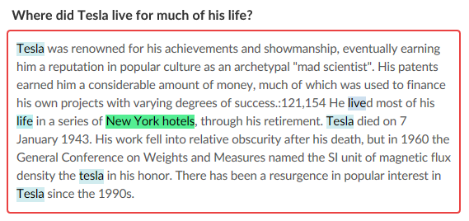
Neural MRC Models
Symbolic Space
human readable
Neural Space
- Computationally efficient
Input: Q
Symbolic → Neural
by Encoding (Q/D/Knowledge)
Reasoning: Q + D → answer vector via multi-step inference, summarization, deduction etc.
Output: A
Neural → Symbolic
by Decoding (synthesizing answer)

Slide 48
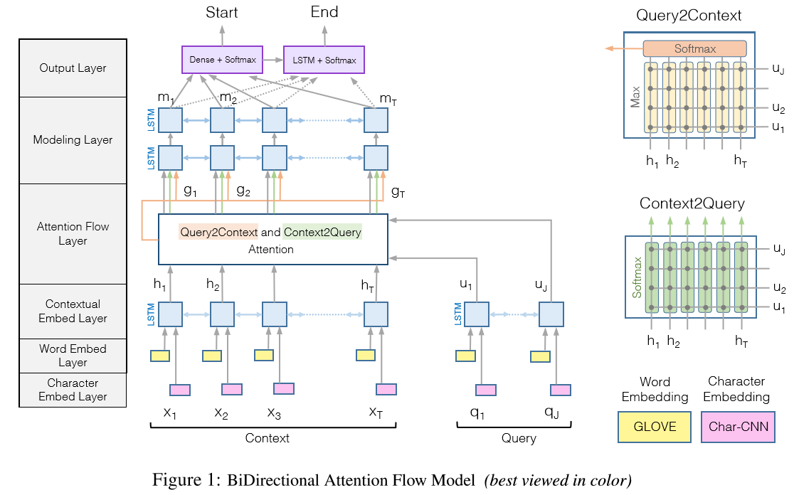
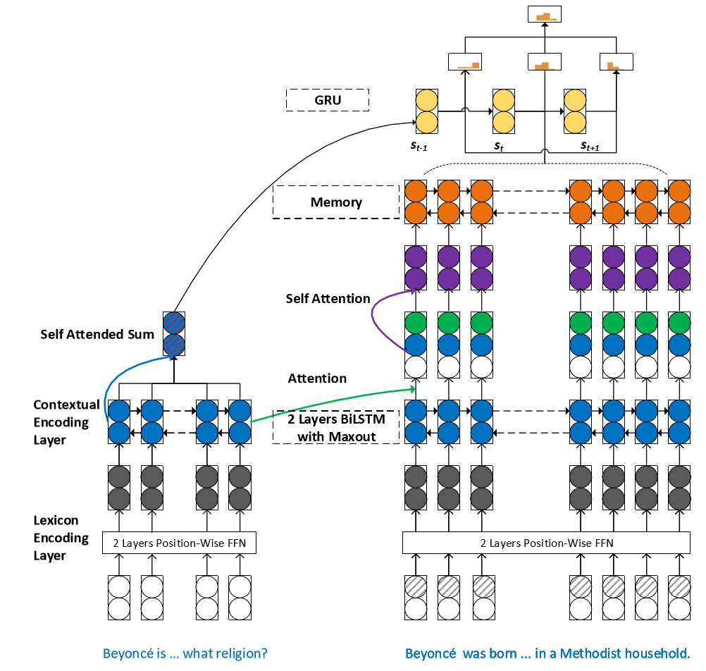
Examples: BiDAF and SAN
Compare them to DSSM
[Seo+ 16; Liu+ 18]

Slide 49
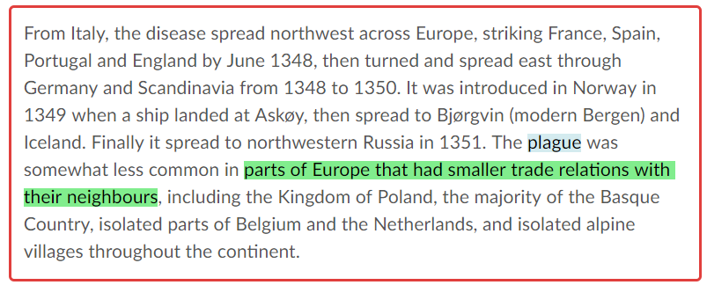
Neural MRC Models on SQuAD
What types of European groups were able to avoid the plague?
A limited form of comprehension:
No need for extra knowledge outside the paragraph
No need for clarifying questions
The answer must exist in the paragraph
The answer must be a text span, not synthesized
Encoding: map each text span to a semantic vector
Reasoning: rank and re-rank semantic vectors
Decoding: map the top-ranked vector to text

Slide 50
Three encoding components
Word embedding – word semantic space
  represent each word as a low-dim continuous vector via GloVe [Pennington+ 14]
Context embedding – contextual semantic space
  capture context info for each word, via
    BiLSTM [Melamud+ 16]
    ELMo [Peter+ 18]: a task-specific combo of the intermediate layer representations of biLM
    Stacked embedding encoder blocks [Yu+ 18]: convolution + self-attention
Query-context attention – query dependent semantic space
  fuse query info into passage via Attention
  [Huang+ 17; Wang+ 17; Hu+ 17; Seo+ 16; Wang&Jiang 16]

Slide 51
Word embedding: word semantic space
Fast food
1-hot vector
dim=|V|=100K~100M
Continuous vector
dim=100~1K
hot dog
Dog racing
[Mikolov+ 13; Pennington+ 14]

Slide 52
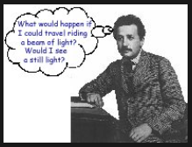
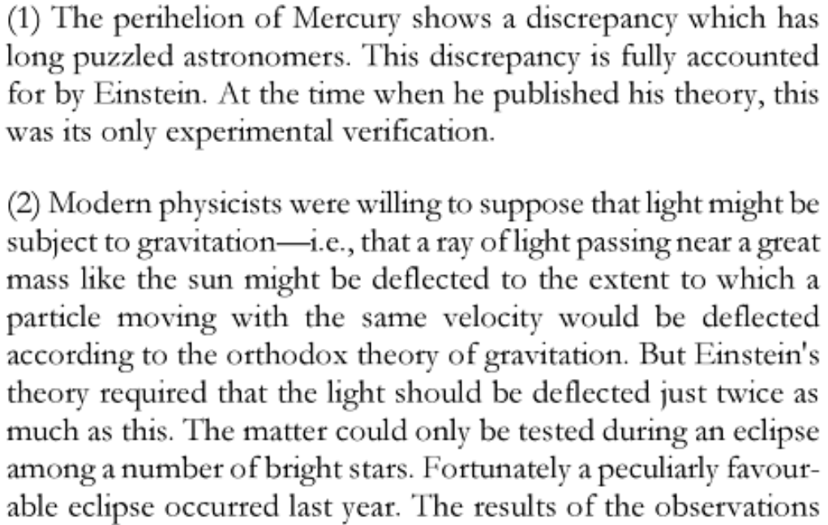
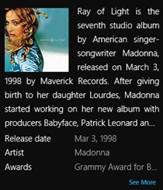
Context embedding: contextual semantic space
The Einstein Theory of Relativity
Ray of Light (Experiment)
ray of light
Ray of Light (Song)

Slide 53


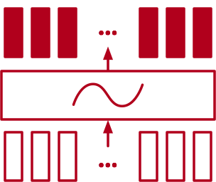
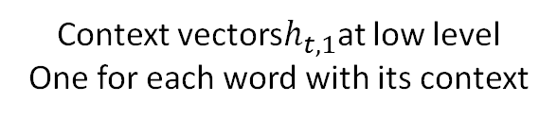

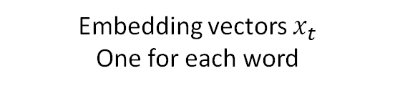

Context embedding via BiLSTM / ELMo
Context vectors $h_{t,L}$ at high level
One for each word with its context
BiLSTM
$$ELMo_{t}^{task}=γ^{task}\sum_{l=1…L}{w_{l}^{task}h_{t,l}}$$
Context vectors$h_{t,1}$at low level
One for each word with its context
Task-specific combination of
hidden layers in BiLSTM
BiLSTM
Embedding vectors $x_{t}$
One for each word
[Peter+ 18; McCann+ 17; Melamud+ 16]

Slide 54

Context embedding via self-attention and convolution
[Yu+ 18]

Slide 55
Query-context attention: query-dependent semantic space
semantic space
S1: free online car body shop repair estimates
S2: online body fat percentage calculator
S3: Body Language Online Courses Shop
Query: auto body repair cost calculator software

Slide 56
Query-context attention: query-dependent semantic space
query-dependent
semantic space
S1: free online car body shop repair estimates
S2: online body fat percentage calculator
S3: Body Language Online Courses Shop
Query: auto body repair cost calculator software

Slide 57









Context-query attention: query-dependent semantic space
Compute attention scores (similarity btw $i$ and $j$): $S_{ij}=S(h_{i}^{A},h_{j}^{B})$
Compute attention weights thru softmax: $α_{ij}=\exp{(S_{ij})/\sum_{k}{\exp{(S_{ik})}}}$
Fusion info from B to A: ${\hat{h}}_{i}^{A}=\sum_{j}{α_{ij}h_{j}^{B}}$
$${\hat{h}}_{i}^{A}$$
fusing
$$α_{ij}∝S(h_{i}^{A},h_{j}^{B})$$
$$h_{i}^{A}$$
$$h_{j}^{B}$$
$$h_{i}^{A}$$
$$h_{j}^{B}$$
[Huang+ 17; Wang+ 17; Hu+ 17; Seo+ 16; Wang&Jiang 16]

Slide 58
Multi-step reasoning for Text-QA
Learning to stop reading: dynamic multi-step inference
Step size is determined based on the complexity of instance (QA pair)
Query | Who was the 2015 NFL MVP?
Passage | The Panthers finished the regular season with a 15–1 record, and quarterback Cam Newton was named the 2015 NFL Most Valuable Player (MVP).
Answer (1-step) | Cam Newton
Query | Who was the #2 pick in the 2011 NFL Draft?
Passage | Manning was the #1 selection of the 1998 NFL draft, while Newton was picked first in 2011. The matchup also pits the top two picks of the 2011 draft against each other: Newton for Carolina and Von Miller for Denver.
Answer (3-step) | Von Miller

Slide 59
Multi-step reasoning: example
Query | Who was the #2 pick in the 2011 NFL Draft?
Passage | Manning was the #1 selection of the 1998 NFL draft, while Newton was picked first in 2011. The matchup also pits the top two picks of the 2011 draft against each other: Newton for Carolina and Von Miller for Denver.
Answer | Von Miller
Step 1:
  Extract: Manning is #1 pick of 1998
  Infer: Manning is NOT the answer
Step 2:
  Extract: Newton is #1 pick of 2011
  Infer: Newton is NOT the answer
Step 3:
  Extract: Newton and Von Miller are top 2 picks of 2011
  Infer: Von Miller is the #2 pick of 2011

Slide 60


ReasoNet: learn to stop reading
With Q in mind, read Doc repeatedly, each time focusing on different parts of doc until a satisfied answer is formed:
Given a set of docs in memory: $M$
Start with query: $S$
Identify info in $M$that is related to $S$: $X=f_{a}(S,M)$
Update internal state: $S=RNN(S,X)$
Whether a satisfied answer $O$ can be formed based on $S$: $f_{tc}(S)$
If so, stop and output answer $O=f_{o}(S)$; otherwise return to 3.
The step size is determined dynamically based on the complexity of the problem using reinforcement learning.
[Shen+ 17]

Slide 61

ReasoNet: learn to stop reading
Query | Who was the #2 pick in the 2011 NFL Draft?
Passage | Manning was the #1 selection of the 1998 NFL draft, while Newton was picked first in 2011. The matchup also pits the top two picks of the 2011 draft against each other: Newton for Carolina and Von Miller for Denver.
Answer | Von Miller
Step | Termination Probability | Prob. Answer
1 | 0.001 | 0.392
Rank-1
Rank-2
Rank-3
$S$: Who was the #2 pick in the 2011 NFL Draft?

Slide 62

ReasoNet: learn to stop reading
Query | Who was the #2 pick in the 2011 NFL Draft?
Passage | Manning was the #1 selection of the 1998 NFL draft, while Newton was picked first in 2011. The matchup also pits the top two picks of the 2011 draft against each other: Newton for Carolina and Von Miller for Denver.
Answer | Von Miller
Step | Termination Probability | Prob. Answer
1 | 0.001 | 0.392
2 | 0.675 | 0.649
Rank-1
Rank-2
Rank-3
$S$: Manning is #1 pick of 1998, but this is unlikely the answer.

Slide 63


ReasoNet: learn to stop reading
Query | Who was the #2 pick in the 2011 NFL Draft?
Passage | Manning was the #1 selection of the 1998 NFL draft, while Newton was picked first in 2011. The matchup also pits the top two picks of the 2011 draft against each other: Newton for Carolina and Von Miller for Denver.
Answer | Von Miller
Step $$t$$ | Termination Probability $f_{tc}$ | Prob. Answer $$f_{o}$$
1 | 0.001 | 0.392
2 | 0.675 | 0.649
3 | 0.939 | 0.865
Rank-1
Rank-2
Rank-3
$S$: Manning is #1 pick of 1998, Newton is #1 pick of 2011, but neither is the answer.

Slide 64

Stochastic Answer Net
Training uses stochastic prediction dropout on the answer module
Reasoning employs all the outputs of multiple-step reasoning via voting
Best documented MRC model on the SQuAD leaderboard as of Dec. 19, 2017
[Liu+ 18]

Slide 65
Interim summary
Knowledge base QA tasks
  From semantic parsing to embedding-based approaches
  Reasoning in symbolic or neural space
  Multi-turn knowledge base QA agents
Neural MRC models for text-based QA
  MRC tasks, e.g., SQuAD, MS MARCO
  Three embedding components: word/context/query-context
  Multi-step reasoning

Slide 66
Outline
Part 1: Introduction
Part 2: Question answering and machine reading comprehension
Part 3: Task-oriented dialogues
  Overview
  Traditional approaches
  Natural language understanding and dialogue state tracking
  Deep RL for dialogue policy learning
  Neural approaches and E2E learning
Part 4: Fully data-driven conversation models and chatbots

Slide 67

An Example Dialogue with Movie-Bot
Actual dialogues can be more complex:
Speech/Natural language understanding errors
    Input may be spoken language form
    Need to reason under uncertainty
Constraint violation
    Revise information collected earlier
...
Source code available at https://github/com/MiuLab/TC-Bot

Slide 68
Task-oriented, slot-filling, Dialogues
Domain: movie, restaurant, flight, …
Slot: information to be filled in before completing a task
  For Movie-Bot: movie-name, theater, number-of-tickets, price, …
Intent (dialogue act):
  Inspired by speech act theory (communication as action)
  request, confirm, inform, thank-you, …
  Some may take parameters:
    thank-you(), request(price), inform(price=$10)
    "Is Kungfu Panda the movie you are looking for?"
    confirm(moviename=“kungfu panda”)

Slide 69







A Multi-turn Task-oriented Dialogue Architecture
Dialog Manager (DM)
“Find me a
Bill Murray movie”
Request(movie;
actor=bill murray)
(Spoken) Language Understanding (LU)
State Tracking
Knowledge Base
“When was it
released”
Request
(release_year)
Natural Language Generation / Synthesis
Dialog Policy

Slide 70


Microsoft’s solution:
Building Task-Oriented Dialogue Agents via LUIS/TCP/BF
LUIS -> LU, trained on labeled data via active learning (more data = more robust to paragraphing)
Task Completion Platform (TCP) -> DM, hand-crafted, easy to use but not flexible & robust to corner cases
Bot Framework (BF) -> publish bots thru multiple channels (e.g., Cortana, MS Teams, Skype, FB Messenger)
Active research: Improving agents E2E via Reinforcement Learning (RL)

Slide 71













Reinforcement Learning (RL)
action $a_{t}$
Goal of RL
At each step $t$, given history so far $s_{t}$, take action $a_{t}$ to maximize long-term reward (“return”):
$$R_{t}=r_{t}+γr_{t+1}+γ^{2}r_{t+2}+⋯$$
Agent
World
reward $r_{t}$
next-observation $o_{t+1}$
"Reinforcement Learning: An Introduction", 2nd ed., Sutton & Barto

Slide 72


RL vs. SL (supervised learning)
Differences from supervised learning
Learn by trial-and-error (“experimenting”)
  Need efficient exploration
Optimize long-term reward ($r_{1}+{γr}_{2}+…$)
  Need temporal credit assignment
Similarities to supervised learning
Generalization and representation
Hierarchical problem solving
…
action
RL
reward &
next-observation/state
world
input/feature
SL
true label
teacher

Slide 73


Conversation as RL
Observation and action
  Raw representation
  (utterances in natural language form)
  Semantic representation
  (intent-slot-value form)
Reward
  +10 upon successful termination
  -10 upon unsuccessful termination
  -1 per turn
  …
raw
semantic
Pioneered by [Levin+ 00]
Other early examples: [Singh+ 02; Pietquin+ 04; Williams&Young 07; etc.]

Slide 74
Dialogue System Evaluation
Metrics: what numbers matter?
  Success rate: #Successful_Dialogues / #All_Dialogues
  Average turns: average number of turns in a dialogue
  User satisfaction
  Consistency, diversity, engaging, ...
  Latency, backend retrieval cost, …
Methodology: how to measure those numbers?

Slide 75
Methodology (I): Human Subject Study
Recruit human subjects, randomly split into two groups (A and B)
Blindly test two systems on these groups
Compare metrics of interests between A and B
Pros
  Real humans involved
Cons
  Expensive and time-consuming, does not scale well
  Lab users and actual users may behave differently
  Limited use, mostly for comparing two (or few) given systems

Slide 76
Methodology (II): Actual users
Deploy the dialogue system to serve actual users
Keep track of metrics of interest from user logs
Pros
  Arguably the gold standard evaluation setup
Cons
  Mostly feasible for major companies with a large user base
  Expensive and risky (potential business disruptions)

Slide 77
Methodology (III): Simulated users
Create a simulated user U: conversational history -> next utterance
  Agenda based [Schatzmann & Young 09]
  Model based [El Asri+ 16]
Can run any policy or RL algorithm against U to measure metrics
Pros
  Cheap to run, with unlimited amount of data
Cons
  User simulation is only a (usually rough) approximation of real users
  Building a good user simulator is nontrivial

Slide 78


Agenda-based Simulated User [Schatzmann & Young 09]
User state consists of (agenda, goal); goal is fixed throughout dialogue
Agenda is maintained (stochastically) by a first-in-last-out stack
Implementation of a simplified user simulator: https://github.com/MiuLab/TC-Bot

Slide 79

A Simulator for E2E Neural Dialogue System [Li+ 17]

Slide 80


Methodology: Summary
 | Lab user subjects | Actual users | Simulated users
Truthfulness
Scalability
Flexibility
Expense
Risk
A Hybrid Approach
User Simulation
Small-scale Human Evaluation
(lab, Mechanical Turk, …)
Large-scale Deployment (optionally with continuing incremental refinement)

Slide 81
Outline
Part 1: Introduction
Part 2: Question answering and machine reading comprehension
Part 3: Task-oriented dialogues
  Overview
  Traditional approaches
  Natural language understanding and dialogue state tracking
  Deep RL for dialogue policy learning
  Neural approaches and E2E learning
Part 4: Fully data-driven conversation models and chatbots

Slide 82
Decision-theoretic View of Dialogue Management
Principle of Maximum Expected Utility (MEU):
An optimal decision maximizes the expected utility of outcomes.
Same in RL that typically aims to maximize expected long-term reward
Dialog Manager
“Find me a
Bill Murray movie”
Request(movie;
actor=bill murray)
(Spoken) Language Understanding
State Tracking
Knowledge Base
“When was it
released”
Request
(release_year)
Natural Language Generation / Synthesis
Dialog Policy

Slide 83

Language Understanding in Dialogue Systems
Goal is to predict (domain, intent, slot) from user utterance
Often treated as a classification problem
Solved by SVM, CRF, generative models (e.g., HMM), ...,
See surveys by Wang+ [2005] and De Mori+ [2008]
More to cover in the next section
"Find me a
Bill Murray movie"
Language Understanding
Request(movie; actor=bill murray​)

Slide 84
Decision-theoretic View of Dialogue Management
Dialog Manager
“Find me a
Bill Murray movie”
Request(movie;
actor=bill murray)
(Spoken) Language Understanding
State Tracking
Knowledge Base
“When was it
released”
Request
(release_year)
Natural Language Generation / Synthesis
Dialog Policy

Slide 85



Dialogue Management
Typical assumptions in earlier work: small number of hand-coded states
$Q(s,a)$ measures the highest long-term reward, updated by
Once learned, action $a$ in state $s$ is
[Levin+ 00; Walker+ 98; Singh+ 00; Scheffler & Young 02; etc.]
(From NJFun
[Singh+ 00])

Slide 86
Language Understanding Uncertainty
True state of a conversation is partially observable
Partially Observable MDP (POMDP) as a principled framework
  Key idea: maintains a posterior distribution of current dialogue state
[ Roy+ 00; Zhang+ 01; Williams &Young 07, etc.]
Limitations: (1) scalability, (2) domain knowledge required
Confidence | Result
0.9 | Inform(date="Tuesday")
0.1 | Inform(date="Thursday")
0.05 | Inform(moviename="Tuesday")
... | ...
"I'd like to watch a movie on Tuesday"
SLU/NLU
"N-best list"

Slide 87
Scaling up Dialogue Optimization
Use approximate POMDP algorithms leveraging problem-specific structures
  Augmented MDP [Roy+ 00]
  Summary POMDPs [Williams & Young 07]
Use RL algorithms with function approximation
  Requires human designed features that implicitly encode domain knowledge
  Use of linear Q-functions [Henderson+ 08]
  Automated feature selection for improved scalability [Li+ 09]
  Nonparametric Gaussian processes [Gasic+ 14]

Slide 88
Outline
Part 1: Introduction
Part 2: Question answering and machine reading comprehension
Part 3: Task-oriented dialogues
  Overview
  Traditional approaches
  Natural language understanding and dialogue state tracking
  Deep RL for dialogue policy learning
  Neural approaches and E2E learning
Part 4: Fully data-driven conversation models and chatbots

Slide 89
Decision-theoretic View of Dialogue Management
Dialog Manager
“Find me a
Bill Murray movie”
Request(movie;
actor=bill murray)
(Spoken) Language Understanding
State Tracking
Knowledge Base
“When was it
released”
Request
(release_year)
Natural Language Generation / Synthesis
Dialog Policy

Slide 90

Language Understanding
Often a multi-stage pipeline
Metrics
  Sub-sentence-level: intent accuracy, slot F1
  Sentence-level: whole frame accuracy
1. Domain Classification
2. Intent Classification
3. Slot Filling

Slide 91
DNN for Domain/Intent Classification (Ravuri & Stolcke, 2015)
RNN and LSTMs for utterance classification
Intent decision after reading all words performs better

Slide 92

RNN for Slot Tagging – I [Hakkani-Tur+ 16]
Variations:
  RNNs with LSTM cells
  Look-around LSTM
  Bi-directional LSTMs
  Intent LSTM
May also take advantage of …
  whole-sentence information
  multi-task learning
  contextual information
For further details on NLU, see this IJCNLP tutorial by Chen & Gao.

Slide 93




E2E MemNN for Contextual LU [Chen+ 16]
1. Sentence Encoding
2. Knowledge Attention
3. Knowledge Encoding
p_{i}
y
Knowledge Attention Distribution
RNN Tagger
slot tagging sequence
Contextual Sentence Encoder
y_{t-1}
y_{t}
m_{i}
V
V
RNN_{mem}
Weighted Sum
h_{t-1}
h
h_{t}
W
W
W
x₁
x₂
…
x_{i}
Memory Representation
M
U
M
U
Sentence Encoder
Inner Product
w_{t-1}
w_{t}
RNN_{in}
∑
W_{kg}
x₁
…
x₂
x_{i}
Knowledge Encoding Representation
c
u
o
history utterances {x_{i}}
current utterance
Idea: additionally incorporating contextual knowledge during slot tagging
→ track dialogue states in a latent way

Slide 94


LU Importance [Li+ 17]
Compare different types of LU errors
Sensitivity to Intent Error
Sensitivity to Slot Error
Slot filling is more important than intent detection in language understanding

Slide 95

Dialogue State Tracking (DST)
Maintain a probabilistic distribution instead of a 1-best prediction for better robustness to SLU errors or ambiguous input
Slot | Value
# people | 5 (0.5)
time | 5 (0.5)
How can I help you?
Book a table at Sumiko for 5
Slot | Value
# people | 3 (0.8)
time | 5 (0.8)
How many people?
3

Slide 96

Multi-Domain Dialogue State Tracking (DST)
A full representation of the system's belief of the user's goal at any point during the dialogue
Used for making API calls
Do you wanna take Angela to go see a movie tonight?
Sure, I will be home by 6.
Movies
Restaurants
Let's grab dinner before the movie.
11/15/16
11/15/16
How about some Mexican?
Date
Date
Time
6 pm
7 pm
8 pm
9 pm
Time
6:30 pm
7 pm
7:30 pm
Let's go to Vive Sol and see Inferno after that.
# of tickets
2
3
Cuisine
Mexican
Angela wants to watch the Trolls movie.
Movie name
Inferno
Trolls
Restaurant
Vive Sol
Movie theatre
Century 16
Ok. Lets catch the 8 pm show.

Slide 97
Dialog State Tracking Challenge (DSTC)
(Williams+ 13, Henderson+ 14, Henderson+ 14, Kim+ 16, Kim+ 16)
Challenge | Type | Domain | Data Provider | Main Theme
DSTC1 | Human-Machine | Bus Route | CMU | Evaluation Metrics
DSTC2 | Human-Machine | Restaurant | U. Cambridge | User Goal Changes
DSTC3 | Human-Machine | Tourist Information | U. Cambridge | Domain Adaptation
DSTC4 | Human-Human | Tourist Information | I2R | Human Conversation
DSTC5 | Human-Human | Tourist Information | I2R | Language Adaptation

Slide 98
DST Evaluation
Dialogue State Tracking Challenges
  DSTC2-3, human-machine
  DSTC4-5, human-human
  DSTC6, three tracks
Metric
  Tracked state accuracy with respect to user goal
  Recall/Precision/F-measure individual slots

Slide 99

Neural Belief Tracker [Mrkšić+ 16]
Compare it to MRC
Encoding & Reasoning

Slide 100

NN-Based DST [Henderson+ 13; Mrkšić+ 15; Mrkšić+ 16]
Compare it to MRC
Contextual embedding
(Figure from Wen+ 17)

Slide 101
Outline
Part 1: Introduction
Part 2: Question answering and machine reading comprehension
Part 3: Task-oriented dialogues
  Overview
  Traditional approaches
  Natural language understanding and dialogue state tracking
  Deep RL for dialogue policy learning
  Neural approaches and E2E learning
Part 4: Fully data-driven conversation models and chatbots

Slide 102
Decision-theoretic View of Dialogue Management
Dialog Manager
“Find me a
Bill Murray movie”
Request(movie;
actor=bill murray)
(Spoken) Language Understanding
State Tracking
Knowledge Base
“When was it
released”
Request
(release_year)
Natural Language Generation / Synthesis
Dialog Policy

Slide 103

Deep RL for Dialogue Policy Optimization
dialogue state s
Action may be semantic (confirm(date="tuesday"))
or in NLP form ("is it for tuesday?")
or a backend operation (e.g., API call, KB lookup)
Two main classes of RL algorithms
  Value function based: Q-learning (DQN), Sarsa, …
  Policy based: REINFORCE, policy gradient / actor-critic, ...
NLU/DST
Deep RL
action $a$

Slide 104
Policy Gradient vs. Q-learning
 | Policy Gradient | Q-learning
Apply to complex actions
Stable convergence
Sample efficiency
Relation to final policy quality
Flexibility in algorithmic design

Slide 105



Policy Optimization with DQN
DQN-learning of network weights $θ$: apply SGD to solve
$$\hat{θ}←\arg{\min_{θ}{\sum_{t}{{\left(r_{t+1}+γ\max_{a}{Q_{T}\left(s_{t+1},a\right)−Q_{L}\left(s_{t},a_{t}\right)}\right)}^{2}}}}$$
state
Q-values
“Target network” to synthesize regression target
[Mnih+ 15]
“Learning network” whose weights are to be updated
RNN/LSTM may be used to implicitly track states (without a separate dialogue state tracker) [Zhao & Eskenazi 16]

Slide 106


Policy Optimization with Policy Gradient
PG does gradient descent in policy parameter space to improve reward
REINFORCE [Williams 1992]: simplest PG algorithm
Advantaged Actor-Critic (A2C) / TRACER
  $w$: updated by least-squared regression
  $θ$: updated as in PG
A2C/TRACER [Su+ 17]

Slide 107

Domain Extension and Exploration
Most goal-oriented dialogs require a closed and well-defined domain
Hard to include all domain-specific information up-front
New slots can be gradually introduced
producer
box office
actress
writer
time
Initial system deployed
Challenge for exploration:
How to explore efficiently
to collect data for new slots
When deep models are used

Slide 108





Bayes-by-Backprop Q (BBQ) network
BBQ-learning of network params $θ=\left(μ,σ^{2}\right)$:
$$\hat{θ}=\arg{\min_{θ_{L}}{KL\left(q\left(w | θ_{L}\right) |\left| p(w|Data\right)\right)}}$$
state
Q-values
Still use “target network” $θ_{T}$ to synthesize regression target
Parameter learning: solve for $\hat{θ}$ with Bayes-by-backprop [Blundell et al. 2015]
Params $θ$ quantifies uncertainty in Q-values
Action selection: use Thompson sampling for exploration
[Lipton+ 18]

Slide 109
Composite-task Dialogues
Travel Assistant
“subtasks”
Reserve Restaurant
Book Flight
Book Hotel
Naturally solved by hierarchical RL
Actions

Slide 110


A Hierarchical Policy Learner
Similar to Hierarchical Abstract Machine (HAM) [Parr’98]
Superior results in both simulated and real users [Peng+ 17]

Slide 111



Integrating Planning for Dialogue Policy Learning [Peng+ 18]
Human-Human conversation data
Supervised/imitation learning
Expensive: need large amounts of real experience except for very simple tasks
Risky: bad experiences (during exploration) drive users away
Dialog agent
Acting
RL
real experience

Slide 112

Integrating Planning for Dialogue Policy Learning [Peng+ 18]
Human-Human conversation data
Inexpensive: generate large amounts of simulated experience for free
Overfitting: discrepancy btw real users and simulators
Supervised/imitation learning
Acting
RL
Dialog agent
simulated experience

Slide 113

Integrating Planning for Dialogue Policy Learning [Peng+ 18]
Dialogued agent trained using
Limited real user experience
Large amounts of simulated experience
Limited real experience is used to improve
Dialog agent
Planner (simulated user)
Human-Human conversation data
Supervised/imitation learning
Planning
simulated user
Acting
RL
Model learning
real experience
(limited)

Slide 114
Outline
Part 1: Introduction
Part 2: Question answering and machine reading comprehension
Part 3: Task-oriented dialogues
  Overview
  Traditional approaches
  Natural language understanding and dialogue state tracking
  Deep RL for dialogue policy learning
  Neural approaches and E2E learning
Part 4: Fully data-driven conversation models and chatbots

Slide 115
Decision-theoretic View of Dialogue Management
Dialog Manager
“Find me a
Bill Murray movie”
Request(movie;
actor=bill murray)
(Spoken) Language Understanding
State Tracking
Knowledge Base
“When was it
released”
Request
(release_year)
Natural Language Generation / Synthesis
Dialog Policy

Slide 116

Hybrid Code Networks [Williams+ 17]
Allows domain knowledge to be encoded as API calls or action templates

Slide 117


Differentiating KB Accesses
[Dhingra+ 17]
1
Knowledge Base
Dialog Manager
“Find me a
Bill Murray movie”
Request(movie;
actor=bill murray)
(Spoken) Language Understanding
2
State Tracking
3
“When was it
released”
Request
(release_year)
Natural Language Generation / Synthesis
5
Dialog Policy
4
Use a single deep NN for {dialog manager and KB}
Recurrent network to track states of conversation
Maintain (implicitly) a distribution over entities in KB
A summary network to “summarize” distribution information
Multilayer perceptron policy network
Whole network can be end-to-end trained by BP/SGD!

Slide 118

Soft KB-lookup
Posterior computation:
$$\operatorname{Pr}\left(\text{"}\text{GroundhogDay}\text{"}\right)∝Pr⁡(\text{Actor}=\text{"}\text{Bill} \text{Murray}\text{"})⋅\operatorname{Pr}\left(\text{ReleaseYear}="1993"\right)⋯$$
Each $\operatorname{Pr}\left(\text{slot}=\text{value}\right)$ is computed in terms of LU outputs
Soft KB-lookup: sample a movie according to the posterior
  Randomization results in differentiability (similar to policy gradient alg.)
  As opposed to using SQL queries to look up results deterministically
Whole system can be trained using policy gradient & back-propagation

Slide 119
Microsoft Dialogue Challenge at SLT-2018
Task: build E2E task-oriented dialogue systems
Data: labeled human conversations in 3 domains
Experiment platform with built-in user simulators for training and evaluation
Final evaluation in simulated setting and by human judges
More information:
https://github.com/xiul-msr/e2e_dialog_challenge

Slide 120
An E2E Neural Dialogue System [Li+ 17]
Further empirical study of end-to-end dialogue systems

Slide 121
Outline
Part 1: Introduction
Part 2: Question answering and machine reading comprehension
Part 3: Task-oriented dialogue
Part 4: Fully data-driven conversation models and chatbots
  E2E neural conversation models
  Challenges and remedies
  Grounded conversation models
  Beyond supervised learning
  Data and evaluation
  Chatbots in public
  Future work

Slide 122
Motivation
One statistical
model
Natural language interpreter
Dialogue
State tracker
utterance x
Natural language
generator
Dialogue response
selection
utterance y
Move towards fully data-driven, end-to-end dialogue systems.

Slide 123

Social Bots
Fully end-to-end systems so far most successfully applied to
social bots or chatbots:
  Commercial systems: Amazon Alexa, XiaoIce, etc.
Why social bots?
  Maximize user engagement by generating
  enjoyable and more human-like conversations
  Help reduce user frustration
  Influence dialogue research in general
  (social bot papers often cited in task-completion
  dialogue papers)

Slide 124
Historical overview
Earlier work in fully data-driven response generation:
2010: Response retrieval system (IR) [Jafarpour+ 10]
2011: Response generation using Statistical Machine Translation (phrase-based MT) [Ritter+ 11]
2015: First neural response generation systems (RNN, seq2seq)
[Sordoni+ 15; Vinyals & Le 15; Shang+ 15]

Slide 125
Neural Models for Response Generation
[Sordoni+ 15;
Vinyals & Le 15;
Shang+ 15]
Source:
conversation history
… how
are
you
?
EOS
I
’m
fine
,
encoder
decoder
Target:
response
I
’m
fine
,
thanks
Similar to sequence models in Neural Machine Translation (NMT), summarization, etc.
Uses either RNN, LSTM, GRU, etc.

Slide 126
Neural Models for Response Generation
[Sordoni+ 15;
Vinyals & Le 15;
Shang+ 15]
Source:
conversation history
… how
are
you
?
EOS
I
’m
fine
,
encoder
decoder
Target:
response
I
’m
fine
,
thanks

Slide 127


Neural Response Generation:
Difference with other tasks (e.g., machine translation)
Data: some training sets (social media) are HUGE
For example, Twitter (as of 2016):
304M monthly active users
500M tweets per day (6M conversations per day)
→ often train on subset of the data; leaner and “faster” models preferred
System input: LONG conversation history
T₁ T₂
Either limit
context size [Sordoni+ 05]
or truncate backprop
[Vinyals+ 05, pc]
T₁ T₂ T₃ T₄ … T_{N}
T₁ T₂ T₃
...
… T_{N-2} T_{N-1} T_{N}
Conversation (N turns)
N-1 training instances

Slide 128
Neural conversation engine
[Sordoni+ 15; Li+ 16a]
Neural model learns the general shape of conversation, and the system output is situationally appropriate and coherent…
A more goal-oriented example. No grounding into a real calendar, but the “shape” of the conversation is fluent and plausible…
H: | Hi
M: | How are you?
H: | Not bad
M: | What's wrong?
H: | Nothing really
M: | Wanna talk about it? I'm here if you wanna talk x
H: | Well, I'm just tired
M: | Me too, I'm here if you wanna talk
H: | Thanks, what are you doing?
M: | You're welcome and I'm watching TV and you?
H: | On Netflix?
M: | Yeah, I'm watching it on Netflix.
H: | What are you watching?
M: | A TV show.
H: | Nice, did you have dinner already?
M: | No, not yet. what about you?
H: | Would Thursday afternoon work sometime?
M: | Yeah, sure. just let me know when you‘re free.
H: | After lunch is probably the best time
M: | Okay, sounds good. Just let me know when you’re free.
H: | Would 2pm work for you?
M: | Works for me.
H: | Well let’s say 2pm then I’ll see you there
M: | Sounds good.
Neural E2E system trained on 35M Twitter conversations.

Slide 129
Fully Data-driven Response Generation:
Challenges and remedies

Slide 130


Challenge: The blandness problem
How was your weekend?
I don’t know.
What did you do?
I don’t understand what you are talking about.
This is getting boring…
Yes that’s what I’m saying.

Slide 131




Blandness problem: cause and remedies
[Li+ 16a]
Common MLE objective (maximum likelihood)
Mutual information objective:
(whatever the user says)
I don’t know.
I don’t understand...
That’s what I’m saying
(whatever the user says)
I don’t know.
(whatever the user says)
I don’t know.

Slide 132




Mutual Information for Neural Network Generation
[Li+ 16a]
Mutual information objective:
Bayes’ rule
standard
likelihood
anti-LM
Bayes’ theorem

Slide 133
Sample outputs (MMI)
Wow sour starbursts really do make your mouth water... mm drool.
Can I have one?
Of course you can! They’re delicious!
Milan apparently selling Zlatan to balance the books... Where next, Madrid?
I think he'd be a good signing.
‘tis a fine brew on a day like this! Strong though, how many is sensible?
Depends on how much you drink!
Well he was on in Bromley a while ago... still touring.
I’ve never seen him live.

Slide 134

MLE vs MMI: results
[Li+ 16a]
Lexical diversity
(# of distinct tokens / # of words)
BLEU
MMI: best system in Dialogue Systems Technology Challenge 2017 (DSTC, E2E track)

Slide 135

Challenge: The consistency problem
E2E systems often exhibit poor response consistency:

Slide 136
The consistency problem: why?
Conversational data:
Where were you born?
London
NOT
1-to-1
Where did you grow up?
New York
Where do you live?
Seattle
P(response | query, SPEAKER_ID)

Slide 137







Personalized Response Generation
[Li+ 2016b]
D_Gomes25
Jinnmeow3
skinnyoflynny2
u.s.
london
TheCharlieZ
england
Rob_712
great
Tomcoatez
Dreamswalls
good
Speaker embeddings (70k)
Bob_Kelly2
Word embeddings (50k)
Kush_322
okay
kierongillen5
monday
live
This_Is_Artful
tuesday
The_Football_Bar
DigitalDan285
stay
where
do
you
live?
Rob
EOS
Rob
in
Rob
england
Rob
.
in
england
.
EOS

Slide 138

Persona model results
Baseline model:
Persona model using speaker embedding: [Li+ 16b]

Slide 139



Personal modeling as multi-task learning
[Luan+ 17]
Source
LSTM
Target
LSTM
Seq2Seq
query
response
What’s your job?
Software engineer
I’m a code ninja
Source
LSTM
Target
LSTM
Personalized data
(e.g., non-convo)
personalized data
Autoencoder
I’m a code ninja
Tied parameters

Slide 140

Improving personalization with multiple losses [Al-Rfou+ 16]
Single-loss:
P(response | context, query, persona, …)
  Problem with single-loss:
  context or query often
  “explain away” persona
Multiple loss adds:
P(response | persona)
P(response | query)
etc.
  Optimized so that
  persona can “predict”
  response all by itself
  → more robust
  speaker embeddings

Slide 141

Challenge: Long conversational context
It can be challenging for LSTM/GRU to encode very long context
(i.e. more than 200 words: [Khandelwal+ 18])
Hierarchical Encoder-Decoder (HRED) [Serban+ 16]
Encodes:
utterance (word by word) +
conversation (turn by turn)

Slide 142

Challenge: Long conversational context
Hierarchical Latent Variable Encoder-Decoder (VHRED) [Serban+ 17]
  Adds a latent variable to the decoder
  Trained by maximizing variational lower-bound on the log-likelihood
Related to persona
model [Li+ 2016b]:
Deals with 1-N
problem, but
unsupervisedly.

Slide 143

Hierarchical Encoders and Decoders:
Evaluation
[Serban+ 17]

Slide 144
Outline
Part 1: Introduction
Part 2: Question answering and machine reading comprehension
Part 3: Task-oriented dialogue
Part 4: Fully data-driven conversation models and chatbots
  E2E neural conversation models
  Challenges and remedies
  Grounded conversation models
  Beyond supervised learning
  Data and evaluation
  Chatbots in public
  Future work

Slide 145










Towards Grounded E2E Conversation Models
calendar
Understanding
(NLU)
State tracker
input x
Environment
Traditional
Generation
(NLG)
Dialog policy
output y
Grounded
input x
Fully data-driven
output y
NOT grounded

Slide 146





E2E Conversation Models in the real world
  Personalization data
  (ID, social graph, ...)
  Device sensors
  (GPS, vision, ...)
  External
  “knowledge”
Context
encoder

Slide 147

A Knowledge-Grounded Neural Conversation Model [Ghazvininejad+ 17]
Going to
Kusakabe tonight
Try omakase, the best in town
DIALOG
ENCODER
h_{t}
h_{t}
DECODER
CONVERSATION HISTORY
FACTS
ENCODER
RESPONSE
Consistently the best omakase
Amazing sushi tasting […]
.
A
They were out of kaisui […]
.
.
.
.
.
WORLD
“FACTS”
CONTEXTUALLY-RELEVANT
“FACTS”
[Sukhbaatar+ 15]

Slide 148


Learns implicit slot filling
You know any good A restaurant in B?
Try C, one of the best D in the city.
You know any good Japanese restaurant in Seattle?
Try Kisaku, one of the best sushi restaurants in the city.

Slide 149

Sample knowledge-grounded responses
I would give ALMOST anything for some [Mexican restaurant] right now.
Me too. Jalapeno sauce is really good.
Obsessed with [jewelry company] :-*
oh my gosh obsessed with their bracelets and the meaning behind them!
Visiting the celebs at Los Angeles airport - [...] w/ 70 others
Nice airport terminal. Have a safe flight.
Experimental results (23M conversations): outperforms competitive neural baseline (human + automatic eval)

Slide 150






Grounded E2E Dialogue Systems
Grounding: images
Conversations around images e.g.,
Q-As [Das+ 16] or chat [Mostafazadeh+ 17]
Grounding: affect [Huber+ 18]
facial actions influence response
convo

Slide 151
Beyond supervised learning
Limitations of SL for E2E dialogue:
  Train on human-human data, test with human-machine
  (Twitter-ese often not what we want at test time.)
  Optimizes for immediate reward p(T_{N} | … T_{N-1}), not long-term reward
  No user feedback loop
Emergence of reinforcement learning (RL) for E2E dialogue
  Tries to promote long-term dialogue success

Slide 152





Deep Reinforcement Learning for E2E Dialogue
[Li+ 16c]
REINFORCE algorithm [Williams+ 92]
Reward functions:
  Ease of answering:
  Information flow:
  Meaningfulness:
reward function
what we
want to learn

Slide 153

Simulation (without RL)
See you later!
See you later!
See you later!
See you later!
See you later!
See you later!
See you later!
153

Slide 154
Simulation (with RL)
How old are you ?
i 'm 4, why are you asking ?
I thought you were 12 .
What made you think so ?
I don’t know what you are talking about .
You don’t know what you are saying.
I don’t know what you are talking about .

Slide 155

Deep RL: Evaluation
MTurk evaluation (500 responses)

Slide 156
Outline
Part 1: Introduction
Part 2: Question answering and machine reading comprehension
Part 3: Task-oriented dialogue
Part 4: Fully data-driven conversation models and chatbots
  E2E neural conversation models
  Challenges and remedies
  Grounded conversation models
  Beyond supervised learning
  Data and evaluation
  Chatbots in public
  Future work

Slide 157
Conversational datasets
(for social bots, E2E dialogue research)
Survey on dialogue datasets [Serban+ 15]
Name | Type / Topics | Size
Reddit | Unrestricted | 3.2B responses (growing)
Twitter | Unrestricted | N/A (growing)
OpenSubtitles | Movie subtitles | 1B words
Ubuntu Dialogue Corpus | Chat on Ubuntu OS | 100M words
Ubuntu Chat Corpus | Chat on Ubuntu OS | 2B words

Slide 158



Evaluating E2E Dialogue Systems
Human evaluation (crowdsourcing):
Automatic evaluation:
Less expensive, but is it reliable?
Context: … Because of your game?
Input: Yeah, I’m on my way now
Response: Ok good luck!
Is this a good¹ response?
Strongly Disagree
Strongly
Agree
Disagree
Unsure
Agree
¹: replaced as appropriate (relevant, interesting,…)

Slide 159


Machine-Translation-Based Metrics
BLEU [Papineni+ 02]: ngram overlap metric
NIST [Doddington+ 02]
  Seldom used in dialogue, but copes with blandness issue
  Considers info gain of each ngram: score(interesting calculation) >> score(of the)
METEOR
  Accounts for synonyms, paraphrases, etc.
Reference:
John resigned yesterday .
System:
Yesterday , John quit .

Slide 160
The challenge with MT-based metrics
Input: How are you?
Response (gold): I ’m good , thanks .
Response A: Good thanks !
Response B: Doing pretty good thanks
Response C: Doing well thank you !
Semantically equivalent
(as in Machine Translation)
Response D: Fantastic . How are you ?
Response E: I 'm getting sick again .
Response F: Bored . you ?
Response G: Sleepy .
Response H: Terrible tbh
Pragmatically appropriate
Many false negative!

Slide 161


Sentence-level correlation of MT metrics
Poor correlation with human judgments:
Dialogue task
“How NOT to evaluate dialogue systems” [Liu+ 16]
But same problem even for Translation task
[Graham +15]

Slide 162

The importance of sample size
MT metrics were NOT designed to operate at the sentence level:
  BLEU [Papineni+ 02] == “corpus-level BLEU”
  Statistical Significant Tests for MT [Koehn 06; etc.]:
  BLEU not reliable with sample size < 600,
  even for Machine Translation (easier task)
Central Limit Theorem (CLT) argument:
  Matching against reference (e.g., n-grams)
  is brittle → greater variance
  Remedy: reduce variance by
  increasing sample size (CLT),
  i.e., corpus-level BLEU
(Figure from [Brooks+ 12])

Slide 163
Corpus-level Correlation
Generally good for Machine Translation (MT):
  Spearman’s rho of 0.8 to 0.9 for BLEU, METEOR [Przybocki+ 08]
Can it work for Dialogue?
  Currently no definite answer, as corpus-level human judgments very expensive.
  Experiments with smaller N [Galley+ 15]:
Spearman’s rho
deltaBLEU = human-rating weighted
version of BLEU [Galley+ 15]
N=

Slide 164



Trainable Metric
BLEU-2
(N=1)
rho=0.051
Towards an automatic turning test [Lowe+ 17]:
ADEM: Metric based on hierarchical RNN (VHRED)
context c
ADEM
(N=1)
rho=0.428

Slide 165


Social Bots: commercial systems
For end users:
  Amazon Alexa
  (trigger: say “Alexa, let’s chat”)
  Microsoft XiaoIce
  Microsoft Zo (on Kik)
  Replika.ai [system description]
For bot developers:
  Microsoft Personality Chat (includes speaker embedding LSTM)
XiaoIce
(translated from Chinese)
Replika.ai

Slide 166


https://labs.cognitive.microsoft.com/en-us/project-personality-chat

Slide 167
Open Benchmarks
Alexa Challenge (2017-)
- Academic competition, 15 sponsored teams in 2017, 8 in 2018
- $250,000 research grant (2018)
- Proceedings [Ram+ 17]
Dialogue System Technology Challenge (DSTC) (2013-)
(formerly Dialogue State Tracking Challenge)
Focused this year on grounded conversation:
Visual-Scene [Hori +18], background article [Galley +18]
Conversational Intelligence Challenge (ConvAI) (2017-)
Focused this year on personalized chat (FB Persona-Chat dataset)

Slide 168


DSTC7 Challenge:
Knowledge-Grounded Conversation
…….
………….
………
…………
…………….
……………..
Reddit conversation
about article
“Sentence Generation” track (61 registrants as of June)
Registration link: http://workshop.colips.org/dstc7/call.html

Slide 169

Sample grounded conversation
A woman fell 30,000 feet from an airplane and survived.
The page states that a 2009 report found the plane only fell several hundred meters.
Well if she only fell a few hundred meters and survived then I'm not impressed at all.
Still pretty incredible, but quite a bit different that 10,000 meters.

Slide 170

Conclusions
E2E Neural Conversation Models
  Learn the backbone or shell of open-domain natural conversation
  Face significant challenges (blandness, consistency, long context), but
  alleviated using better models and objectives (e.g., MMI and HRED)
Grounded conversational AI models
  Exploit external textual knowledge, device sensors
  (e.g., images), personal information
  Produce more informational and “useful” dialogues

Slide 171


Moving beyond chitchat
chitchat
informational,
task-completion
dialogue
Fully data-driven systems

Slide 172
Fully Data-driven Response Generation:
Challenges and future work

Slide 173
Better objective functions and evaluation metrics
Lack of good objective or reward functions is a challenge for SL and RL:
  MLE causes blandness (mitigated by MMI)
  Evaluation metrics (BLEU, METEOR, etc.) reliable only on large datasets
  → expensive for optimization (e.g., sequence-level training [Ranzato+ 15])
  RL reward functions currently too ad-hoc
Final system evaluation:
  Still need human evaluation
  Corpus-level metrics (BLEU, METEOR, etc.): How effective are they really?

Slide 174








Better leverage heterogeneous data
.
.
query 1
response 1
.
.
.
.
English sentence 1
French sentence 1
.
.
.
.
much of world knowledge
in non-conversational form
(often unstructured)
.
.
query N
response N
.
.
general domain dialog
English sentence N
French sentence N
in-domain data (e.g., decision making, task-oriented)
most NLP / AI problems
(homogeneous data)
conversational AI
(heterogeneous data)

Slide 175

Thank you
Contact Information:
Jianfeng Gao http://research.microsoft.com/~jfgao
Michel Galley http://research.microsoft.com/~mgalley
Lihong Li https://lihongli.github.io
Slides and references available:
http://microsoft.com/en-us/research/publication/neural-approaches-to-conversational-ai/

