Slide 1
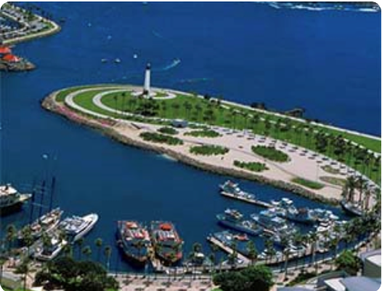
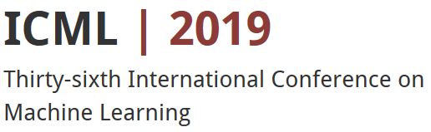
Neural Approaches to Conversational AI
Jianfeng Gao, Michel Galley
Microsoft Research
ICML 2019
Long Beach, June 10, 2019

Slide 2
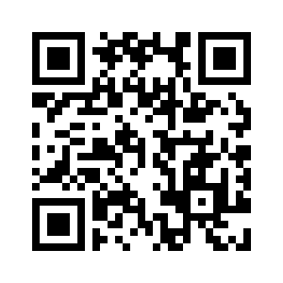
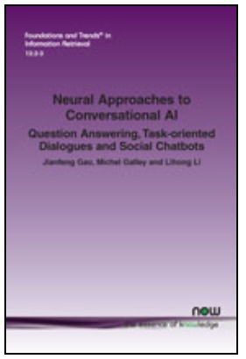
Book details:
https://www.nowpublishers.com/article/Details/INR-074
https://arxiv.org/abs/1809.08267 (preprint)
Contact Information:
Jianfeng Gao http://research.microsoft.com/~jfgao
Michel Galley http://research.microsoft.com/~mgalley
Slides:
http://microsoft.com/en-us/research/publication/neural-approaches-to-conversational-ai/
We thank Lihong Li, Bill Dolan and Yun-Nung (Vivian) Chen for contributing slides.

Slide 3
Outline
Part 1: Introduction
  Who should attend this tutorial
  Dialogue: what kinds of problem
  A unified view: dialogue as optimal decision making
  Deep learning leads to paradigm shift in NLP
Part 2: Question answering and machine reading comprehension
Part 3: Task-oriented dialogues
Part 4: Fully data-driven conversation models and chatbots

Slide 4
Who should attend this tutorial?
Whoever wants to understand and create modern dialogue agents that
  Can chat like a human (to establish long-term emotional connections with users)
  Can answer questions of various topics (movie stars, theory of relativity)
  Can fulfill tasks (whether report, travel planning)
  Can help make business decision
  …
Focus on neural approaches, but hybrid approaches are widely used.

Slide 5
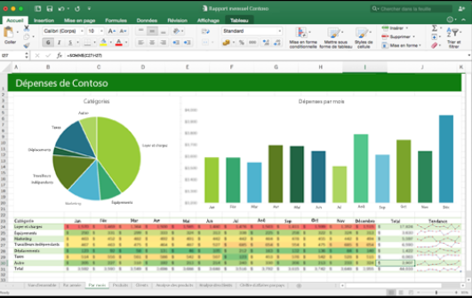
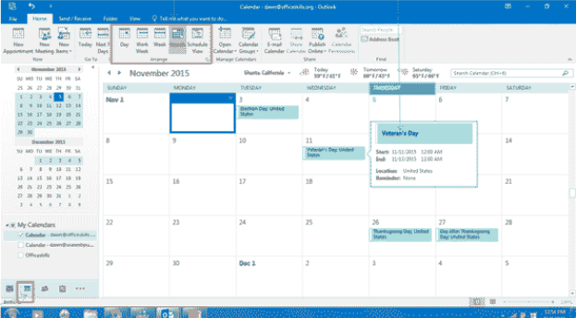
Aspirational Goal:
Enterprise Assistant
Where are sales lagging behind our forecast?
Task Completion
The worst region is [country], where sales are XX% below projections
Do you know why?
QA (decision support)
The forecast for [product] growth was overly optimistic
How can we turn this around?
Here are the 10 customers in [country] with the most growth potential, per our CRM model
Can you set up a meeting with the CTO of [company]?
Info Consumption
Yes, I’ve set up a meeting with [person name] for next month when you’re in [location]
Task Completion
Thanks

Slide 6
What kinds of problems?
“I am smart”
“I have a question”
“I need to get this done”
“What should I do?”
Turing Test (“I” talk like a human)
Information consumption
Task completion
Decision support

Slide 7
What kinds of problems?
Chitchat (social bot)
“I am smart”
“I have a question”
“I need to get this done”
“What should I do?”
Turing Test (“I” talk like a human)
Information consumption
Task completion
Decision support
Goal-oriented dialogues

Slide 8








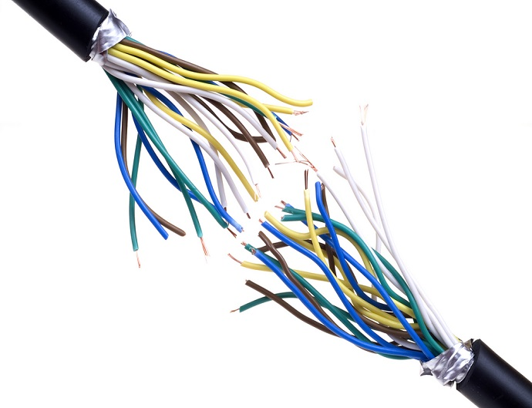
Dialog Systems
Understanding
(NLU)
State tracker
input x
Goal-Oriented Dialog
DB
Database
Memory
External knowledge
Generation
(NLG)
Dialog policy
output y
Statistical model
(e.g., neural)
Understanding
(NLU)
State tracker
input x
Fully data-driven
DB
Generation
(NLG)
Dialog policy
output y
[Young+ 13; Tur & De Mori 11; Ritter+ 11; Sordoni+ 15; Vinyals & Le 15; Shang+ 15; etc.]

Slide 9

A unified view: dialogue as optimal decision making
Dialogue as a Markov Decision Process (MDP)
  Given state $s$, select action $a$ according to (hierarchical) policy $π$
  Receive reward $r$, observe new state $s′$
  Continue the cycle until the episode terminates.
Goal of dialogue learning: find optimal $π$ to maximize expected rewards
Dialogue | State (s) | Action (a) | Reward (r)
Info Bots (Q&A bot over KB, Web etc.) | Understanding of user Intent (belief state) | Clarification questions, Answers | Relevance of answer # of turns (less is better)
Task Completion Bots (Movies, Restaurants, …) | Understanding of user goal (belief state) | Dialog act + slot_value | Task success rate # of turns (less is better)
Social Bot (XiaoIce) | Conversation history | Response | Engagement, # of turns (more is better)

Slide 10
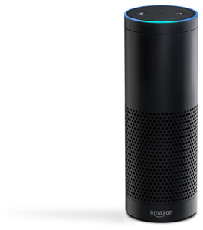


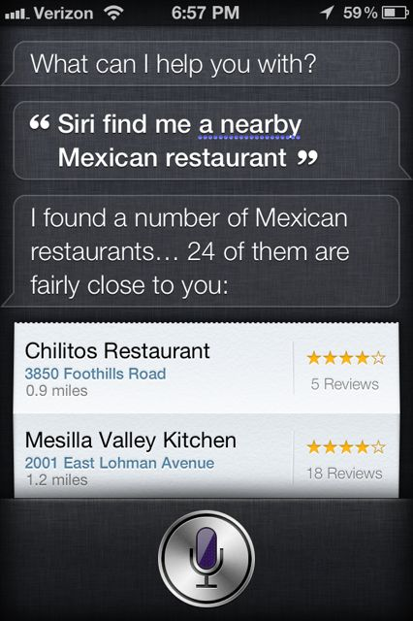
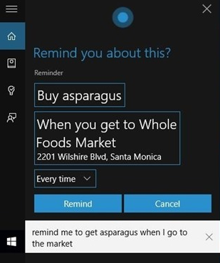
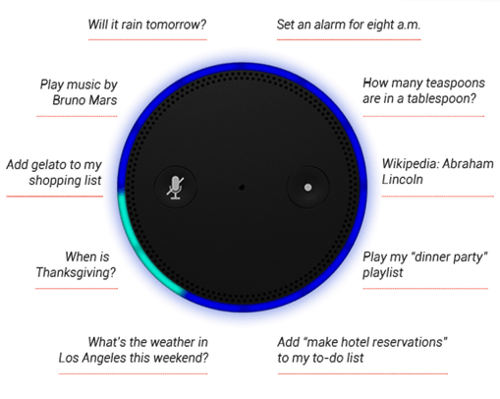
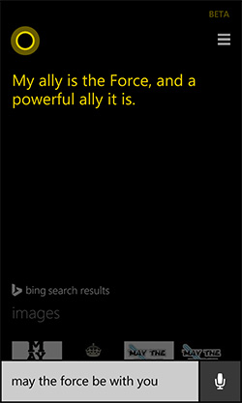
Personal assistants today
goal oriented
Engaging (social bots)

Slide 11



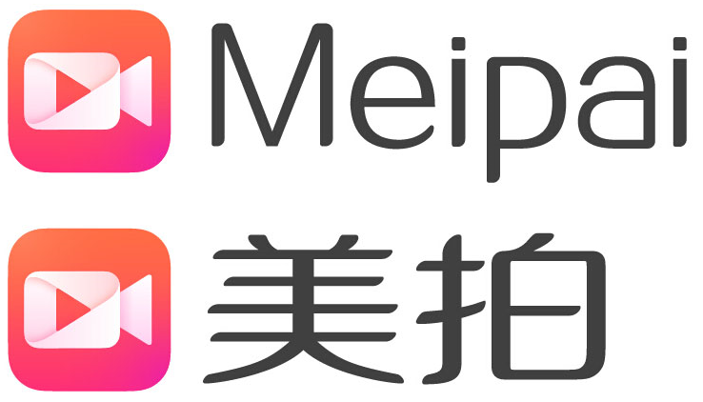


XiaoIce System Architecture
User Experience Layer
Conversation Engine Layer
Data Layer
Core Chat
Skills
General Chat
Domain Chat
Task Completion
Deep Engagement
Full Duplex steam-based conversations
(voice)
XiaoIce Profile
User Profiles
Image Commenting
Content Creation
Paired Datasets (text, image)
Unpaired Datasets (text)
Empathetic
Computing
User Understanding
Social skills
XiaoIce personality
Message-based conversations
(text, image, voice, video clips)
Dialogue Manager
Topic Index
Knowledge Graphs
Global
State Tracker
Dialogue
Policy
Top level policy for skill selection
Topic manager for Core Chat
[Design and Implementation of XiaoIce, an empathetic social chatbot]

Slide 12
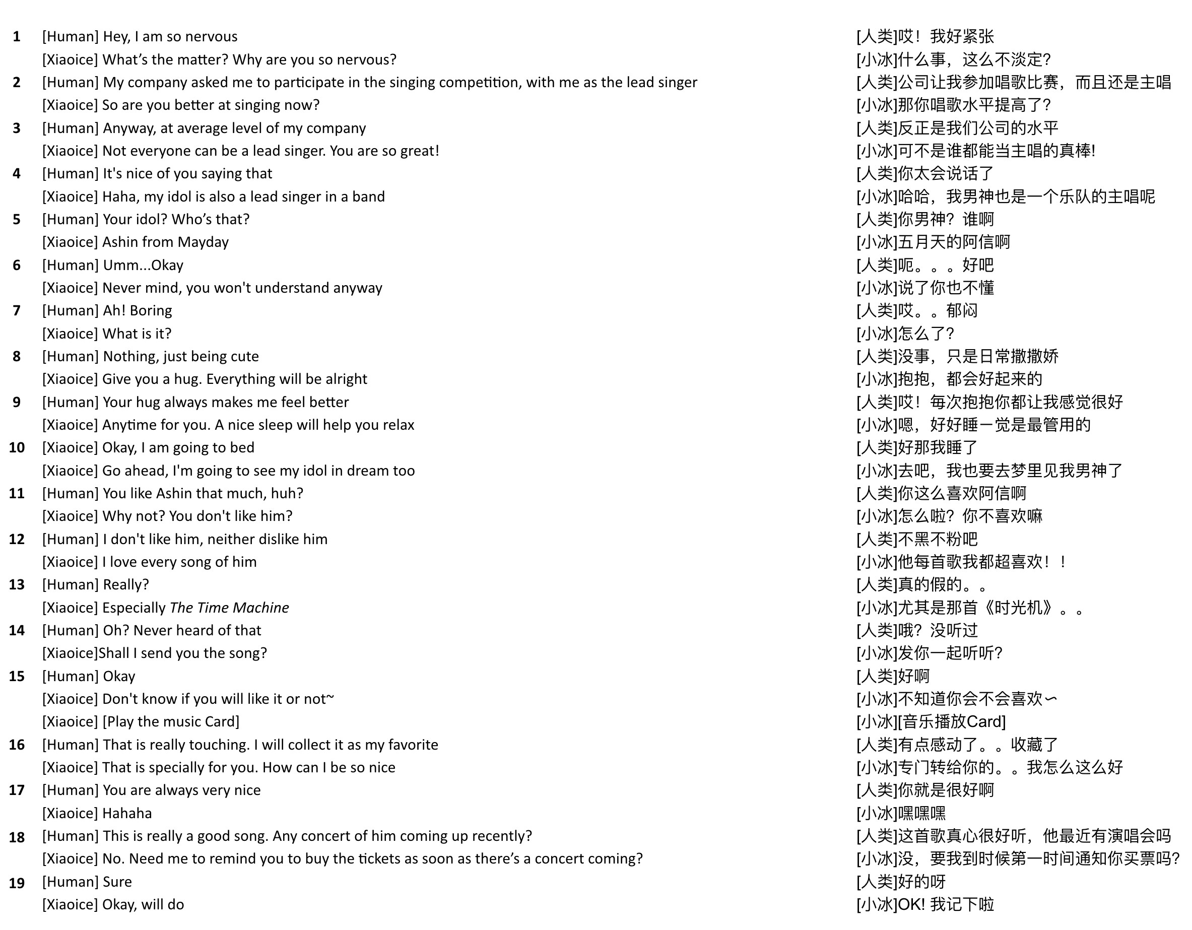
General Chat Skill
Music Chat Skill
Switch to a new topic
Song-On-Demand Skill
Ticket-Booking Skill

Slide 13
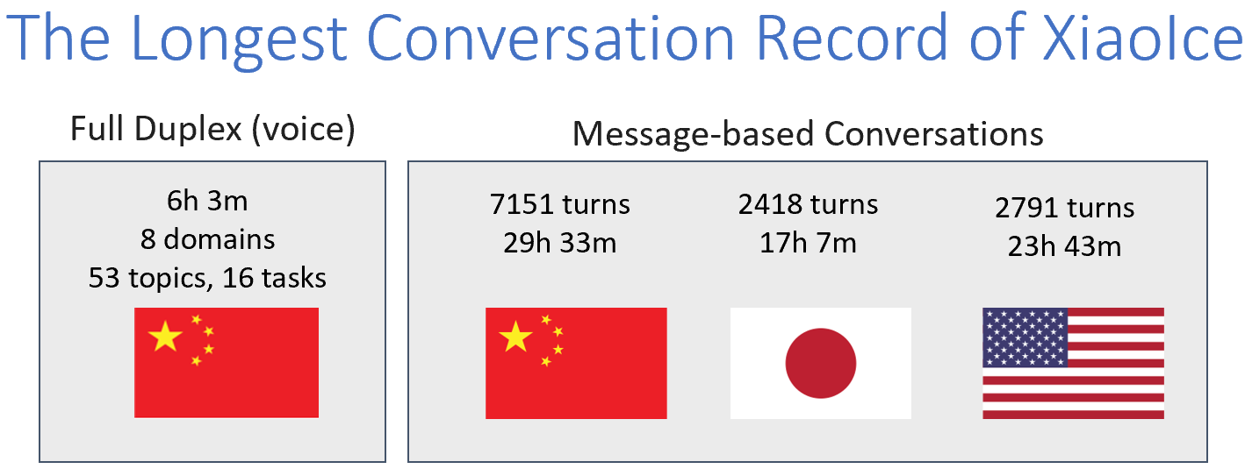
XiaoIce: the Most Popular Social Chatbot in the World [Zhou+ 18]
660 million users worldwide
5 countries: China, Japan, USA, India, Indonesia
40 platforms, e.g., WeChat, QQ, Weibo, FB Messenger, LINE
Average CPS of 23 (better than human conversations)

Slide 14
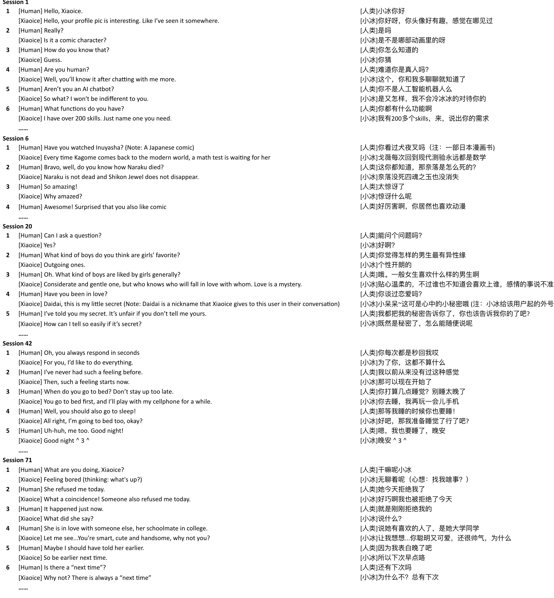

Slide 15
Traditional definition of NLP: the branch of AI
Understanding and generating the languages that humans use naturally (natural language)
Study knowledge of language at different levels
  Phonetics and Phonology – the study of linguistic sounds
  Morphology – the study of the meaning of components of words
  Syntax – the study of the structural relationships between words
  Semantics – the study of meaning
  Discourse – they study of linguistic units larger than a single utterance
[Jurafsky & Martin 09]

Slide 16
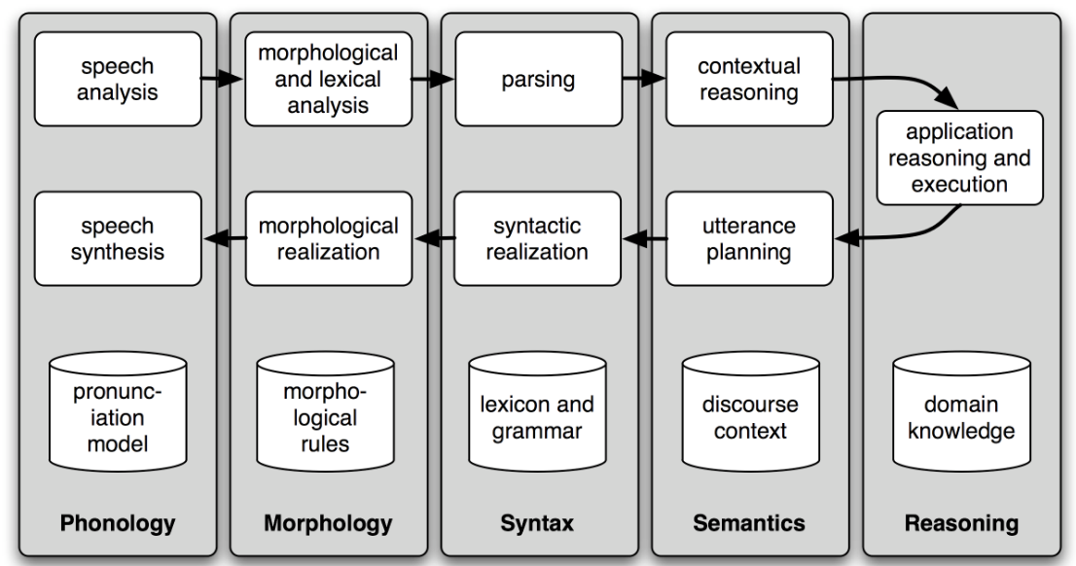
Traditional NLP component stack
Natural language understand (NLU): parsing (speech) input to semantic meaning and update the system state
Application reasoning and execution: take the next action based on state
Natural language generation (NLG): generating (speech) response from action
[Bird et al. 2009]

Slide 17
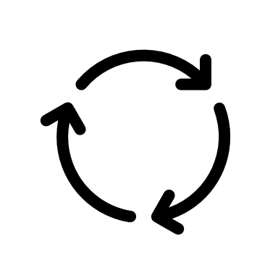
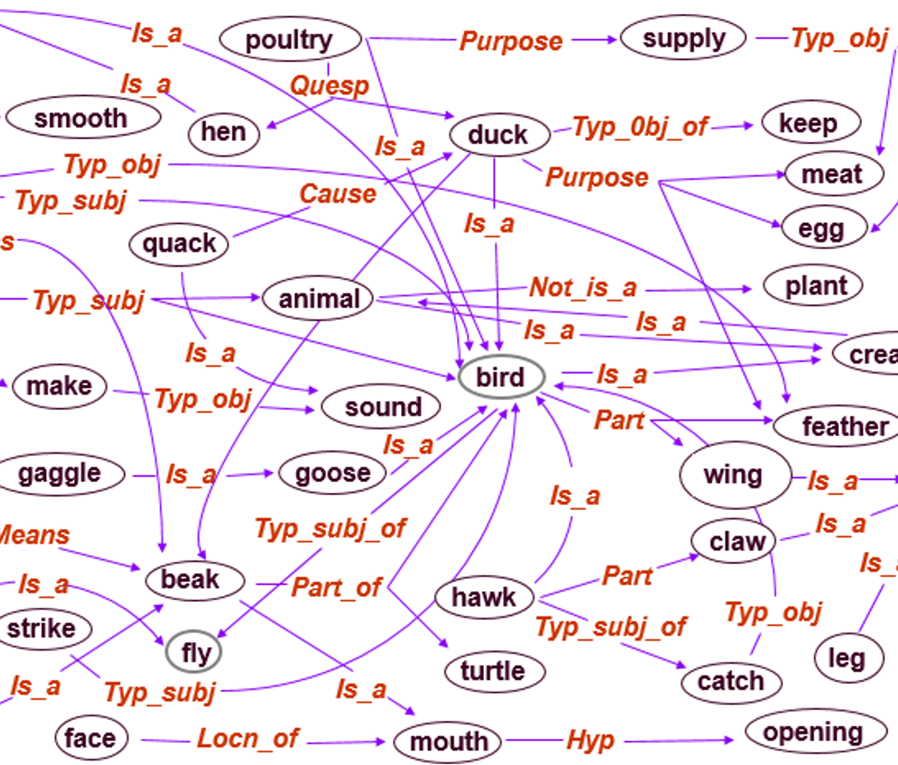
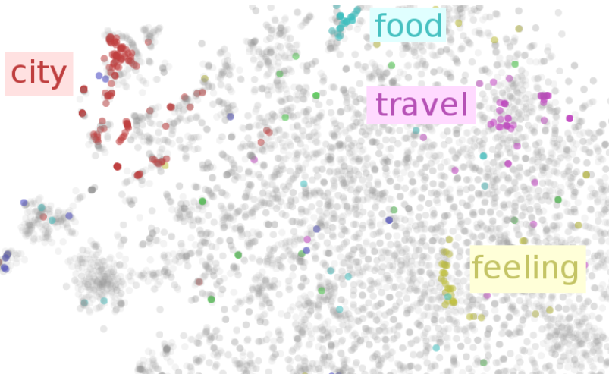

Symbolic Space
Input: Query
Neural Space
Symbolic → Neural
Encoding the query/knowledge
Knowledge is explicitly represented using words/relations/templates
Reasoning is based on keyword matching, sensitive to paraphrase alternations
Interpretable and efficient in execution but difficult to train E2E.
Knowledge is implicitly represented by semantic classes as cont. vectors
Reasoning is based on semantic matching, robust to paraphrase alternations
Easy to train E2E, but uninterpretable and inefficient in execution
E2E training via back propagation
Reasoning in neural space to generate answer vector
Errors
Output: Answer
Neural → Symbolic
Decoding the answer in NL
[Gao et al. 2018]

Slide 18
Outline
Part 1: Introduction
Part 2: Question answering (QA) and machine reading comprehension (MRC)
  Neural MRC models for text-based QA
  Knowledge base QA
  Multi-turn knowledge base QA agents
Part 3: Task-oriented dialogues
Part 4: Fully data-driven conversation models and chatbots

Slide 19
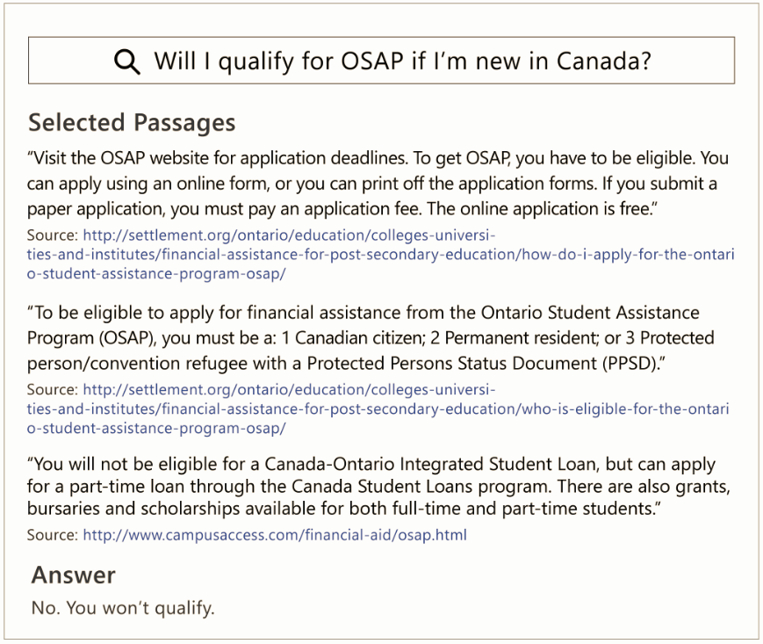

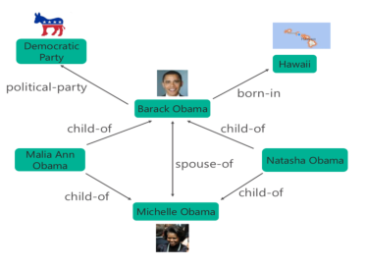
Open-Domain Question Answering (QA)
What is Obama’s citizenship?
Selected Passages from Bing
Selected subgraph from Microsoft’s Satori
Answer
USA
Text-QA
MS MARCO [Nguyen+ 16]
Knowledge Base (KB)-QA
Freebase

Slide 20
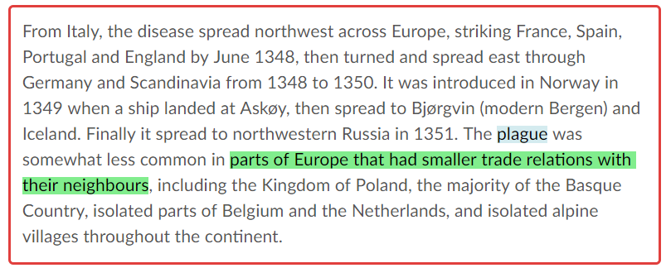
Neural MRC Models on SQuAD
What types of European groups were able to avoid the plague?
A limited form of comprehension:
No need for extra knowledge outside the paragraph
No need for clarifying questions
The answer must be a text span in the paragraph if it exists, not synthesized,
Encoding: map each text span to a semantic vector
Reasoning: rank and re-rank semantic vectors
Decoding: map the top-ranked vector to text

Slide 21
Three components
Word embedding – word semantic space
  represent each word as a low-dim continuous vector via GloVe
Context embedding – contextual semantic space
  capture context info for each word (in query or doc), via
    BiLSTM [Melamud+ 16]
    ELMo [Peter+ 18]: task-specific combo of the intermediate layer representations of biLM
    BERT [Devlin et al. 2018]: multi-layer transformer.
Ranking – task-specific semantic space
  fuse query info into passage via Attention
  [Huang+ 17; Wang+ 17; Hu+ 17; Seo+ 16; Wang&Jiang 16]

Slide 22

Language Embeddings (context free)
Fast-food
-0.2
1-hot vector
dim=|V|=100K~100M
0
0.7
1
0.1
0
…
Continuous vector
dim=100~1K
…
0.4
0
0.2
0
-0.3
0
Hot-dog
Dog-racing
[Mikolov+ 13; Pennington+ 14]

Slide 23
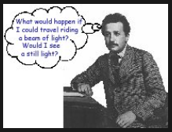
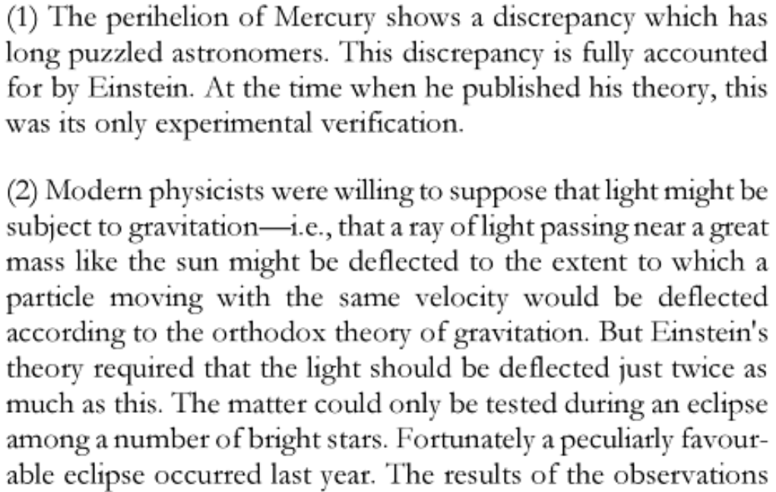
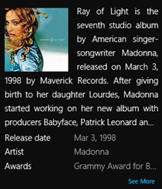
Contextual Language Embeddings
The Einstein Theory of Relativity
Ray of Light (Experiment)
ray of light
Ray of Light (Song)

Slide 24


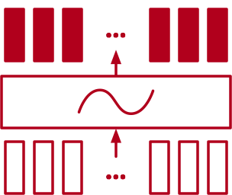
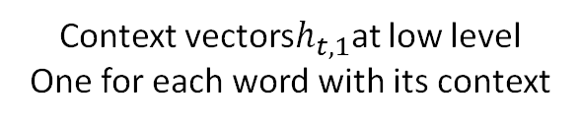

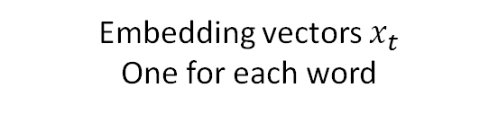
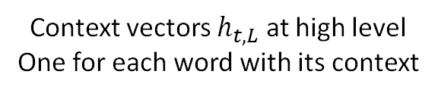
Context embedding via BiLSTM / ELMo
Context vectors $h_{t,L}$ at high level
One for each word with its context
BiLSTM
$$ELMo_{t}^{task}=γ^{task}\sum_{l=1…L}{w_{l}^{task}h_{t,l}}$$
Context vectors$h_{t,1}$at low level
One for each word with its context
Task-specific combination of
hidden layers in BiLSTM
BiLSTM
Embedding vectors $x_{t}$
One for each word
[Peter+ 18; McCann+ 17; Melamud+ 16]

Slide 25

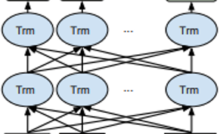
BERT: pre-training of deep bidirectional transformers for language understanding [Devlin et al. 2018]
Train deep (12 or 24 layers) bidirectional transformer LMs
Fine-tune on individual tasks using task-specific data
store
Milk
Classifier:
Sentiment analysis
the man went to the [MAS] to buy [word]

Slide 26
Ranker: task-specific semantic space
semantic space
S1: free online car body shop repair estimates
S2: online body fat percentage calculator
S3: Body Language Online Courses Shop
Query: auto body repair cost calculator software

Slide 27

Ranker: task-specific semantic space
query-dependent
semantic space
S1: free online car body shop repair estimates
S2: online body fat percentage calculator
S3: Body Language Online Courses Shop
Query: auto body repair cost calculator software

Slide 28
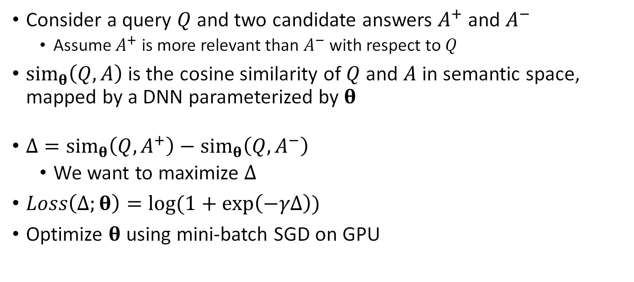
Learning an answer ranker from labeled QA pairs
Consider a query $Q$ and two candidate answers $A^{+}$ and $A^{−}$
  Assume $A^{+}$ is more relevant than $A^{−}$ with respect to $Q$
$sim_{θ}\left(Q,A\right)$is the cosine similarity of $Q$ and $A$ in semantic space, mapped by a DNN parameterized by $θ$
$Δ=sim_{θ}\left(Q,A^{+}\right)−sim_{θ}\left(Q,A^{−}\right)$
  We want to maximize $Δ$
$Loss\left(Δ;θ\right)=\log{(1+\exp\left(−γΔ\right))}$
Optimize $θ$using mini-batch SGD on GPU

Slide 29
Multi-step reasoning for Text-QA
Learning to stop reading: dynamic multi-step inference
Step size is determined based on the complexity of instance (QA pair)
Query | Who was the 2015 NFL MVP?
Passage | The Panthers finished the regular season with a 15–1 record, and quarterback Cam Newton was named the 2015 NFL Most Valuable Player (MVP).
Answer (1-step) | Cam Newton
Query | Who was the #2 pick in the 2011 NFL Draft?
Passage | Manning was the #1 selection of the 1998 NFL draft, while Newton was picked first in 2011. The matchup also pits the top two picks of the 2011 draft against each other: Newton for Carolina and Von Miller for Denver.
Answer (3-step) | Von Miller

Slide 30
Multi-step reasoning: example
Query | Who was the #2 pick in the 2011 NFL Draft?
Passage | Manning was the #1 selection of the 1998 NFL draft, while Newton was picked first in 2011. The matchup also pits the top two picks of the 2011 draft against each other: Newton for Carolina and Von Miller for Denver.
Answer | Von Miller
Step 1:
  Extract: Manning is #1 pick of 1998
  Infer: Manning is NOT the answer
Step 2:
  Extract: Newton is #1 pick of 2011
  Infer: Newton is NOT the answer
Step 3:
  Extract: Newton and Von Miller are top 2 picks of 2011
  Infer: Von Miller is the #2 pick of 2011

Slide 31
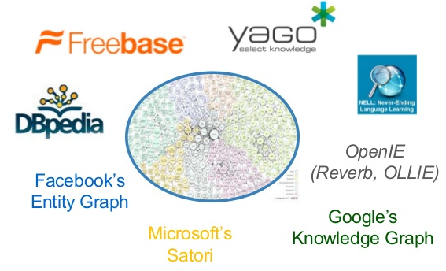
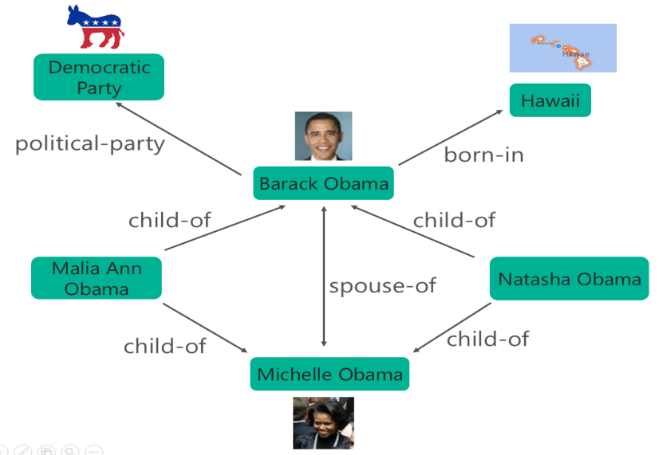
Question Answering (QA) on Knowledge Base
Large-scale knowledge graphs
Properties of billions of entities
Plus relations among them
An QA Example:
Question: what is Obama’s citizenship?
Query parsing:
  (Obama, Citizenship,?)
Identify and infer over relevant subgraphs:
  (Obama, BornIn, Hawaii)
  (Hawaii, PartOf, USA)
correlating semantically relevant relations:
  BornIn ~ Citizenship
Answer: USA

Slide 32
Symbolic approaches to KB-QA
Understand the question via semantic parsing
  Input: what is Obama’s citizenship?
  Output (LF): (Obama, Citizenship,?)
Collect relevant information via fuzzy keyword matching
  (Obama, BornIn, Hawaii)
  (Hawaii, PartOf, USA)
  Needs to know that BornIn and Citizenship are semantically related
Generate the answer via reasoning
  (Obama, Citizenship, USA)
Challenges
  Paraphrasing in NL
  Search complexity of a big KG
[Richardson+ 98; Berant+ 13; Yao+ 15; Bao+ 14; Yih+ 15; etc.]

Slide 33
Key Challenge in KB-QA:
Language Mismatch (Paraphrasing)
Lots of ways to ask the same question
  “What was the date that Minnesota became a state?”
  “Minnesota became a state on?”
  “When was the state Minnesota created?”
  “Minnesota's date it entered the union?”
  “When was Minnesota established as a state?”
  “What day did Minnesota officially become a state?”
Need to map them to the predicate defined in KB
  location.dated_location.date_founded

Slide 34
Scaling up semantic parsers
Paraphrasing in NL
  Introduce a paragraphing engine as pre-processor [Berant&Liang 14]
  Using semantic similarity model (e.g., DSSM) for semantic matching [Yih+ 15]
Search complexity of a big KG
  Pruning (partial) paths using domain knowledge
More details: IJCAI-2016 tutorial on “Deep Learning and Continuous Representations for Natural Language Processing” by Yih, He and Gao.

Slide 35
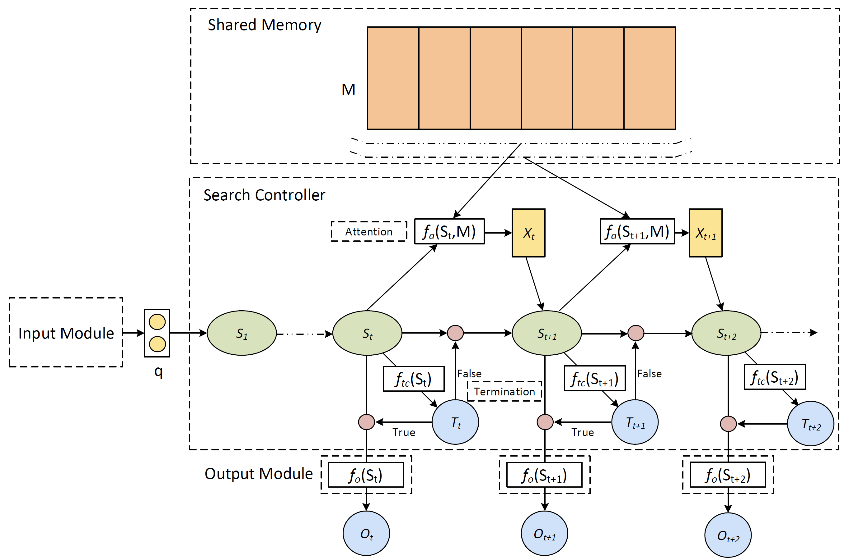
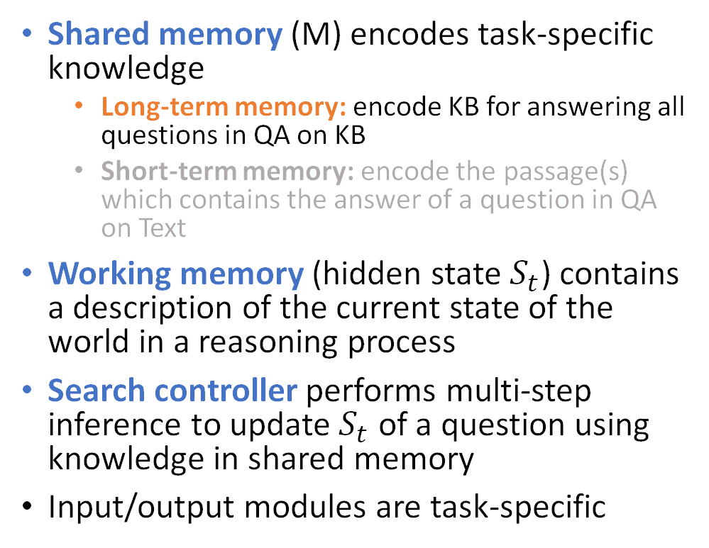
Case study: ReasoNet with Shared Memory
Shared memory (M) encodes task-specific knowledge
  Long-term memory: encode KB for answering all questions in QA on KB
  Short-term memory: encode the passage(s) which contains the answer of a question in QA on Text
Working memory (hidden state $S_{t}$) contains a description of the current state of the world in a reasoning process
Search controller performs multi-step inference to update $S_{t}$ of a question using knowledge in shared memory
Input/output modules are task-specific
[Shen+ 16; Shen+ 17]

Slide 36

Joint learning of Shared Memory and Search Controller
Embed KG to memory vectors
Citizenship
BornIn
Paths extracted from KG:
(John, BornIn, Hawaii)
(Hawaii, PartOf, USA)
(John, Citizenship, USA)
…
Training samples generated
(John, BornIn, ?)->(Hawaii)
(Hawaii, PartOf, ?)->(USA)
(John, Citizenship, ?)->(USA)
…
(John, Citizenship, ?)
(USA)

Slide 37
Joint learning of Shared Memory and Search Controller
Citizenship
BornIn
Paths extracted from KG:
(John, BornIn, Hawaii)
(Hawaii, PartOf, USA)
(John, Citizenship, USA)
…
Training samples generated
(John, BornIn, ?)->(Hawaii)
(Hawaii, PartOf, ?)->(USA)
(John, Citizenship, ?)->(USA)
…
(John, Citizenship, ?)
(USA)

Slide 38
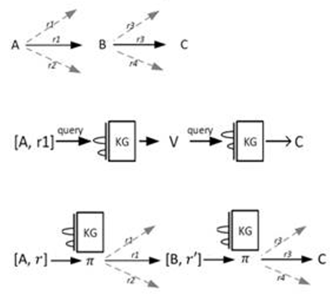
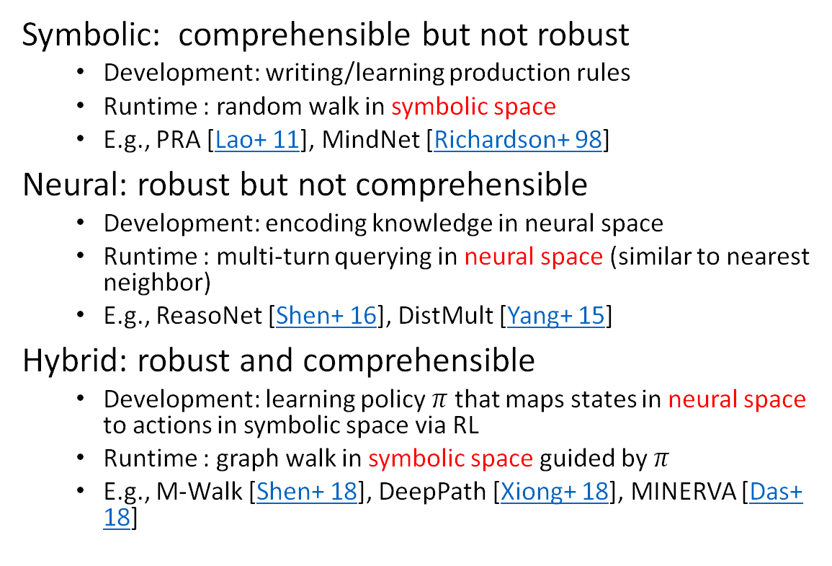
Reasoning over KG in symbolic vs neural spaces
Symbolic: comprehensible but not robust
  Development: writing/learning production rules
  Runtime : random walk in symbolic space
  E.g., PRA [Lao+ 11], MindNet [Richardson+ 98]
Neural: robust but not comprehensible
  Development: encoding knowledge in neural space
  Runtime : multi-turn querying in neural space (similar to nearest neighbor)
  E.g., ReasoNet [Shen+ 16], DistMult [Yang+ 15]
Hybrid: robust and comprehensible
  Development: learning policy $π$ that maps states in neural space to actions in symbolic space via RL
  Runtime : graph walk in symbolic space guided by $π$
  E.g., M-Walk [Shen+ 18], DeepPath [Xiong+ 18], MINERVA [Das+ 18]

Slide 39
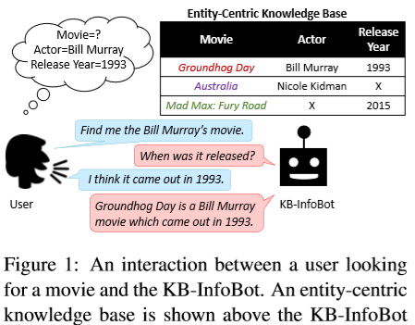
Multi-turn KB-QA: what to ask?
Allow users to query KB interactively without composing complicated queries
Dialogue policy (what to ask) can be
  Programmed [Wu+ 15]
  Trained via RL [Wen+ 16; Dhingra+ 17]

Slide 40
Interim summary
Neural MRC models for text-based QA
  MRC tasks, e.g., SQuAD, MS MARCO
  Three components of learning word/context/task-specific hidden spaces
  Multi-step reasoning
Knowledge base QA tasks
  Semantic-parsing-based approaches
  Neural approaches
  Multi-turn knowledge base QA agents

Slide 41
Outline
Part 1: Introduction
Part 2: Question answering and machine reading comprehension
Part 3: Task-oriented dialogues
  Task and evaluation
  System architecture
  Deep RL for dialogue policy learning
  Building dialog systems via machine learning and machine teaching
Part 4: Fully data-driven conversation models and chatbots

Slide 42
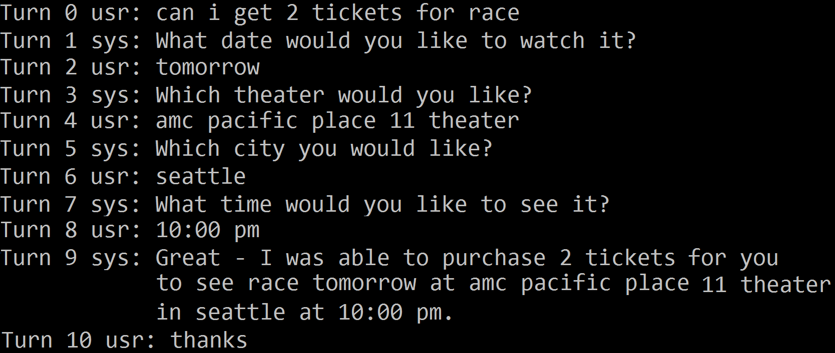
An Example Dialogue with Movie-Bot
Actual dialogues can be more complex:
Speech/Natural language understanding errors
    Input may be spoken language form
    Need to reason under uncertainty
Constraint violation
    Revise information collected earlier
...
Source code available at https://github/com/MiuLab/TC-Bot

Slide 43
Task-oriented, slot-filling, Dialogues
Domain: movie, restaurant, flight, …
Slot: information to be filled in before completing a task
  For Movie-Bot: movie-name, theater, number-of-tickets, price, …
Intent (dialogue act):
  Inspired by speech act theory (communication as action)
  request, confirm, inform, thank-you, …
  Some may take parameters:
    thank-you(), request(price), inform(price=$10)
    "Is Kungfu Panda the movie you are looking for?"
    confirm(moviename=“kungfu panda”)

Slide 44
Dialogue System Evaluation
Metrics: what numbers matter?
  Success rate: #Successful_Dialogues / #All_Dialogues
  Average turns: average number of turns in a dialogue
  User satisfaction
  Consistency, diversity, engaging, ...
  Latency, backend retrieval cost, …
Methodology: how to measure those numbers?

Slide 45


Methodology: Summary
 | Lab user subjects | Actual users | Simulated users
Truthfulness
Scalability
Flexibility
Expense
Risk
A Hybrid Approach
User Simulation
Small-scale Human Evaluation
(lab, Mechanical Turk, …)
Large-scale Deployment (optionally with continuing incremental refinement)

Slide 46
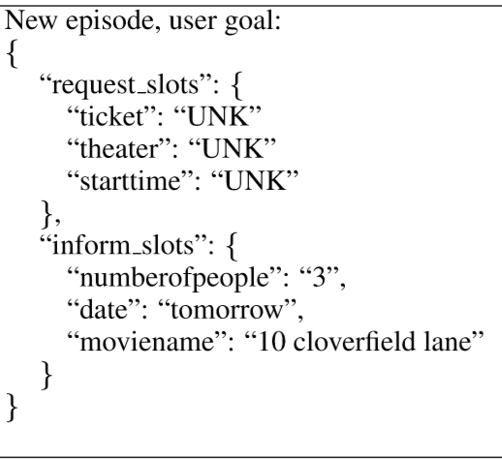
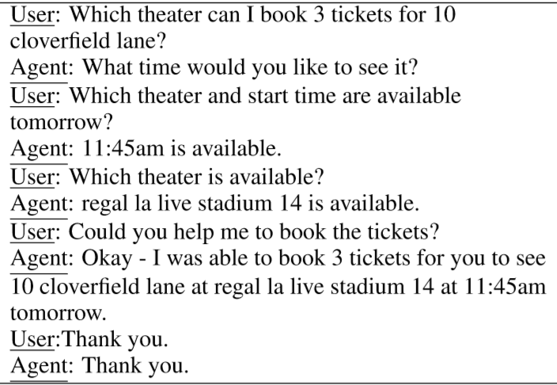
Agenda-based Simulated User [Schatzmann & Young 09]
User state consists of (agenda, goal);
  goal (constraints and request) is fixed throughout dialogue
  agenda (state-of-mind) is maintained (stochastically) by a first-in-last-out stack
Implementation of a simplified user simulator: https://github.com/MiuLab/TC-Bot

Slide 47
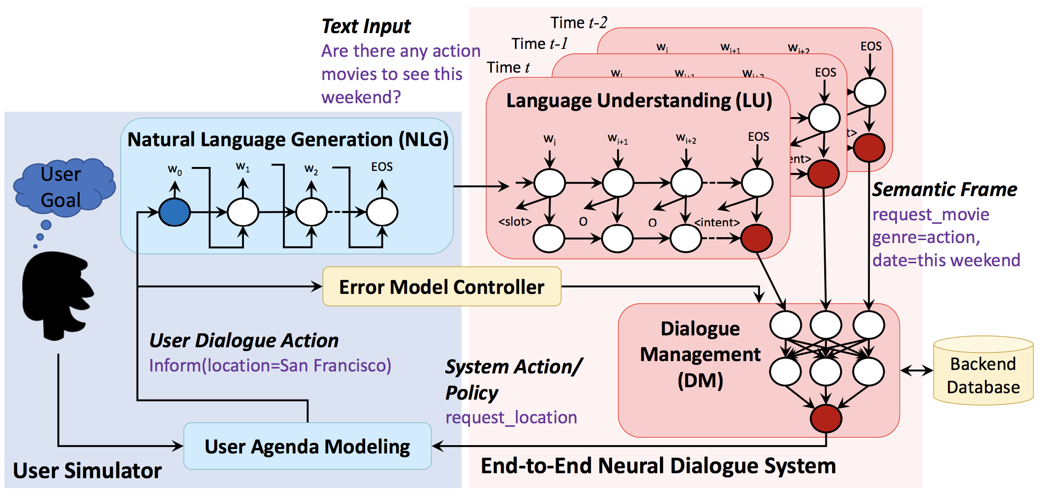
A Simulator for E2E Neural Dialogue System [Li+ 17]

Slide 48
Multi-Domain Task-Completion Dialog Challenge at DSTC-8
Traditionally dialog systems are tasked for unrealistically simple dialogs
In this challenge, participants will build multi-domain dialog systems to address real problems.
Traditional Tasks
Single domain Single dialog act per utterance Single intent per dialog Contextless language understanding Contextless language generation Atomic tasks
This Challenge
Multiple domains Multiple dialog acts per utterance Multiple intents per dialog Contextual language understanding Contextual language generation Composite tasks with state sharing
Track site: https://www.microsoft.com/en-us/research/project/multi-domain-task-completion-dialog-challenge/
Codalab site: https://competitions.codalab.org/competitions/23263?secret_key=5ef230cb-8895-485b-96d8-04f94536fc17

Slide 49
Classical dialog system architecture
Dialog Manager (DM)
Find me a
Bill Murray movie
Language understanding
Dialog state tracking
intent: get_movie
actor: bill murray
Service
APIs
words
meaning
state
When was it released?
Language generation
Policy
(action selection)
intent: ask_slot
slot: release_year

Slide 50
E2E Neural Models
RNN / LSTM
Attention / memory
Find me a
Bill Murray movie.
Unified machine learning model
Service
APIs
Service
APIs
words
When was it released?
Attractive for dialog systems because:
Avoids hand-crafting intermediate representations like intent and dialog state
Examples are easy for a domain expert to express

Slide 51
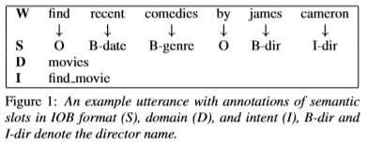
Language Understanding
Often a multi-stage pipeline
Metrics
  Sub-sentence-level: intent accuracy, slot F1
  Sentence-level: whole frame accuracy
1. Domain Classification
2. Intent Classification
3. Slot Filling

Slide 52
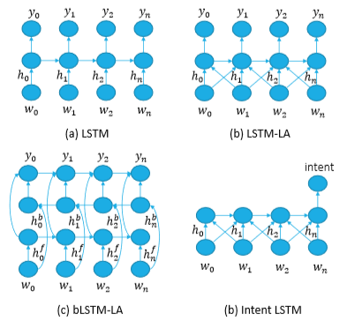
RNN for Slot Tagging – I [Hakkani-Tur+ 16]
Variations:
  RNNs with LSTM cells
  Look-around LSTM
  Bi-directional LSTMs
  Intent LSTM
May also take advantage of …
  whole-sentence information
  multi-task learning
  contextual information
For further details on NLU, see this IJCNLP tutorial by Chen & Gao.

Slide 53

Dialogue State Tracking (DST)
Maintain a probabilistic distribution instead of a 1-best prediction for better robustness to LU errors or ambiguous input
Slot | Value
# people | 5 (0.5)
time | 5 (0.5)
How can I help you?
Book a table at Sumiko for 5
Slot | Value
# people | 3 (0.8)
time | 5 (0.8)
How many people?
3

Slide 54

Multi-Domain Dialogue State Tracking (DST)
A full representation of the system's belief of the user's goal at any point during the dialogue
Used for making API calls
Do you wanna take Angela to go see a movie tonight?
Sure, I will be home by 6.
Movies
Restaurants
Let's grab dinner before the movie.
11/15/16
11/15/16
How about some Mexican?
Date
Date
Time
6 pm
7 pm
8 pm
9 pm
Time
6:30 pm
7 pm
7:30 pm
Let's go to Vive Sol and see Inferno after that.
# of tickets
2
3
Cuisine
Mexican
Angela wants to watch the Trolls movie.
Movie name
Inferno
Trolls
Restaurant
Vive Sol
Movie theatre
Century 16
Ok. Lets catch the 8 pm show.

Slide 55
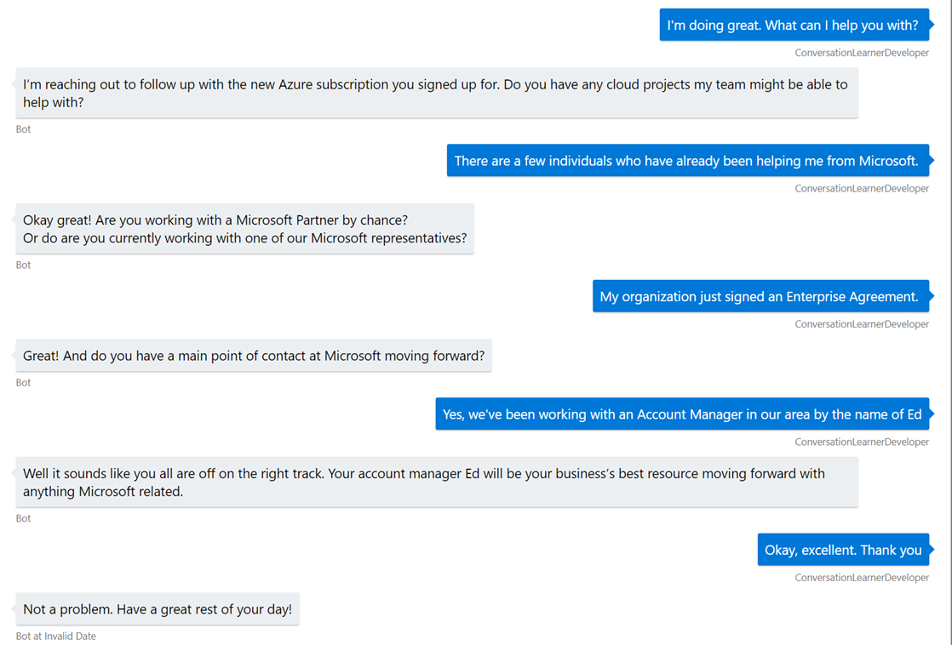
Dialogue policy learning: select the best action according to state to maximize success rate
Lead
Agent
Lead
NLU
State (s): dialogue history
Agent
Lead
Supervised/imitation
learning
LSTM
Agent
Reinforcement
learning
Lead
NLG
Action (a): agent response
Agent
Lead
Agent

Slide 56
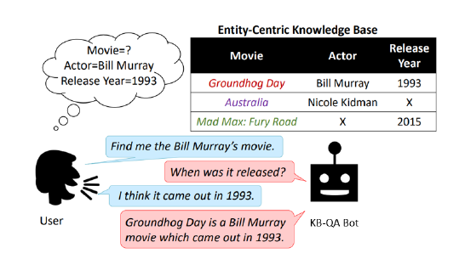
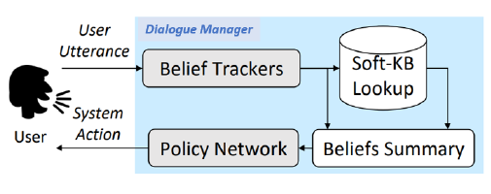
Movie on demand [Dhingra+ 17]
PoC: leverage Bing tech/data to develop task-completion dialogue (Knowledge Base Info-Bot)
[Dhingra+ 17]

Slide 57
Learning what to ask next, and when to stop
Initial: ask all questions in a randomly sampled order
Improve via learning from Bing log
  Ask questions that users can answer
Improve via encoding knowledge of database
  Ask questions that help reduce search space
Finetune using agent-user interactions
  Ask questions that help complete the task successfully via RL
  Results on simulated users​

Slide 58
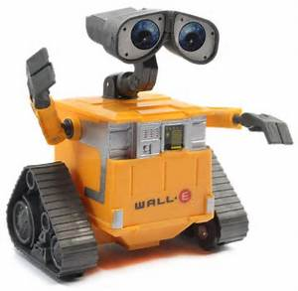












Reinforcement Learning (RL)
action $a_{t}$
Goal of RL
At each step $t$, given history so far $s_{t}$, take action $a_{t}$ to maximize long-term reward (“return”):
$$R_{t}=r_{t}+γr_{t+1}+γ^{2}r_{t+2}+⋯$$
Agent
World
reward $r_{t}$
next-observation $o_{t+1}$
"Reinforcement Learning: An Introduction", 2nd ed., Sutton & Barto

Slide 59


Conversation as RL
State and action
  Raw representation
  (utterances in natural language form)
  Semantic representation
  (intent-slot-value form)
Reward
  +10 upon successful termination
  -10 upon unsuccessful termination
  -1 per turn
  …
raw
semantic
Pioneered by [Levin+ 00]
Other early examples: [Singh+ 02; Pietquin+ 04; Williams&Young 07; etc.]

Slide 60



Policy Optimization with DQN
DQN-learning of network weights $θ$: apply SGD to solve
$$\hat{θ}←\arg{\min_{θ}{\sum_{t}{{\left(r_{t+1}+γ\max_{a}{Q_{T}\left(s_{t+1},a\right)−Q_{L}\left(s_{t},a_{t}\right)}\right)}^{2}}}}$$
state
Q-values
“Target network” to synthesize regression target
[Mnih+ 15]
“Learning network” whose weights are to be updated
RNN/LSTM may be used to implicitly track states (without a separate dialogue state tracker) [Zhao & Eskenazi 16]

Slide 61


Policy Optimization with Policy Gradient (PG)
PG does gradient descent in policy parameter space to improve reward
REINFORCE [Williams 1992]: simplest PG algorithm
Advantaged Actor-Critic (A2C) / TRACER
  $w$: updated by least-squared regression
  $θ$: updated as in PG
A2C/TRACER [Su+ 17]

Slide 62
Policy Gradient vs. Q-learning
 | Policy Gradient | Q-learning
Apply to complex actions
Stable convergence
Sample efficiency
Relation to final policy quality
Flexibility in algorithmic design

Slide 63
Three case studies
How to efficiently explore the state-action space?
  Modeling model uncertainty
How to decompose complex state-action space?
  Using hierarchical RL
How to integrate planning into policy learning?
  Balance the use of simulated and real experience – combining machine learning and machine teaching

Slide 64

Domain Extension and Exploration
Most goal-oriented dialogs require a closed and well-defined domain
Hard to include all domain-specific information up-front
New slots can be gradually introduced
producer
box office
actress
writer
time
Initial system deployed
Challenge for exploration:
How to explore efficiently
to collect data for new slots
When deep models are used

Slide 65





Bayes-by-Backprop Q (BBQ) network
BBQ-learning of network params $θ=\left(μ,σ^{2}\right)$:
$$\hat{θ}=\arg{\min_{θ_{L}}{KL\left(q\left(w | θ_{L}\right) |\left| p(w|Data\right)\right)}}$$
state
Q-values
Still use “target network” $θ_{T}$ to synthesize regression target
Parameter learning: solve for $\hat{θ}$ with Bayes-by-backprop [Blundell et al. 2015]
Params $θ$ quantifies uncertainty in Q-values
Action selection: use Thompson sampling for exploration
[Lipton+ 18]

Slide 66
Composite-task Dialogues
Travel Assistant
“subtasks”
Reserve Restaurant
Book Flight
Book Hotel
Naturally solved by hierarchical RL
Actions

Slide 67


A Hierarchical Policy Learner
Similar to Hierarchical Abstract Machine (HAM) [Parr’98]
Superior results in both simulated and real users [Peng+ 17]

Slide 68


Integrating Planning for Dialogue Policy Learning [Peng+ 18]
Human-Human conversation data
Supervised/imitation learning
Expensive: need large amounts of real experience except for very simple tasks
Risky: bad experiences (during exploration) drive users away
Dialog agent
Acting
RL
real experience

Slide 69

Integrating Planning for Dialogue Policy Learning [Peng+ 18]
Human-Human conversation data
Inexpensive: generate large amounts of simulated experience for free
Overfitting: discrepancy btw real users and simulators
Supervised/imitation learning
Acting
RL
Dialog agent
simulated experience

Slide 70

Human-Human conversation data
Imitation Learning
Supervised Learning
No, then run planning using simulated experience
Simulated experience
Dialog agent
Whether to switch to real users?
simulated user
Yes
“discriminator” learning
Run Reinforcement Learning using real experience
Model learning
real experience
(limited)
[Peng+ 18, Su +18, Wu + 19, Zhang+ 19,]

Slide 71


Programmatic
Declarative
Machine Learning
this.dialogs.add(
new WaterfallDialog(GET_FORM_DATA,
[
this.askForCity.bind(this),
this.collectAndDisplayName.bind(this)
]
));
async collectAndDisplayName(step) {…
<rule>
<if>
city == null
</if>
<then>
Which city?
</then>
…
Neural network
What City?
Seattle
What Day?
Today
❑ | Accessible to non-experts
❑ | Easy to debug
❐ | Explicit Control
❐ | Support for complex scenarios
❑ | Ease of Modification
❑ | Handle Unexpected Input
❑ | Improve / Learn from conversations
❐ | No Dialog Data Required
❐ | Accessible to non-experts
❑ | Easy to debug
❐ | Explicit Control
❑ | Support for complex scenarios
❑ | Ease of Modification
❑ | Handle Unexpected Input
❑ | Improve / Learn from conversations
❐ | No Dialog Data Required
❐ | Accessible to non-experts
❐ | Easy to debug
❑ | Explicit Control
❐ | Support for complex scenarios
❐ | Ease of Modification
❑ | Handle Unexpected Input
❐ | Improve / Learn from conversations
❑ | Requires Sample Dialog Data

Slide 72

Programmatic
Declarative
Machine Learning
this.dialogs.add(
new WaterfallDialog(GET_FORM_DATA,
[
this.askForCity.bind(this),
this.collectAndDisplayName.bind(this)
]
));
async collectAndDisplayName(step) {…
<rule>
<if>
city == null
</if>
<then>
Which city?
</then>
…
Neural network
What City?
Seattle
What Day?
One Solution Does Not Fit All
Today
❑ | Accessible to non-experts
❑ | Easy to debug
❐ | Explicit Control
❐ | Support for complex scenarios
❑ | Ease of Modification
❑ | Handle Unexpected Input
❑ | Improve / Learn from conversations
❐ | No Dialog Data Required
❐ | Accessible to non-experts
❑ | Easy to debug
❐ | Explicit Control
❑ | Support for complex scenarios
❑ | Ease of Modification
❑ | Handle Unexpected Input
❑ | Improve / Learn from conversations
❐ | No Dialog Data Required
❐ | Accessible to non-experts
❐ | Easy to debug
❑ | Explicit Control
❐ | Support for complex scenarios
❐ | Ease of Modification
❑ | Handle Unexpected Input
❐ | Improve / Learn from conversations
❑ | Requires Sample Dialog Data

Slide 73

Goal: Best of both worlds
Rules - Based
ML - Based
Good for garden path
Not data intensive
Explicit Control
Easily interpretable
Handle unexpected input
Learn from usage data
Often viewed as black box
Give developer control
Start with rules-based policy => Grow with Machine Learning
Make ML more controllable by visualization
Not unidirectional : Rules-based policy can evolve side-by-side with ML Model

Slide 74
Conversation Learner – building a bot interactively
What is it: A system built on the principles of Machine Teaching, that enables individuals with no AI experience (designers, business owners) to build task-oriented conversational bots
Goal: Push the forefront of research on conversational systems using input from enterprise customers and product teams to provide grounded direction for research
Status: In private preview with ~50 customers to various levels of prototyping
Hello World Tutorial
Primary repository with samples:
https://github.com/Microsoft/ConversationLearner-samples

Slide 75

Conversation Learner – building a bot interactively
Rich machine teaching and dialog management interface accessible to non-experts
Free-form tagging, editing and working directly with conversations
Incorporating rules makes the teaching go faster
Independent authoring of examples allows dialog authors to collaborate on one/multiple intents

Slide 76





ConvLab
Published @ https://arxiv.org/abs/1904.08637
Fully annotate data
for training individual components or end-to-end models with supervision
User Simulators
for reinforcement learning
1 rule-based simulator
2 data-driven simulators
SOTA Baselines
Multiple models for each component
Multiple end-to-end system recipes

Slide 77
Outline
Part 1: Introduction
Part 2: Question answering and machine reading comprehension
Part 3: Task-oriented dialogue
Part 4: Fully data-driven conversation models and chatbots
  E2E neural conversation models
  Challenges and remedies
  Grounded conversation models
  Beyond supervised learning
  Data and evaluation
  Chatbots in public
  Future work

Slide 78
Motivation
One statistical
model
Natural language interpreter
Dialogue
State tracker
utterance x
Natural language
generator
Dialogue response
selection
utterance y
Move towards fully data-driven, end-to-end dialogue systems.

Slide 79

Social Bots
Fully end-to-end systems so far most successfully applied to
social bots or chatbots:
  Commercial systems: Amazon Alexa, XiaoIce, etc.
Why social bots?
  Maximize user engagement by generating
  enjoyable and more human-like conversations
  Help reduce user frustration
  Influence dialogue research in general
  (social bot papers often cited in task-completion
  dialogue papers)

Slide 80
Historical overview
Earlier work in fully data-driven response generation:
2010: Response retrieval system (IR) [Jafarpour+ 10]
2011: Response generation using Statistical Machine Translation (phrase-based MT) [Ritter+ 11]
2015: First neural response generation systems (RNN, seq2seq)
[Sordoni+ 15; Vinyals & Le 15; Shang+ 15]

Slide 81
Neural Models for Response Generation
[Sordoni+ 15;
Vinyals & Le 15;
Shang+ 15]
Source:
conversation history
… how
are
you
?
EOS
I
’m
fine
,
encoder
decoder
Target:
response
I
’m
fine
,
thanks
Similar to sequence models in Neural Machine Translation (NMT), summarization, etc.
Uses either RNN, LSTM, GRU, Pointer-Generator Networks, Transformer, etc.

Slide 82


Neural Response Generation:
Difference with other tasks (e.g., machine translation)
Data: some training sets (social media) are HUGE
For example, Twitter (as of 2016):
304M monthly active users
500M tweets per day (6M conversations per day)
→ often train on subset of the data; leaner and “faster” models preferred
System input: LONG conversation history
T₁ T₂
Either limit
context size [Sordoni+ 05]
or truncate backprop
[Vinyals+ 05, pc]
T₁ T₂ T₃ T₄ … T_{N}
T₁ T₂ T₃
...
… T_{N-2} T_{N-1} T_{N}
Conversation (N turns)
N-1 training instances

Slide 83
Neural conversation engine
[Sordoni+ 15; Li+ 16a]
Neural model learns the general shape of conversation, and the system output is situationally appropriate and coherent…
A more goal-oriented example. No grounding into a real calendar, but the “shape” of the conversation is fluent and plausible…
H: | Hi
M: | How are you?
H: | Not bad
M: | What's wrong?
H: | Nothing really
M: | Wanna talk about it? I'm here if you wanna talk x
H: | Well, I'm just tired
M: | Me too, I'm here if you wanna talk
H: | Thanks, what are you doing?
M: | You're welcome and I'm watching TV and you?
H: | On Netflix?
M: | Yeah, I'm watching it on Netflix.
H: | What are you watching?
M: | A TV show.
H: | Nice, did you have dinner already?
M: | No, not yet. what about you?
H: | Would Thursday afternoon work sometime?
M: | Yeah, sure. just let me know when you‘re free.
H: | After lunch is probably the best time
M: | Okay, sounds good. Just let me know when you’re free.
H: | Would 2pm work for you?
M: | Works for me.
H: | Well let’s say 2pm then I’ll see you there
M: | Sounds good.
Neural E2E system trained on 35M Twitter conversations.

Slide 84
Fully Data-driven Response Generation:
Challenges and remedies

Slide 85


Challenge: The blandness problem
How was your weekend?
I don’t know.
What did you do?
I don’t understand what you are talking about.
This is getting boring…
Yes that’s what I’m saying.

Slide 86




Blandness problem: cause and remedies
[Li+ 16a]
Common MLE objective (maximum likelihood)
Mutual information objective:
(whatever the user says)
I don’t know.
I don’t understand...
That’s what I’m saying
(whatever the user says)
I don’t know.
(whatever the user says)
I don’t know.

Slide 87




Mutual Information for Neural Network Generation
[Li+ 16a]
Mutual information objective:
Bayes’ rule
standard
likelihood
anti-LM
Bayes’ theorem

Slide 88
Sample outputs (MMI)
Wow sour starbursts really do make your mouth water... mm drool.
Can I have one?
Of course you can! They’re delicious!
Milan apparently selling Zlatan to balance the books... Where next, Madrid?
I think he'd be a good signing.
‘tis a fine brew on a day like this! Strong though, how many is sensible?
Depends on how much you drink!
Well he was on in Bromley a while ago... still touring.
I’ve never seen him live.

Slide 89

MLE vs MMI: results
[Li+ 16a]
Lexical diversity
(# of distinct tokens / # of words)
BLEU
MMI: best system in Dialogue Systems Technology Challenge 2017 (DSTC, E2E track)

Slide 90

Challenge: The consistency problem
E2E systems often exhibit poor response consistency:

Slide 91
The consistency problem: why?
Conversational data:
Where were you born?
London
NOT
1-to-1
Where did you grow up?
New York
Where do you live?
Seattle
P(response | query, SPEAKER_ID)

Slide 92






Personalized Response Generation
[Li+ 2016b]
D_Gomes25
Jinnmeow3
skinnyoflynny2
u.s.
london
TheCharlieZ
england
Rob_712
great
Tomcoatez
Dreamswalls
good
Speaker embeddings (70k)
Bob_Kelly2
Word embeddings (50k)
Kush_322
okay
kierongillen5
monday
live
This_Is_Artful
tuesday
The_Football_Bar
DigitalDan285
stay
where
do
you
live?
Rob
EOS
Rob
in
Rob
england
Rob
.
in
england
.
EOS

Slide 93

Persona model results
Baseline model:
Persona model using speaker embedding: [Li+ 16b]

Slide 94



Personal modeling as multi-task learning
[Luan+ 17]
Source
LSTM
Target
LSTM
Seq2Seq
query
response
What’s your job?
Software engineer
I’m a code ninja
Source
LSTM
Target
LSTM
Personalized data
(e.g., non-convo)
personalized data
Autoencoder
I’m a code ninja
Tied parameters

Slide 95




Challenges with multi-task learning
[Gao+ 19]
So we add regularization:
Vanilla S2S
+ Mtask
objective
vanilla multi-task
ideally
where:
cross-space distance
same-space distance

Slide 96

Improving personalization with multiple losses [Al-Rfou+ 16]
Single-loss:
P(response | context, query, persona, …)
  Problem with single-loss:
  context or query often
  “explain away” persona
Multiple loss adds:
P(response | persona)
P(response | query)
etc.
  Optimized so that
  persona can “predict”
  response all by itself
  → more robust
  speaker embeddings

Slide 97

Challenge: Long conversational context
It can be challenging for LSTM/GRU to encode very long context
(i.e. more than 200 words: [Khandelwal+ 18])
Hierarchical Encoder-Decoder (HRED) [Serban+ 16]
Encodes:
utterance (word by word) +
conversation (turn by turn)

Slide 98

Challenge: Long conversational context
Hierarchical Latent Variable Encoder-Decoder (VHRED) [Serban+ 17]
  Adds a latent variable to the decoder
  Trained by maximizing variational lower-bound on the log-likelihood
Related to persona
model [Li+ 2016b]:
Deals with 1-N
problem, but
unsupervisedly.

Slide 99

Hierarchical Encoders and Decoders:
Evaluation
[Serban+ 17]

Slide 100
Outline
Part 1: Introduction
Part 2: Question answering and machine reading comprehension
Part 3: Task-oriented dialogue
Part 4: Fully data-driven conversation models and chatbots
  E2E neural conversation models
  Challenges and remedies
  Grounded conversation models
  Beyond supervised learning
  Data and evaluation
  Chatbots in public
  Future work

Slide 101








Towards Grounded E2E Conversation Models
Understanding
(NLU)
State tracker
input x
Environment
Traditional
Generation
(NLG)
Dialog policy
output y
input x
Fully data-driven
output y
NOT grounded

Slide 102





E2E Conversation Models in the real world
  Personalization data
  (ID, social graph, ...)
  Device sensors
  (GPS, vision, ...)
  External
  “knowledge”
Context
encoder

Slide 103

Knowledge-Grounded Neural Conversation Model [Ghazvininejad+ 17; Agarwal+ 18; Liu+ 18]
Going to
Kusakabe tonight
Try omakase, the best in town
DIALOG
ENCODER
h_{t}
h_{t}
DECODER
CONVERSATION HISTORY
FACTS
ENCODER
RESPONSE
Consistently the best omakase
Amazing sushi tasting […]
.
A
They were out of kaisui […]
.
.
.
.
.
WORLD
“FACTS”
CONTEXTUALLY-RELEVANT
“FACTS”
[Sukhbaatar+ 15]

Slide 104

Sample knowledge-grounded responses
I would give ALMOST anything for some [Mexican restaurant] right now.
Me too. Jalapeno sauce is really good.
Obsessed with [jewelry company] :-*
oh my gosh obsessed with their bracelets and the meaning behind them!
Visiting the celebs at Los Angeles airport - [...] w/ 70 others
Nice airport terminal. Have a safe flight.
Experimental results (23M conversations): outperforms competitive neural baseline (human + automatic eval)

Slide 105

Conversations grounded in Full-Length Documents
A woman fell 30,000 feet from
an airplane and survived.
The page states that a 2009 report found the plane only fell several hundred meters.
Well if she only fell a few hundred meters and survived then I 'm not impressed at all.
Few hundred meters is still pretty incredible , but quite a bit different than 10,000 meters.
Task: Generate a human-like response that is not only conversationally appropriate,
but also informative (→ useful task) and grounded (-> evaluation closer to MRC).

Slide 106

Models with Document-Level Grounding
[Dinan+ 19; Qin+ 19]​
Machine Reading Comprehension-based Model [Qin+ 19]:
Main difference with MRC:
Replaced span prediction with attention recurrent generator [Luong et al., 2015]

Slide 107






Grounded E2E Dialogue Systems
Grounding: images
Conversations around images e.g.,
Q-As [Das+ 16] or chat [Mostafazadeh+ 17]
Grounding: affect [Huber+ 18]
facial actions influence response
convo

Slide 108
Beyond supervised learning
Limitations of SL for E2E dialogue:
  Train on human-human data, test with human-machine
  (Twitter-ese often not what we want at test time.)
  Optimizes for immediate reward p(T_{N} | … T_{N-1}), not long-term reward
  No user feedback loop
Emergence of reinforcement learning (RL) for E2E dialogue
  Tries to promote long-term dialogue success

Slide 109





Deep Reinforcement Learning for E2E Dialogue
[Li+ 16c]
REINFORCE algorithm [Williams+ 92]
Reward functions:
  Ease of answering:
  Information flow:
  Meaningfulness:
reward function
what we
want to learn

Slide 110

Simulation (without RL)
See you later!
See you later!
See you later!
See you later!
See you later!
See you later!
See you later!
110

Slide 111
Simulation (with RL)
How old are you ?
i 'm 4, why are you asking ?
I thought you were 12 .
What made you think so ?
I don’t know what you are talking about .
You don’t know what you are saying.
I don’t know what you are talking about .

Slide 112

Deep RL: Evaluation
MTurk evaluation (500 responses)

Slide 113
Outline
Part 1: Introduction
Part 2: Question answering and machine reading comprehension
Part 3: Task-oriented dialogue
Part 4: Fully data-driven conversation models and chatbots
  E2E neural conversation models
  Challenges and remedies
  Grounded conversation models
  Beyond supervised learning
  Data and evaluation
  Chatbots in public
  Future work

Slide 114
Conversational datasets
(for social bots, E2E dialogue research)
Survey on dialogue datasets [Serban+ 15]
Name | Type / Topics | Size
Reddit | Unrestricted | 3.2B dialog turns (growing)
Twitter | Unrestricted | N/A (growing)
OpenSubtitles | Movie subtitles | 1B words
Ubuntu Dialogue Corpus | Chat on Ubuntu OS | 100M words
Ubuntu Chat Corpus | Chat on Ubuntu OS | 2B words
Persona-Chat Corpus | Crowdsourced / personalized | 164k dialog turns

Slide 115



Evaluating E2E Dialogue Systems
Human evaluation (crowdsourcing):
Automatic evaluation:
Less expensive, but is it reliable?
Context: … Because of your game?
Input: Yeah, I’m on my way now
Response: Ok good luck!
Is this a good¹ response?
Strongly Disagree
Strongly
Agree
Disagree
Unsure
Agree
¹: replaced as appropriate (relevant, interesting,…)

Slide 116


Machine-Translation-Based Metrics
BLEU [Papineni+ 02]: ngram overlap metric
NIST [Doddington+ 02]
  Seldom used in dialogue, but copes with blandness issue
  Considers info gain of each ngram: score(interesting calculation) >> score(of the)
METEOR
  Accounts for synonyms, paraphrases, etc.
Reference:
John resigned yesterday .
System:
Yesterday , John quit .

Slide 117
The challenge with MT-based metrics
Input: How are you?
Response (gold): I ’m good , thanks .
Response A: Good thanks !
Response B: Doing pretty good thanks
Response C: Doing well thank you !
Semantically equivalent
(as in Machine Translation)
Response D: Fantastic . How are you ?
Response E: I 'm getting sick again .
Response F: Bored . you ?
Response G: Sleepy .
Response H: Terrible tbh
Pragmatically appropriate
Many false negative!

Slide 118


Sentence-level correlation of MT metrics
Poor correlation with human judgments:
Dialogue task
“How NOT to evaluate dialogue systems” [Liu+ 16]
But same problem even for Translation task
[Graham +15]

Slide 119

The importance of sample size
MT metrics were NOT designed to operate at the sentence level:
  BLEU [Papineni+ 02] == “corpus-level BLEU”
  Statistical Significant Tests for MT [Koehn 06; etc.]:
  BLEU not reliable with sample size < 600,
  even for Machine Translation (easier task)
Central Limit Theorem (CLT) argument:
  Matching against reference (e.g., n-grams)
  is brittle → greater variance
  Remedy: reduce variance by
  increasing sample size (CLT),
  i.e., corpus-level BLEU
(Figure from [Brooks+ 12])

Slide 120
Corpus-level Correlation
Generally good for Machine Translation (MT):
  Spearman’s rho of 0.8 to 0.9 for BLEU, METEOR [Przybocki+ 08]
Can it work for Dialogue?
  Currently no definite answer, as corpus-level human judgments very expensive.
  Experiments with smaller N [Galley+ 15]:
Spearman’s rho
deltaBLEU = human-rating weighted
version of BLEU [Galley+ 15]
N=

Slide 121



Trainable Metric
BLEU-2
(N=1)
rho=0.051
Towards an automatic turning test [Lowe+ 17]:
ADEM: Metric based on hierarchical RNN (VHRED)
context c
ADEM
(N=1)
rho=0.428

Slide 122


Social Bots: commercial systems
For end users:
  Amazon Alexa
  (trigger: say “Alexa, let’s chat”)
  Microsoft XiaoIce [Zhou+ 2018]
  Microsoft Zo (on Kik)
  Replika.ai [system description]
For bot developers:
  Microsoft Personality Chat (includes speaker embedding LSTM)
XiaoIce
(translated from Chinese)
Replika.ai

Slide 123


https://labs.cognitive.microsoft.com/en-us/project-personality-chat

Slide 124
Open Benchmarks
Alexa Challenge (2017-)
- Academic competition, 15 sponsored teams in 2017, 8 in 2018
- $250,000 research grant (2018)
- Proceedings [2017, 2018]
Dialogue System Technology Challenge (DSTC) (2013-)
(formerly Dialogue State Tracking Challenge)
Focused this year on grounded conversation:
Visual-Scene [Hori +18], knowledge grounding [Galley +18]
Conversational Intelligence Challenge (ConvAI) (2017-)
Last occurrence focused on personalized chat (Persona-Chat dataset)

Slide 125

Conclusions
E2E Neural Conversation Models
  Learn the backbone or shell of open-domain natural conversation
  Face significant challenges (blandness, consistency, long context), but
  alleviated using better models and objectives (e.g., MMI and HRED)
Grounded conversational AI models
  Exploit external textual knowledge, device sensors
  (e.g., images), personal information
  Produce more informational and “useful” dialogues

Slide 126



Moving beyond chitchat
Traditional
task-oriented bots
Modern
task-oriented bots
“Usefulness”
Grounded E2E Systems
E2E Systems (Chatbots)
Fully end-to-end

Slide 127
Fully Data-driven Response Generation:
Challenges and future work

Slide 128
Better objective functions and evaluation metrics
Lack of good objective or reward functions is a challenge for SL and RL:
  MLE causes blandness (mitigated by MMI)
  Evaluation metrics (BLEU, METEOR, etc.) reliable only on large datasets
  → expensive for optimization (e.g., sequence-level training [Ranzato+ 15])
  RL reward functions currently too ad-hoc
Final system evaluation:
  Still need human evaluation
  Corpus-level metrics (BLEU, METEOR, etc.): How effective are they really?

Slide 129










Better leverage heterogeneous data
.
.
query 1
response 1
.
.
.
.
English sentence 1
French sentence 1
.
.
.
.
much of world knowledge
in non-conversational form
(often unstructured)
.
.
query N
response N
.
.
general domain dialog
English sentence N
French sentence N
in-domain data (e.g., decision making, task-oriented)
most NLP / AI problems
(homogeneous data)
conversational AI
(heterogeneous data)

Slide 130


Thank you
Contact Information:
Jianfeng Gao http://research.microsoft.com/~jfgao
Michel Galley http://research.microsoft.com/~mgalley
Slides:
https://icml.cc/Conferences/2019/Schedule
Journal paper version of this tutorial:
https://www.nowpublishers.com/article/Details/INR-074 (final)
https://arxiv.org/abs/1809.08267 (preprint)

