Slide 1
CHET: An Optimizing Compiler
for Fully-Homomorphic
Neural Network Inferencing
Roshan Dathathri Olli Saarikivi Hao Chen
Kim Laine Kristin Lauter Saeed Maleki
Madanlal Musuvathi Todd Mytkowicz

Slide 2
Neural Network Inference on Sensitive Data
Credits: ScienceSoft
Credits: MIT News

Slide 3
Motivation: Fully-Homomorphic Encryption (FHE)
+ Compute on encrypted data $→$ offload storage and compute to cloud
+ Computation overhead of FHE is rapidly reducing
+ Simple trust model: keep the secret key
+ No need to trust hardware/software like Intel/Microsoft
- Programming FHE applications is hard
- Requires cryptographic domain expertise
- Akin to writing assembly for custom hardware
All are addressed by CHET
Notes:
Limited instruction set of FHE
First FHE compiler

Slide 4
Fully-Homomorphic DNN Inference Latency
Expert tuned
CHET generated
Network | CHET
LeNet5-small | 3 s
LeNet5-medium | 11 s
LeNet5-large | 35 s
Industrial | 56 s
SqueezeNet-CIFAR | 165 s
922 s

Slide 5
Fully-Homomorphic Encryption (FHE)
plaintext
a
b
+
a + b
ciphertext
a
b
a + b
Encrypt
Decrypt
Homomorphic
+
Privacy Barrier
FHE: homomorphic operators for addition and multiplication

Slide 6
Performance overhead of FHE over unencrypted
Slowdown
FPGA
CPU
GPU
ASIC
Year
Notes:
Overheads reduced due to improvements in theory and implementation
GPU and FPGA can reduce slowdown
Systems and compiler community can help reduce slowdown

Slide 7
Example Neural Network Inference
2
Customer
plaintext
0.1
-3
10
1.5
-4
-1
0.2
2.6
1.9
1.3
ciphertext
0.1
-3
10
1.5
-4
-1
0.2
2.6
1.9
1.3
Encrypt
Server
Decrypt
Privacy Barrier
Not privy to the image, prediction, or any intermediate state

Slide 8
Compiling Tensor Programs for FHE libraries
Tensor Programs
CHET Compiler
Automation and optimizations
CHET Runtime
FHE Programs
FHE-optimized tensor kernels
HEAAN
SEAL
FHE Libraries
FHE libraries for integer/fixed-point arithmetic
CPU
GPU
FPGA
Notes:
DNN inference – tensor programs

Slide 9
Compiler for Homomorphic Evaluation of Tensor programs (CHET)
Rest of this talk:
How to ensure generated code is correct, secure, and performant?
How to map tensor operations into the limited instruction set of FHE?
Check our paper for other optimizations

Slide 10
Encryption Parameters
Ciphertexts are polynomials with parameters:
N: degree of polynomial
Q: modulus of each coefficient
$${a_{n}x}^{N}+{a_{n−1}x}^{N−1}+…+a_{1}x+a_{0}$$
$${∀i, a}_{i} ={(c}_{i} \% Q)$$

Slide 11
Encryption Parameters
FHE standard
Q
Better performance
CHET selects
N and Q
automatically
Correct and Secure
Correct
Program Dependent
Incorrect
Insecure
Secure
$$N$$
Notes:
Larger Q or N =>
Larger cost of homomorphic operations
Larger size of ciphertext

Slide 12
FHE for Approximate Fixed-Point Arithmetic
Maintain explicit scaling factor and “re-scale”
plaintext
1.1
2.2
x
2.4
ciphertext
11
22
24
Encode
10
10
10
Q/10
Encrypt
11
22
24
Decrypt
10
10
10
Decode
Q
Privacy Barrier
x
242
Rescale
100

Slide 13
Encryption Parameters Selection
Dataflow analysis:
Re-scale primitives consume modulus
Other primitives propagate modulus
Compute total modulus consumed -> set Q
Given Q -> set N
Pre-populated table
x
x
Rescale
Rescale
x
Rescale

Slide 14
FHE Packing
Pack many plaintext scalars into single ciphertext vector
Fixed width of N/2 (N is 2¹⁰ or larger)
11
22
33
44
55
66
11
22
33
44
55
66
0
0

Slide 15
FHE Vectorization
Limited set of SIMD instructions:
Element-wise addition
Element-wise subtraction
Element-wise multiplication
Rescale (all elements)
Rotation
Random access of a vector element not supported
$$V$$
11
22
33
44
55
66
0
0
V = V $⋅2$
22
44
66
88
110
132
0
0
V = $Rot(V, 3)$
132
0
0
22
44
66
88
110
V = V $⋅Mask$
132
0
0
0
0
0
0
0

Slide 16
Example of Matrix Multiplication: C = A x B
$$a_{11}$$
$$a_{12}$$
$$b_{11}$$
$$b_{12}$$
$$A$$
$$B$$
$$a_{21}$$
$$a_{22}$$
$$b_{21}$$
$$b_{22}$$
$$a_{11}$$
0
$$a_{12}$$
0
$$a_{21}$$
0
$$a_{22}$$
0
$$b_{11}$$
$$b_{12}$$
$$b_{21}$$
$$b_{22}$$
0
0
0
0
$$A^{′}=Rot(A, 1)$$
$$B^{′}=Rot(B, 4)$$
0
$$a_{11}$$
0
$$a_{12}$$
0
$$a_{21}$$
0
$$a_{22}$$
0
0
0
0
$$b_{11}$$
$$b_{12}$$
$$b_{21}$$
$$b_{22}$$
$$A^{′′}=A+A′$$
$$B^{′′}=B+B′$$
$$a_{11}$$
$$a_{11}$$
$$a_{12}$$
$$a_{12}$$
$$a_{21}$$
$$a_{21}$$
$$a_{22}$$
$$a_{22}$$
$$b_{11}$$
$$b_{12}$$
$$b_{21}$$
$$b_{22}$$
$$b_{11}$$
$$b_{12}$$
$$b_{21}$$
$$b_{22}$$
Notes:
Utilization of slots in vector
Packing into a vector is a data layout

Slide 17
Example of Matrix Multiplication: C = A x B
$$a_{11}$$
$$a_{11}$$
$$a_{12}$$
$$a_{12}$$
$$a_{21}$$
$$a_{21}$$
$$a_{22}$$
$$a_{22}$$
$$C^{′}=A^{′′}⋅B′′$$
$$b_{11}$$
$$b_{12}$$
$$b_{21}$$
$$b_{22}$$
$$b_{11}$$
$$b_{12}$$
$$b_{21}$$
$$b_{22}$$
$$c_{111}$$
$$c_{112}$$
$$c_{121}$$
$$c_{122}$$
$$c_{211}$$
$$c_{212}$$
$$c_{221}$$
$$c_{222}$$
$$Rot(C^{′}, 6)$$
$$c_{121}$$
$$c_{122}$$
$$c_{211}$$
$$c_{212}$$
$$c_{221}$$
$$c_{222}$$
$$c_{111}$$
$$c_{112}$$
CHET chooses
data layouts
automatically
$$C^{′′}=C^{′}+ Rot(C^{′}, 6)$$
$$c_{11}$$
$$c_{12}$$
$$\#\#$$
$$\#\#$$
$$c_{21}$$
$$c_{22}$$
$$\#\#$$
$$\#\#$$
$$C=C^{′′}⋅Mask$$
$$c_{11}$$
$$c_{12}$$
0
0
$$c_{21}$$
$$c_{22}$$
0
0

Slide 18
Mapping Tensors to Vector of Vectors
0
1
2
3
HW (Height-Width) layout:
Easier convolutions due to channels being aligned
Wasted space
H
C
W
There are many ways to layout tensors into vectors, with different tradeoffs
0
1
2
3
CHW (Channel-Height-Width) layout:
More efficient space usage
Convolutions require more rotations

Slide 19
Data Layout Selection
Search space: explore possible data layouts
Cost estimation: estimate cost of each search point
Pick the best-performing one

Slide 20
Data Layout Selection: Search Space
Search space is exponential
2 choices per tensor operation: HW or CHW
Prune search space: use domain knowledge -> limits to only 4 choices for the circuit
Convolution faster in HW while rest faster in CHW
Matrix multiplication faster if output is in CHW
Convolution
HW or CHW?
Activation
HW or CHW?
Pooling
HW or CHW?
Matrix Mult.
HW or CHW?

Slide 21
Data Layout Selection: Cost Estimation
Cost model for FHE primitives:
Asymptotic complexity (specific to FHE scheme)
Microbenchmarking to determine constants
Cost of a circuit: sum the costs for all operations

Slide 22
Experimental Setup
FHE-compatible Deep Neural Networks (DNN):
Evaluation:
Latency of image inference (batch size = 1)
Systems:
Hand-written HEAAN
CHET with HEAAN
CHET with SEAL
Machine:
Dual-socket Intel Xeon E5-2667v3
16 cores
224 GB of memory
DNN | Dataset | # Layers | # FP ops (M) | Accuracy
LeNet-5-small | MNIST | 8 | 0.2 | 98.5%
LeNet-5-medium | MNIST | 8 | 5.8 | 99.0%
LeNet-5-large | MNIST | 8 | 8.7 | 99.3%
Industrial | - | 13 | - | -
SqueezeNet-CIFAR | CIFAR-10 | 19 | 37.8 | 81.5%
Notes:
Difficult to write code for SEAL: it was written that way because we had a compiler
Accuracy trade-off: Loss of precision when making program FHE-compatible

Slide 23
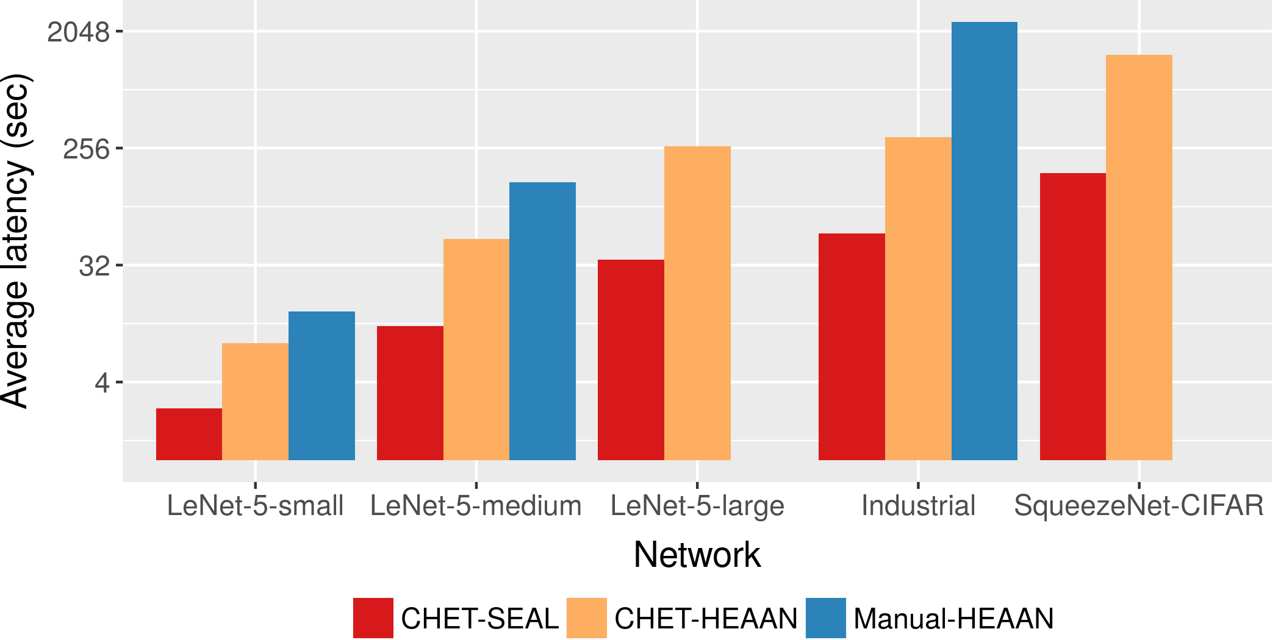
CHET outperforms hand-written implementations
Notes:
Manual-HEAAN difficult to implement for large networks
Industrial: 40 mins to 1 min

Slide 24
Best data layout depends on FHE library and DNN
Slowdown
Slowdown

Slide 25
Prior Compilers for Deep Learning
Optimizing deep learning compilers target varied backends
Our perspective: FHE is just another backend
CHET is the first optimizing compiler for deep learning on FHE
Lot more optimizations from literature to incorporate
Hand-Written Models
Automatic Layout Selection
Scheduling Language
Automatic Tuning
Fully Automatic Kernel Generation
More automation
CHET
Halide
TVM
TC, PlaidML

Slide 26
Conclusions
FHE programming is a “systems and compiler” problem
CHET outperforms hand-written FHE implementations
CHET enables homomorphic inference using large Deep Neural Networks (DNN)
CHET makes it easy to port to new FHE schemes
Future work:
Approximate non-linear functions automatically
Generalize to other application domains

Slide 27
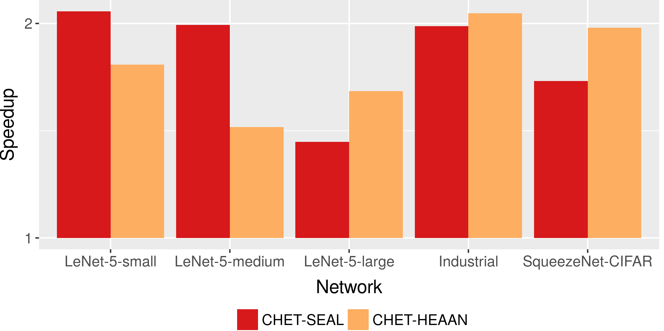
Rotation keys selection improves performance

Slide 28
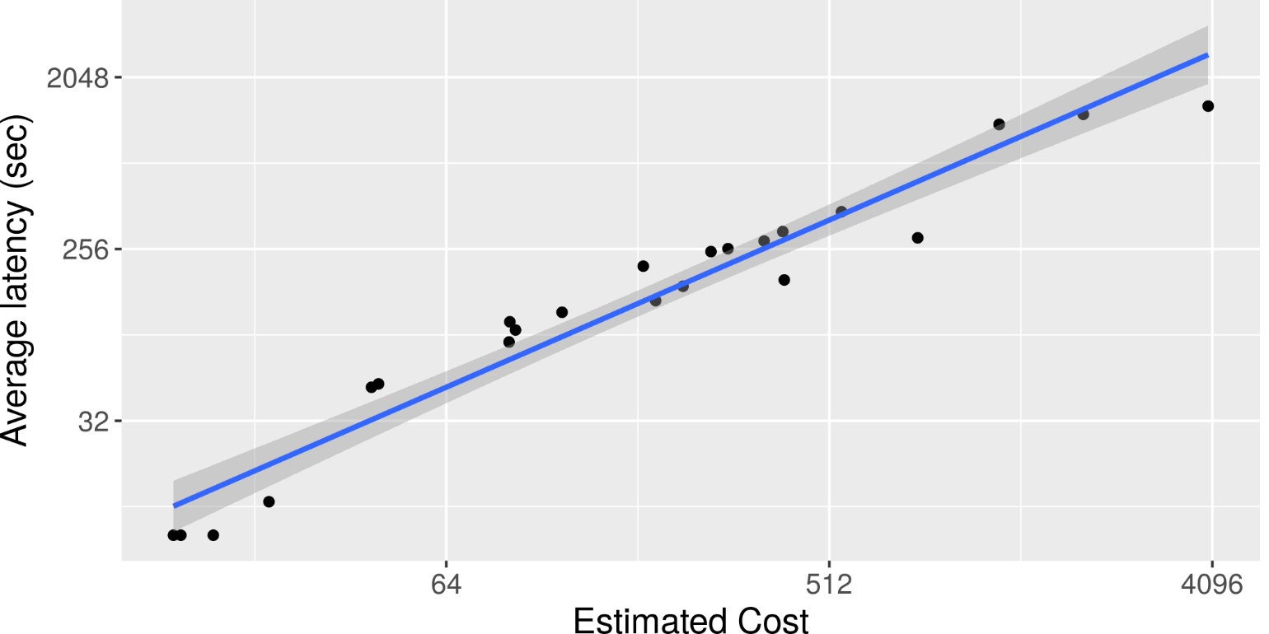
CHET selects the best-performing data layout

Slide 29
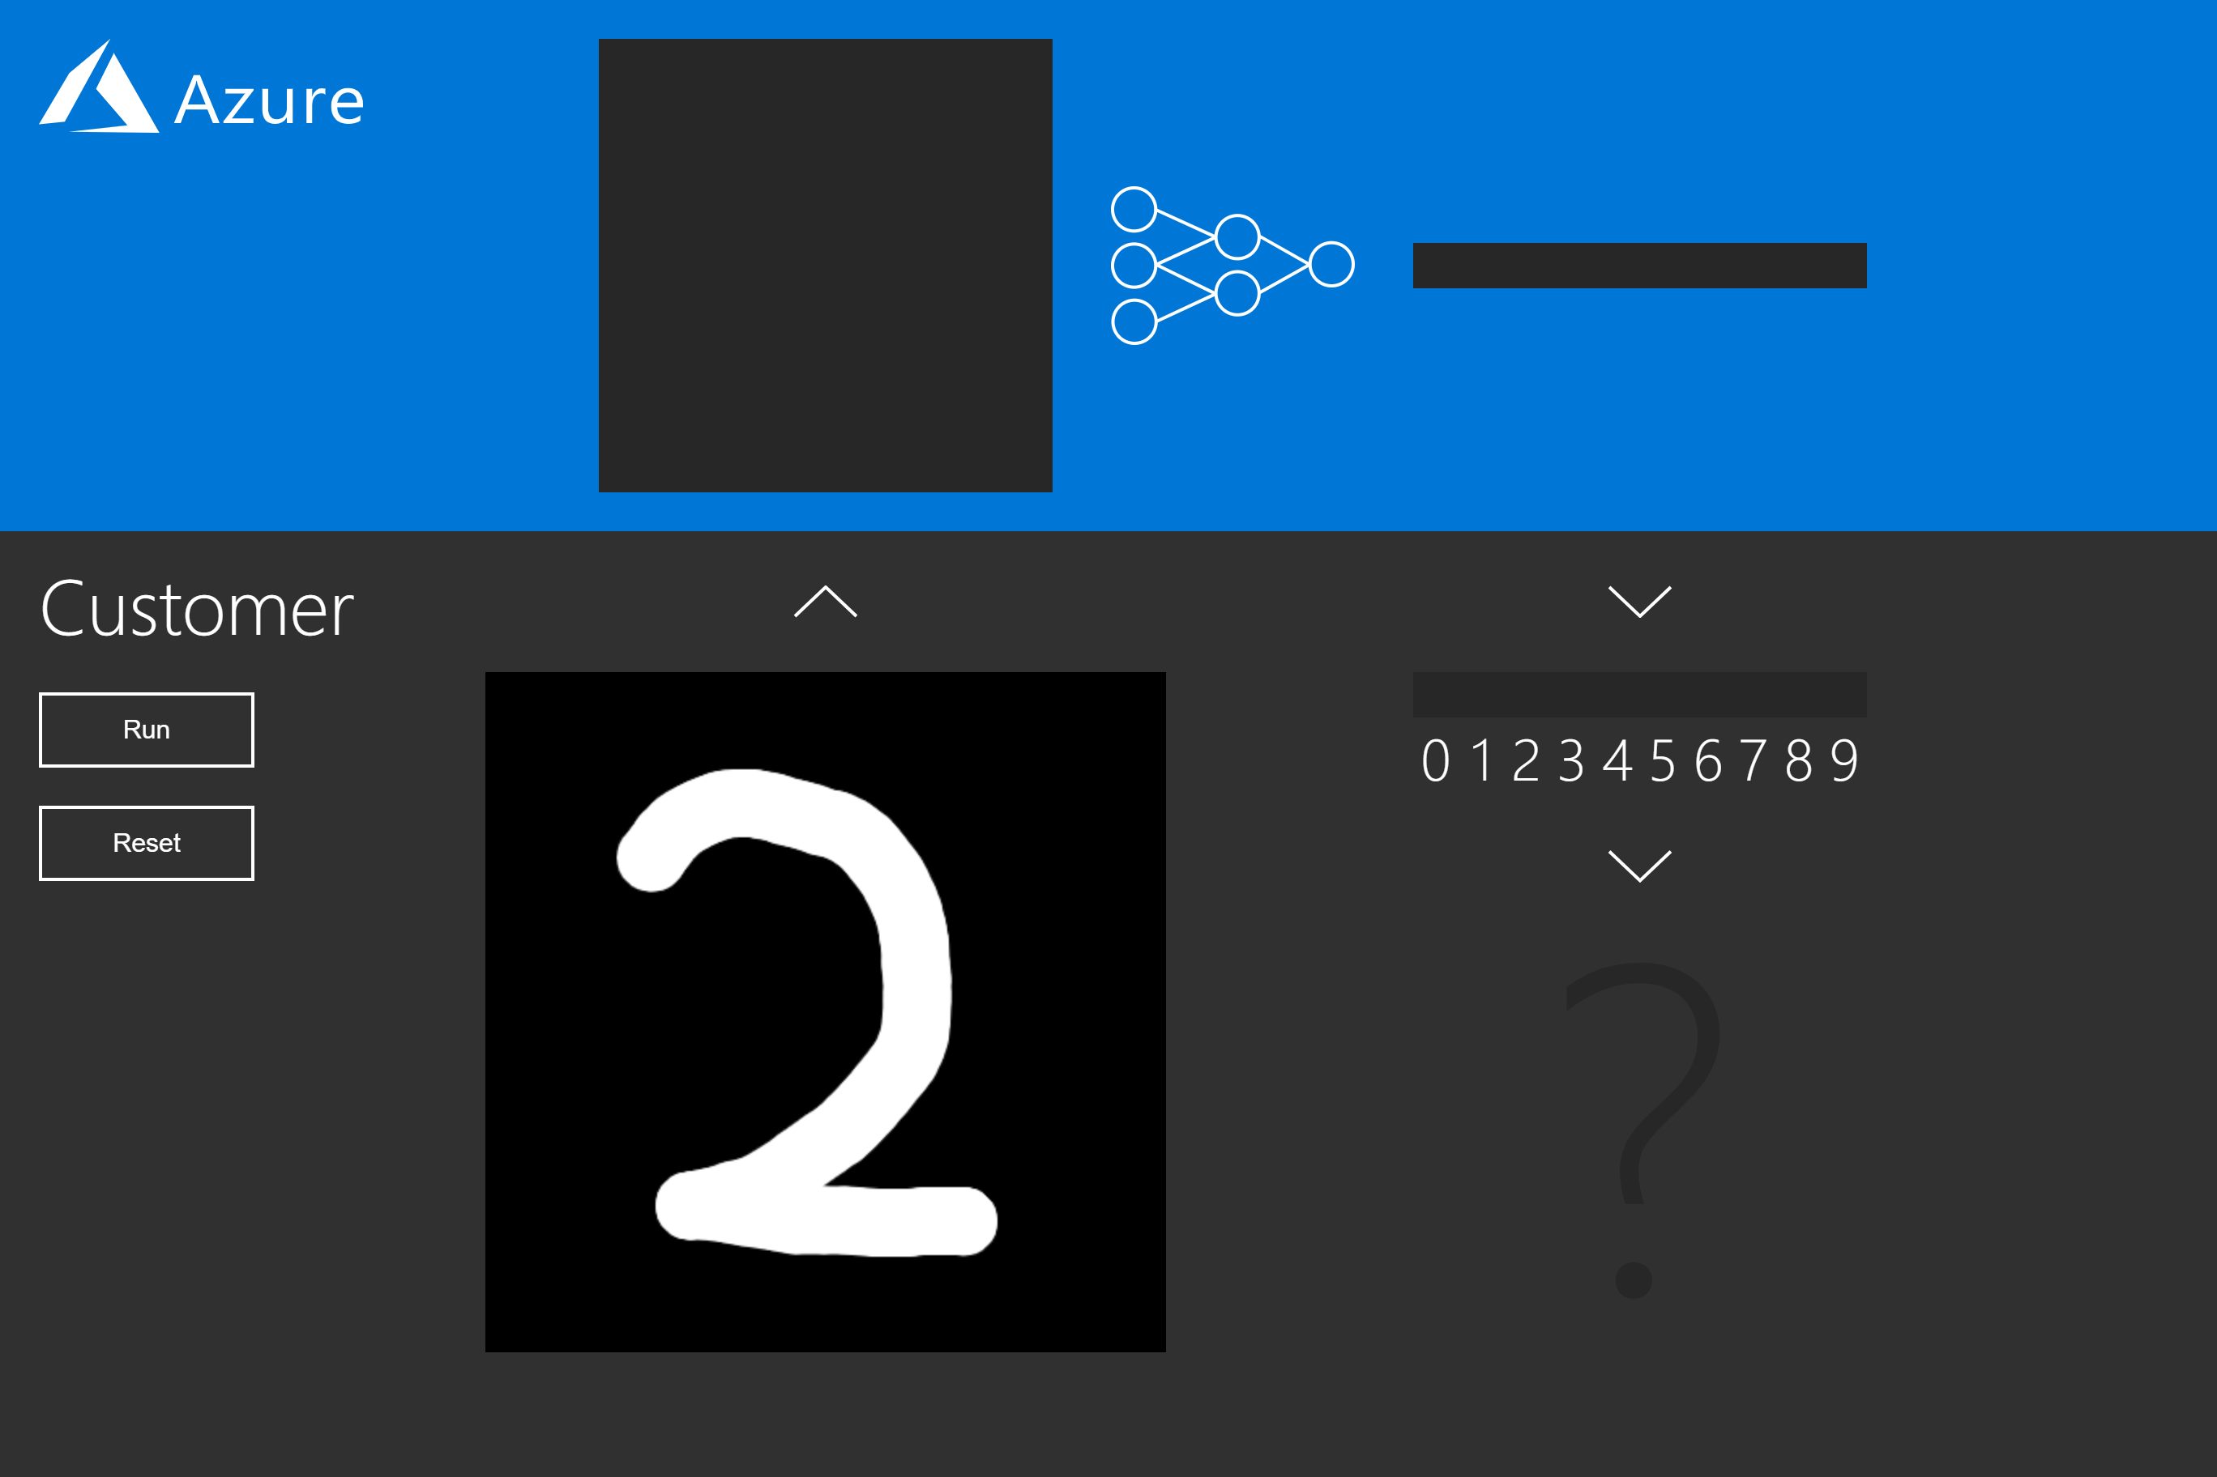
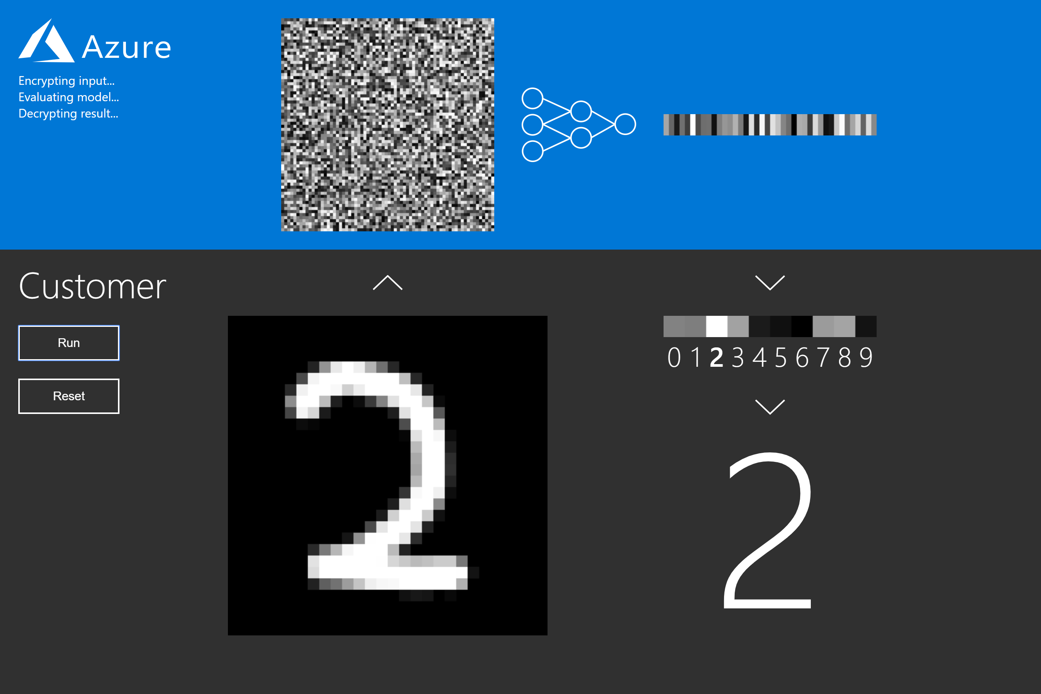
Not privy to the image, prediction, or any intermediate state
Notes:
Program can be seen but input cannot be seen
Demo in MSR booth

Slide 30
Rotation Keys Selection
Distinct public key for each distinct amount of rotation
Consumes significant memory
By default, FHE schemes generate power-of-2 rotation keys
Too conservative
O(log(N)) keys
CHET analyzes the circuit to capture all the distinct rotations used
In practice, very few rotations are used: not O(N)

Slide 31
Overview of CHET at compile-time
CHET Compiler
Optimized Homomorphic Tensor Circuit
Tensor Circuit
Schema of Inputs
Encryptor
&
Decryptor
Desired Output Precision

Slide 32
Overview of CHET at runtime
Server
Not privy to the image, prediction, or any intermediate state
Weights
Optimized Homomorphic Tensor Circuit
CHET Runtime
HEAAN/SEAL
CPU/GPU/FPGA
Client
Encryptor
&
Decryptor
Encrypted Image
Encrypted Prediction
Encryptor
&
Decryptor
Image
Prediction
Private key
Public keys

Slide 33
Tensor Programs
Tensor is a multi-dimensional array
Common tensor operations:
Convolution
Matrix multiplication
Pooling
Element-wise operations
Reshaping

Slide 34
Linear-time Dataflow Analysis Framework
Dataflow equations for FHE primitives
Properties of tensor circuits:
Dataflow graph is a Directed Acyclic Graph (DAG)
Tensor dimensions are known at compile-time
Analysis: execute dataflow equations using CHET runtime
Dynamically unrolls the dataflow graph on-the-fly
Interpret ciphertext/plaintext as dataflow information

Slide 35
Semi-Honest Threat Model
Hardware and software execute requested computation faithfully
Hardware and software are curious about the data
Client or user data must remain confidential

