Slide 1



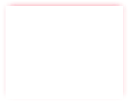
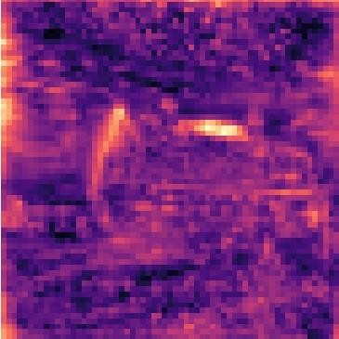

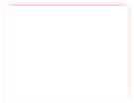
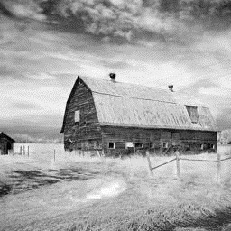
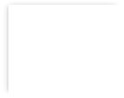
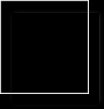
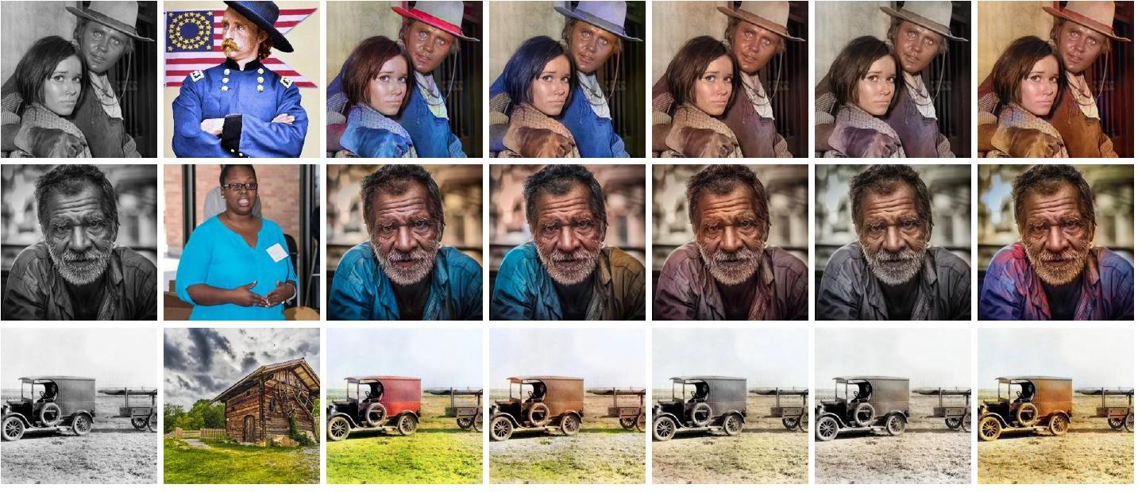
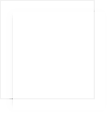

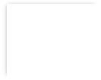
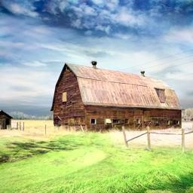
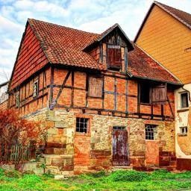
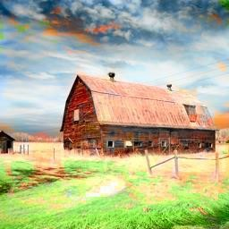

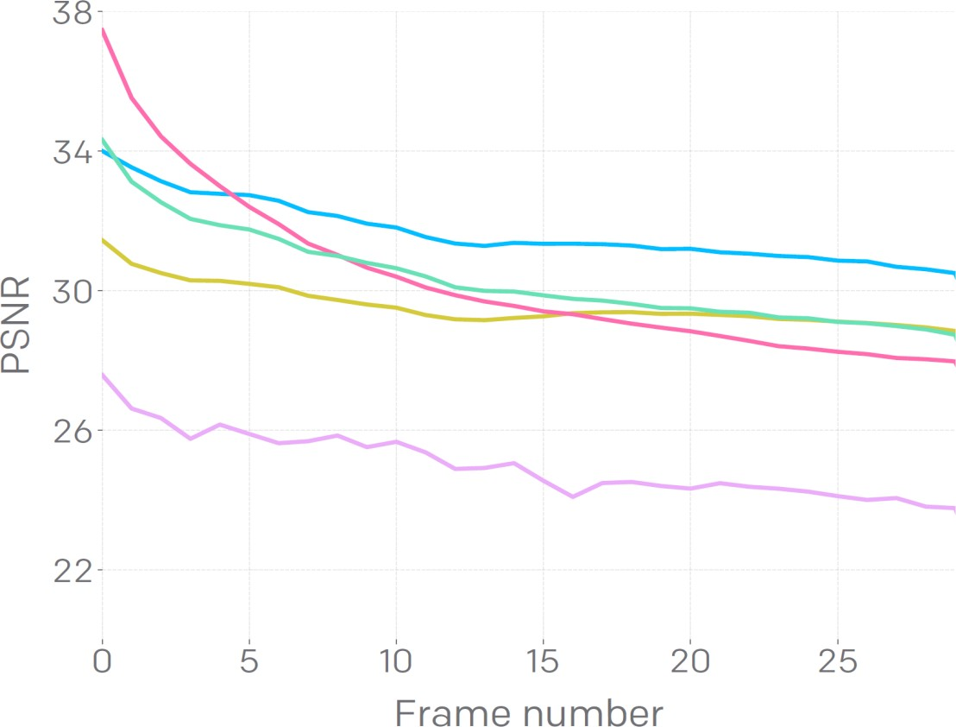

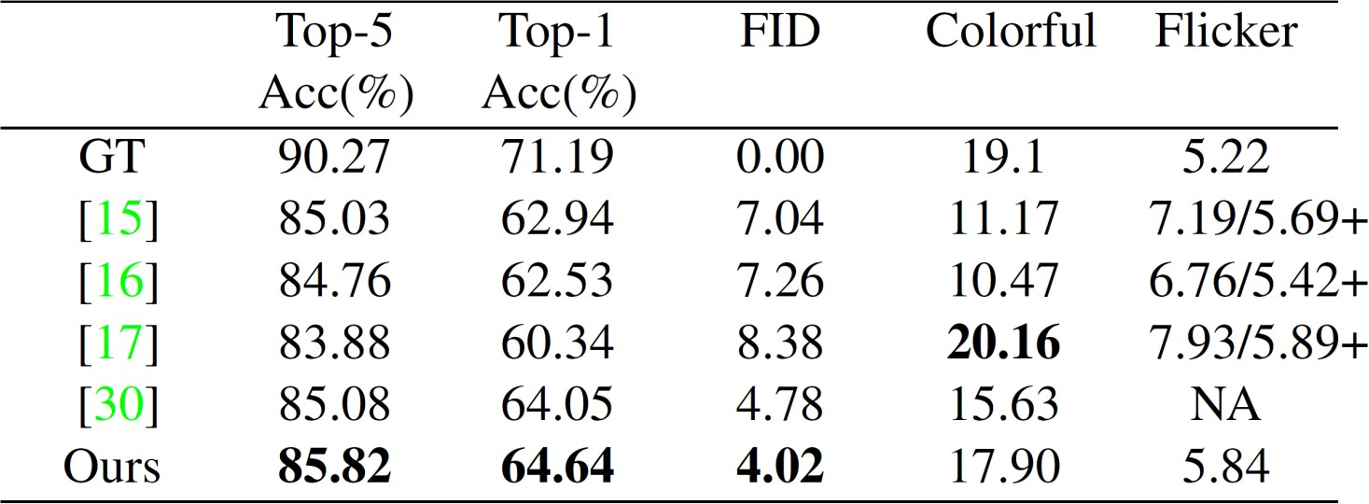

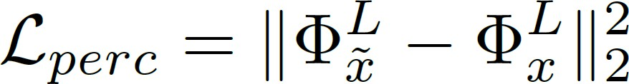
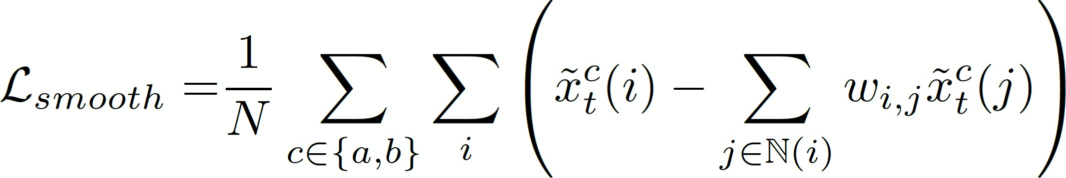
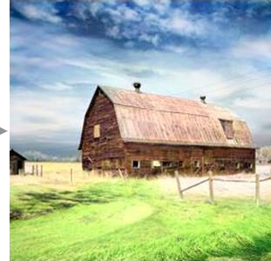



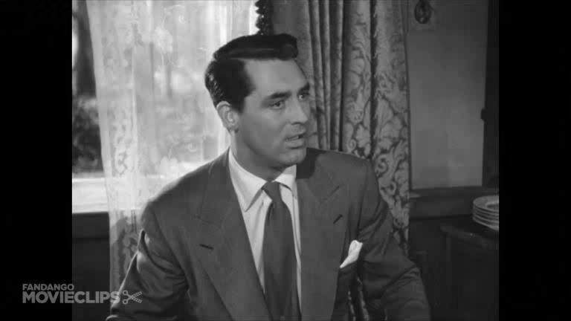

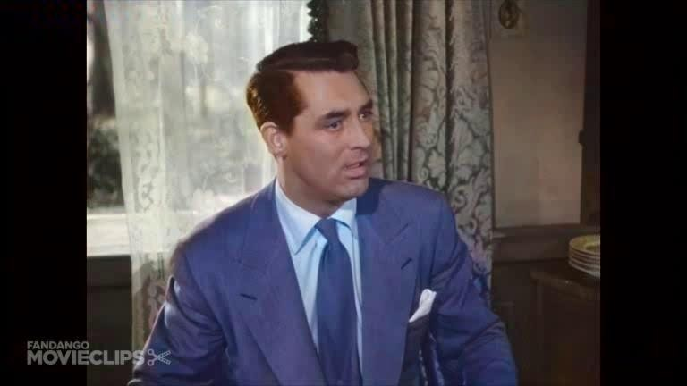
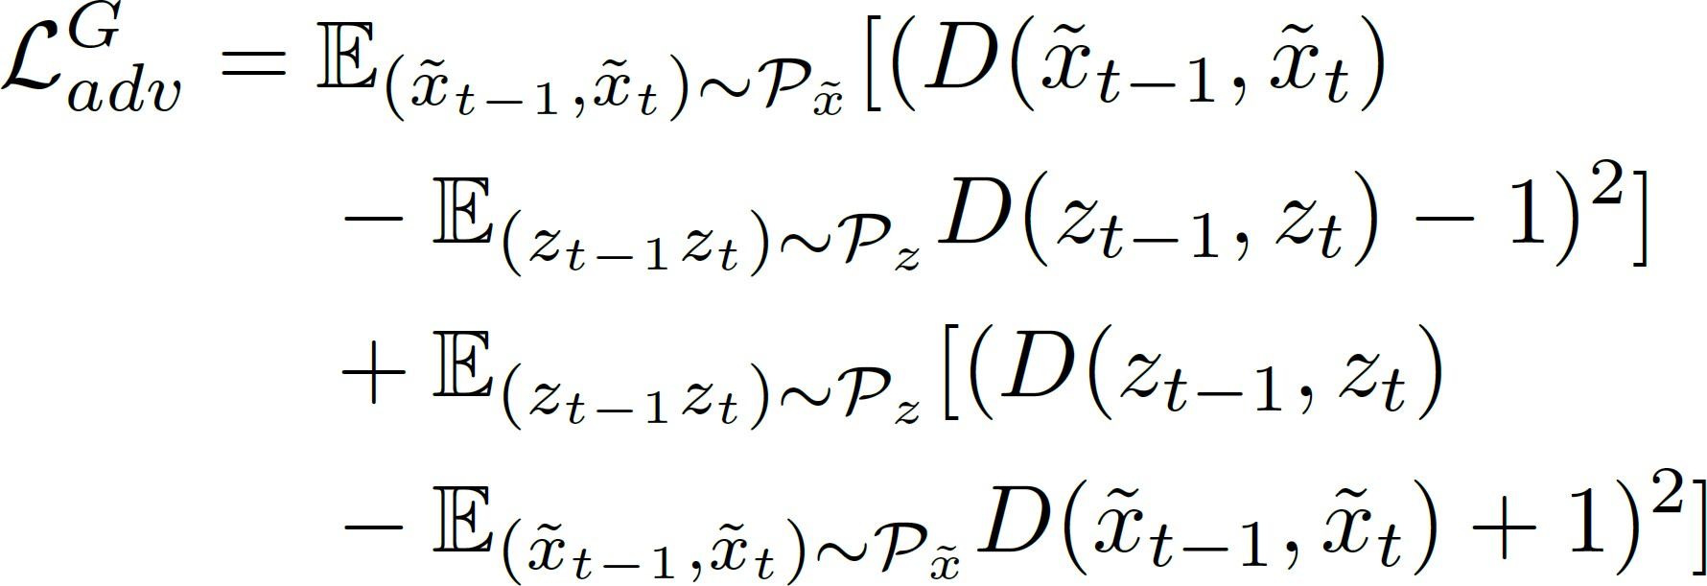
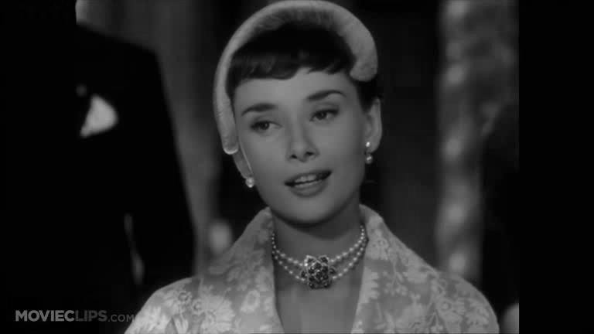
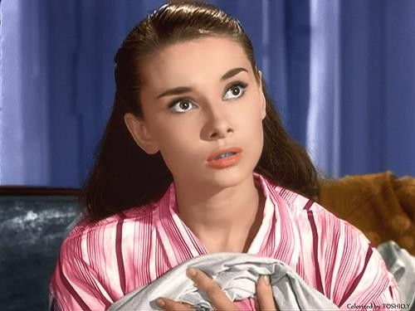
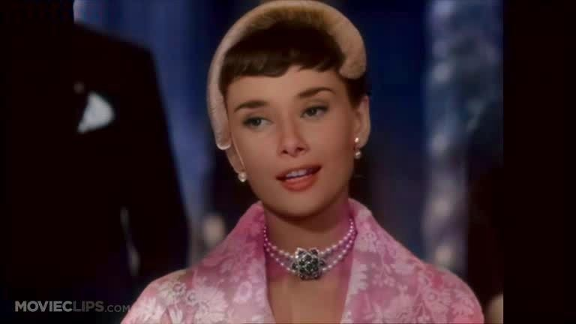
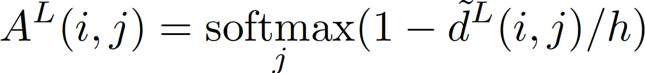
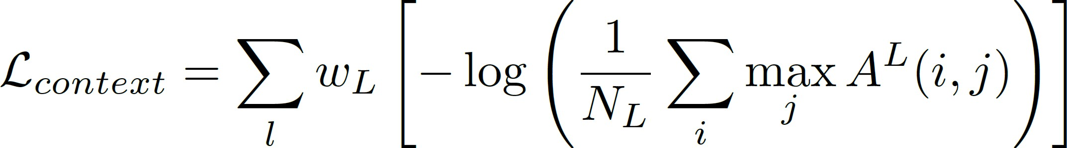
Deep Exemplar-based Video Colorization
Bo Zhang^{1,3}, Mingming He^{2,5}, Jing Liao^{2,3}, Pedro V. Sander¹, Lu Yuan^{3,4}, Amine Bermak¹, Dong Chen³ ¹Hong Kong University of Science and Technology, ²City University of Hong Kong, ³Microsoft Research Asia,
⁴Microsoft AI Perception and Mixed Reality, ⁵USC Institute for Creative Technologies
Joint Learning of Correspondence and Colorization
Introduction
We propose the first end-to-end network for exemplar- based video colorization. The contributions are:
Introduction
Correspondence subnet
H x W x (HW)
Image colorization
input reference
Iizuka 2016
Larsson 2016
Zhang 2016
Semantic dense correspondence in an unsupervised manner
Correspondence and colorization are jointly trained, yielding faster inference speed and better quality
State-of-the-art multi-modal video colorization
Two modes: automatic colorization & color propagation
Features: H x W x
ours
He. 2018
Pre- trained VGG
C
𝐹_{𝑥}(𝑗)
Channel-
wise
Residual blocks
𝜃_{𝑐}
max pooling
Colorization
=
subnet
Correlation matrix 𝑀
Similarity map 𝑆
Source image 𝑥^{𝑙}
𝑡
ReLU2.2~ReLU5.
2
Features: H x W x
C
⨂
Overall Framework
The colorization for the current frame 𝑥_{𝑡} depends on the semantically corresponding region of the example
Pre- trained VGG
Residual blocks
𝜃_{𝑐}
Colorized last frame 𝑥෤^{𝑙}
=
𝑡−1
𝐹_{𝑦}(𝑗)
HW x HW
H x W x 3 Warped color 𝑊^{𝑎𝑏}
𝑙
𝑎,𝑏
Reference 𝑦
𝑙𝑎𝑏
HW x 2
+ Source image 𝑥
Color channels in the 𝐿𝑎∗𝑏∗ space
𝑡
Quantitative comparison
image 𝑦 _{𝑙𝑎𝑏} , and the historic colorization 𝑥෤^{𝑎,𝑏}
optical flow
proposed method
𝑡
Loss Function
Smoothness loss: coherent region should have similar color
Discriminator
Perceptual loss
Colorization subnet
Colorization subnet
Source image 𝑥^{𝑙}
Temporal loss
Legacy film colorization
input
𝑡
reference
ours
_{𝑥}𝑙𝑎𝑏
_{𝑥෤}𝑙𝑎𝑏
Output image
𝑡−2
𝑡−1
_{𝑊}𝑎𝑏 _{𝑆}𝑎𝑏
_{𝑊}𝑎𝑏 _{𝑆}𝑎𝑏
𝑡 𝑡
𝑡−1 𝑡−1
Correspondence subnet
Correspondence subnet
Contextual loss
Video adversarial loss
Reference 𝑦^{𝑙𝑎𝑏}
_{𝑦}𝑙𝑎𝑏 _{𝑥}𝑙
𝑡−1
_{𝑦}𝑙𝑎𝑏 _{𝑥}𝑙
𝑡

