Slide 1
Industry Trends, Risks, & Challenges
Scot Gillespie
Vice President, CTO
Notes:
Good morning and thank you very much for having me here today.
I am Scot Gillespie, the CTO of the Washington Post
Needless to say this has ben a very interesting and quite honestly tiring week at the Post.
I actually welcome the opportunity to get out for a couple hours.
While I am sure many of you know the Washington Post brand well, the mission and purpose we serve, and our outstanding journalism,
what you may not know is that we actually are a tech company.
Over the last few years the Post has become one of the most innovative media companies in the industry.
Tand oday I am going to talk about my thoughts on some industry trends, risks, and challenges. And how we are addressing some of them from a tech perspective at the Post.

Slide 2
Title Text
Body Level One
Notes:
Bandito is a multi-variant platform that automatically tests and directs traffic to the winners.

Slide 3
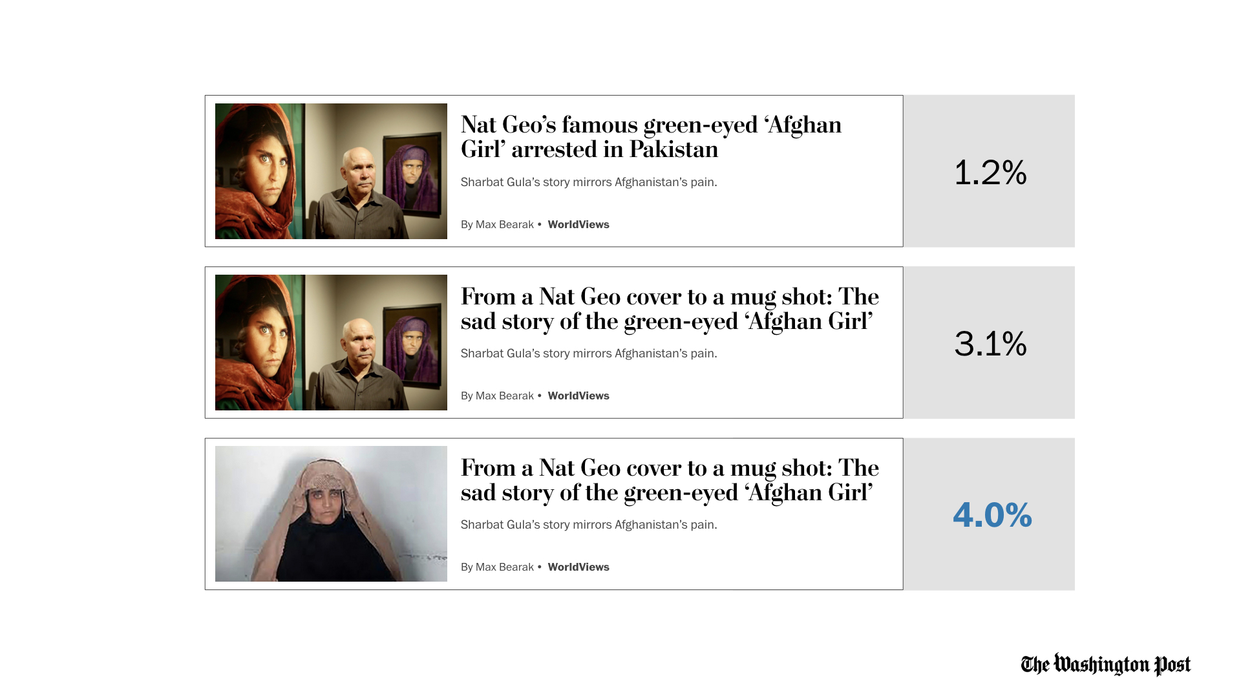
Title Text
Body Level One
Notes:
As you can see here we ran three tests, where a journalist created multiple variants of the same story.
One with a headline change,
and the other with a new image and headline. We then ran the variants on the site using bandito
As a winner emerges, Bandito will automatically route traffic to that winner

Slide 4
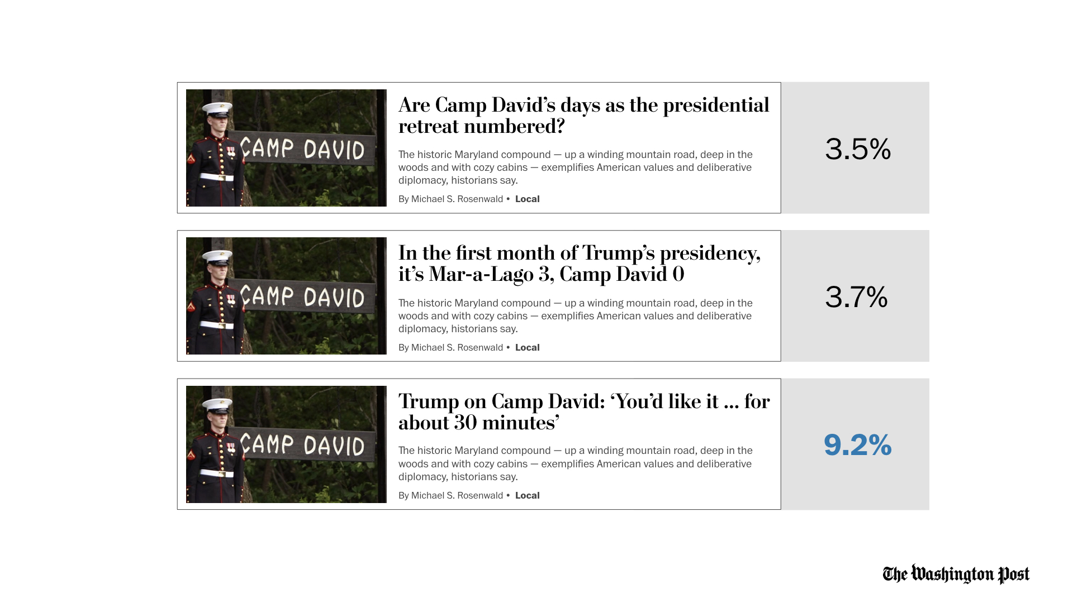
Title Text
Body Level One
Notes:
Here another example of variance in headline only.
And again bandito will automatically route traffic to the winner.
Now given the fact that changing culture in the newsroom is hard,
and getting them to actually create three separate headlines isn't easy either we decided to build a product to automatically do it for them.

Slide 5
Title Text
Body Level One
Notes:
Headliner automatically generates headlines based on the context of the story content

Slide 6
Title Text
Body Level One
Notes:
Headliner uses multiple methods to test and and tune the automatic headline generation.

Slide 7
Title Text
Body Level One
Notes:
And the takeaway from this is regardless of method,
Is if you cover the method on the left side you cant tell what was human generated or machine generated.
So this is useful to again improve productivity in the newsroom and ultimately when paired with bandito increase engagement across the site.
While machine generated headline helps improve productivity of the newsroom, automated machine generated stories helps even more.

