Slide 1
Fast Algorithms for Top-k Personalized PageRank Queries
Manish Gupta
Amit Pathak
Dr. Soumen Chakrabarti
IIT Bombay

Slide 2
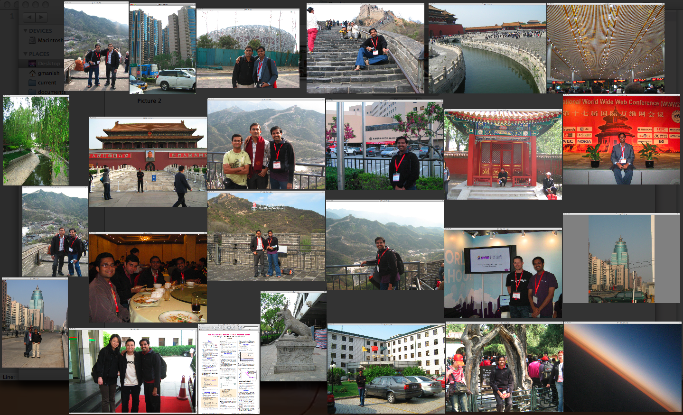

Slide 3
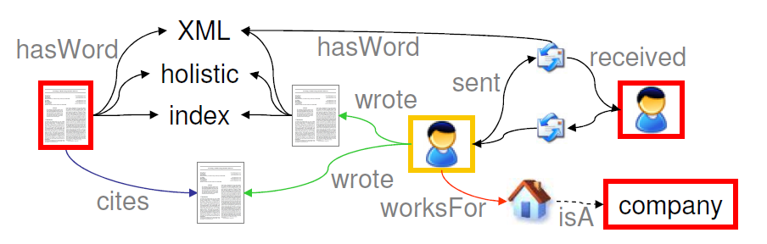
Problem: PageRank for ER graph queries
Find top-k experts from industry to review a submitted paper p under category “Information Systems”
Low index size, low query time
200–1600× faster than whole-graph Pagerank (top-k ranking contributes 4×)
10–20% smaller index; accuracy comparable to ObjectRank
Extension to handle hard predicates

Slide 4
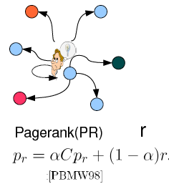
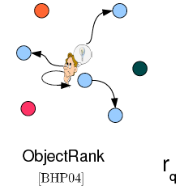
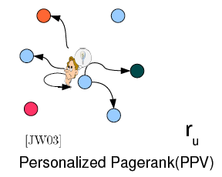
Explaining Page Rank

Slide 5

Notations
Graph G= (V, E) with edges (u, v) Є E
Conductance C(v,u) such that Σ_{v} C(v,u) =1
Teleport prob 1-α and vector r, Σ_{v} r(v) =1
Personalized PageRank [5](PPR) for vector r is PPV_{r} = p_{r} = α C p_{r} + (1- α) r= (1- α) (I- α C)⁻¹r
For node v, r(v)=1 ➔its PPV is PPV_{v}
H is Hubset; sloppyTopK varies in

Slide 6

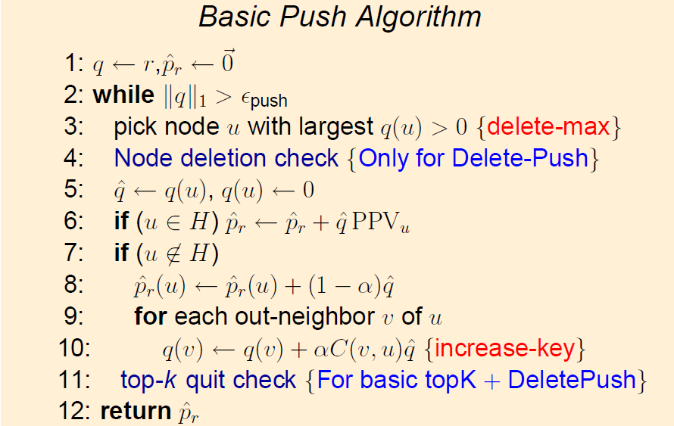
Previous work
ObjectRank [1]
Graph proximity queries modeled as authority flow originating from match nodes
It requires pre-computation of all word PPVs.
Asynchronous Weight-Pushing Algorithm (BCA) [2]
HubRank [4]
Based on Personalized PageRank [5] and BCA [2]
Proposes a hubset selection model

Slide 7
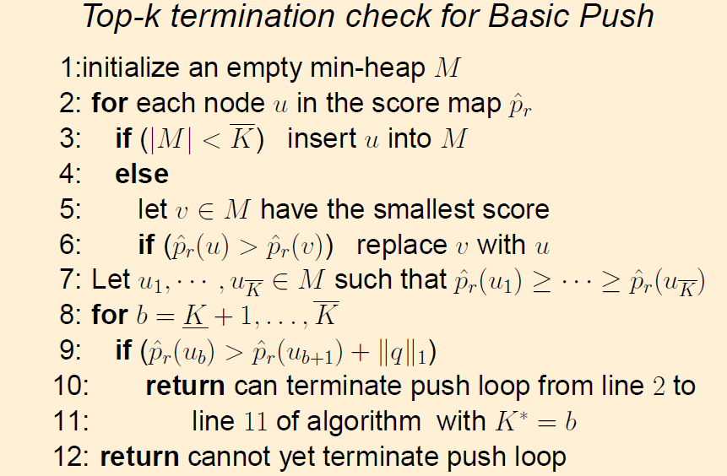
Basic top-k Framework
For most applications, top-k answers are sufficient.
Proposition 1: At any time, for all nodes u,

Slide 8




Basic top-k Framework
If u₁, u₂, … are the nodes sorted in non-increasing order of their scores , u₁, u₂, …, u_{k} are the best k answer nodes iff
Sloppy top-k
Half of the queries terminate via top-K quit check and at k=K* near
Proposition 2: At any time, for all nodes u,
Need to maintain lower and upper bounds separately
Proposition 3: At any time, for all nodes u,
Needs less book-keeping; 6% less query time; more queries quit earlier at lower K*

Slide 9

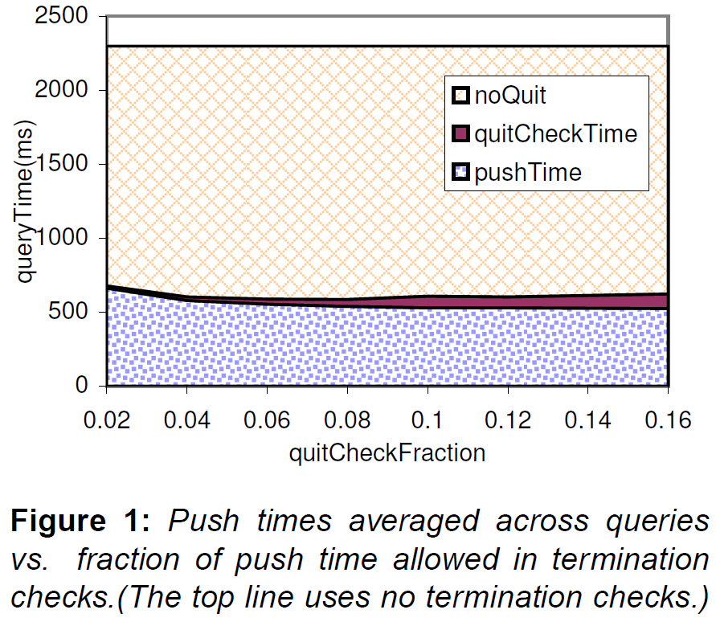
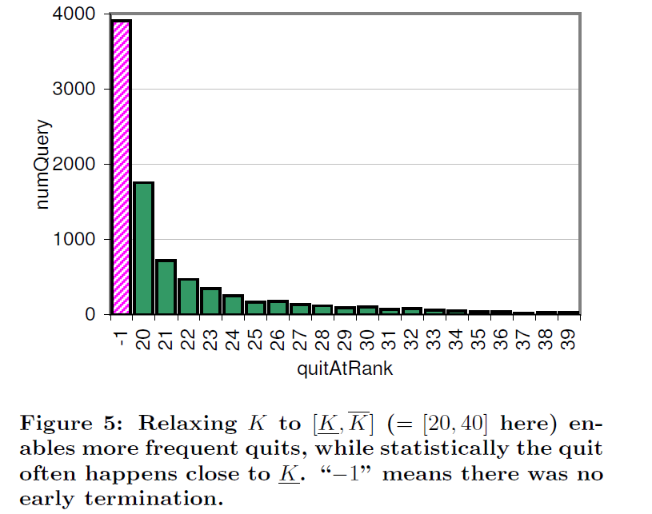
Experiments
1994 snapshot of CITESEER corpus has 74000 nodes and 289000 edges
Lucene text indices - 55MB
1.9M CITESEER queries; = [20, 40]
Naive one-shot Hubset [4] of size 15000
4% time invested in quit checks result 4× speed boost

Slide 10
Hard Predicates
Find top-k papers related to XML published in 2008
Target nodes (nodes that strictly satisfy the hard predicates) are returned as answer nodes
2 approaches
a. naiveTopk: Modified “basic top-k for soft predicate queries”, such that a node is considered to be put in heap M only if it belongs to target set
b. Node-deletion algorithm
No need to rank non-target nodes; delete non-target nodes while executing push

Slide 11

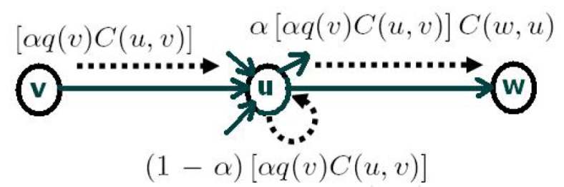
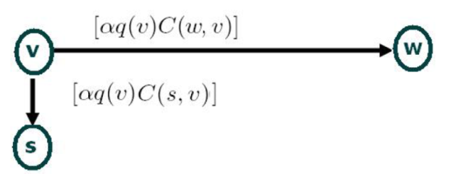
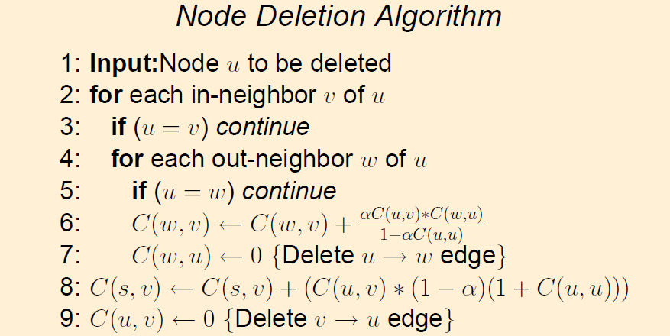
Node Deletion Algorithm
Special sink node s with self-loop of C(s, s) = 1.
Delete a node u from graph G to create G’=(V’,E’) such that for any teleport r’^{|V’|×1} over G’,p’_{r’}(v) = p_{r}(v) for all nodes v Є V’−s where p’_{r’}(v) is computed over G’, r(v) = r’(v) for v Є V’ and r(v) = 0 for
What fraction of q(v) reaches w on path v→u→w?

Slide 12
Ranking only target nodes (Delete -Push)
Deleting non-target node avoids further pushes from it and so saves work but can bloat number of edges.
Victim selection
Block structure [6] in social network graphs
Indegree and outdegree of nodes in graph follow power law [3]
Aggressive approach: Delete all non-target nodes
Simple non-aggressive approach: Local search from node u and delete non-target non-hubset out-neighbours of u if it doesn’t bloat number of edges

Slide 13
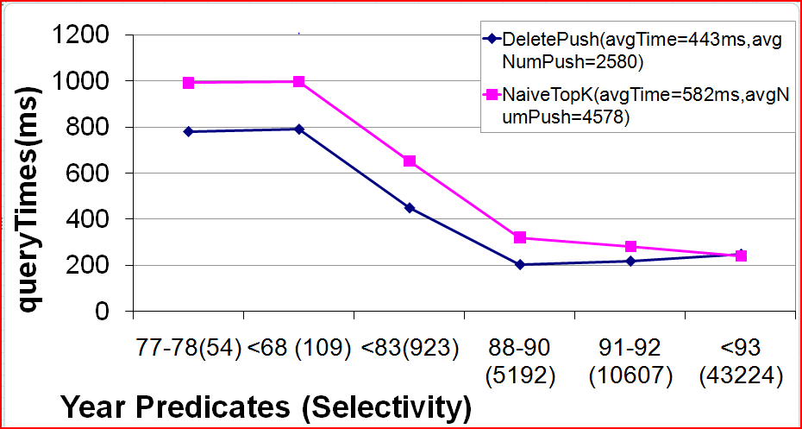
Experiments
Target set size was varied by having different hard predicates on publication years
DeletePush works better when the target set sizes are not too large

Slide 14
References
[1] A. Balmin, V. Hristidis, and Y. Papakonstantinou. Objectrank: Authority-based keyword search in databases. In VLDB, pages 564–575, 2004.
[2] P. Berkhin. Bookmark-coloring approach to personalized pagerank computing. Internet Mathematics, 3(1):41–62, Jan. 2007.
[3] A. Z. Broder, R. Kumar, F. Maghoul, P. Raghavan, S. Rajagopalan, R. Stata, A. Tomkins, and J. L. Wiener. Graph structure in the web. Computer Networks, 33(1-6):309–320, 2000.
[4] S. Chakrabarti. Dynamic personalized PageRank in entity-relation graphs. In www, Banff, May 2007.
[5] G. Jeh and J. Widom. Scaling personalized web search. In WWW Conference, pages 271–279, 2003.
[6] S. D. Kamvar, T. H. Haveliwala, C. D. Manning, and G. H. Golub. Exploiting the block structure of the web for computing, Mar. 12 2003.

Slide 15
Questions?
Thanks for your time and attention!

