Slide 2
Situated Interaction
demo
Dan Bohus, Eric Horvitz
Microsoft Research

Slide 3
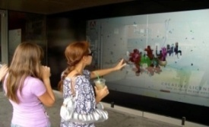
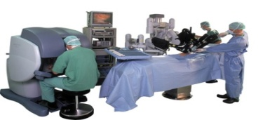
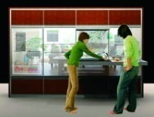
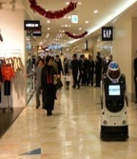
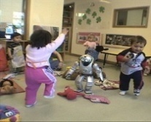
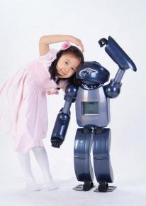
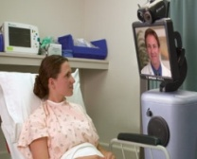
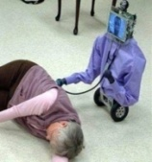
Situated Interaction
Long-term goal
Embed interaction deeply into the flow of everyday situations & collaborations
Sample challenge
Conversational agent that can serve as a Microsoft receptionist

Slide 4
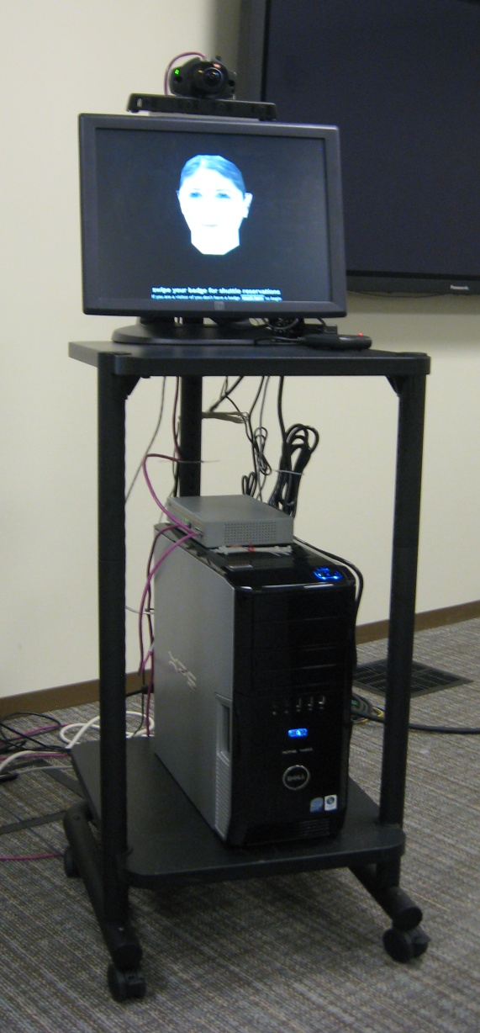
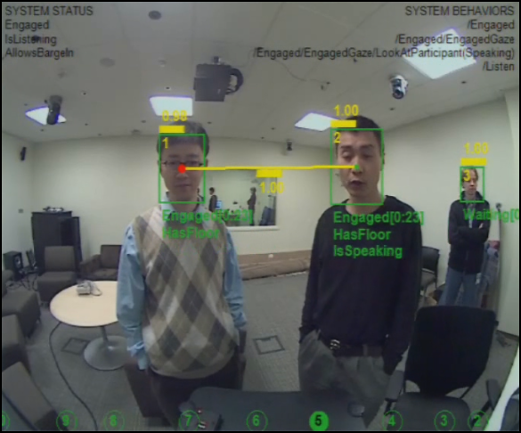
Prototype
wide-angle camera
4-element microphone array
touch screen
card reader
speakers
Speech Synthesis
Avatar Synthesis
Speech Recognition
Tracker
Output Management
Conversational
Scene
Analysis
Behavioral control
quad core PC
Dialog management & Interaction Planning
Microsoft Robotics Studio [Concurrency, Coordination and Distributed Services]

Slide 5
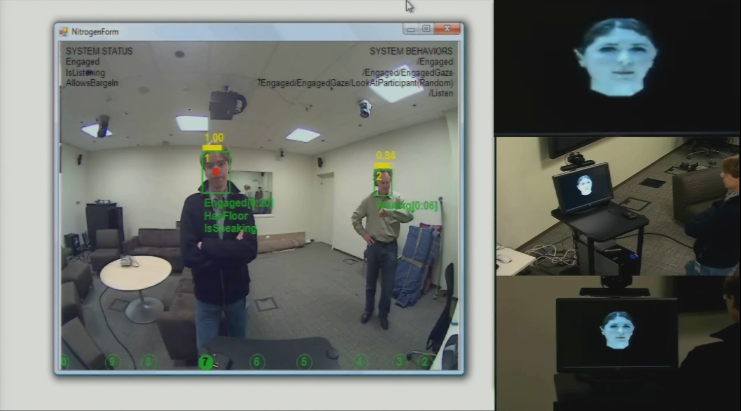
Handling Participants Waiting in Line
detect and track multiple participants
infer roles and needs
infer and track current speaker
and the conversational floor
maintain engagement with both participants via gaze and direct interaction

Slide 6
InkSeine
demo
Ken Hinckley
Senior Researcher
Microsoft Research

Slide 7
It's next, in McKinley
DemoFest
New user interfaces
Natural language translation
Robotics
and much more…

Slide 8
© 2008 Microsoft Corporation. All rights reserved. Microsoft, Windows, Windows Vista and other product names are or may be registered trademarks and/or trademarks in the U.S. and/or other countries. The information herein is for informational purposes only and represents the current view of Microsoft Corporation as of the date of this presentation. Because Microsoft must respond to changing market conditions, it should not be interpreted to be a commitment on the part of Microsoft, and Microsoft cannot guarantee the accuracy of any information provided after the date of this presentation. MICROSOFT MAKES NO WARRANTIES, EXPRESS, IMPLIED OR STATUTORY, AS TO THE INFORMATION IN THIS PRESENTATION.

