Slide 2
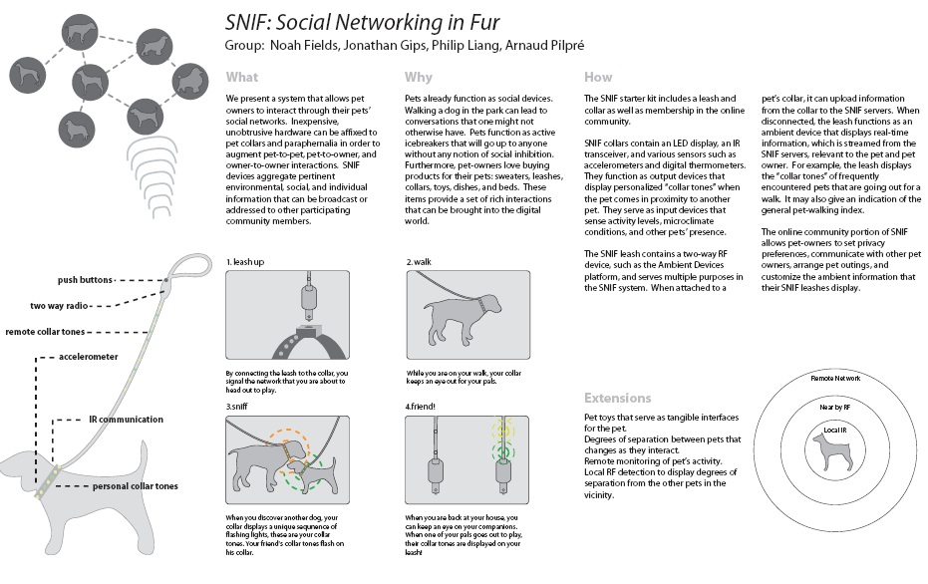

Enabling Social Networks Using Semantics
Noshir Contractor
Jane S. & William J. White Professor of Behavioral Sciences Professor of Ind. Engg & Mgmt Sciences, McCormick School of Engineering
Professor of Communication Studies, School of Communication &
Professor of Management & Organizations, Kellogg School of Management,
Director, Science of Networks in Communities (SONIC) Research Laboratory
nosh@northwestern.edu

Slide 3

Aphorisms About Networks
Social Networks
Its not what you know, its who you know
Cognitive Social Networks
Its not who you know, its who they think you know.
Knowledge Networks
Its not who you know, its what they think you know.
SONIC
Advancing the Science of Networks in Communities

Slide 4

Cognitive Knowledge Networks
SONIC
Advancing the Science of Networks in Communities

Slide 5




Interaction Networks
Non Human Agent to
Non Human Agent
Communication
Publishing to
knowledge repository
Non Human Agent
(webbots, avatars, databases,
“push” technologies)
To Human Agent
Retrieving from
knowledge repository
Human Agent to Human Agent
Communication
SONIC
Advancing the Science of Networks in Communities

Slide 6
Cognitive Knowledge Networks
Non Human Agent’s
Perception of Resources
in a Non Human Agent
Human Agent’s Perception of
Provision of Resources in a
Non Human Agent
Non Human Agent’s Perception of what a Human Agent knows
*
Human Agent’s Perception of
What Another Human Agent
Knows
SONIC
Advancing the Science of Networks in Communities
* … Why Amazon thinks I am pregnant & Tivo thinks I am gay ….

Slide 7
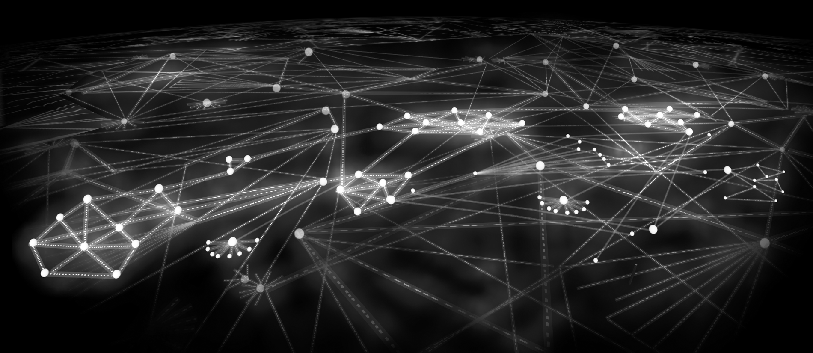
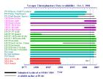



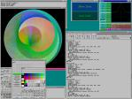

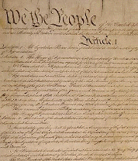
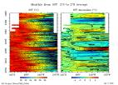
















Multidimensional Networks in Web 2.0 Multiple Types of Nodes and Multiple Types of Relationships

Slide 8
Why Do We Create, Maintain, Dissolve, And Reconstitute Our Communication And Knowledge Networks?
SONIC
Advancing the Science of Networks in Communities

Slide 9
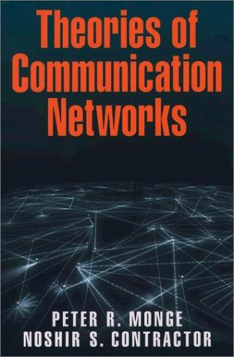
Monge, P. R. & Contractor, N. S. (2003). Theories of Communication Networks. New York: Oxford University Press.
SONIC
Advancing the Science of Networks in Communities

Slide 10
Social Drivers Why do we create and sustain networks?
Theories of self-interest
Theories of social and resource exchange
Theories of mutual interest and collective action
Theories of contagion
Theories of balance
Theories of homophily
Theories of proximity
Theories of co-evolution
Sources:
Contractor, N. S., Wasserman, S. & Faust, K. (2006). Testing multi-theoretical multilevel hypotheses about organizational networks: An analytic framework and empirical example. Academy of Management Review.
Monge, P. R. & Contractor, N. S. (2003). Theories of Communication Networks. New York: Oxford University Press.
SONIC
Advancing the Science of Networks in Communities

Slide 11
A Contextual “Meta-theory” of Social Drivers for Creating and Sustaining Communities
SONIC
Advancing the Science of Networks in Communities

Slide 12
Projects Investigating Social Drivers for Communities
Science Applications
Nano-IKNOW: Enabling and Evaluating the Network for Computational Nanotechnology (NSF)
CP2R: Collaboration for Preparedness, Response & Recovery (NSF)
TSEEN: Tobacco Surveillance Evaluation & Epidemiology
Network (NSF, NIH, CDC)
Business Applications
PackEdge Community of Practice (P&G)
Vodafone-Ericsson “Club” for virtual supply chain management (Vodafone)
Core Research
Social Drivers for
Creating & Sustaining
Communities
Societal Justice Applications
Cultural & Networks Assets
In Immigrant Communities
(Rockefeller Program on
Culture & Creativity)
Mapping the Digital Media and
Learning Environment
(MacArthur Foundation)
Entertainment Applications
Second Life (Linden Labs)
Everquest 2 (NSF, Sony Online
Entertainment)
SONIC
Advancing the Science of Networks in Communities

Slide 13
Contextualizing Goals of Communities
Challenges of empirically testing, extending, and exploring theories about networks … until now
SONIC
Advancing the Science of Networks in Communities

Slide 14
Its all about “Relational Metadata”
Technologies that “capture” communities’ relational meta-data (Pingback and trackback in interblog networks, blogrolls, data provenance)
Technologies to “tag” communities’ relational metadata (from Dublin Core taxonomies to folksonomies (‘wisdom of crowds’) like
Tagging pictures (Flickr)
Social bookmarking (del.icio.us, LookupThis, BlinkList)
Social citations (CiteULike.org)
Social libraries (discogs.com, LibraryThing.com)
Social shopping (SwagRoll, Kaboodle, thethingsiwant.com)
Social networks (FOAF, XFN, MySpace, Facebook)
Technologies to “manifest” communities’ relational metadata (Tagclouds, Recommender systems, Rating/Reputation systems, ISI’s HistCite, Network Visualization systems)
SONIC
Advancing the Science of Networks in Communities

Slide 15
Design Examples: Mapping & Enabling Networks in …
Tobacco Research: TobIG Demo
Computational Nanotechnology: nanoHUB Demo
Cyberinfrastructure: CI-Scope Demo
Oncofertility: Onco-IKNOW
SONIC
Advancing the Science of Networks in Communities

Slide 16
Tobacco Informatics Grid (TobIG) Network Referral System
Low-tar cigarettes cause more cancer than regular cigarettes …
A pressing need for systems that will help the TSEEN members effectively connect with other individuals, data sets, analytic tools, instruments, sensors, documents, related to key concepts and issues
SONIC
Advancing the Science of Networks in Communities

Slide 17
Summary
Research and application of semantics to enable networks is well poised to make a quantum leap by leveraging recent advances in
Theories about the social and organizational incentives for creating, maintaining, dissolving and re-creating social and knowledge network ties
Exponential random graph modeling techniques to statistically model and make theoretically grounded network recommendations
Development of cyberinfrastructure/Web 2.0 provide the semantic and technological capability that go beyond SNIF
SONIC
Advancing the Science of Networks in Communities

Slide 18









Acknowledgements
SONIC
Advancing the Science of Networks in Communities

