Slide 2
myExperiment
David De Roure
University of Southampton, UK

Slide 3
myExperiment
What it does
myExperiment is a Web 2.0 Virtual Research Environment
It makes it really easy for the next generation of scientists to contribute to a pool of scientific workflows, build communities and form relationships
It enables scientists to share, reuse and repurpose workflows and reduce time-to-experiment, share expertise and avoid reinvention
Go to www.myexperiment.org to access publicly available content or create an account

Slide 4
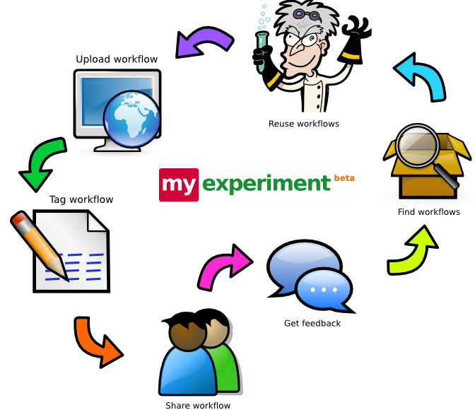
myExperiment
How it does it
An infrastructure to encourage sharing
“Facebook for Scientists”...but different to Facebook!
A community social network
A federated repository
A gateway to other publishing environments
A platform to launch workflows

Slide 5
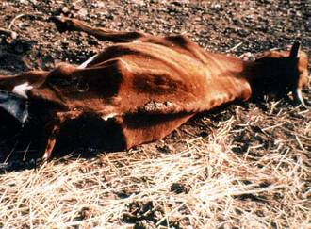
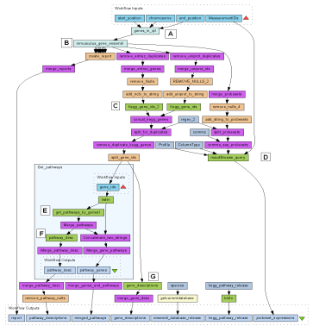
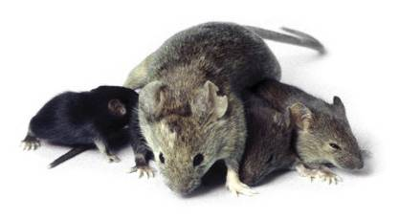
myExperiment
Why do we want to share?
Paul writes workflows to identify biological pathways implicated in resistance to Trypanosomiasis in cattle
Paul meets Jo. Jo is investigating Whipworm in mouse.
Jo reuses one of Paul’s workflow without change
Jo identifies the biological pathways involved in sex dependence in the mouse model
Previously a manual two year study by Jo had failed to do this

Slide 6





myExperiment
The Project
Funded by JISC and Microsoft
Part of the ^{my}Grid Consortium
Started March 2007
Closed beta since July 2007
Open beta November 2007
1000 registered users
1400 unique IP visits last month

Slide 7


myExperiment
Stats July 2008
959 active users
82 groups
248 group memberships
296 workflow entries
425 workflow versions
101 files
1382 taggings
46,427 downloads
77,393 viewings
408 creditations
12 packs (with 237 total entries)

Slide 8
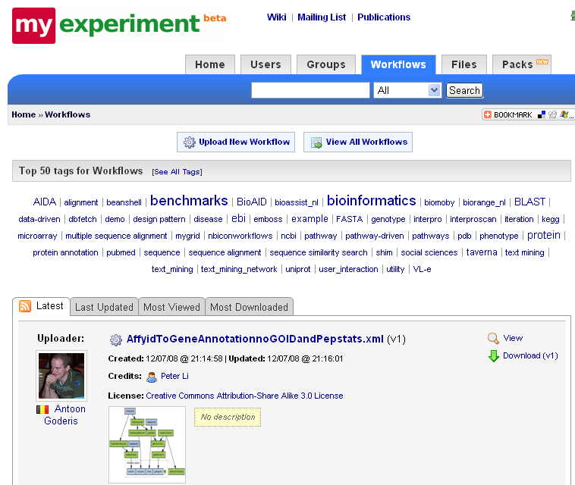
myExperiment
Features
User Profiles
Groups
Friends
Sharing
Tags
Messaging
News Feeds
Workflows
Credits, Attributions,
Licensing
Packs
RESTful API
Alternative Interfaces
Special Features

Slide 9
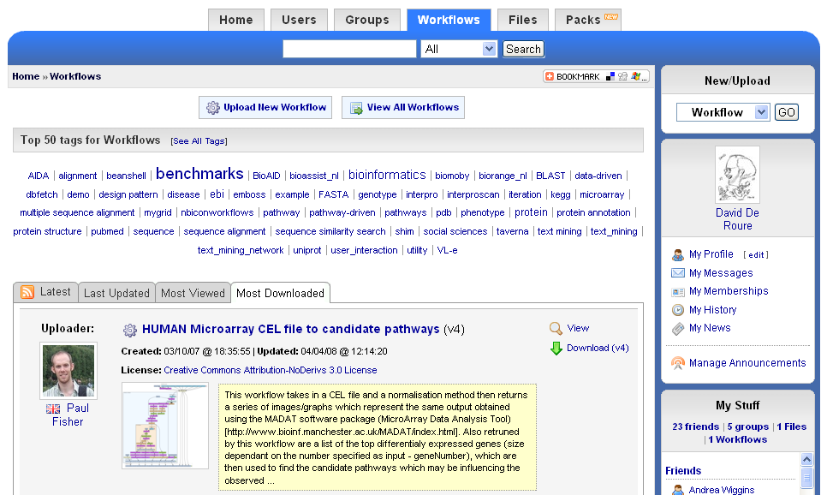
myExperiment

Slide 10
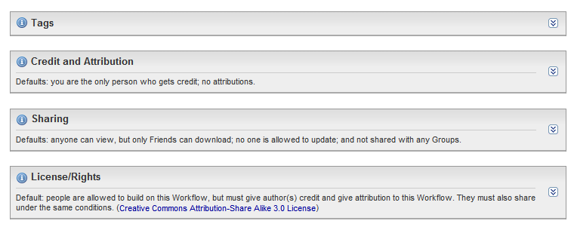
myExperiment Features
Ownership and Attribution

Slide 11
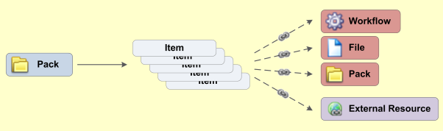
myExperiment Features
Packs
Packs allow you to collect different items together, like with a wish list or shopping basket, by linking to different things
You can link to internal things (workflows, files and even other packs) as well as things outside myExperiment
Your packs can then be shared, tagged, discovered and
discussed easily
Packs are exported
using Object Reuse
and Exchange

Slide 12
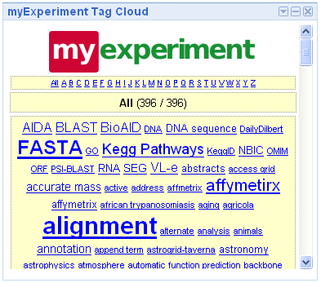
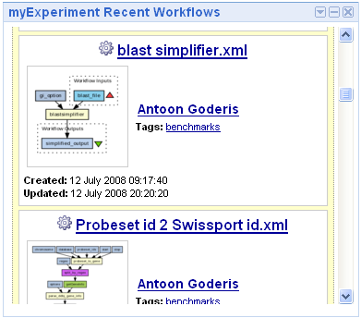
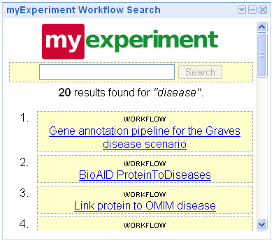
myExperiment Features
Google Gadgets

Slide 13
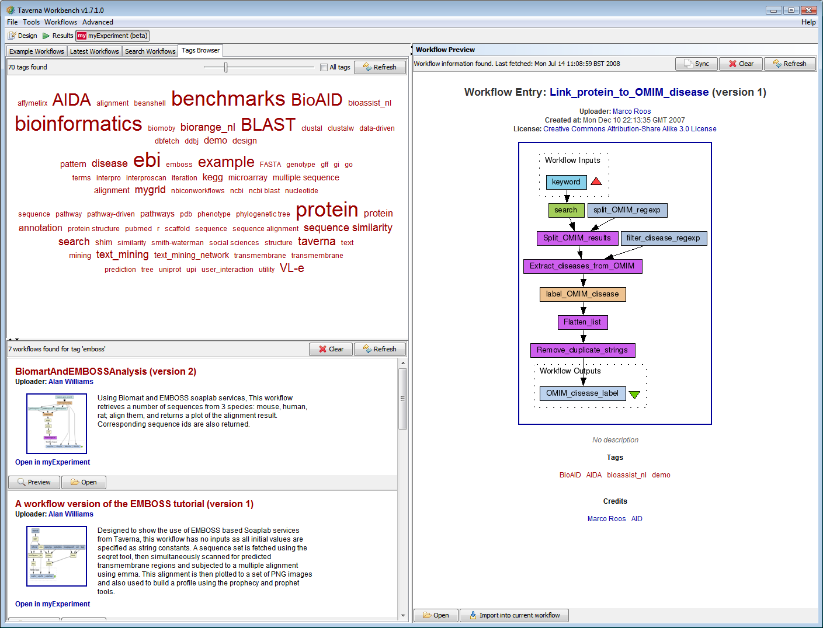
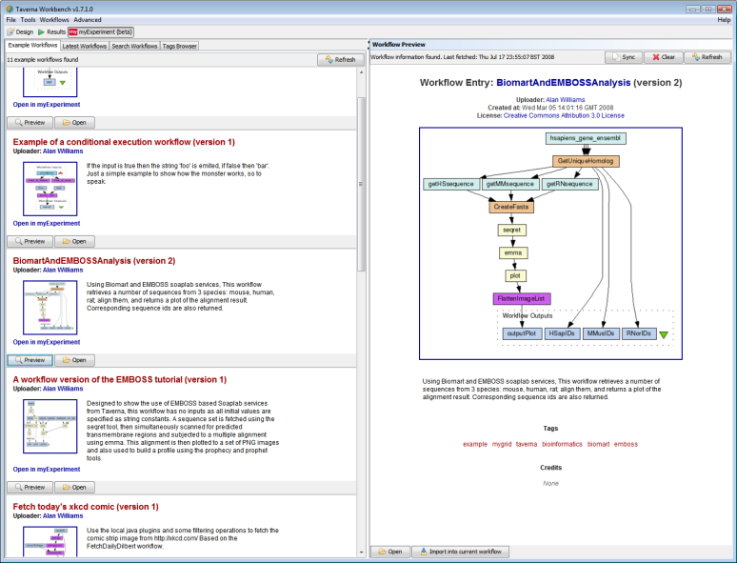
myExperiment Features
Taverna Plugin

Slide 14
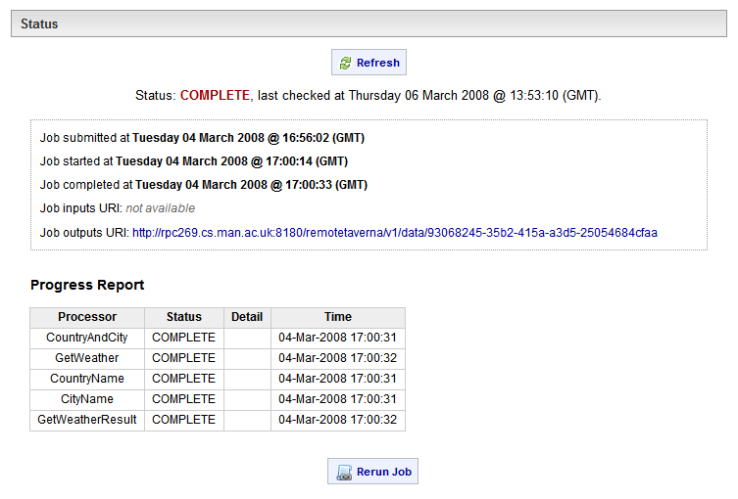
myExperiment Features
Enactment

Slide 15
myExperiment Features
Developer Community
All the myExperiment services are accessible through simple RESTful programming interfaces
  Use your existing environment and augment it with myExperiment functionality
  Build entirely new interfaces and functionality mashups
The open source Web 2.0 Software that powers the myexperiment.org web site is downloadable so you can run your own myExperiment for your lab or projects
Go to wiki.myexperiment.org for information about our Developer Community

Slide 16
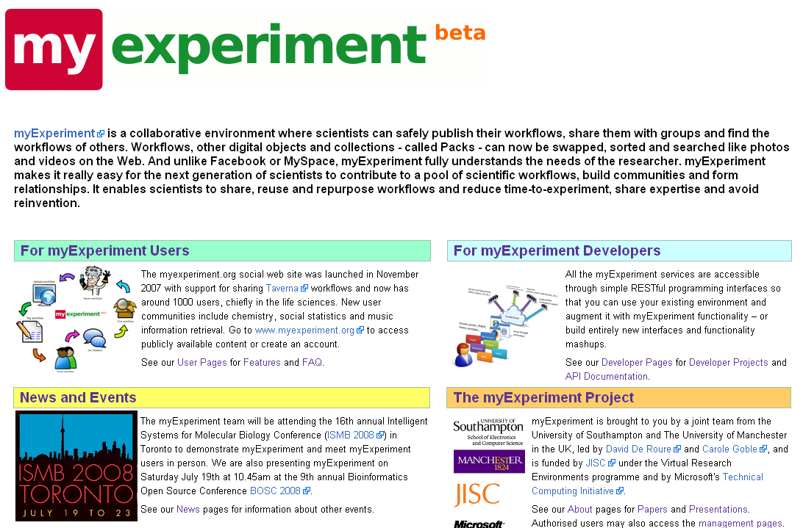
myExperiment Features
Developer Community
wiki.myexperiment.org

Slide 17
myExperiment
Summary
myExperiment provides social infrastructure – it facilitates sharing
Special support for Taverna workflows, others being added
Packs enable items to be collected together, shared and tagged
RESTful API for developing other interfaces and integration
Functionality mashups in Silverlight
Source code (BSD) can be downloaded from RubyForge
See wiki.myexperiment.org for more information

Slide 18
myExperiment
Contacts and Credits
Jiten Bhagat
Don Cruickshank
Danius Michaelides
Marco Roos
Duncan Hull
Paul Fisher
Simon Coles
Savas
The ^{my}Grid Family
The National Centre for e-Social Science
WHIP
Contact
David De Roure
dder@ecs.soton.ac.uk
Carole Goble
carole.goble@manchester.ac.uk

