Slide 2
Towards a Data Cauldron
Ian Foster
Computation Institute
University of Chicago & Argonne National Laboratory

Slide 3
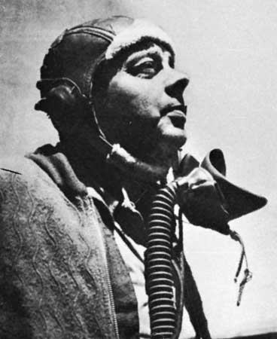
If you want to build a ship, don’t drum up the men to gather wood, divide the work, and give orders. Instead, teach them to yearn for the vast and endless sea.
Antoine de Saint-Exupéry

Slide 4
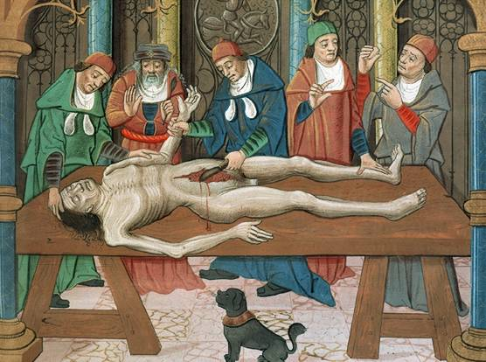
Biomedical Research, circa 1600

Slide 5
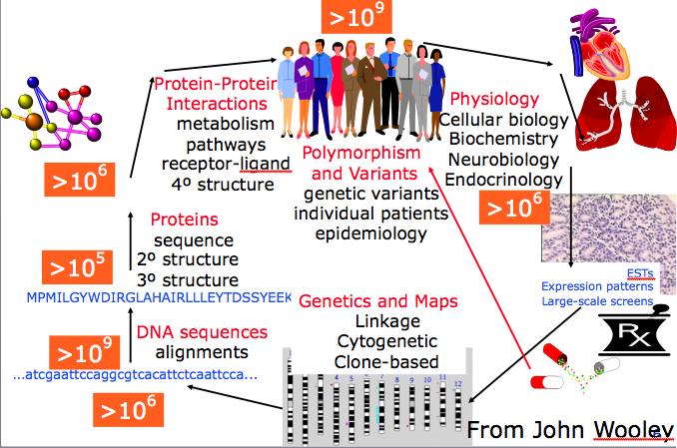
Biomedical Research, circa 2000

Slide 6
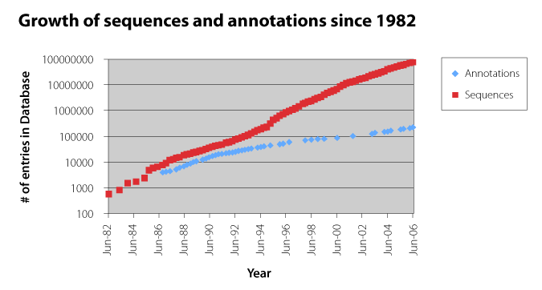
Growth of Sequences &Annotations since 1982
Folker Meyer, Genome Sequencing vs. Moore’s Law: Cyber Challenges for the Next Decade, CTWatch, August 2006.

Slide 7
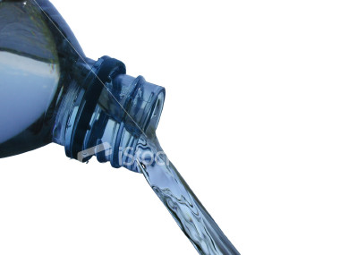
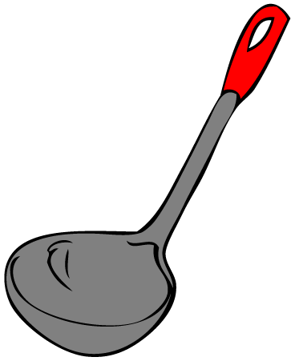
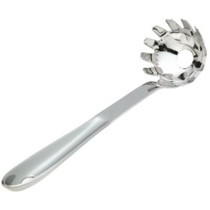
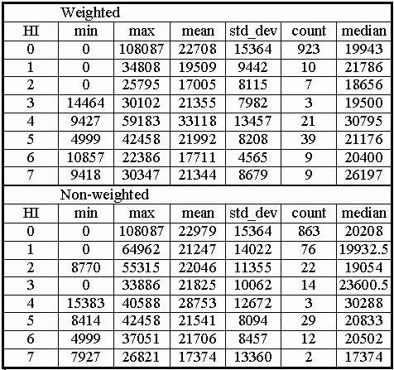
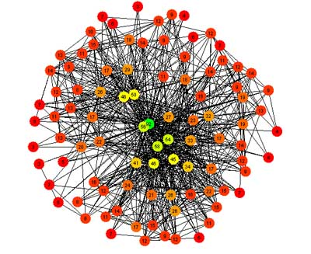


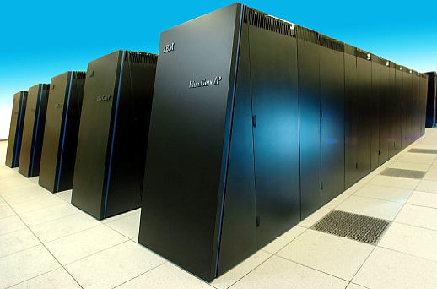
An Open Analytics Environment
Programs
& rules in
Data
in
Results out
“No limits”
Storage
Computing
Format
Program
Allowing for
Versioning
Provenance
Collaboration
Annotation

Slide 8
o·pen [oh-puhn] adjective
having the interior immediately accessible
relatively free of obstructions to sight, movement, or internal arrangement
generous, liberal, or bounteous
in operation; live
readily admitting new members
not constipated

Slide 9
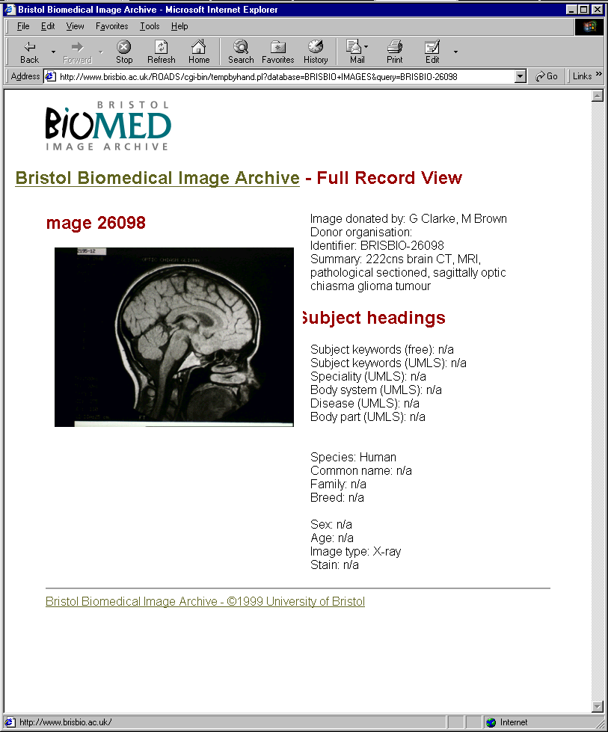
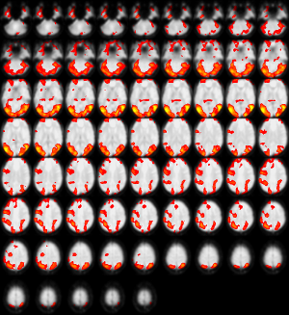

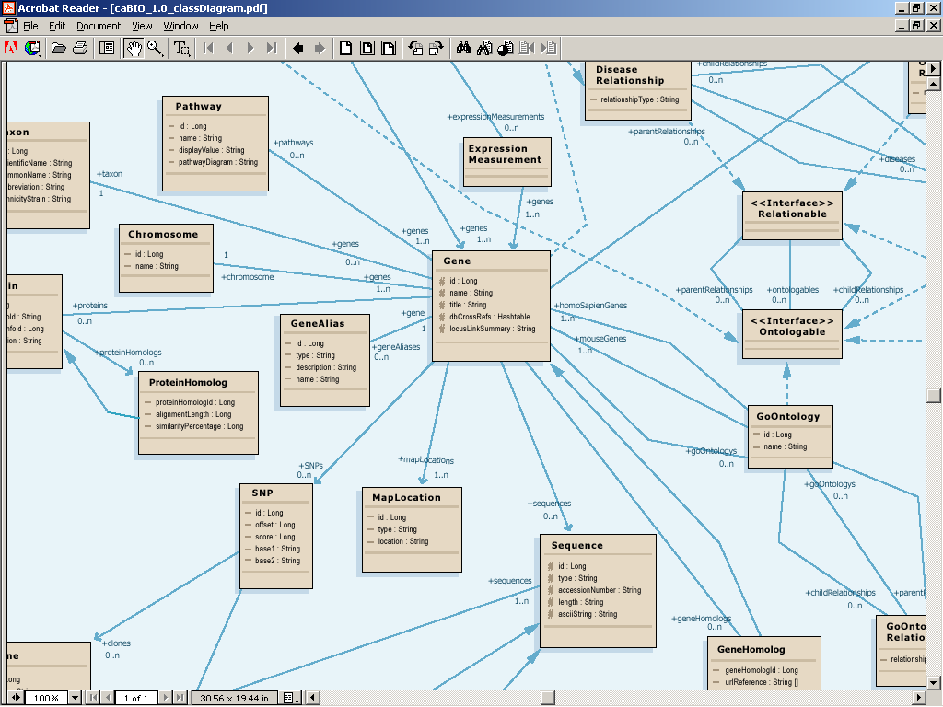
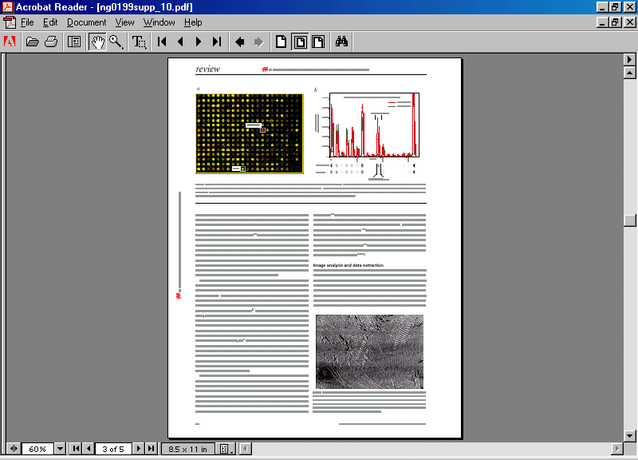

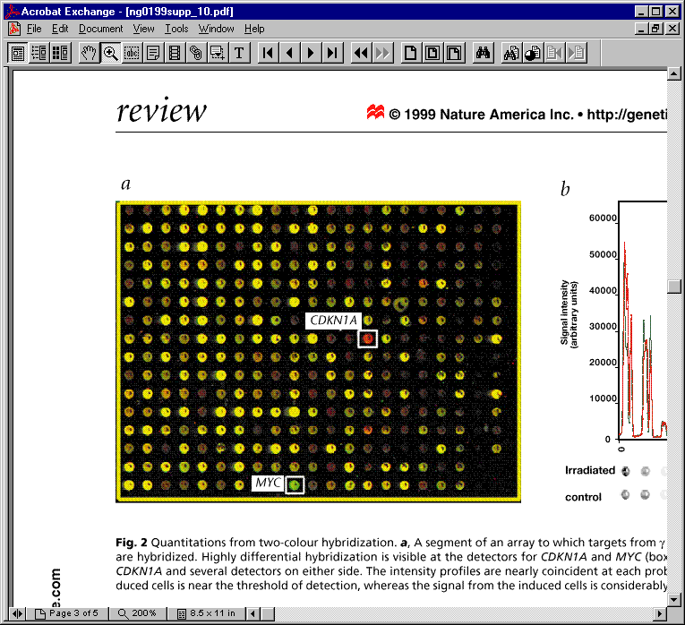
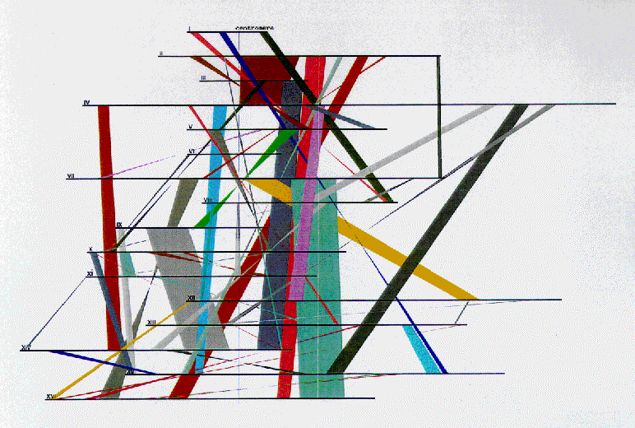
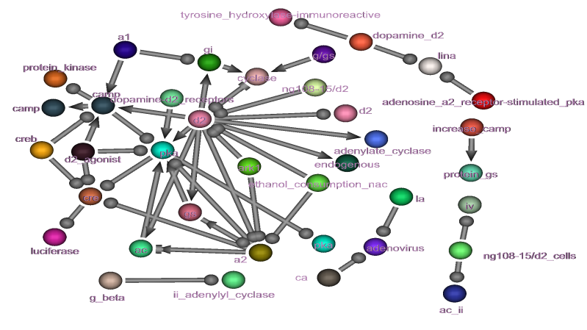

What Goes In (1)

Slide 10
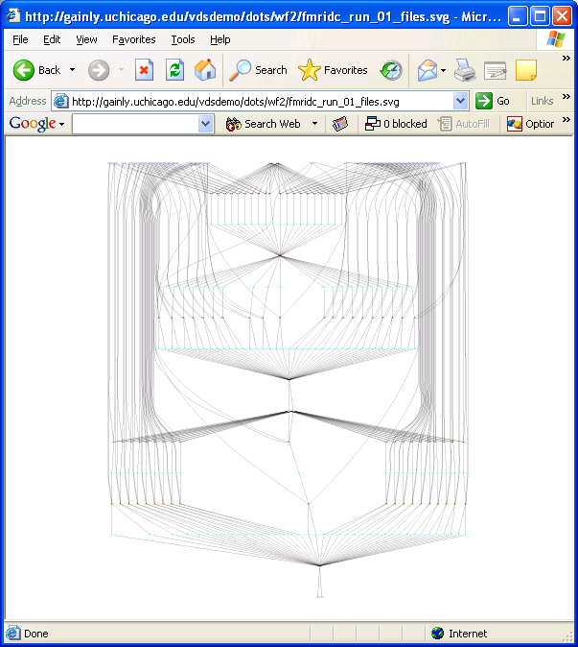
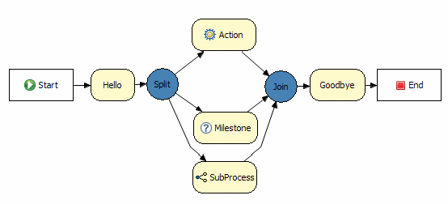
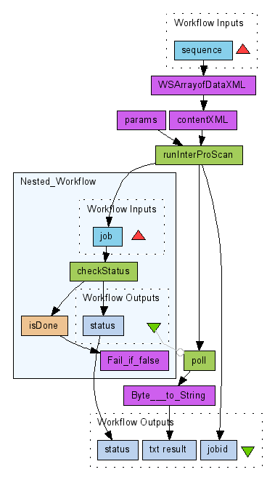
What Goes In (2)
Rules
Parallel programs
Swift
MapReduce
Workflows
R
MatLab
Dryad
SQL
Octave
BPEL
SCFL

Slide 11
How it Cooks
Virtualization
Run any program, store any data
Indexing
Automated maintenance
Provisioning
Policy-driven allocation of resources to competing demands

Slide 12

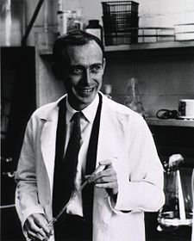

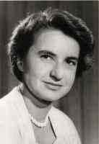
What Comes Out
Data
Data

Slide 13
Analysis as (Collaborative) Process
Transform
Annotate
Search
Add to
Tag
Visualize
Discover
Extend
Group
Share

Slide 14
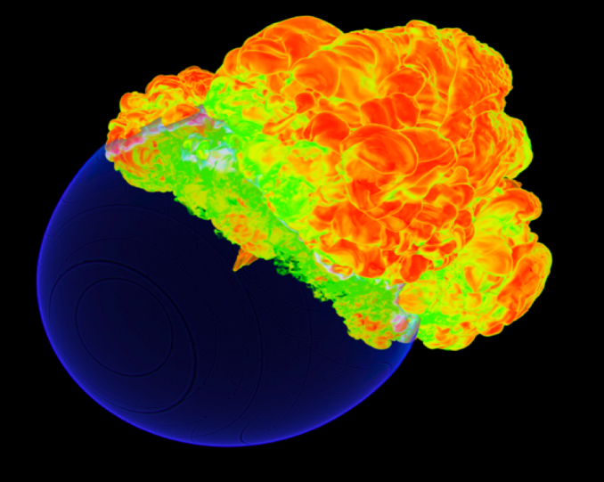
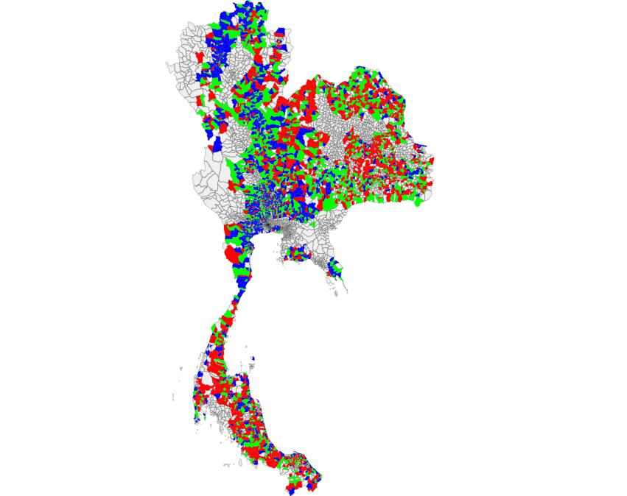
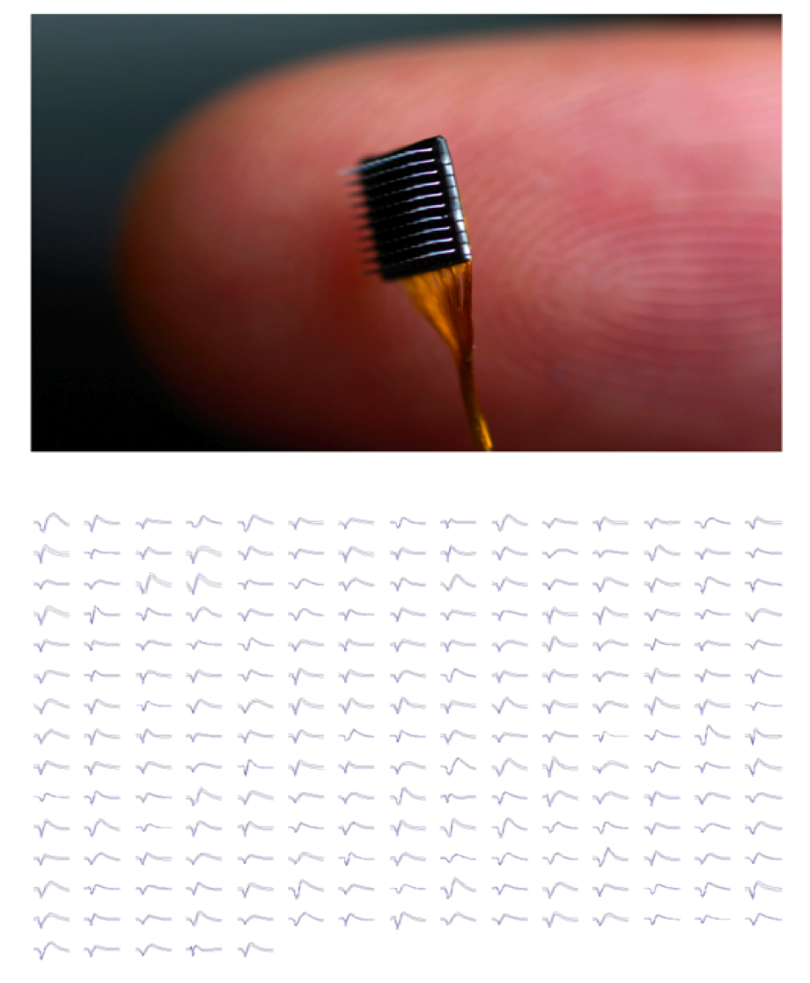
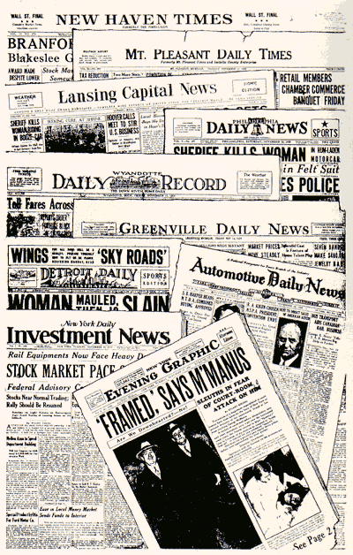
Data Cauldron @ U.Chicago: Applications
Astrophysics
Cognitive science
East Asian studies
Economics
Environmental science
Epidemiology
Genomic medicine
Neuroscience
Political science
Sociology
Solid state physics

Slide 15
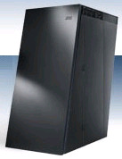
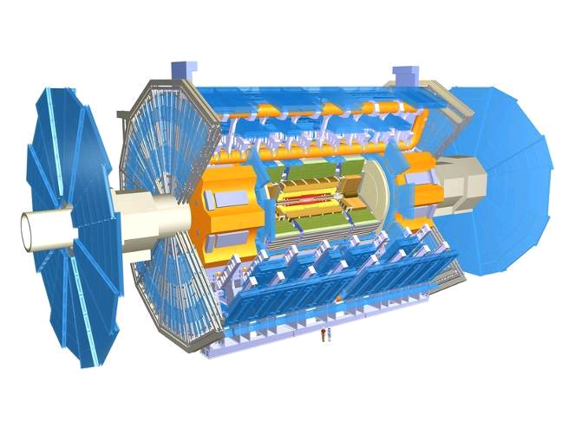
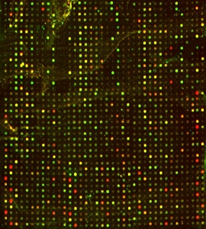
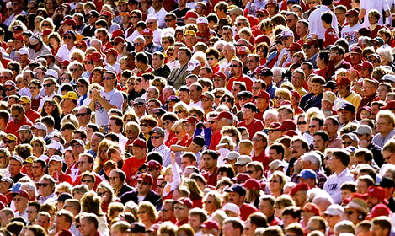
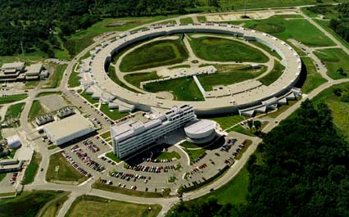

Data Cauldron @ U.Chicago: Hardware
1000 TB tape backup
Dynamic provisioning
500 TB reliable storage (data, metadata)
Parallel analysis
Diverse data sources
P A D S
Remote access
180 TB,
180 GB/s
17 Top/s
analysis
Diverse users
Data
ingest
Offload to remote data centers

Slide 16
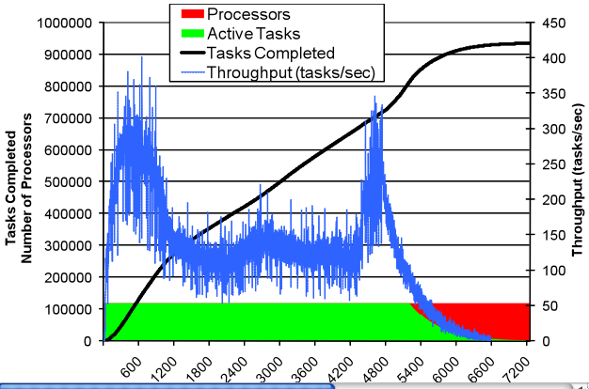
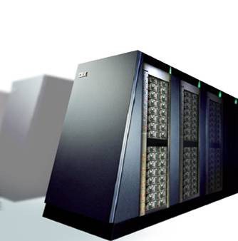

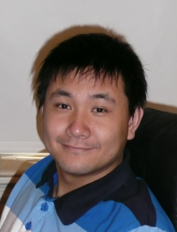
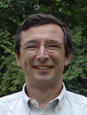
DOCK on BG/P: ~1M Tasks on 118,000 CPUs
CPU cores: 118784
Tasks: 934803
Elapsed time: 7257 sec
Compute time: 21.43 CPU yr
Average task time: 667 sec
Relative Efficiency: 99.7%
(from 16 to 32 racks)
Utilization:
Sustained: 99.6%
Overall: 78.3%
Time (secs)
Ioan Raicu
Zhao Zhang
Mike Wilde

Slide 17
Data Cauldron @ U.Chicago:Methods
HPC systems software (MPICH, PVFS, ZeptOS)
Collaborative data tagging (GLOSS)
Data integration (XDTM)
HPC data analytics and visualization
Loosely coupled parallelism (Swift, Hadoop)
Dynamic provisioning (Falkon)
Service authoring (Introduce, caGrid, gRAVI)
Provenance recording and query (Swift)
Service composition and workflow (Taverna)
Virtualization management (Workspace Service)
Distributed data management (GridFTP, etc.)

Slide 18


High-PerformanceData Analytics
Functional
MRI
Ben Clifford, MihaelHatigan, Mike Wilde,
Yong Zhao

Slide 19
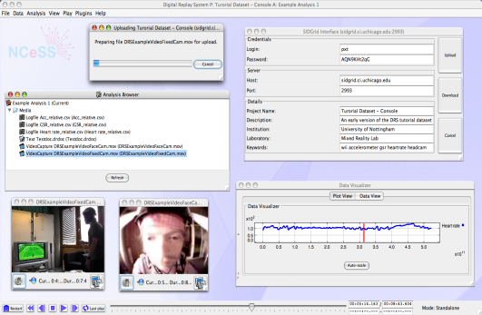
Social Informatics Data Grid (SIDgrid) Collaborative, multi-modal analysis of cognitive science data
Diverse experimental
data & metadata
Browse data
Search
Content preview
Transcode
Download
Analyze
SIDgrid
Bennett Berthenthal Mike Papka Mike Wilde
… and others
TeraGrid
PADS
…

Slide 20
A Vast and Endless Sea …
Programs
& rules in
Data
in
Results out
“No limits”
Storage
Computing
Format
Program
Allowing for
Versioning
Provenance
Collaboration
Annotation

Slide 21
