Slide 2
Ontologies on the Web
Jim Hendler
RPI
http://www.cs.rpi.edu/~hendler

Slide 3
Ontologies on the Web…
Widely varying ideas of what we are after:
  Ontology: provide a definitive and exhaustive classification of entities in all spheres of being” (Smith 2003).
  Ontology: an abstract, simplified view of the world that we wish to represent for some purpose (Gruber 1995)
This talk will look at some of the emerging models and ongoing work, and explore some of the research
and development challenges new models of Web
ontologies present

Slide 4
From a Pragmatic Viewpoint..
"The solution to any problem in AI may be found in the writings of Wittgenstein, though the details of the implementation are sometimes rather sketchy.” (Hirst, 2000)
This talk aims at exploring "implementation details" for "knowledge" on the Web
  Individual and Collective

Slide 5
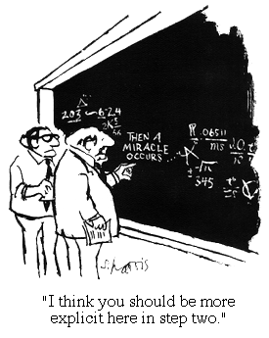
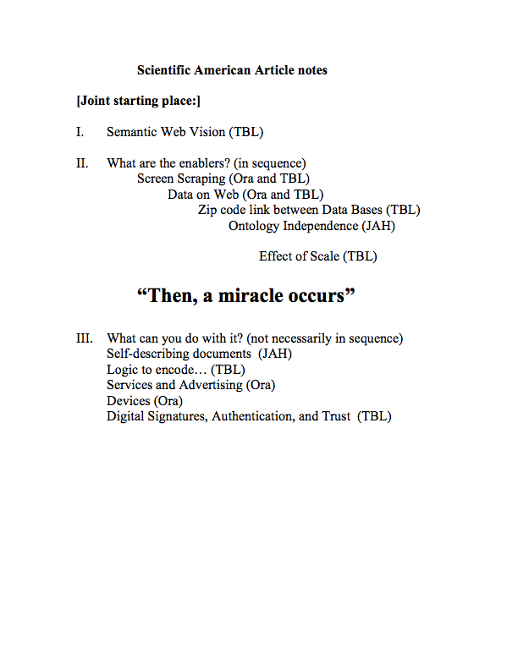
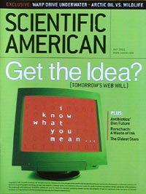
The Semantic Web (ca. 2001)

Slide 6
Semantic Web ca. 2008
Semantic Web companies starting & growing
  Siderean, SandPiper, SiberLogic, Ontology Works, Intellidimension, Intellisophic, TopQuadrant, Data Grid, Mondeca, ontoPrise…
  Web 3.0 new buzzword: Garlik, Metaweb, RadarNetworks, Joost, Talis, …
  (not to mention Powerset)
Bigger players buying in
  Adobe, Cisco, HP, IBM, Microsoft™, Nokia, Oracle, Sun, Vodaphone, Yahoo!, Reuters, …
  Gartner identifies Corporate Semantic Web as one of three "High impact" Web technologies
  Tool market forming: AllegroGraph, Altova, TopBraid, …
Government projects in and across agencies
  US, UK, EU, Japan, Korea, China, India…
Several "verticals" heavily using Semantic Web technologies
  Health Care and Life Sciences
    Interest Group at W3C
  Financial services
  Human Resources
  Sciences other than Life Science
    Virtual observatory, Geo ontology, …
Many open source tools available
  Kowari, RDFLib, Jena, Sesame, Protégé, SWOOP, Pellet, Onto(xxx), Wilbur, …
SW now becoming "visible" on the Web

Slide 7
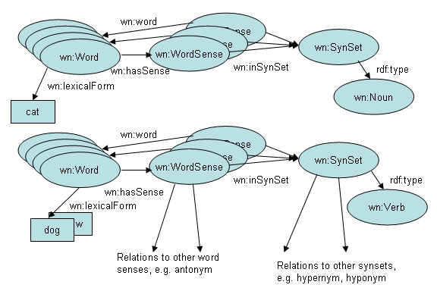
An Emerging Area of Promise
While "folksonomy" has not been a big win, lexical semantics are showing great promise
  the relations between words and/or the contexts they appear in can be powerful
    cf. the links and context that power Google
    cf. Powerset and other "Semantic Search" engines
  Wordnet, a "lexical ontology" is an example source of power

Slide 8
But There are Known Problems
Traditional Language issues
  Latent Semantics
  Cross-language problems
  Social Context requirements
  Culture issues
  Personalization and individual differences
Non-linguistic resources are a growing percentage of the Web
  Image markup/search promising, but restricted
    Precision very low
  Video, multimedia, "new media" present huge challenges
  Data integration, search, interoperability gets a failing grade

Slide 9
Traditional AI Knowledge Representation
Relation between contents can be defined as logical entailments in a formal system
  Student(?x) => Person(?x)
  In this view, ontology is defined as the formal domain model for some segment of the world
Which is often criticized (rightly) for
  Complexity/Undecidability
  Definitional adequacy
  Knowledge Engineering bottleneck
  Grounding

Slide 10
Seeing New Life as Part of the Semantic Web
Web ontology language OWL
  A small set of terms, formally defined to produce specific entailments
    i.e. given some facts, specify the mandated entailments (All and Only)
    A standard for the Web
      High buy in from many in the "KR" community
      Some buy in from many in the Web Application community
    Most used KR language in history (by many orders of magnitude)
      Depending on how you ask, Google finds thousands to tens of thousands OWL ontologies
So why is it working this time?

Slide 11
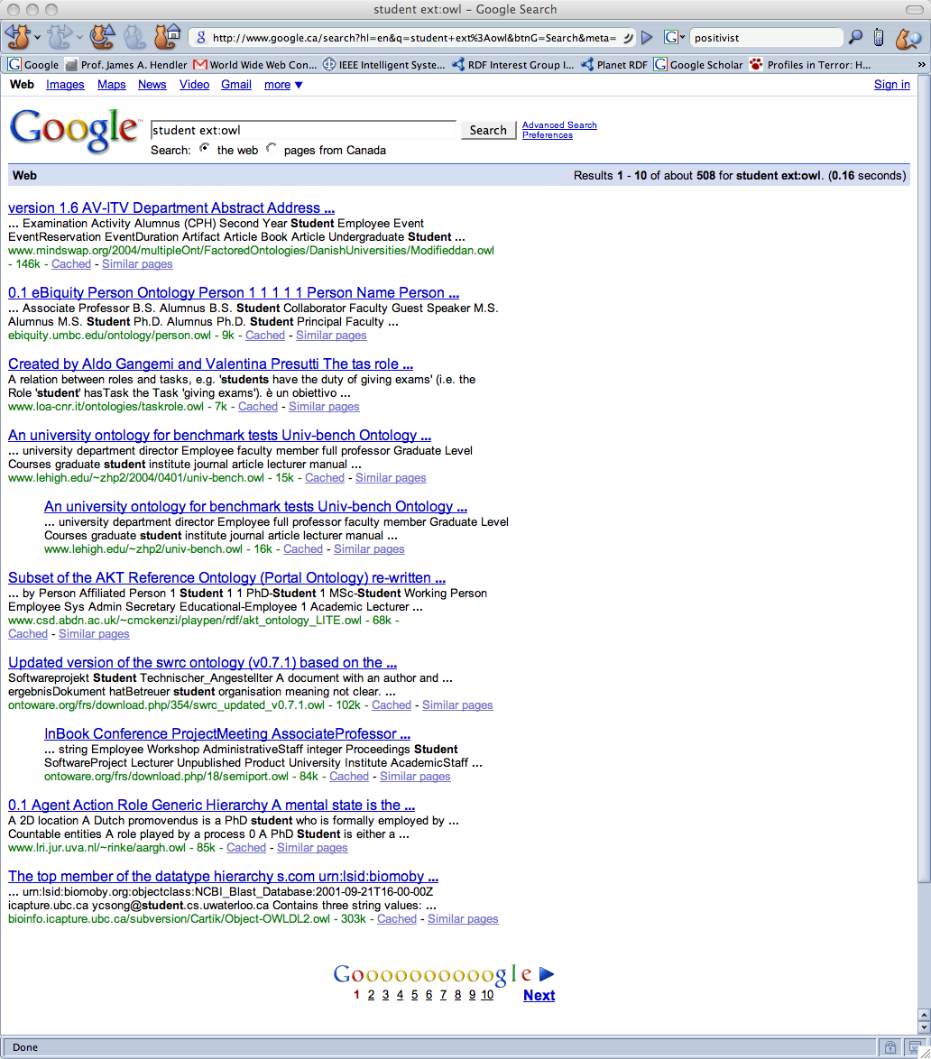
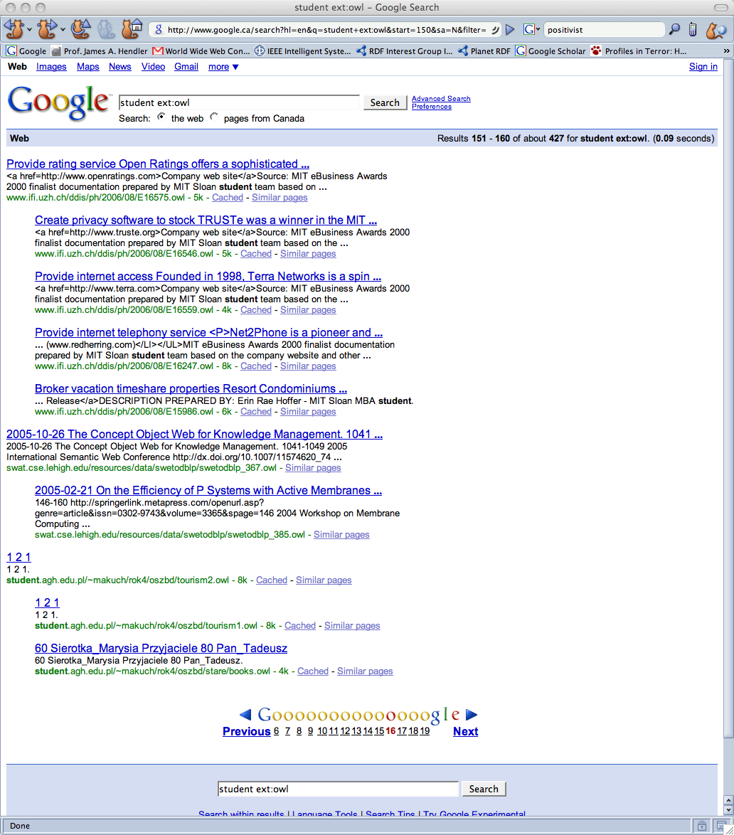
Google for "student ext:owl"
…

Slide 12
Widely Varying Use Cases
cf. US National Center for Biotechnology Information, "Oncology Metathesaurus"
  50,000+ classes, ~8 people supporting full time, monthly updates, mandated for use by NIH-funded cancer researchers
    OWL DL rigorously followed
    Provably consistent
cf. Friend of a Friend (Foaf)
  30+ classes, Dan Brickley and Libby Miller made it, maintained by consensus in a small community of developers
    Violates DL rules (undecidable)
    Used inconsistently

Slide 13
With Different Costs/Commitments
NCBI Oncology Ontology
  High use in medical community
  High cost for specific representational need
  Not much data on the web
FOAF
  ~60M Foaf people (not necessarily distinct individuals)
  Used by a number of large providers
    If you use LiveJournal, you have a FOAF file
      Also flickr, ecademy, tribe, joost, …
      And you can export Foaf from Facebook and many other social networking sites
  Becoming de facto standard for open social networking

Slide 14
Why?
CLAIM SET 1: Formal properties
  Based on a decidable subset of KR
    Description logics
  For which much scaling research has been happening
    Ca. 2000 - 10,000 axioms, no facts, 1 day
    Ca. 2008 - 50,000 axioms, million facts, 10 min.
      Not just faster computers (but Moore's Law helps), significant research into optimization, "average case"
      Moving to parallel (Web server)
  With some new ways of linking to larger data sets
    SHER, IBM, "reduced Abox"
    OWL-Prime, Oracle, "materialized views"
In this view OWL is a formal KR standard

Slide 15
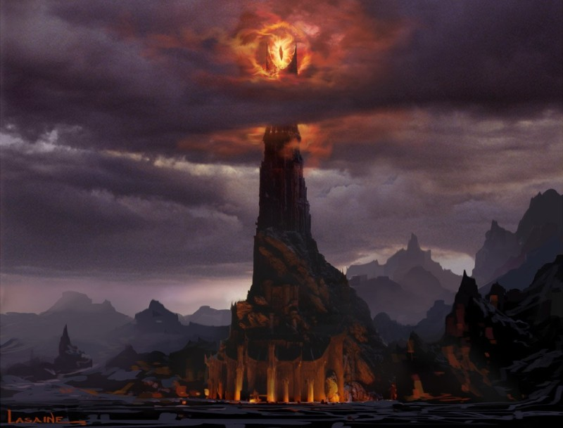
Ontology: the Formal KR view
Ontology as Barad-Dur (Sauron's tower):
  Extremely powerful!
  Patrolled by Orcs
    Let one little hobbit in, and the whole thing could come crashing down
Decidable Logic basis
inconsistency

Slide 16
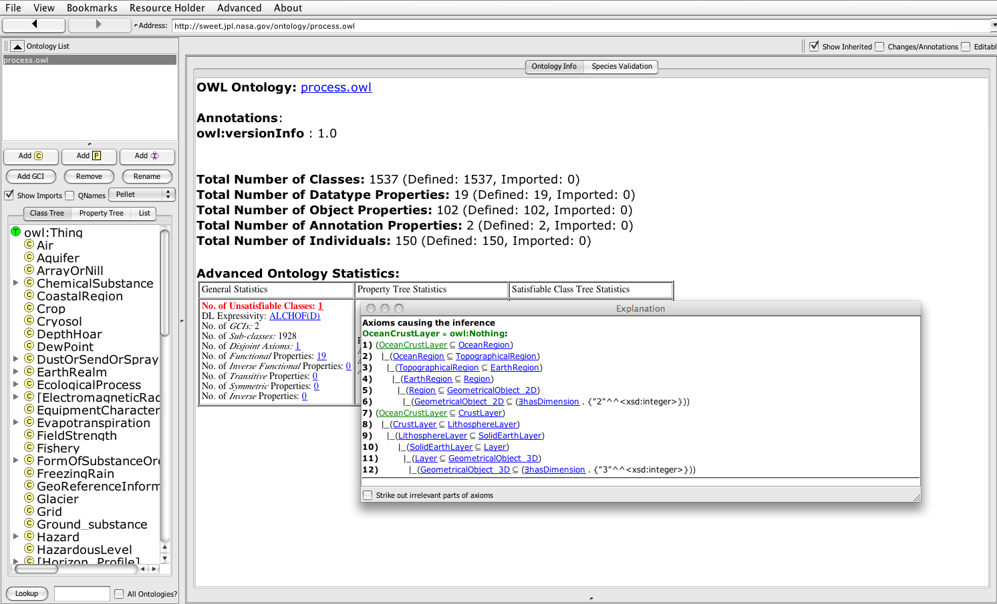
Inconsistency is the Bane of this view
1537 classes,
1 modeling error
= failure!
(Swoop w/Pellet)

Slide 17
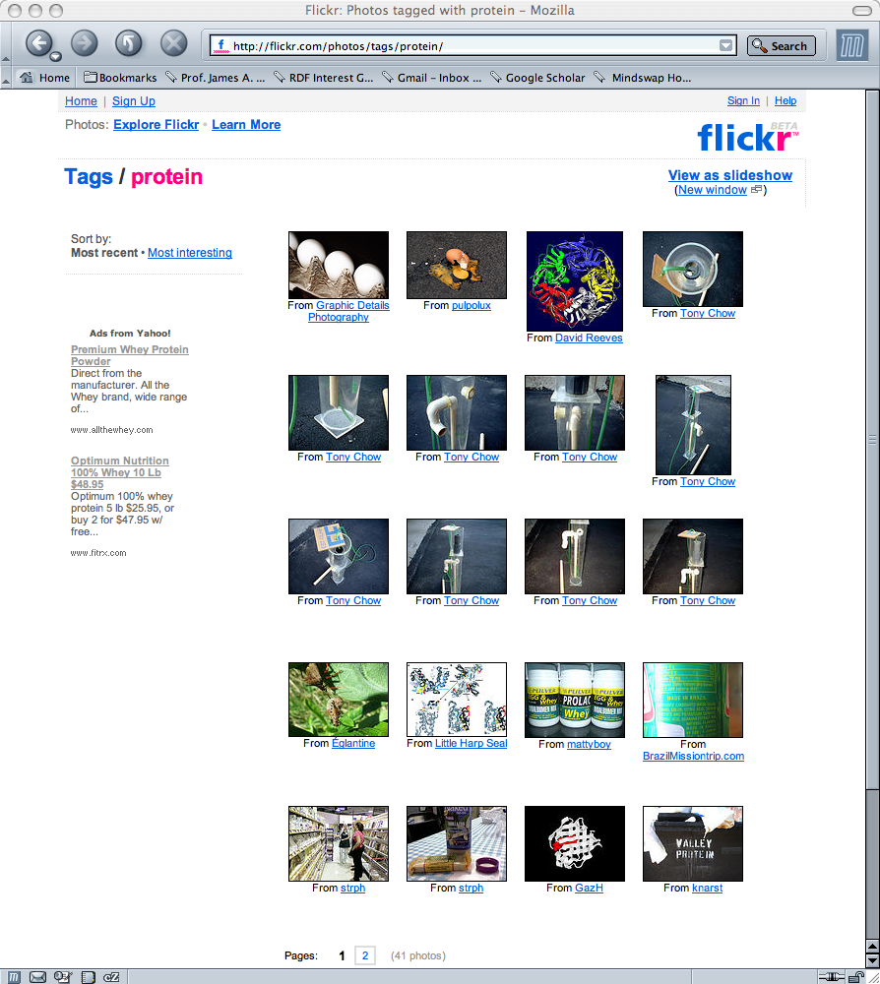
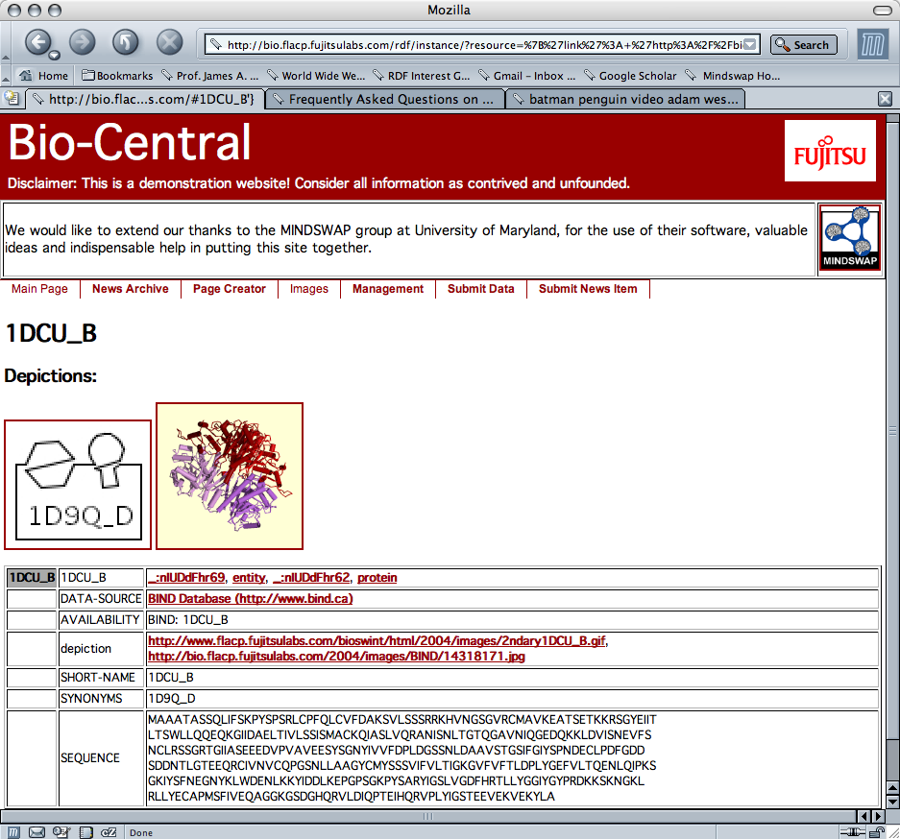
The Argument For this is Often Compelling
When "folksonomy" isn't enough…
Which one do you want your doctor to use?

Slide 18
Goal: Reasoning over (Enterprise) data
Formal modeling finds its use cases in verticals and enterprises
  Where the vocabulary can be controlled
  Where finding things in the data is important
Example
  Drug discovery from data
    Model the molecule (site, chemical properties, etc) as faithfully and expressively as possible
    Use "Realization" to categorize data assets against the ontology
      Bad or missed answers are money down the drain
But the modeling is very expensive and the return on investment must be
very high!
  Which is part of why the "expert systems revolution" wasn't one
  Became part of the technology tool kit, a useful niche in the programming pantheon, but didn't change the world

Slide 19
The Alternative View
OWL is based on RDF, a language designed for the (Semantic) Web
  Built with Web architecture in mind
    Exploits Web infrastructure, respects W3C TAG recommendations
      Internationalization, accessibility, extensibility
  Fits the Web culture
    Open and extensible, supports communities of interest
      If you don't like my ontology, extend it, change it, or build your own
    Fits the Web application development paradigm
      Scales like "databases"
  With some new ways of linking to formal models
    Heavy use of a small amount of OWL
    Generally used "like it sounds" not like the formal model
      Example "owl:sameAs" debate
OWL is a "webized" ontology language

Slide 20
Goal: Create "Web 3.0"
"Data Web" approach finds its use cases in Web Applications (at Web scales)
  A lot of data, a little semantics
  Finding anything in the mess can be a win!
Example
  Declare simple inferable relationships and apply, at scale, to large, heterogeneous data collections
    eg. Use InverseFunctional triangulation to find the entities that can be inferred to be the same
      These are "heuristics" not every answer must be right (qua Google)
      But remember time = money!

Slide 21
Web 3.0 is Happening
~2006: Web app developers discover the Semantic Web
Web App
HTTP
(w SPARQL)
RDF
Triple
Store
Dynamic
Content
Engine
HTML
RDF
Triple
Store
RDF
…
examples include not just the "Web 3.0" players,
but also sites from Dow Jones and Reuters to Yahoo!

Slide 22
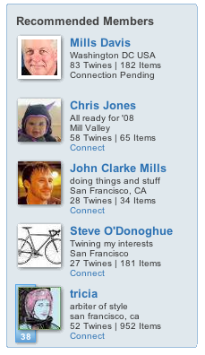
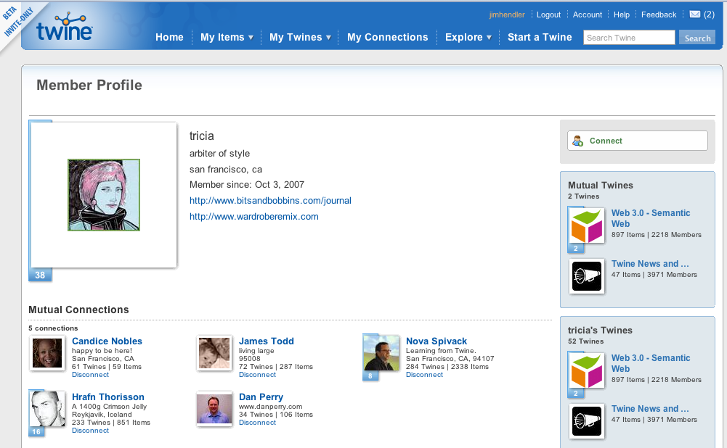
How Do these Applications Ignore Completeness?
Twine recommends some people I may want to connect to
  What is correctness in this case?
    If I find some folks I like this way, I use twine more. Surprises
    can be fun
  I'm only seeing a few of a very large set (think Google) so "first" is more important than "there somewhere"

Slide 23
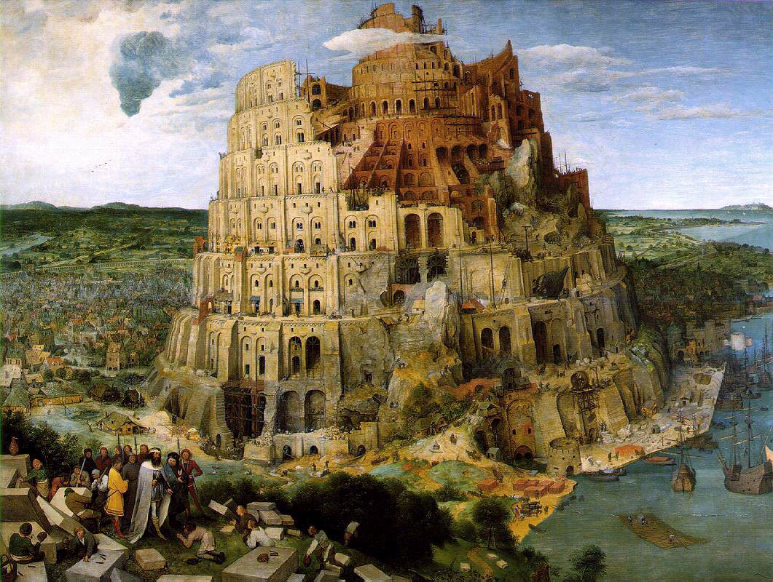
Ontology: the Webbie view
Ontology and the tower of Babel
  We will build a tower to reach the sky
  We only need a little ontological agreement
    Use Wordnet or other "linguistic" constructs
Genesis 11:7 Let us go down, and there confound their language, that they may not understand one another's speech. So the Lord scattered them abroad from thence upon the face of all the earth: and they left off to build the city.

Slide 24
Avoiding Babel
The essential process in webizing is to take a system which is designed as a closed world, and then ask what happens when it is considered as part of an open world. Practically, this effect on a computer language is to replace the names/ tokens/identifiers for URIs. Thus, where before reference could only be made to something in the same document/ program/module one can with equal ease make reference to something in a different one somewhere in that abstract space which is the Web. (Berners-Lee, 1998)

Slide 25
Advantages
Why ground terms in URIs?
  "student" ≠ http://www.cs.rpi.edi/~hendler/Twgroup.owl#student
  Can recognize equality (same URI = same concept)
  Can assert equality (URI1 owl:sameAs URI2)
  Can assert inequality (URI1 owl:differentFrom URI2)
  Can combine (URI1 foaf:depicts URI2 foaf:name "Jim Hendler")
Other advantages
  Infinitely extensible name space
  Can be dereferenced
    Click on the term, see the definition (and thus know the entailments)
    Ubiquitously implemented (from server to phone)
  Well understood social conventions
    RPI's server maintains, and user hendler controls, the URI above
  And can be displayed in any browser anywhere in the world
    (and w/labels in different languages, character ses, etc.)

Slide 26
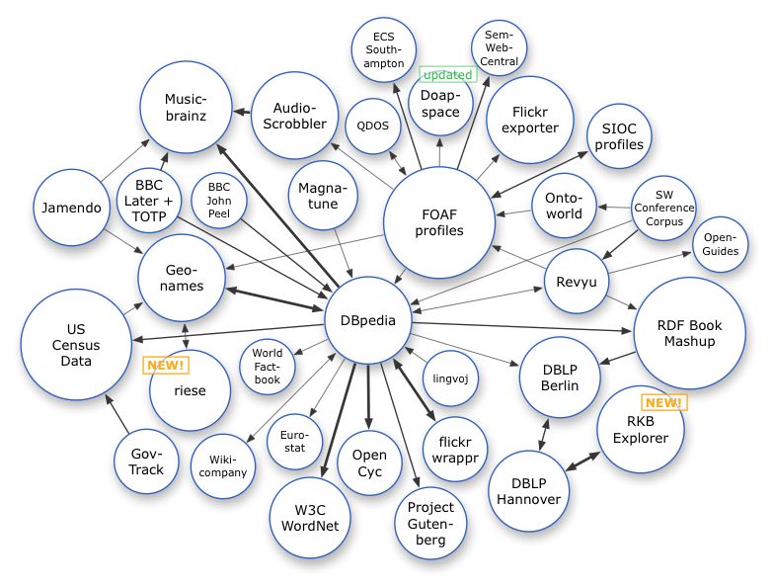
The linked open data cloud now has billions of assertions,
and is growing rapidly

Slide 27
Linking is Power
Today we can find thousands of ontologies
  Available on the Web
    Linked to Web resources
    Linked to data resources
    Linked to each other
    Linked to Web 2.0-like annotations
And billions of annotated (semi-Knowledge
engineered) objects
  Available on the Web
    Linked to Web resources
    Linked to data resources
    Linked to each other
    Linked to the ontologies
Many Large (and curated) "Vocabularies" for
Grounding Applications
  Natl Library of Agriculture (SKOS)
  NCI Ontology (OWL)
  Getty Catalog (OWL, licensed), UMLS (RDFS, licensed),
  GeoNames (RDF), PlaceNames (OWL, proprietary)
  …

Slide 28
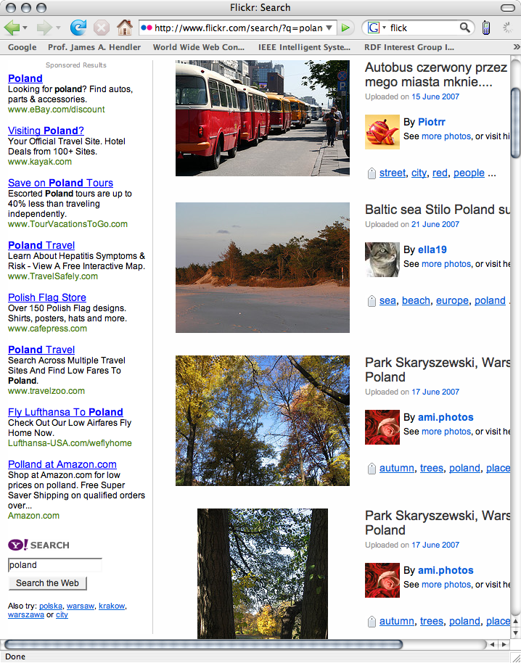
Example: Seeded Tagging
Place names
http://ex.com/places#poland
poland
Lublin
Lubusz

Slide 29
Network Effect
Dopplr
http://ex.com/places#poland
Freebase
http://ex.com/places#poland
http://ex.com/places#poland
http://ex.com/places#poland
LiveJournal
twine

Slide 30
The Wine Ontology (wine.owl)
Original view: Consensus knowledge of wine and food
  Lots of debate in its creation
  Eventually completed with "correct" wine recommendations
    You disagree, tough! You're wrong.

Slide 31
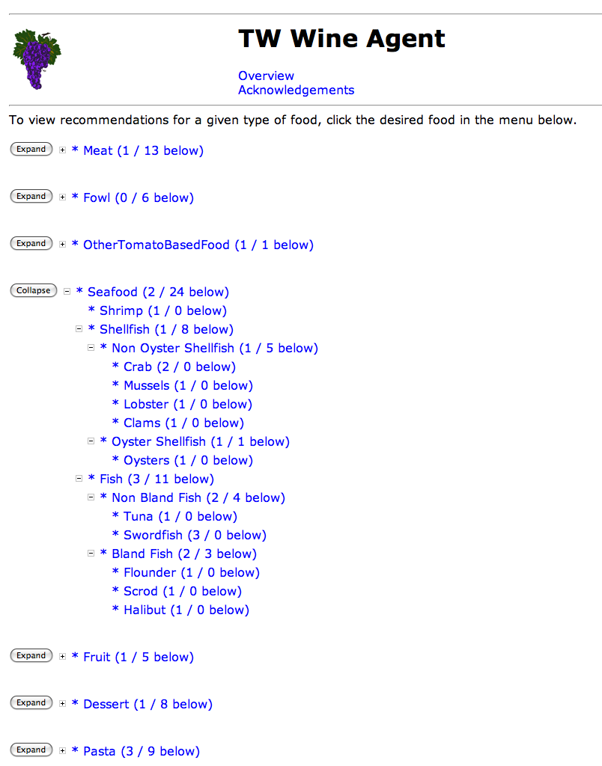
Wine Ontology Take II

Slide 32
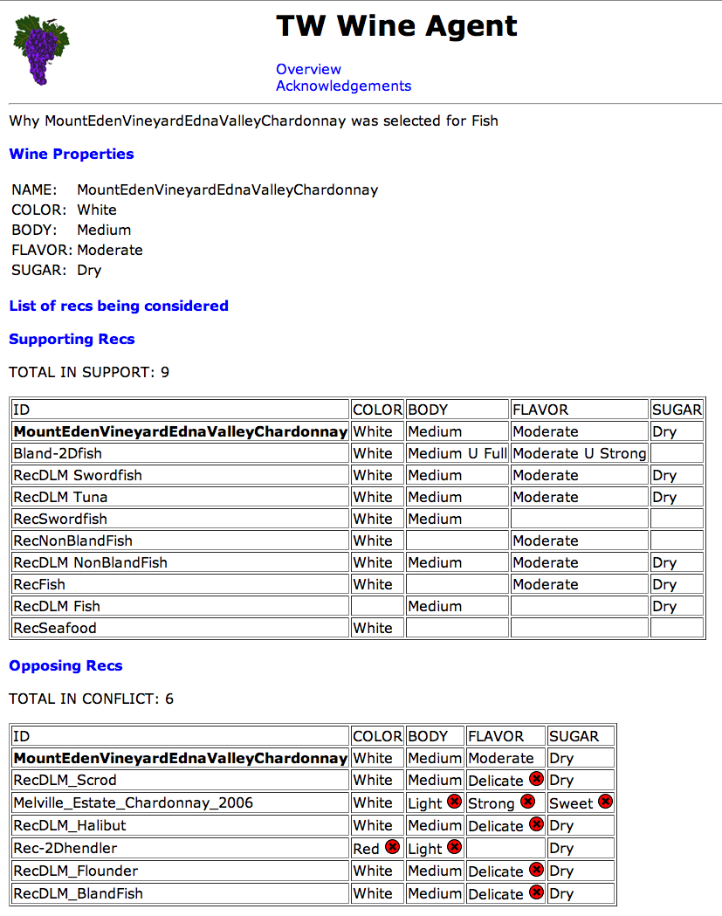

Slide 33
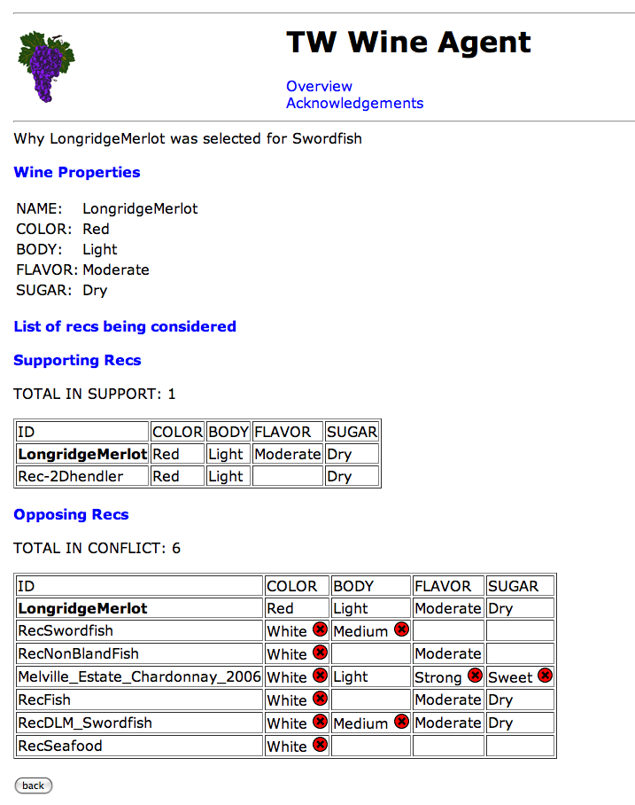

Slide 34
The New Challenge…
What do we do with all this stuff?
* The primary goal is to for submissions to show how they add value to the very large triple store. This can involved anything from helping people figure out what is in the store via browsing, visualization, etc; could include inferencing that adds information not directly queriable in the original dataset; could involve showing how ontological information could be tied to part(s) or the whole of the dataset; etc.
* The tool or application has to make use of at least a significant portion of the data provided by the organizers.
* The tool or application is allowed to use other data that can be linked to the target dataset, but there is still an expectation that the primary focus will be on the data provided.
* The tool or application does not have to be specifically an end-user application, as defined for the Open Track Challenge, but usability is a concern. The key goal is to demonstrate an interaction with the large data-set driven by a user or an application. However, given the scale of this challenge, solutions that can be justified as leading to such applications, or as crucial to the success of future applications, will be considered.
(ISWC 2008 - Open Web, Billion Triple Challenge)
http://iswc2008.semanticweb.org/calls/call-for-semantic-web-challenge-and-billion-triples-tracks/

Slide 35
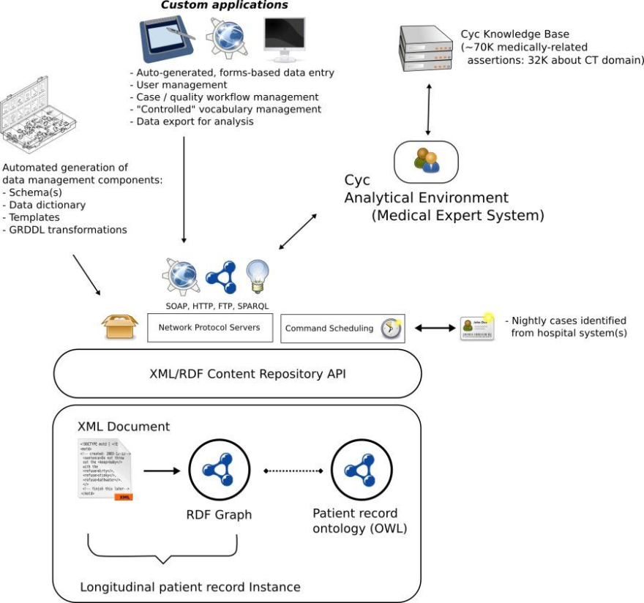
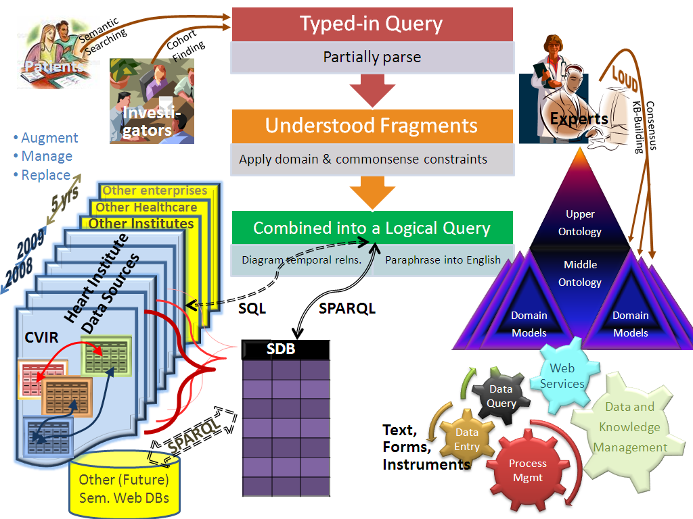
Integrating the Approaches
Cf. Cleveland Clinic "Semantic DB" effort
OR ≠ XOR

Slide 36
Why Does this Matter?
Different issues of concern
  Confuses messaging
    Empowers Semantic Web critics
Effort is spent in different parts of the space
  i.e. scaling vs. modeling
    Leads to confusion in costs, esp. for interested parties
    Starting out: You must know which O/o you're going after
Different "first-concern" tools for the different models
  traditional ontology creation and modeling
  Web 3.0: triple store scaling and SPARQL extensions
Different challenges to research community
  Traditional AI concerns outweighed by others in this space
    Analogy,:Data management ca. 1950s

Slide 37
Summary
Lightweight ontologies near data a growing part of the (Semantic) Web
  Grounds in URIs
    Critical! Without it no linking, no network effect
  RDF/OWL being used on tens of millions of web pages
    Early 90s web scale and growing
  New "informal" models seem to be emerging
    New efforts explore how to link these with traditional AI models
    Research challenges in the new domain largely unexplored

Slide 38

© 2008 Microsoft Corporation. All rights reserved. Microsoft, Windows, Windows Vista and other product names are or may be registered trademarks and/or trademarks in the U.S. and/or other countries. The information herein is for informational purposes only and represents the current view of Microsoft Corporation as of the date of this presentation. Because Microsoft must respond to changing market conditions, it should not be interpreted to be a commitment on the part of Microsoft, and Microsoft cannot guarantee the accuracy of any information provided after the date of this presentation. MICROSOFT MAKES NO WARRANTIES, EXPRESS, IMPLIED OR STATUTORY, AS TO THE INFORMATION IN THIS PRESENTATION.

