Slide 1

AI Meets Markets:
Trading Agents & Strategic Reasoning
Michael P. Wellman
University of Michigan

Slide 2
Trading Agent
A software program
that makes decisions autonomously
about bidding in electronic markets

Slide 3
Research In Trading Agents
Trading domains
  Financial markets
  B2B marketplaces
  Specialized:
    Spectrum
    Electricity
    Advertising
    Prediction markets
    …
  Simulations and
  abstract mechanisms
Research issues
  Agent architecture
  Techniques
    Forecasting
    Learning
    Optimization
    …
  Strategic analysis
  Design methodology
  Effect of automated
  trading on markets

Slide 4
A Trading Agent Competition
An open invitation market game
Why hold a competition?
  Do research on trading agents, but get others to write the agents
  Focus effort on common problem
  Measure progress as experience accumulates

Slide 5
Trading Agent Competition (TAC)
Open-invitation int’l tournaments, featuring market games
18-43 entrants/year, worldwide
Travel-shopping scenario (2000–06)
  Designed at U Michigan
  Focus: interdependent markets, multiple market types
Supply Chain Mgmt (SCM) game (2003–)
  Designed at CMU, SICS
  Focus: Multi-tier mult-iattribute negotiation, intertemporal
CAT Market Design Game (2007–)
  Designed at U Liverpool, U Southampton, Brooklyn College

Slide 6
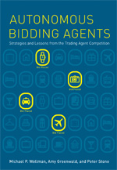
TAC Travel: The Book
Autonomous Bidding Agents
Strategies and Lessons from the Trading Agent Competition
Michael P. Wellman, Amy Greenwald, and Peter Stone
(MIT Press, July 2007)

Slide 7
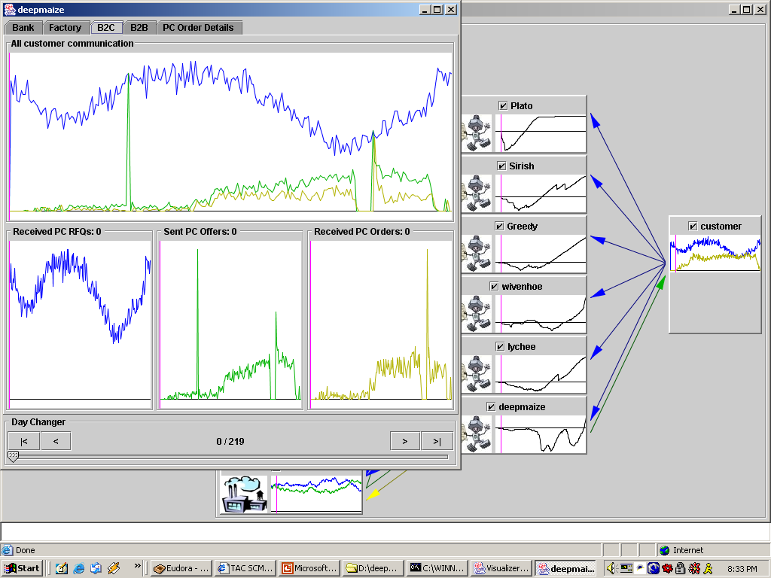
TAC/SCM Configuration
suppliers
Pintel
Manufacturer 1
CPU
IMD
component RFQs
Manufacturer 2
Basus
PC RFQs
Motherboard
supplier offers
Manufacturer 3
PC bids
Macrostar
customer
PC orders
Mec
Manufacturer 4
Memory
component orders
Queenmax
Manufacturer 5
10 component types
16 PC types
220 simulation days
15 seconds per day
Watergate
Hard Disk
Manufacturer 6
Mintor

Slide 8
The Coordination Problem
Decisions interact across markets and time
  If PC demand is rising, build extra component inventory now
  If capacity is constrained, raise selling price and pay premiums
  for critical components
Formulating the entire game as a single optimization is daunting—both computationally and conceptually

Slide 9
Value-Based Decomposition
Decomposition simplifies the problem
  Modularity yields substantial advantages
    Computation
    Software development
  Natural subproblems with local constraints
Need a way to coordinate separate decisions
Solution: Explicit values for resources
  PCs and components

Slide 10
Deep Maize Design
State Estimation
Supplier Market Predictions
Customer Market Predictions
Market
Prediction
Projected Manufacturing Schedule
Coarse
Decisions
PC
Values
Component Values
Supply Purchasing
Specific
Decisions
Customer Bidding

Slide 11
Market Prediction
Supply
Market
Factory
Planning
Sales
Market
Procurement
Sales
Day d
Day d+1
Day d+2
Day d+3
. . .
. . .
. . .
. . .
. . .

Slide 12
Coarse Decisions
Supply
Market
Factory
Planning
Sales
Market
Procurement
Sales
Day d
Day d+1
Day d+2
Day d+3
. . .
. . .
. . .
. . .
. . .

Slide 13
Specific Decisions
Supply
Market
Factory
Planning
Sales
Market
Procurement
Sales
Day d
Day d+1
Day d+2
Day d+3
. . .
. . .
. . .
. . .
. . .

Slide 14
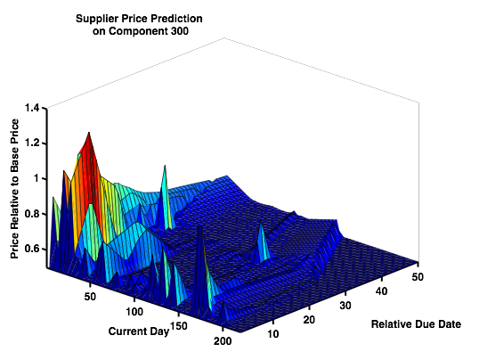
Market Prediction
State Estimation
Supplier Market Predictions
Customer Market Predictions
Market predictions: prices, availability
  Depend on strategic behavior
  of agents
State estimates: demand,
supplier capacities, inventories
Employ a variety of machine learning and modeling techniques

Slide 15
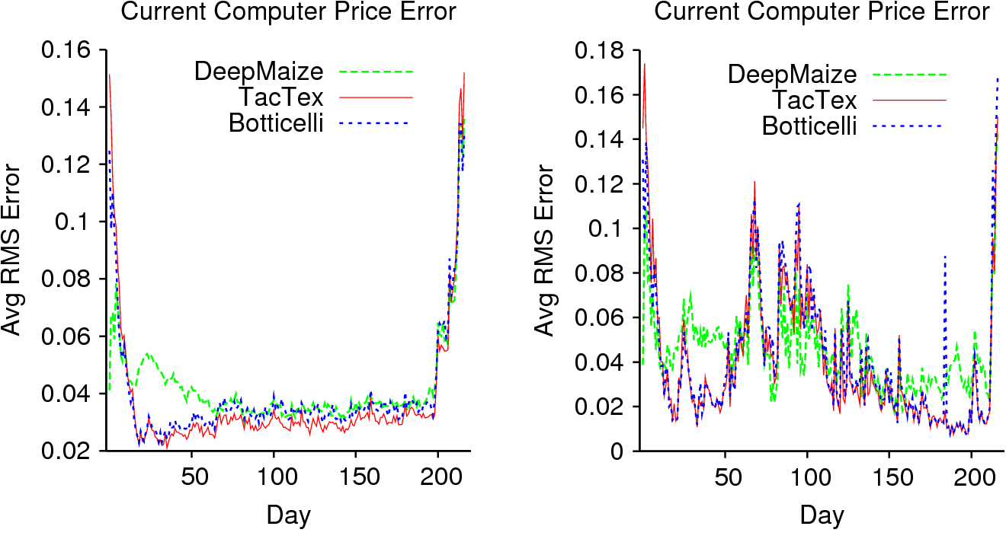
Prediction Challenge
Predicting current computer prices
Sidecompetition to compare performance on prediction subtask
average over all games single game
(Pardoe& Stone, 2008)
avg over all games
single game

Slide 16
Coarse Decisions
Projected Manufacturing Schedule
PC
Values
Component Values
Comprehensive production plan
  All levels of the supply chain
  Future decisions (out to a horizon)
Approximate optimization, subject to cross-cutting constraints:
  Factory capacity
  Inventory availability
Coarse decisions about sales and procurement:
  Sell a PC of type T for delivery on day D
  Buy a component of type T before day D

Slide 17
Specific Decisions
Supply Purchasing
Customer Bidding
Deal with intricacies of supplier/customer interactions
  Specific customer bids to generate desired sales
  Which supplier to buy from
  Lead times for component orders
  Limits of number of RFQs
Very large action spaces
  Anytime search algorithms

Slide 18
Values
Projected Manufacturing Schedule
PC
Values
Component Values
Derive marginal values for components and PCs
  Given type and day
  Relative to projected manufacturing schedule
Purchasing and sales account for these values
Represent information about global conditions
  If PC selling prices are low, component values fall
  If factory capacity is constrained, PC and component values rise

Slide 19
Discussion: Value-Based Decomposition
Accounts for (many) global interactions, yet retains modularity
Values serve as an interface, allowing different techniques in
each sub-problem and prediction task
Deep Maize design makes many approximations for
simplicity and speed
  No iteration of solutions
  Most logical sub-problems are never solved
  Approximate optimization at all stages
See Kiekintveld et al, ACM Conference on
Electronic Commerce, 2006.

Slide 20
TAC/SCM 2008
Held at AAAI-08, Chicago, 15–16 July
  Final round results:
Deep Maize $5.3M U Michigan
TacTex 2.3M U Texas
CMieux –0.8M Carnegie Mellon U
CrocodileAgent –5.4M U Zagreb
Botticelli –5.4M Brown U
Merlion –11.5M Singapore Mgmt U

Slide 21
Strategic Analysis
Tournament result tells only part of the story
  Agent performance depends on other strategies
  Ranking sensitive to tournament structure
Game-theoretic analysis
  Evaluate stability of strategy profiles
  Search profile space for plausible agent configurations
  Problems: Game procedurally defined, too large
  for standard analysis

Slide 22
Empirical Game-Theoretic Analysis
Experimental methodology for MAS, addressing
  Exploration of large strategy spaces
  Use of simulation in lieu of analytic models
Employing game-theoretic criteria for assessing
strategies and guiding search

Slide 23
TAC/SCM Analysis
Strategy space
  Select TAC agents from online repository: Deep Maize, GoBlueOval, Mertacor, MinneTAC, PhantAgent, TacTex, many others
Profile space
  In general, SNprofiles, with symmetry “only” choose(N+S–1,N)
  With N = S = 6, there are 462 distinct symmetric profiles
Reduced games
  Consider a reduced 3-player version of the 6-player
  TAC/SCM game
  Each player controls 2 agents
    Less fidelity, more tractable
    With S = 6, 56 profiles

Slide 24
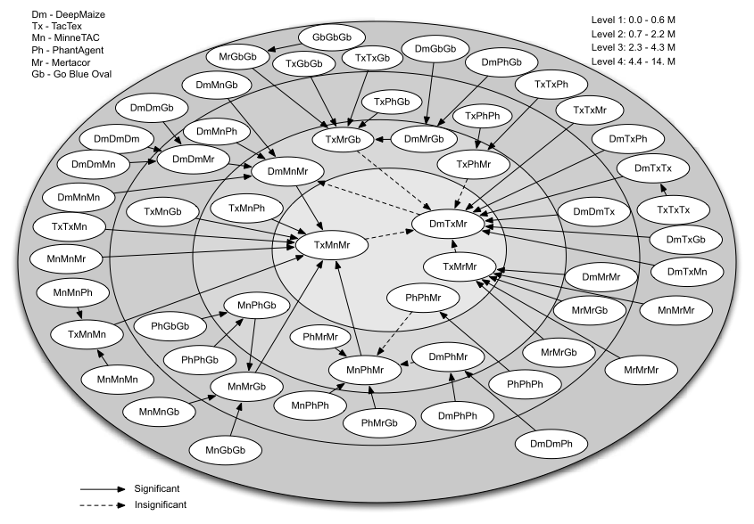
Deviation Graph

Slide 25
Deviation Edge Explained
Best deviation from all-DM profile is to Mr
value of deviation represented in concentric levels

Slide 26
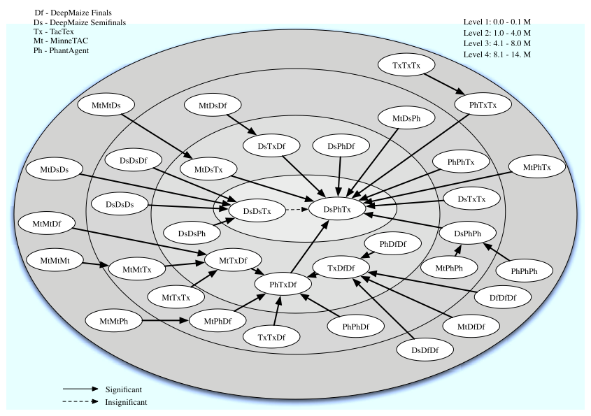
2006 Deviation Graph

Slide 27
Ranking Analysis
Select a background “other-agent” context
  Criterion: stability
  Evolutionary or game-theoretic
Evaluate payoff of each agent in this context

Slide 28

Comparing 05 and 06
Background Context
Deviation Gain ($M)
05 Agent | Mixture
Deep Maize | 8.3%
Mertacor | 43.1%
PhantAgent | 31.4%
TacTex | 17.2%
06 Agent | 2005 Server | 2006 Server
PhantAgent | 5.55 | 6.57
TacTex | 5.07 | 4.73
Deep Maize SF | 4.22 | 4.56
Conclusion: substantial gains in 06

Slide 29
NE-Response Ranking
Agent | Deviation Gain | Finals 05 | Finals 06
TacTex 06 | 0 | n/a | 5.85
PhantAgent 06 | 0 | n/a | 4.15
Deep Maize 06 SF | 0 | n/a | n/a
Mertacor 05 | -0.57 | 0.55 | n/a
Deep Maize 06 F | -0.95 | n/a | 3.58
Maxon 06 S | -1.03 | n/a | n/a
MinneTAC 05 | -1.23 | -0.31 | n/a
PhantAgent 05 | -1.51 | n/a | n/a
Deep Maize 05 | -3.18 | -0.22 | n/a
MinneTAC 06 | -3.48 | n/a | -2.70
TacTex 05 | -5.96 | 4.74 | n/a

Slide 30
Searching For Deep Maize 2008
Find equilibrium among all identified strategies
Search for new strategy with beneficial deviation
Add new strategy to mix, derive new equilibrium
Repeat until tournament deadline
Select strategy from final equilibrium

Slide 31
Other Market Domains
TAC Travel (multiple interdependent auctions)
Abstract market models
  Simultaneous ascending auctions
  Continuous double auctions
Keyword Ad Auctions for Sponsored Search

Slide 32
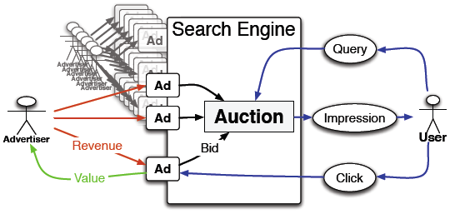
Keyword Ad Auctions
Markets in targeted advertising
Complex strategic issues for advertiser bidders

Slide 33
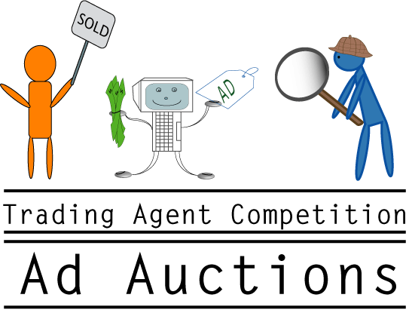
TAC Ad Auction Game
announcing
coming Summer 2009

