Slide 1

Example-Based Texture Synthesis
Li-Yi Wei
Microsoft Incubation

Slide 2
Acknowledgements (sorted alphabetically by last name)
People who allow me to use their materials
Alyosha Efros
Aaron Hertzmann
Sylvain Lefebvre
Yanxi Liu
Jianye Lu
Emil Praun
Ravi Ramamoorthi
Eero Simoncelli
Xin Tong
Co-authors
Sylvain Lefebvre
Vivek Kwatra
Greg Turk

Slide 3
Preliminaries
Some basic stuff to
warm/wake you up

Slide 4
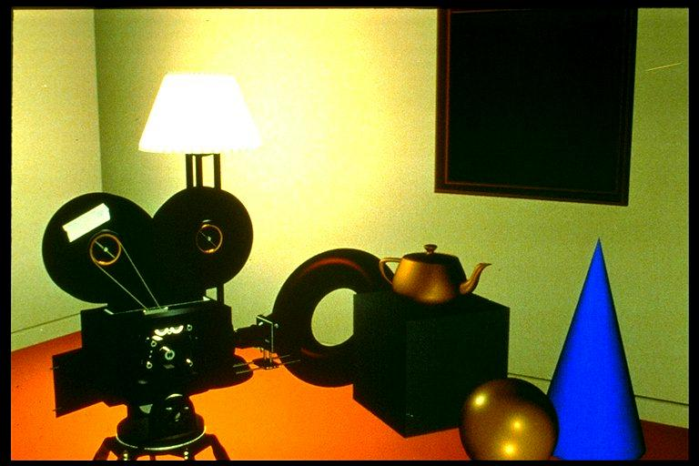
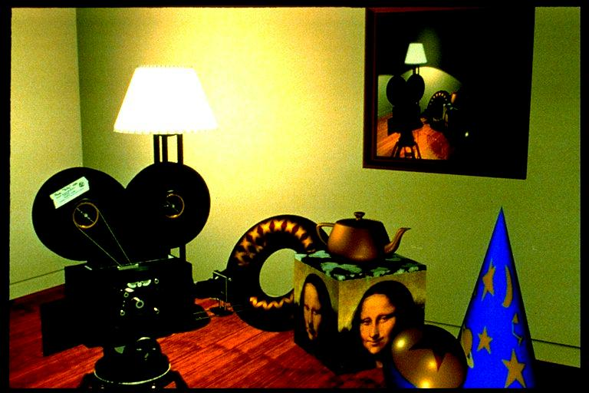
Texturing
Apply texture images to surfaces to represent
Surface color, geometry, material property, etc
Smaller data size, faster computation
not textured
textured

Slide 5
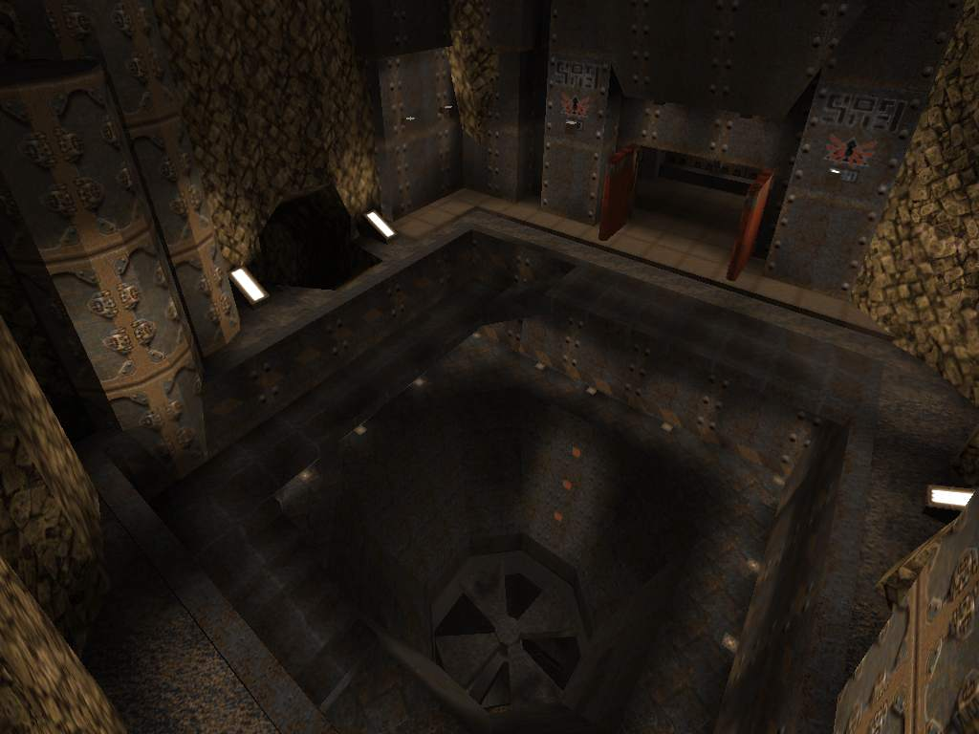
Texturing Example
Game
Logo/sign
Material
Light/shadow

Slide 6
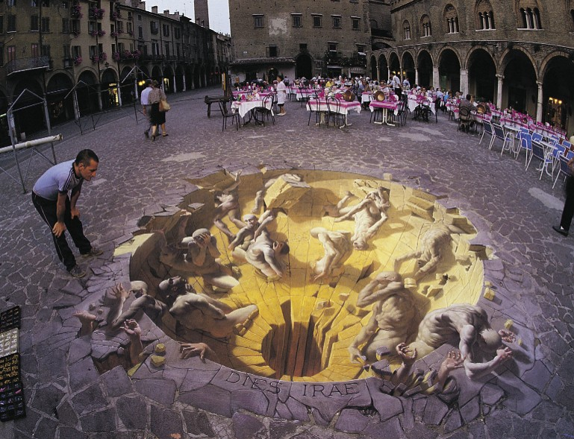
Texturing Example
It is just an image

Slide 7
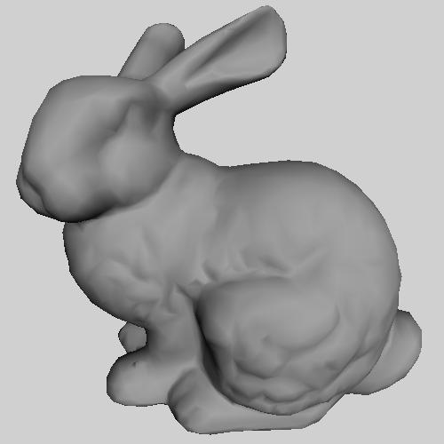
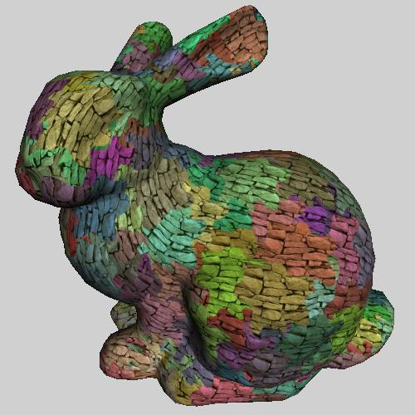
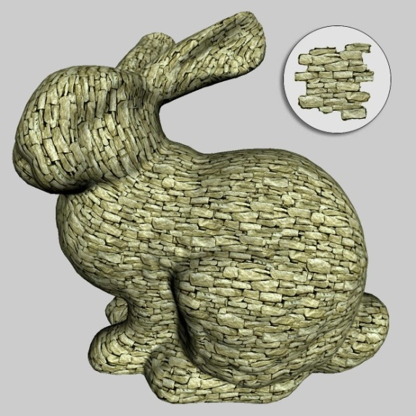
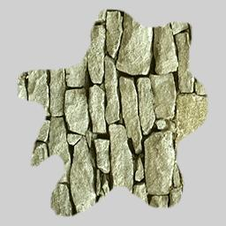
Steps of Texturing (from Greg Turk)
texture
acquisition
texture
mapping
texture
rendering
Image courtesy of Emil Praun

Slide 8
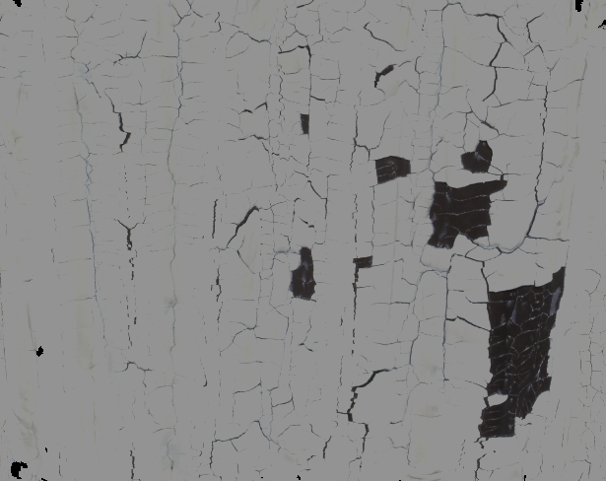
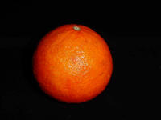
How to Acquire Textures
Manual art
○ Flexible & control
× Not for everyone, tedious
Procedural code
○ Efficiency, compact, & control
× Not general
Photographs
○ General
× Control
× Too small due to curvature & limited surface area
× Too large due to global variation

Slide 9
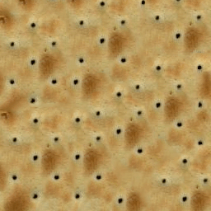
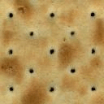
Example-based Texture Synthesis
For (photographic) textures that are too small
Produce an arbitrarily large output with similar look
General Input – needs to satisfy certain assumptions
Synthesis
Algorithm
input
output

Slide 10
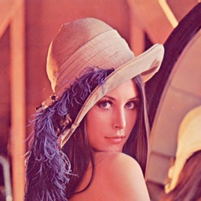
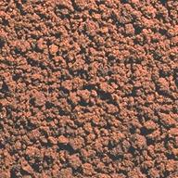
What is Texture?
For texture mapping
(General definition)
Arbitrary images
For (example-based) texture synthesis
(Narrow definition)
Images with repetitive patterns
Synthesis of arbitrary images (general definition) is called – Rendering!

Slide 11
Methods/Models for Texture Synthesis
Many algorithms exist through out the history
Will briefly mention them later
They are all great – but impossible to cover all
We will begin with a simple but very useful one
Spatial neighborhoods
Most recent papers are based on this

Slide 12
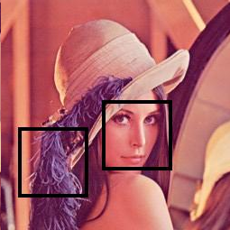
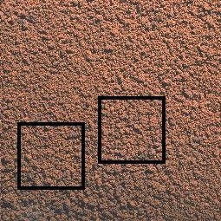




Neighborhood-based Texture Model
Local and stationary (Markov Random Field)
non-texture
texture

Slide 13
E(X_{p}) = |X_{p} – Z_{p}|²
E(X_{p}) = ∑ p X |X_{p} – Z_{p}|²

Slide 14

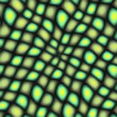
Basic Formulation for Texture Synthesis
Ensure local neighborhood similarity
Search
Z input
X output
Notes:
And define neighborhood xp around it.
[Click]
We want to find a neighborhood that has the same appearance as xp, so we search the nearest neighbor in the input texture Z.
[Click]
The energy of a single pixel p is squared distance of xp and zp
14

Slide 15
Basic Algorithms
Solvers for the aforementioned basic formulation

Slide 16
Pixel-based Algorithms
Many previous MRF algorithms
Mostly complex & heavy weight
[Efros & Leung 1999]
One of the simplest (and most elegant) algorithms
Works surprisingly well

Slide 17
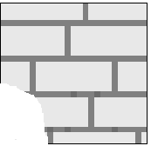

Pixel-based Algorithm [Efros & Leung 1999]
Grow an output texture pixel-by-pixel in an onion skin order
Partial neighborhood search
p
input
output (zoom in)

Slide 18

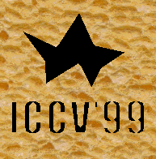
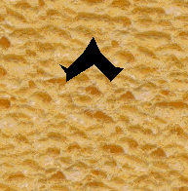
Pixel-based Algorithm [Efros & Leung 1999]
initial condition: 3x3 patch or hole
“grow” the texture one pixel at a time
neighborhood size the only parameter

Slide 19

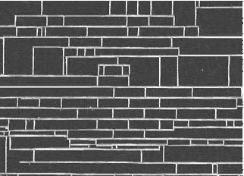
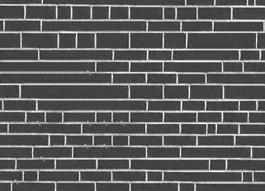
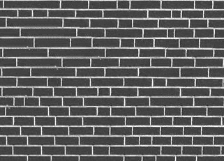
Pixel-based Algorithm [Efros & Leung 1999]
Window size the only crucial parameter
input
output
Increasing window size

Slide 20
Pixel-based Algorithm [Wei & Levoy 2000]
Similar to [Efros & Leung 1999], but uses a “fixed” neighborhood as in [Popat & Picard 1993]
Easier to process, e.g. acceleration

Slide 21


Pixel-based Algorithm [Wei & Levoy 2000]
Basic Idea - notice the use of fixed neighborhoods
copy
search
input
output

Slide 22


Pixel-based Algorithm [Wei & Levoy 2000]
Use multiple resolutions
Copy
noise
Search
noise
input
output

Slide 23
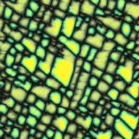
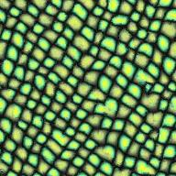
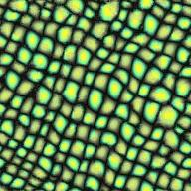
Pixel-based Algorithm [Wei & Levoy 2000]
Multi-resolution allows the use of smaller neighborhoods
1 level
5×5
1 level
11×11
3 levels
5×5

Slide 24
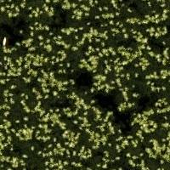



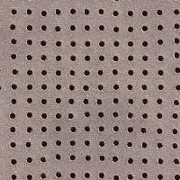
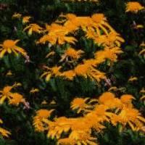
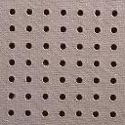

Pixel-based Algorithm Results
Random
Oriented
Regular
Semi-regular

Slide 25
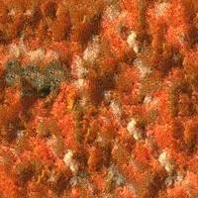



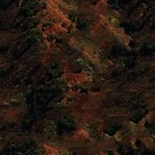
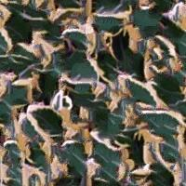


Pixel-based Algorithm Results

Slide 26
Pixel-based Algorithm Acceleration
Q: why is the advantage of a fixed neighborhood?
A: easy for acceleration!

Slide 27
Pixel-based Algorithm Acceleration
A major issue with pixel-based algorithms introduced so far – they are very slow
For input with N pixels and output with M pixels
O(MN) time complexity
Make it O(cMN) for neighborhood size c
A fixed neighborhood allows us to do it faster
O( c log(N) M ) – TSVQ
O(cM) – k-coherence (also gives you better quality)

Slide 28
Acceleration - TSVQ
Tree-structured Vector Quantization [Gersho & Gray 1991]
Accelerate the search process
copy
search
input
output

Slide 29
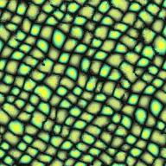
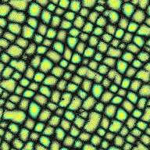
Acceleration - TSVQ
tree
Search per output pixel
Full search O(N)
TSVQ O(log N)

Slide 30
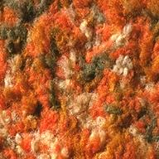
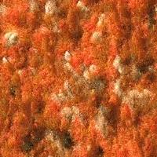
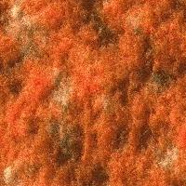
Acceleration - TSVQ
Can degrade quality (blur)
original
Full search
TSVQ

Slide 31
Acceleration – k-coherence
[Tong et al 2002]
See also [Ashikhmin 2001] [Zelinka & Garland 2004]
O(c) search time per output pixel
c ↑ neighborhood size
Parallel computation (e.g. GPU)
Better quality than even exhaustive search!
IMO: most useful acceleration data structure

Slide 32
Acceleration – k-coherence Preprocess
For each input pixel, find k others with similar neighborhoods
2
1
1
1
2B
1
1A
1
1
1
1
k = 2
2A
1
1
1
1
1
1
1
1
1
1
1
1
1
1B
1
1
1
1
input

Slide 33
Acceleration – k-coherence Synthesis
For each output pixel, keep input location info
1
1A
1B
2
2A
2B
2
2B
1A
1
2
3
2A
4
5
1
6
7
8
1B
input
output

Slide 34

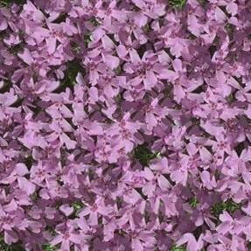

Acceleration – k-coherence Results
input
full search
k-coherence

Slide 35
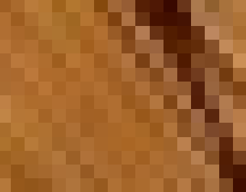

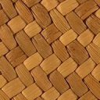
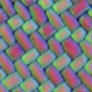
[Lefebvre & Hoppe 2006] Gather neighborhood information into pixels
Acceleration – Appearance Space
Exemplar
Texture being synthesized
Appearance space
Notes:
Appearance Space Texture Synthesis
4/2/2009
SIGGRAPH 2006
35
Let me start by introducing the appearance space transform.
At the very heart of most per-pixel synthesis algorithms lies a very simple procedure, which is neighborhood matching.
The idea is to determine the color of a pixel from its surrounding. # The neighborhood of the pixel is extracted # and the exemplar is searched for the most similar neighborhood.
# Once found, the color of the pixel is updated. Notice that we can easily keep track of the coordinate from where the pixel has been copied.
#
With the appearance space transform we seek to improve this neighborhood matching process.
We start by replacing colors # by small appearance vectors better describing pixels and their surrounding. This makes the process better at distinguishing neighborhoods, and let us reduce the computational cost by using a smaller neighborhood. # In fact we use the smallest symmetric neighborhood, which is only four samples.

Slide 36
Acceleration – Appearance Space Neighborhood → Pixel Information
PCA
4D/8D
Color exemplar
5x5
Appearance-space
exemplar
Transformed
exemplar
Appearance
Vector
75D
(5x5xRGB)
➔ Possibly, non linear dimensionality reduction
Notes:
Appearance Space Texture Synthesis
4/2/2009
SIGGRAPH 2006
36
I will now describe how we transform the exemplar in appearance space.
We start from an RGB example image.
# We first compute an appearance space exemplar where each pixel is an appearance vector.
# We compute the appearance vectors by concatenating the 5x5 neighborhood of the corresponding pixel in the color exemplar.
This forms 75D appearance vectors. So each appearance vector contains not only information about the pixel, but also about its neighbors.
# As these are likely to lie on a lower dimensional space, we perform dimensionality reduction to obtain the transformed exemplar used for synthesis.
We chose the number of dimensions depending on the data, but typically we reduce to 4 or 8 dimensions.
# We usually perform dimensionality reduction with a PCA, but it is important to note that non linear dimensionality reductions could also be used here. Please refer to the paper for more details.

Slide 37
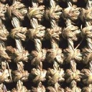

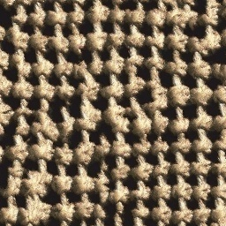
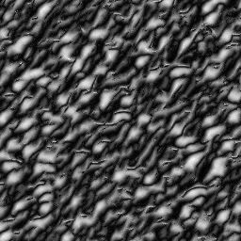
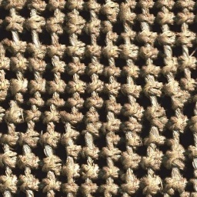
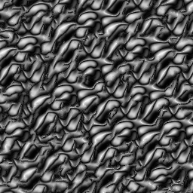

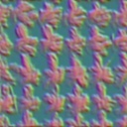
RGB versus 3D appearance space
RGB
3D appearance
space
PCA
3D
Appearance
Vector
Notes:
Appearance Space Texture Synthesis
4/2/2009
SIGGRAPH 2006
37
To verify the quality improvement of the appearance transform, we compare synthesis quality using just RGB colors, and using a 3D appearance space: We perform dimensionality reduction of the appearance vectors to 3D only.
The computational cost of the top and bottom rows are thus exactly the same: the algorithm inputs an image with 3d pixels in both cases.
However, as you can see at the bottom, appearance space does a much better job at capturing the texture appearance – The result is more faithful to the example. The transform exemplar *does* contain more information than the original RGB image.

Slide 38
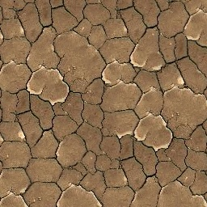

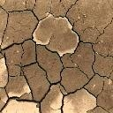


Acceleration – Appearance Space Appearance Vectors
PCA
Appearance
Vector
Feature distance 5x5x4D (➔ 100D)
Feature mask
[Zhang et al 2003,
Wu and Yu 2004]
Feature distance
4D
Notes:
Appearance Space Texture Synthesis
4/2/2009
SIGGRAPH 2006
38
A very important element of the appearance space transform is that we can use more than just colors in the appearance vectors.
# For instance, to better capture non local information, we also include feature distance, that is a map of the distance to the closest feature. This distance map is computed from a user specified feature mask, shown here in small. The exemplar is now 4D: RGB and distance information.
The appearance vectors are 100D,
# and we reduce them to 4D to compute the transformed exemplar
# that we use for synthesis.
I’ll show more results later, but the important point is that we get results similar to previous schemes, without any explicit feature matching during the synthesis process.
Instead of synthesizing colors,
# we also applied our approach to radiance transfer textures.
In this setting, each pixel is a vector of 36 SH coefficients representing its response to a lighting environment. Each appearance vector is then 900D
# that we reduce to obtain an 8D transformed exemplar, used for synthesis.
The result can then be lighted with a different environment.

Slide 39







Acceleration – Appearance Space Feature preservation
Add feature distance to appearance vector
(100D ➔ 4D)
With
Without
Notes:
Appearance Space Texture Synthesis
4/2/2009
SIGGRAPH 2006
39
Here are some results using feature distance.
On the left, you can see both the exemplar and the distance field that was used.
As you can see by comparing with the right column, synthesis quality is greatly improved. Also note that the left and right column have the same synthesis cost: both are using a 4D transformed exemplar.

Slide 40
Patch-based Algorithm
Synthesis in unit of patches instead of pixels
Chaos mosaic [Liang et al 2000]
input
idea
result

Slide 41
Patch-based Algorithm [Liang et al 2000]
Problematic for structured textures
input
result

Slide 42


Patch-based Algorithm [Efros & Freeman 2001]
Replacing pixels in [Efros & Leung 1999] with patches
non-parametric
sampling
p
B
Input image
Synthesizing a block
Input image

Slide 43







block
Input texture
B1
B2
B1
B2
B1
B2
Random placement
of blocks
Neighboring blocks
constrained by overlap
Minimal error
boundary cut

Slide 44








Minimal error boundary
overlapping blocks
vertical boundary
2
_
=
overlap error
min. error boundary

Slide 45
Patch-based Algorithm Graph cut [Kwatra et al 2004]
Use graph cut rather than dynamic programming for finding path

Slide 46





Portilla & Simoncelli
Xu, Guo & Shum
input image
Wei & Levoy
Image Quilting

Slide 47





Portilla & Simoncelli
Xu, Guo & Shum
input image
Wei & Levoy
Image Quilting

Slide 48
Remember Our Goal?
Pixel/patch-based algorithms are heuristics
Search
Z input
X output

Slide 49
Texture Optimization [Kwatra et al 2005]
Really try to solve this energy function!
Search
Z input
X output

Slide 50
Other Methods
A lot of interesting methodologies other than the ones I just described
I will mention a few here; it is impossible to provide an exhaustive coverage in 45 min
Sylvain will cover more
Don’t hate us if you don’t see your stuff ☺

Slide 51



Pyramid Statistics [Heeger & Bergen 1995; Portilla & Simoncelli 2000]
Global statistics based on filter responses
Quality not yet there for graphics
But interesting & fundamental human perception issue
input
optimization
Portilla&Simoncelli

Slide 52



Lower Resolution Pyramid Statistics [De Bonet 1997]
Correlations at the same pyramid level not considered
input
De Bonet
pixel-based

Slide 53








Wang Tiles [Cohen et al 2003]
3
4
1
2
tiling
Input tiles
continuous pattern across identical edge color
adjacent tiles share identical edge color

Slide 54

Near-Regular Textures [Liu et al 2004]
Classification of textures

Slide 55

Near-Regular Textures [Liu et al 2004]
Photo editing

Slide 56
Black Magic
Parameter tuning is important
Texture synthesis cannot guarantee success for every input
But more often than not, people get bad results because of bad parameters, not bad algorithms
Most important ones:
Neighborhood size, # pyramid resolutions, # iterations
Like everything else, this requires some experience
Texture synthesis is not alone here

Slide 57
Texture Replacement
A huge & important literature
but I can only briefly touch it here

Slide 58


Image Editing

Slide 59


Artifact Removal

Slide 60


Detail Hallucination
Alcatraz

Slide 61
Globally Varying Textures

Slide 62



Globally Varying Texture
So far we discuss only homogeneous textures
Limited practical applications, lack variation & control
Most natural textures are globally varying

Slide 63



Def of Globally-Varying Texture
Local, but not stationary
Control map
Moisture, curvature, exposure, temperature, age, etc
homogeneous
local + stationary
globally-varying
local only
globally-varying
control map

Slide 64




Globally-Varying Texture Synthesis
Control serves as constraint
user
control
input
control
result
input

Slide 65


Globally-Varying Synthesis Method
Treat control and color together
Do not change output control
Applicable to pixel/patch copy or optimization
Z_{p}
X_{p}

Slide 66
Control Map
Heuristics
[Ashikhmin 2001; Efros & Freeman 2001; Hertzmann et al. 2001; Wang et al. 2006]
Captured
[Gu et al. 2006; Lu et al. 2007]

Slide 67




Image analogies [Hertzmann et al 2001] Control Map from Input Images
Simple Blur
?
:
::
:
A
Control map
A’
B
Control map
B’

Slide 68
Image analogies
Artistic Styles
?
:
::
:
A
Control map
A’
B
Control map
B’

Slide 69
Image analogies
Goal: Match conditional image statistics
:
::
A (Control)
A’
:
B (Control)
B’ (Output)

Slide 70
Synthesis
:
::
A
A’
:
B
B’

Slide 71


Texture-by-numbers
:
A
control map
A’

Slide 72


Texture-by-numbers
::
:
B
Control map
B’

Slide 73
Efros & Freeman 2001 Control Map from Target Color
+
=
parmesan
rice
+
=

Slide 74








+
=

Slide 75




+
=

Slide 76




Source
texture
Target image
Source
correspondence
image
Target
correspondence image

Slide 77

+
=

Slide 78

[Gu et al. 2006] Space-time Surface Appearance
Capturing from real data!

Slide 79


























Database of TSV-BRDF
Burning
Corrosion
Drying (Smooth Surface)
Charred Wood 1
Bread Toasting
Rusting Steel 1
Copper Patina
Light Wood 1
White Felt
Light Wood 2
Waffle Toasting
Charred Wood 2
Rusting Steel 2
Iron Rusting
Orange Cloth
Pattern Cloth
Cotton Cloth
Drying (Rough Surface)
Decaying
Rock
Cardboard
Tree Bark
Brick
Apple Slice
Leaf
Potato
Dark Wood
Paper Towel
Granite
Banana
Apple Core

Slide 80





Space-Time Factorization
With factorization, we can easily do:
Control
Synthesis
Transfer
…
Spatial Variation
Time-Varying Appearance
Temporal Variation

Slide 81



Key Assumption
All points have one common “overall temporal variation”.
Different points evolve at different rates and offsets.
A
?
C
B
Original Data
Overall Temporal Variation
Two problems:
What is the “overall temporal variation”?
How to define and calculate the rates and offsets?

Slide 82
STAF Model
For texture synthesis, assign A/D/R/O per (x,y)
A/D: spatial variation
R/O: temporal variation
p(x,y,t) = A(x,y) φ(t’) + D(x,y)
t’ = R(x,y) t - O(x,y)

Slide 83






STAF Model Estimation Result
Diffuse: φ(t’)
Rate: R(x,y)
Initial: Aφ(0)+D
Specular: φ(t’)
Offset: O(x,y)
Final: Aφ(1)+D

Slide 84



STAF Synthesis Result
Rate: R(x,y)
Offset: O(x,y)

Slide 85







Context-Aware Texture [Lu et al. 2007] Control Map from Measurement
time
control
color

Slide 86





Context-Aware Texture Synthesis
The color contains multiple frames
input
output

Slide 87








Globally-Varying Synthesis Result [Lu et al 2007]
iron rust
paint crack
dust accumulation
cheese mold

Slide 88





Context-Aware Texture Synthesis Result
iron rust

Slide 89






Context-Aware Texture Synthesis Result
paint crack

Slide 90





Context-Aware Texture Synthesis Result
dust accumulation

Slide 91





Context-Aware Texture Synthesis Result
cheese mold

Slide 92

Issues with Globally-Varying Texture
Often very large
To cover sufficient variation and detail
Traditional image compression little help

Slide 93

Inverse Texture Synthesis [Wei et al. 2008]
For inputs that are too big
Inverse
Synthesis
output
input

Slide 94




Overview
inverse texture synthesis
input
(large)
output
(small)
texturing
(slow)
texturing
(fast)
similar quality
Notes:
Inverse texture synthesis can solve these problems.
Given a large input, the algorithm will produce a small compaction that retains vital information of the input.
The compaction can be used for texturing with similar visual results from the original input, with faster computation and smaller memory consumption.

Slide 95



Related work: image compression
pixel-wise
identical
compress
decompress
inverse synth
texture synth
input
perceptual
similar

Slide 96


Basic formulation
Inspired by texture optimization [Kwatra et al. 2005]
inverse term (New!)
forward term [Kwatra et al. 2005]
x_{p}
best match
Z_{p}
z_{q}
best match
Z (output)
x_{q}
X (input)

Slide 97

















Energy plot
energy
original
compaction size

Slide 98









Why both terms?
inverse
forward
inverse term preserves all input features
forward term avoids artifacts in compaction
both
both
f-only
missing feature
i-only
garbage
both
i-only
discontinuity

Slide 99
Solver
How to solve this?
Texture optimization [Kwatra et al. 2005]
Discrete solver [Han et al. 2006]

Slide 100
Optimization [Kwatra et al. 2005]
NO inverse term
forward term [Kwatra et al. 2005]
E-step
fix x_{q}
argmin_{z} E(x,z)
least square
M-step
fix Z
argmin_{xq} |x_{q}-z_{q}|²
search
fix x_{q}
x_{q}
Z_{q}
z_{q}
Z
argmin_{xq} |x_{q}-z_{q}|²
x_{q}
X

Slide 101
Our solver
inverse term
forward term [Kwatra et al. 2005]
E-step
fix x_{q}
argmin_{z} E(x,z)
least square
M-step (forward)
fix Z
argmin_{xq} |x_{q}-z_{q}|²
search
x_{p}
x_{q}
z_{p}
Z_{q}
discrete solver [Han et al. 2006]
M-step (inverse)
fix x_{p}
argmin_{zp} |x_{p}-z_{p}|²
discrete solver
z_{q}
x_{p}
Z
argmin_{xq} |x_{q}-z_{q}|²
x_{q}
discrete solver
X

Slide 102
To Be Continued …

