Slide 1



Ten Things You Don’t Know
About Microsoft
Derick Campbell
Microsoft Research
See this presentation online: http://docs.com/@derickc
DerickC
DerickAtMS
derickc@microsoft.com

Slide 2
The Challenge
I wager that I can show you Ten Things You Don’t Know About Microsoft
Keep track of each fact/tool/resource you didn’t know about
  At the end, add them up
Tweet how you did to DerickAtMS
  “I learned ‘x’ new things about Microsoft!”
Let’s see who doesn’t learn at least Ten Things
  Fine print: Full Time Microsoft employees are not eligible. ☺

Slide 3















Incubation Labs @ Microsoft
  Deep Zoom Ads
  Digital Lens (visual impaired usability testing)
  Docs.com, Spindex
  Project Emporia, Bing Twitter, Bing Twitter Maps
  Kodu
  Forgotten Attachment Detector
  StickySorter, Chart Advisor
HPC++ Labs
  Cluster computing for the classroom
  Office Add-in for Moodle, SharePoint as a FileSystem for Moodle, Live Services Plug-in for Moodle
  Math Worksheet Generator, Flashcards
  Audience Intelligence: Demographics Prediction
  Keyword Research: Keyword group detection, Keyword mutation detection, keyword forecast
  Content Analysis: Name detection
MSDN DevLabs
  Pex and Moles
  Code Contracts
  Axum
Online Labs
  Incarnate
  Archivist
  Flotzam
  Descry
Notes:
Microsoft incubation labs often have strong relationships with Microsoft Research. Many of the projects you see here have been incubated by or heavily influenced by MSR.
Live Labs
Pivot =
Seadragon =
PhotoSynth =
FUSE Labs
Docs.com = Office Online + Facebook
Spindex = Your entire social world in one page
Project Emporia = Explore trending Social networking topics
Bing Twitter = Search Twitter
Bing Twitter Maps = Browse tweets close to you
Israel Innovation Labs
Deep Zoom Advertising =
OneAlbum =
Digital Lens =

Slide 4


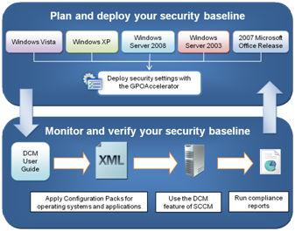





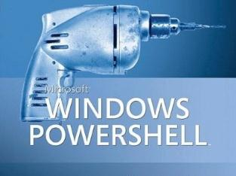

Resources for IT Professionals
  Live.sysinternals.com
  Autoruns
  AutoLogon
  Desktops
  Process Explorer
Microsoft Assessment and Planning (MAP) Toolkit
Windows XP Mode for Windows 7

Slide 5





















Resources for Developers and Designers
Silverlight Learning Snacks
Sync Framework
Facebook SDK
Windows Live SDK

Slide 6

Video Training Resources
Developers & Designers
Microsoft Professional Developers Conference
Microsoft MIX
Channel 9
“How Do I?” Videos on MSDN
Microsoft Expression Training Videos
Getting Started with Silverlight
Demo:
PowerPoint 2010
Video Features
Another example
IT Professionals
TechNet Edge
Microsoft TechEd
“How Do I?” Videos on TechNet
Microsoft Showcase
Channel 10
IT Walkthrough Videos
Other
Windows 7 Video Tours
MSR TechFest 2009 (Videos, demos, photos)
MSR TechFest 2010
MSR Videos on ResearchChannel
Microsoft News Center
Bing Videos

Slide 7









Security Investments
  Performs millions of malware removals per year worldwide
  World’s most popular browser
  Millions of Forefront
  users worldwide
Number of computers cleaned for every 1,000 MSRT
executions, by operating system, 2H09
Source: Microsoft Security Intelligence Report
SmartScreen Filter
Microsoft Phishing Filter
  Scanning billions of e-mail messages per year
  More than 100 million
  users worldwide
Windows 7, which was released in 2H09, and Windows Vista with Service Pack 2 have the lowest infection rate of any platform on the chart
  More than 19.4 billion
  MSRT executions since 2005
Microsoft Malware Protection Center (MMPC)
Microsoft Security Engineering Center (MSEC)
Microsoft Security Response Center (MSRC)
  Billions of web-page
  scans per month
Malicious Software
Removal Tool
Security
Development
Lifecycle
Protecting Microsoft customers throughout the entire life cycle

Slide 8






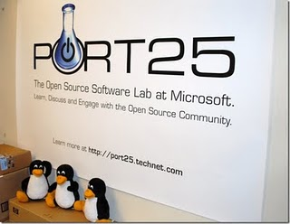






Open Source @ Microsoft
Linux Device Drivers

Slide 9
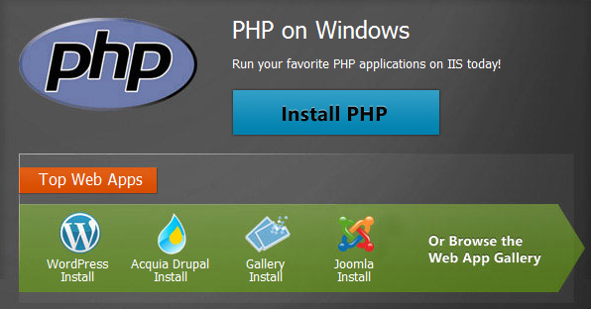



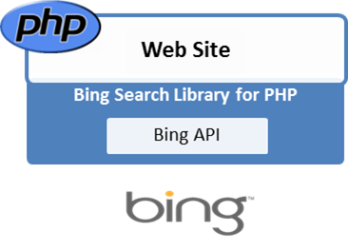


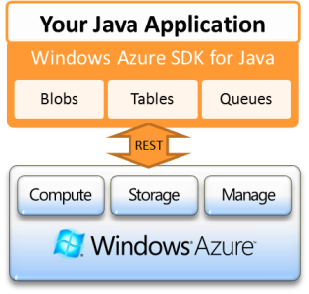
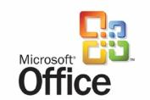


Interoperability @ Microsoft
Microsoft Open Specification Promise
Notes:
Mono is a software platform designed to allow developers to easily create cross platform applications. Sponsored by Novell (http://www.novell.com/), Mono is an open source implementation of Microsoft's .NET Framework based on the ECMA standards for C# and the Common Language Runtime. A growing family of solutions and an active and enthusiastic contributing community is helping position Mono to become the leading choice for development of Linux applications.
Channel 9
Channel 10
Port 25
Most Valuable Professional (MVP) program
Technical Communities. (Forums, newsgroups, webcasts)
Microsoft Learning. (Learning snacks)
Microsoft Connect. (Beta products and technologies from Microsoft.)
Microsoft DreamSpark. (Free software for students.)
Microsoft BizSpark. (Software for startups.)
Solution Accelerators
Research Accelerators
Patterns and Practices

Slide 10


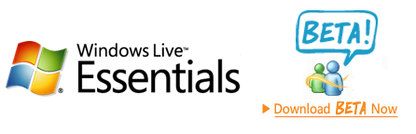

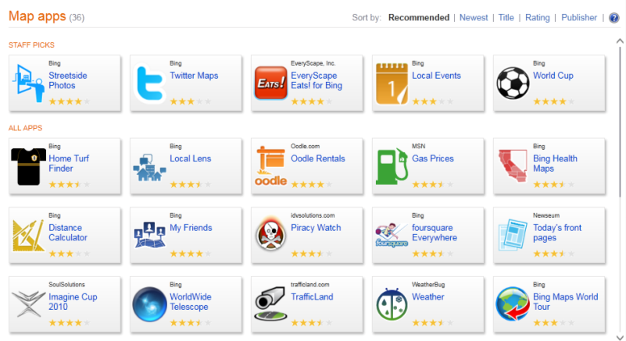





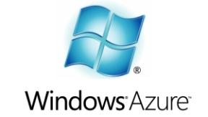

Online Services
Notes:
Live Writer – my wife’s favorite blog authoring tool – supports multiple concurrent blogs
Movie Maker – our favorite tool for making stop motion movies!
Photo Gallery – supports tags for easier organizing and filtering

Slide 11


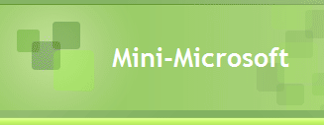
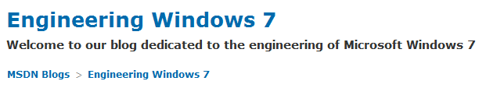











Microsoft Culture
Working to enable sustained social and economic opportunity for everyone

Slide 12
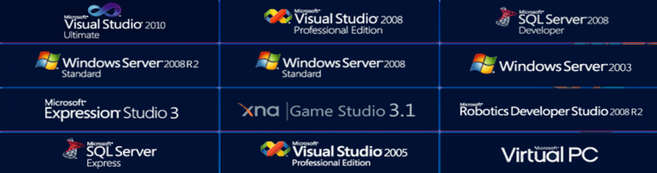











Student, Faculty and Academic Resources
You are the controller

Slide 13




Collaborative development teams
  “By researchers, for researchers”
Sponsored by Microsoft Research
  Incubated inside and outside of Microsoft
Interoperable, open, software solutions
  Open APIs
  Published source code
Supporting university researchers & scientists
  Advancing the research process
http://research.microsoft.com/Accelerators
Notes:
Sponsorship might be with time or money.

Slide 14
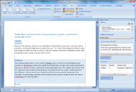


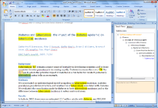


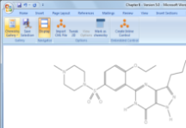
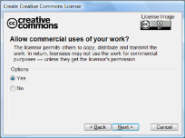


Research Accelerators for Publishing
Publishing
Research Management
Scientific Computing
Article Authoring
Add-in for Word
Ontology Add-in
for Word
Chemistry Add-in
for Word
Creative Commons
Add-in for Word
Notes:
Chem4Word represents over half of these download numbers. Lots of interest in Office-based add-ons.
Downloads:
Chemistry Add-in on RMC 174,719
Creative Commons Add-in 2003 on DLC 78,461
Creative Commons Add-in 2007 on DLC 10,793
Ontology Add-in on Codeplex 2,193
Article Authoring Add-in on RMC 1,074

Slide 15




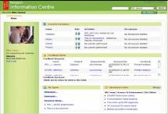



Research Accelerators for Research Management
Publishing
Research Management
Scientific Computing
Research Information Center
Zentity
Notes:
These accelerators focus on the institution – not the end user unlike our other categories. This has an impact on number of downloads that we should expect.
Lessons learned: Academic research environments have limited IT expertise, prefer out of the box solutions, and prefer not to host or be responsible for infrastructure.
Downloads:
Zentity on RMC 918
RIC on CodePlex 777

Slide 16
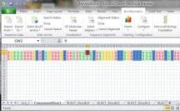

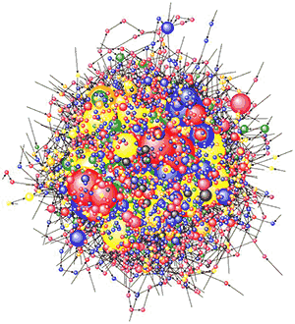


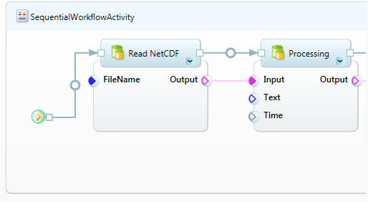
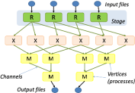


Research Accelerators for Scientific Computing
Publishing
Research Management
Scientific Computing
Microsoft Biology Foundation
BLAST
Scientific Workflow Workbench
NodeXL
Dryad and DryadLINQ
Notes:
NodeXL – MSR-Cambridge led collaboration. AzureBlast from the XCG team.
Downloads:
NodeXL on CodePlex 21,466
MBF 3,278
Trident on RMC 2,178
Dryad 1,802

Slide 17
Ten Things You Don’t Know
About Microsoft
Derick Campbell
Microsoft Research
See this presentation online: http://docs.com/@derickc
DerickC
DerickAtMS
derickc@microsoft.com

Slide 18




Microsoft External Research
Work broadly with the academic and research community to speed research,
improve education, foster innovation, and improve lives around the world.
Core Computer Science
Earth, Energy &
Environment
Health & Wellbeing
Education & Scholarly Communication
Research Accelerators: Software for Scientists
Notes:
Microsoft External Research Core Computer Science advances the state of the art in computer and computational sciences, focusing on ground-breaking research that is high-impact and disruptive.
Microsoft External Research Earth, Energy and Environment applies technology to improve our understanding of the world around us enabling insights into highly complex domains such as energy efficiency, climate modeling and oceanography.
Microsoft External Research Education and Scholarly Communication efforts are focused on the academic community’s use of technology on a daily basis to conduct research and how to better teach higher education students around the world.
Microsoft External Researching Health and Wellbeing is helping researchers explore technologies that advance healthcare solutions and empower people to make better choices about their health.

Slide 19



CodePlex Foundation: Bringing Communities Together
The Switzerland of IP
  An independent, non-profit
  legal entity that can own
  intellectual property
Provides OSS experience and guidance, launch and community services
Help community developers commercialize projects
License, forge, and technology agnostic
OSS
Developers
Software
Companies
Provide a clear and safe way to participate in open source
Corporate
and Academic Developers
Community Viable
Commercial Friendly
Not Just Another Open Source Foundation
Notes:
The CodePlex Foundation is a separate legal entity for open source projects with collaborators from many different communities: commercial software companies (like Microsoft), corporations, academic institutions, and a massive community of open source developers.
Commercial software companies and academic institutions often have strategic patent portfolios that they need to protect, while enabling work on open source. The CodePlex Foundation allows you to work in both worlds.

Slide 20
Windows 7
Bitlocker
BitLocker-To-Go: Supports removable devices – both NTFS and FAT
  Can require all removable media to be encrypted by default
  Can be decrypted on any Windows 7 computer
  Encrypted FAT, exFAT, FAT32 can be shared with Windows XP and Vista (read-only).
  Bitlockertogo.exe, uses password or recovery password
Boot, system drives
Right-click encrypt from Explorer
TPM chip, PIN, password, smart card
Tip: Save your Bitlocker recovery information elsewhere
AppLocker
Taskbar
  Pin apps, docs
  Jump lists
  Aero Peek, Shake, Snap
Virtual Windows XP Mode
  Professional, Enterprise, or Ultimate
Accessories
  Paint and Wordpad use the ribbon
  Ribbon available to developers
Netbook support
Multicore support
  Thread locking performance
Internet Explorer 8
  SmartScreen Filter (safety menu)
Notes:
Direct access
Branch Cache

Slide 21
Keyboard Shortcuts
Ctrl+C (or Ctrl+Insert)
  Copy the selected item
Ctrl+X
  Cut the selected item
Ctrl+V (or Shift+Insert)
  Paste the selected item
Ctrl+Z
  Undo an action
Ctrl+Y
  Redo an action
Shift+Delete
  Delete without Recycle Bin
F1
  Help
F2
  Rename the selected item
F3
  Search for a file or folder
ALT-F4, Close App
CTRL-F4, Close Window
Visibility
  CTRL-Mouse Wheel
    Zoom: Office, Desktop, Explorer
  CTRL – show Mouse location
  Peek at Desktop
Shift-F10 Shortcut menu
Shift, when inserting a CD – prevent AutoPlay
Windows
   + D, Show Desktop
   + M, Minimize Windows
   + SHIFT + M, Restore Minimized Windows
   + SHIFT + Up, Stretch screen to top and bottom
Other
   + E, Open Computer
   + L, Lock Computer
   + R, Run program
Taskbar
   + T, Cycle Taskbar
   + number, Taskbar
   + ALT + number, Taskbar Jump Lists
   + TAB, Aero Flip 3D

Slide 22
Mouse Shortcuts
Snap to side or top
   + Arrow, or grab with mouse
Shake off/on
  Double click or

Slide 23
Magnifier
  Win +/- Zoom in and out
  CTRL-ALT-F, Full screen mode
  CTRL-ALT-L, Lens mode
  CTRL-ALT-D, Docked mode
  CTRL-ALT-I, Invert colors
  CTRL-ALT-R, Resize lens
  WIN-ESC, Exit Magnifier

Slide 24
Internet Explorer 8
Personalize the Title Bar
Maximize viewing space
  View -> Toolbars (ALT to return)
Printing
  Change header/footer
Dev Tools (F12)
  Clear cache & cookies
  Validation
  Outline elements
Sharing Favorites via SkyDrive
Tabs
  Home page tabs
InPrivate Browsing
  Removes traces: history, temp files, log-in data
IE Accelerators
  Map, search, translate, blog, share,
  3rd party: Facebook, Wikipedia, StumbleUpon
Web Slices
  Xbox news
  The Sun UK, Twittered videos,

