Slide 1
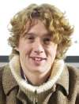
Simulating [the] global carbon-climate feedback
Drew Purves
Microsoft Research Cambridge, UK

Slide 2

Using...
Joined
Up
ecology
Drew Purves, Head, Computational Ecology and Environmental Science group, MSRC

Slide 3
Demo here
http://www.microsoft.com/presspass/presskits/collegetour/Default.aspx

Slide 4
Why science at Microsoft Research?
Science is a key driver of our times
* Global challenges
* 21st century economy
* Healthcare, Agriculture, Energy, Nanotech, Biotech
A new kind of science
* Complex, interacting, non-linear, multi-scale
* Computational and scientific barriers not separable
Business case
* Emerging markets
* Ecosystem engineering
* Pushing the envelope
* Spin-offs
* Moral imperative

Slide 5
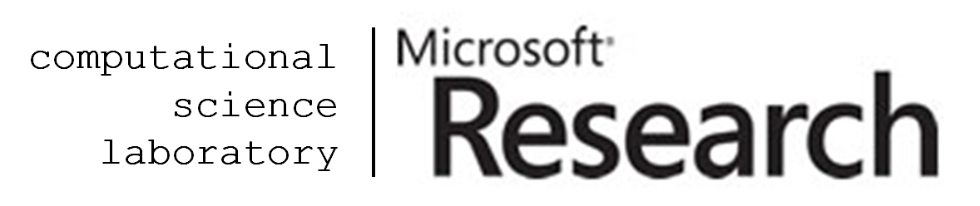
CSL and CEES
A unique melting pot of scientists and software engineers with single common aim – to research and develop novel computational approaches to tackle fundamental problems in science in areas of societal importance and develop the software tools that implement those methods to enable fundamentally new science to be undertaken *
The goal of CEES is to develop the methods and tools necessary to predict the behaviour of ecological systems at a variety of spatial and temporal scales
* Carbon-Climate Feedback Project
* Global Biodiversity Modelling Project (UNEP-WCMC)
*Stephen Emmott internal email March 2010

Slide 6
Ecology and Ecological Challenges
Definition of Ecology
The study of how the distribution and abundance of organisms follows from their interactions with each other and the environment
Oikos (ancient Greek: οἶκος, plural: οἶκοι) is the ancient Greek equivalent of a household, house, or family.... The conflicting interests with [sic] both the oikos and polis lead to the structural decay of the society *
Challenges
* Global biodiversity
* Global agriculture
* Forestry, biofuels, fisheries
* Carbon-climate crisis
* Global disease pandemics
* Wikipedia

Slide 7
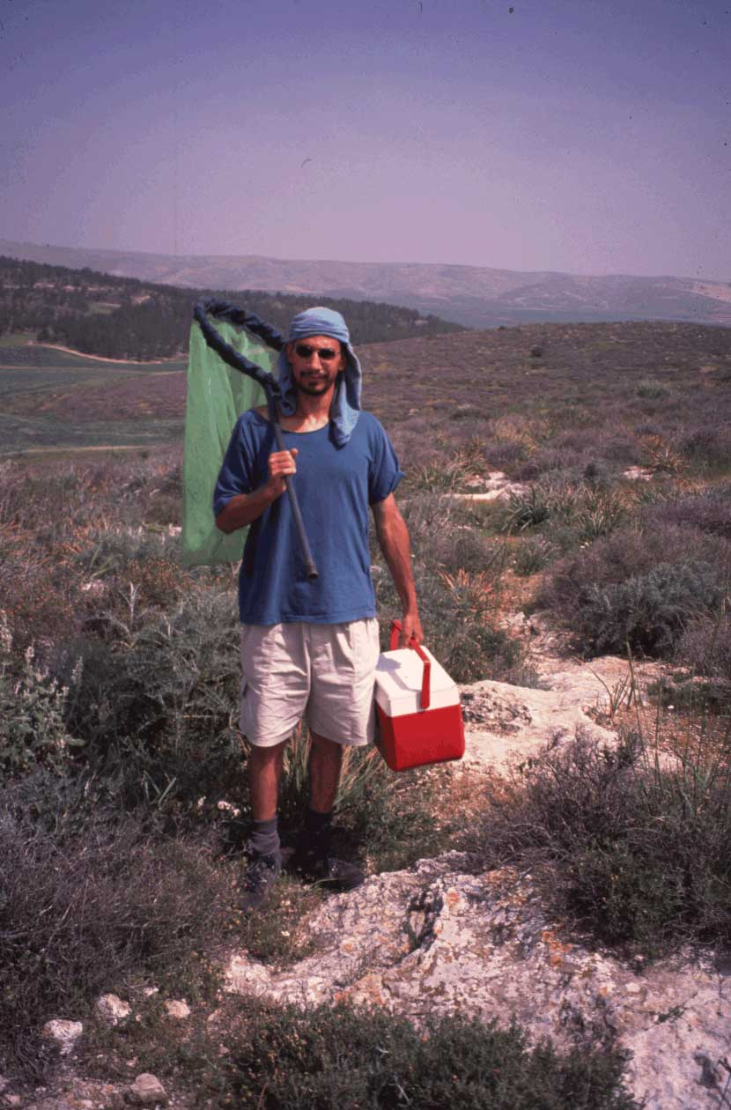
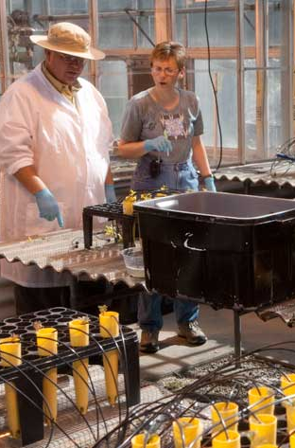

Ecology as it is today
Field work
Experiments
Theorizing
* Wikipedia

Slide 8
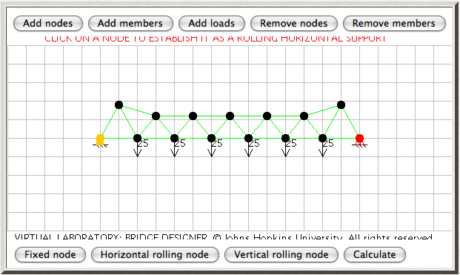
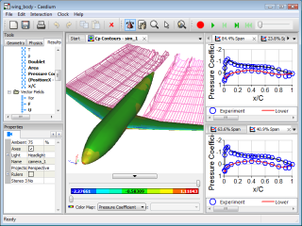
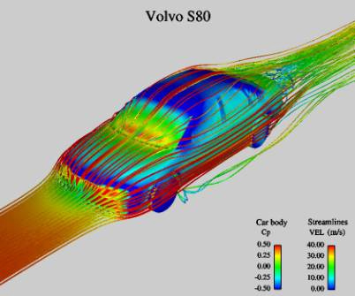
What’s missing: useful predictive models
Bridges
Planes
Cars
The Bridges of Northumberland *
‘... bridge diversity is greatest around Newcastle (p < 0.05) ... ‘
On the behaviour of beams strung over gaps **
‘... potential for three modes of behaviour ... stability, collapse, or wobbling ...’
A test of bridge design theory ***
‘...built from spaghetti ... critical mass was correlated with the number of pieces of spaghetti ... (p < 0.05) ...’
* Bridgeogeography, ** Theoretical Engineering, *** Experimentae Spaghettiae

Slide 9
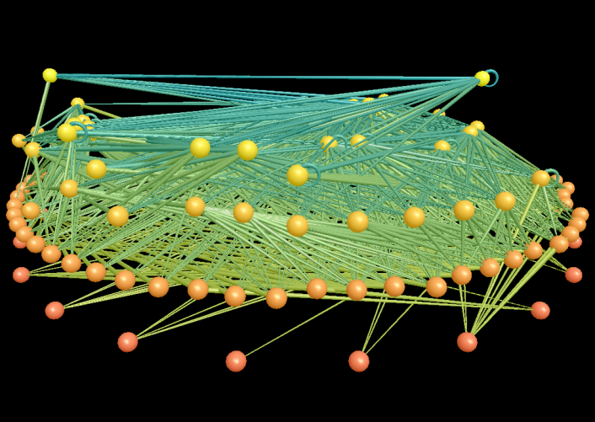
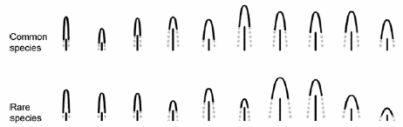
Questions we can’t answer
Bridges
Planes
Cars
Which ecosystems will collapse?
Which are the keystone species?
Which species will survive?
Which ecosystem is optimal for x?
A test of bridge design theory ***
‘...built from spaghetti ... critical mass was corrlated with the number of pieces of spaghetti ... (p < 0.05) ...’

Slide 10
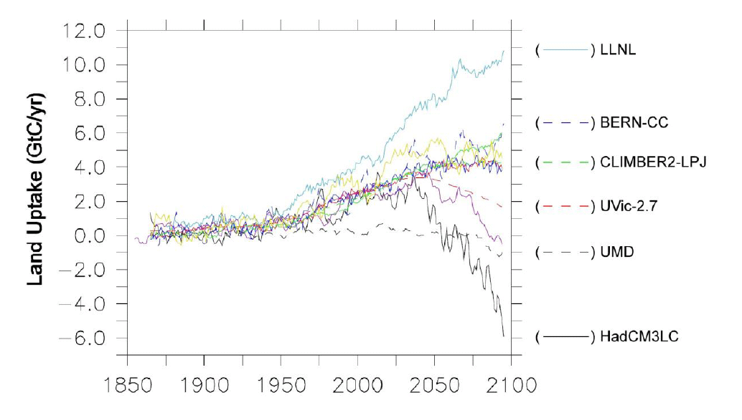
A really big question we can’t answer
Will forests accelerate, or decelerate, climate change?
A test of bridge design theory ***
‘...built from spaghetti ... critical mass was corrlated with the number of pieces of spaghetti ... (p < 0.05) ...’
* Purves & Pacala Science 2008, based on Friedlingstein et al. 2006

Slide 11
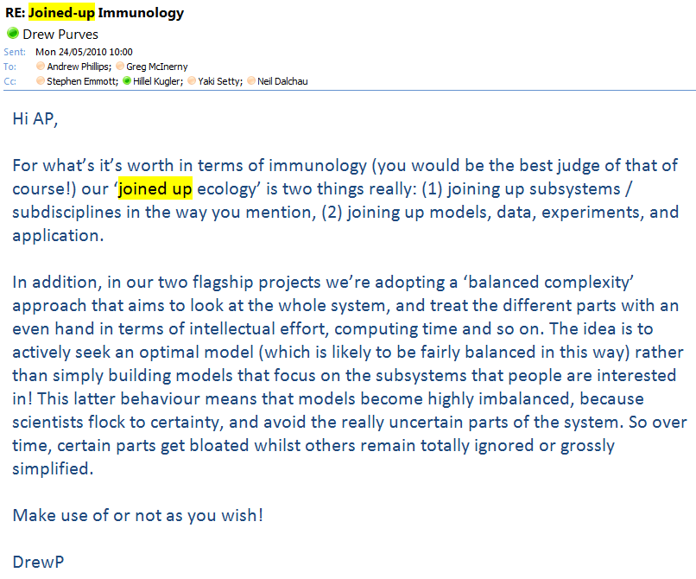
Joined up Ecology
A test of bridge design theory ***
‘...built from spaghetti ... critical mass was corrlated with the number of pieces of spaghetti ... (p < 0.05) ...’
Drew Purves internal email May 2010

Slide 12
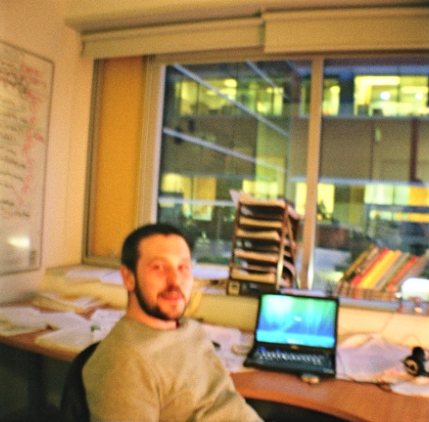
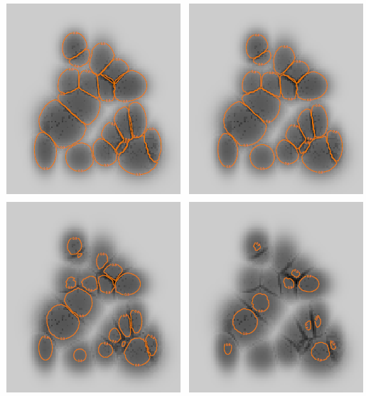
Joining theory and models: next-gen species distribution modelling
Why are species where they are now?
Where will species be in the future?
Greg McInerny

Slide 13
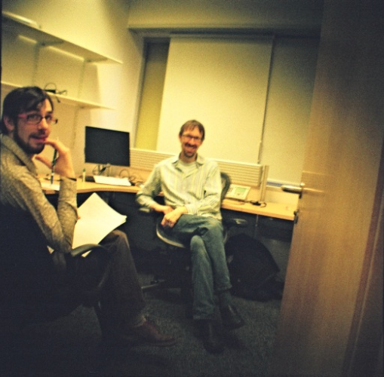
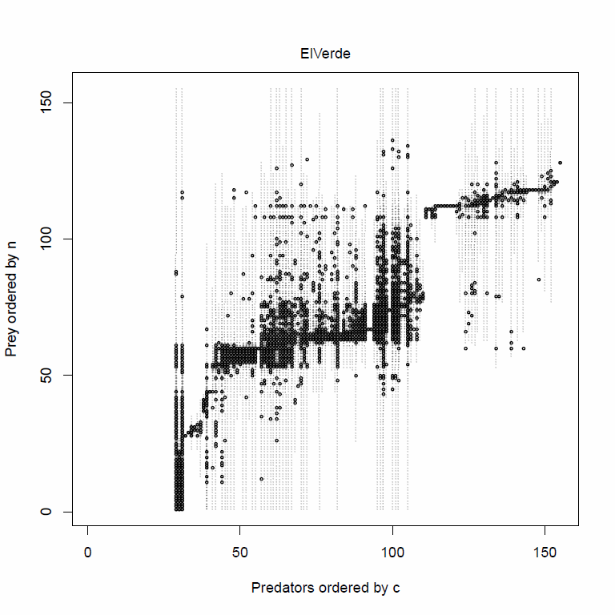
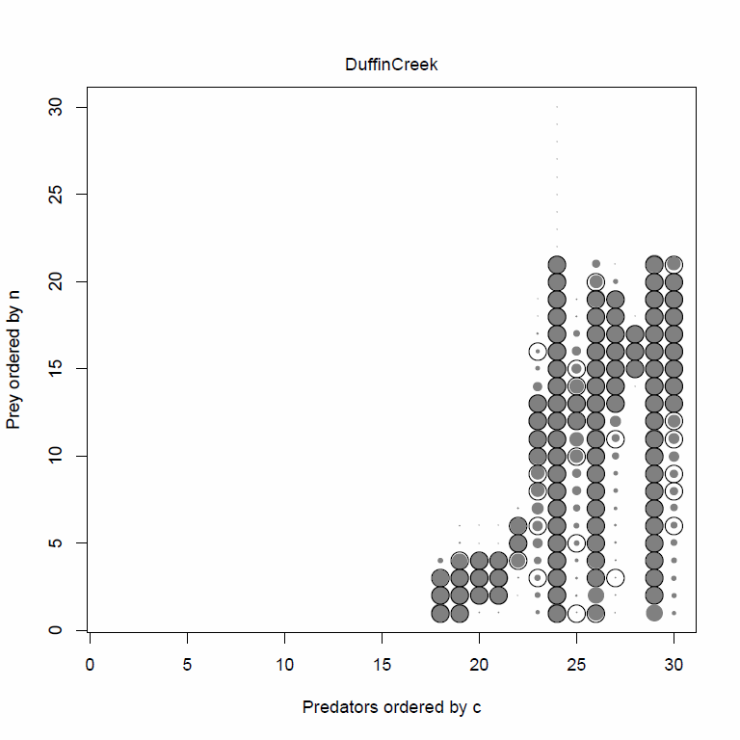
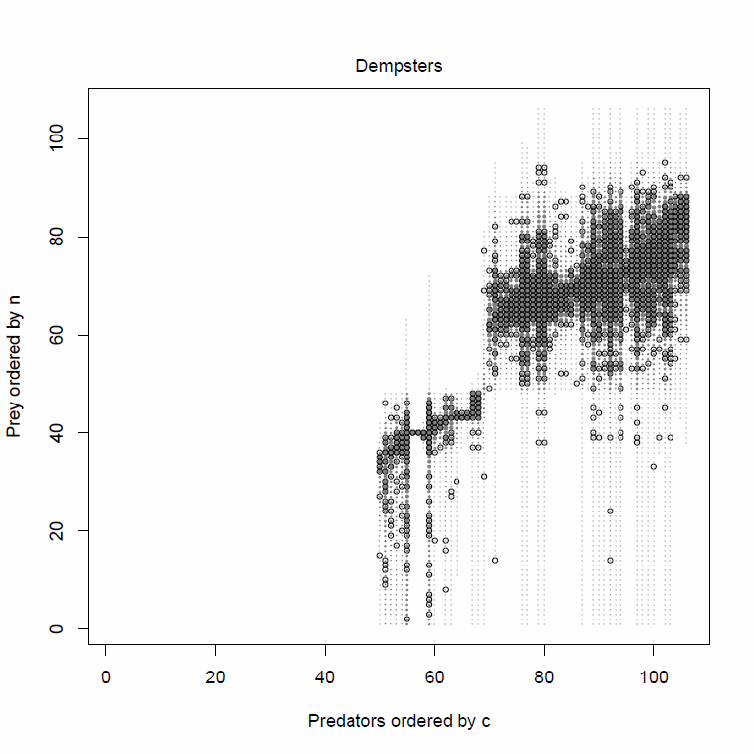
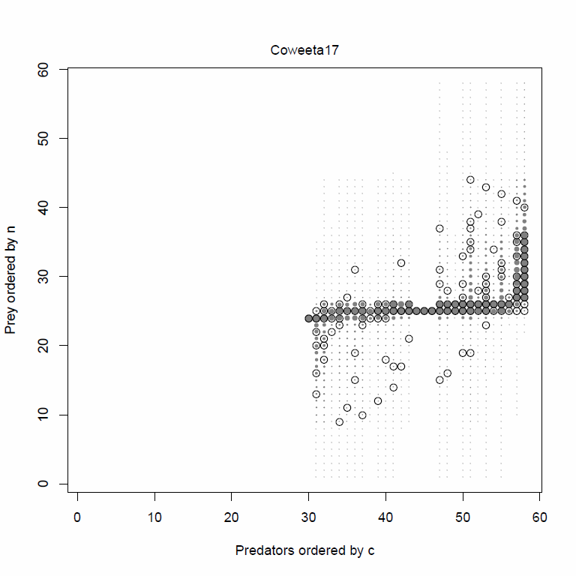
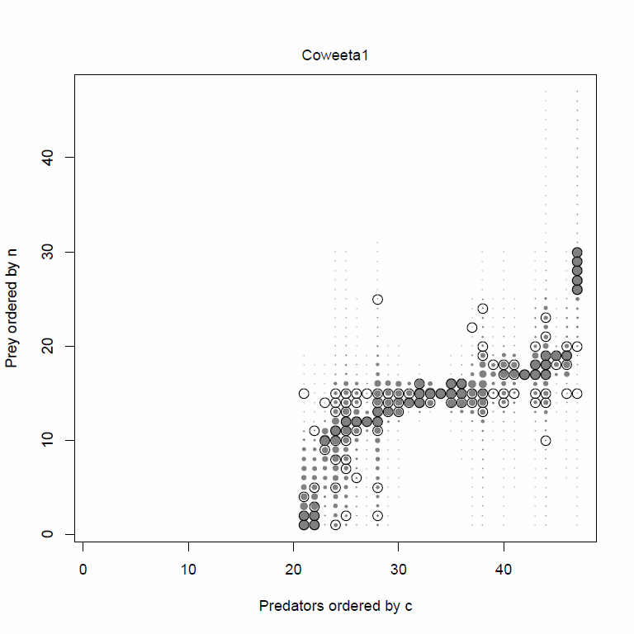
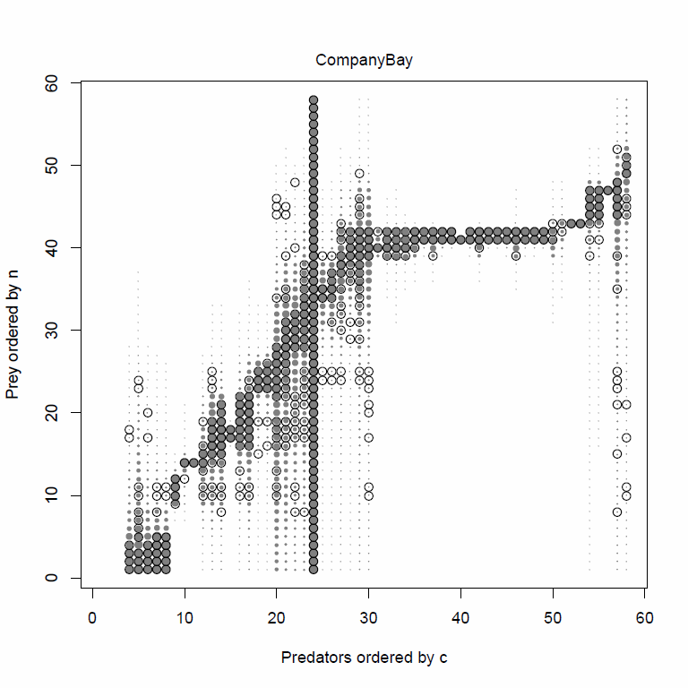
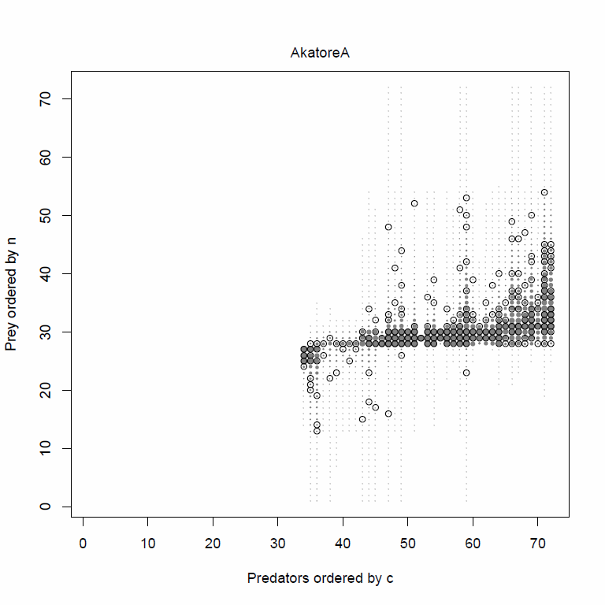
Joining up theory, models and data
Understanding and modelling food web structure
Rich Williams
r_{i}
n_{i}
0
1
c_{i}

Slide 14

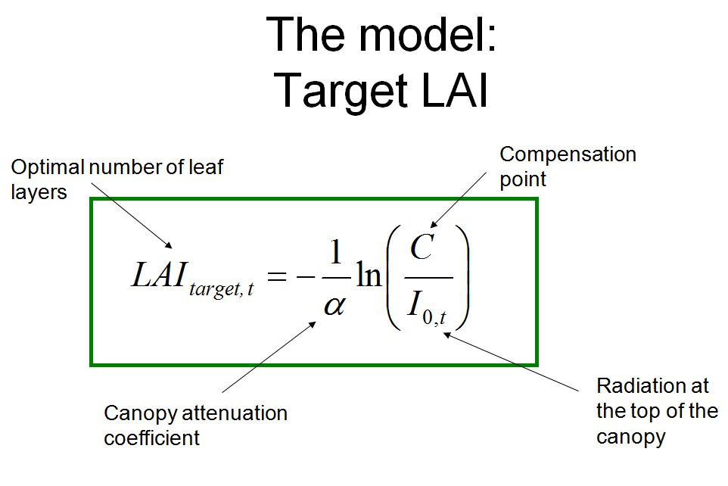
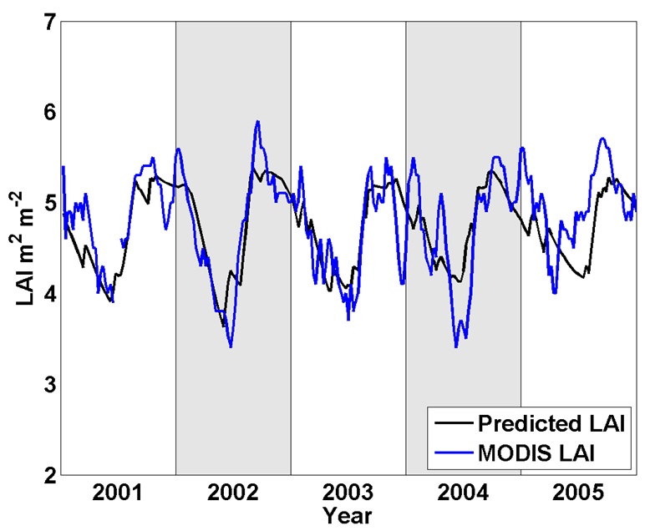
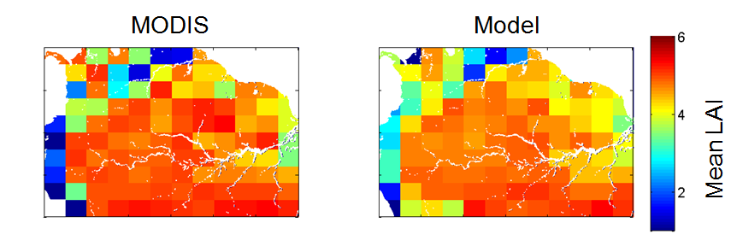
Joining up theory, models and data
Understanding and modelling Tropical Leaf Phenology
Silvia Caldararu

Slide 15
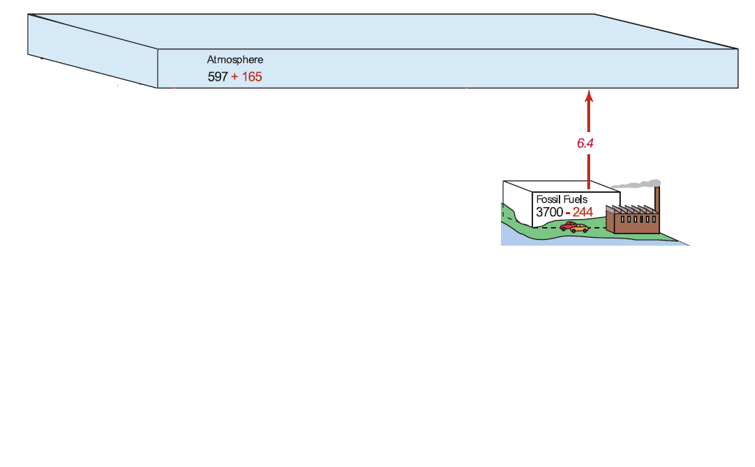
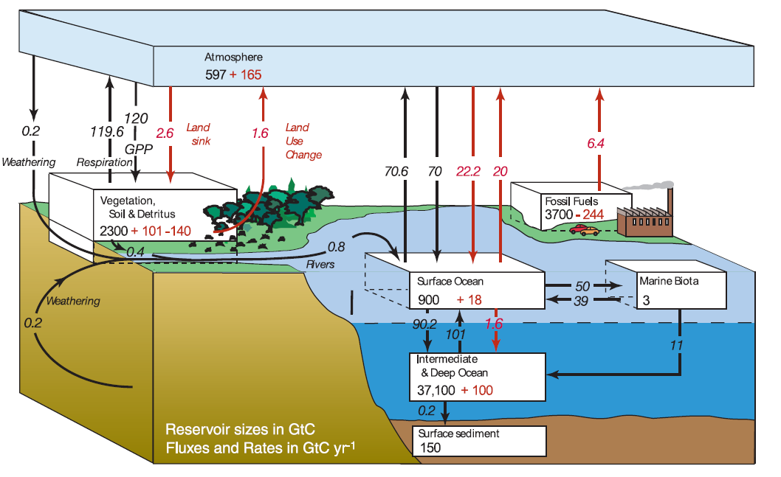
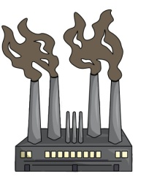
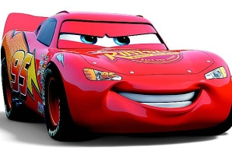
The carbon-climate problem
CO2

Slide 16
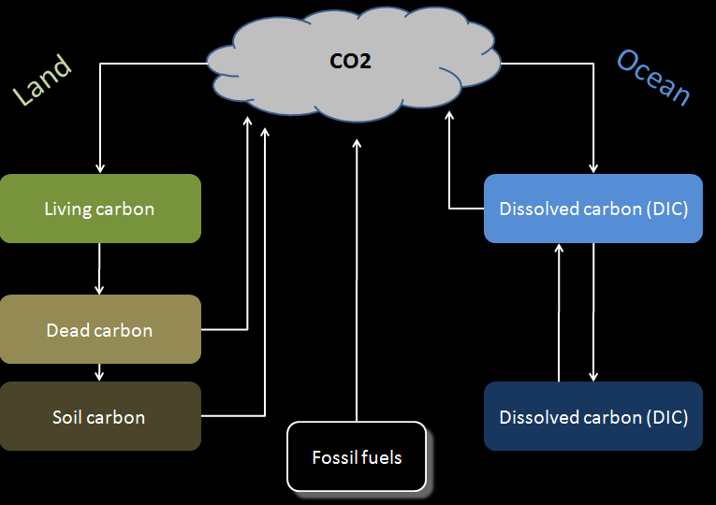
Why Climate-Carbon Feedback?
Climate
Human behaviour

Slide 17
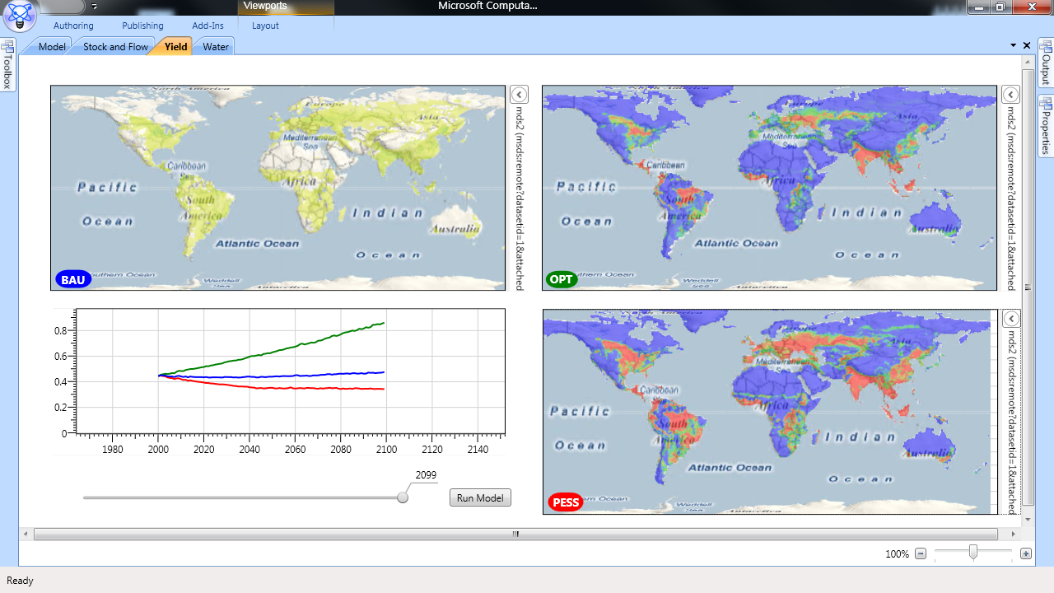
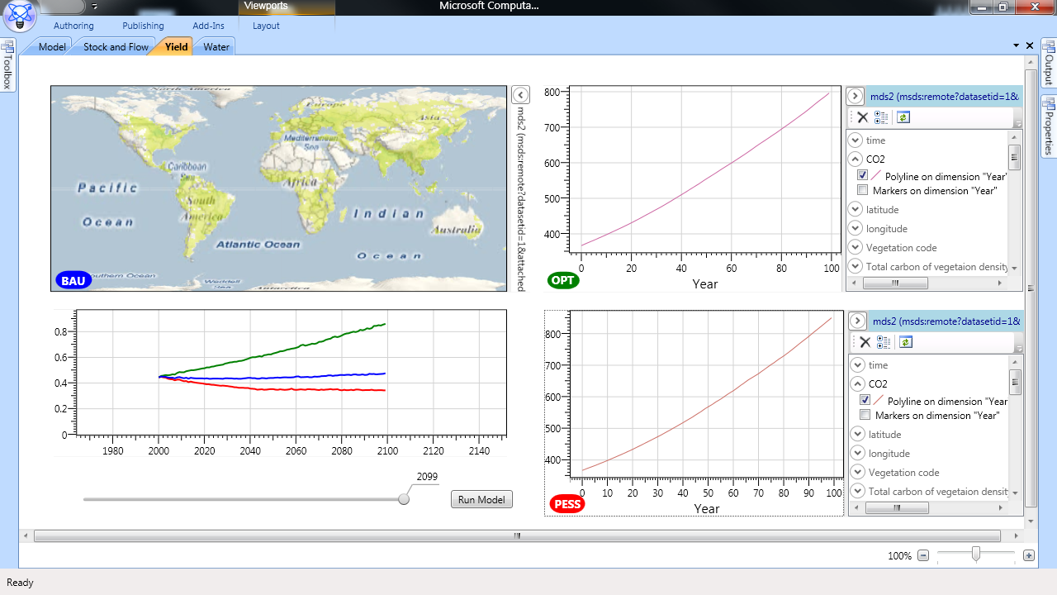
Human feedbacks
Agricultural yield affects crop prices affects deforestation...
...affects carbon emissions affects climate affects agricultural yield

Slide 18
Fossil fuel emissions

Slide 19
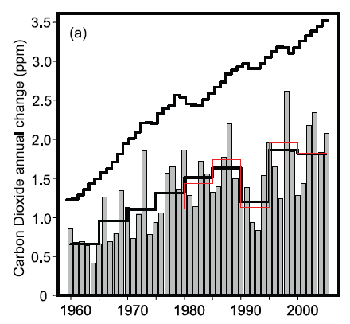
How do we know the increases in CO2 are due to fossil fuels?
Fossil fuel emissions are much larger than CO2 increases!
Not all CO2 is the same – the atmospheric carbon is becoming more ‘fossil fuel’ like
Model inversions
  North-South gradient in CO2
  Bayesian inversions of CO2 fluxes
But not just fossil fuels
  - Tropical deforestation
Fossil fuel emissions are one of the most certain terms in the global carbon budget

Slide 20
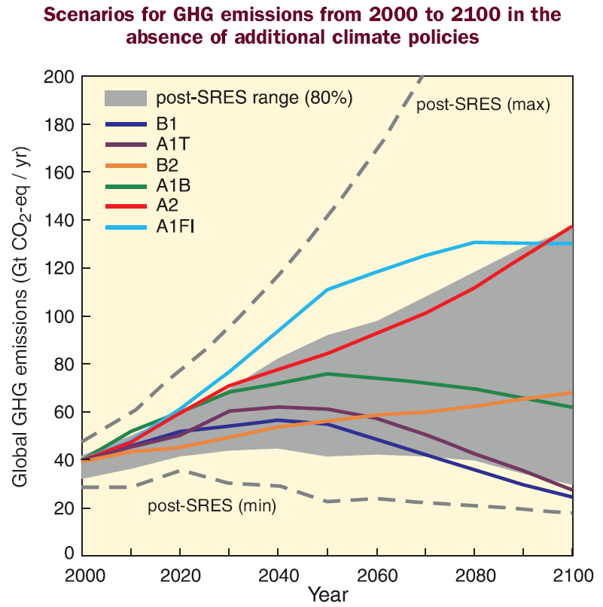
Fossil fuel emissions in the future
Scenario modelling
Population growth
GDP growth
Technological change
Important for more than just CO2

Slide 21
The ocean carbon sink

Slide 22
The ocean carbon sink
CO2
92.2
90.0
Dissolved carbon (DIC)
6.4
101.0
102.8
Fossil fuels
Dissolved carbon (DIC)

Slide 23
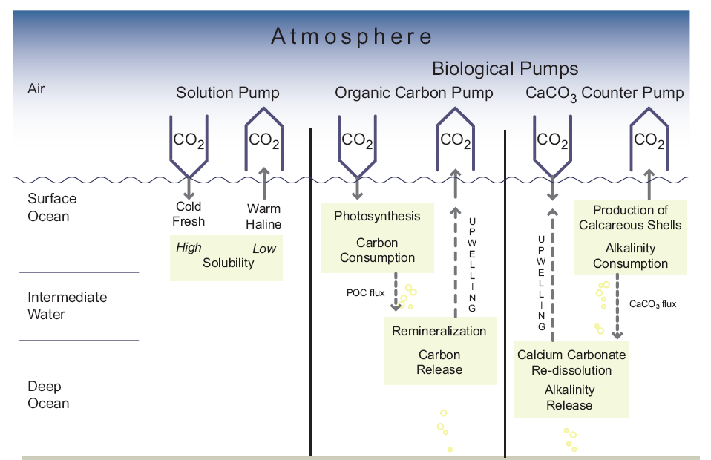
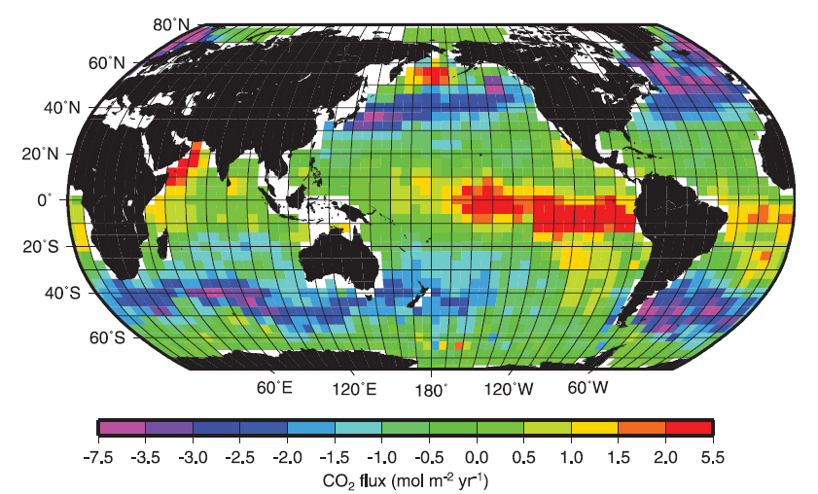
What drives the ocean sink?
How do we know?
Model-data inversions based on large data sets
7 different modelling methods – but they pretty much agree!
Current ocean sink considered well constrained

Slide 24
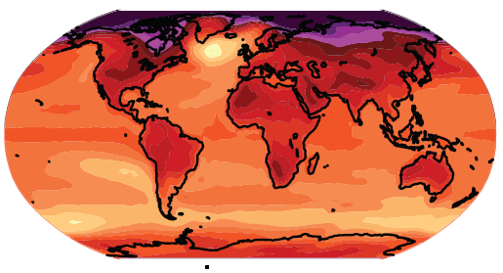
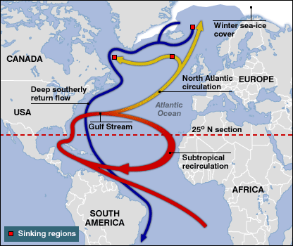
Ocean sink: the future
Ocean pump
Temperature change
The biological pump
Circulation patterns

Slide 25
The terrestrial carbon cycle

Slide 26
The terrestrial carbon sink
60.0 (+-)
CO2
-1.0
120.0 (+-)
Living carbon
deforestation (+ ve)
60.0 (+-)
60.0 (+-)
Dead carbon
Vegetation processes huge amounts of carbon
After deforestation taken out, net carbon sink
This sink higher in 1990s than 1980s
i.e., sink is sensitive
Soil carbon

Slide 27
The terrestrial carbon sink
CO2
60.0 (+-)
-1.0
Living carbon
deforestation (+ ve)
60.0 (+-)
60.0 (+-)
Dead carbon
Vegetation processes huge amounts of carbon
After deforestation taken out, net carbon sink
This sink higher in 1990s than 1980s
i.e., sink is sensitive
Soil carbon

Slide 28
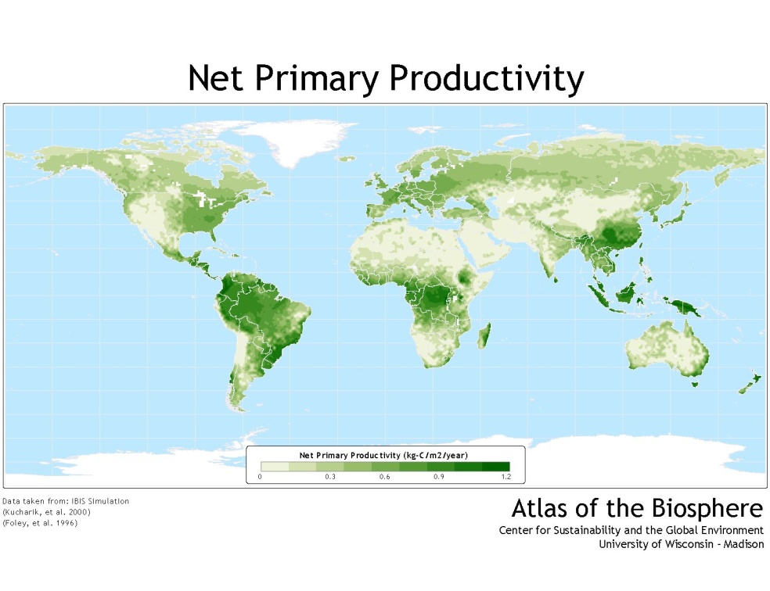
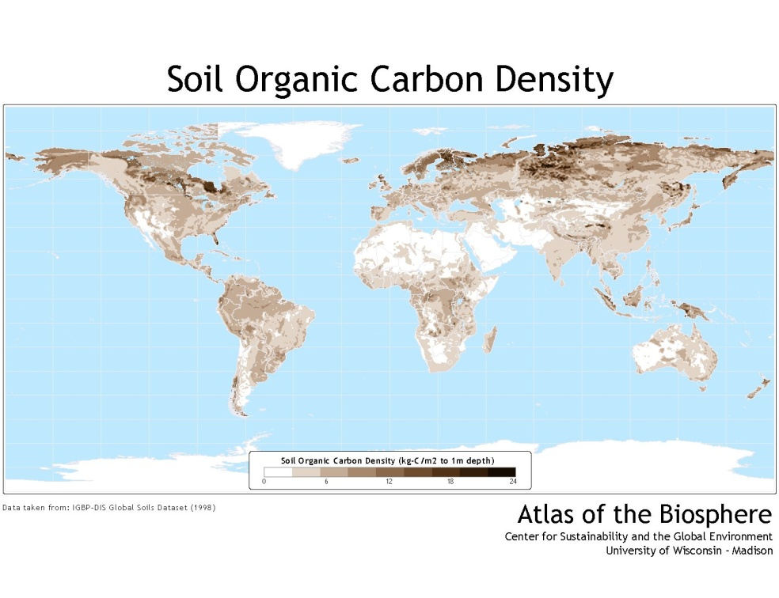
The terrestrial carbon cycle: global patterns

Slide 29
The future terrestrial carbon cycle

Slide 30
The Carbon-Climate Feedback Project
Aim
To substantially improve predictions of the future atmospheric CO2, by developing and applying new and better models of the global carbon cycle
Method
Develop a new carbon-climate modelling system that allows for rapid experimentation with a wide variety of carbon cycle models
Take a balanced, multi-scale modelling approach
Develop whatever software is necessary to achieve this

Slide 31
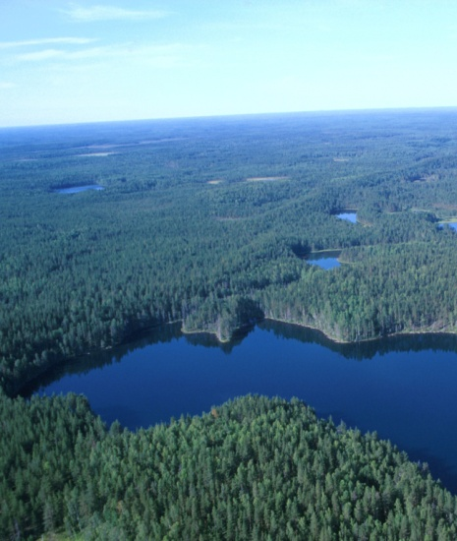
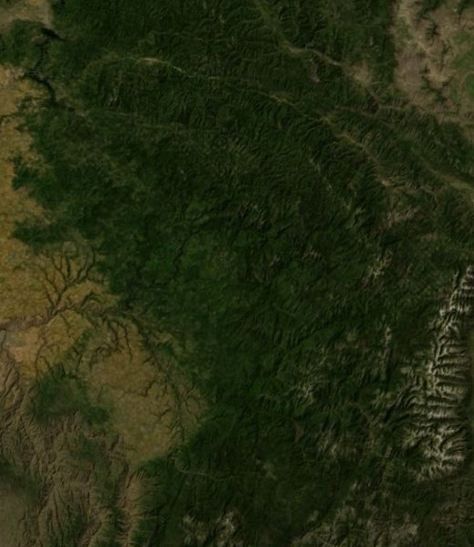
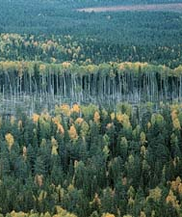
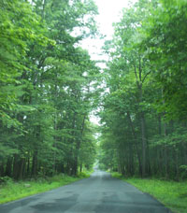
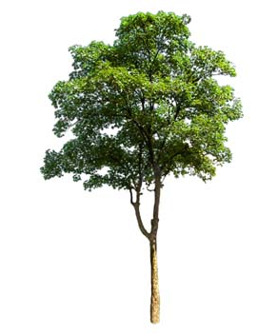
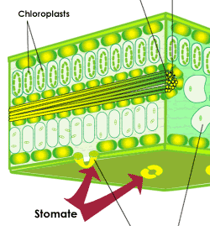
Joining up subsystems / subdisciplines
Spatial and temporal scale

Slide 32
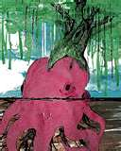
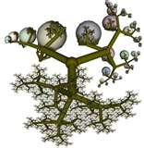
Trimming the arbitrary tree

Slide 33
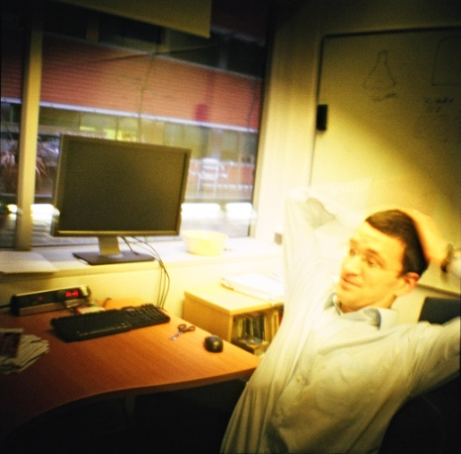
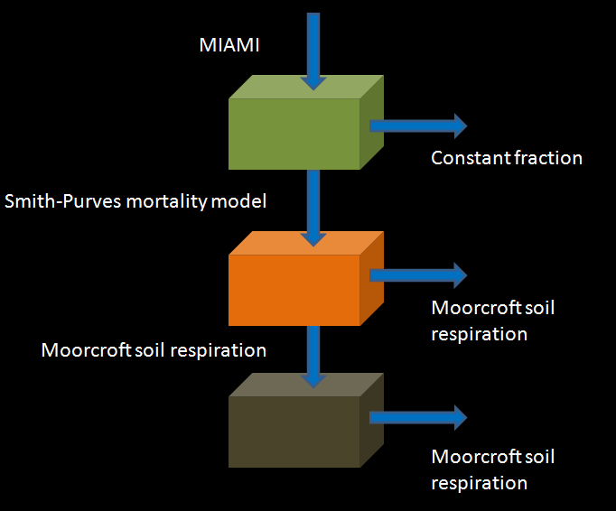
Balanced Complexity Modelling
Step 1: go back and start again
Matt Smith

Slide 34
Balanced Complexity Modelling
Step 1: go back and start again
Matt Smith
Matt Smith, recent unpublished work

Slide 35
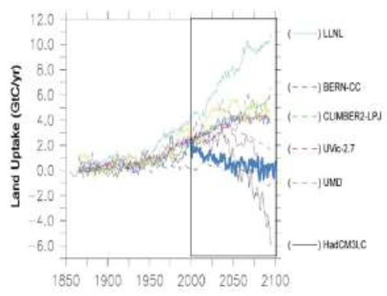
Balanced Complexity Modelling
Step 1: go back and start again
Matt Smith
Matt Smith, recent unpublished work

Slide 36

Joined up ecology: enabling the collective mind

Slide 37

Defensible Modelling, Plug and Play Modelling, Publishing Extensible Models
Matt Smith internal email May 2010

Slide 38



Defensible Modelling, Plug and Play Modelling, Publishing Extensible Models
Vassily Lyutsarev
Matt Smith internal email May 2010

Slide 39




Where next? Multi-scale Modelling
Putting the trees into the forests
Drew Purves
Purves et al., PNAS, PLoS-One, Ecological Monographs, Proc Roy Soc B

Slide 40


Multi-scale Modelling
Putting the trees into the forests
Mark Vanderwel
Mark Vanderwel, recent unpublished work

Slide 41

Multi-scale Modelling
Putting the trees into the forests
Mark Vanderwel
Mark Vanderwel, recent unpublished work

Slide 42

Multi-scale Modelling
Putting the trees into the forests
Mark Vanderwel
Mark Vanderwel, recent unpublished work

Slide 43



Where next? Community Ecology
Emily Lines
http://sharepointemea/sites/cscience/data/FetchClimate/Fetch%20Climate%20Get%20Started.docx

Slide 44

Wrapping up
Science is the driver of our times
* Science of complex, multi-scale, biological systems
* Predictive models of these systems
Joined up Ecology
* Joining up subsystems / subdisciplines
* Joining up theory, models, data, computation, application
A new ecosystem of software tools
* Complex, heterogeneous data
* Define, parameterize, select between, and share extensible models
* Visualize and communicate scientific outputs to stakeholders
* From small & simple to big & complex
The most important thing
* Deciding to take this stuff seriously

Slide 45

Drew’s advice to you dear listeners
Build a cog

