Slide 1
Purity Analysis :
Abstract Interpretation Formulation
Ravichandhran Madhavan,
G. Ramalingam,
Kapil Vaswani
Microsoft Research, India

Slide 2
Purity Analysis
[Salcianu & Rinard VMCAI ‘05, Whaley & Rinard OOPSLA ‘99]
A (side) effect analysis for the heap
A foundational analysis with several applications
  Pointer analysis
  Escape analysis
  Checking correctness of speculative parallelism [Prabhu et al., PLDI’10]
  Lightweight bug finding tools
  Heavyweight software model checking and verification tools (like SLAM)

Slide 3
Our Contributions
An Abstract Interpretation formalization
  A simpler explanation of the analysis
  A simpler and more standard correctness proof
  Helps extend and modify algorithm …
    for Scalability
    Precision
    Functionality
  and verify correctness of extensions/modifications
  A step towards formalizing similar modular heap analyses like Lattner et al. [PLDI ‘07], Buss et al. [SAC ’08]
3 new optimizations with empirical evaluations

Slide 4
Modular
Heap Effect Analysis

Slide 5
Problem and Challenges
Heap Effect Analysis: Determine effect of a procedure call on heap (global program state)
Modularity: Compute a context-independent summary for each procedure
Challenge: Procedure behavior and effect depend on aliasing in input heap
Very few modular analyses can handle aliasing in input heap.
WSR analysis is one of them.

Slide 6
Challenging Example
P(x,y) {
t = new ()
x.next = t
t.next = y
retval = y.next
}
x
y
x
t
y
retval
o₁
o₂
next
o₃
o₁
next
n₂
next
o₂
next
o₃
x
y
x
y
u₁
next
n₂
u₂
u₁
next
u₂
next
t
retval

Slide 7
Two possible Approaches
Compute different summaries for different aliasing configurations.
  Pros: Better precision
  Cons: Possible explosion in the number of summaries
Compute a single summary – approach taken by WSR.

Slide 8
Two approaches - Example
x
t
y
retval
x
y
o₁
o₂
next
o₃
o₁
next
n₂
next
o₂
next
o₃
x
y
x
y
u₁
next
n₂
u₂
u₁
next
u₂
next
t
retval
WSR summary
x
t
y
retval
p₁
next
n₂
next
p₂
next
n₅

Slide 9
Computing
WSR Summaries

Slide 10
Overview
(Transformer Graph)
P(x,y) {
t = new ()
x.next = t
t.next = y
retval = y.next
}
x
t
y
retval
p₁
next
n₂
next
p₂
next
n₅
Read edge
(External edge)
Place holders
(External node)
Write edge
(Internal edge)
Local allocs
(Internal node)

Slide 11
Formalizing WSR analysis
Like shape analyses, WSR analysis computes a graph at every program point.
But the graphs are abstractions of state transformers rather than states.

Slide 12
Abstract Interpretation Formulation

Slide 13
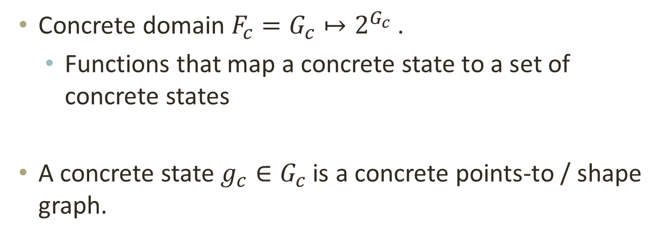
Concrete Domain
Concrete domain $F_{c}=G_{c}↦2^{G_{c}}$.
  Functions that map a concrete state to a set of concrete states
A concrete state ${g_{c}∈G}_{c}$ is a concrete points-to / shape graph.

Slide 14
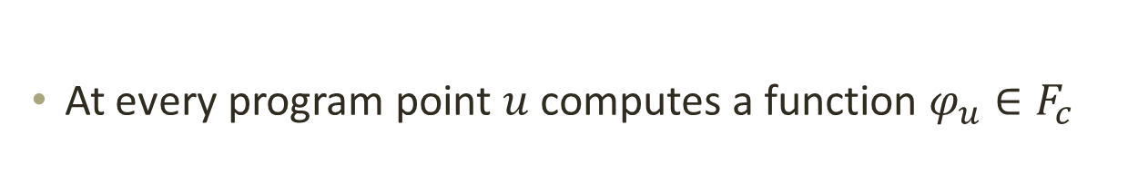



Concrete Semantics
At every program point $u$ computes a function $φ_{u}∈F_{c}$
$$g$$
P() {
…
…
…
u:
…
}
$$φ_{u}$$
$$g_{1},g_{2}, …$$
Parametric collecting semantics
In the style of Sharir and Pnueli’s functional approach.

Slide 15
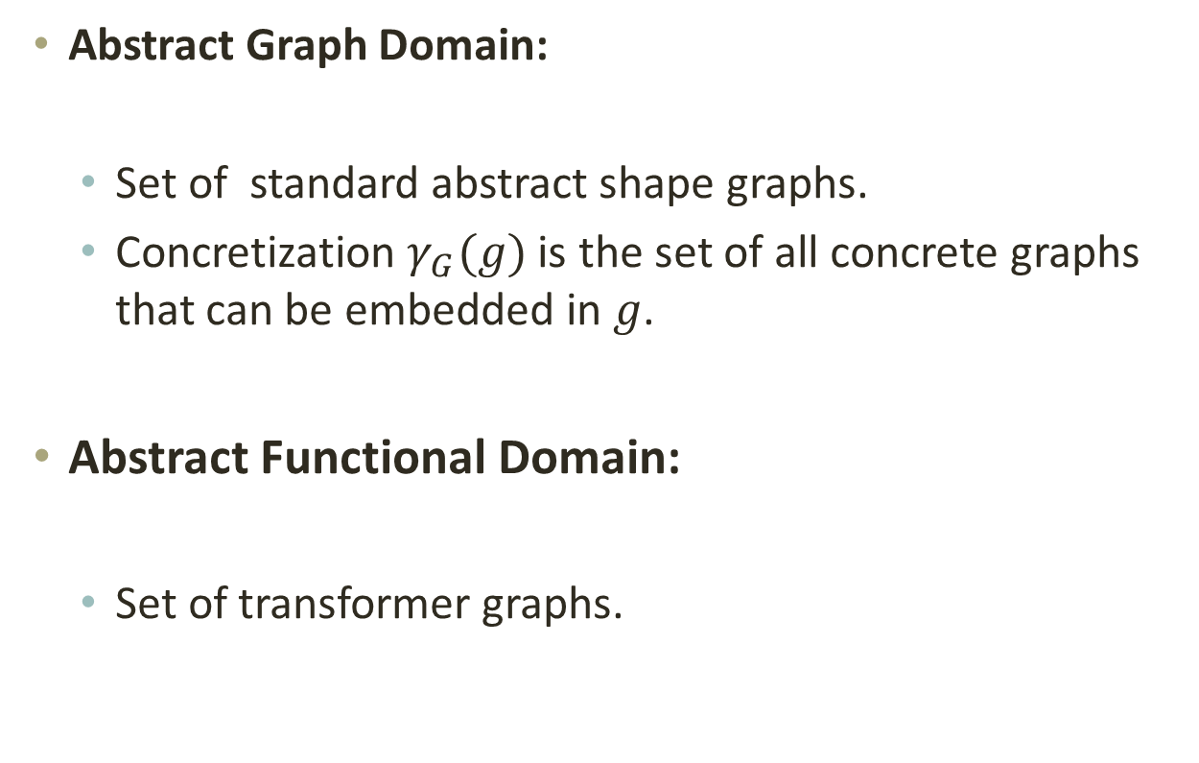
Abstract Domains
Abstract Graph Domain:
  Set of standard abstract shape graphs.
  Concretization $γ_{G}(g)$ is the set of all concrete graphs that can be embedded in $g$.
Abstract Functional Domain:
  Set of transformer graphs.

Slide 16
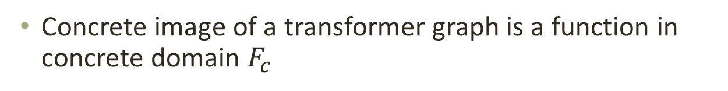
Concretization
Concrete image of a transformer graph is a function in concrete domain $F_{c}$
Concrete state
Concrete state(s)
Modified portion
Transformed portion
Mapping Phase
(Identifies modified portion)
Transformation Phase
Transformer graph

Slide 17
Mapping Phase Illustration
x
y
u₁
next
u₂
Concrete state
x
y
p₁
next
n₂
next
p₂
next
n₅
Transformer graph
t
retval

Slide 18
Transformation Phase Illustration
x
y
u₁
next
u₂
x
y
p₁
next
n₂
next
p₂
next
n₅
t
retval

Slide 19
Transformation Phase Illustration
x
y
next
u₁
next
n₂
u₂
next
retval
x
y
p₁
next
n₂
next
p₂
next
n₅
t
retval

Slide 20
Transformation Phase Illustration
x
y
next
u₁
next
n₂
u₂
next
retval
Abstract shape graph representing a set of concrete states

Slide 21

Abstract Vs Concrete Summary
x
y
next
x
y
$$γ(τ)$$
u₁
next
n₂
u₂
u₁
next
u₂
next
retval
x
y
x
y
Concrete summary
u₁
next
u₂
u₁
next
n₂
u₂
next
t
retval
Notes:
First function is an over-approximation of the second function.
After Animation:
- This because of the two additional edges which are a result of weak update.

Slide 22
Correctness and Termination

Slide 23
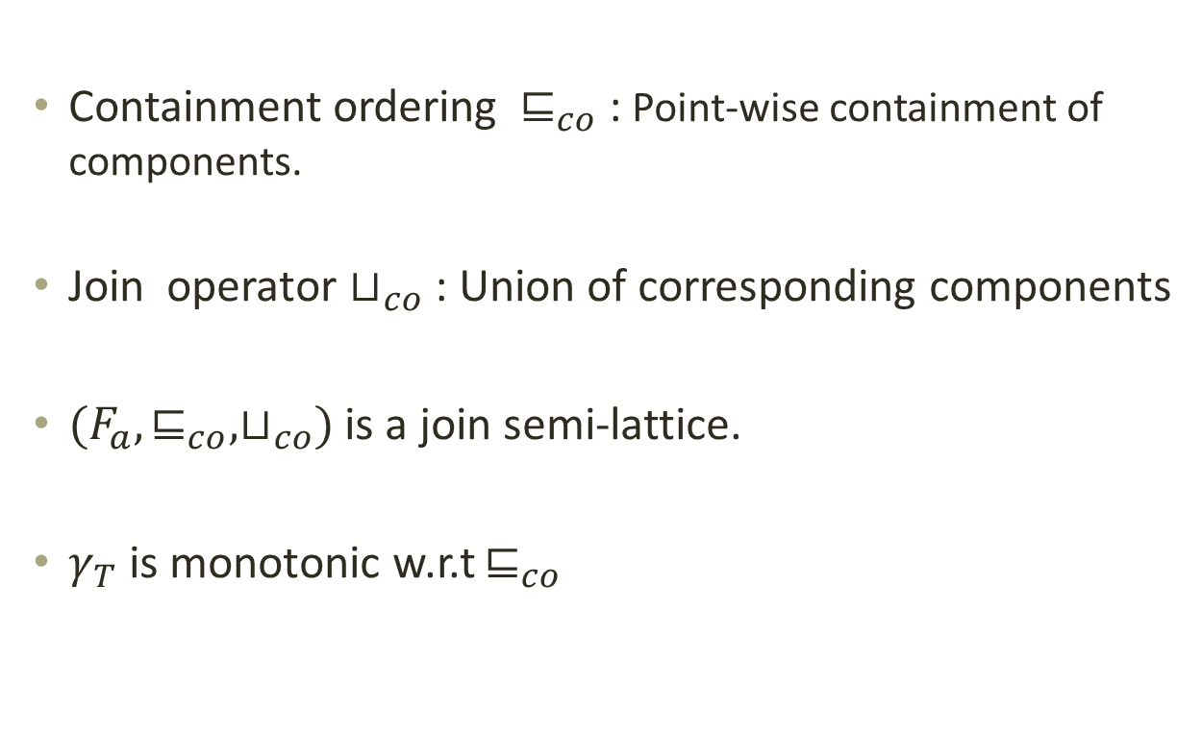
Partial order and join
Containment ordering $⊑_{co}$ : Point-wise containment of components.
Join operator $⊔_{co}$ : Union of corresponding components
$(F_{a},⊑_{co}, ⊔_{co})$ is a join semi-lattice.
$γ_{T}$ is monotonic w.r.t $⊑_{co}$

Slide 24
Abstract Semantics
Computes a transformer graph at every program point.
Uses a set of equations having the same structure as the concrete semantics.
Uses the abstract transformers for statements and procedure calls.
Handles procedure calls using the summary of the called function.

Slide 25
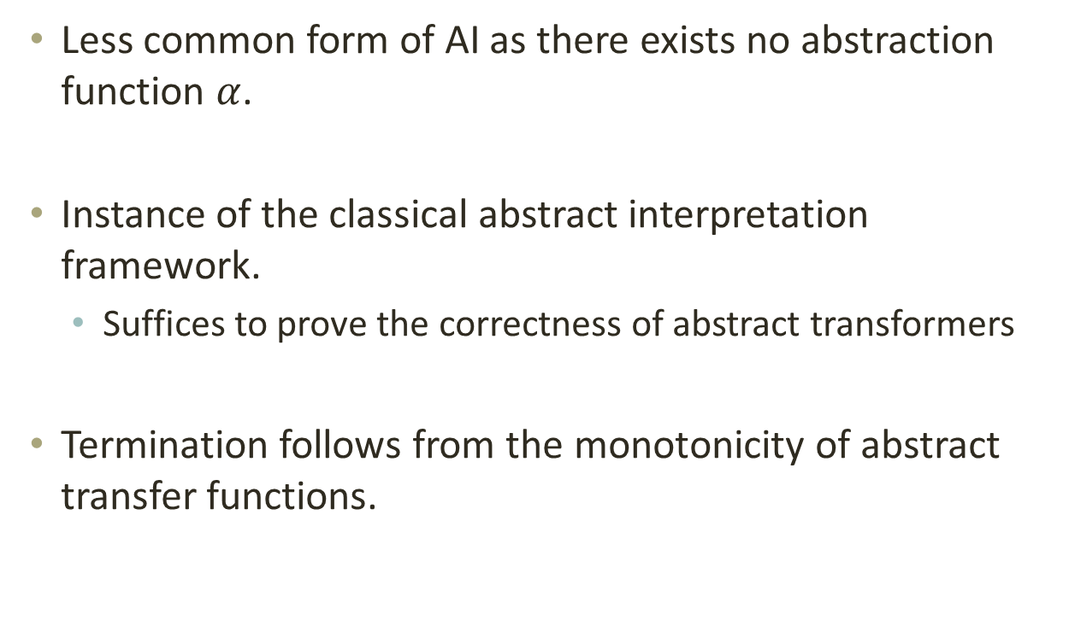
Correctness and Termination
Less common form of AI as there exists no abstraction function $α$.
Instance of the classical abstract interpretation framework.
  Suffices to prove the correctness of abstract transformers
Termination follows from the monotonicity of abstract transfer functions.

Slide 26
Optimizations

Slide 27
Need for optimizations
Benchmark | Lines of Code | WSR analysis
 |  | Time(s) | Memory (MB)
Dynamic data display | 25K | 4696 | 1937
SharpMap | 26K | Time out | -
PDFsharp | 96K | 5088 | 1502
Dotspatial (12 DLLS) | 200K | Time out | -

Slide 28

Node Merging Optimization
x
n₃
P(x) {
If(*)
t = new …;
t = new …;
x.f = t;
t.g = new …;
}
g
f
n₆
p₁
f
n₄
g
t
Same concrete image
Nodes $n_{3},n_{4}$ are merged
x
p₁
f
n₃
g
n₆
t

Slide 29
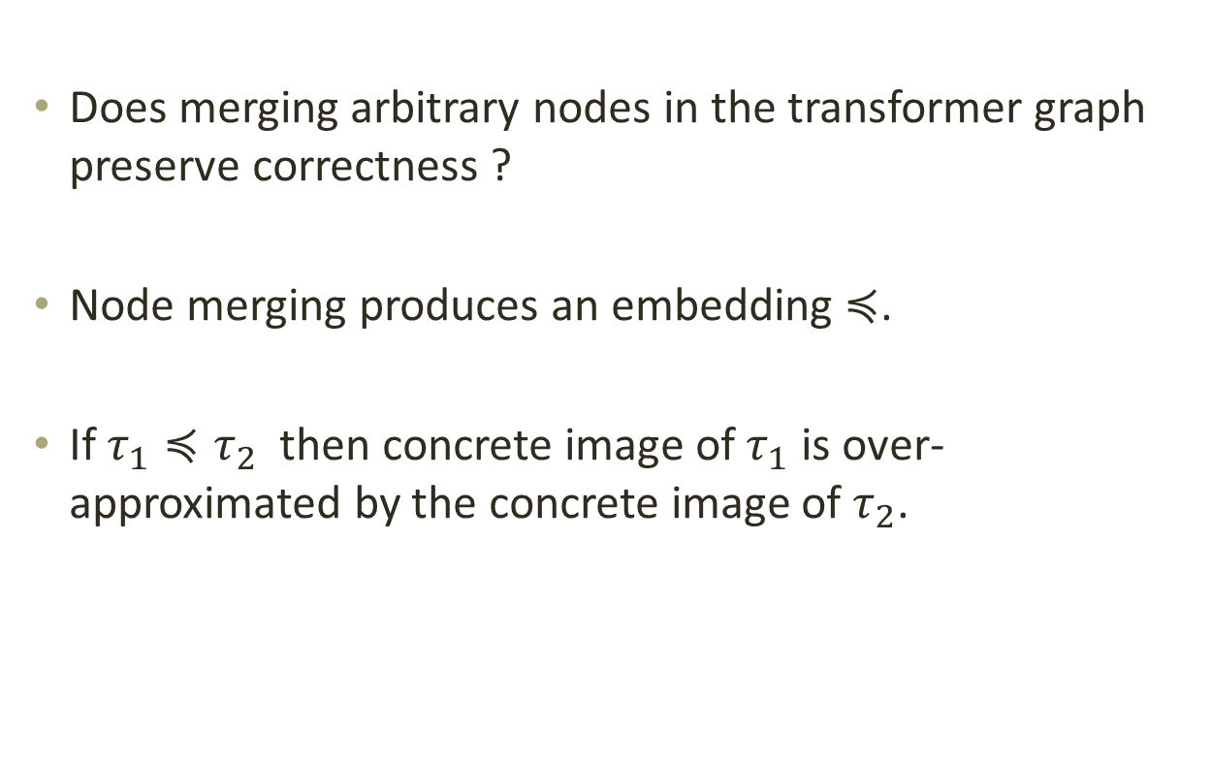
Correctness of node merging
Does merging arbitrary nodes in the transformer graph preserve correctness ?
Node merging produces an embedding $≼$.
If $τ_{1}≼τ_{2}$ then concrete image of $τ_{1}$ is over-approximated by the concrete image of $τ_{2}$.

Slide 30
Termination with node merging
Node merging doesn’t preserve containment ordering.
Termination is guaranteed only if merged nodes do not reappear in subsequent steps.

Slide 31
Termination with node merging [Cont.]
Solution : Track (transformer graph, equivalence relation) pairs.
The equivalence relation records nodes merged in the previous steps.
Whenever a new node is created replace it with the representative of its equivalence class.

Slide 32
Identifying nodes to merge
Arbitrarily merging nodes will reduce precision.
Our Heuristics:
n₂
f
n₁
n₁
f
n₂
f
n₃
n₂
f
n₁
n₁
f
n₂
f
n₃
Results in no loss of precision in our benchmarks when used in a purity analysis

Slide 33
Evaluation of Node merging
Benchmark | Lines of Code | With Node merging
 |  | Time (s) | Memory (MB)
Dynamic data display | 25K | 58 | 427
SharpMap | 26K | 615 | 356
PDFsharp | 96K | 125 | 535
Dotspatial (12 DLLS) | 200K | 963 | 568

Slide 34














Optimization 2 : Summary merging
Applies to virtual method calls.
With optimization
$$τ_{in}$$
$$τ_{in}$$
$$τ_{in}$$
$$τ_{in}$$
$$τ_{merge}$$
$$τ_{1}$$
$$τ_{2}$$
…
$$τ_{n}$$
$$τ_{merge}〈〈τ_{in}〉〉$$
$$τ_{2}〈〈τ_{in}〉〉$$
$$τ_{1}〈〈τ_{in}〉〉$$
$$τ_{n}〈〈τ_{in}〉〉$$
$$τ_{merge}=merge(τ_{1} ⊔_{co}…⊔_{co} τ_{n})$$
$$τ_{out}$$

Slide 35
Optimization 3: Safe node elimination
Removes unnecessary external nodes.
Eg: Set::Contains is pure but its WSR summary has many external edges/nodes.
Does not affect precision.

Slide 36
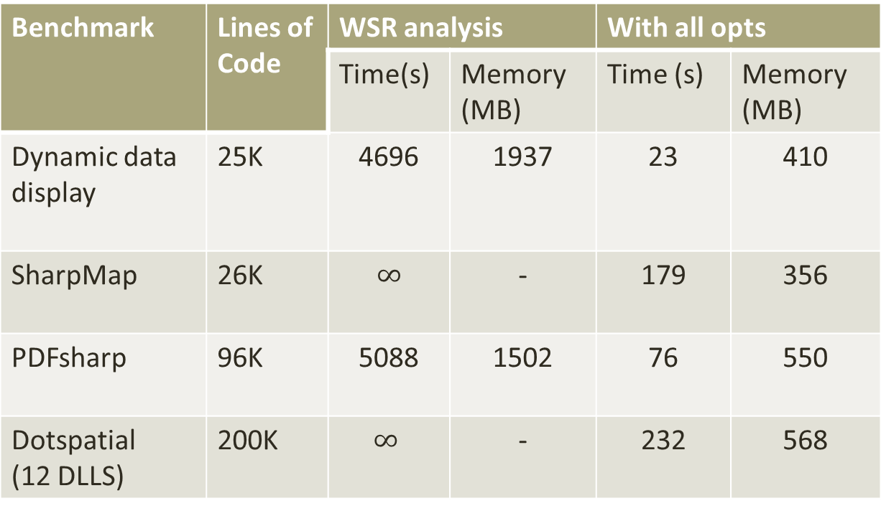
Empirical evaluation
Benchmark | Lines of Code | WSR analysis |  | With all opts
 |  | Time(s) | Memory (MB) | Time (s) | Memory (MB)
Dynamic data display | 25K | 4696 | 1937 | 23 | 410
SharpMap | 26K | $∞$ | - | 179 | 356
PDFsharp | 96K | 5088 | 1502 | 76 | 550
Dotspatial (12 DLLS) | 200K | $$∞$$ | - | 232 | 568

Slide 37
Conclusion
WSR analysis is a widely used modular heap analysis.
Formalized WSR analysis as an Abstract Interpretation.
  Mentioned as an open problem by Salcianu.
Proposed 3 Optimizations to WSR analysis.
  Proved them correct using the AI formulation.
  They make the analysis to scale to large programs.

