Slide 1

Community Distribution Outliers in Heterogeneous Information Networks
Manish Gupta¹, Jing Gao², Jiawei Han³
¹Microsoft, India ²SUNY Buffalo, NY, USA ³UIUC, IL, USA
EUROPEAN CONFERENCE ON MACHINE LEARNING
AND
PRINCIPLES AND PRACTICE OF KNOWLEDGE DISCOVERY IN DATABASES
2013

Slide 2
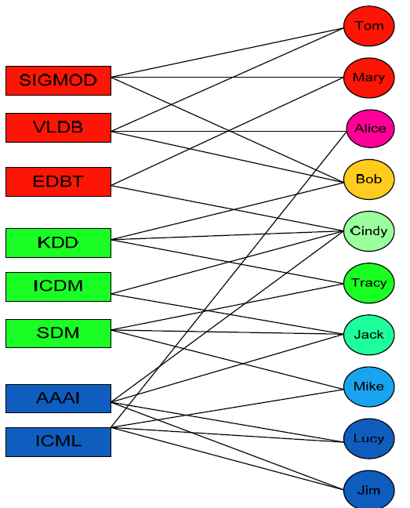
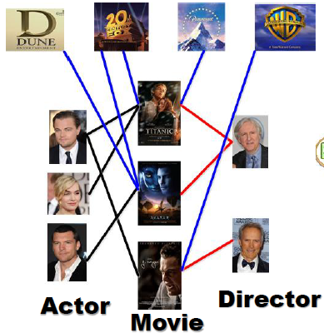
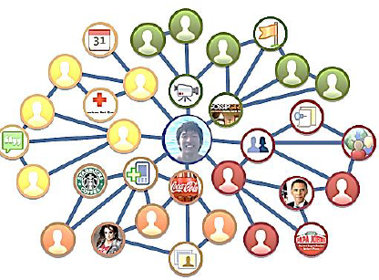




Heterogeneous Networks are Ubiquitous
Studio
IMDB Network
DBLP Network
Facebook Network
Actor
Movie
Studio
Director
Image Credits:
http://cairo.cs.uiuc.edu/projects/firstResponder/pics/fsnetwork.jpg http://h71000.www7.hp.com/network/works.gif
http://www.few.vu.nl/~michielh/img/eculture_datacloud.png http://www.pnas.org/content/101/9/2981/F2.large.jpg
Notes:
MultiMediaN E-Culture
By linking the collections and vocabularies from multiple museums together the E-Culture project constructed a graph of cultural heritage data. Within the MultimediaN E-Culture team I investigated how keyword search can be applied to this heterogeneous graph to find artworks that are semantically related artworks to a keyword query?

Slide 3
Abstract
Community Distribution Outliers (CDOutliers) for heterogeneous information networks: Objects whose community distribution does not follow any of the popular community distribution patterns
Distribution Patterns
  Discovered by exploiting both intra-type and inter-type information
An iterative two-stage approach to identify outliers
Experiments on multiple real and synthetic datasets

Slide 4
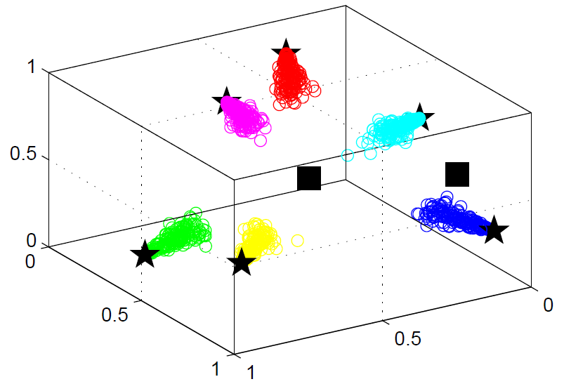
Community Distribution Outliers
Type | x | y | z
Pattern “b” | 0.8 | 0.0 | 0.2
Pattern “g” | 0.2 | 0.8 | 0.0
Pattern “r” | 0.0 | 0.2 | 0.8
Pattern “c” | 0.4 | 0.0 | 0.6
Pattern “m” | 0.0 | 0.4 | 0.6
Pattern “y” | 0.4 | 0.6 | 0.0
Outlier 1 | 0.6 | 0.0 | 0.4
Outlier 2 | 0.33 | 0.33 | 0.34
Distribution Pattern
  A cluster obtained by grouping rows of a belongingness matrix
  Can be represented using cluster centroids
Community Distribution Outliers: Objects whose community distribution does not follow any of the popular community distribution patterns

Slide 5





Real-life Examples
EXPERT
User
Tag
URL
Fashion
Arts
Science
Sports
MARKETER
User
Tag
Video
Fashion
Arts
Science
Sports

Slide 6
Existing Work
Outlier Detection for Networks with Global Context
  Sub-Structure Outliers [Noble and Cook, 2003], SCAN [Xu et al., 2007], Stream Outliers [Aggarwal et al., 2011b]
  Global versus community context
Outlier Detection for Homogeneous Networks
  Community outlier detection algorithms [Gao et al., 2010], [Gupta et al., 2012a], [Gupta et al., 2012b]
  Homogeneous versus heterogeneous networks.

Slide 7




Our Approach in Brief
Pattern Discovery
Outlier Detection
H₁
Top $κ$ Outliers
T₁
W₁
Joint NMF
H₂
W₂
Top $κ$ Outliers
T₂
H₃
Top $κ$ Outliers
W₃
T₃
Remove Outliers from T_{i}

Slide 8
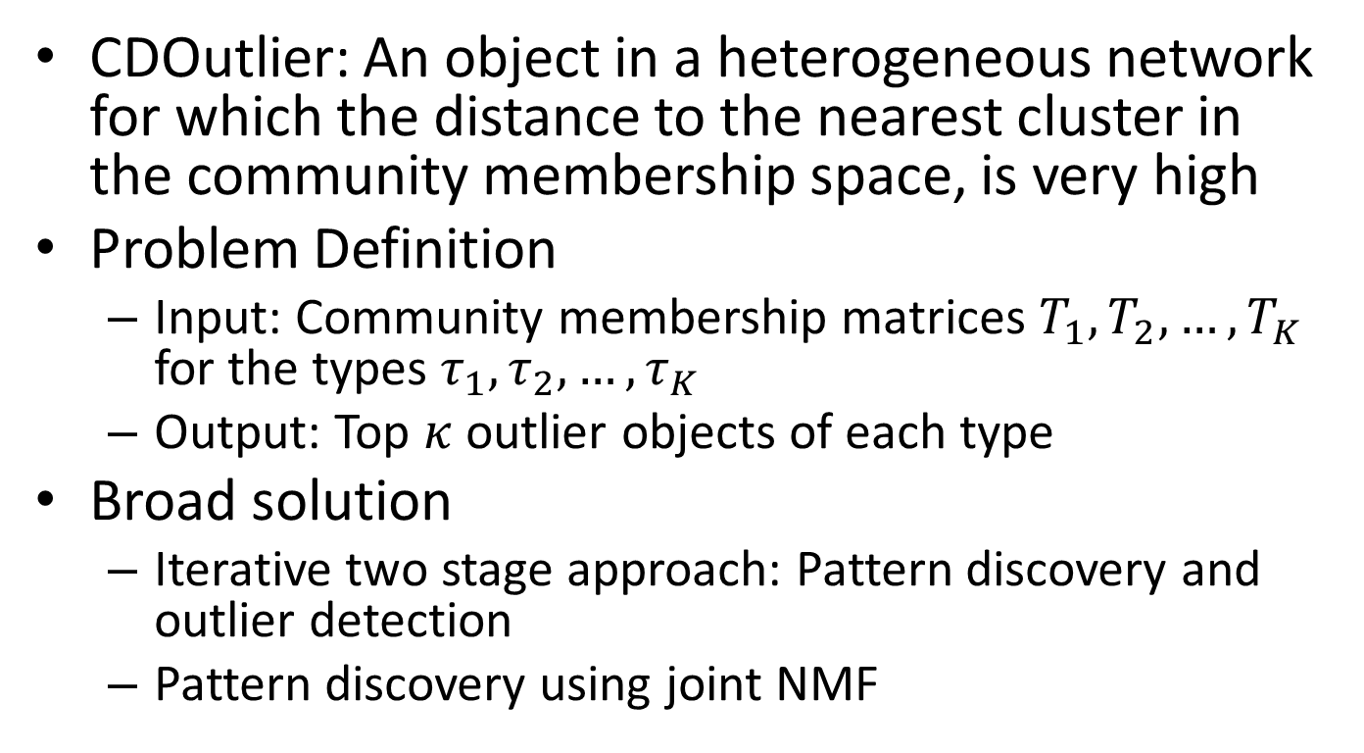
Community Distribution Outlier Detection Problem
CDOutlier: An object in a heterogeneous network for which the distance to the nearest cluster in the community membership space, is very high
Problem Definition
  Input: Community membership matrices $T_{1}, T_{2}, …, T_{K}$ for the types $τ_{1},τ_{2},…, τ_{K}$
  Output: Top $κ$ outlier objects of each type
Broad solution
  Iterative two stage approach: Pattern discovery and outlier detection
  Pattern discovery using joint NMF

Slide 9
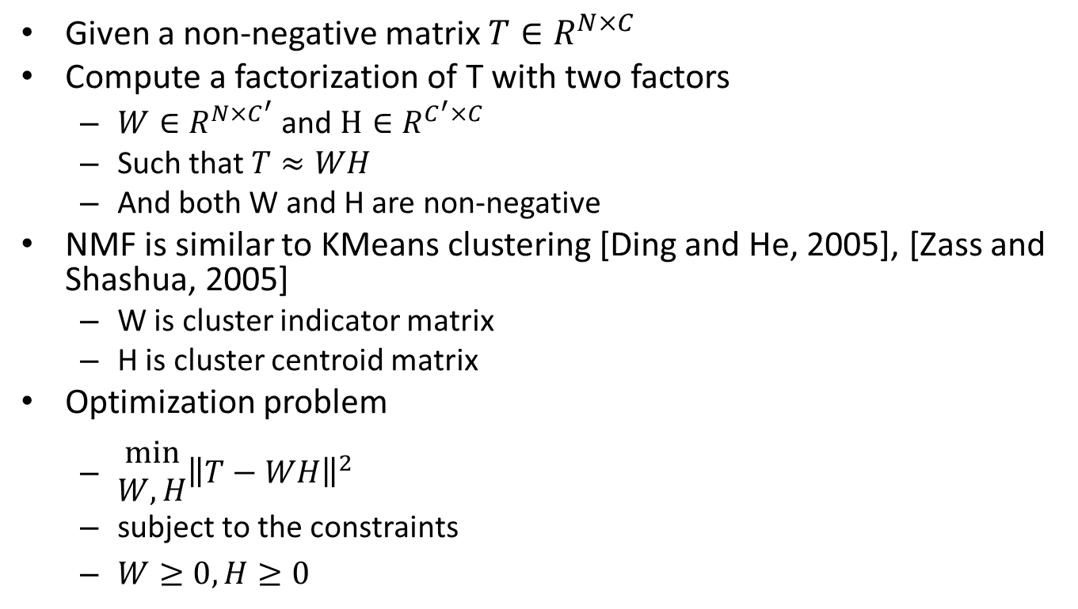
Brief Overview of NMF
Given a non-negative matrix $T∈R^{N×C}$
Compute a factorization of T with two factors
  $W∈R^{N×C^{′}}$ and $H∈R^{C^{′}×C}$
  Such that $T≈WH$
  And both W and H are non-negative
NMF is similar to KMeans clustering [Ding and He, 2005], [Zass and Shashua, 2005]
  W is cluster indicator matrix
  H is cluster centroid matrix
Optimization problem
  $\begin{aligned}min \\ W,H\end{aligned}{{\left\|T−WH\right\|}^{2}}$
  subject to the constraints
  $W≥0, H≥0$

Slide 10
Discovery of Distribution Patterns
Each of the T matrices can be clustered individually
But the membership matrices T
  Are defined for objects that are connected to each other
  Represent objects in the same space of C dimensions
Hidden structures across types should be consistent with each other
Divergence between any two clusterings should be small

Slide 11
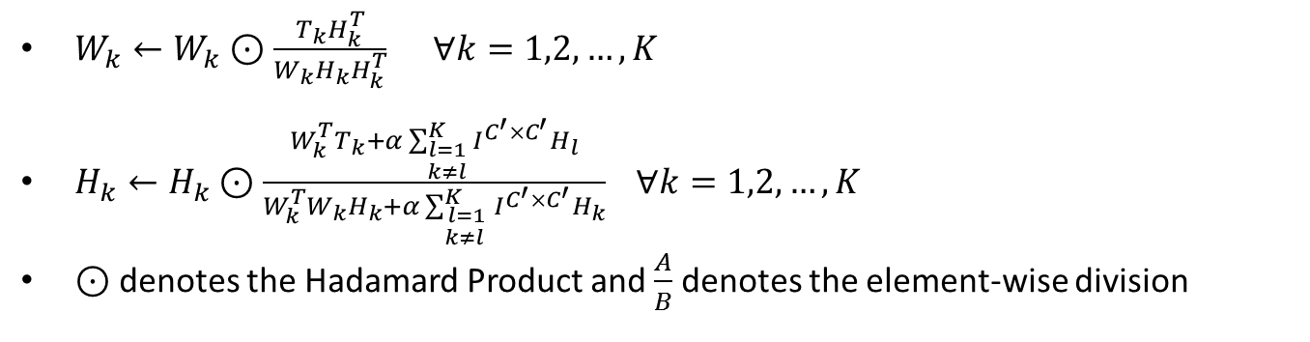
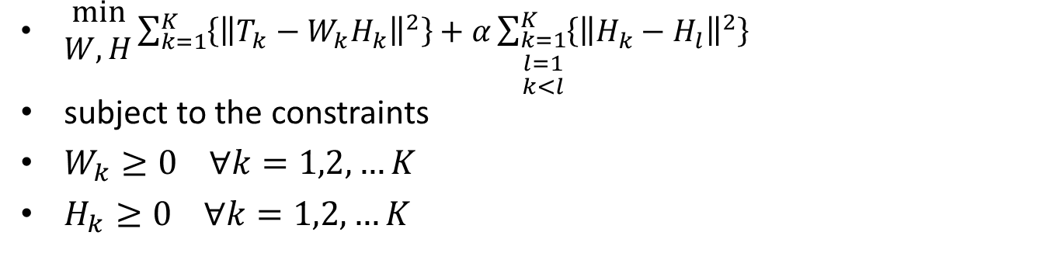
Optimization & Iterative Update Rules
  $\begin{aligned}min \\ W,H\end{aligned}{{\sum_{k=1}^{K}{\left\{{\left\|T_{k}−W_{k}H_{k}\right\|}^{2}\right\}}+α\sum_{\begin{aligned}k=1 \\ l=1 \\ k<l\end{aligned}}^{K}{\left\{{\left\|H_{k}−H_{l}\right\|}^{2}\right\}}}^{}}$
subject to the constraints
$W_{k}≥0 ∀k=1,2,…K$
$H_{k}≥0 ∀k=1,2,…K$
$W_{k}←W_{k}⊙\frac{T_{k}H_{k}^{T}}{W_{k}H_{k}H_{k}^{T}} ∀k=1,2,…, K$
$H_{k}←H_{k}⊙\frac{W_{k}^{T}T_{k}+α\sum_{\begin{aligned}l=1 \\ k≠l\end{aligned}}^{K}{I^{C^{′}×C^{′}}H_{l}}}{W_{k}^{T}W_{k}H_{k}+α\sum_{\begin{aligned}l=1 \\ k≠l \end{aligned}}^{K}{I^{C^{′}×C^{′}}H_{k}}} ∀k=1,2,…, K$
$⊙$denotes the Hadamard Product and $\frac{A}{B}$ denotes the element-wise division

Slide 12
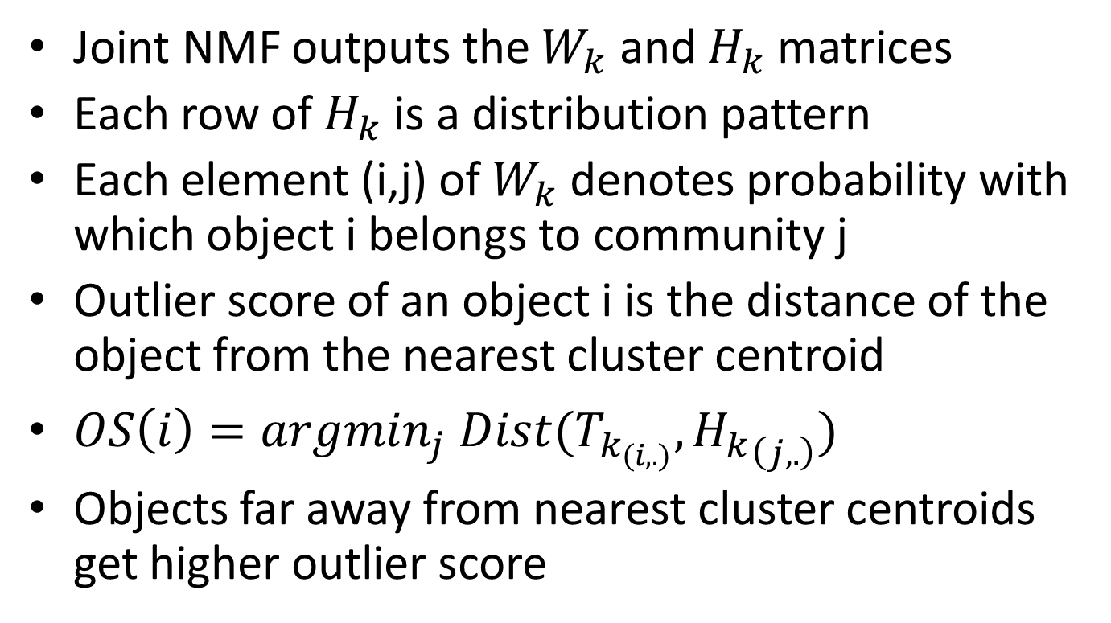
Outlier Detection
Joint NMF outputs the $W_{k}$ and $H_{k}$ matrices
Each row of $H_{k}$ is a distribution pattern
Each element (i,j) of $W_{k}$ denotes probability with which object i belongs to community j
Outlier score of an object i is the distance of the object from the nearest cluster centroid
$OS\left(i\right)=argmin_{j} Dist(T_{k_{\left(i,.\right)}}, {H_{k}}_{\left(j,.\right)})$
Objects far away from nearest cluster centroids get higher outlier score

Slide 13
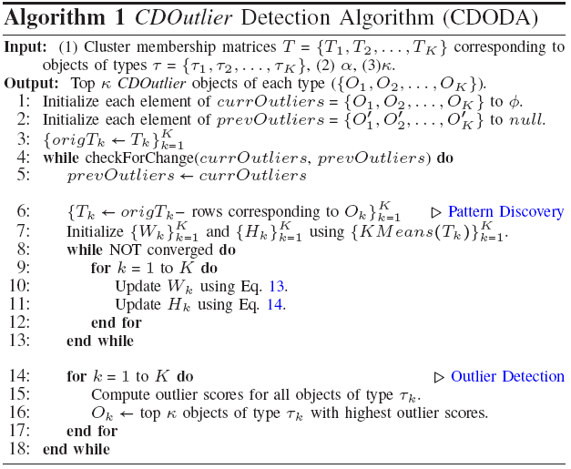




Iterative Refinement Algorithm
$$O(NI^{′}K[KIC^{′2}+log⁡(κ)])$$
Linear in
number of
objects
$$O(K^{2}INC^{′2})$$
$$O(N{KC}^{′2})$$
$$O(KNlog(κ))$$

Slide 14
Experiments
Lack of ground truth
Multiple Synthetic Datasets with different parameter settings
  Number of objects
  Number of object types
  Percent outlierness
  Number of dimensions
Two real datasets: DBLP, Delicious
  Case Studies and Analysis

Slide 15
Baselines
SingleIteration (SI)
  CDO performs community pattern discovery and outlier detection iteratively
  SI performs only one iteration
  Pattern Discovery in SI suffers from presence of CDOutliers
Homogeneous (Homo)
  CDO performs pattern discovery using joint-NMF
  Homo treats all objects to be of the same type and so performs a single matrix NMF

Slide 16
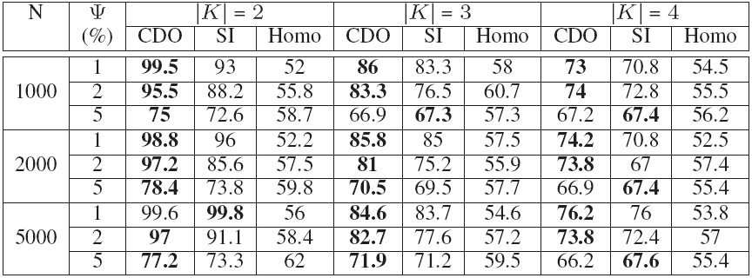
Synthetic Dataset Results Summary
Synthetic Dataset Results (CDO =The Proposed Algorithm CDODA, SI = Single Iteration Baseline, Homo = Homogenous (Single NMF) Baseline) for C=6
100 experiments per setting
Average std deviations are 3.07% for CDO, 3.48% for SI and 2.19% for Homo
SI (2.9%)
Homo(21%)

Slide 17
Running Time and Convergence

Slide 18
Real Dataset Case Studies (DBLP)
Each research area appears as a pattern and then there are other patterns with distributions across multiple areas. E.g., “Data Mining” and “Computational Biology” is a pattern
Some patterns are specific to particular types
  “Software engineering” and “Operating systems” for conferences
  “Concurrent Distributed and Parallel Computing” and “Security and privacy” for authors
  “Security and privacy” and “Education” for terms
Top Outlier Author: Giuseppe de Giacomo - Algorithms and Theory (0.25), Databases (0.47), Artificial Intelligence (0.13), Human Computer Interaction (0.06)
Top conference outlier: From integrated publication and information systems to virtual information and knowledge environments - Databases (0.5), Artificial Intelligence (0.09), Human Computer interaction (0.4)
Top terms outlier: military - Algorithms and theory (0.02), Security and Privacy (0.37), Databases (0.22), Computer Graphics (0.37)

Slide 19
Real Dataset Case Studies (Delicious)
Outlier users
  saassaga: Arts and Design (0.25), Food (0.04), Lifestyle (0.35), Travel (0.34)
  lbbrad: Food (0.24), LifeStyle (0.37), News and Politics (0.37)
Outlier tags
  canoeing - Sports (0.62), Travel (0.38)
  xmen - Entertainment (0.39), Sports (0.61)
Outlier pages (for categories Lifestyle and Travel)
  http://globetrooper.com/
  http://vandelaydesign.com/blog/galleries/travelwebsites/

Slide 20
Conclusions
Introduced outliers with respect to latent communities for heterogeneous networks
Proposed a joint-NMF optimization framework to learn distribution patterns across multiple object types
Proposed an iterative two stage approach for outlier detection
Experimented with multiple real and synthetic datasets

Slide 21
Thanks! gmanish@microsoft.com

Slide 22
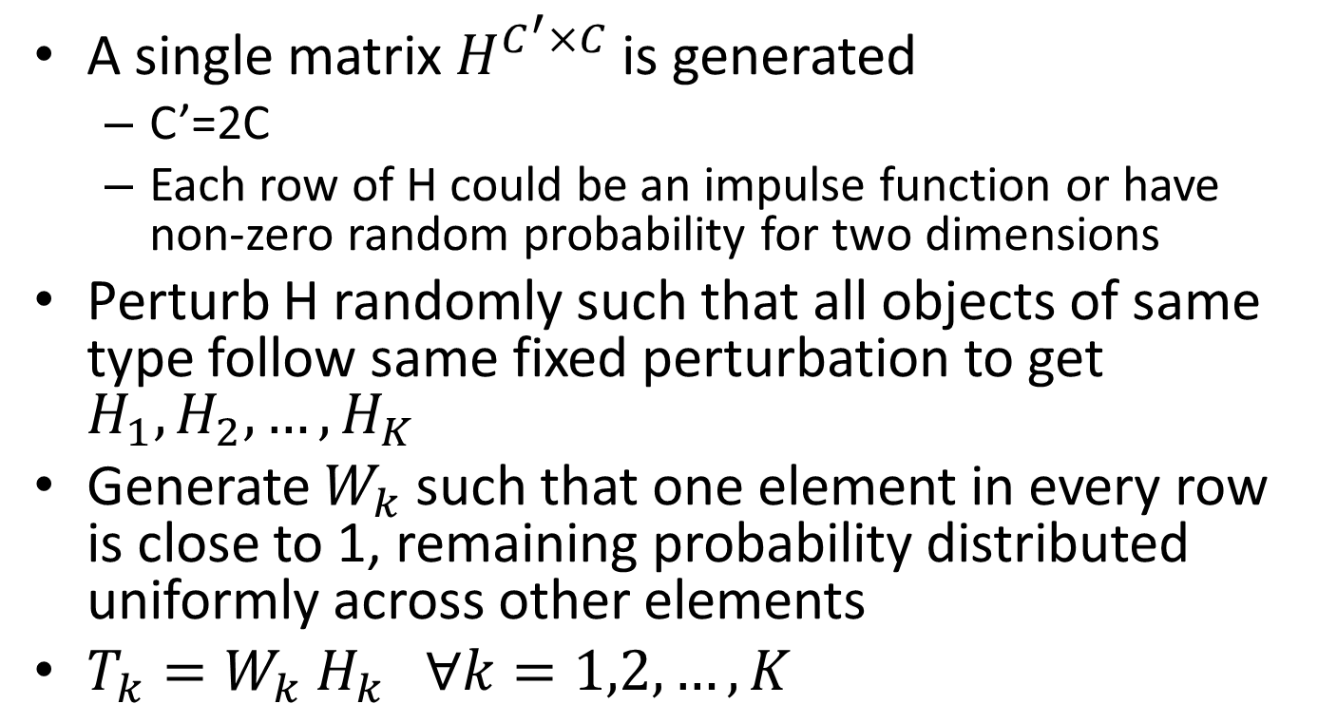
Synthetic Dataset Generation
A single matrix $H^{C^{′}×C}$ is generated
  C’=2C
  Each row of H could be an impulse function or have non-zero random probability for two dimensions
Perturb H randomly such that all objects of same type follow same fixed perturbation to get $H_{1},H_{2},…, H_{K}$
Generate $W_{k}$ such that one element in every row is close to 1, remaining probability distributed uniformly across other elements
$T_{k}=W_{k}{ H}_{k} ∀k=1,2,…, K$

Slide 23
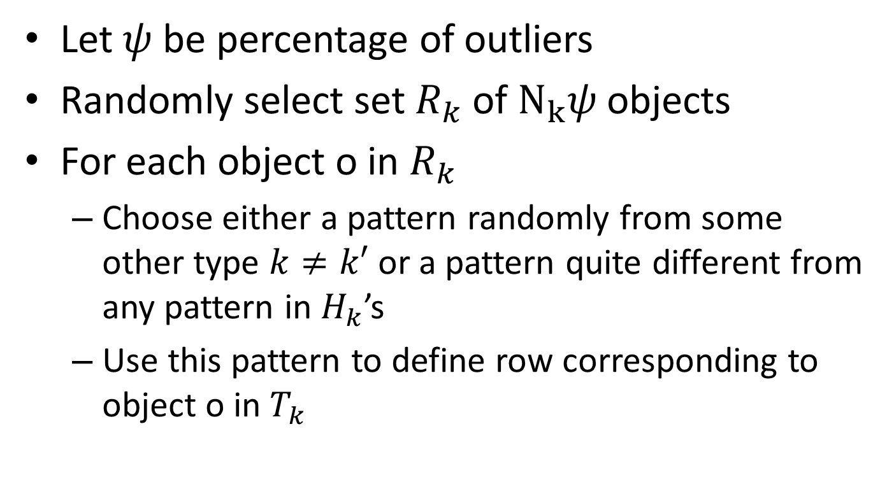
Injecting Outliers in Synthetic Dataset
Let $ψ$ be percentage of outliers
Randomly select set $R_{k}$ of $N_{k}ψ$ objects
For each object o in $R_{k}$
  Choose either a pattern randomly from some other type $k≠k′$ or a pattern quite different from any pattern in $H_{k}$’s
  Use this pattern to define row corresponding to object o in $T_{k}$

Slide 24
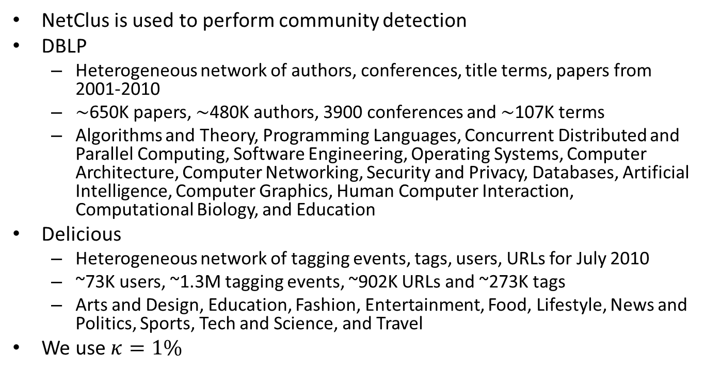
Real Datasets
NetClus is used to perform community detection
DBLP
  Heterogeneous network of authors, conferences, title terms, papers from 2001-2010
  ∼650K papers, ∼480K authors, 3900 conferences and ∼107K terms
  Algorithms and Theory, Programming Languages, Concurrent Distributed and Parallel Computing, Software Engineering, Operating Systems, Computer Architecture, Computer Networking, Security and Privacy, Databases, Artificial Intelligence, Computer Graphics, Human Computer Interaction, Computational Biology, and Education
Delicious
  Heterogeneous network of tagging events, tags, users, URLs for July 2010
  ~73K users, ~1.3M tagging events, ~902K URLs and ~273K tags
  Arts and Design, Education, Fashion, Entertainment, Food, Lifestyle, News and Politics, Sports, Tech and Science, and Travel
We use $κ=1\%$

