Slide 1

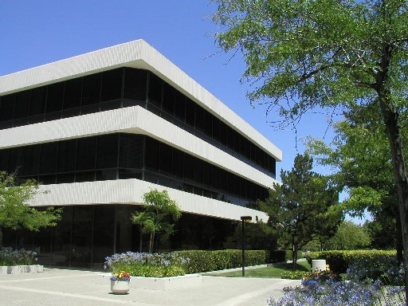
Context-Aware Time Series Anomaly Detection for Complex Systems
Manish Gupta, UIUC
Abhishek B. Sharma, NEC Labs America
Haifeng Chen, NEC Labs America
Guofei (Geoff) Jiang, NEC Labs America

Slide 2
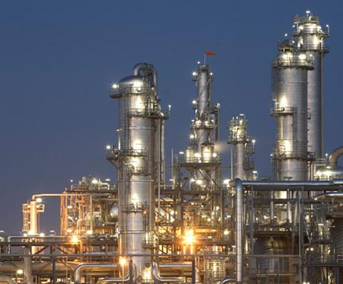

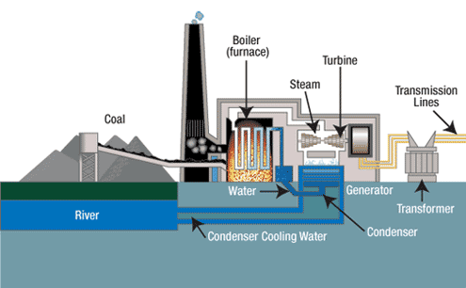
Focus on Complex Systems
Lots of components interacting to accomplish challenging tasks
Data centers
Power plant
Manufacturing plant
Notes:
http://aws.amazon.com/message/65648/
One bullet summary of Amazon outage

Slide 3
Switch to proactive maintenance
Continuous monitoring from multiple vantage points
Replace calendar-based or reactive maintenance with early detection, localization, and remediation
Enabling technologies
  low cost ubiquitous sensing and communication
Challenge
  How to combine heterogeneous data?
  Unstructured or semi-structured log data
  Multivariate time series data

Slide 4
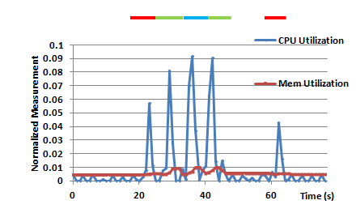
Importance of Collating Information
Only time series data
  No context or the global semantic view
  Many false positives
  Multiple alarms related to a single event
Only system logs
  High level application/workflow view
  Incomplete Coverage
    “Cost”
  Lack of root-cause visibility
    Absence of observed system behavior
Task execution

Slide 5
Our vision
Logs capture the context of a system’s operations
Time series monitoring data record the state of different components
Hypothesis: jointly mining log and time series data for anomaly detection is more accurate and robust.
  Context-aware time series anomaly detection

Slide 6
Outline
Introduction and Motivation
Framework for combining logs and time series data
Proposed solution
Instantiation details for Hadoop
Evaluation
Conclude

Slide 7
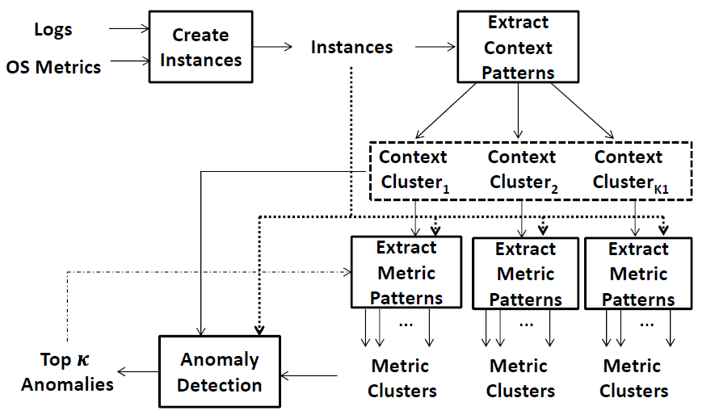
Framework for combining logs and time series data
Time series

Slide 8

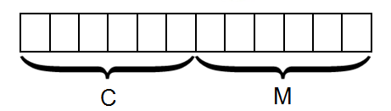
What is an instance?
An instance spans the interval between two consecutive context changing events on a component.
  Assumption: we can identify context changing events.
Instance I = (C,M); C: content features, M: metrics/time series
t₁
t₂
t1: Task execution starts
t2: Task execution finishes

Slide 9
Problem statement and solution approach
Given: Instances I₁, I₂ , …, I_{L}
Find: Top K anomalous instances
2 stage solution
  Find patterns
    Context patterns
    Metric patterns
  Find anomalies
Two notions of similarity:
Peer similarity: similarity in context variables across instances
Temporal similarity: similarity in time series data for similar contexts

Slide 10



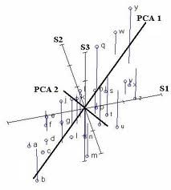
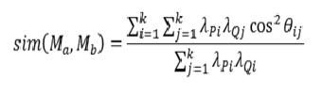



Proposed Solution
Extraction of Context Patterns
  Normalize the data
  Use K-means clustering
Extraction of Metric Patterns
C₁
M₁
M₄
C₂
M₂
M₃
similarity?
$$score\left(I\right)= 1−sim\left(M, M_{2}\right)$$
C₃
CPU | Memory | Disk Read | Disk Write | eth0 TX | eth0 RX | CPU
10 | 20.9 | 622.4 | 14.0 | 4.2 | 5.6 | 10
20 | 24.5 | 977.7 | 82.7 | 4.0 | 1.8 | 20
10 | 24.6 | 836.4 | 90.0 | 1.6 | 1.6 | 10
30 | 20.6 | 198.6 | 78.6 | 7.1 | 0.3 | 30
40 | 29.3 | 850.9 | 99.1 | 5.1 | 10.0 | 40
CPU | Memory | Disk Read | Disk Write | eth0 TX | eth0 RX | CPU
10 | 20.9 | 622.4 | 14.0 | 4.2 | 5.6 | 10
20 | 24.5 | 977.7 | 82.7 | 4.0 | 1.8 | 20
10 | 24.6 | 836.4 | 90.0 | 1.6 | 1.6 | 10
30 | 20.6 | 198.6 | 78.6 | 7.1 | 0.3 | 30
$$P^{c×k }$$
$$Q^{c×k }$$
Anomaly Detection
Anomaly Post-processing
  Remove instance if nearest context
  cluster is far away.
Not an anomaly
Anomaly
similarity?

Slide 11

Instantiating the framework for MapReduce (Hadoop)
MapReduce programming model
  Example: count the frequency of all words appearing in a document
Distributed block storage (e.g. HDFS)
Two phases of computation: Map and Reduce
Intermediate output
Map
Final output
A B C
A: 1 B: 1 C: 1
A: 2
B: 3
C: 2
D: 2
E: 1
F: 1
G: 1
Map
Reduce
B C D
B: 1 C: 1 D: 1
Map
E F G
E: 1 F: 1 G: 1
Map
A B D
A: 1 B: 1 D: 1

Slide 12

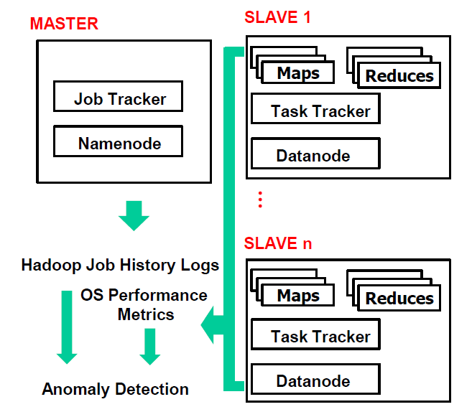
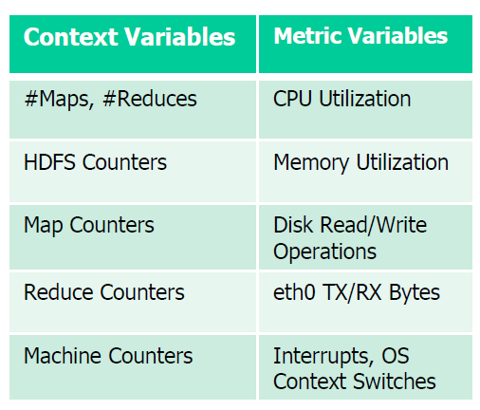
Hadoop: Open source implementation of MapReduce runtime
Map and Reduce phases exhibit
peer and temporal similarity

Slide 13
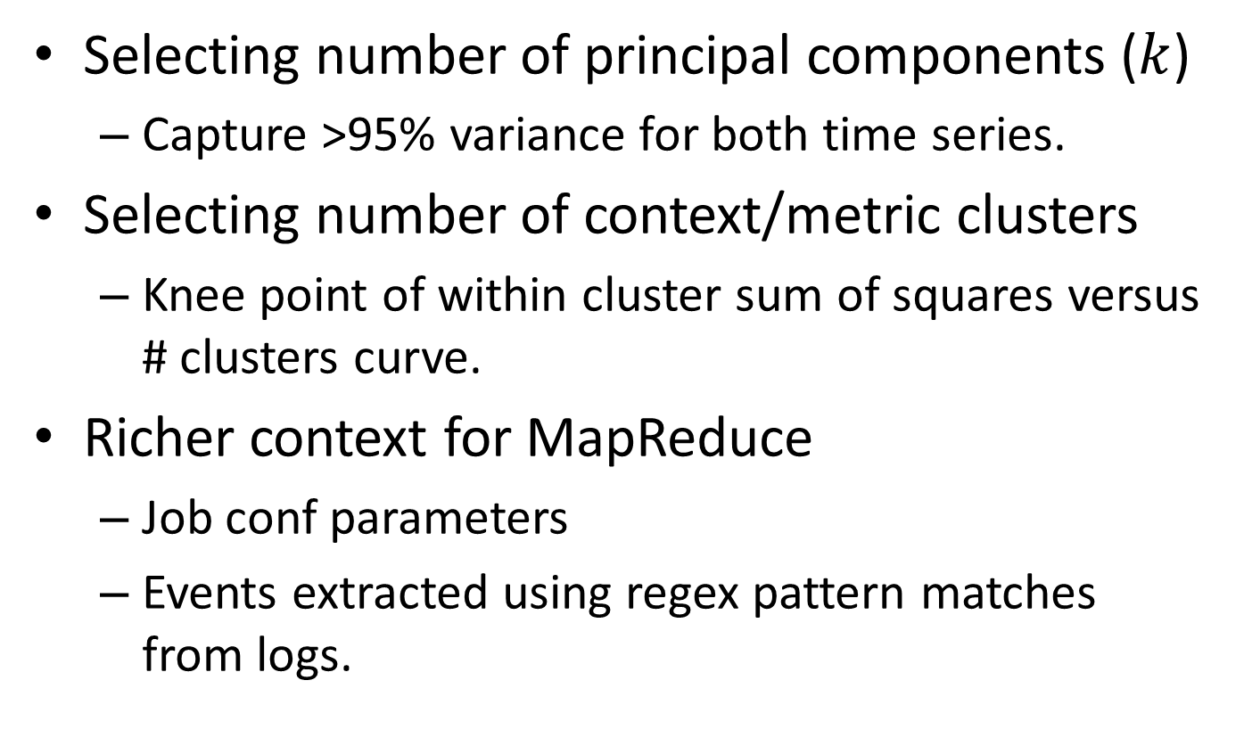
Discussion
Selecting number of principal components ($k$)
  Capture >95% variance for both time series.
Selecting number of context/metric clusters
  Knee point of within cluster sum of squares versus # clusters curve.
Richer context for MapReduce
  Job conf parameters
  Events extracted using regex pattern matches from logs.

Slide 14
Evaluation
Synthetic datasets
  Context part comes from real Hadoop runs.
  Metrics part is synthetically generated.
  Hadoop cluster: master + 5 slaves.
  Workload: standard Hadoop examples like sorting, count word frequencies, etc.
  3 context clusters.
Real Hadoop runs with injected faults
  CPU hog and Disk hog

Slide 15
Synthetic data:
Context Clusters for Hadoop Examples
Cluster 1: large number of Map tasks high values for Map counters.
Cluster 2: instances with a few Map and a few Reduce tasks.
Cluster 3: instances with large number of Reduce tasks and high values for Reduce counters.

Slide 16
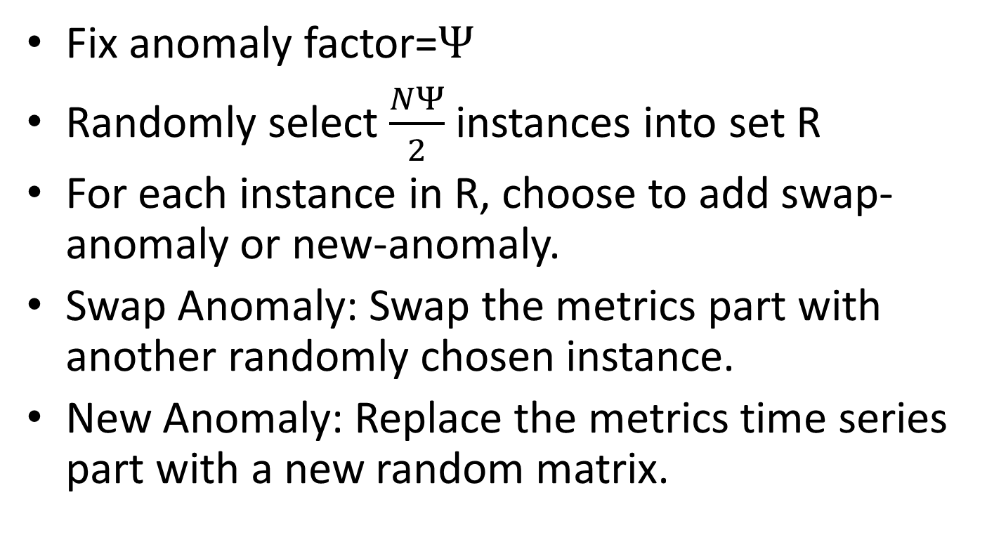
Injecting Anomalies in Synthetic Dataset
Fix anomaly factor=$Ψ$
Randomly select $\frac{NΨ}{2}$ instances into set R
For each instance in R, choose to add swap-anomaly or new-anomaly.
Swap Anomaly: Swap the metrics part with another randomly chosen instance.
New Anomaly: Replace the metrics time series part with a new random matrix.

Slide 17
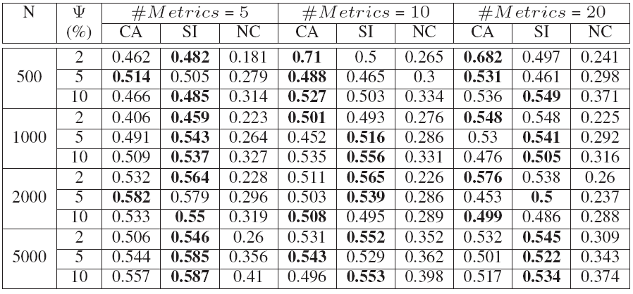
Synthetic Dataset Results
20 experiments per setting.
Avg. standard deviations are 3.34% for CA, 7.06 % for SI and 4.58% for NC.
SI (1%)
NC (28%)

Slide 18
Results on real Hadoop runs with injected faults
Original number of anomalies
  Disk hog: 7.
  CPU hog: 4.
Detected anomalies
  Disk hog: 4 in top5, all 7 in top 10.
  CPU hog: 3 in top 5, all 4 in top 10.
Notes:
In the particular context
Expected CPU utilization is quite low and shows a fluctuating trend.
Anomaly shows a very high CPU utilization which is almost flat.

Slide 19
Conclusion and Future work
Proactive maintenance is more effective when we combine information from heterogeneous sources
  System logs and time series measurements
We proposed a clustering based approach for finding context patterns from log data and metric patterns from time series
  Use these patterns for anomaly detection
Future directions
  How to define context and instances in other settings?
  Define anomalies based on transition in context and expected change in metrics

Slide 20
Appendix

Slide 21
Running Time
Algorithm is linear in number of instances.
Time spent in anomaly detection: ~188ms.

Slide 22
Real Datasets
Workload: Multiple runs of RandomWriter and Sort.
RandomWriter (16 Maps) writes 1 GB data in 64 MB chunks and Sort (16 Maps and 16 Reduces) sorts the data.
Anomalies are inserted on 1 machine for
  CPU Hog: Infinite loop.
  Disk Hog: Sequential write to file on disk.
Total instances: 134 (Disk Hog) & 121 (CPU Hog).

Slide 23
Context Clusters for RandomWriter+Sort Dataset
Cluster 1 consists of a mix of Maps and Reduces and has a distinctly high number of HDFS bytes being written.
Cluster 2 is Map-heavy and shows a large number of Map Output Records.
Cluster 3 is Reduce-heavy and hence demonstrates a large activity in Reduce counters.

Slide 24
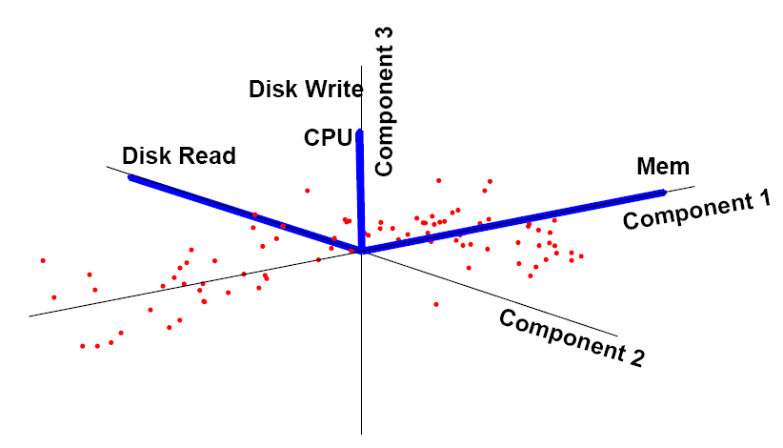
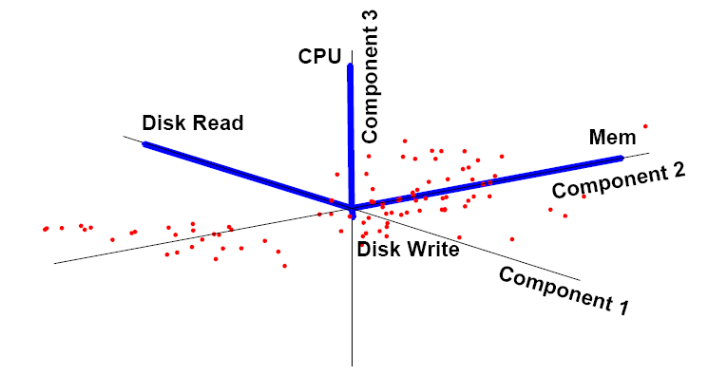
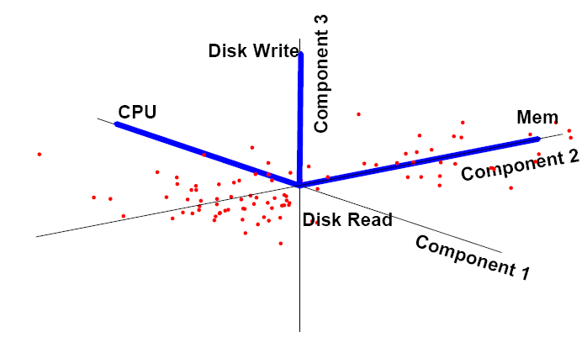
Metric Patterns

