Slide 1








Outlier Detection for Graph Data
Manish Gupta
Jing Gao
Charu Aggarwal
Jiawei Han
Microsoft
SUNY
IBM
UIUC

Slide 2
Tutorial Outline
Introduction [10 min]
Static Graph Outlier Detection Algorithms [45 min]
Break [10 min]
Dynamic Graph Outlier Detection Algorithms [45 min]
Summary [10 min]
* Slides borrowed with permission from authors

Slide 3
Tutorial Outline
Introduction [10 min]
Static Graph Outlier Detection Algorithms [45 min]
Break [10 min]
Dynamic Graph Outlier Detection Algorithms [45 min]
Summary [10 min]

Slide 4
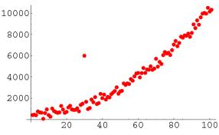
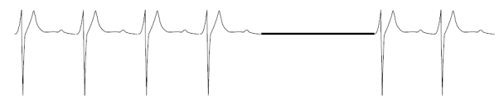




Outlier Detection
Also called anomaly detection, event detection, novelty detection, deviant discovery, change point detection, fault detection, intrusion detection or misuse detection
Three types
Techniques: classification, clustering, nearest neighbor, density, statistical, information theory, spectral decomposition, visualization, depth, and signal processing
Outlier packages:
Data types: high-dimensional data, uncertain data, stream data, network data, time series data
Normal
Outlier
Point Outliers
Contextual Outliers
Collective Outliers

Slide 5
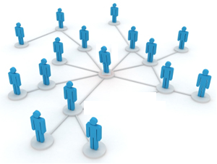
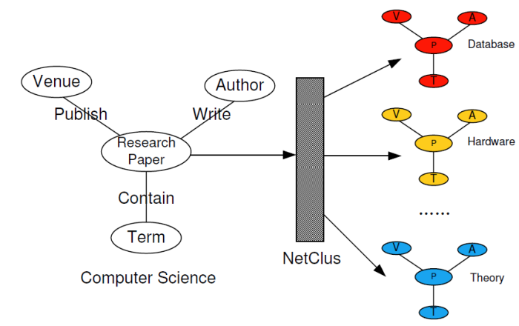
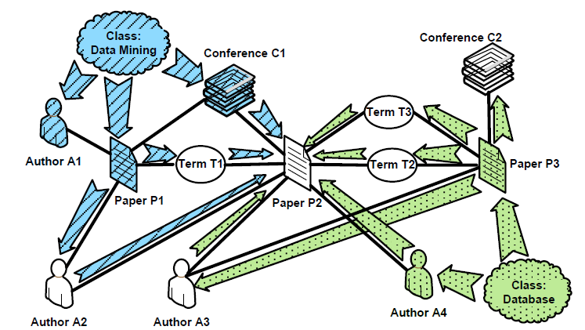
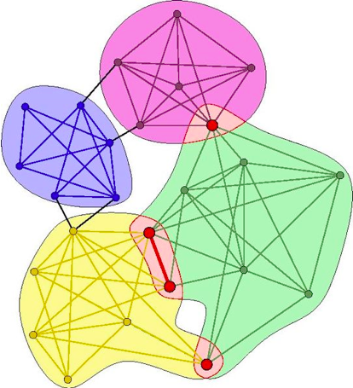















Information Network Analysis
?
Clustering
Classification
Link Prediction
0.13
0.6
0.1
0.3
0.27
0.41
0.54
0.2
0
0.11
0.01
0.7
0.2
0.8
0.1
0.9
0.7
Community Detection
PageRank
Influence Propagation

Slide 6

Outlier Detection for Information Networks
Network Analysis
Outlier
Detection
Outlier
Detection
For
Networks

Slide 7







Need for Outlier Detection on Networks (Social Media Analysis)
EXPERT
MARKETER
User
Tag
User
Tag
URL
Fashion
Video
Fashion
Arts
Science
Sports
Arts
Science
Sports

Slide 8
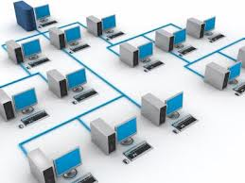
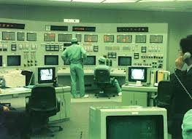

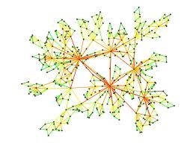

Need for Outlier Detection on Networks
Distributed Systems
Data Integration Systems
Intrusion Detection
Link Failures
Input/Output Correlation breach
Civil Rights
Movement
Gandhi
1893-1914
Kasturba
Gandhi
X
X
1869-1944
1969
X
Entity Network
Obama
1869
1889
1961-

Slide 9
Challenges in Outlier Detection on Networks
Extraction of patterns
Across multiple node types
Across multiple types of node attribute data
Across time
Scale
Matching patterns across time
Modeling links and data together
Defining outliers given the patterns

Slide 10
Tutorial Outline
Introduction [10 min]
Static Graph Outlier Detection Algorithms [45 min]
Minimum Description Length [10 min]
Ego-net Metrics [5 min]
Random Walks [5 min]
Random Field Models [10 min]
Outliers in Heterogeneous Networks [15 min]
Break [10 min]
Dynamic Graph Outlier Detection Algorithms [45 min]
Summary [10 min]

Slide 11
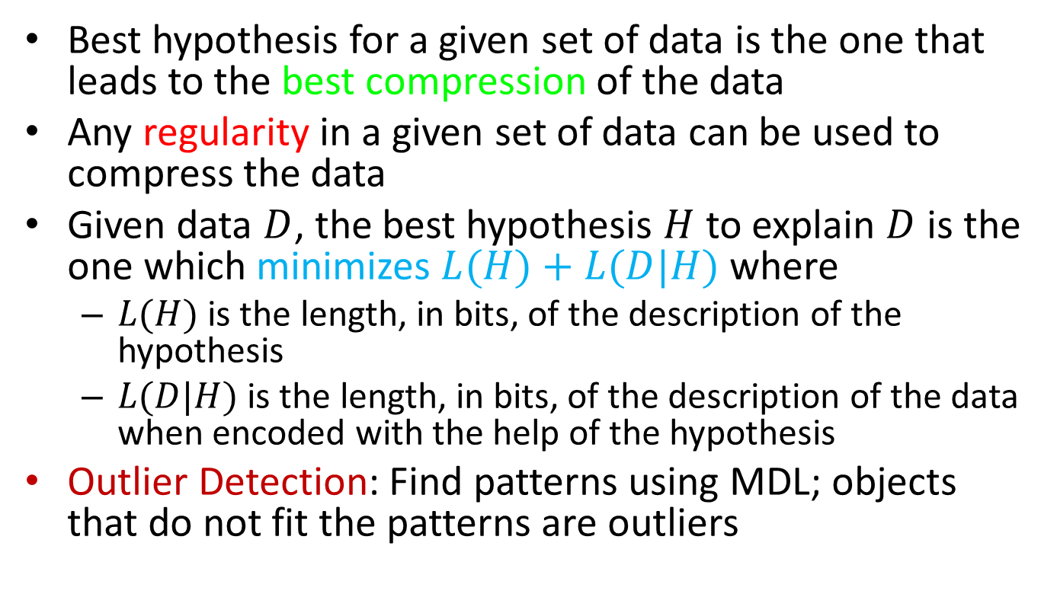
Minimum Description Length (MDL) Principle
Best hypothesis for a given set of data is the one that leads to the best compression of the data
Any regularity in a given set of data can be used to compress the data
Given data $D$, the best hypothesis $H$ to explain $D$ is the one which minimizes $L(H)+L(D|H)$ where
$L(H)$ is the length, in bits, of the description of the hypothesis
$L(D|H)$ is the length, in bits, of the description of the data when encoded with the help of the hypothesis
Outlier Detection: Find patterns using MDL; objects that do not fit the patterns are outliers

Slide 12
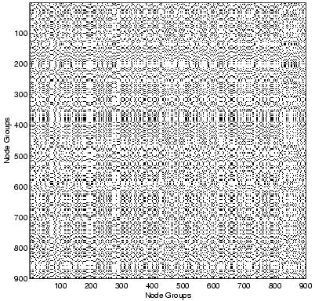
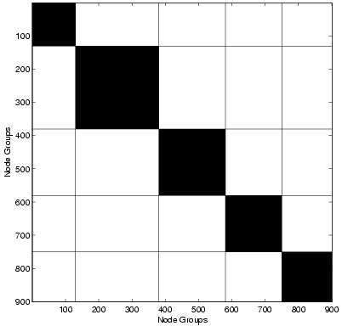
MDL for Graph Partitioning and Outlier Edge Detection
Chakrabarti PKDD’04
People
People Groups
People
People Groups
Goals
[#1] Find groups (of people, species, proteins, etc.)
[#2] Find outlier edges (“bridges”)
Similar nodes are grouped together
As few groups as necessary
Good Clustering
A few, homogeneous blocks
Good Compression
implies

Slide 13
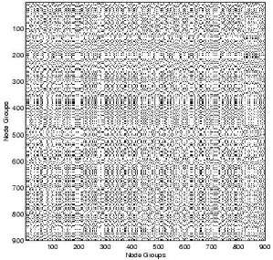
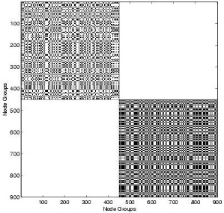
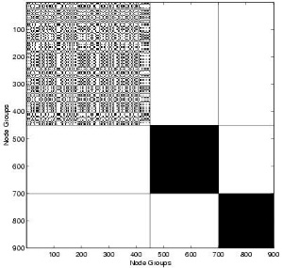
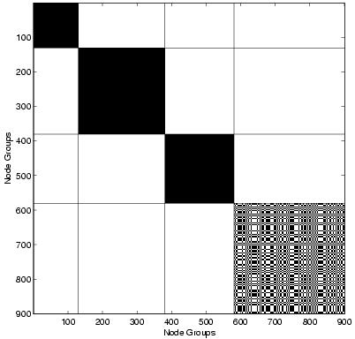
MDL for Graph Partitioning and Outlier Edge Detection: Algorithm
Iteratively reassign each node to the
group which minimizes the code cost
Find good groups for fixed k
Start with initial matrix
Lower the encoding cost
Final grouping
Choose k=k+1
Split group with maximum entropy
per node; assign “bad” nodes to new group
Notes:
So, the algorithm starts with the initial matrix, with all nodes being in one group (k=1). Then we have a black where we iteratively try to reduce the encoding cost, and when we cannot do any better, we output the final grouping. Inside the black box, we have two portions: (1) Find good groupings GIVEN a fixed number of groups, and (2) Update the number of groups to allow better clusterings.

Slide 14
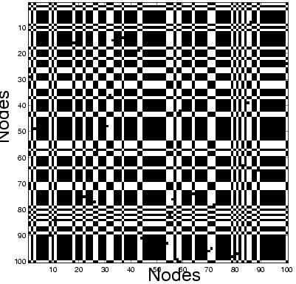
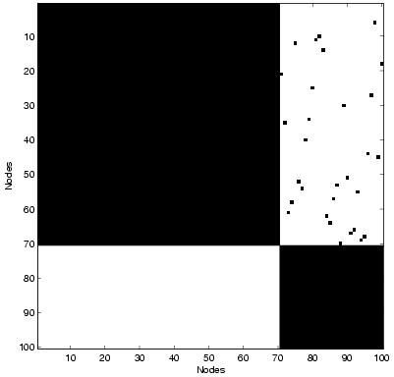
MDL for Graph Partitioning and Outlier Edge Detection: Outlier Edges
Outlier Edges
Nodes
Node Groups
Nodes
Node Groups
Outliers
Deviations from “normality”
Lower quality compression
Find edges whose removal maximally reduces cost
Notes:
How do we find outlier edges? Suppose we were given the matrix on the left, and applied our algorithm to find the clusters on the right. Clearly the edges in the top-right block are the outliers. How do we automatically choose them? The idea is that outliers are “deviations from normality”. Now, if everything was normal/homogeneous, then we would get excellent compression. So these deviations must lower the quality of compression. Thus, our algorithm is: Find the edges whose removal maximally reduces the encoding cost. So, these were the edges which were causing the increased encoding cost in the first place, and so are probably outliers. This reduction in cost is a measure of the “outlierness” of the edge. By this metric, we pick up exactly the outlier edges in the top-right block.

Slide 15
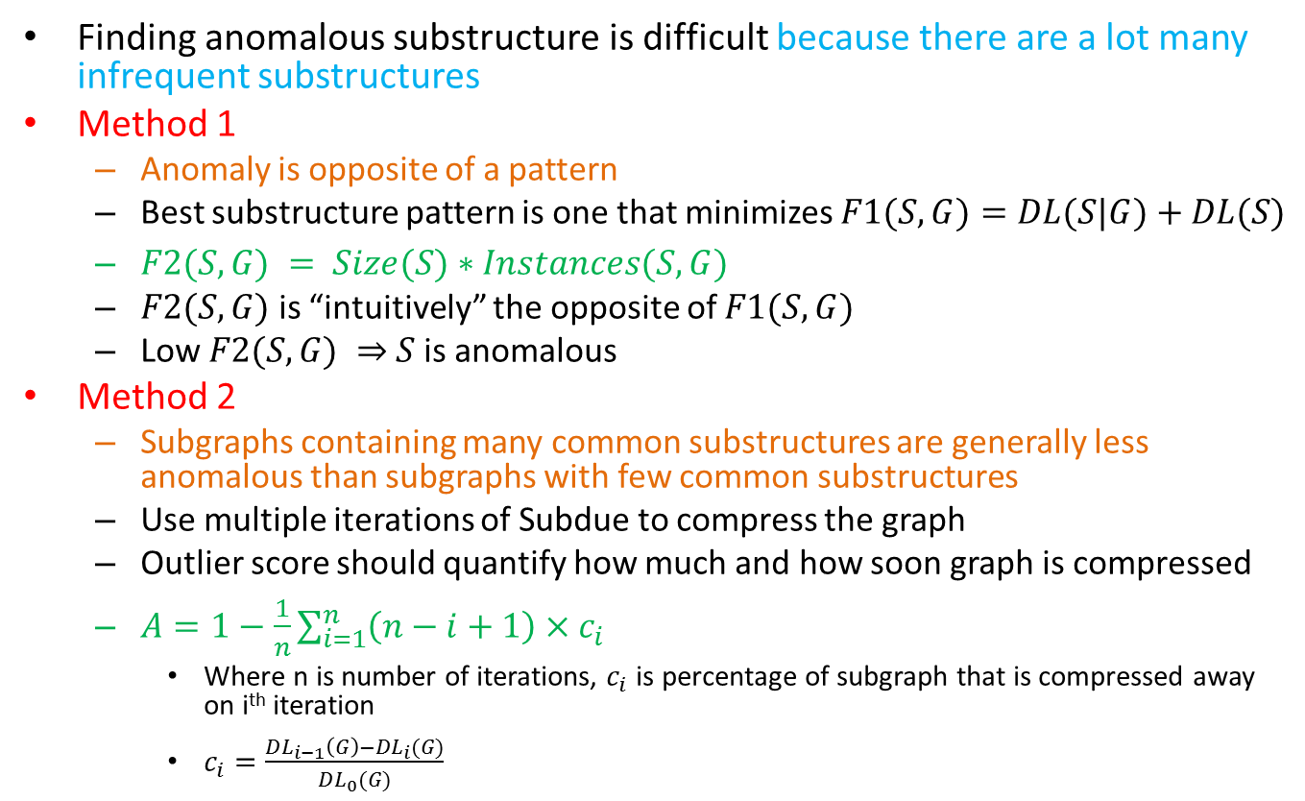
MDL for Anomalous Substructure Detection: Graph Based Anomaly Detection
Noble and Cook, KDD’03
Finding anomalous substructure is difficult because there are a lot many infrequent substructures
Method 1
Anomaly is opposite of a pattern
Best substructure pattern is one that minimizes $F1(S,G)=DL(S|G)+DL(S)$
$F2(S,G) = Size(S)∗Instances(S,G)$
$F2(S,G)$ is “intuitively” the opposite of $F1(S,G)$
Low $F2(S,G) ⇒$ $S$ is anomalous
Method 2
Subgraphs containing many common substructures are generally less anomalous than subgraphs with few common substructures
Use multiple iterations of Subdue to compress the graph
Outlier score should quantify how much and how soon graph is compressed
$A=1−\frac{1}{n}\sum_{i=1}^{n}{\left(n−i+1\right)×c_{i}}$
Where n is number of iterations, $c_{i}$ is percentage of subgraph that is compressed away on i^{th} iteration
$c_{i}=\frac{DL_{i−1}\left(G\right)−DL_{i}(G)}{DL_{0}(G)}$

Slide 16

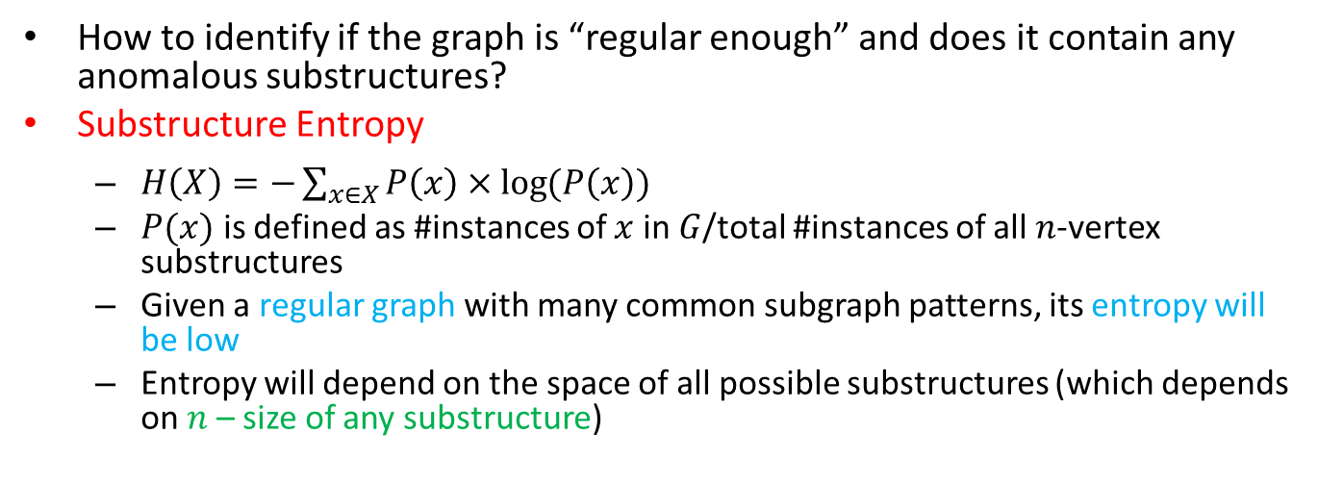
Entropy Measures of Graph Regularity (1)
How to identify if the graph is “regular enough” and does it contain any anomalous substructures?
Substructure Entropy
$H\left(X\right)=−\sum_{x∈X}{P\left(x\right)×\log{(P\left(x\right))}}$
$P(x)$ is defined as #instances of $x$ in $G$/total #instances of all $n$-vertex substructures
Given a regular graph with many common subgraph patterns, its entropy will be low
Entropy will depend on the space of all possible substructures (which depends on $n$ – size of any substructure)
Example Graph
A
B
C
B
C
$P(x)$ values for $n$=2
A
B
B
C
C
B
C
A
1/5
2/5
1/5
1/5

Slide 17
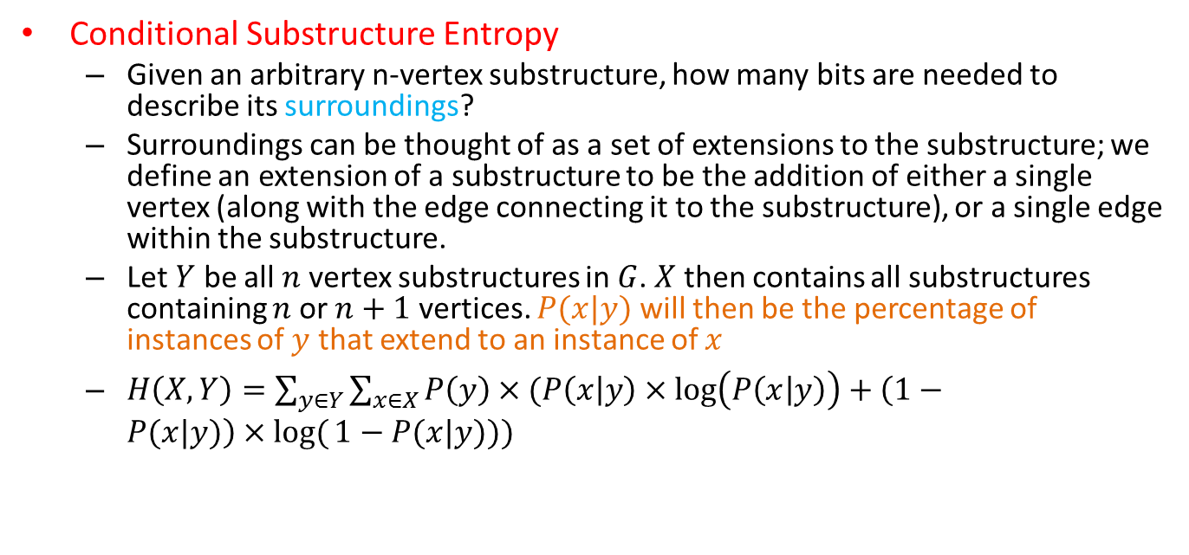
Entropy Measures of Graph Regularity (2)
Conditional Substructure Entropy
Given an arbitrary n-vertex substructure, how many bits are needed to describe its surroundings?
Surroundings can be thought of as a set of extensions to the substructure; we define an extension of a substructure to be the addition of either a single vertex (along with the edge connecting it to the substructure), or a single edge within the substructure.
Let $Y$ be all $n$ vertex substructures in $G$. $X$ then contains all substructures containing $n$ or $n+1$ vertices. $P(x|y)$ will then be the percentage of instances of $y$ that extend to an instance of $x$
$H\left(X,Y\right)=\sum_{y∈Y}{\sum_{x∈X}{P\left(y\right)×(P\left(x | y\right)×\log\left(P\left(x | y\right)\right)+\left(1−P(x|y)\right)×log⁡(}}1−P(x|y)))$
A
B
C
B
C
B
C
If y =
B
C
B
And x=
P(x|y)=1/2

Slide 18
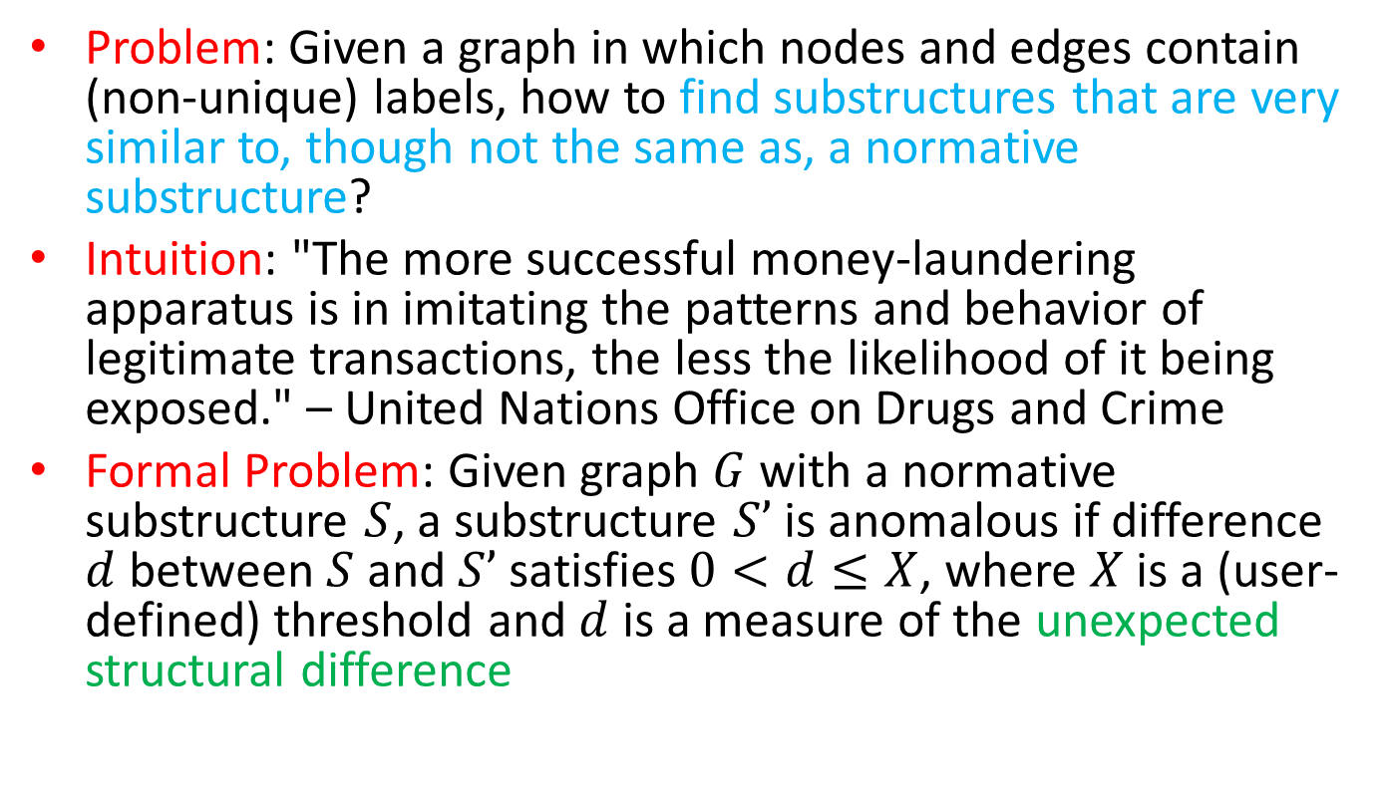
Structural Anomalies in Graph Data
Eberle and Holder, ICDMW’07
Problem: Given a graph in which nodes and edges contain (non-unique) labels, how to find substructures that are very similar to, though not the same as, a normative substructure?
Intuition: "The more successful money-laundering apparatus is in imitating the patterns and behavior of legitimate transactions, the less the likelihood of it being exposed." – United Nations Office on Drugs and Crime
Formal Problem: Given graph $G$ with a normative substructure $S$, a substructure $S’$ is anomalous if difference $d$ between $S$ and $S’$ satisfies $0<d≤X$, where $X$ is a (user-defined) threshold and $d$ is a measure of the unexpected structural difference
Notes:
Assumptions
Majority of G consists of a normative pattern, and no more than X% of it is altered in an anomaly
Anomalies consist of one or more modifications, insertions or deletions
Normative pattern is connected

Slide 19
Three Types of MDL-based Subgraph Anomalies
Subgraph patterns are obtained using the Graph Based Anomaly Detection (GBAD) tool based on SUBDUE algorithm
Three types of anomalies
GBAD-MDL (Minimum Descriptive Length): anomalous modifications
GBAD-P (Probability): anomalous insertions
GBAD-MPS (Maximum Partial Substructure): anomalous deletions
Note: Prone to miss more than one type of anomaly e.g., a deletion followed by modification

Slide 20
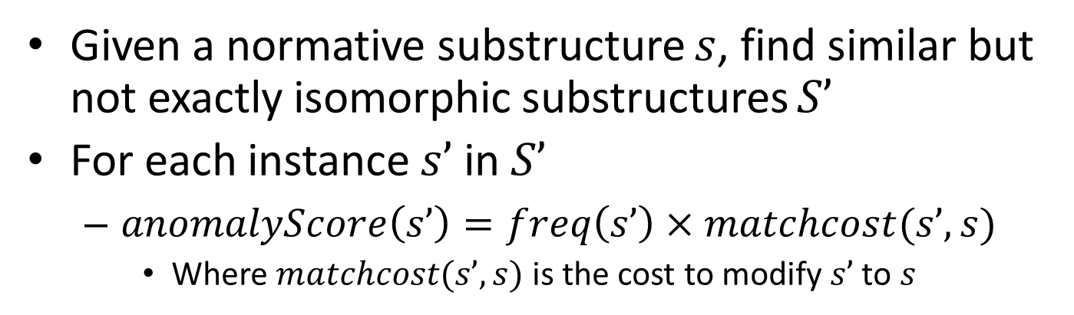
GBAD-MDL (Information Theoretic Approach)
Given a normative substructure $s$, find similar but not exactly isomorphic substructures $S’$
For each instance $s’$ in $S’$
$anomalyScore\left(s’\right)=freq\left(s’\right)×matchcost(s’,s)$
Where $matchcost(s’,s)$ is the cost to modify $s’$ to $s$

Slide 21
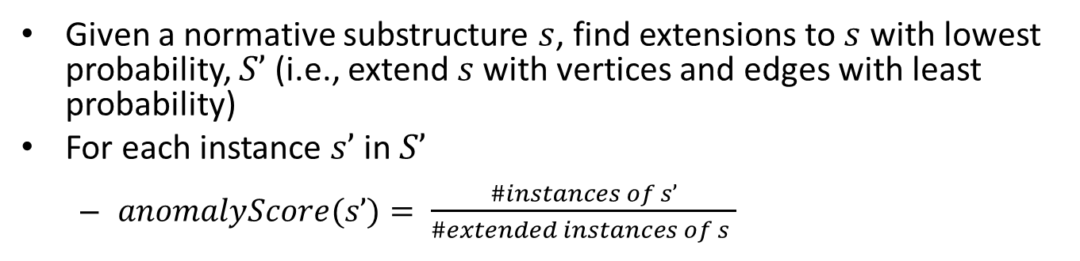
GBAD-P (Probabilistic Approach)
Given a normative substructure $s$, find extensions to $s$ with lowest probability, $S’$ (i.e., extend $s$ with vertices and edges with least probability)
For each instance $s’$ in $S’$
$anomalyScore(s’)= \frac{\#instances of s’}{\#extended instances of s }$

Slide 22
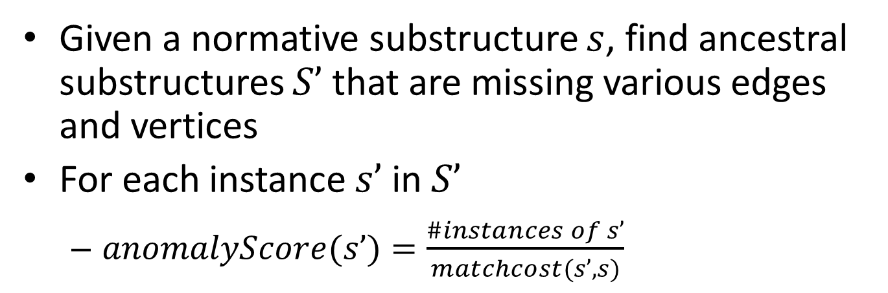
GBD-MPS (Maximum Partial Substructure Approach)
Given a normative substructure $s$, find ancestral substructures $S’$ that are missing various edges and vertices
For each instance $s’$ in $S’$
$anomalyScore(s’)=\frac{\#instances of s’}{matchcost(s’,s)}$

Slide 23
Anomalies in Real Datasets (Cargo Shipment Data)
Cargo Shipment Data: obtained from Customs and Borders Protection (CBP)
Scenario: Marijuana seized at Florida port [press release by U.S. Customs Service, 2000]. Smuggler did not disclose some financial information, and ship traversed extra port
GBAD-P discovers the extra traversed port
GBAD-MPS discovers the missing financial info
Network Intrusion Data: 1999 KDD Cup Network Intrusion
100% of attacks were discovered with GBAD-MDL
55.8% for GBAD-P and 47.8% for GBAD-MPS
Data consists of TCP packets that have fixed size
Thus, the inclusion of additional structure, or the removal of structure, is not relevant here
Modification is the only relevant one, at which GBAD-MDL performs well
High false positive rate!

Slide 24
Tutorial Outline
Introduction [10 min]
Static Graph Outlier Detection Algorithms [45 min]
Minimum Description Length [10 min]
Ego-net Metrics [5 min]
Random Walks [5 min]
Random Field Models [10 min]
Outliers in Heterogeneous Networks [15 min]
Break [10 min]
Dynamic Graph Outlier Detection Algorithms [45 min]
Summary [10 min]

Slide 25
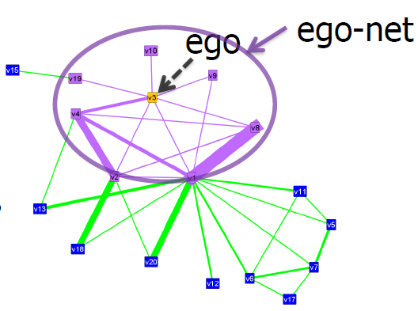
Oddball: Outlier Detection using Ego-net Metrics (1)
Akoglu et al, PAKDD’10
For each node
Extract ego-net (=1-step neighborhood)
Extract features (#edges, total weight, etc.)
Features that could yield “laws”
Features fast to compute and interpret
Detect patterns
Regularities
Detect anomalies
Distance to patterns

Slide 26
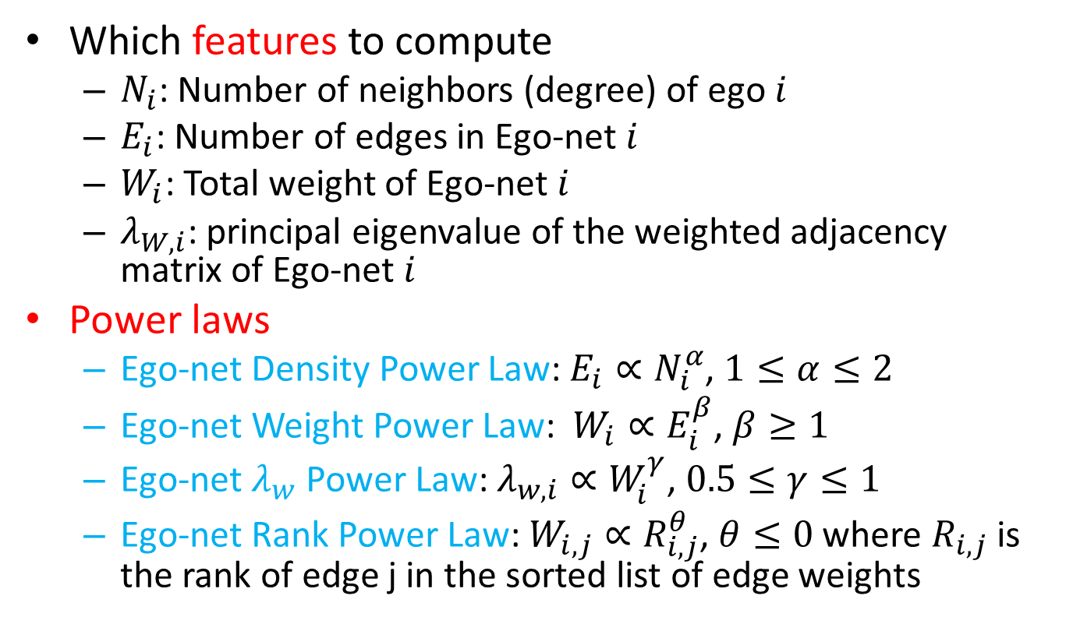
Oddball: Outlier Detection using Ego-net Metrics (2)
Which features to compute
$N_{i}$: Number of neighbors (degree) of ego $i$
$E_{i}$: Number of edges in Ego-net $i$
$W_{i}$: Total weight of Ego-net $i$
$λ_{W, i}$: principal eigenvalue of the weighted adjacency matrix of Ego-net $i$
Power laws
Ego-net Density Power Law: $E_{i}∝N_{i}^{α}$, $1≤α≤2$
Ego-net Weight Power Law: $W_{i}∝E_{i}^{β}$, $β≥1$
Ego-net $λ_{w}$ Power Law: $λ_{w,i}∝W_{i}^{γ}$, $0.5≤γ≤1$
Ego-net Rank Power Law: $W_{i,j}∝R_{i,j}^{θ}$, $θ≤0$ where $R_{i,j}$ is the rank of edge j in the sorted list of edge weights

Slide 27
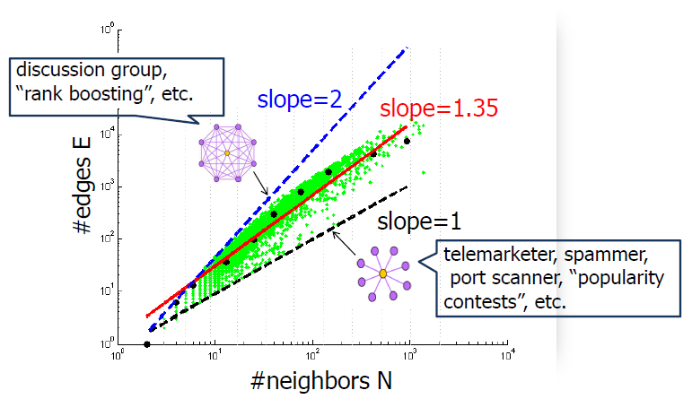
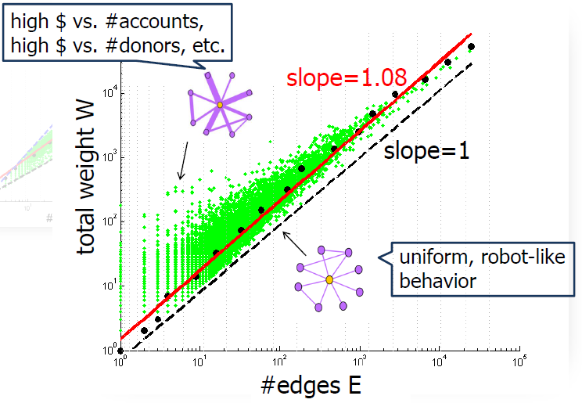

Oddball: Outlier Detection using Ego-net Metrics (3)
Outlier score for instance $i$is the distance to the fitting power law curve

Slide 28
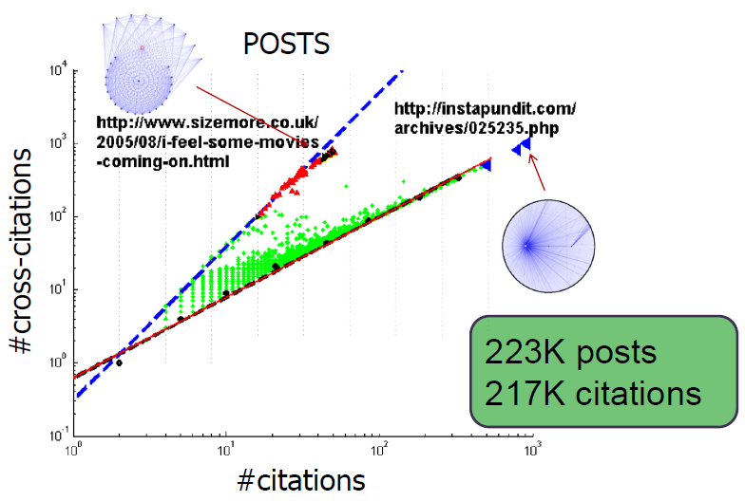
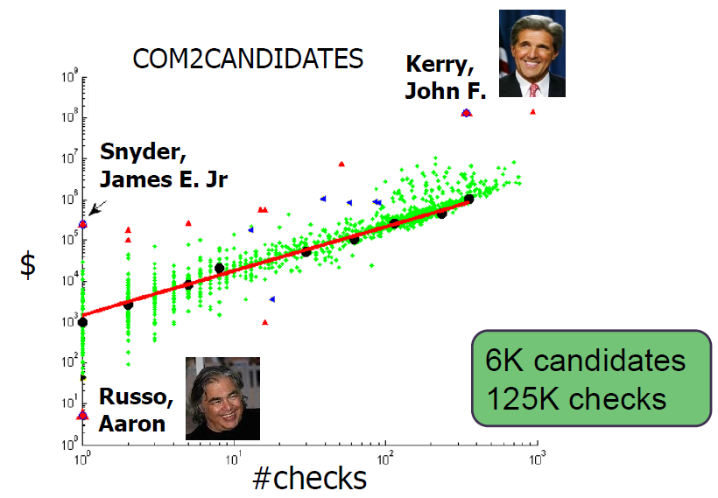
Oddball: Outlier Detection using Ego-net Metrics (4)

Slide 29
Link-based Outlier and Anomaly Detection in Evolving Data Sets (LOADED)
Ghoting et al, ICDM’04
Convert the multi-dimensional dataset with a few categorical and continuous attributes to a network dataset
Two data points are linked if they have at least 1 categorical attribute value in common
Association link strength = number of attribute-value pairs shared in common
Outlier score computation
A point with no links to other points will have the highest possible score
A point that shares only a few links, each with a low link strength, will have a high score
A point that shares only a few links, some with a high link strength, will have a moderately high score
A point that shares several links, but each with a low link strength, will have a moderately high score
Every other point will have a low to moderate score

Slide 30
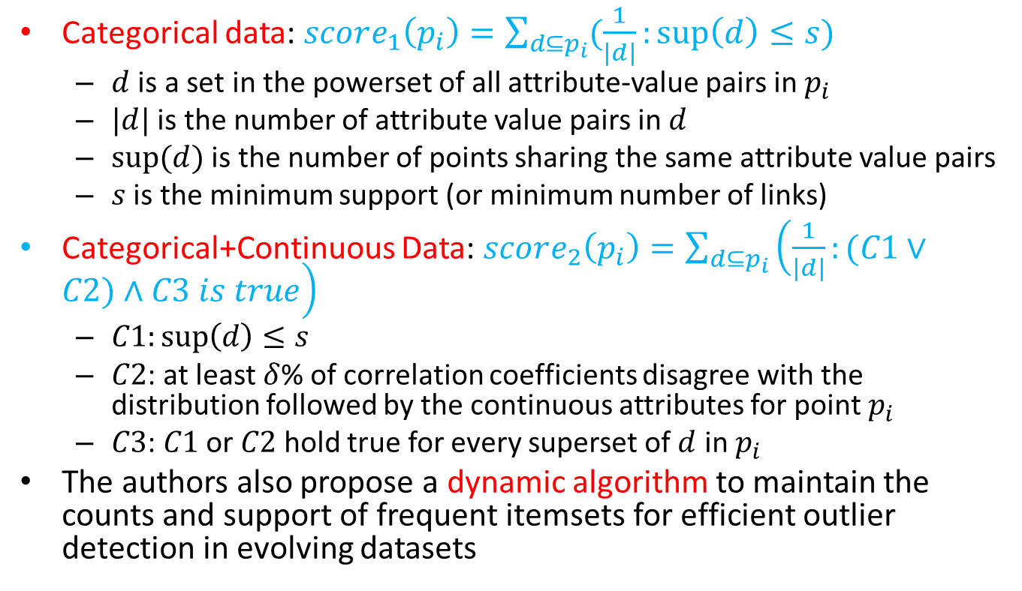
LOADED Outlier Score Computation
Categorical data: $score_{1}\left(p_{i}\right)=\sum_{d⊆p_{i}}{(\frac{1}{\left|d\right|}:\sup\left(d\right)≤s)}$
$d$ is a set in the powerset of all attribute-value pairs in $p_{i}$
$|d|$ is the number of attribute value pairs in $d$
$sup⁡(d)$ is the number of points sharing the same attribute value pairs
$s$ is the minimum support (or minimum number of links)
Categorical+Continuous Data: $score_{2}\left(p_{i}\right)=\sum_{d⊆p_{i}}{\left(\frac{1}{\left|d\right|}:(C1∨C2)∧C3 is true\right)}$
$C1:\sup\left(d\right)≤s$
$C2$: at least $δ$% of correlation coefficients disagree with the distribution followed by the continuous attributes for point $p_{i}$
$C3$: $C1$ or $C2$ hold true for every superset of $d$ in $p_{i}$
The authors also propose a dynamic algorithm to maintain the counts and support of frequent itemsets for efficient outlier detection in evolving datasets

Slide 31
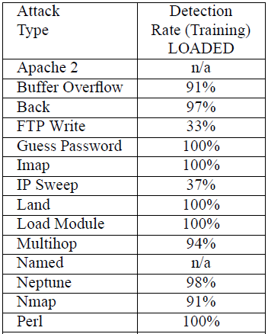

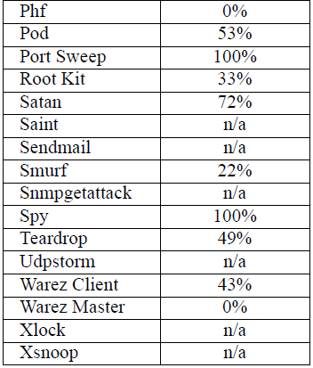
LOADED Performance on KDD-Cup 1999 Dataset

Slide 32
Tutorial Outline
Introduction [10 min]
Static Graph Outlier Detection Algorithms [45 min]
Minimum Description Length [10 min]
Ego-net Metrics [5 min]
Random Walks [5 min]
Random Field Models [10 min]
Outliers in Heterogeneous Networks [15 min]
Break [10 min]
Dynamic Graph Outlier Detection Algorithms [45 min]
Summary [10 min]

Slide 33
Outlier Detection Using Random Walks
Moonesinghe et al, ICTAI’06
Given a multi-dimensional dataset create a network dataset
OutRank-a: Use cosine similarity between objects as the edge weight
OutRank-b: Generate graph using cosine similarity and connect nodes only if cos-sim>threshold; on this graph, similarity between nodes is based on number of shared neighbors
Connectivity score is then computed similar to the Pagerank score using power iterations
Outliers are nodes that are very weakly connected, i.e., ones with low connectivity scores

Slide 34
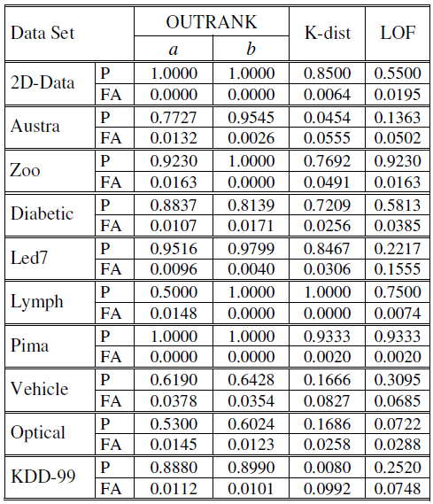
Outlier Detection Using Random Walks
Notes:
FA=False alarms.

Slide 35
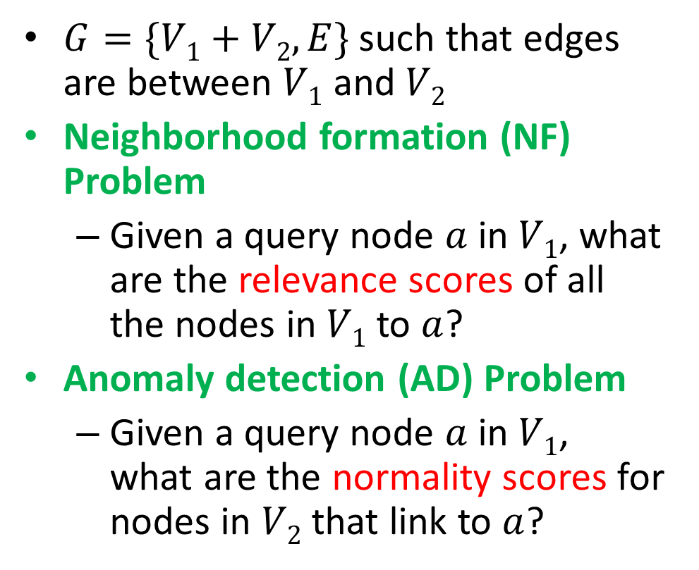
Anomalies using Random Walks on Bipartite Graphs
Sun et al, ICDM’05
$G=\{V1+V2,E\}$ such that edges are between $V1$ and $V2$
Neighborhood formation (NF) Problem
Given a query node $a$ in $V1$, what are the relevance scores of all the nodes in $V1$ to $a$?
Anomaly detection (AD) Problem
Given a query node $a$ in $V1$, what are the normality scores for nodes in $V2$ that link to $a$?

Slide 36
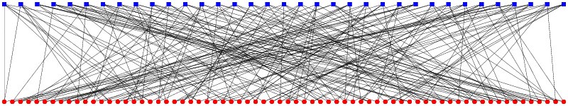
Application Settings for Bipartite Graphs
Publication network
(similar) authors vs. (unusual) papers
P2P network
(similar) users vs. (“cross-border”) files
Financial trading network
(similar) stocks vs. (cross-sector) traders
Collaborative filtering
(similar) users vs. (“cross-border”) products

Slide 37
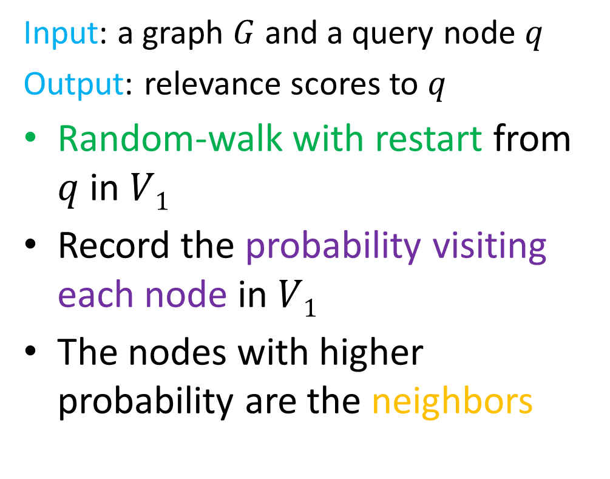


Neighborhood Formation on Bipartite Graphs
Input: a graph $G$ and a query node $q$
Output: relevance scores to $q$
Random-walk with restart from $q$ in $V1$
Record the probability visiting each node in $V1$
The nodes with higher probability are the neighbors
V1
V2
.3
.2
q
.05
.01
.002
.01

Slide 38

Anomaly Detection on Bipartite Graphs
$t$ in $V2$ is normal if all $a$ in $V1$ that link to $t$ belong to the same neighborhood
t
t
high normality
low normality

Slide 39
Tutorial Outline
Introduction [10 min]
Static Graph Outlier Detection Algorithms [45 min]
Minimum Description Length [10 min]
Ego-net Metrics [5 min]
Random Walks [5 min]
Random Field Models [10 min]
Outliers in Heterogeneous Networks [15 min]
Break [10 min]
Dynamic Graph Outlier Detection Algorithms [45 min]
Summary [10 min]

Slide 40
Community Outliers
Gao et al, KDD’10
Definition
Two information sources: links, node features
There exist communities based on links and node features
Objects that have feature values deviating from those of other members in the same community are defined as community outliers
high-income
low-income
community outlier

Slide 41
Alternative Network Outlier Definitions
Global outlier: only consider node features
Structural outlier: only consider links
Local outlier: only consider the feature values of direct neighbors
structural outlier
local outlier

Slide 42
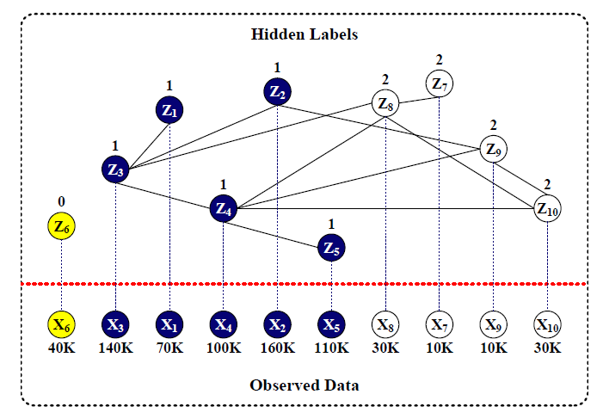
A Unified Probabilistic Model (1)
community label Z
{0,1,2,… K}
outlier
node features X
link structure W
model parameters
high-income:
mean: 116k
std: 35k
low-income:
mean: 20k
std: 12k
K: number of communities

Slide 43
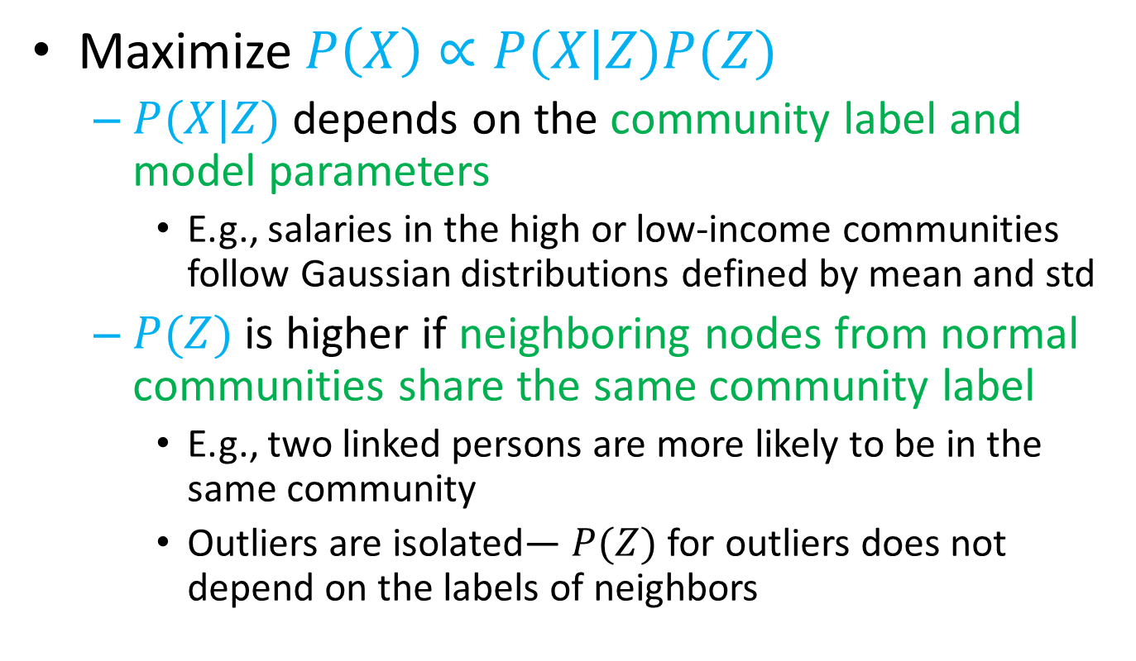
A Unified Probabilistic Model (2)
Maximize $P\left(X\right)∝P(X|Z)P(Z)$
$P(X|Z)$ depends on the community label and model parameters
E.g., salaries in the high or low-income communities follow Gaussian distributions defined by mean and std
$P(Z)$ is higher if neighboring nodes from normal communities share the same community label
E.g., two linked persons are more likely to be in the same community
Outliers are isolated— $P(Z)$for outliers does not depend on the labels of neighbors

Slide 44
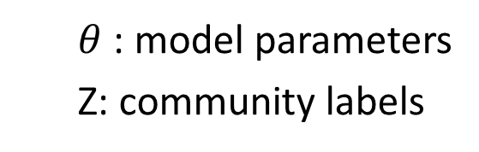
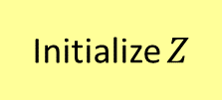
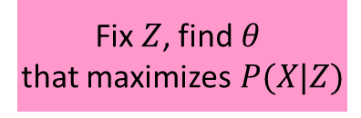
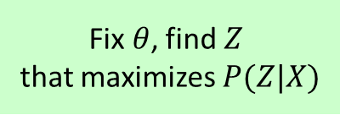
Community Outlier Detection Algorithm
$θ$ : model parameters
Z: community labels
Initialize $Z$
Continuous Data
Gaussian distribution
Model parameters: mean, standard deviation
Text Data
Multinomial distribution
Model parameters: probability of a word appearing in a community
Fix $Z$, find $θ$
that maximizes$P(X|Z)$
Parameter
estimation
Fix $θ$, find $Z$
that maximizes $P(Z|X)$
Inference

Slide 45
Comparing Community Outliers with Alternative Outlier Definitions
Baseline models
GLODA: global outlier detection (based on node features only)
DNODA: local outlier detection (check the feature values of direct neighbors)
CNA: partition data into communities based on links and then conduct outlier detection in each community

Slide 46
Community Outliers in DBLP
Conferences graph
Links: % common authors among two conferences
Node features: publication titles in the conference
Communities
Database: ICDE, VLDB, SIGMOD, PODS, EDBT
Artificial Intelligence: IJCAI, AAAI, ICML, ECML
Data Mining: KDD, PAKDD, ICDM, PKDD, SDM
Information Retrieval: SIGIR, WWW, ECIR, WSDM
Community Outliers
CVPR and CIKM

Slide 47
Community Outlier Links on Heterogeneous Networks
Qi et al, WSDM’12
Both content and link structure are important when performing clustering of objects in a network
Heterogeneous random fields model is proposed to model the structure and content together
Noisy links (spam, errors, or incidental links) are detected and their impact on the clustering algorithm can be significantly reduced

Slide 48
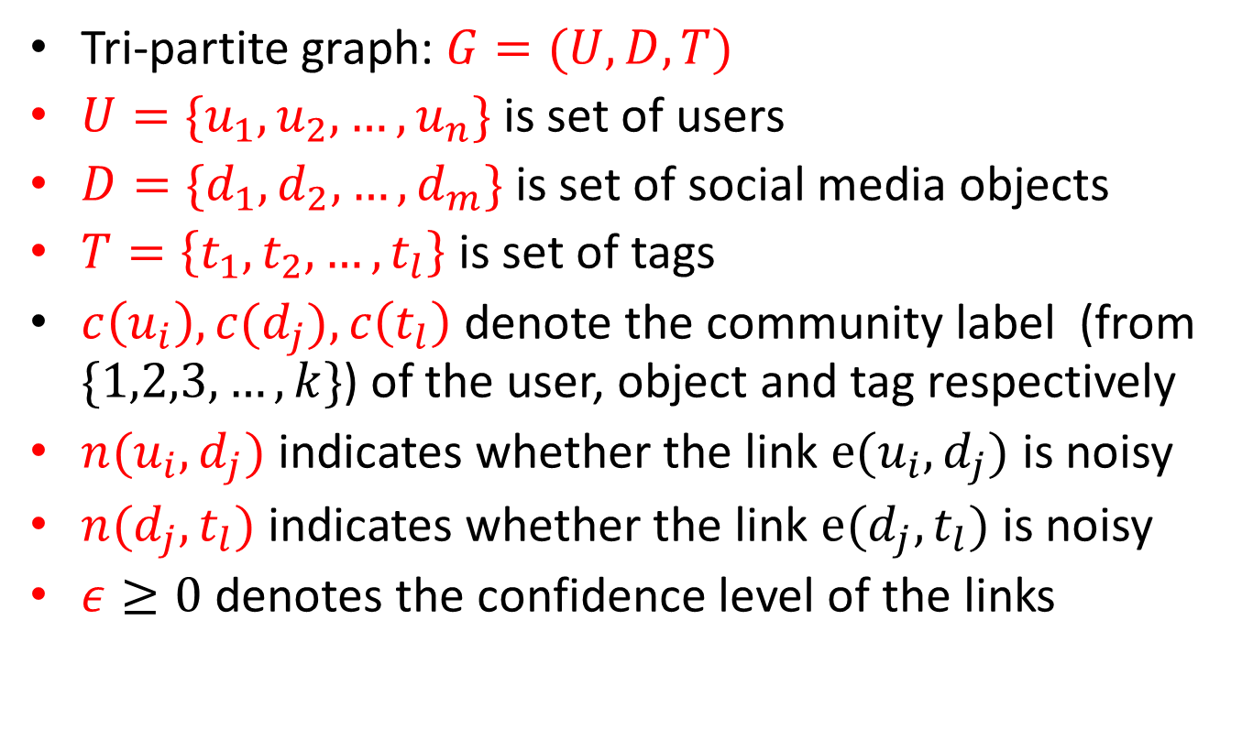
Heterogeneous Random Field Model Notations
Tri-partite graph: $G=(U,D,T)$
$U=\{u_{1},u_{2},…, u_{n}\}$ is set of users
$D=\{d_{1}, d_{2},…, d_{m}\}$ is set of social media objects
$T=\left\{t_{1}, t_{2},…, t_{l}\right\}$ is set of tags
$c\left(u_{i}\right), c(d_{j}), c\left(t_{l}\right)$ denote the community label (from $\{1,2,3, …, k\}$) of the user, object and tag respectively
$n(u_{i}, d_{j})$ indicates whether the link $e(u_{i}, d_{j})$ is noisy
$n(d_{j}, t_{l})$ indicates whether the link $e(d_{j}, t_{l})$ is noisy
$ε≥0$ denotes the confidence level of the links

Slide 49
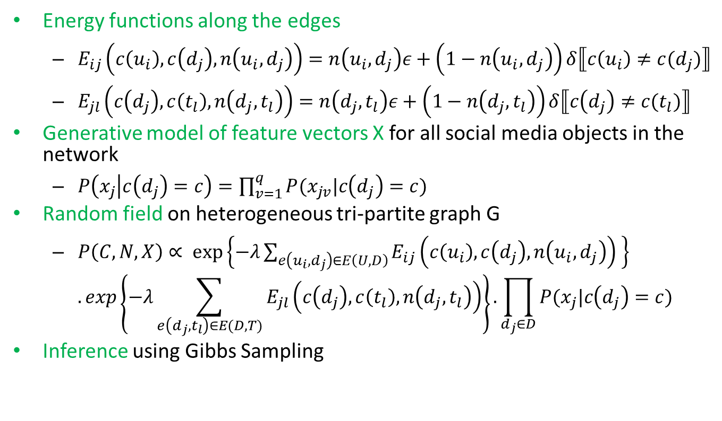
Heterogeneous Random Field Model
Energy functions along the edges
$E_{ij}\left(c\left(u_{i}\right), c\left(d_{j}\right), n\left(u_{i}, d_{j}\right)\right)=n\left(u_{i}, d_{j}\right)ε+\left(1−n\left(u_{i},d_{j}\right)\right)δ⟦c\left(u_{i}\right)≠c(d_{j})⟧$
$E_{jl}\left(c\left(d_{j}\right), c\left(t_{l}\right), n\left(d_{j}, t_{l}\right)\right)=n\left(d_{j}, t_{l}\right)ε+\left(1−n\left(d_{j}, t_{l}\right)\right)δ⟦c\left(d_{j}\right)≠c(t_{l})⟧$
Generative model of feature vectors X for all social media objects in the network
$P\left(x_{j} | c\left(d_{j}\right)=c\right)=\prod_{v=1}^{q}{P(x_{jv}|c\left(d_{j}\right)=c)}$
Random field on heterogeneous tri-partite graph G
$P\left(C,N,X\right)∝ \exp\left\{−λ\sum_{e\left(u_{i},d_{j}\right)∈E\left(U,D\right)}{E_{ij}\left(c\left(u_{i}\right), c\left(d_{j}\right), n\left(u_{i}, d_{j}\right)\right)} \right\}$ $. exp\left\{−λ\sum_{e\left(d_{j}, t_{l}\right)∈E(D,T)}{E_{jl}\left(c\left(d_{j}\right), c\left(t_{l}\right), n\left(d_{j}, t_{l}\right)\right)}\right\}. \prod_{d_{j}∈D}{P(x_{j}|c\left(d_{j}\right)=c)}$
Inference using Gibbs Sampling

Slide 50
Tutorial Outline
Introduction [10 min]
Static Graph Outlier Detection Algorithms [45 min]
Minimum Description Length [10 min]
Ego-net Metrics [5 min]
Random Walks [5 min]
Random Field Models [10 min]
Outliers in Heterogeneous Networks [15 min]
Break [10 min]
Dynamic Graph Outlier Detection Algorithms [45 min]
Summary [10 min]

Slide 51
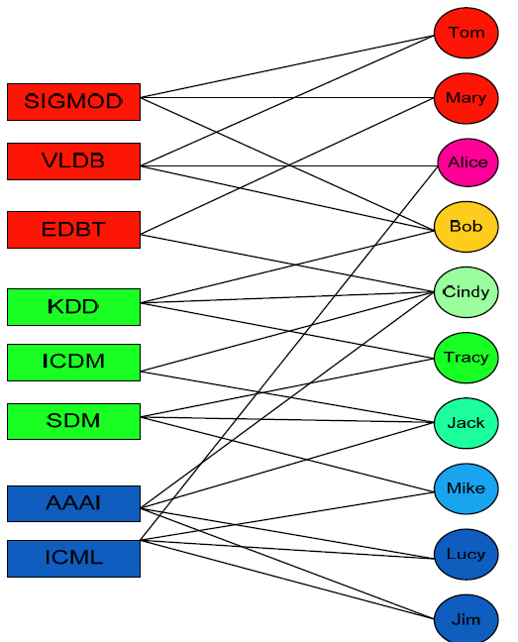
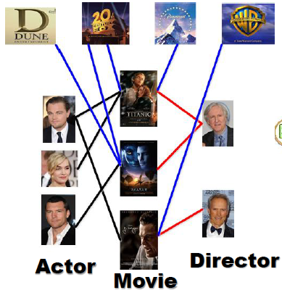





Heterogeneous Networks are Ubiquitous
Studio
IMDB Network
DBLP Network
Facebook Network
Actor
Movie
Studio
Director
Notes:
MultiMediaN E-Culture
By linking the collections and vocabularies from multiple museums together the E-Culture project constructed a graph of cultural heritage data. Within the MultimediaN E-Culture team I investigated how keyword search can be applied to this heterogeneous graph to find artworks that are semantically related artworks to a keyword query?

Slide 52
Association-Based Clique Outliers (ABC-Outliers)
Gupta et al, ASONAM’13
A conjunctive select query on a network consists of (type, predicate) pairs
Expected result are cliques ranked by outlierness
ABCOutliers: Cliques containing rare and interesting associations between constituent entities
Applications
Discovering interesting relationships
Data de-noising (removing incorrect data attributes or entity associations)
Explaining the future behavior of objects participating in such associations
Research
Area
Author
Conference
Energy and
Sustainability
Computer Networking
Author
Data engineering
Conference

Slide 53





Concept Definitions: A Network
Network G
A
Actors
B
Locations
2
5
8
A
B
C
11
3
6
9
A
A
B
C
1
B
4
7
10
B
C
B
A
Query Q
Outlier
Movie
Vietnamese
Actor
American
Country
China
Notes:
$G=〈V,E,F_{1},F_{2}〉$
$F_{1}:V→Τ$ where $Τ$ is set of entity types
$F_{2}$ maps every node to attribute vector
Each node has multiple attributes each with a different data type ($A_{i}=(A_{i_{1}},A_{i_{2}}, …,A_{i_{D_{i}}})$ such that $|A_{i}|=D_{i}$)
Attributes could be numeric, categorical, sets of strings, time durations
Edges are not typed for our work
Person and movie; Edge could be actor, producer, director
Conjunctive Select Query (Q) of length L on a network
$$〈\left(T_{1}, P_{1}\right),\left(T_{2}, P_{2}\right), …, \left(T_{L} , P_{L}\right)〉$$
$P_{i}$ is defined only for type $T_{i}$
Match C for set query Q
$$C_{i}=〈e_{i_{1}}^{D_{1}×1}, …,e_{i_{L}}^{D_{L}×1}〉$$
Contains the same number and type of nodes as mentioned in the query
All nodes in C are connected to each other in G and satisfy the predicates in Q
Association-Based Clique Outlier
Outlierness of a clique =f(outlierness of associations between the attributes of these nodes)
Outlierness of association ${(v}_{1},v_{2})$ for attributes $a_{1}$ and $a_{2}$ is high if
$v_{1}$ and $v_{2}$ are frequent
Co-occurrence of $v_{1}$ and $v_{2}$ is rare
High correlation between $a_{1}$ and $a_{2}$
Association-Based Clique Outlier Detection Problem
Given: a network G and a query Q
Find: top K cliques that satisfy the query with highest outlier scores.

Slide 54

Q=<(T₁,P₁), (T₂,P₂), …, (T_{L},P_{L})>
Q₁=<(T₁,P₁)> | Q₂=<(T₂,P₂)> | … | Q_{L}=<(T_{L},P_{L})>
Matching
…
L₁
Network G
T₁
T₂
L₂
T_{T}
Candidate Computation by Matching
T₃
⋮
L_{L}
Score Computation for a Query Edge
Cluster Computation for an Attribute
$$C_{1}=<e_{1_{1}}^{D_{1}×1}, …,e_{1_{L}}^{D_{L}×1}>$$
⋮
$$C_{M}=<e_{M_{1}}^{D_{1}×1}, …,e_{M_{L}}^{D_{L}×1}>$$
TopK Quit?
No
TopK ABCOutliers
Yes
Outlier Detection

Slide 55

Candidate Computation by Matching Graph Indexing
Relational database: Attribute information associated with each of the vertices (entities) in G
Memory: Connectivity information of the graph
Shared neighbors index: For each entity, store the number of shared neighbors of each type, shared between the entity and its neighbors of a particular type
T₁
T₂
T_{T}
 | A |  |  | B |  |  | C
 | A | B | C | A | B | C | A | B | C
1 | 0 | 0 | 1 | 0 | 0 | 0 | 1 | 0 | 0
2 | 0 | 0 | 0 | 0 | 0 | 0 | 0 | 0 | 0
3 | 0 | 0 | 0 | 0 | 0 | 1 | 0 | 1 | 0
4 | 0 | 1 | 0 | 1 | 0 | 0 | 0 | 0 | 0
5 | 0 | 0 | 0 | 0 | 0 | 0 | 0 | 0 | 0
6 | 0 | 0 | 0 | 0 | 0 | 0 | 0 | 0 | 0
7 | 0 | 0 | 1 | 0 | 0 | 0 | 1 | 0 | 0
8 | 0 | 0 | 1 | 0 | 0 | 0 | 1 | 0 | 0
9 | 0 | 2 | 1 | 2 | 0 | 0 | 1 | 0 | 0
10 | 0 | 0 | 0 | 0 | 0 | 1 | 0 | 2 | 0
11 | 0 | 0 | 0 | 0 | 0 | 1 | 0 | 1 | 1
12 | 0 | 0 | 1 | 0 | 0 | 0 | 2 | 0 | 0
2
5
8
Network G
A
B
C
11
3
6
9
A
A
B
C
1
B
B
4
7
10
C
B
A
$$O(NT^{2})$$

Slide 56

Candidate Computation by Matching Candidate Filtering
Given: $L$ lists $L_{1},L_{2},…, L_{L}$
Find: Cliques of size $L$ such that each clique has a node from each list
Start with size 1 cliques and grow them
$L_{min}$ is list of min size and has type $T_{min}$
Prune $L_{min}$
Prune the node if its typed neighbors cannot satisfy the requirements of the query
Prune the node if its typed neighbors do not have enough shared neighbors

Slide 57

Candidate Computation by Matching Generating Candidates
Size 1 cliques: Elements of list $L_{min}$
Grow each length-$l$ clique to length-$l+1$ cliques
Randomly choose next type $t’$
A node $n$ of type $t’$ is added to length-$l$ clique if it is connected to all nodes in clique
Length-$l$ clique is pruned off if it cannot grow
Algorithm terminates when $l=L$

Slide 58


Outlier Score Computation Scoring Attribute Value Pairs
Outlier score between values $v_{i}$ and $v_{j}$ should be high if
Values $v_{i}$ and $v_{j}$ co-occur rarely
Values $v_{i}$ and $v_{j}$ are individually frequent
$∃s_{j}|$co-occur freq($v_{i},s_{j}$) > $γ×$freq($v_{i}$) and $v_{j}∉s_{j}$
$∃s_{i}|$co-occur freq($v_{j},s_{i}$) > $γ×$freq($v_{j}$) and $v_{i}∉s_{i}$
Computation for individual values may be noisy
Compute clusters for every attribute
KMeans for numbers, time durations
Category label for categorical attributes
Sets of strings: create network and then partition (METIS)
$$0≤γ≤1$$
Hindi
China
Mandarin Mongolian
Southern
India Pakistan

Slide 59

Outlier Score Computation Scoring Attribute Value Pairs, Edges, Cliques
Peakedness of Cluster Co-occurrence Curves
$peakedness(c_{i_{k}}, A_{j_{l}})=max⁡(0, 1−β×(|c_{j}|−1))$
Outlier Score of an Association
$score(v_{i}, v_{j})=\frac{freq\left(c_{i_{k}}\right)×freq\left(c_{j_{l}}\right)}{freq\left(c_{i_{k}}, c_{j_{l}}\right)}×\frac{peakedness(c_{j_{l}}, A_{i_{k}})+peakedness(c_{i_{k}}, A_{j_{l}})}{2}$
$score\left(edge e\right)=\frac{\sum_{a=1}^{D_{i}}{\sum_{b=1}^{D_{j}}{score(v_{a}, v_{b})}}}{D_{i}D_{j}}$
$score\left(clique c\right)=\sum_{e∈c}{score(edge e)}$
Hindi
Country
Peaked
1983
Latitude
Non-Peaked

Slide 60
Case Studies
Query: $〈$(film, country=“us”), (person, true), (settlement, true)$〉$
(film="the road to el dorado", person="hernan cortes", settlement="seville")
No. | Type1 | Attribute1 | Type2 | Attribute2 | Value1 | Value2
1 | settlement | subdivision_type3 | film | screenplay | comarca | ted elliott, terry rossio
2 | settlement | subdivision_type3 | person | birth_place | comarca | Castile
3 | settlement | coordinates_region | film | screenplay | es | ted elliott, terry rossio
4 | settlement | subdivision_type3 | person | death_date | comarca | 1485
5 | settlement | subdivision_type1 | film | studio | autonomous community | dreamworks animation, stardust pictures
Query: (company, country=“us"), (film, lang="english"), (person, birthplace=“us"), (tv, true)
(company="viacom", film="mission:impossible iii", person="tom cruise", tv="south park")
No. | Type1 | Attribute1 | Type2 | Attribute2 | Value1 | Value2
1 | film | writers | company | divisions | alex kurtzman, roberto orci, j. j. abrams | mtv networks, bet networks, paramount pictures corporation
2 | television | creator | company | #employees | trey parker, matt stone | 10900
3 | television | #episodes | company | divisions | 223 | mtv networks, bet networks, paramount pictures corporation
4 | television | network | company | divisions | comedy central | mtv networks, bet networks, paramount pictures corporation
5 | person | birth date | company | foundation | 1962 | 1971

Slide 61

Community Distribution Outliers (CD-Outliers)
Gupta et al., PKDD’13
z
Type | x | y | z
Pattern “b” | 0.8 | 0.0 | 0.2
Pattern “g” | 0.2 | 0.8 | 0.0
Pattern “r” | 0.0 | 0.2 | 0.8
Pattern “c” | 0.4 | 0.0 | 0.6
Pattern “m” | 0.0 | 0.4 | 0.6
Pattern “y” | 0.4 | 0.6 | 0.0
Outlier 1 | 0.6 | 0.0 | 0.4
Outlier 2 | 0.33 | 0.33 | 0.34
y
x
Distribution Pattern for a Type
A cluster obtained by grouping rows of a belongingness matrix of that type
Can be represented using cluster centroids
Community Distribution Outliers: Objects whose community distribution does not follow any of the popular community distribution patterns
EXPERT
User
Tag
URL
Fashion
Arts
Science
Sports

Slide 62




CD-Outlier Framework
Pattern Discovery
Outlier Detection
H₁
Top $κ$ Outliers
T₁
W₁
Joint NMF
H₂
W₂
Top $κ$ Outliers
T₂
H₃
Top $κ$ Outliers
W₃
T₃
Remove Outliers from T_{i}

Slide 63
Discovery of Distribution Patterns
Each of the membership matrices can be clustered individually
But the membership matrices
Are defined for objects that are connected to each other
Represent objects in the same space of C dimensions
Hidden structures across types should be consistent with each other
Divergence between any two clusterings should be small

Slide 64



Optimization and Iterative Update Rules
$\begin{aligned}min \\ W,H\end{aligned}{{\sum_{k=1}^{K}{\left\{{\left\|T_{k}−W_{k}H_{k}\right\|}^{2}\right\}}+α\sum_{\begin{aligned}k=1 \\ l=1 \\ k<l\end{aligned}}^{K}{\left\{{\left\|H_{k}−H_{l}\right\|}^{2}\right\}}}^{}}$
subject to the constraints
$W_{k}≥0 ∀k=1,2,…K$
$H_{k}≥0 ∀k=1,2,…K$
NMF
$$\begin{aligned}min \\ W,H\end{aligned}{{\left\|T−WH\right\|}^{2}}$$
subject to the constraints
$$W≥0, H≥0$$
$W_{k}←W_{k}⊙\frac{T_{k}H_{k}^{T}}{W_{k}H_{k}H_{k}^{T}} ∀k=1,2,…, K$
$H_{k}←H_{k}⊙\frac{W_{k}^{T}T_{k}+α\sum_{\begin{aligned}l=1 \\ k≠l\end{aligned}}^{K}{I^{C^{′}×C^{′}}H_{l}}}{W_{k}^{T}W_{k}H_{k}+α\sum_{\begin{aligned}l=1 \\ k≠l \end{aligned}}^{K}{I^{C^{′}×C^{′}}H_{k}}} ∀k=1,2,…, K$
$⊙$denotes the Hadamard Product and $\frac{A}{B}$ denotes the element-wise division

Slide 65

Community Distribution Outlier Detection
Joint NMF outputs the $W_{k}$ and $H_{k}$ matrices
Each row of $H_{k}$ is a distribution pattern
Each element $(i,j)$ of $W_{k}$ denotes probability with which object $i$ belongs to community $j$
Outlier score of an object $i$ is the distance of the object from the nearest cluster centroid
$OS\left(i\right)=argmin_{j} Dist(T_{k_{\left(i,.\right)}}, {H_{k}}_{\left(j,.\right)})$
Objects far away from nearest cluster centroids get higher outlier score

Slide 66





Iterative Refinement Algorithm
$$O(NI^{′}K[KIC^{′2}+log⁡(κ)])$$
Linear in
number of
objects
$$O(K^{2}INC^{′2})$$
$$O(N{KC}^{′2})$$
$$O(KNlog(κ))$$

Slide 67

Synthetic Dataset Results Summary
Synthetic Dataset Results (CDO =The Proposed Algorithm CDODA, SI = Single Iteration Baseline, Homo = Homogenous (Single NMF) Baseline) for C=6
SI: Single iteration version of CDO
Homo: Treats all objects to be of the same type
SI (2.9%)
Homo(21%)

Slide 68
Real Dataset Case Studies (DBLP)
Each research area appears as a pattern and then there are other patterns with distributions across multiple areas. E.g., “Data Mining” and “Computational Biology” is a pattern
Some patterns are specific to particular types
“Software engineering” and “Operating systems” for conferences
“Concurrent Distributed and Parallel Computing” and “Security and privacy” for authors
“Security and privacy” and “Education” for terms
Top Outlier Author: Giuseppe de Giacomo - Algorithms and Theory (0.25), Databases (0.47), Artificial Intelligence (0.13), Human Computer Interaction (0.06)
Top conference outlier: From integrated publication and information systems to virtual information and knowledge environments - Databases (0.5), Artificial Intelligence (0.09), Human Computer interaction (0.4)
Top terms outlier: military - Algorithms and theory (0.02), Security and Privacy (0.37), Databases (0.22), Computer Graphics (0.37)

Slide 69
Break

Slide 70
Outlier Detection for Graph Data
Manish Gupta
Jing Gao
Charu Aggarwal
Jiawei Han
Microsoft
SUNY
IBM
UIUC

Slide 71
Tutorial Outline
Introduction [10 min]
Static Graph Outlier Detection Algorithms [45 min]
Break [10 min]
Dynamic Graph Outlier Detection Algorithms [45 min]
Graph Similarity [15 min]
Evolutionary Community Outlier Detection [20 min]
Online Graph Outlier Detection [10 min]
Summary [10 min]

Slide 72

Networks Evolve
Social networks: New users join, new friendships are created
Bibliographic networks: New authors publish more papers, more collaborations are done
Transportation/road networks: New roads are constructed
Ad hoc networks: Army vehicles change positions very frequently, new messages are transmitted

Slide 73
Tutorial Outline
Introduction [10 min]
Static Graph Outlier Detection Algorithms [45 min]
Break [10 min]
Dynamic Graph Outlier Detection Algorithms [45 min]
Graph Similarity [15 min]
Evolutionary Community Outlier Detection [20 min]
Online Graph Outlier Detection [10 min]
Summary [10 min]

Slide 74

Graph Similarity-based Outlier Detection Algorithms
Given a series of graph snapshots
Time series of graph distance metrics can be individually modeled using univariate autoregressive moving average (ARMA) model
Outliers are time points where the actual and predicted values differ greater than a threshold
A large variety of similarity/distance measures have been proposed to compare two graph snapshots
Notations
$V_{G}$ and $V_{H}$are vertex sets for G and H resp. If $V_{G}=V_{H}$, V is used
$E_{G}$ and $E_{H}$ are edges in graphs G and H

Slide 75

Graph Similarity/Distance Measures (1)
Papadimitriou et al, Jour. ISA’10; Pincombe, ASOR’05
Weight Distance $d\left(G,H\right)=\frac{\sum_{u,v∈V}{\frac{\left|w_{E}^{G}\left(u,v\right)−w_{E}^{H}\left(u,v\right)\right|}{\max\left(w_{E}^{G}\left(u,v\right),w_{E}^{H}\left(u,v\right)\right)}}}{\left|E_{G}∪E_{H}\right|}$
MCS Weight Distance
Same as weight distance but only for edges in MCS where the maximum common subgraph (MCS) F of G and H is the common subgraph with the most vertices
MCS Edge Distance $d\left(G,H\right)=1−\frac{|mcs(E_{G},E_{H})|}{max(|E_{G}|, |E_{H}|)}$

Slide 76

Graph Similarity/Distance Measures (2)
Dickinson et al, IDC’02
4. MCS Vertex Distance $$d\left(G,H\right)=1−\frac{|mcs(V_{G},V_{H})|}{max(|V_{G}|, |V_{H}|)}$$
5. Median Graph Edit Distance
6. Modality Distance
Absolute value of the difference between the Perron vectors (principal eigen vector of adjacency matrix) of these graphs

Slide 77




Graph Similarity/Distance Measures (3)
Shoubridge et al, IDC’99
7. Graph Edit Distance
d(G,G′) = |V|+|V′|−2|V∩V′|+|E|+|E′|−2|E∩E′|
C_{nd}(n)=cost of deleting node n
C_{ni}(n)=cost of inserting node n
C_{es}(n)=cost of substituting an edge weight for edge e
C_{ed}(n)=cost of deleting edge e
C_{ei}(n)=cost of inserting edge e
C=tradeoff parameter
$β$(e)=weight of edge e
$ε$=smoothing parameter (set to 1)

Slide 78




Graph Similarity/Distance Measures (4)
Gaston et al, AJC’06
8. Diameter Distance
difference in the diameters for each graph
9. Entropy Distance
where
10. Spectral Distance

Slide 79
Graph Similarity/Distance Measures (5)
Dickinson and Kraetzl, Fusion’03
11. Umeyama graph distance
12. The Euclidean distance between the principal eigenvectors of the graph adjacency matrices (Vector Similarity)
13. Spearman’s correlation coefficient
rank correlation between sorted (based on PageRank) lists of vertices of the two graphs

Slide 80
Graph Similarity/Distance Measures (6)
Papadimitriou et al, WWW’08
14. Sequence similarity
Similarity of vertex sequences of the graphs that are obtained through a graph serialization algorithm
15. Signature similarity
Hamming distance between appropriate fingerprints of two graphs
16. Vertex/edge overlap (VEO)
17. Vertex ranking (VR)
w is PageRank value, $π$ is the vertex rank, D is normalization constant

Slide 81

Outlier Web Crawl Snapshot
Given multiple crawls of the web graph, find a crawl graph with anomalies.
These anomalies refer to
Failures of web hosts that do not allow the crawler to access their content
Hardware/software problems in the search engine infrastructure that can corrupt parts of the crawled data
Signature Similarity turned out to be most important measure

Slide 82

Metric Forensics: Introduction
Henderson et al, KDD’10
Study on summary graphs created using some "aggregation" (binary/sum/max) over edge weights of different snapshots in that time interval
Given a volatile graph it can detect interesting events at multiple levels (both temporally and topologically)
At the global level, METRICFORENSICS computes and monitors a suite of graph metrics (e.g., the number of active nodes and links, the first few eigenvalues, their wavelet transforms, etc) at regular intervals.
Only when a deviation from usual behavior is flagged, METRICFORENSICS follows through with a “drill down” approach, where the offending graph is studied at finer temporal and topological resolutions

Slide 83
Metric Forensics: Outlier Types
“Elbows” (where the observed behavior changes while another phenomenon remains stable)
Broken correlations (where previously strong correlations disappear)
Prolonged spikes (where there is low volume but prolonged activity-level)
“Lightweight" stars (i.e., vertices that form very big star-like structures but have lower than expected total incident edge-weights)

Slide 84

Metric Forensics: Metrics
Metrics at three levels
Global
Basic metrics
Number of active vertices
Number of active edges
Average vertex degree
Average edge weight
Maximum vertex degree
Connectivity Metrics
Number of connected components
Fraction of vertices in the largest component
Number of articulation points
Minimum spanning tree weight
Spectral Metrics
Top-k eigenvalues of the adjacency matrix
Stability Metrics
Jaccard($V_{T},$ $V_{T−1}$)
Jaccard($E_{T}, E_{T−1}$)
Community
Static
Fraction of vertices in the largest community
Number of communities
Dynamic
Variation of information between successive community assignments.
Cross Associations
Local
Centrality metrics
OddBall
Impact metrics (e.g., leaving a single vertex out of the graph and recalculating other metrics to determine the impact of the vertex

Slide 85
Metric Forensics: Collection of Analysis Techniques
Single metric analysis
Autoregressive Moving Average (ARMA) Model to identify metric values that are abnormally large or small given recent values.
Fourier analysis can identify periodic behavior, such as daily trends in graph properties.
Wavelet analysis to identify patterns and anomalies in metric values.
Lag plots
Outlier detection techniques such as Local Outlier Factor and fractal dimension analysis
Coupled metric analysis
Pearson Correlation analysis
Outlier detection or clustering on coupled metric data
Non-metric analysis
Visualization (3D display of summary graphs) tools
The size of a vertex can show its degree, while the color can depict the vertex between-ness centrality
Attribute data inspection
Vertices and edges in volatile graphs can have attributes.
For example, IP communication traces often have at least partial packet contents

Slide 86


Metric Forensics: Real Dataset Examples
Three real-world graphs
An enterprise IP trace (LBNL)
A trace of legitimate and malicious network traffic from a research institution (ENTP),
MIT Reality Mining proximity sensor data (RMBT)
Variation of top two principal components for
ENTP graph. Colors represent time. 2 regions denote “elbows”
The top-14 graph metrics correlated with first principal component in the ENTP data. The sharp drop in correlation for Region 1 depicts a broken correlation.

Slide 87
Tutorial Outline
Introduction [10 min]
Static Graph Outlier Detection Algorithms [45 min]
Break [10 min]
Dynamic Graph Outlier Detection Algorithms [45 min]
Graph Similarity [15 min]
Evolutionary Community Outlier Detection [20 min]
Online Graph Outlier Detection [10 min]
Summary [10 min]

Slide 88
Two Definitions for Network Community Outliers
Community based Outliers: Network nodes that evolve against temporal community change trends
Two snapshots: Evolutionary Community Outliers (ECOutliers)
More than two snapshots: Community Trend Outliers (CTOutliers)
Evolutionary Community
Outliers (KDD 2012)
Community Trend Outliers
(PKDD 2012)

Slide 89
Communities Evolve
Gupta et al, KDD’12
Contraction
Expansion
Merge
Split

Slide 90




Real-life Examples of ECOutliers Conglomerate Diversification: Walt Disney
Animation Movies
Theme Parks+ Resorts

Slide 91




ECOutliers: Dataset Representation
Community-Community Correspondence Matrix
Belongingness Matrix
DM IR ML DB
K₁
K₂
Databases (DB)
K₂
Information
Retrieval (IR)
Machine
Learning (ML)
X
$$≈$$
S
K₁
Data Mining (DM)
N
P
N
Q
$P∈{\left[0,1\right]}^{N×K_{1}}$ $Q∈{\left[0,1\right]}^{N×K_{2}}$
$$\sum_{i=1}^{K_{1}}{p_{oi}}=1 \sum_{j=1}^{K_{2}}{q_{oj}}=1$$
$$S∈{\left[0,1\right]}^{K_{1}×K_{2}}$$
$$\sum_{j=1}^{K_{2}}{s_{ij}}=1$$

Slide 92





TwoStage Evolutionary Outlier Detection Framework
Community
Detection
Community Matching
Outlier Detection
Evolutionary
Clustering
X₁
P
$$×$$
$$≈$$
P
S
Q
X₂
Q

Slide 93


OneStage Evolutionary Outlier Detection Framework
Outlierness Matrix: ${A∈[0,1]}^{N×K_{2}}$
Community
Detection
Community Matching
Outlier Detection
X₁
P
$$×$$
$$≈$$
P
S
Q
$$\sum_{o,j}{a_{oj}}$$
= $μ=1$
X₂
A
Q

Slide 94









OneStage$μ$ Evolutionary Outlier Detection Framework
Community
Detection
Community Matching
Outlier Detection
Community Matching
Outlier Detection
X₁
P
$$×$$
$$≈$$
$$×$$
$$≈$$
P
S
Q
P
S
Q
X₂
A
$$\sum_{o,j}{a_{oj}}$$
= $μ=1$
A
$$\sum_{o,j}{a_{oj}}$$
= $μ$
Q
Estimate $μ$

Slide 95








Community Matching and Outlier Detection Together
$$\min{\sum_{o=1}^{N}{\sum_{j=1}^{K2}{\log\left(\frac{1}{aoj}\right)(q_{oj}−\vec{po.}.\vec{s.j})2}}}$$
$$subject to the following constraints$$
$$\sum_{j=1}^{K2}{sij=1} \left(∀i=1…K1\right)$$
$$\sum_{o=1}^{N}{\sum_{j=1}^{K2}{aoj=μ}}$$
$$sij≥0 \left(∀i=1…K1, ∀j=1…K2\right)$$
$$1≥a_{oj}≥0 \left(∀o=1…N, ∀j=1…K2\right)$$
X
$$≈$$
$$S$$
$$P$$
$$Q$$
Given $P$ and $Q$, estimate $S$ and $A$
$N$ = #objects
$K1$ = #clusters in $X1$
$K$₂ = #clusters in $X2$
$PNXK1$ = belongingness matrix for $X1$
$QNXK2$ = belongingness matrix for $X2$
$SK1XK2$= corr. matrix
$ANXK2$ = outlierness matrix
$μ$= maximum level of overall outlierness

Slide 96



Evolutionary Community Outlier Detection Algorithm (OneStage$μ$)
Input: $P$ and $Q$
Output: Estimates of $S$ and $A$
Initialize $μ$, all $sij$ to $\frac{1}{K_{2}}$ and all $aoj$ to $\frac{1}{NK_{2}}$
While (not converged)
Compute $A$ (Outlier Detection step)
Compute $S$ (Community Matching step)
Estimate$μ=\frac{\sum_{o^{′}=1}^{N}{\sum_{j^{′}=1}^{K2}{(q_{o^{′}j^{′}}−\vec{po′.}.\vec{s.j′})2}}}{\begin{aligned}max \\ o, j\end{aligned}\left(q_{oj}^{2}\right)}$
While (not converged)
Compute $A$ (Outlier Detection step)
Compute $S$ (Community Matching step)
Two pass algorithm
Coordinate descent iterative computation of $S$ and $A$
Evolutionary Community
Outlier
Detection
Community
Matching
$$O(NK12K2t)$$
$N$=#objects
$K1$=#clusters in $X1$
$K2$=#clusters in $X2$
$t$=#iterations

Slide 97




Synthetic Datasets
Expansion/Contraction
No Evolution
Cluster Merge
Cluster Split

Slide 98


Synthetic Dataset Results Summary
N | Ψ | SynContractExpand |  |  |  | SynNoEvolution |  |  |  | SynMerge |  |  |  | SynSplit |  |  |  | SynMix
 | (%) | NN | 2S | 1S | 1Sµ | NN | 2S | 1S | 1Sµ | NN | 2S | 1S | 1Sµ | NN | 2S | 1S | 1Sµ | NN | 2S | 1S | 1Sµ
1000 | 1 | 0.755 | 0.947 | 0.966 | 0.966 | 0.832 | 0.791 | 0.853 | 0.965 | 0.72 | 0.774 | 0.835 | 0.926 | 0.786 | 0.918 | 0.929 | 0.931 | 0.606 | 0.891 | 0.904 | 0.925
 | 2 | 0.729 | 0.92 | 0.948 | 0.957 | 0.812 | 0.733 | 0.789 | 0.961 | 0.702 | 0.715 | 0.781 | 0.908 | 0.779 | 0.865 | 0.92 | 0.924 | 0.675 | 0.823 | 0.86 | 0.915
 | 5 | 0.71 | 0.853 | 0.913 | 0.956 | 0.726 | 0.712 | 0.752 | 0.928 | 0.645 | 0.654 | 0.719 | 0.849 | 0.697 | 0.799 | 0.891 | 0.92 | 0.631 | 0.77 | 0.817 | 0.92
 | 10 | 0.619 | 0.766 | 0.833 | 0.96 | 0.657 | 0.684 | 0.706 | 0.881 | 0.58 | 0.617 | 0.656 | 0.801 | 0.63 | 0.749 | 0.832 | 0.918 | 0.594 | 0.73 | 0.776 | 0.917
5000 | 1 | 0.778 | 0.945 | 0.97 | 0.97 | 0.938 | 0.793 | 0.848 | 0.971 | 0.713 | 0.762 | 0.801 | 0.928 | 0.796 | 0.913 | 0.942 | 0.942 | 0.691 | 0.881 | 0.895 | 0.918
 | 2 | 0.756 | 0.93 | 0.947 | 0.961 | 0.864 | 0.772 | 0.815 | 0.962 | 0.677 | 0.752 | 0.791 | 0.903 | 0.768 | 0.885 | 0.938 | 0.94 | 0.646 | 0.862 | 0.876 | 0.919
 | 5 | 0.689 | 0.901 | 0.929 | 0.964 | 0.742 | 0.75 | 0.779 | 0.941 | 0.626 | 0.698 | 0.749 | 0.827 | 0.689 | 0.806 | 0.913 | 0.924 | 0.608 | 0.831 | 0.86 | 0.921
 | 10 | 0.622 | 0.778 | 0.829 | 0.964 | 0.656 | 0.73 | 0.747 | 0.912 | 0.579 | 0.643 | 0.679 | 0.795 | 0.624 | 0.762 | 0.834 | 0.929 | 0.593 | 0.783 | 0.824 | 0.919
10000 | 1 | 0.769 | 0.949 | 0.973 | 0.974 | 0.926 | 0.807 | 0.856 | 0.974 | 0.707 | 0.788 | 0.817 | 0.933 | 0.789 | 0.938 | 0.955 | 0.96 | 0.665 | 0.882 | 0.897 | 0.921
 | 2 | 0.752 | 0.937 | 0.949 | 0.963 | 0.851 | 0.788 | 0.828 | 0.964 | 0.681 | 0.762 | 0.796 | 0.898 | 0.758 | 0.898 | 0.948 | 0.951 | 0.67 | 0.869 | 0.881 | 0.916
 | 5 | 0.695 | 0.9 | 0.93 | 0.964 | 0.738 | 0.763 | 0.788 | 0.951 | 0.627 | 0.719 | 0.756 | 0.826 | 0.683 | 0.807 | 0.914 | 0.922 | 0.604 | 0.847 | 0.871 | 0.919
 | 10 | 0.622 | 0.771 | 0.825 | 0.965 | 0.66 | 0.753 | 0.769 | 0.926 | 0.583 | 0.645 | 0.681 | 0.795 | 0.621 | 0.769 | 0.827 | 0.934 | 0.584 | 0.812 | 0.845 | 0.917
1S (5%)
2S (8%)
NN (36%)
1S (15%)
2S (25%)
NN (21%)
1S (11%)
2S (22%)
NN (33%)
1S (3%)
2S (10%)
NN (30%)
1S (6%)
2S (10%)
NN (46%)
NN: Comparison with old Nearest neighbors without community matching
2S: Outlier detection after community matching
1S: Single pass version of 1S$μ$
1S$μ$: Outlier detection with community matching
Average Variance
NN | 0.0012
1S | 0.0021
2S | 0.0017
1S$μ$ | 0.0005
1S (8%)
2S (15%)
NN (33%)

Slide 99


Real Dataset Case Studies
DBLP Authors Network
Georgios B. Giannakis
X₁ conferences: CISS, ICC, GLOBECOM, INFOCOM
X₂ conferences: ICASSP, ICRA
IMDB Actors Network
Kelly Carlson (I)
X₁: Many Sport, Thriller, and Action movies
X₂: Many Drama, Music, Reality-TV movies

Slide 100
Two Definitions for Network Community Outliers
Community based Outliers: Network nodes that evolve against temporal community change trends
Two snapshots: Evolutionary Community Outliers (ECOutliers)
More than two snapshots: Community Trend Outliers (CTOutliers)
Evolutionary Community
Outliers (KDD 2012)
Community Trend Outliers
(PKDD 2012)

Slide 101



Community Trend Outliers
Gupta et al, PKDD’12
Normal
Anomalous
Community Trend Outliers: Nodes for which evolutionary behaviour across a series of snapshots is quite different from that of its community members
Notes:
Trajectory based outliers [Alon et al.,2003][Basharat et al., 2008]
General patterns could be gapped and multi-level, unlike trajectories.
Patterns in our case are soft clustering results rather than locations
We don’t have features such as speed or direction of motion of objects.

Slide 102


Possible to Extend OneStage$μ$ for Multiple Snapshots?
Belongingness Matrices: $P_{1}, P_{2}, …,P_{T}$
Outlierness Matrices: $A_{2},…, A_{T}$
For two snapshots, we did: $min\left\{log\left(\frac{1}{A}\right)\left[Q−PS\right]\right\}$
For $T$ snapshots?
$\min\left\{\sum_{i=1}^{T−1}{\left[\log\left(\frac{1}{A_{i+1}}\right){\left[P_{i+1}−P_{i}S_{i+1}\right]}^{2}\right]}\right\}$
$\min\left\{\sum_{i=1}^{T}{\sum_{j=i+1}^{T}{\left[{\log\left(\frac{1}{A_{i,j}}\right)\left[P_{i}−P_{j}S_{i,j}\right]}^{2}\right]}}\right\}$
Drawbacks
Inefficient: Too many variables
Unable to capture patterns of length >2
May try to overfit to capture all length-2 patterns
Unable to capture subtle patterns of change

Slide 103


Soft Sequence Representation
Every object has a distribution associated with it across time
In a co-authorship network, an author has a distribution of research areas associated with it across years
Soft sequence for object denoted by $(→)$
<1: (A:0.1 , B:0.8 , C:0.1) , 2: (D:0.07 , E:0.08 , F:0.85) , 3: (G:0.08 , H:0.8 , I:0.08 , J:0.04)>
Hard sequence is <1:B, 2:F, 3:H>
Outliers: ■ and 

Slide 104
Problem Formulation
Problem
Input: Soft sequences (each of length T) for N objects, denoted by matrix S
Output: Set of CTOutlier objects
SubProblems
Pattern Extraction
Input: Soft sequences (S)
Output: Frequent soft patterns (P)
Outlier Detection
Input: Frequent soft patterns (P)
Output: Set of CTOutlier objects

Slide 105




Benefits of Soft Patterns
Data loss
DB
DM
Hard Pattern
DB:0.5
Sys:0.3
Arch:0.2
DM:0.5
DB:0.3
Sys:0.2
Soft
Patterns
DB:0.9
Sys:0.1
DM:0.9
DB:0.1
0
1
Time

Slide 106



Support Computation for Soft Patterns
Notation | Meaning
min_sup | Minimum Support
t | Index for timestamps
o | Index for objects
p | Index for patterns
N | Total number of objects
T | Total number of timestamps
$$S_{t_{o}}$$ | Distribution for object o at time t
$$P_{t_{p}}$$ | Distribution for pattern p at time t
$$TS_{p}$$ | Set of timestamps for pattern p
$$sup\left(P_{t_{p}}\right)=\sum_{o=1}^{N}{\left[1−\frac{Dist\left(S_{t_{o}}, P_{t_{p}}\right)}{maxDist\left(P_{t_{p}}\right)}\right]}$$
For longer patterns
Candidate generation
uses Apriori
$$sup\left(p\right)=\sum_{o=1}^{N}{\prod_{t∈TS_{p}}{\left[1−\frac{Dist\left(S_{t_{o}}, P_{t_{p}}\right)}{maxDist\left(P_{t_{p}}\right)}\right]}}$$

Slide 107


CTOutlier Detection
Given: Set of soft patterns (P) and set of sequences (S)
Output: Find outlier sequences
$score\left(o,p\right)=\sum_{t∈θ_{po}}{\left[\sup\left(P_{t_{p}}\right)×\frac{Dist(S_{t_{o}}, P_{t_{p}})}{maxDist(P_{t_{p}})}\right]}$
$score\left(o\right)=\sum_{p∈P}{\sup\left(p\right)×score(o,p)}$
But object o may follow only one pattern! So, sum may be incorrect
$score\left(o\right)=\min\left[\sup\left(p\right)×score(o,p)\right]$
But generally $\sup\left(p\right)×score\left(o,p\right)$ will be min for very short pattern $p$ mostly of length 2
Gapped Pattern
1 | 2 | 3 | 4 | 5 | 6 | 7 | 8 | 9 | 10
Pattern p
$φpo$ (Match): {1,2,5,7,8}
$θpo$ (Mismatch): {4,10}
Sequence o

Slide 108

Outlier Score using Pattern Configurations
Divide pattern space into different “projections” called configurations
A configuration is a set of timestamps of size>1
E.g., {1,3,4} is a configuration
T=4
$$score\left(o\right)=\sum_{c=1}^{|C|}{score(c,o)}=\sum_{c=1}^{|C|}{score(bmp_{oc},o)}$$
where bmp_{oc} is the best matching pattern for object o given the configuration c, and C is the set of all configurations

Slide 109


Finding Best Matching Pattern
Find all patterns that are defined exactly for configuration $c$
For each such pattern
Match Score is high if
Timestamps where the $o$ and $p$ match are high
$p$ has higher support
$p$ represents compact clusters
$o$ is close to the cluster centroid of $p$ across the various timestamps
Best matching pattern for $o$ is pattern with highest $match(o,p)$
$$match\left(o,p\right)=\sum_{t∈φ_{po}}{\frac{\sup\left(P_{t_{p}}\right)×sup⁡(P_{t_{p}},S_{t_{o}})}{avgDist(P_{t_{p}})}}$$

Slide 110

Outlier Score (Sequence, Best Matching Pattern)
Given a sequence s and a configuration c
Compute best matching pattern q=bmp_{oc}
Next, we compute outlier score as
Outlier score is high if
Mismatch for a large number of timestamps
Sequence is “far away” from patterns for many timestamps, especially if the pattern is compact for those timestamps
$score\left(o,q\right)=$ $\sup\left(q\right)×\sum_{t∈θ_{qo}}{\left[\sup\left(P_{t_{q}}\right)×\frac{Dist(S_{t_{o}}, P_{t_{q}})}{maxDist(P_{t_{q}})}\right]}$
Mismatch between q and o at time t

Slide 111
Experiments
Lack of ground truth
Synthetic Datasets with a variety of settings
Precision at rank=number of injected outliers
Real datasets: Four Area, Budget
Dataset | Duration | T | N | Communities
Four Area | 2000-01 to 2008-09 | 5 | 643 authors | DB, DM, IR, ML
Budget | 2001-10 | 10 | 50 states | Pensions, Health Care, Education, Defense, Welfare, Protection, Transportation, General Government, Other Spending

Slide 112

Baselines
Consecutive (BL1)
Configurations of length-2 with consecutive timestamps only
0
1
2
3
4
Time

Slide 113

Baselines
No-gaps (BL2)
Configurations without any gapped timestamps
Frequent
Not Frequent
Ungapped patterns
Cannot capture this!
0
1
2
3
4
Time

Slide 114
Synthetic Dataset Results
N | Outliers | Outlier Degree=0.8
 | (%) | |P|=5 |  |  | |P|=10 |  |  | |P|=15
 |  | CTO | BL1 | BL2 | CTO | BL1 | BL2 | CTO | BL1 | BL2
 | 1 | 95.5 | 85.5 | 92 | 83 | 76.5 | 84 | 92 | 77 | 86
1000 | 2 | 98.2 | 94.5 | 96.5 | 91.2 | 86.5 | 90 | 95.5 | 76 | 94
 | 5 | 99 | 95.7 | 97.3 | 96.3 | 91 | 95.9 | 97.4 | 79.3 | 96.7
 | 1 | 95.8 | 83.5 | 89.8 | 84.4 | 76.6 | 84.4 | 88.4 | 73.1 | 86.1
5000 | 2 | 97.9 | 89.6 | 94 | 89.4 | 85.6 | 88.4 | 95.4 | 79.8 | 93.1
 | 5 | 98.8 | 95.4 | 97.6 | 95 | 90.5 | 94.7 | 97.7 | 79.7 | 96.9
 | 1 | 95.6 | 84.2 | 89.5 | 81.8 | 76.4 | 82.8 | 91.8 | 76.5 | 87.6
10000 | 2 | 98 | 91.1 | 95 | 89.9 | 86.9 | 90.7 | 95.8 | 80.6 | 93.3
 | 5 | 99.1 | 95.8 | 98 | 95.3 | 90.1 | 95.3 | 97.3 | 76.4 | 96.6
Runtime
(seconds)
83
BL1 (7.4%)
BL2 (2.3%)
116
184
Average Std Dev.
BL1 | 0.0485
BL2 | 0.0339
CTO | 0.0311
CTO=The Proposed Algorithm CTODA BL1=Consecutive Baseline
BL2=No-gaps Baseline

Slide 115
Real Dataset Case Studies (Four Area)
1008 patterns (10% support)
General trends
Authors switch between data mining and machine learning
Authors switch between information retrieval and databases
Outlier’s sequence
2000-01: (IR:0.75, DB:0.25) 2002-03: (IR:1) 2004-05: (DB:1) 2006-07: (DB:0.67, DM:0.33) 2008-09: (DB:0.5, ML:0.5)

Slide 116

Real Dataset Case Studies (Budget)
41545 patterns (20% support)
State of Arkansas
Distributions of Budget Spending for AK
Average trend of 5 states with distributions
close to that of AK for 2004-2009
Notes:
For states with 6% pension, 16% heathcare, 32% education, 16% other spending in 2006, it has been observed that heathcare increased by 4-5% in 2009-2010 while other spending decreased by 4%. But in the case of AK which followed a similar distribution in 2006, heathcare decreased by 3% and other spending increased by 5% in 2009-2010.
States with 16% healthcare, 30% education, 10% transportation and 16% other spending in 2005 and 2008 generally show a similar distribution with around 13% other spending in 2001. But AK shows a clear peak of 43% in other spending for 2001.

Slide 117
Tutorial Outline
Introduction [10 min]
Static Graph Outlier Detection Algorithms [45 min]
Break [10 min]
Dynamic Graph Outlier Detection Algorithms [45 min]
Graph Similarity [15 min]
Evolutionary Community Outlier Detection [20 min]
Online Graph Outlier Detection [10 min]
Summary [10 min]

Slide 118

Eigenspace-based Anomaly Detection
Ide and Kashima,KDD’04
Left
Singular
Vector

Slide 119

Outliers in Mobile Communication Graphs
Akoglu et al, ASC’10

Slide 120
Structural Outlier Detection
Aggarwal et al, ICDE’11
[Aggarwal et al., 2011] propose the problem of structural outlier detection in massive network streams
Outliers are graph objects which contain unusual bridging edges
The network is dynamically partitioned in order to construct statistically robust models of the connectivity behavior
For robustness, multiple such partitionings are maintained
These models are maintained with the use of an innovative reservoir sampling approach for efficient structural compression of the underlying graph stream
Using these models, edge generation probability is defined and then graph object likelihood fit is defined as the geometric mean of the likelihood fits of its constituent edges
Those objects for which this fit is t standard deviations below the average of the likelihood probabilities of all objects received so far are reported as outliers

Slide 121
Graph Outliers in Graph Streams
[Aggarwal et al., 2011] discover graphs representing inter-disciplinary research papers as outliers from the DBLP dataset. They also discover movies with a cast from multiple countries as outliers from the IMDB dataset
(DBLP) Yihong Gong, Guido Proietti, Christos Faloutsos, Image Indexing and Retrieval Based on Human Perceptual Color Clustering, CVPR 1998: 578-585
Yihong Gong: computer vision and multimedia processing
Christos Faloutsos: database and data mining
(DBLP) Natasha Alechina, Mehdi Dastani, Brian Logan, John-Jules Ch Meyer, A Logic of Agent Programs, AAAI 2007: 795-800
Natasha Alechina: United Kingdom
John-Jules Ch Meyer: Netherlands
(IMDB) Movie Title: Cradle 2 the Grave (2003)
Jet Li: Chinese actor
DMX (I): American actor

Slide 122
Tutorial Outline
Introduction [10 min]
Static Graph Outlier Detection Algorithms [45 min]
Break [10 min]
Dynamic Graph Outlier Detection Algorithms [45 min]
Summary [10 min]

Slide 123
Summary
Static Graph Outlier Detection Algorithms
Minimum Description Length
Outlier Edge Detection, GBAD, Entropy Measures of Graph Regularity, Structural Anomalies
Ego-net Metrics
OddBall, LOADED
Random Walks
General Graphs, Bipartite Graphs
Random Field Models
Community Outliers and Outlier Links in Heterogeneous Networks
Outliers in Heterogeneous Networks
Clique outliers and Community Distribution Outliers
Dynamic Graph Outlier Detection Algorithms
Graph Similarity
Graph Similarity/Distance Metrics, Metric Forensics
Evolutionary Community Outlier Detection
Evolutionary Community Outliers, Community Trend Outliers
Online Graph Outlier Detection
Eigenspace-based Anomaly Detection, Structural Outlier Detection

Slide 124

Further Reading
Outlier Analysis (Springer) Authored by Charu Aggarwal, January 2013
Survey on outlier detection for temporal data
http://dais.cs.uiuc.edu/manish/pub/gupta12_temporalOutlierDetectionSurvey.pdf
SDM 2013 Tutorial on Outlier Detection for Temporal Data
http://dais.cs.uiuc.edu/manish/ppt/gupta13_sdmb.pptx

Slide 125
Thanks!

Slide 126
References (1)
[AF10] L. Akoglu and C. Faloutsos. Event Detection in Time Series of Mobile Communication Graphs. In Proc. of the Army Science Conf., 2010.
[AMF10] Leman Akoglu, Mary McGlohon, and Christos Faloutsos. Oddball: Spotting anomalies in weighted graphs. In Proc. of the 14th Pacific-Asia Conf. on Advances in Knowledge Discovery and Data Mining (PAKDD), pages 410–421. Springer, 2010.
[AZY11] Charu C. Aggarwal, Yuchen Zhao, and Philip S. Yu. Outlier Detection in Graph Streams. In Proc. of the 27th Intl. Conf. on Data Engineering (ICDE), pages 399–409. IEEE Computer Society, 2011.
[Cha04] Deepayan Chakrabarti. AutoPart: Parameter-free Graph Partitioning and Outlier Detection. In Proc. of the 8th European Conf. on Principles and Practice of Knowledge Discovery in Databases (PKDD), pages 112–124, 2004.
[DBDK02] P. Dickinson, H. Bunke, A. Dadej, and M. Kraetzl. Median Graphs and Anomalous Change Detection in Communication Networks. In Proc. of the Intl. Conf. on Information, Decision and Control, pages 59–64, Feb 2002.
[DK03] P. Dickinson and M. Kraetzl. Novel Approaches in Modelling Dynamics of Networked Surveillance Environment. In Proc. of the 6th Intl. Conf. of Information Fusion, volume 1, pages 302–309, 2003.
[EH07] William Eberle and Lawrence Holder. Discovering structural anomalies in graph-based data. In Proc. of the 7th IEEE Intl. Conf. on Data Mining Workshops (ICDMW), pages 393–398, 2007.
[GAH11] Manish Gupta, Charu C. Aggarwal, and Jiawei Han. Finding Top-K Shortest Path Distance Changes in an Evolutionary Network. In Proc. of the 12th Intl. Conf. on Advances in Spatial and Temporal Databases (SSTD), pages 130–148, 2011.

Slide 127
References (2)
[GAHS11] Manish Gupta, Charu C. Aggarwal, Jiawei Han, and Yizhou Sun. Evolutionary Clustering and Analysis of Bibliographic Networks. In Proc. of the 2011 Intl. Conf. on Advances in Social Networks Analysis and Mining (ASONAM), pages 63–70, 2011.
[GGSH12a] Manish Gupta, Jing Gao, Yizhou Sun, and Jiawei Han. Community Trend Outlier Detection using Soft Temporal Pattern Mining. In Proc. of the 2012 European Conf. on Machine Learning and Knowledge Discovery in Databases (ECML PKDD), pages 692–708, 2012.
[GGSH12b] Manish Gupta, Jing Gao, Yizhou Sun, and Jiawei Han. Integrating Community Matching and Outlier Detection for Mining Evolutionary Community Outliers. In Proc. of the 18th ACM Intl. Conf. on Knowledge Discovery and Data Mining (KDD), pages 859–867, 2012.
[GLF+10] Jing Gao, Feng Liang, Wei Fan, Chi Wang, Yizhou Sun, and Jiawei Han. On Community Outliers and their Efficient Detection in Information Networks. In Proc. of the 16th ACM Intl. Conf. on Knowledge Discovery and Data Mining (KDD), pages 813–822, 2010. 6
[GOP04] Amol Ghoting, Matthew Eric Otey, and Srinivasan Parthasarathy. LOADED: Link-Based Outlier and Anomaly Detection in Evolving Data Sets. In Proc. of the 4th IEEE Intl. Conf. on Data Mining (ICDM), pages 387–390, 2004.
[HERF+10] Keith Henderson, Tina Eliassi-Rad, Christos Faloutsos, Leman Akoglu, Lei Li, KojiMaruhashi, B. Aditya Prakash, and Hanghang Tong. Metric Forensics: A Multi-level Approach for Mining Volatile Graphs. In Proc. of the 16th ACM SIGKDD Intl. Conf. on Knowledge Discovery and Data Mining (KDD), pages 163–172, 2010.
[IK04] Tsuyoshi ID´E and Hisashi KASHIMA. Eigenspace-based Anomaly Detection in Computer Systems. In Proc. of the 10th ACM Intl. Conf. on Knowledge Discovery and Data Mining (KDD), pages 440–449, 2004.
[KDD07] K. M. Kapsabelis, P. J. Dickinson, and K. Dogancay. Investigation of Graph Edit Distance Cost Functions for Detection of Network Anomalies. In Proc. of the 13th Biennial Computational Techniques and Applications Conf. (CTAC), volume 48, pages C436–C449, Oct 2007.

Slide 128
References (3)
[LYY+05] Chao Liu, Xifeng Yan, Hwanjo Yu, Jiawei Han, and Philip S. Yu. Mining Behavior Graphs for “Back- trace” of Noncrashing Bugs. In Proc. of the 5th SIAM Intl. Conf. on Data Mining (SDM), pages 286–297, 2005.
[MT06] H. D. K. Moonesignhe and Pang-Ning Tan. Outlier Detection Using Random Walks. In Proc. of the 18th IEEE Intl. Conf. on Tools with Artificial Intelligence (ICTAI), pages 532–539, 2006.
[NC03] Caleb C. Noble and Diane J. Cook. Graph-Based Anomaly Detection. In Proc. of the 9th ACM SIGKDD Intl. Conf. on Knowledge Discovery and Data Mining (SIGKDD), pages 631–636. ACM, 2003.
[PCMP05] Carey E. Priebe, John M. Conroy, David J. Marchette, and Youngser Park. Scan Statistics on Enron Graphs. Computational & Mathematical Organization Theory, 11(3):229–247, Oct 2005.
[PDGM10] Panagiotis Papadimitriou, Ali Dasdan, and Hector Garcia-Molina. Web Graph Similarity for Anomaly Detection. Journal of Internet Services and Applications, 1(1):19–30, 2010.
[Pin05] Brandon Pincombe. Anomaly Detection in Time Series of Graphs using ARMA Processes. ASOR Bulletin, 24(4):2–10, 2005.
[QAH12] Guo-Jun Qi, Charu C. Aggarwal, and Thomas S. Huang. On Clustering Heterogeneous Social Media Objects with Outlier Links. In Proc. of the 5th ACM Intl. Conf. on Web Search and Data Mining (WSDM), pages 553–562, 2012.
[SKR99] P. Shoubridge, M. Kraetzl, and D. Ray. Detection of Abnormal Change in Dynamic Networks. In Proc. of the Intl. Conf. on Information, Decision and Control, pages 557–562, 1999.
[SQCF05] Jimeng Sun, Huiming Qu, Deepayan Chakrabarti, and Christos Faloutsos. Neighborhood Formation and Anomaly Detection in Bipartite Graphs. In Proc. of the 5th IEEE Intl. Conf. on Data Mining (ICDM), pages 418–425, 2005.

