Slide 1
Competition Logistics
2015 Microsoft Indoor Localization Competition

Slide 2
Competition Dates - Final
Monday April 13th – Tuesday April 14th
First Day
Setup starts early in the morning and ends later in the afternoon
There will be a 2-hour break for the organizers to mark down the evaluation points. During this time all systems will be off and all contestants will have to leave the evaluation area.
Evaluation will start immediately after the 2-hour break in pre-assigned time slots for each team.
Second Day
Evaluation resumes in the morning for the remaining teams…

Slide 3
Registration
All members of a competing team that want to actively participate to the competition (i.e., attend any of the two days in person), must register for the competition in advance!
Registration is currently open: https://www.regonline.com/Register/Checkin.aspx?EventID=1661510
All contestants attending the competition should register for the Indoor Localization Competition and NOT as Competition Observers
The Competition Observer registration is meant for non-contestants that just want to come and observe the competing teams
The Indoor Localization Competition can be selected as an option under Workshops after you login following the registration link listed above
Teams/Team members that have not been registered will not be allowed to participate in the competition!

Slide 4
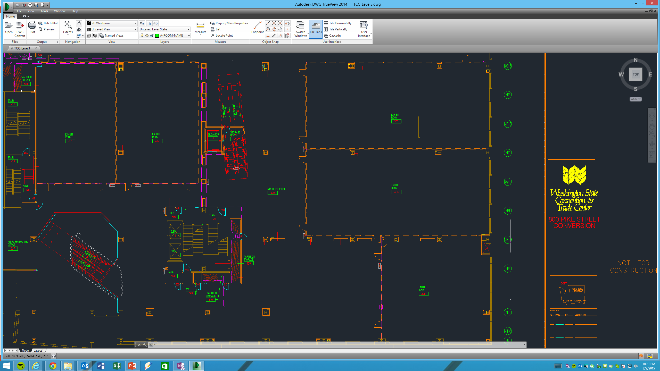
The evaluation area is highlighted in blue
Origin point is indicated on the lower right corner
All systems should report an (X,Y) location with respect to this origin point
The X and Y dimensions are also shown
The (X,Y) coordinates of 4 sample points are shown for reference
The coordinates of these sample points are not real!
Y Axis
(40,15)
(0,15)
Origin Point
(0,0)
(40,0)
(20,0)
X Axis

Slide 5
Evaluation Area
3rd floor of the conference venue. Approximate dimensions
50 m wide
50 m length
Accurate distance measurements can be made using the attached cad files
Exhibition Room 305
The room at the bottom right corner
This will be the only room-type space
Open area
The rest of the evaluation area is open space
There are several structural elements that make the space challenging
Automatic stairs
Structural columns/beams
Elevator shaft
Etc…

Slide 6
Hardware Deployment
You will be able to attach your equipment on:
Floors (carpet), walls, windows or anywhere else you can safely reach
Ceiling
There are 15ft tall industrial-like ceilings throughout the evaluation area
Pipes are exposed, and one could hang/attach equipment from there if necessary.
However, in order to ensure safety of the teams, you will only be able to hang lightweight equipment on the ceiling!
If you plan to use the ceiling, come up with a safe plan in advance!
When attaching equipment
Use paint-safe tape than can be removed without causing damage to the walls
Don’t even think about drilling holes to attach equipment! I mean it…
Maximum number of deployed anchor points: 10
Absolutely no teams will be allowed to deploy more than 10 anchor points!

Slide 7
Hardware Deployment
If your team has been classified into the infrastructure-free category, you will not be allowed to deploy your own hardware (i.e., WiFI APs)
In special cases, the organizers will consider exceptions. To request an exception for your team:
Send an email to dlymper@microsoft.com explaining in detail why you need to deploy your own hardware
You will receive a reply from the organizers with one of the following outcomes:
You are granted the right to deploy your own APs, and you are still classified as an infrastructure-free submission
You are not granted the right to deploy your own APs, and you are still classified as an infrastructure-free submission
You are granted the right to deploy your own APs, but you are now classified as an infrastructure-based submission

Slide 8
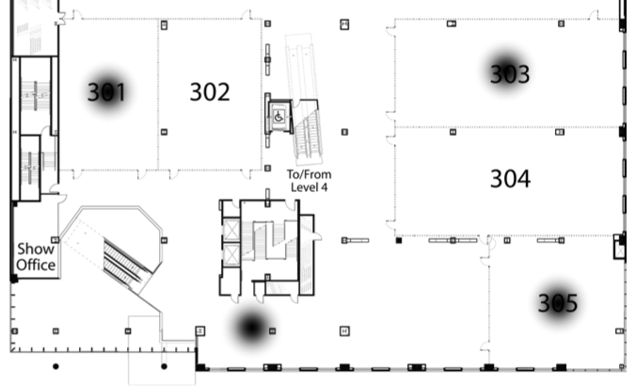
WiFi APs
All teams that leverage WIFi will have to use the WiFi APs that are already deployed in the conference venue for internet connectivity
Only the WiFi APs on the floor level (3rd floor) of the competition should be used.
List of WiFi APs on the 3rd floor and their MAC Addresses
L3 Lobby (Between elevators and Pike St.)
Dot11Radio0 8843.e114.adc0
Dot11Radio1 c47d.4fd8.a600
L3 301
Dot11Radio0 0023.5d0f.2170
Dot11Radio1 0023.5d49.6dd0
L3 303
Dot11Radio0 0021.1c78.e7c0
Dot11Radio1 0021.1c2a.63f0
L3 305
Dot11Radio0 0023.5d0f.6960
Dot11Radio1 0023.5d49.b5c0

Slide 9
WiFi APs – Custom Deployment
Only these teams from the infrastructure-free category that have requested and received permission to deploy their own WiFi Aps, will be allowed to deploy custom hardware
To ensure fairness, these teams will not be able to deploy more than 8 APs.
8 is the number of radios already deployed on the 3rd floor of the conference venue where the competition will take place.

Slide 10
Come prepared!
Make sure you bring everything you need
Tape
Ropes
Attachment mechanisms
Laser range finders for ground truth measurements
Tripods
Cables
…
Given that the conference venue is in downtown Seattle, you can always purchase equipment from nearby stores (walking distance) after you arrive in Seattle.
The organizers will not provide any equipment! It is up to the teams to bring what they will need
Organizers might provide a couple of ladders to facilitate ceiling instrumentation if needed. No need to bring your own ladders! ☺
Organizers will also make sure there are enough power outlets throughout the evaluation area

Slide 11
Competition Logistics – Setup Day
Two-day event
First Day
Teams setup their equipment and calibrate their systems simultaneously in a predetermined time window
The exact amount of time available for setup will be communicated later (assume at least a 5 hour time window for now)
We are also considering providing small time windows (5-10min) where each team can have access to the whole evaluation space with only its system turned on to properly deal with interference caused during setup
Given the large number of submissions, this might not be possible. Don’t count on it!

Slide 12
Competition Logistics – Setup Day
After the end of the first day (setup):
Your deployed hardware will remain at the evaluation area
The deployed hardware must be turned off!
Laptops/phones can be removed from the evaluation area. However, everything else must remain within the evaluation area.
The conference venue is not open to the public after hours, so your hardware will be safe
No other calibration/modification of the deployed system will be allowed after the setup day! Teams that do that will be automatically disqualified!
All contestants will have to leave the evaluation area
The organizers will assume control of the evaluation area to mark approximately 20 evaluation points.
Each point’s ground truth coordinates will be measured with laser range finders

Slide 13
Competition Logistics – Evaluation Day
At the beginning of the evaluation day, the evaluation points will be revealed to all teams
If any team attempts to reverse engineer or manually measure the ground truth locations of the evaluation points, it will be automatically disqualified!
Each team will be assigned a 15min time window (communicated well in advance)
During this time window, only the system from this team will be active
The system under test cannot assume that when powered up it is at a known location that is either predefined or manually entered!
The hardware to be localized will be carried above each evaluation point. Several seconds will be given to the team, and the organizer will record the location reported on the device under test. Teams can leverage this time to perform averaging or any other smoothing techniques they wish to employ
Each team can choose its own way of displaying the estimated location (i.e., webpage, text file, phone, laptop etc.) as long as a member of the team can clearly point the estimated location out to the organizers in real-time. It is not enough for the organizers to be told what the estimated location is. The evaluator will also have to see that location somehow on the system under test. No predetermined path will be followed while visiting the evaluation points
The system under test can perform continuous localization if necessary. Organizers, however, will only record the reported locations on the marked evaluation points only.

Slide 14
Competition Logistics – What to expect
Expect people and furniture/objects in the evaluation area during both setup time and evaluation!
Multiple people will be in the evaluation area and they will be moving
Placement of furniture/objects can change at any given time during, or after setup day, as well as during the evaluation day.
Given the large number of submissions, there will be interference! Plan ahead!

Slide 15
Evaluation Metric
The Euclidean distance between the ground truth coordinates and the estimated by the system under test coordinates will be computed for every evaluation point
The average Euclidean distance across all evaluation points will be the overall score of each team
The team with the lowest score wins!
In case of a tie, the team with the lowest hardware deployment requirements wins

Slide 16
Awards
The top 3 teams from each of the two categories will be awarded prizes
1st place: $1000
2nd place: $600
3rd place: $400
Results Announcement
A special IPSN session will be held on (tentatively) Wednesday April 15th 2015 where the results of the competition will be announced
The top 3 teams from each category will be given the opportunity to present the details of their work during this session
Be ready to give a 10 min talk about your system if you end up in one of the top 3 places in any of the two competition categories!

Slide 17
Poster Session
Every participating team will have the opportunity to present its approach during the IPSN poster session on Tuesday, April 14th 2015
The posters from the competition teams will not be published in the proceedings of the conference

