Slide 1



2016 Microsoft Indoor Localization Competition
Dimitrios Lymberopoulos (Microsoft Research)
Jie Liu (Microsoft Research)
Ying Zhang (Google)
Xue Yang (Intel)
Prabal Dutta (University of Michigan)
Anthony Rowe (CMU)
Vitor Sequeira (European Commission – Joint Research Centre)

Slide 2
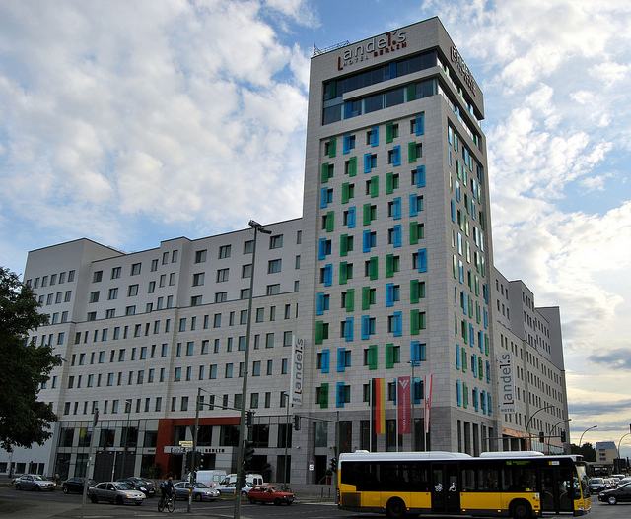
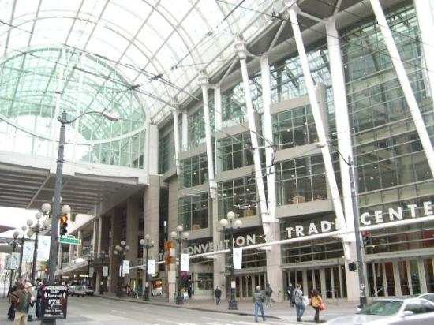
Competition Goals
Evaluate and compare technologies from academia and industry in the same, unfamiliar space.
Bring teams working in this area together in a more effective way.
2014: Berlin, Germany
2015: Seattle, WA

Slide 3
2016: Vienna, Austria
49 teams submitted abstracts
35 teams officially registered - ~100 people registered
31 teams showed up in Vienna
28 teams were evaluated

Slide 4
Two Categories
2D Category
Report (X,Y) locations
Do not require the deployment of any infrastructure (WiFi and/or IMU based)
3 available WiFi access points
3D Category
Report (X,Y,Z) locations
Require custom hardware deployment (UWB, Ultrasound etc.)
Each team can deploy up to 5 anchor devices in the evaluation space

Slide 5
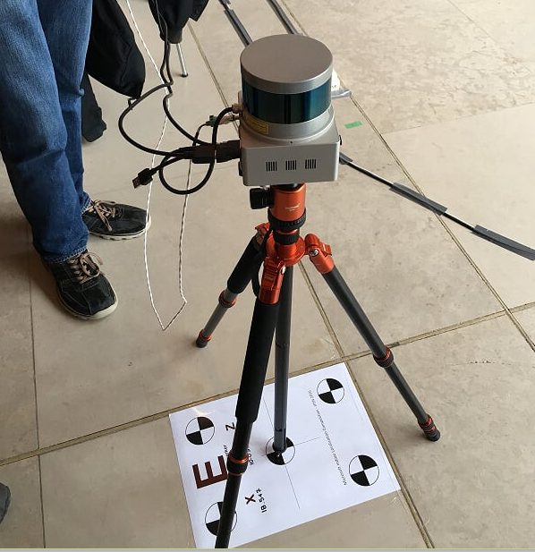
Evaluation Process
Day 1: Sunday
Teams were given 7 hours to setup and calibrate their systems
Day 2: Monday
Each team was asked to provide the coordinates of 15 previously measured test points
Evaluation Metric
Average localization error across the 15 test points
The lower the error the better

Slide 6
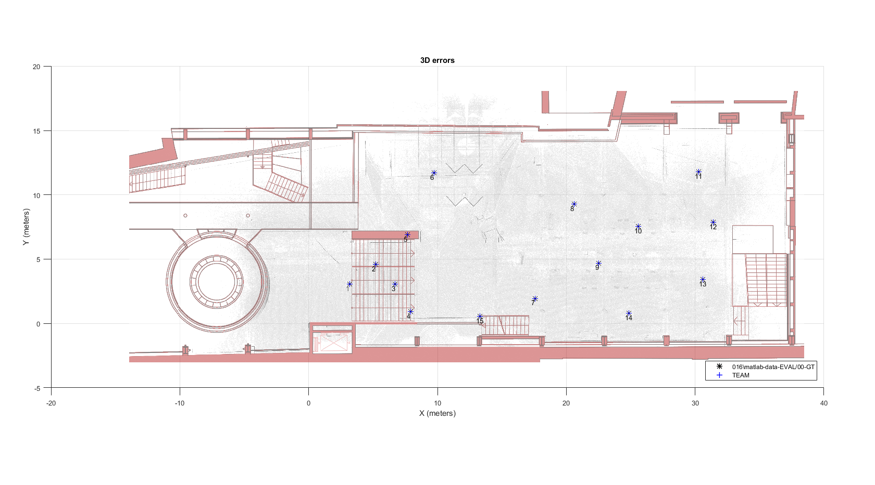
465m² Evaluation Area

Slide 7
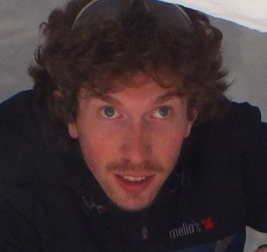

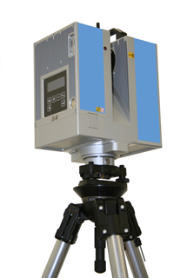
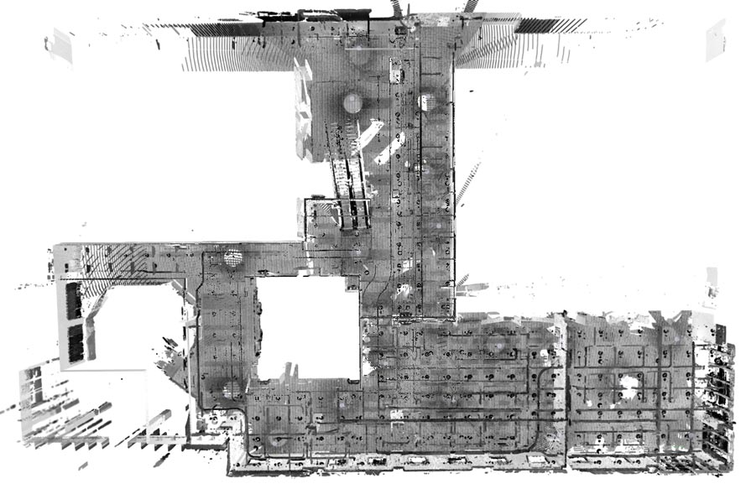
Ground Truth Measurements
High Resolution 3D Acquisition and Registration
Simone Ceriani
Pierluigi Taddei
JRC (https://ec.europa.eu/jrc), the winner of the 2015 competition, volunteered to provide its expertise for ground truth measurements.
JRC has been deploying 3D laser scanning technology to verify design information within nuclear facilities for more than 10 years.
The ground truth environment and the test points were acquired using multiple high definition 3D scans using a tripod mounted laser scanner (e.g. ZF 5006) and proprietary software

Slide 8
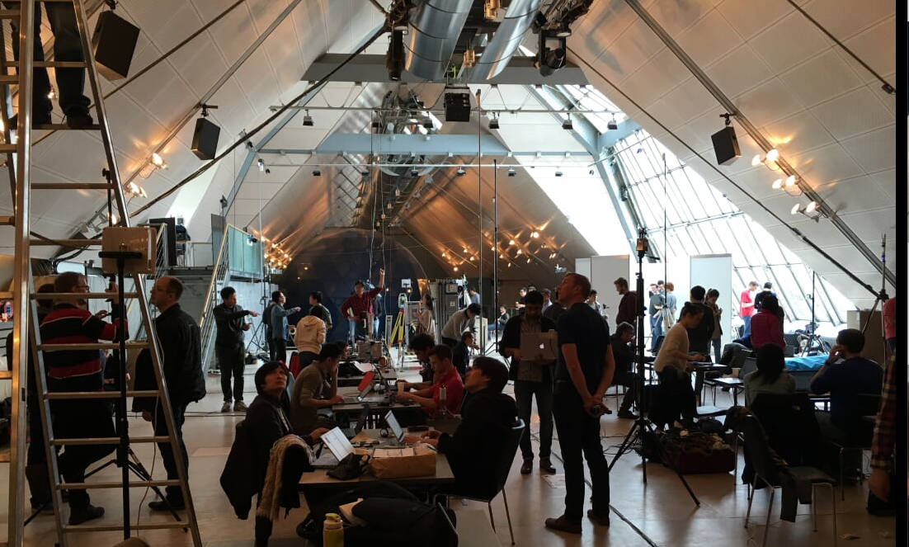
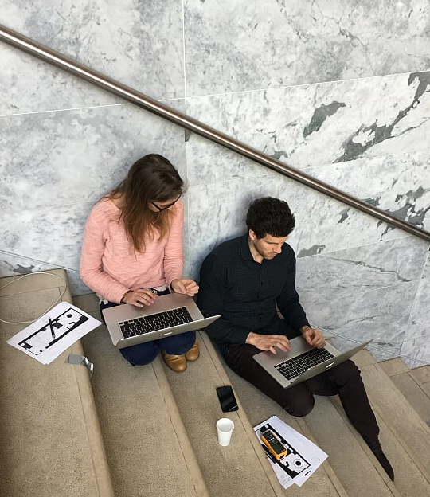
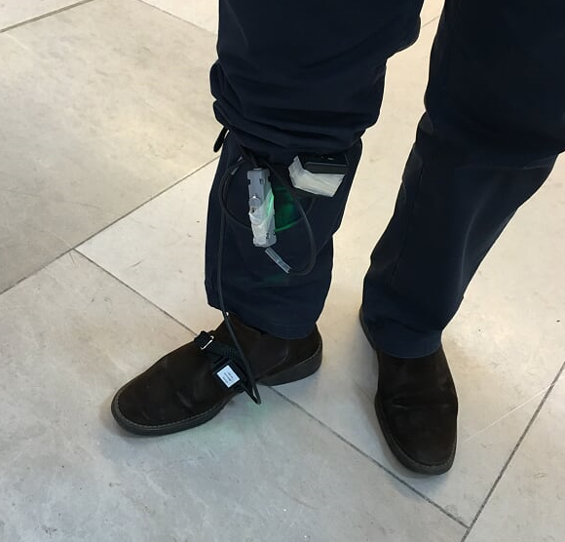
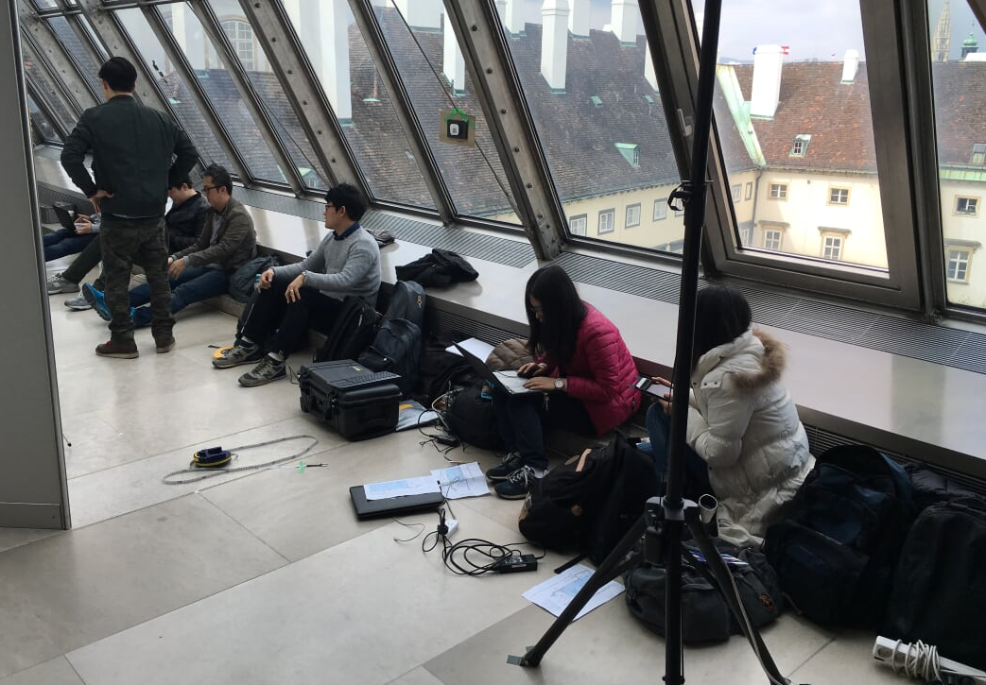
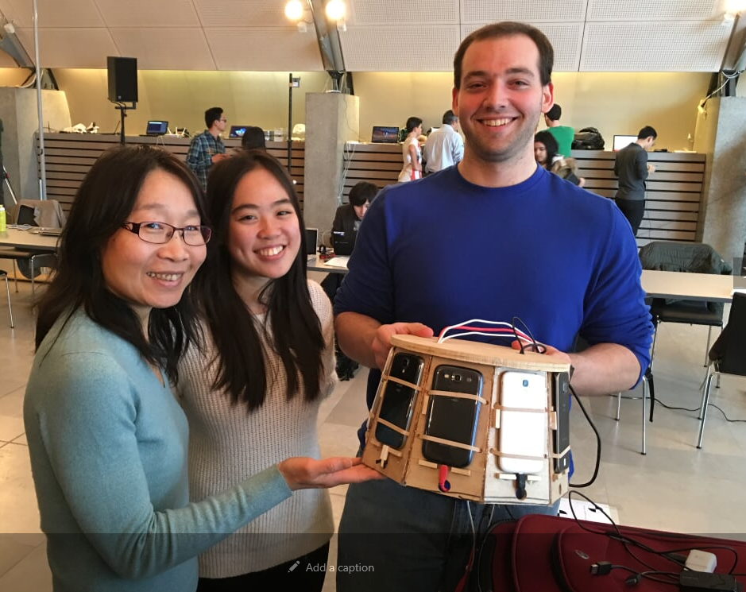
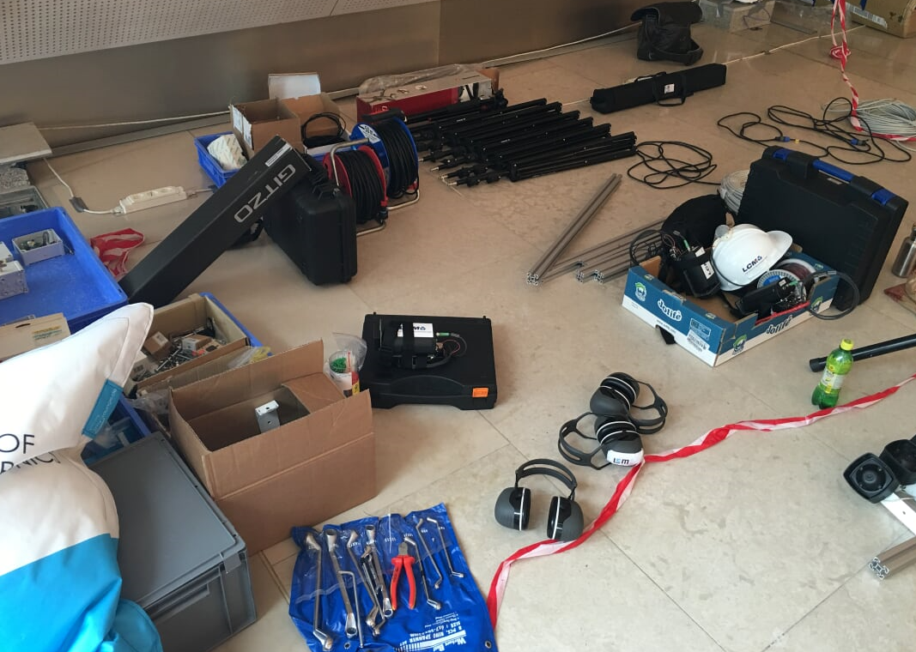
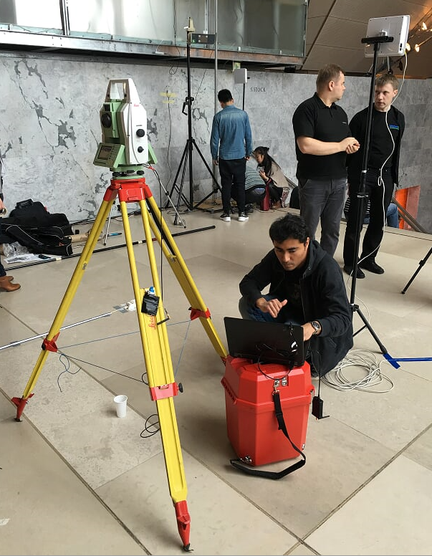
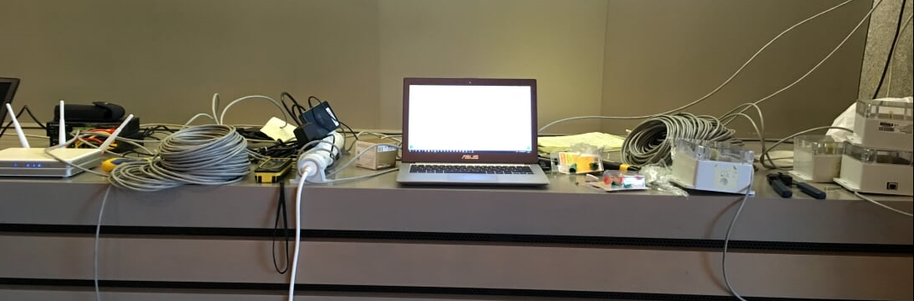
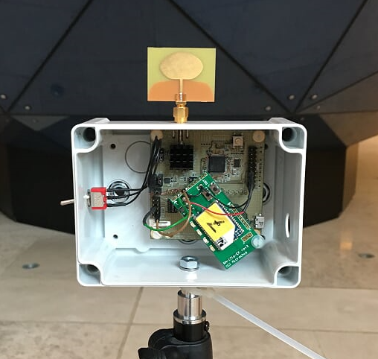
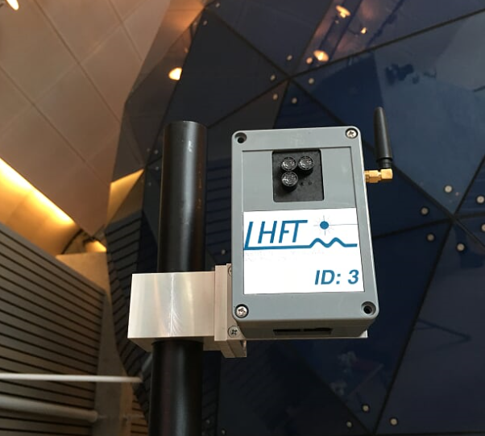
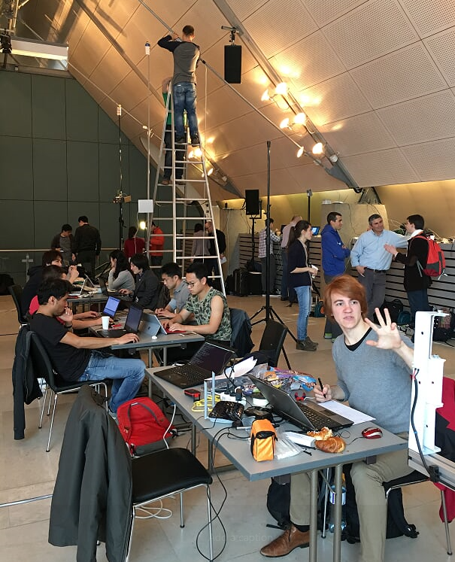
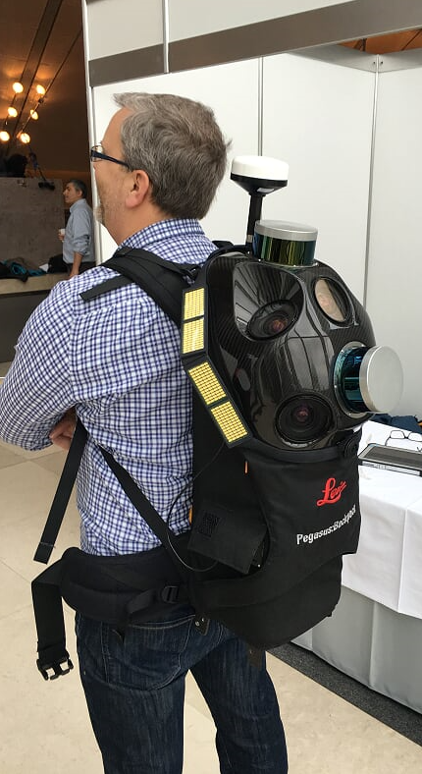
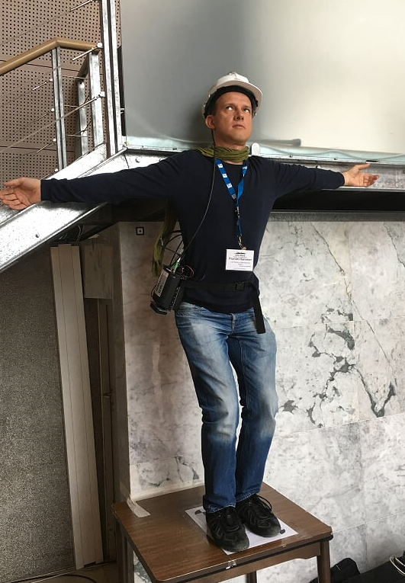
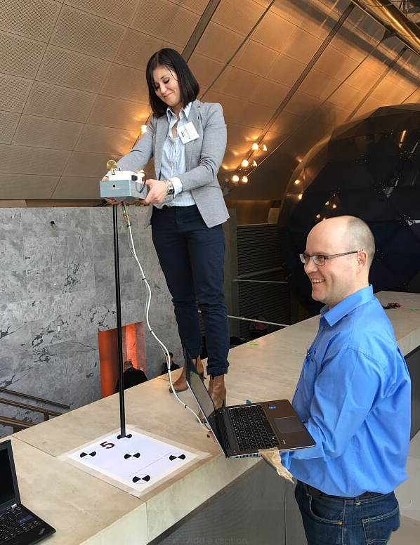
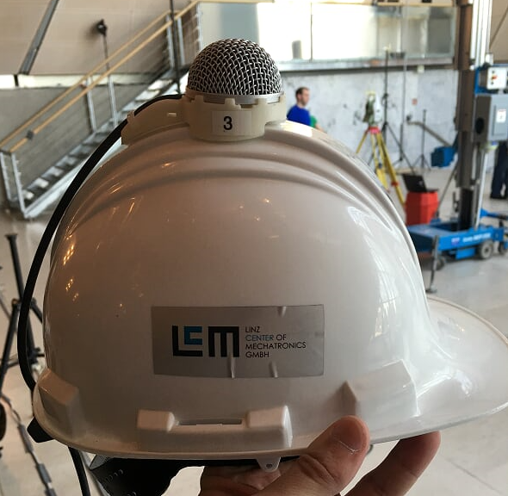
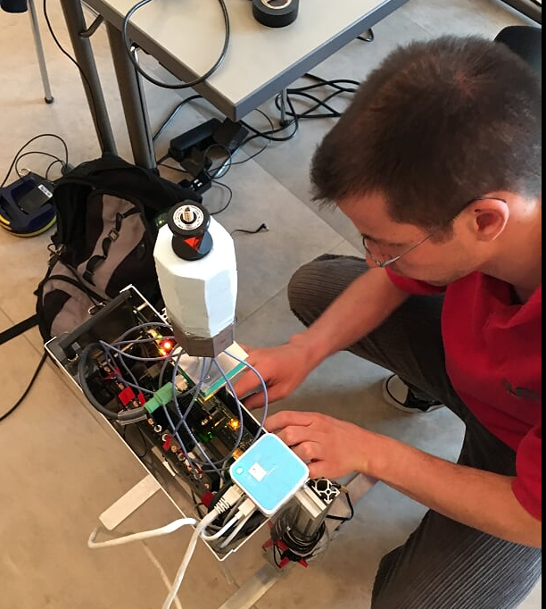
Fun Times…

Slide 9
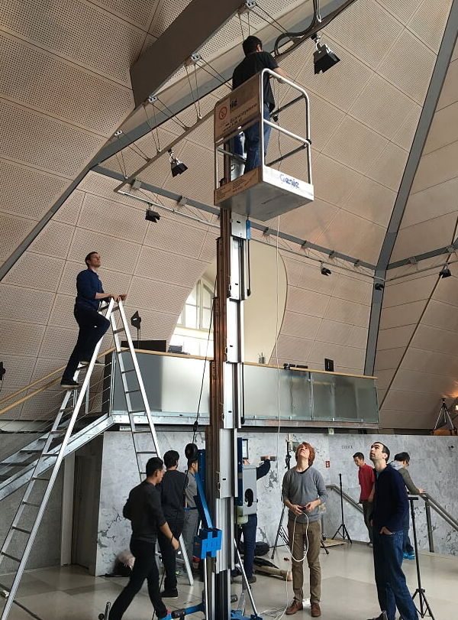
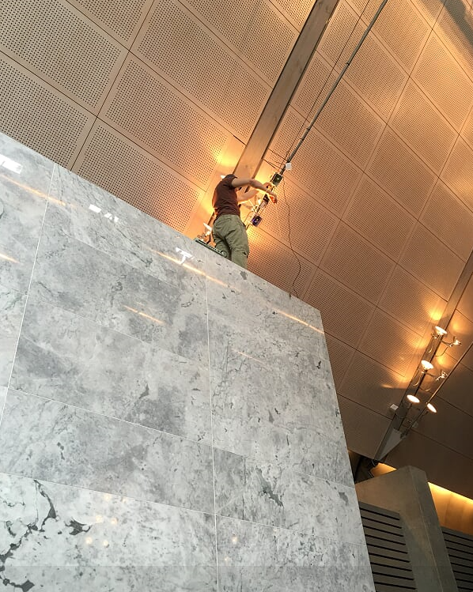
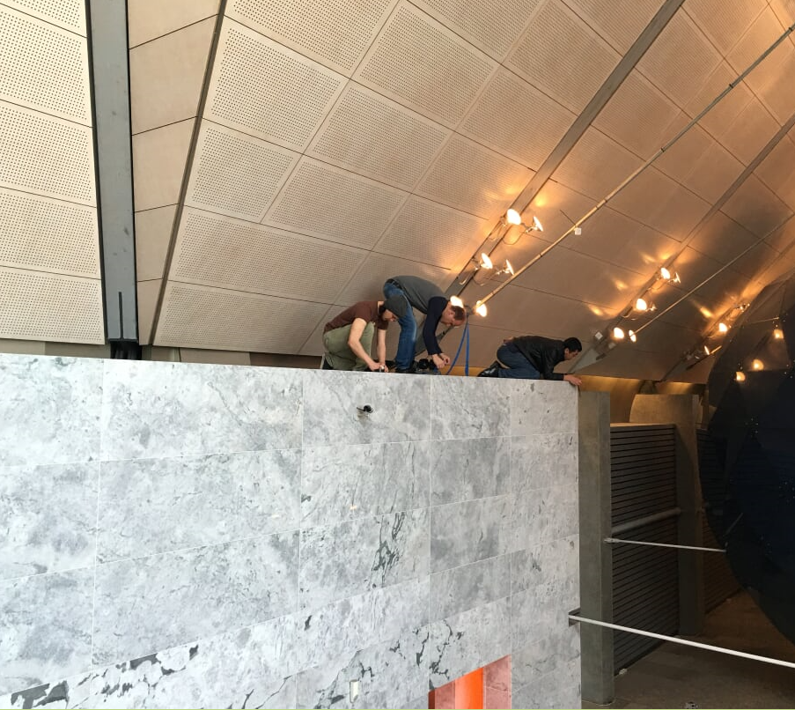
Dangerous times…

Slide 10
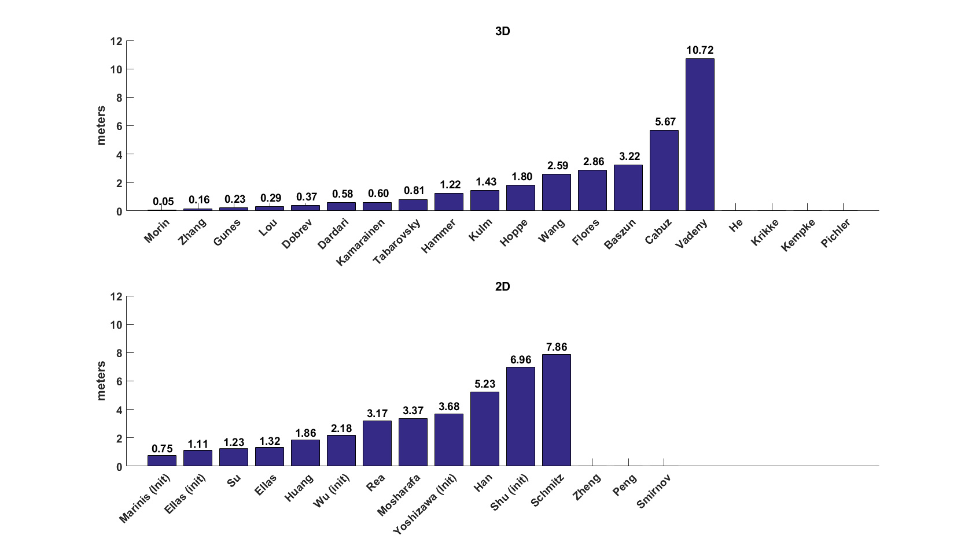
UWB
Sound/Ultrasound
Zigbee
Laser Scanner
24GHZ
Radar
VSLAM
TDoA SDR
WiFi
ToF
PDR + beacons
IMU Only
(init): the system was explicitly initialized to a known ground truth location before evaluation

Slide 11
2D Category
3D Category
1st
Indoor Localization Based on WiFi-GeoMagnetic Fingerprinting and IMU
Su et al.
(Tongji University)
Real-Time Localization without Reliance on Infrastructure
Zhang et al.
(RealEarth)
$1000
1.2m error
0.16m error
2nd
A Motion Tracking Solution for Indoor Location Using Smartphones
Elias et al.
(Fraunhofer Portugal Research Center)
IntraNav
Gunes et al.
(Quantitec)
$600
1.3m error
0.23m error
3rd
A Magnetic Field Based Lightweight Indoor Positioning System for Smartphones
Huang et al.
(Ubirouting)
UWB ToA and TDoA Hybrid Localization System
Lou et al.
(Hangzhou Sunsend Info Tech Co.)
$400
1.9m error
0.29m error

