Slide 1
Competition Logistics
2016 Microsoft Indoor Localization Competition

Slide 2
Competition Dates - Final
Sunday April 10th – Monday April 11th 2016
First Day
Setup starts early in the morning and ends later in the afternoon
At the end of the evaluation day, all teams have to completely shut down their systems and leave the area. The organizers will take over to mark down the evaluation points. During this time all systems will be off and all contestants will have to leave the evaluation area.
Second Day
Evaluation starts early in the morning and continues through the day

Slide 3
Registration
All members of a competing team that want to actively participate to the competition (i.e., attend any of the two days in person), must register for the competition in advance!
Registration is currently open: http://www.cpsweek.org/2016/reg.html
All contestants attending the competition should register for the Indoor Localization Competition and NOT as Competition Observers
The Competition Observer registration is meant for non-contestants that just want to come and observe the competing teams
Teams/Team members that have not been registered will not be allowed to participate in the competition!

Slide 4
Visa Application Letter
You have the opportunity to request a visa application letter through the registration process
The visa application letter will be processed right after the registration payment has been successfully processed.
http://www.cpsweek.org/2016/travel.html

Slide 5
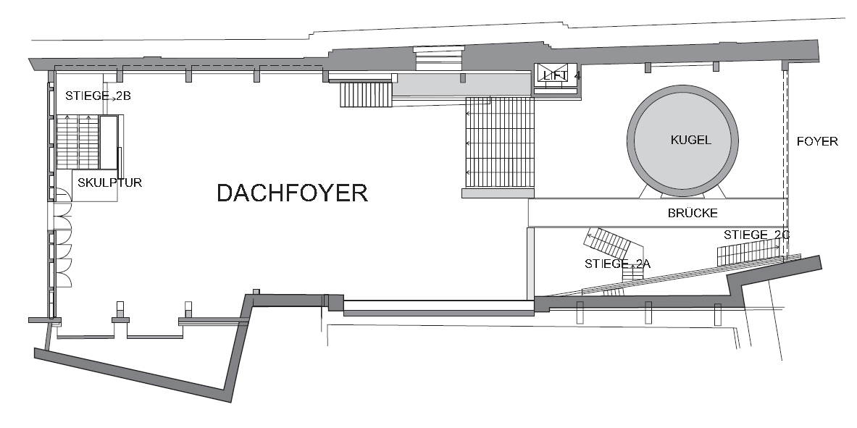
Evaluation area (shaded area)
Origin Point
(0,0,0)
Origin point is indicated on the upper right corner
All systems in the 2D category should report an (X,Y) location with respect to this origin point
All systems in the 3D category should report an (X,Y,Z) location with respect to this origin point
X Axis
Y Axis
Origin Point
(0,0)
Approximate Dimensions:
X: 15m
Y: 24m (this number does not include the small Kugel room area that is part of the evaluation area)

Slide 6
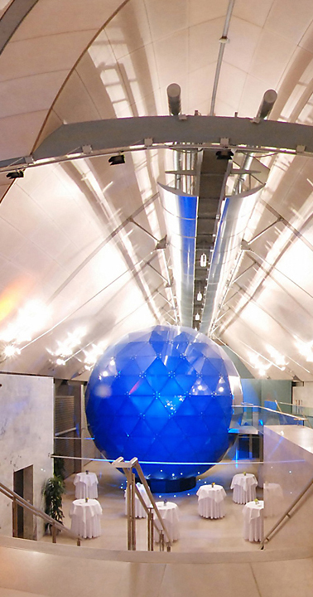
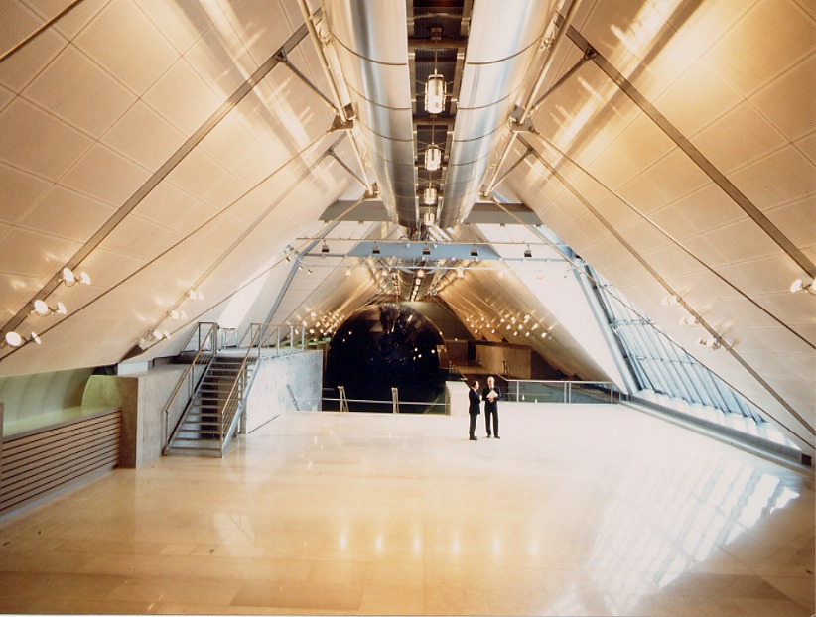
Evaluation area pictures

Slide 7
Ground Truth Measurements
This year, a more reliable and accurate automated process will be followed for ground truth measurements.
JRC (https://ec.europa.eu/jrc), the winner of the 2015 competition, has volunteered to provide its expertise for ground truth measurements
The JRC creates tools for Euratom (European Atomic Energy Community) inspectors and the International Atomic Energy Agency (IAEA), which inspects some 700 facilities worldwide each year. For more than a decade, the JRC has deployed 3D laser scanning technology, to verify design information within nuclear facilities.
Before the competition we will acquire the ground truth positions of the markers employing two independent systems both based on time-of-flight laser measurements.

Slide 8
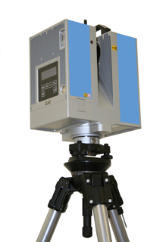
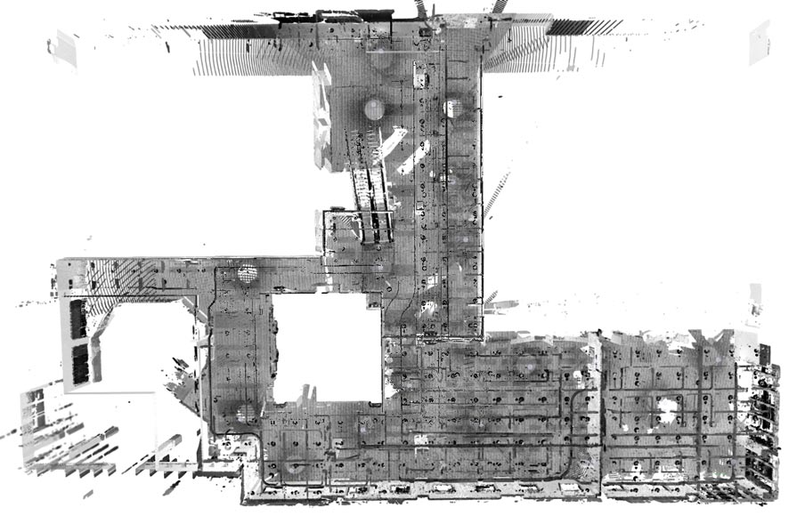
Ground Truth Measurements – System 1
High Resolution 3D Acquisition and Registration
The ground truth environment and the markers location will be acquired using multiple high definition 3D scans using a tripod mounted laser scanner (e.g. ZF 5006).
The single acquisitions will be aligned and the marker positions accurately identified using a proprietary software (JRC 3DLVS).
Robust surface registration using N-points approximate congruent sets
J Yao, MR Ruggeri, P Taddei, V Sequeira
EURASIP Journal on Advances in Signal Processing 2011 DOI:10.​1186/​ 1687-6180-2011-72

Slide 9
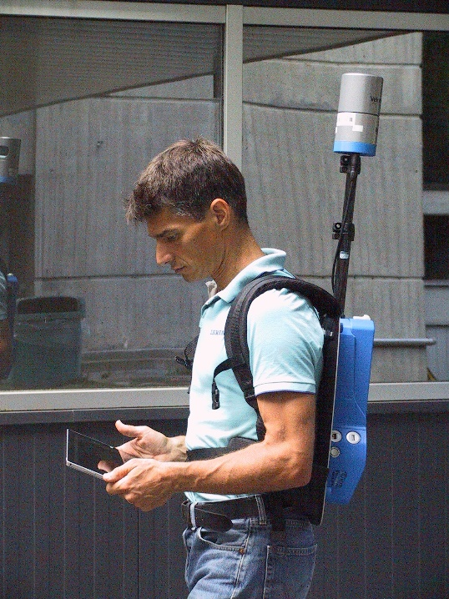
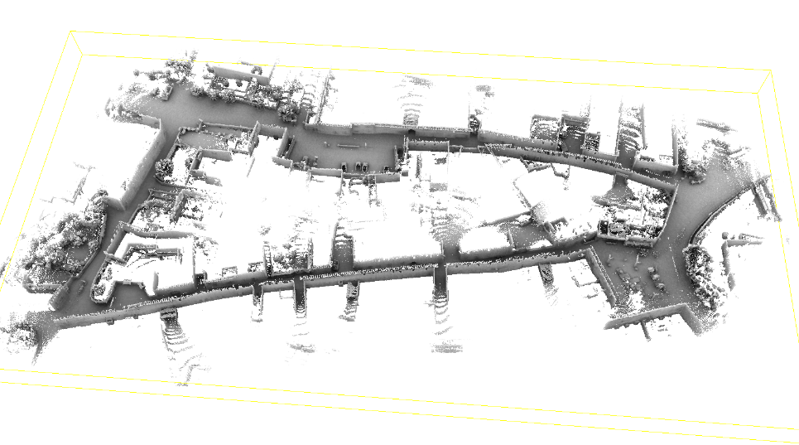
Ground Truth Measurements – System 2
On-the-fly Tracking and Mapping Using a Spinning Laser
A second independent measurement will be done using a backpack mounted spinning laser scanner (e.g. Velodyne VLP-16) while walking in the competition area using a proprietary software (JRC STEAM) and moving on each marker position.
Localization and tracking in known large environments using portable real-time 3Dsensors C.Sánchez, P. Taddei, S. Ceriani, E. Wolfart, V. Sequeira Computer Vision and Image Understanding (2015)
DOI: 10.1016/j.cviu.2015.11.012 to be published
Pose interpolation SLAM for large maps using moving 3D sensors
S. Ceriani, C. Sanchez, P. Taddei, E. Wolfart, V. Sequeira
Intelligent Robots and Systems (IROS)
DOI: 10.1109/IROS.2015.7353456

Slide 10
Hardware Deployment
You will be able to attach your equipment on:
Floors, walls, windows or anywhere else you can safely reach
Ceiling
There are 10m tall ceilings throughout the evaluation area
If you plan to use the ceiling, come up with a safe plan in advance!
When attaching equipment
Use paint-safe tape than can be removed without causing damage to the walls
Don’t even think about drilling holes to attach equipment! I mean it…
Remember: we are deploying hardware in a historic building! Respect the space!
Maximum number of deployed anchor points: 5
Absolutely no teams will be allowed to deploy more than 5 anchor points!

Slide 11
Hardware Deployment
If your team has been classified into the 2D category, you will not be allowed to deploy your own hardware (i.e., WiFi APs)
In special cases, the organizers will consider exceptions. To request an exception for your team:
Send an email to dlymper@microsoft.com explaining in detail why you need to deploy your own hardware
You will receive a reply from the organizers with one of the following outcomes:
You are granted the right to deploy your own APs/hardware, and you are still classified as a 2D solution.
You are not granted the right to deploy your own APs/hardware, and you are still classified as an infrastructure-free submission
You are granted the right to deploy your own APs/hardware, but you are now classified as a 3D submission

Slide 12
WiFi APs
All teams that leverage WiFi will have to use the WiFi APs that are already deployed in the conference venue for internet connectivity
Only the WiFi APs on the floor level of the competition should be used.
There will be exactly 3 WiFi APs deployed in the evaluation area.

Slide 13
Come prepared!
Make sure you bring everything you need
Tape
Ropes
Attachment mechanisms
Laser range finders for ground truth measurements
Tripods
Cables
Power adaptors for your equipment (competition is in Austria!)
…
There will be 2 ladders available to all teams for hanging equipment from the ceiling.
Power outlets will be available throughout the evaluation area
The organizers will not provide any other equipment! It is up to the teams to bring what they need

Slide 14
Competition Logistics – Setup Day
Two-day event
First Day
Teams setup their equipment and calibrate their systems simultaneously in a predetermined time window
The exact amount of time available for setup will be communicated later (assume at least a 5 hour time window for now)
We are also considering providing small time windows (5-10min) where each team can have access to the whole evaluation space with only its system turned on to properly deal with interference caused during setup
Given the large number of submissions, this might not be possible. Don’t count on it!

Slide 15
Competition Logistics – Setup Day
After the end of the first day (setup):
Your deployed hardware will remain at the evaluation area
The deployed hardware must be turned off!
Laptops/phones can be removed from the evaluation area. However, everything else must remain within the evaluation area.
The conference venue is not open to the public after hours, so your hardware will be safe
No other calibration/modification of the deployed system will be allowed after the setup day! Teams that do that will be automatically disqualified!
All contestants will have to leave the evaluation area
The organizers will assume control of the evaluation area to mark approximately 20 evaluation points.
Each point’s ground truth coordinates will be measured with laser range finders

Slide 16
Competition Logistics – Evaluation Day
At the beginning of the evaluation day, the evaluation points will be revealed to all teams
If any team attempts to reverse engineer or manually measure the ground truth locations of the evaluation points, it will be automatically disqualified!
Each team will be assigned a 15min time window (communicated well in advance)
During this time window, only the system from this team will be active
The hardware to be localized will be carried above each evaluation point. Several seconds will be given to the team, and the organizer will record the location reported on the device under test. Teams can leverage this time to perform averaging or any other smoothing techniques they wish to employ
Each team can choose its own way of displaying the estimated location (i.e., webpage, text file, phone, laptop etc.) as long as a member of the team can clearly point the estimated location out to the organizers in real-time or near real-time. It is not enough for the organizers to be told what the estimated location is. The evaluator will also have to see that location somehow on the system under test.
The system under test can perform continuous localization if necessary. Organizers, however, will only record the reported locations on the marked evaluation points only.

Slide 17
Competition Logistics – What to expect
Expect people and furniture/objects in the evaluation area during both setup time and evaluation!
Multiple people will be in the evaluation area and they will be moving
Placement of furniture/objects can change at any given time during, or after setup day, as well as during the evaluation day.
Given the large number of submissions, there will be interference! Plan ahead!

Slide 18
Evaluation Metric
The Euclidean distance between the ground truth coordinates and the estimated by the system under test coordinates will be computed for every evaluation point
The average Euclidean distance across all evaluation points will be the overall score of each team
The team with the lowest score wins!
In case of a tie, the team with the lowest hardware deployment requirements wins

Slide 19
Awards
The top 3 teams from each of the two categories will be awarded prizes
1st place: $1000
2nd place: $600
3rd place: $400
Results Announcement
A special IPSN session will be held (TBD) where the results of the competition will be announced
The top 3 teams from each category will be given the opportunity to present the details of their work during this session
Be ready to give a 10 min talk about your system if you end up in one of the top 3 places in any of the two competition categories!

Slide 20
Poster Session
Every participating team will have the opportunity to present its approach during the IPSN poster session.
The posters from the competition teams will not be published in the proceedings of the conference unless is the same posters were submitted through the official poster track and were accepted.

