Slide 1
Querying Encrypted Data
Arvind Arasu, Ken Eguro,
Ravi Ramamurthy, Raghav Kaushik
Microsoft Research

Slide 2






Cloud Computing
Well-documented benefits
Trend to move computation and data to cloud
Database functionality
  Amazon RDS
  Microsoft SQL Azure
  Heroku PostegreSQL
  Xeround
[AF+09, NIST09]
Notes:
Cloud computing is here to stay
Well-documented benefits both for cloud provider and user
Trend: move computation and data to the cloud to the extent possible

Slide 3

Security Concerns
Data in the cloud vulnerable to:
Snooping administrators
Hackers with illegal access
  Compromised servers
[CPK10, ENISA09a]

Slide 4
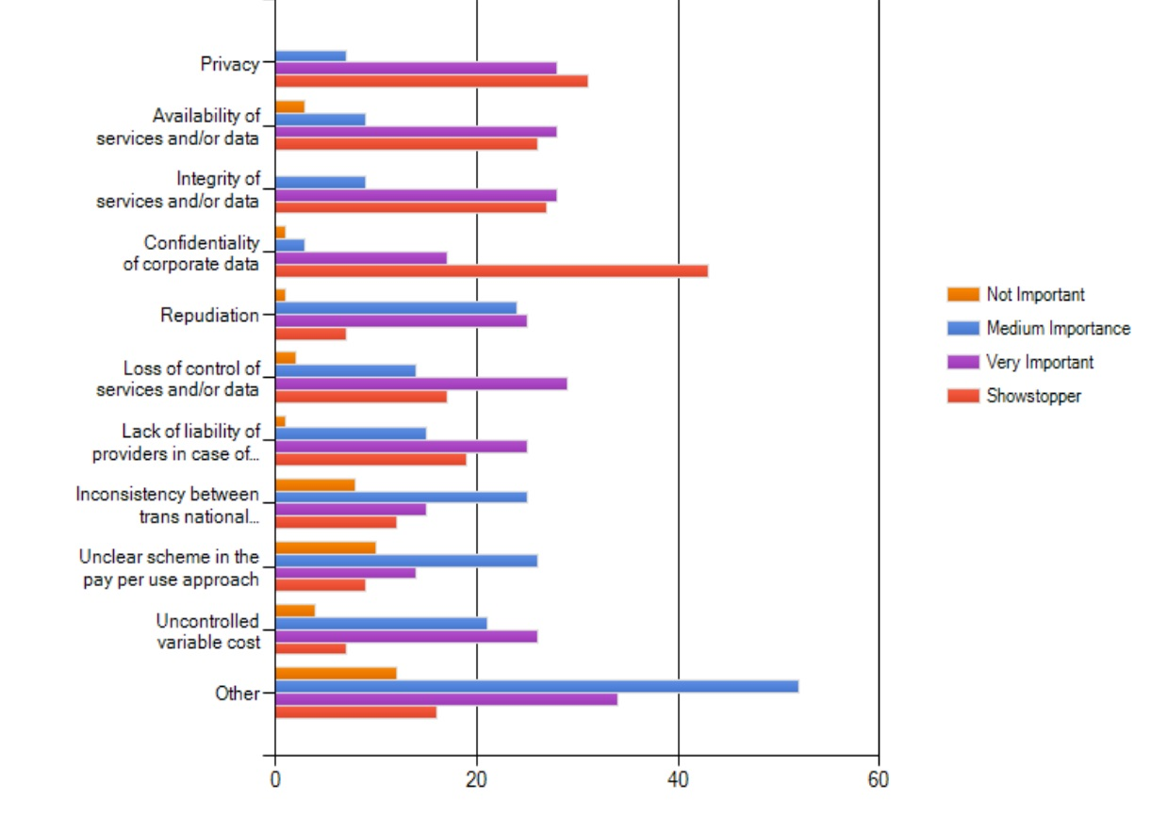
What are your main cloud computing concerns?
Survey: European Network and Information Security Agency, Nov 2009
[ENISA09b]
Notes:
These concerns are not theoretical.
There are a lot of surveys which show that confidentiality and security of data in the cloud is a serious concern.

Slide 5
Sensitive Data in the Cloud: Examples
Software as a Service Applications
Billing
CRM
ERP
Health
Personal Data
Aria Systems
eVapt
nDEBIT
Redi2
Zuora
37 Signals
Capsule
Dynamics
Intouchcrm
LiveOps
Oracle CRM
Parature
Responsys
RO|Enablement
Salesforce.com
Save My Table
Solve 360
Acumatica ERP
Blue Link Elite
Epicor Express
NetSuite
OrderHarmony
Plex Online
CECity
SNO
Google Docs
Microsoft Office
Mint.com
Personal data
Corporate data
Source: http://cloudtaxonomy.opencrowd.com/taxonomy/
Notes:
This point is also clear if we look at examples of applications running in the cloud.
This is a sampling of applications that run fully in the cloud – or SaaS apps.
Billing, CRM, ERP: potentially sensitive corporate data
Health, Personal Data: potentially sensitive personal data

Slide 6


Data Encryption
a7be1a6997ad739bd8c9ca451f618b61
b6ff744ed2c2c9bf6c590cbf0469bf41
47f7f7bc95353e03f96c32bcfd8058df
Encr
Key
The quick brown fox jumps
over the lazy dog
Notes:
A natural approach to securing the data in the cloud is encryption. If we keep the data in the cloud encrypted with a secret key,
Idea: the adversary can snoop at this data but cannot learn anything without the key used to encrypt the data which is ideally not stored in the cloud

Slide 7
AWS Security Advice
7.2. Security. We strive to keep Your Content secure, but cannot guarantee that we will be successful at doing so, given the nature of the Internet. Accordingly, without limitation to Section 4.3 above and Section 11.5 below, you acknowledge that you bear sole responsibility for adequate security, protection and backup of Your Content. We strongly encourage you, where available and appropriate, to use encryption technology to protect Your Content from unauthorized access and to routinely archive Your Content. We will have no liability to you for any unauthorized access or use, corruption, deletion, destruction or loss of any of Your Content.
Source: http://aws-portal.amazon.com/gp/aws/developer/terms-and-conditions.html

Slide 8

Encryption and DbaaS: Functionality
Notes:
So far our discussion on data and confidentiality has been generic
Now we focus on db-as a service and the implications of using encryption as a technology
Most basic question: what does it mean in terms of functionality?

Slide 9
Example: Online Course Database
Student
StudentId | Name | Addr | GPA | CreditCard | …
Course
CourseId | Name | InstrId | …
StudentCourse
CourseId | StudentId | Grade | …
Notes:
Sort of running example: backend database for a hypothetical online course systems (e.g., Coursera).
Contains sensitive attributes shown circled.

Slide 10
Encryption and DbaaS: Functionality
SELECT *
FROM courses
WHERE StudentId = 1234
Client App
Notes:
Plaintext functionality

Slide 11
Encryption and DbaaS: Functionality
Encrypted
SELECT *
FROM courses
WHERE StudentId = 1234
Client App
[HIL+02]
SIGMOD Test of Time Award
Notes:
Desired functionality under encryption: encrypted data stored, encrypted queries, and encrypted results

Slide 12
Tutorial Overview
Survey of existing work
  Building blocks
  End-to-end systems
    Security-Performance-Generality tradeoff
    Taxonomy, organization
Open problems & Challenges
Random pontifications
Notes:
While we will contain enough details to make the tutorial self-contained, our focus will be on end-to-end systems, how they trade off security, performance, and generality. We will also spend some organizational effort classifying various systems along various dimensions. This is one of the contributions of this tutorial. We also include lots of open problems and random pontifications on the subject.

Slide 13
Tutorial Goals & Non-Goals
Takeaway goals:
  Interesting & Important area
  Lots of open (systems) problems
  Multi-disciplinary
Non-goals:
  Latest advances Elliptic Curve Cryptography
Related tutorial:
Secure and privacy preserving Database Services in the Cloud

Slide 14
Roadmap
Introduction
Overview
Basics of Encryption
Trusted Client based Systems
Secure In-Cloud Processing
Security
Conclusion

Slide 15

Passive Adversary
Passive
Honest but curious
Does not alter:
  Database
  Results
Design systems for active adversary
Notes:
To understand security, we need to model powers of the adversary. This tutorial: passive adversary

Slide 16
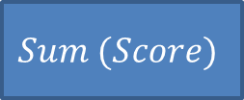
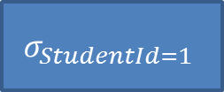
Encryption: Fundamental Challenge
$$Sum (Score)$$
Select Sum (Score)
From Assignment
Where StudentId = 1
$$σ_{StudentId=1}$$
StudentId | AssignId | Score
1 | 1 | 68
1 | 2 | 71
3 | 4 | 99
… | … | …

Slide 17
Encryption: Fundamental Challenge
$$Sum (Score)$$
Select Sum (Score)
From Assignment
Where StudentId = 1
$$σ_{StudentId=1}$$
Assignment
a7be1a6997ad739bd8c9ca451f618b61
b6ff744ed2c2c9bf6c590cbf0469bf41
47f7f7bc95353e03f96c32bcfd8058df
Notes:
Encryption “hides” data, so traditional query processing does not work in an obvious way

Slide 18


Encryption: Fundamental Challenge
$$Sum (Score)$$
Select Sum (Score)
From Assignment
Where StudentId = 1
$$σ_{StudentId=1}$$
Memory
$$Decr$$
$$Key$$
Assignment
a7be1a6997ad739bd8c9ca451f618b61
b6ff744ed2c2c9bf6c590cbf0469bf41
47f7f7bc95353e03f96c32bcfd8058df
Industry state-of-the-art:
[OTDE, STDE]
Storage

Slide 19
Solution Landscape
Two fundamental techniques
  Directly compute over encrypted data
    Special homomorphic encryption schemes
    Challenge: limited class of computations
  Use a “secure” location
    Computations on plaintext
    Challenge: Expensive

Slide 20




Homomorphic Encryption
$$Enc (1)$$
7ad5fda789ef4e272bca100b3d9ff59f
$$+_{Enc}$$
7a9f102789d5f50b2beffd9f3dca4ea7
bd6e7c3df2b5779e0b61216e8b10b689
$$Enc (2)$$
$$Enc (1)$$
Encryption key is not an input
Notes:
Homomorphic encryption: directly compute on encrypted values

Slide 21
Solution Landscape
Two fundamental techniques
  Directly compute over encrypted data
    Special homomorphic encryption schemes
    Challenge: limited class of computations
  Use a “secure” location
    Computations on plaintext
    Challenge: Expensive

Slide 22

Secure Location
Inaccessible
Inaccessible

Slide 23
Solution Landscape
Two fundamental techniques
  Directly compute over encrypted data
    Special homomorphic encryption schemes
    Challenge: limited class of computations
  Use a “secure” location
    Computations on plaintext
    Challenge: Expensive

Slide 24
Systems Landscape
Full
Homomorphic
Partial
Homomorphic
CryptDB
Monomi
TrustedDB
Cipherbase
Non
Homomorphic
“Blob”Store
AWS GovCloud
No Secure
Location
Secure
Server
Crypto
Coprocessor
Client
FPGA

Slide 25
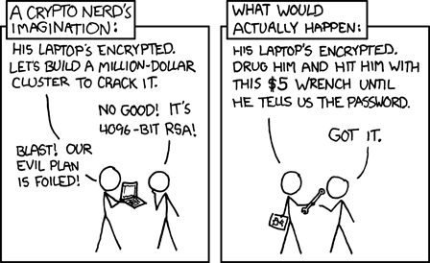
Encryption == Security?
Source: http://xkcd.com/538/
Notes:
There is a lot more to security than encryption. Considered in the last part of the tutorial.

Slide 26
Roadmap
Introduction
Overview
Basics of Encryption
Trusted Client based Systems
Secure In-Cloud Processing
Security
Conclusion

Slide 27
Encryption Scheme
Key:
000102030405060708090a0b0c0d0e0f
Plaintext
Ciphertext
Encr
a7be1a6997ad739bd8c9ca451f618b61
b6ff744ed2c2c9bf6c590cbf0469bf41
47f7f7bc95353e03f96c32bcfd8058df
The quick brown fox jumps
over the lazy dog
Ciphertext
Plaintext
a7be1a6997ad739bd8c9ca451f618b61
b6ff744ed2c2c9bf6c590cbf0469bf41
47f7f7bc95353e03f96c32bcfd8058df
Decr
The quick brown fox jumps
over the lazy dog
Key:
000102030405060708090a0b0c0d0e0f
Crypto Textbook: [KL 07]
Notes:
Encryption scheme – encryption function, decryption function. Given a key the encryption function maps input to seemingly random sequence of bytes. Given the key the decryption function, gets back the original input.

Slide 28
Encryption Scheme
Public Key:
000102030405060708090a0b0c0d0e0f
Plaintext
Ciphertext
Encr
a7be1a6997ad739bd8c9ca451f618b61
b6ff744ed2c2c9bf6c590cbf0469bf41
47f7f7bc95353e03f96c32bcfd8058df
The quick brown fox jumps
over the lazy dog
Ciphertext
Plaintext
a7be1a6997ad739bd8c9ca451f618b61
b6ff744ed2c2c9bf6c590cbf0469bf41
47f7f7bc95353e03f96c32bcfd8058df
Decr
The quick brown fox jumps
over the lazy dog
Private Key:
47b6ffedc2be19bd5359c32bcfd8dff5
Crypto Textbook: [KL 07]
Notes:
Some schemes use different keys (but related) keys for encryption and decryption – but this detail is not very relevant to our tutorial.

Slide 29
AES + CBC Mode
The quick brown
fox jumps over t
lazy dog........
Init. Vector (IV)
000000000001...
Key
AES
Key
AES
Key
AES
a7be1a6997a7...
b6ff744ed2c2...
47f7f7bc9535...
Variable IV => Non-deterministic
[AES, KL 07]
Notes:
There are scores of encryption schemes – we will pick 4-5 which are relevant for database encryption.
Industry standard encryption scheme used to encrypt most of your communication would be AES used in particular way called CBC mode. No need to follow all details.
One detail that is important: typically IV is variable -> overall encryption is non-deterministic

Slide 30
AES + CBC Mode
The quick brown
fox jumps over t
lazy dog........
Init. Vector (IV)
000000000002...
Key
AES
Key
AES
Key
AES
fa636a2825b3...
247240236966...
69c4e0d86a7b...
Variable IV => Non-deterministic
[AES, KL 07]
Notes:
Encrypting the same input multiple times results in totally different ciphertexts.

Slide 31
Nondeterministic Encryption Scheme
Key:
000102030405060708090a0b0c0d0e0f
Encr
a7be1a6997ad739bd8c9ca451f618b61
b6ff744ed2c2c9bf6c590cbf0469bf41
47f7f7bc95353e03f96c32bcfd8058df
The quick brown fox jumps
over the lazy dog
000102030405060708090a0b0c0d0e0f
Encr
fa636a2825b339c940668a3157244d17
247240236966b3fa6ed2753288425b6c
69c4e0d86a7b0430d8cdb78070b4c55a
The quick brown fox jumps
over the lazy dog
Example: AES + CBC + variable IV

Slide 32
AES + ECB Mode
The quick brown
fox jumps over t
lazy dog........
Key
AES
Key
AES
Key
AES
a7be1a6997a7...
b6ff744ed2c2...
47f7f7bc9535...
[AES, KL 07]
Notes:
We can use AES slightly differently to get a deterministic encryption scheme.

Slide 33
Deterministic Encryption Scheme
Key:
000102030405060708090a0b0c0d0e0f
Encr
a7be1a6997ad739bd8c9ca451f618b61
b6ff744ed2c2c9bf6c590cbf0469bf41
47f7f7bc95353e03f96c32bcfd8058df
The quick brown fox jumps
over the lazy dog
000102030405060708090a0b0c0d0e0f
Encr
a7be1a6997ad739bd8c9ca451f618b61
b6ff744ed2c2c9bf6c590cbf0469bf41
47f7f7bc95353e03f96c32bcfd8058df
The quick brown fox jumps
over the lazy dog
Example: AES + ECB
More secure deterministic encryption: [PRZ+11]

Slide 34



Strong Security => Non-Deterministic
Original
Deterministic
Non-Deterministic
Source: http://en.wikipedia.org/wiki/Block_cipher_modes_of_operation

Slide 35
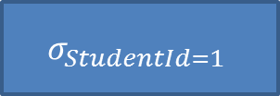
Deterministic Encryption
select *
from assignment
where studentid = 1
$$σ_{StudentId=1}$$
StudentId | AssignId | Score
1 | 1 | 68
1 | 2 | 71
3 | 4 | 99
… | … | …
Notes:
Why deterministic encryption?

Slide 36
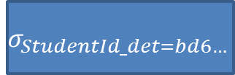
Deterministic Encryption
select *
from assignment
where studentid_det = bd6e7c3df2b5779e0b61216e8b10b689
$$σ_{StudentId_det=bd6…}$$
StudentId_DET | AssignId | Score
bd6e7c3df2b5779e0b61216e8b10b689 | 1 | 68
bd6e7c3df2b5779e0b61216e8b10b689 | 2 | 71
7ad5fda789ef4e272bca100b3d9ff59f | 4 | 99
… | … | …

Slide 37
Homomorphic Encryption
$$Enc (1)$$
7ad5fda789ef4e272bca100b3d9ff59f
$$+_{Enc}$$
7a9f102789d5f50b2beffd9f3dca4ea7
bd6e7c3df2b5779e0b61216e8b10b689
$$Enc (2)$$
$$Enc (1)$$
Encryption key is not an input
Notes:
Which brings us to the general idea of homomorphic encryption. Homomorphic encryption – special encryption that lets us do some computation directly on encrypted values. The remaining encryption schemes are all examples of homomorphic encryption schemes.

Slide 38

Order Preserving Encryption
Value | Enc (Value)
1 | 0x0001102789d5f50b2beffd9f3dca4ea7
2 | 0x0065fda789ef4e272bcf102787a93903
3 | 0x009b5708e13665a7de14d3d824ca9f15
4 | 0x04e062ff507458f9be50497656ed654c
5 | 0x08db34fb1f807678d3f833c2194a759e
$$x<y →Enc \left(x\right)<Enc (y)$$
[BCN11, PLZ13]

Slide 39
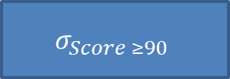
Order-Preserving Encryption
select *
from assignment
where score >= 90
$$σ_{Score ≥90}$$
StudentId | AssignId | Score
1 | 1 | 68
1 | 2 | 71
3 | 4 | 99
… | … | …

Slide 40
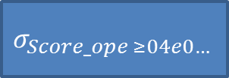
Order-Preserving Encryption
select *
from assignment
where score_OPE >= 0x04e062ff507458f9be50497656ed654c
$$σ_{Score_ope ≥04e0…}$$
StudentId | AssignId | Score_OPE
1 | 1 | 0x0065fda789ef4e272bcf102787a93903
1 | 2 | 0x009b5708e13665a7de14d3d824ca9f15
3 | 4 | 0x08db34fb1f807678d3f833c2194a759e
… | … | …

Slide 41





Homomorphic Encryption Schemes
Fully Homomorphic Encryption
(Any function)
[G09, G10]
Order-Preserving Encryption
$$(≤)$$
[BCN11, PLZ13]
Paillier
Cryptosystem
$$(+)$$
ElGamal
Cryptosystem
$$(×)$$
[P99]
[E84]
Deterministic Encryption
$$(==)$$
Non-Deterministic
Encryption
$$(∅)$$
Notes:
Common homomorphic encryption schemes and what can be computed using them.
Non-deterministic encryption -> no computation

Slide 42
Homomorphic Encryption Schemes
Fully Homomorphic Encryption
(Any function)
[G09, G10]
Partial Homomorphic
Encryption
Order-Preserving Encryption
$$(≤)$$
[BCN11, PLZ13]
Paillier
Cryptosystem
$$(+)$$
ElGamal
Cryptosystem
$$(×)$$
[P99]
[E84]
Deterministic Encryption
$$(==)$$
Non-Deterministic
Encryption
$$(∅)$$
Notes:
In the middle -> encryption schemes that allow some computation -> PHE
Top -> fully homomorphic encryption

Slide 43
Homomorphic Encryption Schemes
Impractical
Fully Homomorphic Encryption
(Any function)
[G09, G10]
Partial Homomorphic
Encryption
Order-Preserving Encryption
$$(≤)$$
[BCN11, PLZ13]
Paillier
Cryptosystem
$$(+)$$
ElGamal
Cryptosystem
$$(×)$$
[P99]
[E84]
Deterministic Encryption
$$(==)$$
Expensive
Non-Deterministic
Encryption
$$(∅)$$
Practical
Notes:
In the middle -> encryption schemes that allow some computation -> PHE
Top -> fully homomorphic encryption

Slide 44
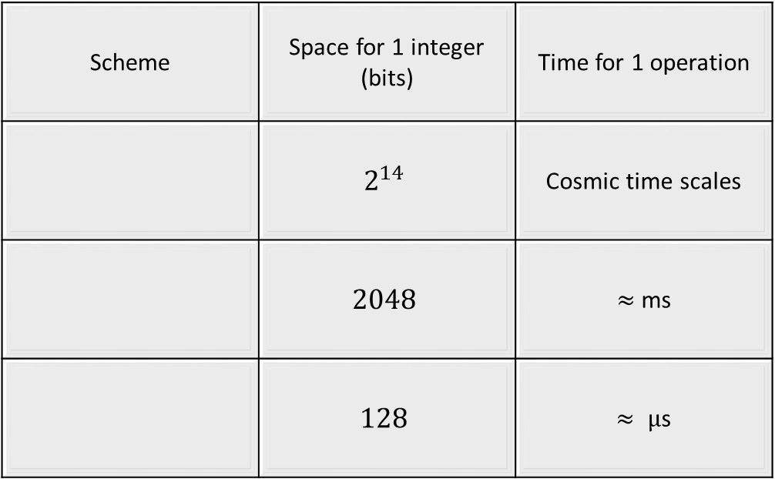
Homomorphic Encryption Schemes: Performance
Scheme | Space for 1 integer (bits) | Time for 1 operation
 | $$2^{14}$$ | Cosmic time scales
 | $$2048$$ | $≈$ms
 | $$128$$ | $≈ µ$s
Fully Homomorphic
Encryption
Paillier
ElGamal
Deterministic
Order-preserving

Slide 45
Homomorphic Encryption Schemes: Notation
Fully Homomorphic Encryption
(FHE)
Partial Homomorphic
Encryption (PHE)
Order-Preserving Encryption
$$(≤)$$
[BCN11, PLZ13]
(OPE)
Paillier
Cryptosystem
$$(+)$$
ElGamal
Cryptosystem
$$(×)$$
[P99]
[E84]
Deterministic Encryption
$$(==)$$
(DET)
Non-Deterministic
Encryption
$$(∅)$$
(NDET)

Slide 46
How do I Encrypt a Database?
Encr
Cell granularity
Advantage:
Random access to a cell contents
Mix n Match encryption

Slide 47
Mix n Match Encryption
Plaintext
Deterministic
Non-deterministic
Id | SSN | Name | Score
Id | SSN_DET | Name_NDET | Score_OPE
Not covered: Deriving multiple keys. See [PRZ+11] for an example.

Slide 48
Example: Online Course Database
Student
StudentId | Name | Addr | GPA | CreditCard | …
Course
CourseId | Name | InstrId | …
StudentCourse
CourseId | StudentId | Grade | …
Notes:
Different columns have different security requirements.

Slide 49
Roadmap
Introduction
Overview
Basics of Encryption
Trusted Client based Systems
Secure In-Cloud Processing
Security
Conclusion

Slide 50
Design Choices
COMPUTE ON
ENCRYPTED DATA
USE SECURE
LOCATION
F.H.E
P.H.E
Client
Server
Notes:
If we need to provide a security guarantee that plain text corresponding to encrypted data will not be revealed in the cloud servers then there are two broad approaches for query processing on encrypted data: 1) compute directly on ciphertext (using partial homomorphic techniques) 2) use a secure location that can decrypt ciphertext.

Slide 51
Trusted Client based Systems
COMPUTE ON
ENCRYPTED DATA
USE SECURE
LOCATION
F.H.E
P.H.E
Client
Server
Notes:
In this part of the tutorial, we will focus on techniques that use a combination of P.H.E and a trusted client.

Slide 52
Trusted Client Architecture
Client
App
PlainText Query
PlainText Results
DBMS
Client
Component
Rewritten Query
Key
Encrypted Data
Data not decrypted in DBMS
  Only ciphertext seen in the DBMS
No changes to DBMS/Client App
Notes:
The DBMS shown in red is untrusted. The client component which has access to the encryption keys is assumed to be trusted (this components is part of the domain of the client app). This architecture does not require any changes to the DBMS and thus can be deployed in today’s cloud services.

Slide 53
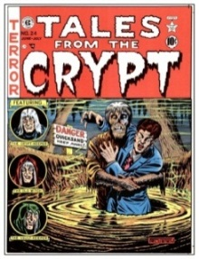


Systems
Minimal Client Computation
  Use P.H.E (Cryptdb)
Residual Query Processing in Client
  Blob Store
  Use in conjunction with P.H.E (Monomi)
Notes:
We use the term “blob store” to refer to work that stores encrypted data in the cloud and uses the trusted client for any query processing on ciphertext. While there is a lot of work in space, we will discuss a few representative systems and focus on query processing.

Slide 54

CryptDB Architecture
Client
App
PlainText Query
PlainText Results
DBMS +
UDFs
Web
Proxy
Rewritten Query
Key
Encrypted Data
Web proxy rewrites queries, decrypts result
Leverage P.H.E techniques
[PRZ+11]
Notes:
We discuss CryptDB which uses P.H.E – we highlight certain aspects relevant to query processing, for a more detailed discussion refer to [PRZ+11].

Slide 55
Database Design
students(ID, grade)
  Point Lookups on ID column
  SELECT and AGGREGATION queries on grade
students(ID_DET, grade_OPE)
students(ID_DET, grade_OPE, grade_PAILLIER)
  Need to store columns encrypted in multiple ways
  Static/Dynamic design based on workload
[PRZ+11]
Notes:
Plaintext schema indicated in green – the corresponding schema in ciphertext is in red. We use the notation grade_OPE to indicate the grade column is encrypted using OPE.

Slide 56




Query Processing
Client
App
DBMS +
UDFs
Web
Proxy
Key
students(ID_DET, grade_OPE, grade_PAILLIER)
[PRZ+11]
Notes:
Example queries issued by the client and corresponding query fragments at the DBMS and the web-proxy.

Slide 57


Dynamic Database Design
students(ID_DET, grade**)
Client
App
DBMS +
UDFs
Web
Proxy
Key
DET
OPE
NDET
ID
grade
OPE
grade
[PRZ+11]
Notes:
So far we discussed static database design. CryptDB also has a novel design feature called onion layers in which each data item is encrypted using multiple layers and outer layers of encryption are removed at query time if necessary. For the example queries, for the first two queries no reorganization is needed but for the third query, the grade column, the outermost encryption layer is removed. See [PRZ+11] for more details on key management.

Slide 58
Summary
P.H.E is not “free” – space overheads
  For Paillier, to store one integer (32 bits), the ciphertext need to use 2048 bits!
  Compact representation for paillier that is updatable – open problem.
P.H.E is inherently limited – cannot address all of SQL
[GZ07]
Notes:
While P.H.E schemes like paillier have significant storage overheads, there is recent work [GZ07] that aims to optimize this overhead. However, such schemes are for static databases and do not work for updates.

Slide 59
Systems
No Client Computation
  Leverage P.H.E
  e.g., Cryptdb
Residual Query Processing on Client
  e.g., Blob store
  Use in conjunction with P.H.E (e.g., Monomi)

Slide 60
Computation in Trusted Client
Client
App
PlainText Query
PlainText Results
DBMS
Shell
DBMS
Encrypted Data
Key
Client Query Fragment
Server Query Fragment
Distributed query processing between DBMS shell and untrusted DBMS
[HMI02]
[HIL+02]
[HMH08]
[TFM13]
Notes:
The main difference between the previous approach and the trusted client is that the trusted client performs non-trivial query processing. The related work gives pointers to different aspects of distributed query processing including query optimization and physical design.

Slide 61
Blob Store: Database Design
Encrypted data stored as ‘blobs’ (No computation)
  students(ID, grade_blob)
Use additional “fake” partitions to index blobs
  students(ID, grade_blob, partition##)
grade | partition##
0 - 1.0 | ccc##
1.0 – 2.0 | aaa##
2.0 – 3.0 | ddd##
3.0 – 4.0 | bbb##
[HIL+02]
Notes:
Since no query evaluation can occur on blobs, this approach uses additional fake partitions to index blobs so that additional filtering predicates can be used as part of the query sent to the DBMS. For example for the grade column, we use an additional partition## column.

Slide 62



Blob Store: Query Processing
Client
App
DBMS
DBMS
Shell
Key
students(ID, grade_blob, partition##)
Distributed query processing
  Choosing appropriate partitioning
  “Optimal” Query Splitting
[HIL+02]
[HIM05]
[HMT04]
Notes:
The efficiency of this approach relies on the appropriate choice of partitioning and efficient query splitting algorithms – refer to the suggested readings for more details.

Slide 63
Trusted Client based Systems
COMPUTE ON
ENCRYPTED DATA
COMPUTE ON
ENCRYPTED DATA
COMPUTE ON
ENCRYPTED DATA
USE SECURE
LOCATION
USE SECURE
LOCATION
USE SECURE
LOCATION
F.H.E
P.H.E
F.H.E
P.H.E
F.H.E
P.H.E
Client
Client
Server
Client
Server
Server
Notes:
We have explored techniques that use P.H.E and the trusted client approach in isolation – we now consider a recent approach that is a hybrid of both techniques.

Slide 64



Augmenting Blob Store
Client
App
DBMS
DBMS
Shell
Key
students(ID, grade_blob, partition##)
students(ID, grade_OPE)
Use P.H.E to push more computation to DBMS
  Monomi
[TFM13]
Notes:
Monomi [TFM13] uses P.H.E to push more computation to the server as the above example illustrates, the entire predicate (grade > 3.5) can be pushed to the server. This is in contrast to the previous approach where only the corresponding predicate on the partition## column could have been pushed.

Slide 65


Pre-computation for complex queries
Find student submissions that have been handled in a day late
Students(ID_DET, submissiondate_DET, deadline_DET, deadlineplusone_DET)
Students(ID_DET, submissiondate_DET, deadline_DET, deadline_PAILLIER)
  Cannot “Mix and Match” different encryptions
[TFM13]
Notes:
Note that the example query cannot be handled even if we store the deadline column encrypted using multiple functions. We can however anticipate such a query and pre-compute a column deadline_plusone which is stored encrypted using DET encryption in order to answer the query.

Slide 66
Trusted Client: Summary
No Server changes required to DBMS
Works well for workloads where amount of data shipped is small
  Physical Design is important for distributed queries
  Pre-computation is not free
Generality of approach is unproven
  Integrity constraints, Triggers etc.
  Automated tools to migrate database applications

Slide 67

“Key” Limitation: Robustness
Stored procedure to find student submissions that have been handed in late (with delay as a parameter)
Cannot pre-compute all possible input values
  why store the table in the cloud!
Notes:
If we consider a variant of the previous example where the delay is passed as a parameter, we cannot “anticipate” all possible invocations of a stored procedure and pre-compute the corresponding columns, thus some invocations of the stored procedure will need to ship the entire table to the client. If we keep doing this repeatedly for query evaluation, why even store the table in the cloud?

Slide 68
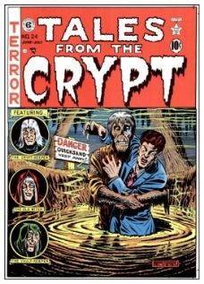

TakeAway Quiz
The Trusted Client approach:
  Is “Dead” on arrival
  Adding BLOB() keyword to SQL
  c) Is effective when most work can be
  offloaded to the server
  d) Is not a robust solution for
  general purpose queries

Slide 69

Still to come …
Is it possible to design a system where only the results are shipped to the client irrespective of query complexity ?
MISSION:IMPOSSIBLE V
TRUSTED SERVER

Slide 70
Roadmap
Introduction
Overview
Basics of Encryption
Trusted Client based Systems
Secure In-Cloud Processing
Security
Conclusion

Slide 71
Secure In-Cloud Processing
COMPUTE ON
ENCRYPTED DATA
USE TRUSTED
MODULE
F.H.E
P.H.E
Client-End
Solution
In-Cloud
Solution
Notes:
As discussed earlier, the trust-client machine approach has a few problems. Specifically, there are many operations we might need to perform on encrypted fields that cannot be processed by untrusted cloud machines. Partial homomorphic operations or pre-computation simply are not general enough to handle any arbitrary request that might come in.
Thus, for these types of computations the only thing we can do in a trusted-client system is to send data to the customer’s on-premise machines for processing. This is a problem because these client machines are comparatively far away from the cloud and shuttling large amounts of data between the cloud and client is time consuming and costly.
To address this problem, the last general approach people have taken is to provide some sort of trustworthy computing resource in the cloud itself.

Slide 72
Secure In-Cloud Processing
COMPUTE ON
ENCRYPTED DATA
USE TRUSTED
MODULE
F.H.E
P.H.E
Client-End
Solution
In-Cloud
Solution
Traditional
Servers
Secure
Hardware
Notes:
The challenge now is, we will be storing and using crypto keys in the cloud to manipulate ciphertext.
How can we provide sufficient guarantees to the customer such that they can believe that the security of the system is equivalent to a trusted-client system?
Broadly, these secure in-cloud platforms can be split into two types of systems, traditional processor-based servers and specially designed secure hardware solutions.

Slide 73
Secure In-Cloud Processing
COMPUTE ON
ENCRYPTED DATA
USE TRUSTED
MODULE
F.H.E
P.H.E
Client-End
Solution
In-Cloud
Solution
Traditional
Servers
Secure
Hardware
Isolation
Verification
Notes:
We’re all familiar with traditional servers, so let’s start by looking at how organizations like Amazon’s special government-certified cloud machines are protected.
Beyond that, and perhaps more importantly, let’s look at why they have to protect them in the first place.
In general, securing traditional servers is an attractive solution because it is simple – just do whatever we would normally in the cloud, just add more security.
We can protect a server using two basic techniques: isolation and verification.

Slide 74
Securing Traditional Servers
Isolation
  Physical (location, network)
  Logical (hypervisor/VM, strict policies)
Verification
Example: Amazon GovCloud [AWSGC]
Notes:
By isolation, we mean two things – 1) physical isolation like putting them in metal security cages or isolating them on a separate subnet and 2) logical isolation – things like setting up virtual machines or restricting cloud access to only specifically vetted customers – maybe we only let government employees connect.

Slide 75
Securing Traditional Servers
Isolation
Verification
  Static (TPM authenticated boot)
  Dynamic (malware detectors)
[TCGNotes, TPMSpec]
Notes:
By verification, we can do static or dynamic verification.
Static verification is something like authenticated boot using a TPM. A TPM (Trusted Platform Module) allows us compute signatures on the BIOS, operating system, applications, etc. before we load them.
If these signatures don’t match known good values, we know that the system has been tampered with somehow and we abort. If the signature do match, we know that the system is coming up the exact same way it did when it was first set the machine up.
In terms of dynamic verification, this is basically virus scanners and the like.

Slide 76
Secure Server Advantages
Lowest impact solution
  Use existing components, software and policies
  We can all go home!
DBMS
(Commodity H/W)
SQL Server
Buffer Pool
Name | Age | Disease
Alice | 12 | Flu
Bob | 51 | Diabetes
Chen | 24 | Flu
Dan | 36 | Cold
Name | Age | Disease
X%*! | )C | !x8J
~4Yz | ## | )zFr#x
T$H2 | !* | ^@tG
<*fB | @$ | BxU3
Notes:
The advantage of secure servers is that they are very easy to set up. All large companies have lengthy and detailed best-practice policies already in place on how to set up servers.
So, we should just use these and we can all go home.
However…

Slide 77
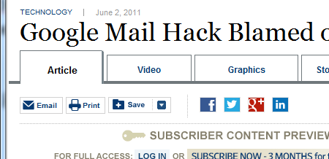
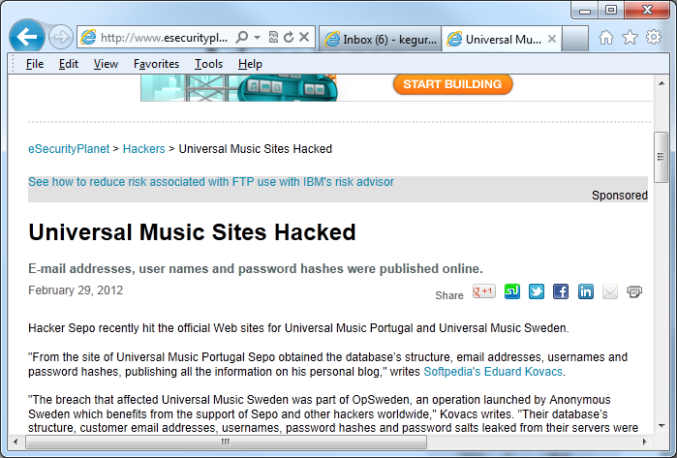
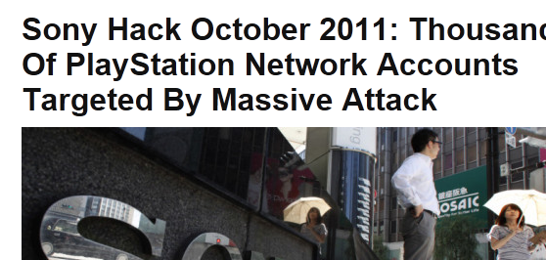


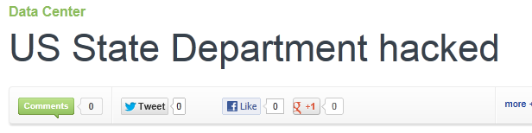
Securing a Server is HARD!
Notes:
… this is the state of the world in terms of server security technology.
Why can’t we do better?

Slide 78
What Makes it Hard to
Secure a Server?
Built for flexibility & adaptability
  General-purpose processors
    A unified-memory space is a serious vulnerability
    Security guarantees require 100% bug-free software
Notes:
The problem is that by their very nature, modern servers, and particularly cloud machines, need be very adaptable.
Towards this end, we build them with that in mind. For example, we use highly flexible processors. We can quickly code up just about any software we can think of on our Intel processors.
However, this generality comes at a cost. For example, the classic processor architecture uses a single, physically unified memory address space for both program and data. This is an adaptable architecture, but it makes exploits such as buffer overruns and rootkits possible.
We could securing this type of system, but in order to provide any rigorous security guarantees, we would have to be absolutely certain that our entire software stack is bug-free – there is no room for error.

Slide 79
What Makes it Hard to
Secure a Server?
Complex software stacks make rigorous security guarantees impossible
  Largest formally verified OS kernel in literature is 8,700 lines of C and 600 lines of assembly
  i.e. ‘Why don’t they make the whole plane out of that “black box” stuff?’
[K09]
Notes:
At the same time, we want to run a modern database, using full-featured virtual machines on top of a sophisticated hypervisor.
To give a point of reference, the largest OS kernel that has been formally verified to be correct contains 8,700 lines of C & 600 lines of assembly.
Thus, what we want to do simply has too large a surface area to be provably secure.

Slide 80
What Makes it Hard to
Secure a Server?
We need to simplify the trusted computing platform!
Better architectural isolation will also help!
Notes:
In the end, we’ll likely have to strip down the functionality we provide in the trusted computing platform in order to provide rigorous security guarantees.
Along with this, changing the computing architecture to provide better isolation between program and data space will also help provide better security at a very fundamental level.

Slide 81
Secure In-Cloud Processing
COMPUTE ON
ENCRYPTED DATA
USE TRUSTED
MODULE
F.H.E
P.H.E
Client-End
Solution
In-Cloud
Solution
Traditional
Servers
Secure
Hardware
Secure
Processors
Dedicated
Hardware
Notes:
Going back to our diagram of the solution space, this is exactly what the last two types of secure database systems do – provide more specialized in-cloud trusted compute platforms.
Some use specialized secure co-processors to compute on encrypted data while others provide even more specialization and, correspondingly, an even smaller attack surface – all the way to implementing dedicated database-specific hardware circuits.

Slide 82
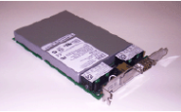
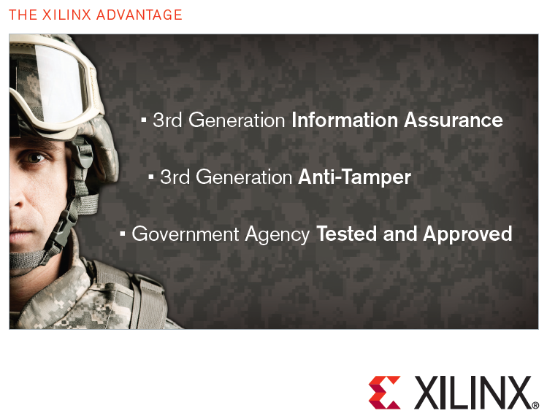
Previous Use of Secure Hardware
Secure Co-Processor
  ATM, smart cards
Hardware Security Modules
  Tamper-proof crypto acceleration
FPGAs
  Military use
Limited Resources!
IBM 4764 PCI-X Cryptographic Coprocessor
Secure FPGA
[TCGNotes]
Notes:
Specialized hardware has been applied to other areas for security reasons.
Secure co-processors like those built by IBM are used in ATMs, special crypto hardware security modules are built into smart networking cards, and even the military uses security-oriented FPGAs to build control and information systems.
The question is, how can we apply this type of technology in the context of query processing over encrypted data?
Beyond this, one challenge of using these systems is as part of being a protected, low-footprint computing platform, they are often limited in terms of onboard memory or even overall computing power.
We need to be mindful of this when we are developing systems using these devices.

Slide 83
Trusted Client Architecture
Client Query Fragment
Server Query Fragment
DBMS
Shell
Encrypted Data
DBMS
Key
Plaintext Results
Plaintext Query
Client
App
Distributed query processing between untrusted DBMS and client-end DBMS shell
Notes:
The secure processor and dedicated hardware types of solutions we are going to talk about borrow heavily from the concepts we already discussed with regards to the various trusted-client architectures.
Before, users connected to a shell DB which translated queries and called out to an untrusted cloud DBMS.
The cloud DBMS returned values back to the shell DB to perform remainder queries.
What the secure processor and dedicated hardware types of solutions will do is simply move the trusted database processing to the cloud.

Slide 84
Secure In-Cloud Compute Architecture
Untrusted Query Fragment
Query
Translation
& Splitting
Encrypted Data
DBMS
Plaintext Results
Plaintext Query
Encrypted Data
Client
App
Trusted
Compute
Key
Trusted Query Fragment
Distributed query processing between untrusted DBMS and trusted cloud compute
Solutions differ in granularity of integration
Notes:
These architectures leave behind a thin shim on the client end to perform query translation and encryption/decryption for the end user, but this shim sends complete query plans to the cloud.
The cloud then distributes the actual query processing among the trusted and untrusted computing platforms – mixing and matching these resources, this time without incurring a huge communication penalty to go between the trusted and untrusted systems.
The chief difference between the secure processor and dedicated hardware types of solutions is in the granularity of how the trusted and untrusted parts of the system work together.

Slide 85
Secure Processors
TrustedDB
  Trusted compute is
  a full DBMS
IBM Secure
Co-processor
Key
Embedded
Linux & SQL Lite
Client
App
Query
Cloud
DBMS
Storage
Results
[BS11]
Notes:
First, let’s talk about secure co-processors - this is the approach that TrustedDB uses.
Here, we leverage commercial off-the-shelf hardware that is a complete, self-sufficient computing platform in a small secure package.
Inside, the trusted compute resource is capable of running a full DBMS, in this case, SQL Lite running on top of an embedded variant of Linux.

Slide 86
Advantages of Loosely-Coupled Arch.
  Full trusted DBMS ➔
  loosely coupled system
  Simple division of labor
  Simple to build
IBM Secure
Co-processor
Key
Embedded
Linux & SQL Lite
select (*) where
SSN_NDET = ‘ad&*$jk’
Client
App
Query
Cloud
DBMS
Storage
Results
select (*) where name_PT = ‘John Doe’
Notes:
Because the trusted platform can run a complete DBMS, the division of labor is fairly simple – queries that have to manipulate encrypted values run on the trusted system while those that don’t run on the untrusted system.

Slide 87
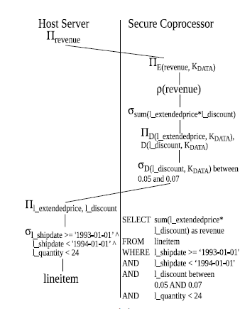
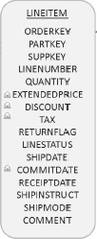
TrustedDB Hybrid Example
[BS11]
Notes:
Example from the TrustedDB.
Just like in the client-server systems, we can mix and match computation between the trusted and untrusted platforms.

Slide 88
Limitations of Loosely-Coupled Arch.
  Full trusted DBMS ➔
  loosely coupled system
  How about everything
  else?
    Inter-query memory governance
    Admission control
    Memory management
    Spooling
    Join/sort algorithms?
    GetNext calls, Storage engine (buffer pool, locking)
IBM Secure
Co-processor
Key
Embedded
Linux & SQL Lite
Client
App
Query
Cloud
DBMS
Storage
Results
Notes:
Although this abstraction is very clean, because the trusted system is a complete DBMS, it also ends up handling many tasks that aren’t specifically decrypting data and performing expression evaluation.
For example, it has to manage things like page fetches, query scheduling, memory management, etc.
In the end, it isn’t a particularly efficient use of precious trusted computing resources and, at least in theory, we could offload this to comparatively cheap and plentiful untrusted computing resources.

Slide 89
Dedicated Expression Evaluation
Cipherbase
  Trusted compute is
  only expression
  evaluation
Secure
Expression Evaluation
Key
Dedicated
Stack Machine
Client
App
Query
Cloud
DBMS
Storage
Results
[ABE+12, ABE+13]
Notes:
This is where our last secure computing architecture comes in.
Here, rather than implementing a comparatively complex DBMS, we have stripped the trusted computing platform down to it’s bare essentials – just crypto operations and expression evaluation.
This is the approach that Cipherbase takes.

Slide 90





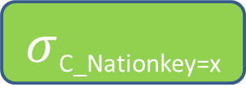
Dedicated Expression Evaluation
Inter query memory governance
Admission control
Secure
Expression Evaluation
Dec(C_Custkey1)>Dec(C_Custkey2)
Enc(Dec(O_totalprice) +
Dec(currentSum))
$$γsort, sum(o_totalprice)$$
Memory Mgmt
Spooling
Specifics of join/sort algorithm
$$⋈hash$$
Hash(Dec(C_Custkey))
Hash(Dec(O_Custkey))
Dec(O_Custkey)=Dec(C_Custkey)
$σ$_{C_Nationkey=x}
$σ$_{O_Orderdate>y}
Dec(O_Orderdate)>Dec(y)
$$Customer$$
$$Orders$$
Dec(C_Nationkey)=Dec(x)
Data-flow (GetNext calls)
Storage engine (buffer pool, locking)
[ABE+12, ABE+13]
Notes:
If we look at how a system like Cipherbase would work, even for a query that only operates on strongly encrypted data, we see very efficient division of labor.
The trusted hardware is only responsible for decryption, expression evaluation and re-encryption.
In a loosely-coupled architecture, all of this would need to run in the trusted system.

Slide 91
Dedicated Expression Evaluation
Advantages
  Efficiency of trusted compute resources
  Dedicated circuits ➔ virus-proof
  Small footprint ➔ formal verification
Drawbacks
  Fundamentally changes expression evaluation ➔ non-trivial changes to host DBMS
[ABE+12, ABE+13]
Notes:
Beyond the fact that this can maximize efficiency of limited trusted compute resources, this system can also be more secure.
First, dedicated circuits cannot be infected with a virus (they can be fed invalid data, but this will not change the primary operation of the circuit itself).
Second, since the trusted hardware simply doesn’t have to do nearly as much (the untrusted DBMS essentially spoon-feeds data to the secure expression evaluation), it is considerable simpler. This brings formal verification back into the realm of possibility.

Slide 92
Summary
Secure in-cloud trusted compute resources
Open issues
  Query optimization
    e.g. Statistics on encrypted data, security-aware type matching
  Execution engine
    e.g. Data/computation reuse, masking latency to trusted computation
  Physical Design
    e.g. Leveraging stronger encryption
Notes:
To summarize this section, we started with the trusted-client model but said that it’s hard to use trusted compute that is so far away from the cloud. What happens if we try to lock down in-cloud servers? Beyond that, could we provide low-footprint in-cloud specialized trusted modules?
There are still many open questions around these types of systems. We are changing some fairly important characteristics by orders of magnitude. For example, consider the communication latency between first going off-processor, and then off-cloud.
The realities are simply very different and there are some important questions need to visit concerning query optimization, the execution engine, and physical design.

Slide 93
Roadmap
Introduction
Overview
Basics of Encryption
Trusted Client based Systems
Secure In-Cloud Processing
Security
Conclusion

Slide 94

SECURITY
Notes:
In case you were wondering what the security of various systems we have seen is, we will discuss it now.

Slide 95
Encryption and Security
Key:
000102030405060708090a0b0c0d0e0f
Encr
a7be1a6997ad739bd8c9ca451f618b61
b6ff744ed2c2c9bf6c590cbf0469bf41
47f7f7bc95353e03f96c32bcfd8058df
The quick brown fox jumps
over the lazy dog
Notes:
Let us start with the basics of security. In order to analyze the security of an encryption scheme, we ask…

Slide 96
Encryption and Security
Key:
Encr
a7be1a6997ad739bd8c9ca451f618b61
b6ff744ed2c2c9bf6c590cbf0469bf41
47f7f7bc95353e03f96c32bcfd8058df
?
Notes:
… what information the adversary can learn about the plaintext given the ciphertext (without the key)

Slide 97
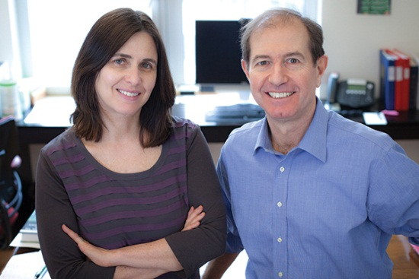
Encryption and Security
Key:
Encr
a7be1a6997ad739bd8c9ca451f618b61
b6ff744ed2c2c9bf6c590cbf0469bf41
47f7f7bc95353e03f96c32bcfd8058df
?
Semantic security:
  No information leakage except input length
Winner of this year’s Turing Award
[KL07]
Notes:
The above problem is well-studied in classic cryptography. The classic notion of semantic security stipulates that no information should be revealed other than the length of the input. Incidentally, this contribution was recognized by this year’s Turing Award.
In this talk, we will talk about information leakage informally while noting that it is possible to formalize all that we are saying using the classic notion of semantic security.

Slide 98
Encryption and Security
Key:
Encr
a7be1a6997ad739bd8c9ca451f618b61
b6ff744ed2c2c9bf6c590cbf0469bf41
47f7f7bc95353e03f96c32bcfd8058df
?
Encryption schemes such as AES in CBC mode (non-deterministic) are believed to be semantically secure
Notes:
Encryption schemes such as AES discussed earlier are widely believed to be semantically secure.

Slide 99
Security of Database Encryption
Disease
Flu
Diabetes
Flu
Cold
Disease_NDET
!x8J
)zFr#x
^@tG
BxU3
Apply AES-CBC to every cell
Leaks cell lengths
Notes:
The first part of database security is the security of encrypting “data at rest”. If we apply AES (in non-det.) mode on every cell, what information does it leak? Answer: cell lengths.

Slide 100
Deterministic Encryption
Disease
Flu
Diabetes
Flu
Cold
Disease_DET
!x8J
)zFr#x
!x8J
BxU3
Leaks cell lengths
Also, no. of distinct values + frequency distribution [BFO+08]
Notes:
Suppose that we encrypt every cell deterministically. Will we leak anything besides row sizes? Answer: no. of distinct values and frequency distribution. Bellare et al. have formally analyzed the security yielded by det. schemes.

Slide 101
Order-Preserving Encryption
Age
12
51
24
36
Age_OPE
0x000a
0x0f12
0x00a1
0x00b2
Leaks cell lengths
Also, order of cell values [AKS+04, BCN11]
Design of order-preserving encryption
Notes:
Order-preserving encryption seeks to leak cell lengths and ordering of cell values. However, the OPEs proposed in practice leak more than that. Designing an OPE that leaks only the ordering (and cell lengths) is an open problem.

Slide 102
Overall Security of Data Encryption
Name | Age | Disease
Alice | 12 | Flu
Bob | 51 | Diabetes
Chen | 24 | Flu
Dan | 36 | Cold
Name_NDET | Age | Disease_DET
X%*! | 12 | !x8J
~4Yz | 51 | )zFr#x
T$H2 | 24 | !x8J
<*fB | 36 | BxU3
Name: AES-CBC non-deterministic
Age: Clear-text
Disease: AES deterministic
Total information leaked = “sum” of column-level leakage
Notes:
If we encrypt different columns differently, the total info leakage is essentially the sum of leakage from each individual column.

Slide 103
Impact of Querying & Updating
Trusted Client
Untrusted Server
Update Employee
Set Salary = *&@#
Where Name = ‘Alice’
Client
Server
Key
Name | Salary_NDET
Alice | X%*!
Bob | ~4Yz
Chen | T$H2
Dan | <*fB
Notes:
What happens when we query or update the data? Suppose that we have an employee table with a “Name” field and a “Salary” field. The “Salary” field is strongly encrypted and “Name” is stored in the clear. Since “Salary” is strongly encrypted, no information about it leaks other than row sizes.
Now suppose we modify the salary of an individual by identifying the individual’s name. Note that this process performs no computation on “Salary”, i.e. it treats “Salary” as a blob. While the adversary can see that Alice’s salary got modified, they presumably have no information about its old or new value since “Salary” is strongly encrypted.
However, suppose we have a series of updates….

Slide 104
Impact of Querying & Updating
Trusted Client
Untrusted Server
Update Employee
Set Salary = *!-#
Where Name = ‘Alice’
Client
Server
Key
Name | Salary_NDET
Alice | X%*!
Bob | ~4Yz
Chen | T$H2
Dan | <*fB
Notes:
…two to Alice’s salary

Slide 105
Impact of Querying & Updating
Trusted Client
Untrusted Server
Update Employee
Set Salary = 23=$<
Where Name = ‘Bob’
Client
Server
Key
Name | Salary_NDET
Alice | X%*!
Bob | ~4Yz
Chen | T$H2
Dan | <*fB
Notes:
…and three to Bob’s.

Slide 106
Impact of Querying & Updating
Trusted Client
Untrusted Server
Update Employee
Set Salary = +=$<
Where Name = ‘Bob’
Client
Server
Key
Name | Salary_NDET
Alice | X%*!
Bob | ~4Yz
Chen | T$H2
Dan | <*fB

Slide 107
Impact of Querying & Updating
Trusted Client
Untrusted Server
Update Employee
Set Salary = #2$^
Where Name = ‘Bob’
Client
Server
Key
Background knowledge
  Full-time employees earn more
  Salaries of hourly-wage employees updated more
Learn partial ordering of employee salary
  Alice’s salary > Bob’s
Name | Salary_NDET
Alice | X%*!
Bob | ~4Yz
Chen | T$H2
Dan | <*fB
Query access patterns reveal information! [OS07]
Notes:
Then, the adversary can observe the frequency with which a particular individual’s salary was updated. In this instance, the adversary knows that Alice’s salary was updated less often than Bob’s. Suppose that the adversary knows as part of background knowledge that full-time employees earn more, and that salaries of hourly wage employees are updated more often. Then, the adversary can learn some information about the ordering of employee salaries, in this instance that Alice likely has a higher salary than Bob.

Slide 108
Impact of Querying & Updating
True/False
Sort
TM
Record 1
<
Record 2
Sort leaks ordering
Encryption across the stack (disk + in-memory) does NOT imply no information leakage
The overall query workflow reveals information
Dynamic security (different from security of data at rest)
Notes:
What happens when we do computations over encrypted data? Let us consider a sort operator that uses a trusted module (whether in the client or in the server) to compare records. The adversary can observe the result of comparing various records and can hence infer the ordering. Note that this leakage happens even if the data stays encrypted throughout the system stack.
In other words, encryption of data alone does not prevent information leakage. The overall query workflow – query access patterns and data movement patterns – leak information. We will refer to this as “Dynamic” security to distinguish it from the security of data at rest.

Slide 109
Design Space
Cipherbase, TrustedDB,
CryptDB,
Monomi,
BlobStore
Stop with encryption
Can we bridge this gap?
Operations on column | Leakage
Equality (including joins) | Frequency distribution
Indexing/Sorting/range predicates | Order
Full Leakage
No Leakage
Notes:
Now let’s see where the systems discussed previously fall. Briefly, none of them addresses dynamic security.
On the security spectrum, they all fall in between storing the data in the clear (full leakage) and leaking no information. The information leaked includes frequency distribution on columns on which equality is performed and ordering on columns in which sorting/indexing is performed.
We would like to point out that the security yielded by encryption is a significant improvement over today’s alternative, namely keeping the data in the clear in the cloud. It is hence a great starting point to build a secure DBMS-as-a-service. As we have seen before, there are sufficient system design challenges just in that space.
Having said that, the question remains whether we can bridge this gap. The short answer is that while is prior work on addressing dynamic security, it is generally impractical. In the rest of the talk, we will discuss some of the above ideas. The question of *practical* designs that bridge this gap is by and large open.

Slide 110
No Leakage
Trusted Client
Untrusted Server
Q2
Server
Client
Q1
Result2
Result1
Encrypted Database
Reveals size of query result
Hide query result size by making all query result sizes equal to maximum size
  Joins reduce to cross products
  Impractical
Notes:
Let’s start with what it takes to achieve “No Leakage”. The end-to-end protocol we presented where the client ships an encrypted query and gets back an encrypted result reveals the query result size. Essentially, the only way to hide the query result size is to make all result sizes equal which would imply that for example joins would reduce to cross products. This makes “no leakage” impractical.

Slide 111
Design Space
Cipherbase, TrustedDB,
CryptDB,
Monomi,
BlobStore
Stop with encryption
Full Leakage
Output Size,
Running Time
No Leakage
Impractical
Notes:
If we require efficient execution at the server, we must intuitively be willing to reveal at the least the output size and (similar to output size) running time so let’s consider whether we can achieve it.

Slide 112
Access Patterns Leak Information
Data
CPU (program P)
Notes:
There is previous work in an area known as oblivious computation that answers in the affirmative. The previous result is stated for programs not just DBMSes. Suppose that we model program execution simplistically as a trusted CPU that has the program accessing data in untrusted memory. A program in general accesses some data items more than others, defining its access pattern. The notion of “oblivious” computation recognizes that these access patterns leak information and attempts to hide them.

Slide 113
Oblivious Simulation
Data
CPU (oblivious program P’)
Simulation: P’ equivalent to P
Theoretically Efficient: Running time of P’ within polylog factor of running time of P
Oblivious: Access patterns of P’ look random
Information leakage: input size, output size, running time
[GO96, W12, SS13]
Notes:
There is a well-known result that shows that any program has an efficient simulation that is oblivious. That is, there is a program P’ that is a simulation (equivalent), efficient (polylog) and oblivious (access patterns look random). It is known that by keeping memory contents encrypted, an oblivious simulation leaks only the output size and running time of P.

Slide 114
Application to DBMS
Data
Oblivious simulation of DBMS
Notes:
We could apply this technology to achieve our goal by running the oblivious simulation of a DBMS.

Slide 115
But…
Destroys spatial and temporal locality of reference
Data
DBMS
Range scan
Notes:
But the simulation destroys spatial and temporal locality of reference by design. A range scan is reduced to…

Slide 116
But…
Destroys spatial and temporal locality of reference
Data
Oblivious Simulation of DBMS
Random seeks
Range scan of 100M records on hard disk → 100M seeks
  10^5 seconds (~1 day)
Notes:
Random seeks. This can be prohibitively inefficient.

Slide 117
Design Space
Cipherbase, TrustedDB,
CryptDB,
Monomi,
BlobStore
Stop with encryption
Full Leakage
Output Size,
Running Time
Impractical
No Leakage
Impractical
Is there a stronger and practically achievable security model?
Notes:
This brings us to the end of this segment. Wrapping up, I would like to reiterate that the systems proposed stop with encryption for a good reason. Designing a stronger and practically achievable security model for DBMSes is an open problem.

Slide 118
Summary
Trusted Client
Untrusted Server
DBMS
DBMS
Key
Data
EncryptedData
Homo-morphic Encryption
Cloud Admin
Super-user with console access
Name | Age | Disease
Alice | 12 | Flu
Bob | 51 | Diabetes
Chen | 24 | Flu
Dan | 36 | Cold
Name | Age | Disease
X%*! | )C | !x8J
~4Yz | ## | )zFr#x
T$H2 | !* | ^@tG
<*fB | @$ | BxU3
Notes:
Let me summarize the tutorial. The overall problem is that we want to migrate data to the cloud where untrusted cloud administrators could get access to it. Encrypting the data before migration addresses this problem but it makes the problem of query processing challenging.
One approach is to use homomorphic encryption. There are several open problems in this space – improving FHE, improving PHE, designing new PHE. However, given the state of the art, this approach is incomplete.

Slide 119
Summary
Trusted Client
Untrusted Server
Trusted Machine
Untrusted Machine
Key
Encrypted Database
Name | Age | Disease
X%*! | )C | !x8J
~4Yz | ## | )zFr#x
T$H2 | !* | ^@tG
<*fB | @$ | BxU3
Notes:
So we consider adding a trusted machine that has access to the key into the mix. The TM can run in the client or in the server.
Either way, this makes QP a distributed QP problem. This is however a non-standard QP problem where one node is trusted and the other is not. Moreover, there is a resource asymmetry between the two. This leads to many exciting systems design/performance problems as well as security problems that we have introduced. Furthermore, even designing a trusted machine to be hosted in the cloud is a challenging area.

Slide 120
Summary
Untrusted Server
Trusted Machine
Untrusted Machine
Key
Encrypted Database
Name | Age | Disease
X%*! | )C | !x8J
~4Yz | ## | )zFr#x
T$H2 | !* | ^@tG
<*fB | @$ | BxU3

Slide 121
Other Challenges
Application Security
  DBMS is only a part of the overall system stack
Usability
  Clients need tools and interpretable security models to navigate security-performance tradeoff
Connections to other areas of security
  Data privacy, access control, auditing

Slide 122
Bibliography
[ABE+12] Arvind Arasu, Spyros Blanas, Ken Eguro, Manas Joglekar, Raghav Kaushik, Donald Kossmann, Ravishankar Ramamurthy, Prasang Upadhyaya, Ramarathnam Venkatesan: Engineering Security and Performance with Cipherbase. IEEE Data Eng. Bull. 35(4): 65-72 (2012).
[ABE+13] Orthogonal Security With Cipherbase. Arvind Arasu, Spyros Blanas, Ken Eguro, Raghav Kaushik, Donald Kossmann, Ravi Ramamurthy, and Ramaratnam Venkatesan. CIDR 2013.
[AES] AES Standard. FIPS 197. http://csrc.nist.gov/publications/fips/fips197/fips-197.pdf
[AF+ 09] Above the Clouds: A Berkeley View of Cloud Computing. by Michael Armbrust, Armando Fox, and others. Tech Report EECS-2009-28, Univ. of Calif., Berkeley.
[AKS+04] R. Agrawal, J. Kiernan, R. Srikant, and Y. Xu. Order-preserving encryption for numeric data. In SIGMOD 2004.
[AWSGC] Amazon GovCloud. http://aws.amazon.com/govcloud-us/.
[B68] K.E. Batcher, Sorting networks and their applications, Proceedings of the AFIPS Spring Joint Computer Conference 32, 307–314 (1968).
[BCL09] Order-Preserving Symmetric Encryption. Alexandra Boldyreva, Nathan Chenette, Younho Lee, Adam O'Neill. EUROCRYPT 2009.

Slide 123
Bibliography
[BCN11] Order-Preserving Encryption Revisited: Improved Security Analysis and Alternative Solutions. Alexandra Boldyreva, Nathan Chenette, Adam O’Neill. CRYPTO 2011.
[BFO+08] M. Bellare, M. Fischlin, A. O'Neill, T. Ristenpart: Deterministic Encryption: Definitional Equivalences and Constructions without Random Oracles. CRYPTO 2008.
[BG11] Luc Bouganim, Yanli Guo: Database Encryption. Encyclopedia of Cryptography and Security (2nd Ed.) 2011.
[BOA] Buffer Overflow Attack. Lecture Notes. http://www.cse.scu.edu/~tschwarz/coen152_05/Lectures/BufferOverflow.html
[BP02] Luc Bouganim, Philippe Pucheral: Chip-Secured Data Access: Confidential Data on Untrusted Servers. VLDB 2002
[BS11] Sumeet Bajaj, Radu Sion: TrustedDB: a trusted hardware based database with privacy and data confidentiality. SIGMOD Conference 2011.
[CPK 10] What’s New About Cloud Computing Security?. Yanpei Chen, Vern Paxson and Randy H. Katz. Tech Report EECS-2010-5. Univ. of Calif., Berkeley.
[E84] A public key cryptosystem and a signature scheme based on discrete logarithms. Taher El Gamal. CRYPTO 1984.

Slide 124
Bibliography
[ENISA 09a] Cloud Computing Risk Assessment. European Network and Information Security Agency. 2009.
[ENISA 09b] An SME perspective on cloud computing (survey). European Network and Information Security Agency, 2009.
[G09] Fully homomorphic encryption using ideal lattices. Craig Gentry. STOC 2009.
[G10] Computing arbitrary functions of encrypted data. Craig Gentry. CACM 2010.
[G11] Michael T. Goodrich. Data-oblivious external-memory algorithms for the compaction, selection, and sorting of outsourced data. In SPAA, pages 379–388, 2011.
[GO96] O. Goldreich, R. Ostrovsky: Software Protection and Simulation on Oblivious RAMs. J. ACM 43(3): 431-473 (1996)
[GZ07] Tingjian Ge, Stanley B. Zdonik. Answering Aggregation Queries in a Secure System Model. VLDB 2007.
[GZ07b] Tingjian Ge, Stanley B. Zdonik: Fast, Secure Encryption for Indexing in a Column-Oriented DBMS. ICDE 2007.

Slide 125
Bibliography
[HIL+02] Executing SQL over Encrypted Data in the Database-Service-Provider Model. Hakan Hacigumus, Balakrishna R. Iyer, Chen Li, Sharad Mehrotra, SIGMOD 2002.
[HIM04] Hakan Hacigümüs, Balakrishna R. Iyer, Sharad Mehrotra: Efficient Execution of Aggregation Queries over Encrypted Relational Databases. DASFAA 2004.
[HIM05] Hakan Hacigümüs, Balakrishna R. Iyer, Sharad Mehrotra: Query Optimization in Encrypted Database Systems. DASFAA 2005.
[HIM05b] Efficient Execution of Aggregation Queries over Encrypted Relational Databases. Hakan Hacigümüs, Balakrishna R. Iyer, Sharad Mehrotra. DASFAA 2005.
[HMH08] Bijit Hore, Sharad Mehrotra, Hakan Hacigümüs: Managing and Querying Encrypted Data. Handbook of Database Security 2008
[HMI02] Providing Database as a Service. Hakan Hacigumus, Sharad Mehrotra, Balakrishna R. Iyer. ICDE 2002.
[HMT04] Bijit Hore, Sharad Mehrotra, Gene Tsudik: A Privacy-Preserving Index for Range Queries. VLDB 2004.
[K09] G. Klein et al, “seL4: formal verification of an OS kernel” SOSP 2009.

Slide 126
Bibliography
[KL07] Introduction to Modern Cryptography. Jonathan Katz and Yehuda Lindell. Chapman & Hall/CRC Press. 2007.
[NIST 09] P. Mell and T. Grance. NIST definition of cloud computing. National Institute of Standards and Technology. October 7, 2009.
[OTDE] Oracle Transparent Data Encryption. http://www.oracle.com/technetwork/database/options/advanced-security/index-099011.html
[P99] Public-Key Cryptosystems Based on Composite Degree Residuosity Classes. Pascal Paillier. EUROCRYPT 1999.
[PLZ13] An Ideal-Security Protocol for Order-Preserving Encoding. Raluca Ada Popa, Frank H Li, Nickolai Zeldovich. Symp on Security and Privacy, 2013.
[PRZ+11] CryptDB: protecting confidentiality with encrypted query processing. Raluca A. Popa, Catherine M. S. Redfield, Nickolai Zeldovich, Hari Balakrishnan. SOSP 2011.
[S96] Applied Cryptography. Bruce Schneier. John Wiley & Sons, 1996.
[SS05] Trusted Computing Platforms: Design and Applications. Sean W Smith. Springer. 2005.

Slide 127
Bibliography
[SS13] E. Stefanov, E. Shi. ObliviStore: High Performance Oblivious Cloud Storage. IEEE S&P. 2013.
[STDE] Sql Server Transparent Data Encryption.
http://technet.microsoft.com/en-us/library/bb934049.aspx
[TCGNotes] Trusted Computing Architecture and its applications. CS255 Lecture Notes. Stanford University. http://crypto.stanford.edu/cs155old/cs155-spring11/lectures/08-TCG.pdf
[TFM13] Stephen Tu, M. Frans Kaashoek, Samuel Madden et al. Processing Analytical Queries over Encrypted Data. VLDB 2013.
[TPMSpec] TPM Main Specification. http://www.trustedcomputinggroup.org/resources/tpm_main_specification
[VYK12] Vaibhav Khadilkar, Kerim Yasin Oktay, Murat Kantarcioglu, Sharad Mehrotra: Secure Data Processing over Hybrid Clouds. IEEE Data Eng. Bull. 35(4): 46-54 (2012).
[W12] P. Williams. Oblivious Remote Data Access Made Parallel. PhD Thesis. 2012.

