Slide 1
Partitioned Logistic Regression for Spam Filtering
Ming-wei Chang
University of Illinois at Urbana-Champaign
Wen-tau Yih and Christopher Meek
Microsoft Research
The work was done while the first author was an intern at MSR

Slide 2
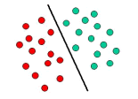
Linear Classifiers
Linear classifiers are used in many applications
  Document classification, information extraction tasks, spam filtering …
  Why? Good performance in high dimensional spaces
  Very Efficient
Two popular algorithms
  Naïve Bayes (NB) and Logistic Regression (LR)
  NB: conditional independence assumption
  LR: can capture the dependence between features

Slide 3
Our Contributions
We propose partitioned logistic regression (PLR)
  A new hybrid model of NB and LR
  A weaker conditional independence assumption
  Suitable for tasks with “natural feature groups”
It works great on spam filtering!
  It improves the AUC_{fpr<=10%} by 28.8% and 23.6% compared to NB and LR, respectively
Easy to implement and use

Slide 4
Outline
Introduction
The Model: Partitioned Logistic Regression
Analysis of Partitioned Logistic Regression
Application to Spam Filtering
Conclusion

Slide 5
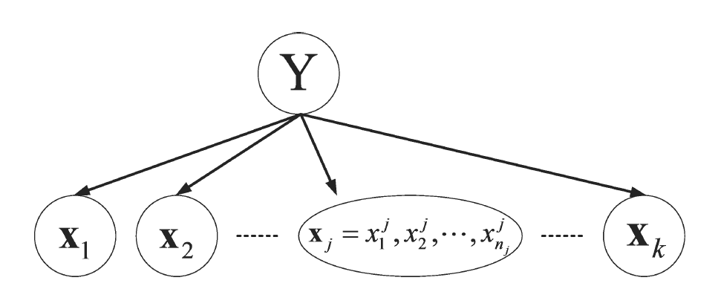
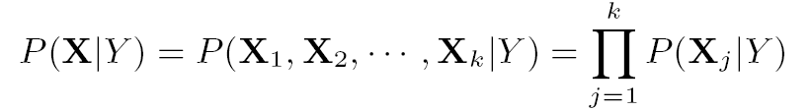
Partitioned Logistic Regression
Key Assumption: each feature group is conditionally independent of each other given the label
Feature Groups

Slide 6
Feature Groups
Only one feature per group: Naïve Bayes
Only one feature group: Logistic Regression
How to decide feature groups?
  Some applications have natural feature groups
  Spam Filtering: User, Sender, Content
  Document Classification: Title, Content
  Webpage Classification: Content and hyperlink

Slide 7
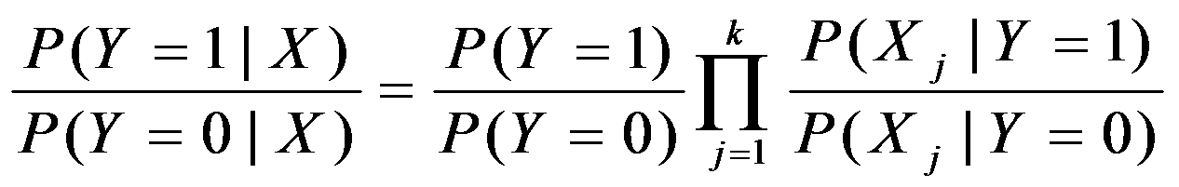
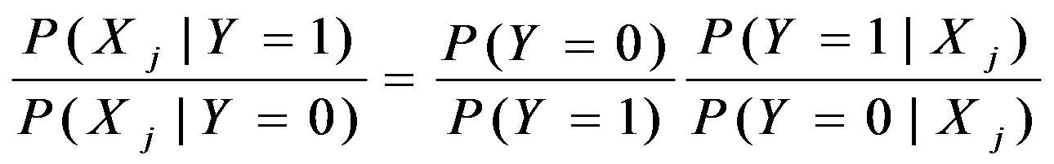
Training and Testing PLR
Prediction: Combine sub-models (NB Principle)
Class Distribution
Probability From LR

Slide 8
Outline
Introduction
The Model: Partitioned Logistic Regression
Analysis of Partitioned Logistic Regression
Application to Spam Filtering
Conclusion

Slide 9
Generative vs. Discriminative
Generative (NB) V.S. Discriminative (LR)
  Small number of labeled instances, NB can be etter !
    [Ng and Jordan 2002]
  Asymptotic Error (with enough examples)
    Err(LR) ≤ Err(NB)
  Number of training examples required to converge
    #Example(NB) ≤ #Example(LR)
Trade off between
  Approximation Error + Estimation Error
  NB might have a higher approximation error
    But might have a lower estimation error

Slide 10
PLR: A Hybrid Model
  Asymptotic Error (with enough examples)
  Err(LR ) ≤ Err(PLR) ≤ Err(NB)
  Number of training examples required to converge
  #Example(NB) ≤ #Example(PLR) ≤ #Example(LR)
Therefore, which algorithm is preferred?
  Depends on the task and the amount of training data
  In practice, PLR often outperforms LR and NB
    If we have good feature groups

Slide 11
Experiments on Synthetic Dataset
Draw artificial data from Gaussian distributions
  Control the co-variance of two feature groups
When feature groups are conditionally independent,
  PLR is better than LR!
When feature groups are not conditionally independent
  Small amount of labeled data, PLR is still better
  Large amount of labeled data, LR is better

Slide 12
Outline
Introduction
The Model: Partitioned Logistic Regression
Analysis of Partitioned Logistic Regression
Application to Spam Filtering
Conclusion

Slide 13
Fighting Spam with PLR
Spam filtering: just a text classification problem? NO!
  Relying on only email content is vulnerable
  [Lowd and Meek 2005]
  Need other types of information
    User information (Personalized Spam Filtering)
    Sender information (Reputation)
  Natural Feature Groups !
Adding all information into a single LR
  limited improvement (AUC_{fpr<=10%} 0.512 (content)-> 0.521 (all))
Our Solution : Partitioned Logistic Regression
  Three feature groups: User, Sender and content

Slide 14
Experimental Setting
Algorithms: NB, LR, PLR
All use the same features, labeled data
The smoothing parameter is selected using development set
Evaluation: ROC Curves
Dataset
  Hotmail Feedback Loop (Content, Sender, Receiver)
    Train: July t0 Nov, 2005, Test: Dec 2005
  TREC 05 & 06 (Content, Sender)

Slide 15
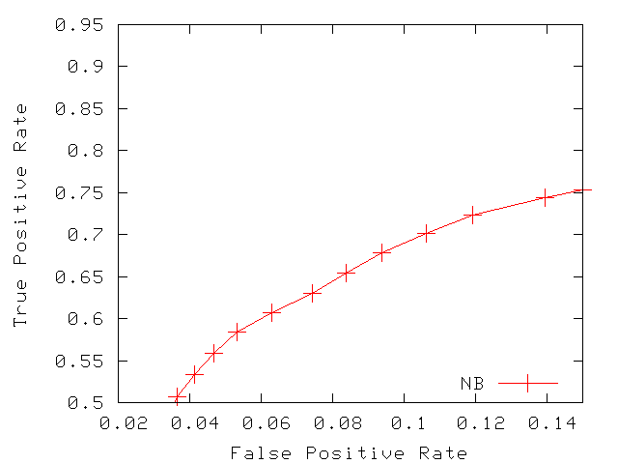
ROC Curves (Hotmail)
Larger AUC = Better

Slide 16
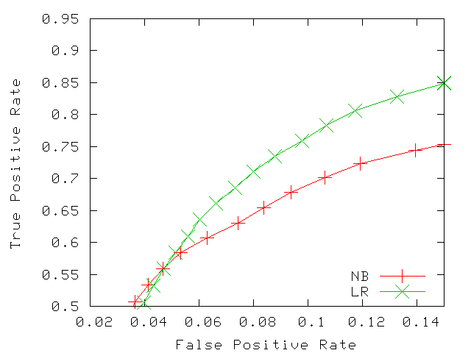
ROC Curves (Hotmail)

Slide 17
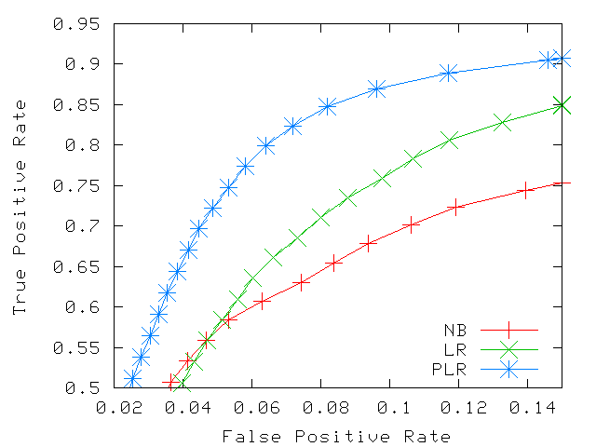
ROC Curves (Hotmail)

Slide 18
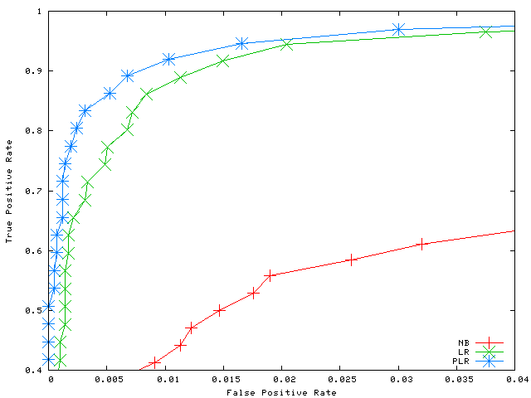
ROC Curves (TREC 06)

Slide 19
Related Works
Product of Experts [Hinton 1999]
Logarithmic opinion pool [Kahn et. al. 1998] [ Smith et. al. 2005]
Alternative NB/LR mixture model
  Learn a LR on top of NB [Rania et al. 2004]
Model Combination [Bennett 2006]
The view of conditional independence assumption is novel
Demonstrate the effectiveness of PLR in spam filtering

Slide 20
Conclusion
Machine learning perspective
  A novel mixture of discriminative and generative models
    Suitable for the applications with “natural feature groups”
Spam Filtering
  PLR integrates various information sources nicely
    Significantly better than LR and NB
Future Works
  Detecting good feature groups automatically
  Different methods of combining sub-models

