Slide 1


Unbiasing Network Path Measurements
Srikanth Kandula Ratul Mahajan

Slide 2
Current Internet Path Measurements
suffer from bias
Correct bias post facto

Slide 3
Property of Interest
latency
loss rate
capacity
To Estimate…
Mean
Xth percentile
Knee in distrib.
Sample Paths & Measure
Widely Used
characterize
optimize common case
evaluate ideas
Methodology
measure every path?...
only a few vantage points
pick whatever is available

Slide 4
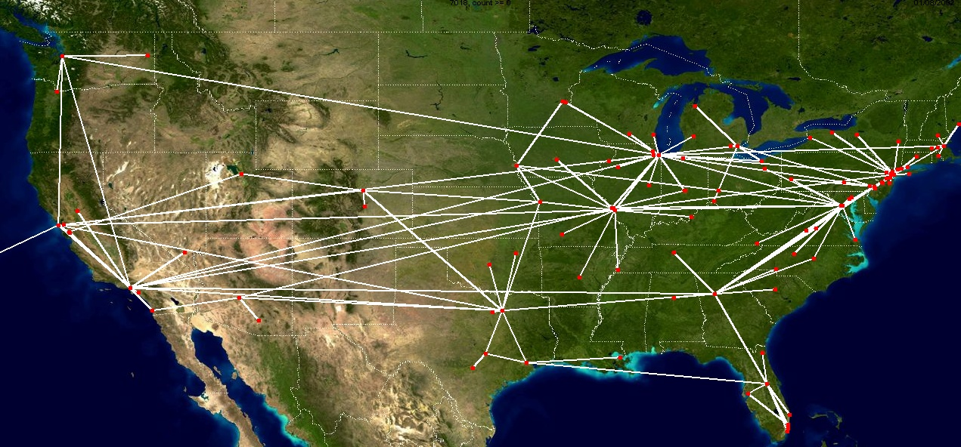
Q: What is the average path latency in AT&T’s backbone network?
circa 2001 from Rocketfuel
any vantage point contributes some bias
bias decreases as you use more vantage points
ad-hoc choices likely more biased than random

Slide 5
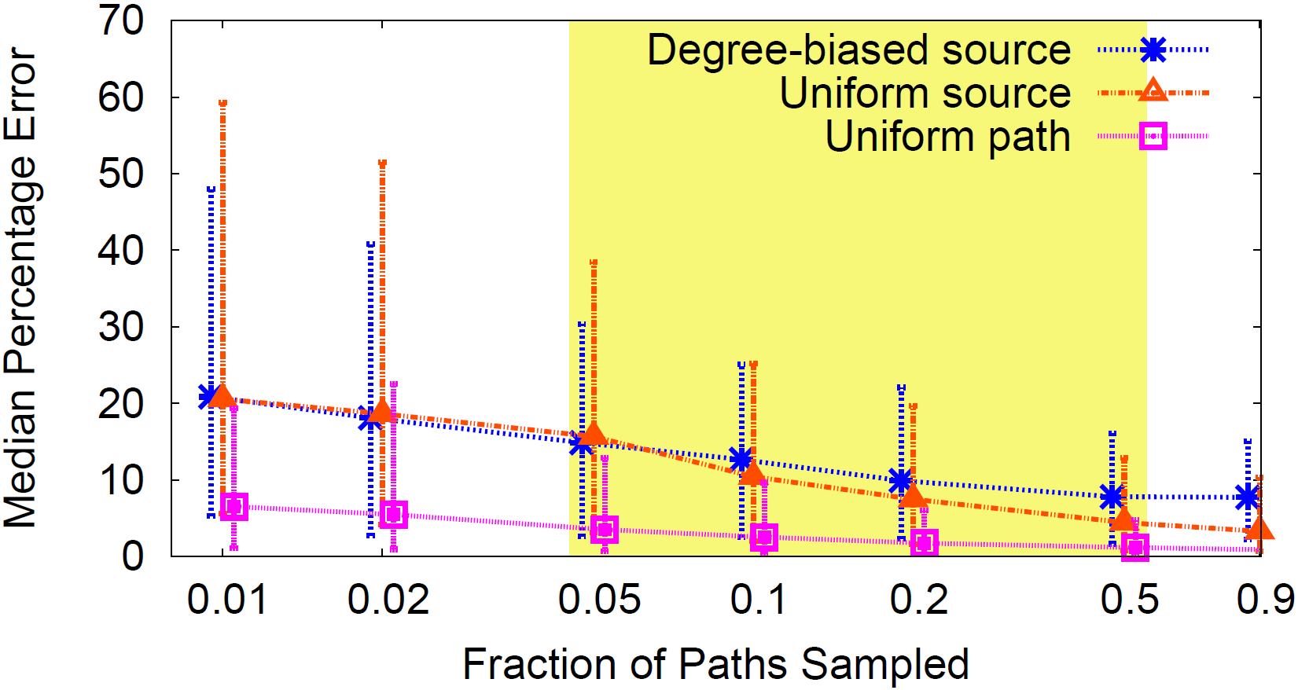
Error due to biased samples
To measure average path latency in the network.
Rocketfuel topologies of eight ISPs
Ideal + 2 biased sampling
Median error is 4x higher

Slide 6
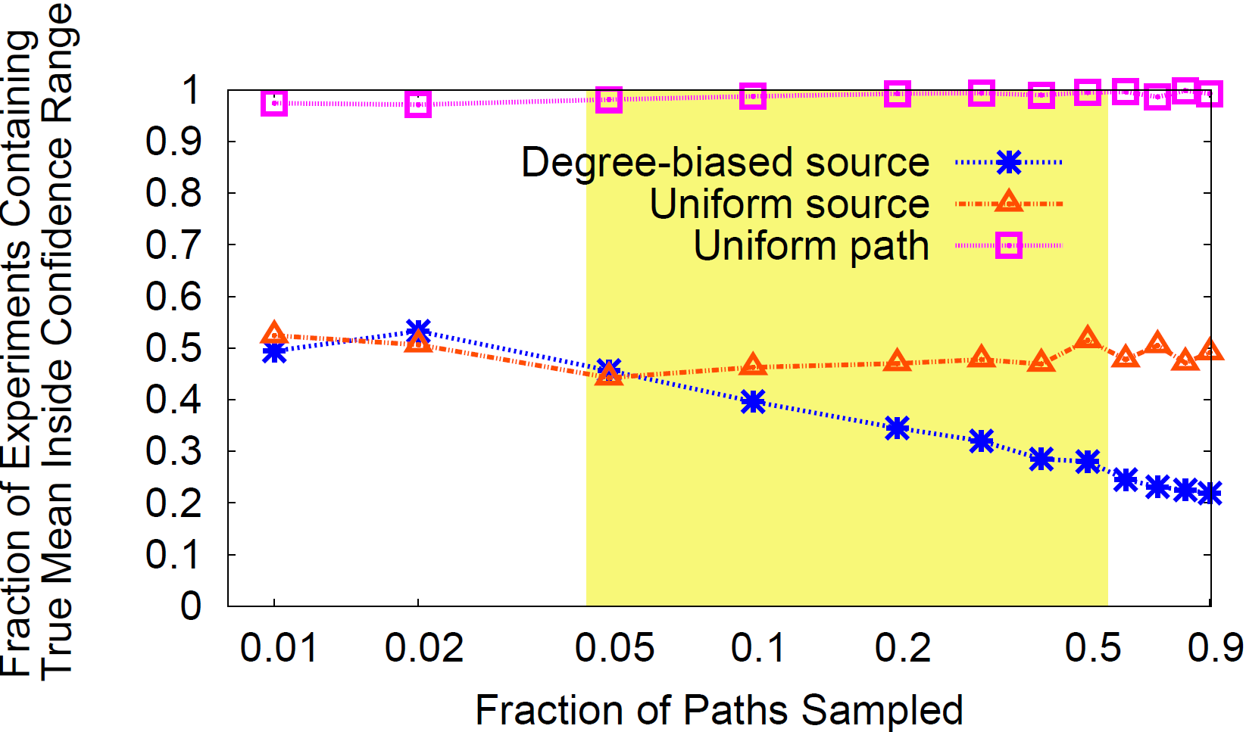
To err is ok, if one can estimate how much error…
99th percent confidence intervals using the student’s t-distribution

Slide 7
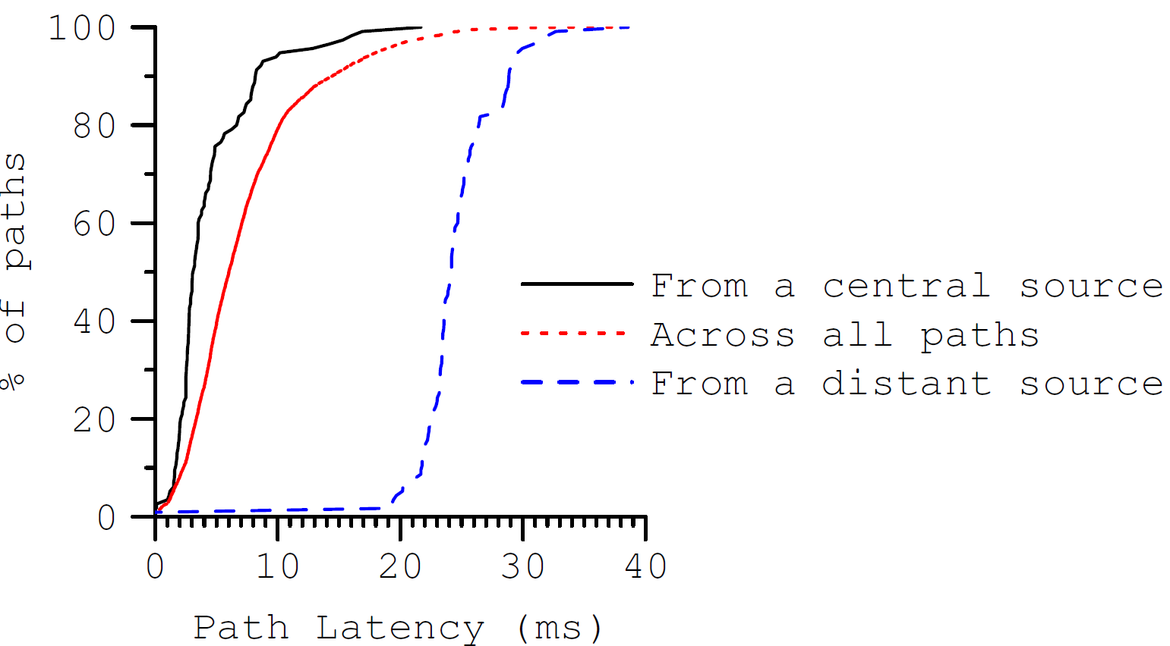
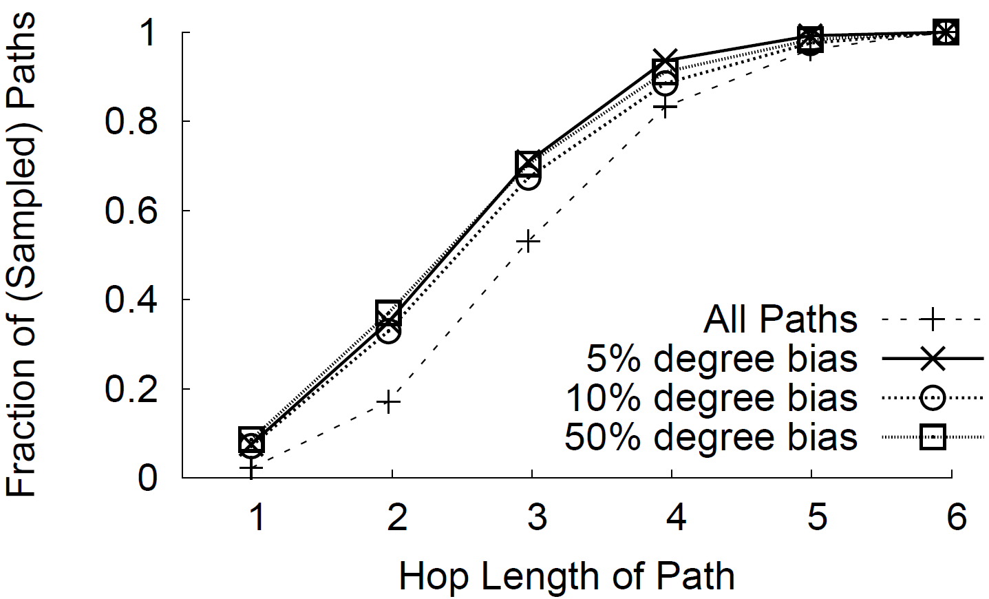
Why do biased samples hurt?
not representative
can’t tell what they missed
may systematically miss some types of paths

Slide 8

Goal: Correct for bias, post facto.
Property of Interest
latency
loss rate
capacity
To Estimate…
Mean
Xth percentile
Knee in distrib.
Sample Paths & Measure
Better estimate + Confidence Range

Slide 9
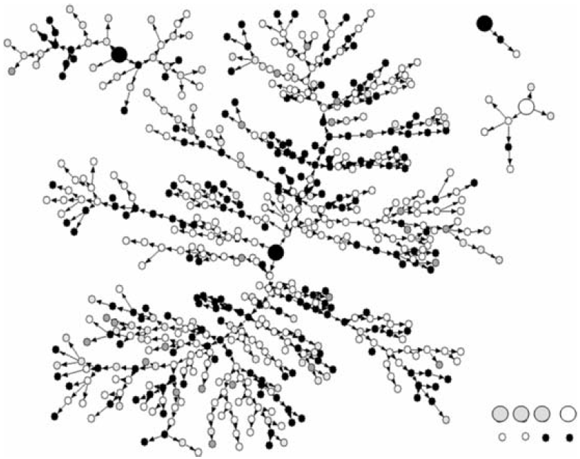
Bias Removal, Elsewhere
Remove impact due to source selection
Respondent driven sampling, D. Heckathorn et al. J Urban Health. 2006

Slide 10


Bias Removal, Elsewhere
Remove impact due to source selection
Re-weigh using properties of the system
3x
2x
Obama 2
McCain 1
Obama 1
McCain 1
Obama 55%
McCain 45%

Slide 11
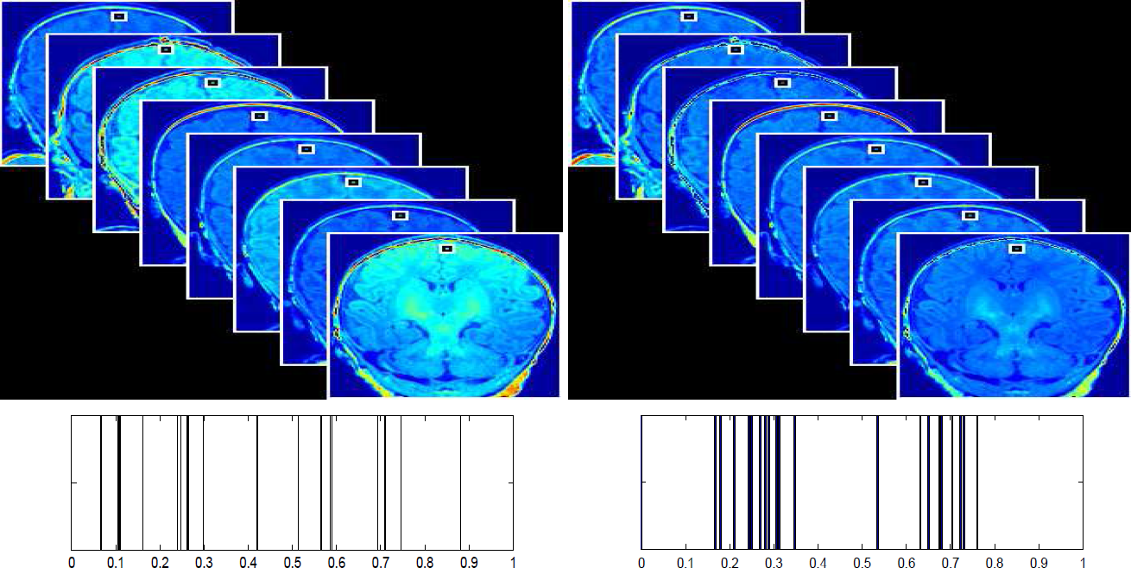
Bias Removal, Elsewhere
Remove impact due to source selection
Re-weigh using properties of the system
Compute source contribution
Miller and Jain. Information Processing in Medical Imaging. 2005

Slide 12
Bias Removal, Elsewhere
Remove impact due to source selection
Re-weigh using properties of the system
Compute source contribution
Details are domain specific, yet flavors translate.

Slide 13
(Bad) Idea 1: Only use the tail
Impact due to the source lessens as you go further away
Proposal:
Use the tail half of each path & extrapolate (as needed)
For this to work:
Expt. should have hop-by-hop breakdown
Sampled paths should have a representative # of hops
Helps, iff vantage points are chosen at random

Slide 14
Idea 2: Coordinate Embedding
x₂
x₁
Proposal:
Use measurements to embed in metric space
For unmeasured paths, use co-ordinates
How?
Pipe measurements into Vivaldi
For this to work:
Measured property must be embeddable in metric space
can unbias latency experiments
  robust to several sources of bias
  can estimate mean, percentiles, knees etc.

Slide 15
Idea 3: Path Decomposition
Path_{ij}= D_{i} ⊕ U[C_{r}] ⊕ D_{j}
Exploit hierarchical nature of Internet paths
Proposal:
Decompose into values of components along path
For unmeasured paths, stitch components
goal = approximate measurements
constraints = succinctness
How?
an optimization:
for several sources of bias, can fix latency, min(capacity) …
beyond mean, imprecise (i.e., for percentiles, knees…)

Slide 16
Further details
Estimating intervals of high confidence
Randomized
Co-ordinates,
Path Component Val.
Estimated Values for each path
Co-ordinates,
Path Component Val.
Estimated Values for each path
Mean,
Percentile,
Knee …
Measured
Paths
Estimated Values for each path
Estimated Values for each path
Path-wise Min
for low end
Path-wise Max
for high end

Slide 17
Results

Slide 18
Evaluation Setup
ISPs from Rocketfuel
Topologies
Metrics
  Relative Error
  Prob(true value within 99th conf. interval)
For measurements in the wild (from other work)
  compare reported measurements w. bias corrected
BRITE, 100 nodes
expo | heavy tailed degree distr.

Slide 19
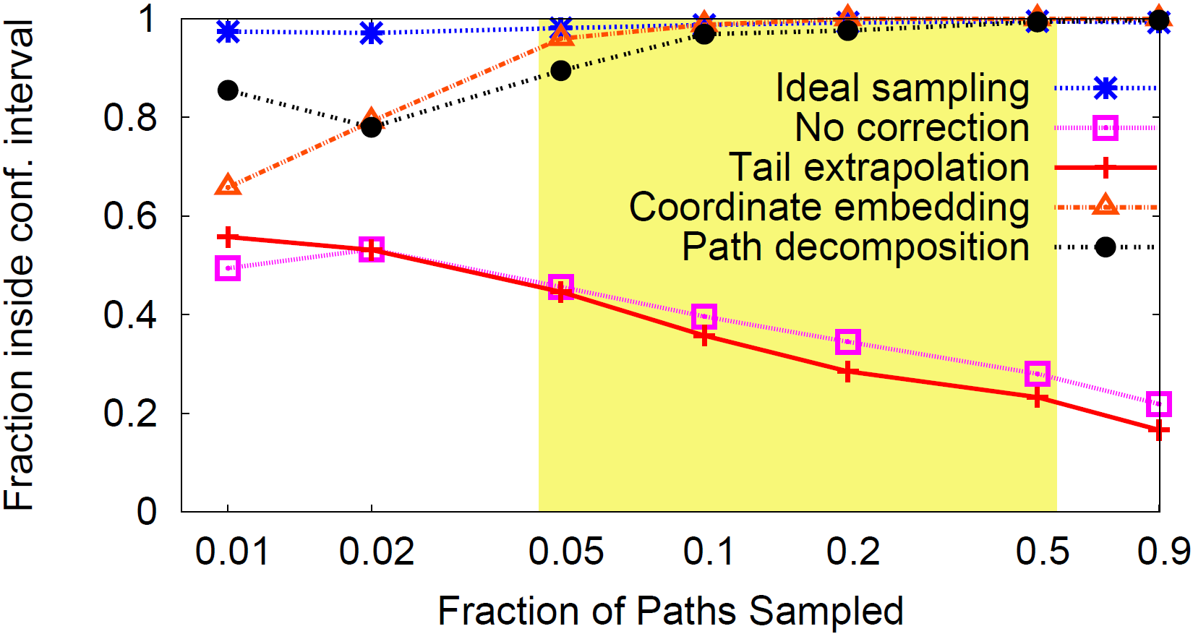
Estimating Latency, Degree Biased Sampling
Biased Samples + Broom ~ Ideal Sampling

Slide 20
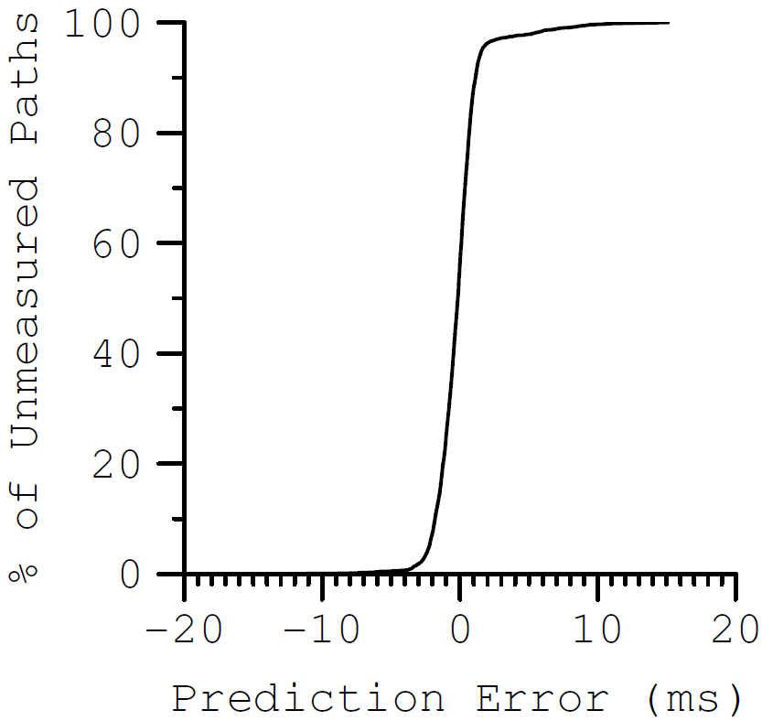
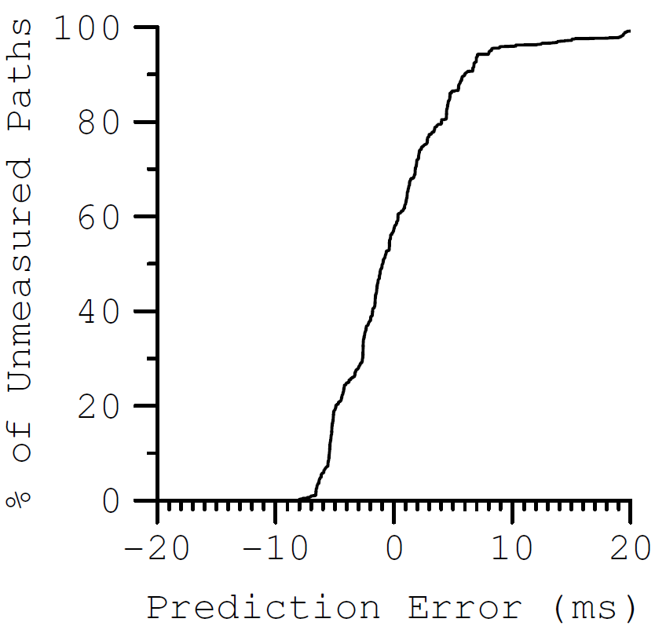
Why does Broom help?
Degree biased samples, 10% of all paths sampled, latency
Coordinate Embedding
Path Decomposition
By reasonably estimating unmeasured paths!

Slide 21
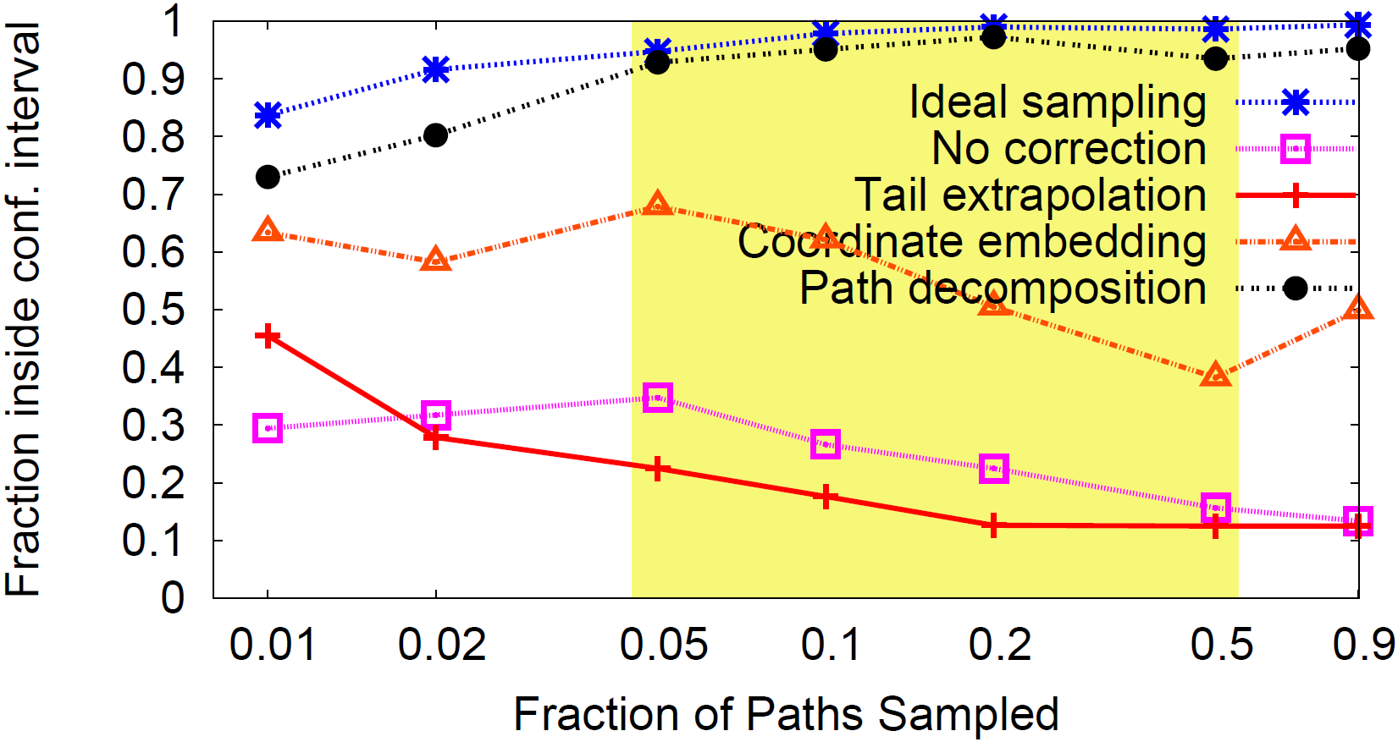
Estimating min(Capacity), Degree Bias
For non-embeddable metrics, path decomposition is better

Slide 22
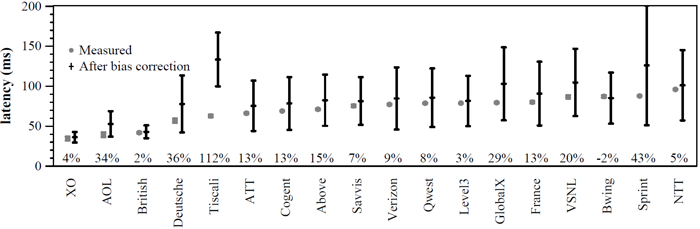
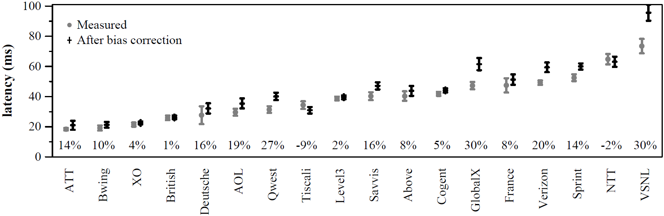
Reported Measurements vs. Bias Corrected
NetDiff: by probing from many vantage points,
  measure paths inside the ISP and ISP – destinations
  rank ISP performance (backbone, connectivity to a dest.)
ISP – Destination
ISP Internal Paths

Slide 23
Broom: A Toolkit to Unbias Network Path Measurements
biased sampling messes up measurements
  4x higher error than ideal
  99th confidence interval contains answer only ½ the time
first to present techniques that (post facto) correct biased internet path measurements
  approximates ideal sampling for a variety of cases
  stochastic imputation (ok estimates for un-sampled)

