Slide 1


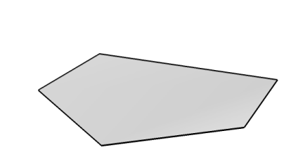
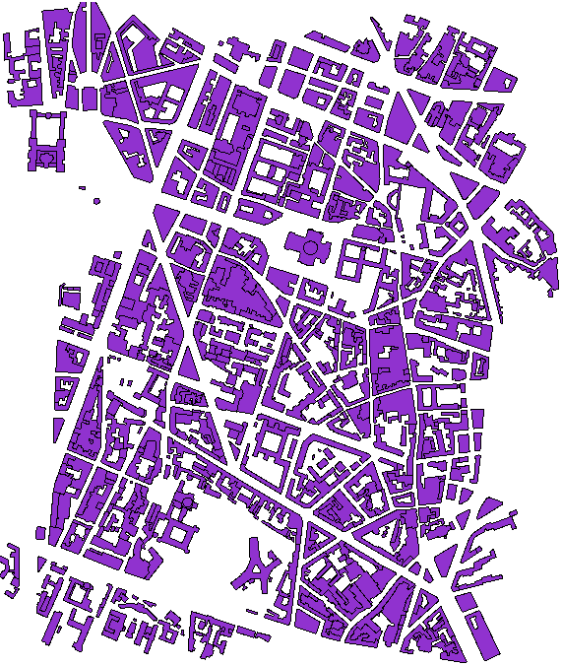
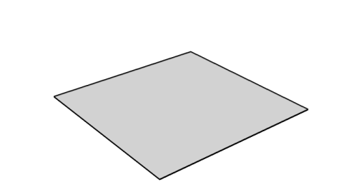
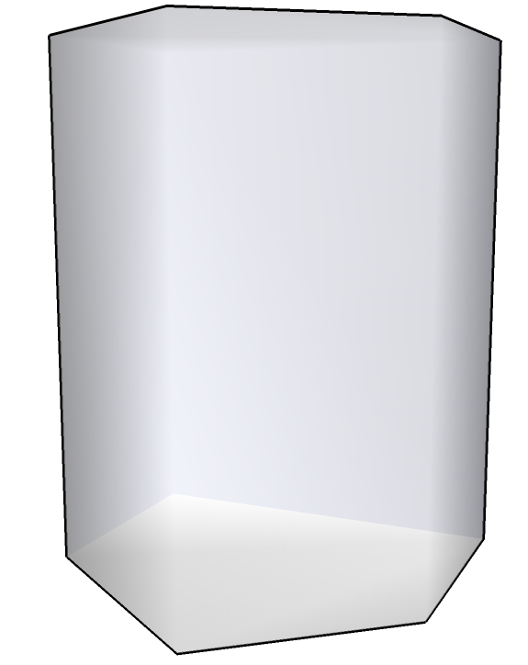
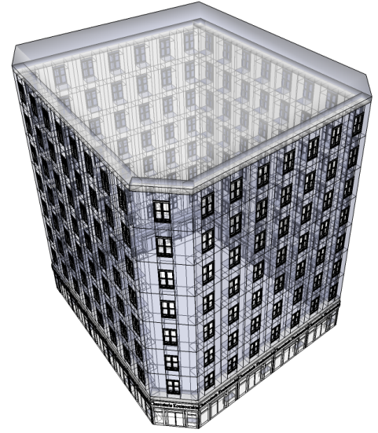
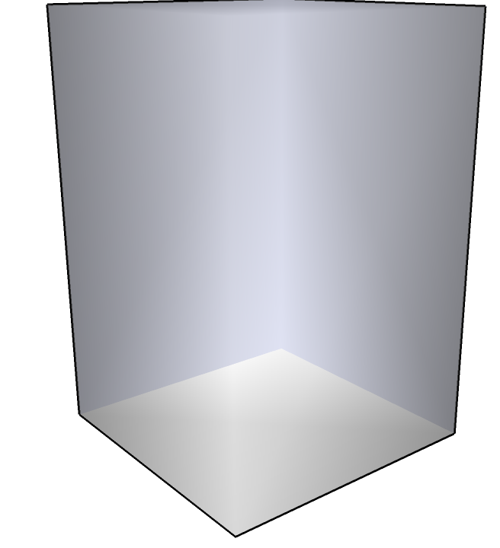
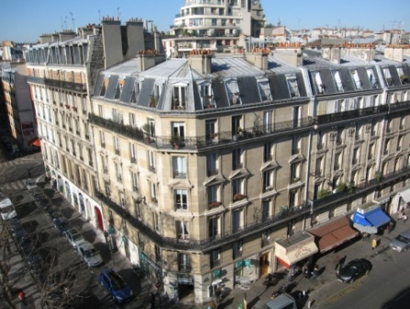
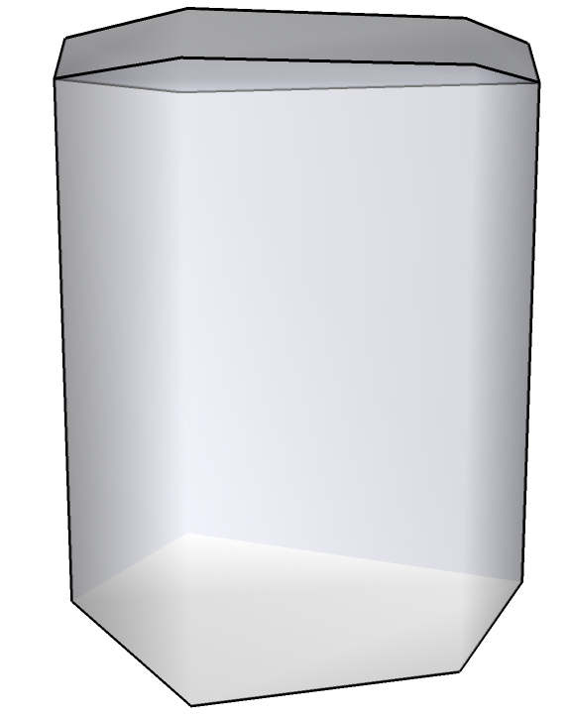
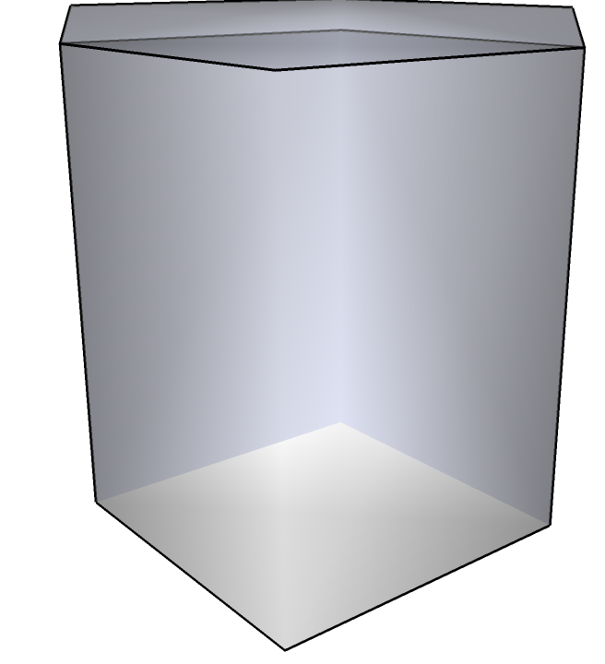
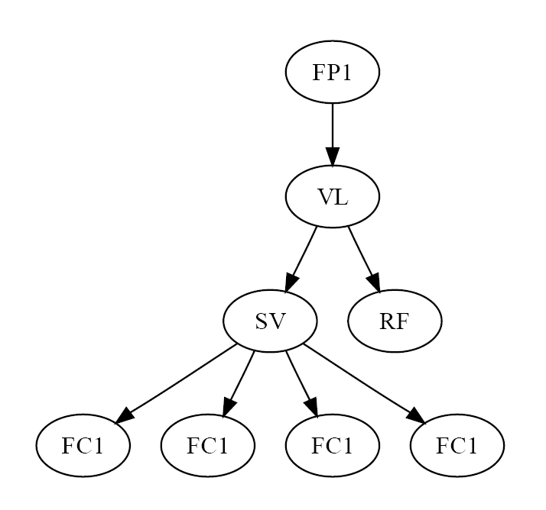
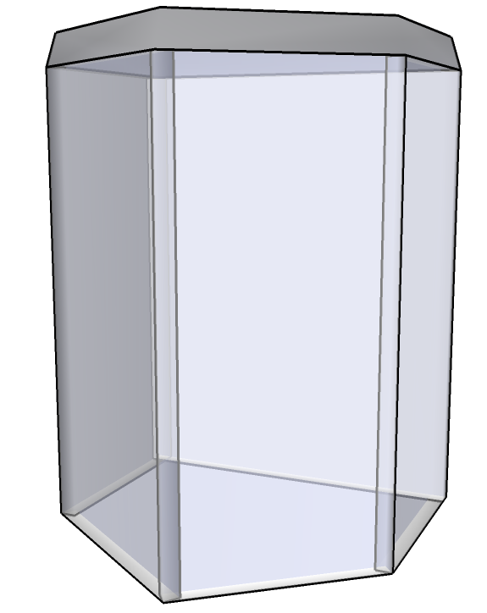
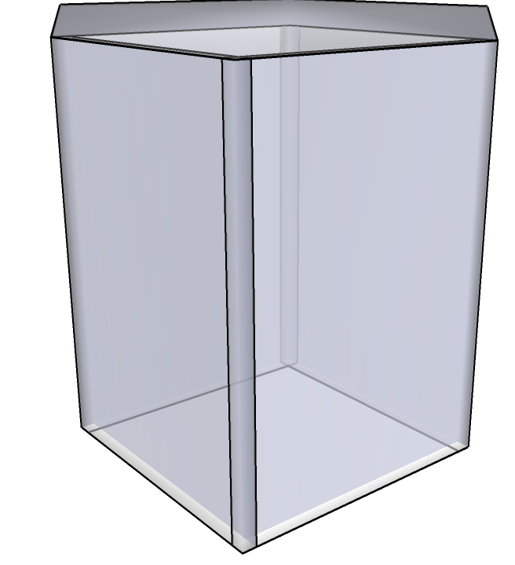
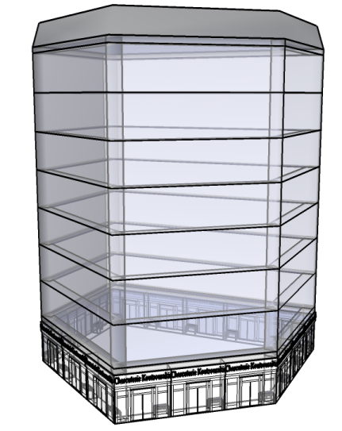
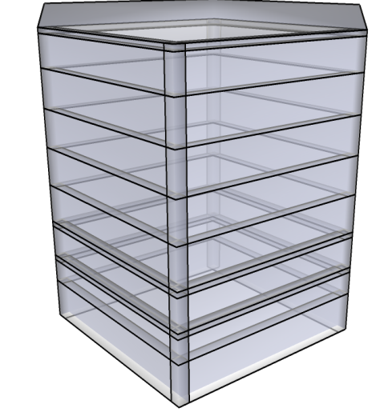
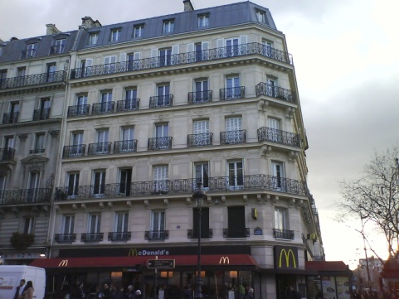
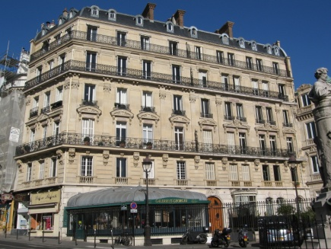
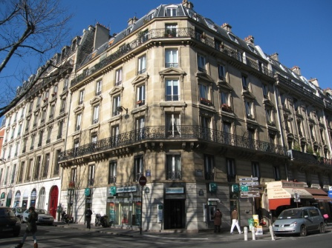
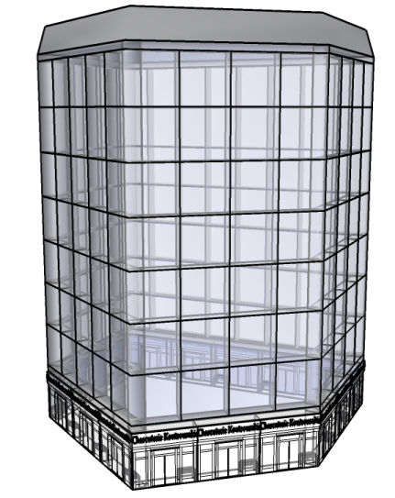
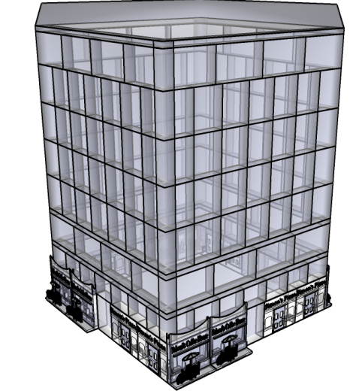
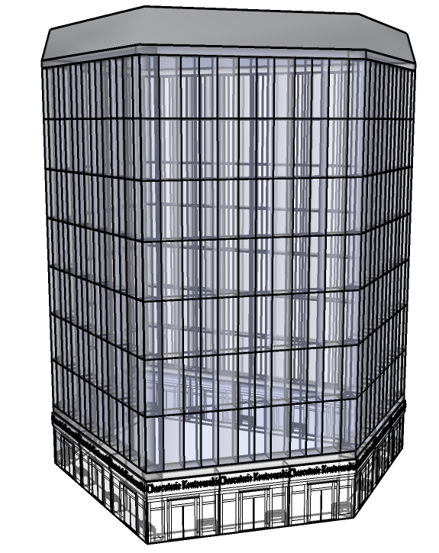
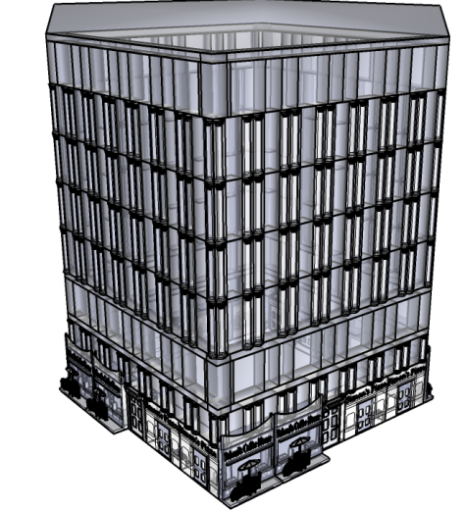
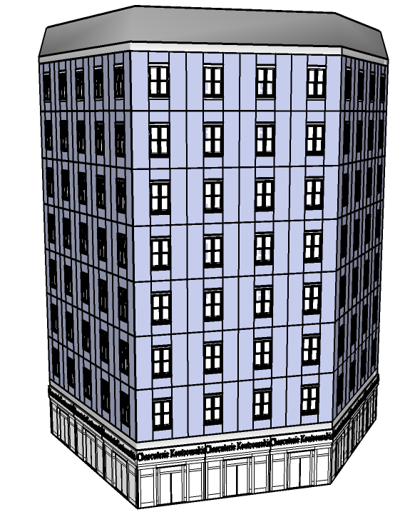
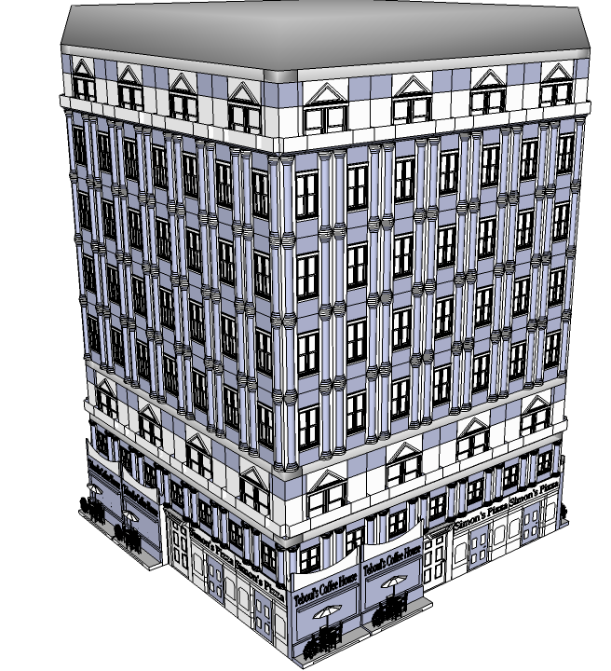
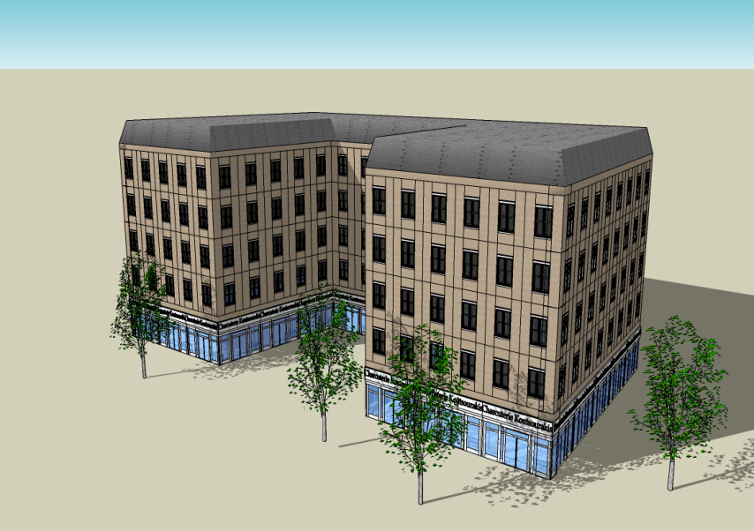
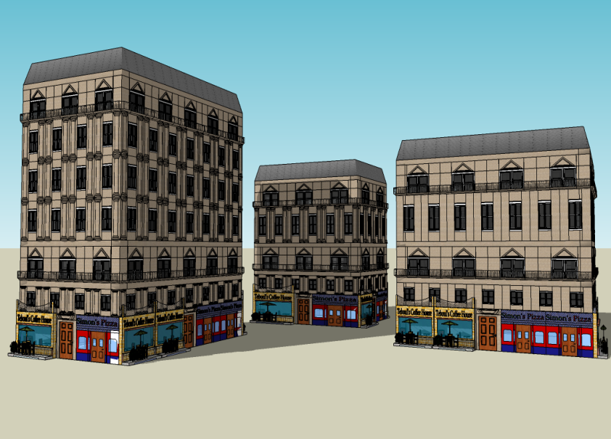
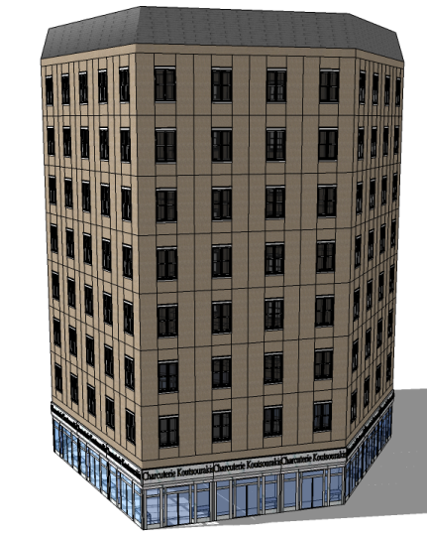
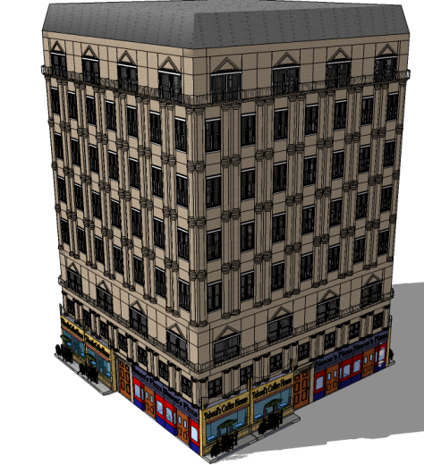
Shape Grammar and Image based
3D reconstruction of buildings
Olivier Teboul, Loic Simon, Panagiotis Koutsourakis, Nikos Paragios
Ecole Centrale Paris
Abstract
While very topical, creating 3D content is still very challenging. It's even more tedious when aiming at large scale contents like a whole city. In this work, we tackle grammar-based techniques [1] to generate efficiently large scale urban environment. We will propose a general framework adapted from the work of Muller & al [2,3] to cope with image-based reconstruction of Paris buildings. Although the optimization method will not be considered in details, some clues are given to understand why such techniques can efficiently represent complex geometry and may solve 3D reconstruction problems.
Problem
Knowing the footprint of a building and a single image of its façade, and having a model of the architectural style, am I able to reconstruct a 3D model of the observed building ?
Hint
Despite its apparent complexity, the geometry of buildings is highly structured and associated with strong semantics.
Cadastral
Map
?
Façade
picture
Shape Grammar
(Procedural Model)
Challenges
Find a proper representation of 3D geometry with the following properties :
spans a space of 3D models (buildings)
compact representation
highly flexible
semantic information
highly structured
In order to perform efficiently :
3D reconstruction of a building from a single 2D image
Large scale reconstruction of a whole city
Applications
Video Games
Cinema
Online 3D applications
Architecture design and prototyping
Research on Shape Grammars
Generic Definition : a shape grammar is a made of
An axiom shape
Basic shapes
Rules
Starting from the axiom a sequence of rules is applied to create a complex shape.
Contribution :
We record a shape as a tree made of basic shapes. Each node of the tree is associated to a scope which provides a local frame.
A rule adds children to a node, and defined their scopes. The defined rules comes from generic shape operators such as :
Split
Extrude (2D to 3D)
Facade (3D to 2D)
Current Results :
grammar based building generation
Implementation of a generic shape grammar for architecture
Architectural survey of different styles in Paris [3] + data acquisition, supervised by Eric Mathieu.
Implementation of a specific grammar for Haussmannian-like buildings
Future Work
Fully functional grammar (complex roofs, balconies,…)
Design a grammar for each studied architectural style from the 17th century to the early 20th century
Image-based reconstruction of a building, assuming that the camera is calibrated. This problem is to be formulated as a discrete optimization, involving machine learning as well as low and mid level computer vision.
Learning the grammar rules of an architectural style from images.
Bibliography :
[1] Introduction to shape and shape grammars.
G. Stiny, Environment and Planning, 1980
[2] Procedural Modeling of buildings, P. Müller, P. Wonka, S. Haegler, A. Ulmer, L. Van Gool, SIGGRAPH 2006
[3] Paris XIXème siècle, L’immeuble et la rue. François Loyer,
Edition Hazan, 1994

