Slide 1

Programming Principles and Tools Group
and
Security Group
Lightning Overview

Slide 2










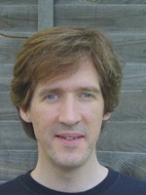

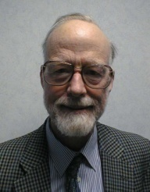



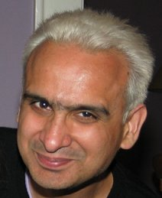




Programming Principles and Tools Group Security Group
Tuomas Aura | Mo Becker | Nick Benton | Josh Berdine | Karthik Bhargavan | Gavin Bierman | Luca Cardelli
Byron Cook | Cédric Fournet | Georges Gonthier | Andy Gordon | Tim Harris | Tony Hoare | Andrew Kennedy
James Margetson | Simon Marlow | Simon Peyton Jones | Mike Roe | Claudio Russo | Satnam Singh | Don Syme

Slide 3
What do we do? (1 of 3)
We develop new ideas for research conferences like:
  Programming Language Design and Implementation (PLDI)
  Principles of Programming Languages (POPL)
  International Conference on Functional Programming (ICFP)
  Object Oriented Programming, Systems, Languages and Applications (OOPSLA)
  Security & Privacy (Oakland)
  Computer Security Foundations (CSF)
  Theorem Proving in Higher Order Logics (TPHOLs)
  Computer Aided Verification (CAV)
  DNA Computing
  Field Programmable Gate Arrays (FPGA)
Some of this is purely theoretical, some of it is building programming systems,
some of it is a mixture
And often it is collaborations with researchers elsewhere

Slide 4
What do we do? (2 of 3)
We also get to work with product groups
  For example, DevDiv, SQL, Windows SDV, Excel
We consult on initial designs (eg security protocols, SecPAL)
We build prototype extensions of products (eg Cω -> LINQ)
We ship code in products (eg generics for C# and CLR)
Sometimes research projects turn into products (eg F#)

Slide 5
What do we do? (3 of 3)
We also serve the research and academic community
Programme committees and other reviewing
Invited talks and summer schools
Co-supervising graduate students
And we take research interns... Consider applying!
http://research.microsoft.com/en-us/groups/ppt/
http://research.microsoft.com/en-us/groups/security/

Slide 6
Principles and Applications of Refinement Types
Andrew D. Gordon (MSR)
Joint work with Gavin Bierman (MSR) and David Langworthy (MS Corp)
MSR Summer School, June 2009

Slide 7
A Type of Positive Numbers: Why Not?
fun MyFun (x:pos, y:pos): pos = if x>y then x-y else 42
Q: No currently popular or hip language has these – why not?
A: The typechecker would need to know
and computers don’t do arithmetic reasoning, do they?
This is an example refinement type
Known since the 1980s, but typechecking impractical, because automated reasoning is hard, inefficient, and unreliable
∀x. ∀y. x>y ⇒ x-y>0
Integer where value>0

Slide 8
Objectives
This lecture is a primer on refinement types
I’m assuming you know about types in standard languages like C, Java, C#, etc, but not that you’re a type theory geek
Why learn about refinement types?
What’s on offer in this lecture?
How do I find out more?
Q: How did the typechecker decide ?
A: It didn’t. It didn’t even try. It asked an SMT solver.
∀x. ∀y. x>y ⇒ x-y>0

Slide 9
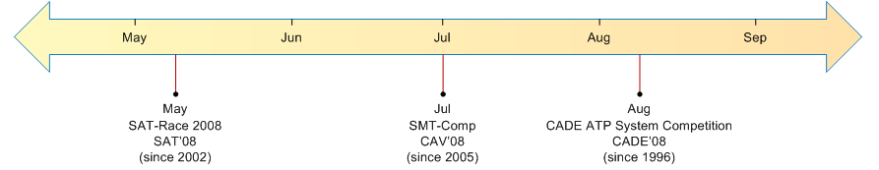
An Opportunity: Logic as a Platform
“Satisfiability Modulo Theory (SMT) solvers decide logical satisfiability (or dually, validity) with respect to a background theory expressed in classical first-order logic with equality. These theories include: real or integer arithmetic, and theories of program or hardware structures such as bitvectors, arrays, and recursive datatypes.”
Dramatic advances in theorem proving this decade
  Contenders include Simplify (HPL), Yices (SRI), Z3 (MSR)
  Annual competitions, standard formats for logical goals – a platform
http://research.microsoft.com/en-us/um/redmond/projects/z3/

Slide 10
Refinement types and M
How typechecking based on an external solver makes type-safe systems modeling practical, and helps extend the Microsoft platform

Slide 11

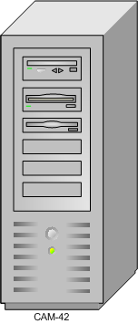
The Oslo Modeling Language
<?xml version="1.0" encoding="utf-8"?>
<policies xmlns="http://schemas.microsoft.com/wse/2005/06/policy">
<policy name="policy-CAM-42">
<mutualCertificate10Security
establishSecurityContext="false"
messageProtectionOrder="EncryptBeforeSign">
</mutualCertificate10Security>
</policy>
</policies>
MyApp.exe.config
MyApp.exe
Server stacks (eg .NET) allow post-deployment configuration
  But as server farms scale, manual configuration becomes problematic
  Better to drive server configurations from a central repository
M is a new modeling language for such configuration data
  Ad hoc modeling languages remarkably successful in Unix/Linux world
  M is in development (first CTP at PDC’08, most recent May 2009)
  Next, Oslo in their own words...
http://msdn.microsoft.com/oslo

Slide 12
The Core of the M Language
A value may be a general value (integer, text, boolean, null)
Or a collection (an unordered list of values),
Or an entity (a finite map from string labels to values)
The expression
has the type
and evaluates to
Semantic domain of values (in F# syntax)
( from n in { 5, 4, 0, 9, 6, 7, 10}
where n < 5
select {Num=>n, Flag=>(n>0)} )
{Num:Integer; Flag:Logical;}*
{{Num=>4,Flag=>true},
{Num=>0, Flag=>false}}
type General = G_Integer of int | G_Logical of bool | G_Text of string | G_Null
type Value = G of General | C of Value list | E of (string * Value) list

Slide 13
Interdependent Types and Expressions
T where e
A refinement type T where e consists of the values of type T such that boolean expression e holds
A typecase expression e in T returns a boolean to indicate whether the value of e belongs to type T
  returns true (due to subtyping)
A type ascription e : T requires that e have type T
  Verify statically if possible
  Compile to if necessary
e in T
{x=>1, y=>2} in {x:Any;}
e : T
(e in T) ? e : throw "type error"

Slide 14
Some Examples in M
Example: type-safe unions
Demo: comparison of M/MiniM
Case study: how static typing may help Dynamic IT

Slide 15
Some Derived Types
Empty ≡ Any where false
Empty type
Singleton type
Null type
Union type
Nullable type
{e} ≡ Any where value==e
Null ≡ {null}
T | U ≡ Any where
(value in T || value in U)
Nullable T ≡ T | {null}

Slide 16
Example: Type-Safe Union Types
Given source
our typechecker calls the solver as follows:
type NullableInt : Integer | {null}
from x in ({1, null, 42, null } : NullableInt*)
where x!=null
select (x:Integer)
(x!=null), x:NullableInt |- x in Integer
===
Asked Z3:
(BG_PUSH (FORALL (x) (IFF ($NullableInt x) (OR (In_Integer x) (EQ x (v_null))))))
(IMPLIES (AND (NOT (EQ $x (v_null))) ($NullableInt $x)) (In_Integer $x))
Z3 said : True

Slide 17
Interlude: Implementation Notes
Expressions typed by “bidirectional rules” as in eg C#
  But no constraint inference
Subtyping decided semantically, by external solver
  Term T(e) for each expression e, formula F(T)(x) for each type T
  Subtyping is implication:
F( [42] )(x) = (x=42)
F( Integer where value < 100 )(x) = (x<100)
T <: U iff ∀x. F(T)(x) ⇒ F(U)(x)
[42] <: (Integer where value < 100) iff ∀x. (x=42) ⇒ (x<100)

Slide 18
DemO
module M {
F() : Integer32 where value == 2 { 3 }
}
module TaggedUnions
{
type T1 : {tag: {42}; bar: Integer32;};
type T2 : {tag: {43}; foo: Text;};
type U : T1 | T2;
// this fails to typecheck, because it makes insufficient checks
// Test1(xs:U*) : Text* { from x in xs select x.foo }
Test2(xs : U*) : Text*
{
from x in xs select ( x.tag==42 ? "Hello" : x.foo )
}
Test3(xs : U*) : Text*
{
from x in xs where (x.tag==43) select x.foo
}
}
module MinimTests
{
type Operator : Text where
value=="plus" || value=="minus" ||
value=="times" || value=="div";
type Expression :
{kind:{"variable"}; name: Text;} |
{kind:{"integer"}; val: Integer32;} |
{kind:{"binary app"}; operator: Operator;arg1: Expression; arg2: Expression;};
type Statement :
{kind:{"assignment"}; var: Text; rhs: Expression;} |
{kind:{"while"}; test:Expression; body:Statement;} |
{kind:{"if"}; test:Expression; tt:Statement; ff:Statement;} |
{kind:{"seq"}; s1:Statement; s2:Statement;} |
{kind:{"skip"};};
FirstExp(E:Expression) : Text
{
(E.kind=="variable") ? E.name : (
(E.kind=="integer") ? "integer" :
E.operator)
}
FirstStatement(S:Statement) : Expression
{
(S.kind=="assignment") ? S.rhs : (
(S.kind=="while" || S.kind=="if") ? S.test :
{kind=>"integer", val=>42})
}
//Test(S:Statement) : Expression { S.rhs } // this correctly fails to typecheck
}
module Constraints
{
type Person : { Name:Text; Age:Integer32; };
type EligiblePerson : Person where value.Age > 17;
type Marriage : { SpouseA: EligiblePerson; SpouseB: EligiblePerson; };
PatChris(): Marriage
{
{SpouseA => {Name => "Pat", Age => 24},
SpouseB => {Name => "Chris", Age => 32}}
}
BillySam(): Marriage
{
{SpouseA => {Name => "Billy", Age => 4},
SpouseB => {Name => "Sam", Age => 5}}
}
}
//typeful
module Points
{
type Nat : Integer32 where value==0 || value>0;
type Byte : Nat where value<256;
type Color : {Red:Byte; Green:Byte; Blue:Byte;};
type Point : {X: Integer32; Y:Integer32;};
type ColorPoint : Point & {Color:Color;};
type Points : Point*;
type ColorPoints : ColorPoint*;
f(x:Point) : ColorPoint { x }
}
Comparing the MiniM typechecker with the May CTP M typechecker;
MiniM focuses on types, lacks significant features like extents

Slide 19
Better Dynamic IT by Typing
MyApp.exe.config
Many systems errors arise from misconfigurations
  Formats often too flexible; operators make mistakes
Numerous ad hoc tools advise on config “safety”
  Find misconfigurations in firewalls, routers, protocol stacks, etc; check that adequate security patches have been applied
  Tools package specialist expertise; more accessible than best practice papers; easy to update as new issues arise
M is a general purpose platform for systems modeling
  User-defined types can express advisories, subsuming ad hoc tools
  Let’s look at a concrete example: WSE Policy Advisor
MyApp.exe

Slide 20
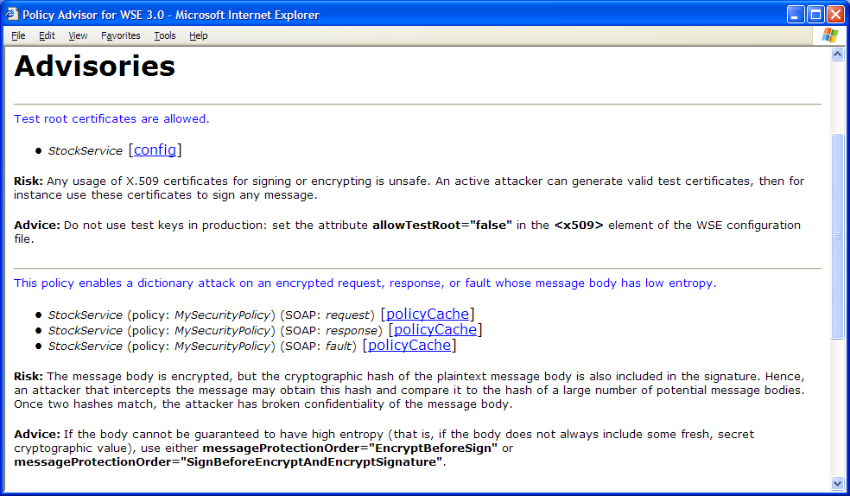
A Typical Config-Based Advisor
Web Services Enhancements (WSE) endpoint configuration, rendered by Policy Advisor XSLT style sheet in Internet Explorer
Risks and advice for an endpoint policy & config

Slide 21
1: Representing XML Data
<?xml version="1.0" encoding="utf-8"?>
<policies xmlns="http://schemas.microsoft.com/wse/2005/06/policy">
<policy name="policy-CAM-42">
<mutualCertificate10Security
establishSecurityContext="false"
messageProtectionOrder="EncryptBeforeSign">
</mutualCertificate10Security>
</policy>
</policies>
{tag="policies",
xmlns="http://schemas.microsoft.com/wse/2005/06/policy",
body={{tag=>"policy",
name=>"policy-CAM-42",
body={{tag=>"mutualCertificate10Security",
establishSecurityContext=>"false",
messageProtectionOrder=>"EncryptBeforeSign" }}}}}

Slide 22
2: Types for Schema-Correct Configs
type bool : {"true"} | {"false"};
type messageProtectionOrder : {"EncryptBeforeSign"}|{"SignBeforeEncrypt"};
type mutualCertificate10Security :
{tag:{"mutualCertificate10Security"};
establishSecurityContext:bool;
messageProtectionOrder:messageProtectionOrder; } ;
Policy = mutualCertificate10Security | ...
Config = {tag:{"policies"}; body:{tag:{"policy"}; body:Policy*; }*; } ;
<?xml version="1.0" encoding="utf-8"?>
<policies xmlns="http://schemas.microsoft.com/wse/2005/06/policy">
<policy name="policy-CAM-42">
<mutualCertificate10Security
establishSecurityContext="false"
messageProtectionOrder="EncryptBeforeSign">
</mutualCertificate10Security>
</policy>
</policies>
has type Config

Slide 23
3: Types for Safe Configs
type q_credit_taking_attack_10 :
(mutualCertificate10Security
where value.messageProtectionOrder == "EncryptBeforeSign") ;
type Advisory = q_credit_taking_attack_10 | ...
type SafePolicy : Policy & (!Advisory)
type SafeConfig : {tag:{"policies"}; body:{tag:{"policy"}; body:SafePolicy*; }*; } ;
<?xml version="1.0" encoding="utf-8"?>
<policies xmlns="http://schemas.microsoft.com/wse/2005/06/policy">
<policy name="policy-CAM-42">
<mutualCertificate10Security
establishSecurityContext="false"
messageProtectionOrder="EncryptBeforeSign">
</mutualCertificate10Security>
</policy>
</policies>
has type Config
but not type SafeConfig

Slide 24
Related Work
 |  |  | Refinement | Typecase | Subtyping
1983 | Nordström/Petersson | Subset types | {x:A | B(x)} | no | no
1986 | Rushby/Owre/Shankar | Predicate subtyping | predicate subtype | no | limited
1989 | Cardelli et al | Modula-3 Report | no | on references | structural
1991 | Pfenning/Freeman | Refinement types | refined sorts | no | no
1993 | Aiken and Wimmers | Type inclusion... | no | no | semantic
1999 | Pfenning/Xi | DML | {x: General | e} | no | no
1999 | Buneman/Pierce | Unions for SSD | no | yes, as pattern | structural
2000 | Hosoya/Pierce | XDuce | no | yes, as pattern | semantic, ad hoc
2006 | Flanagan et al | SAGE | {x: T | e} | no (but has cast) | structural, SMT
2006 | Fisher et al | PADS | {x:T | e} | no | structural
2007 | Frisch/Castagna | CDuce | no | e in T | semantic, ad hoc
2007 | Sozeau | Russell | {x:T | e} | no | structural
2008 | Bhargavan/Fournet/G | F7/RCF | {x: T | C} (formula C) | no | structural, SMT
2008 | Rondon/Jhala | Liquid Types | {x: General | e} | no | structural, SMT
2009 | Bierman/G/Langworthy | M/MiniM | {x: T | e} | e in T | semantic, SMT

Slide 25
Refinement Types and M
The interdependence between typecase expressions and refinement types in M is a novel source of great expressivity
Relying on an external solver achieves type safety for union and dependent types without complex, arbitrary rules
Security and error checking expressible within M type system
  Helps M extend the Microsoft platform
Our Z3-based typechecker Minim was jointly developed with the Oslo team in parallel with the mainline typechecker
  We hope to merge the code-bases this year

Slide 26
Refinement types and F7
Applying refinement types to the verification of cryptographic protocols and APIs

Slide 27
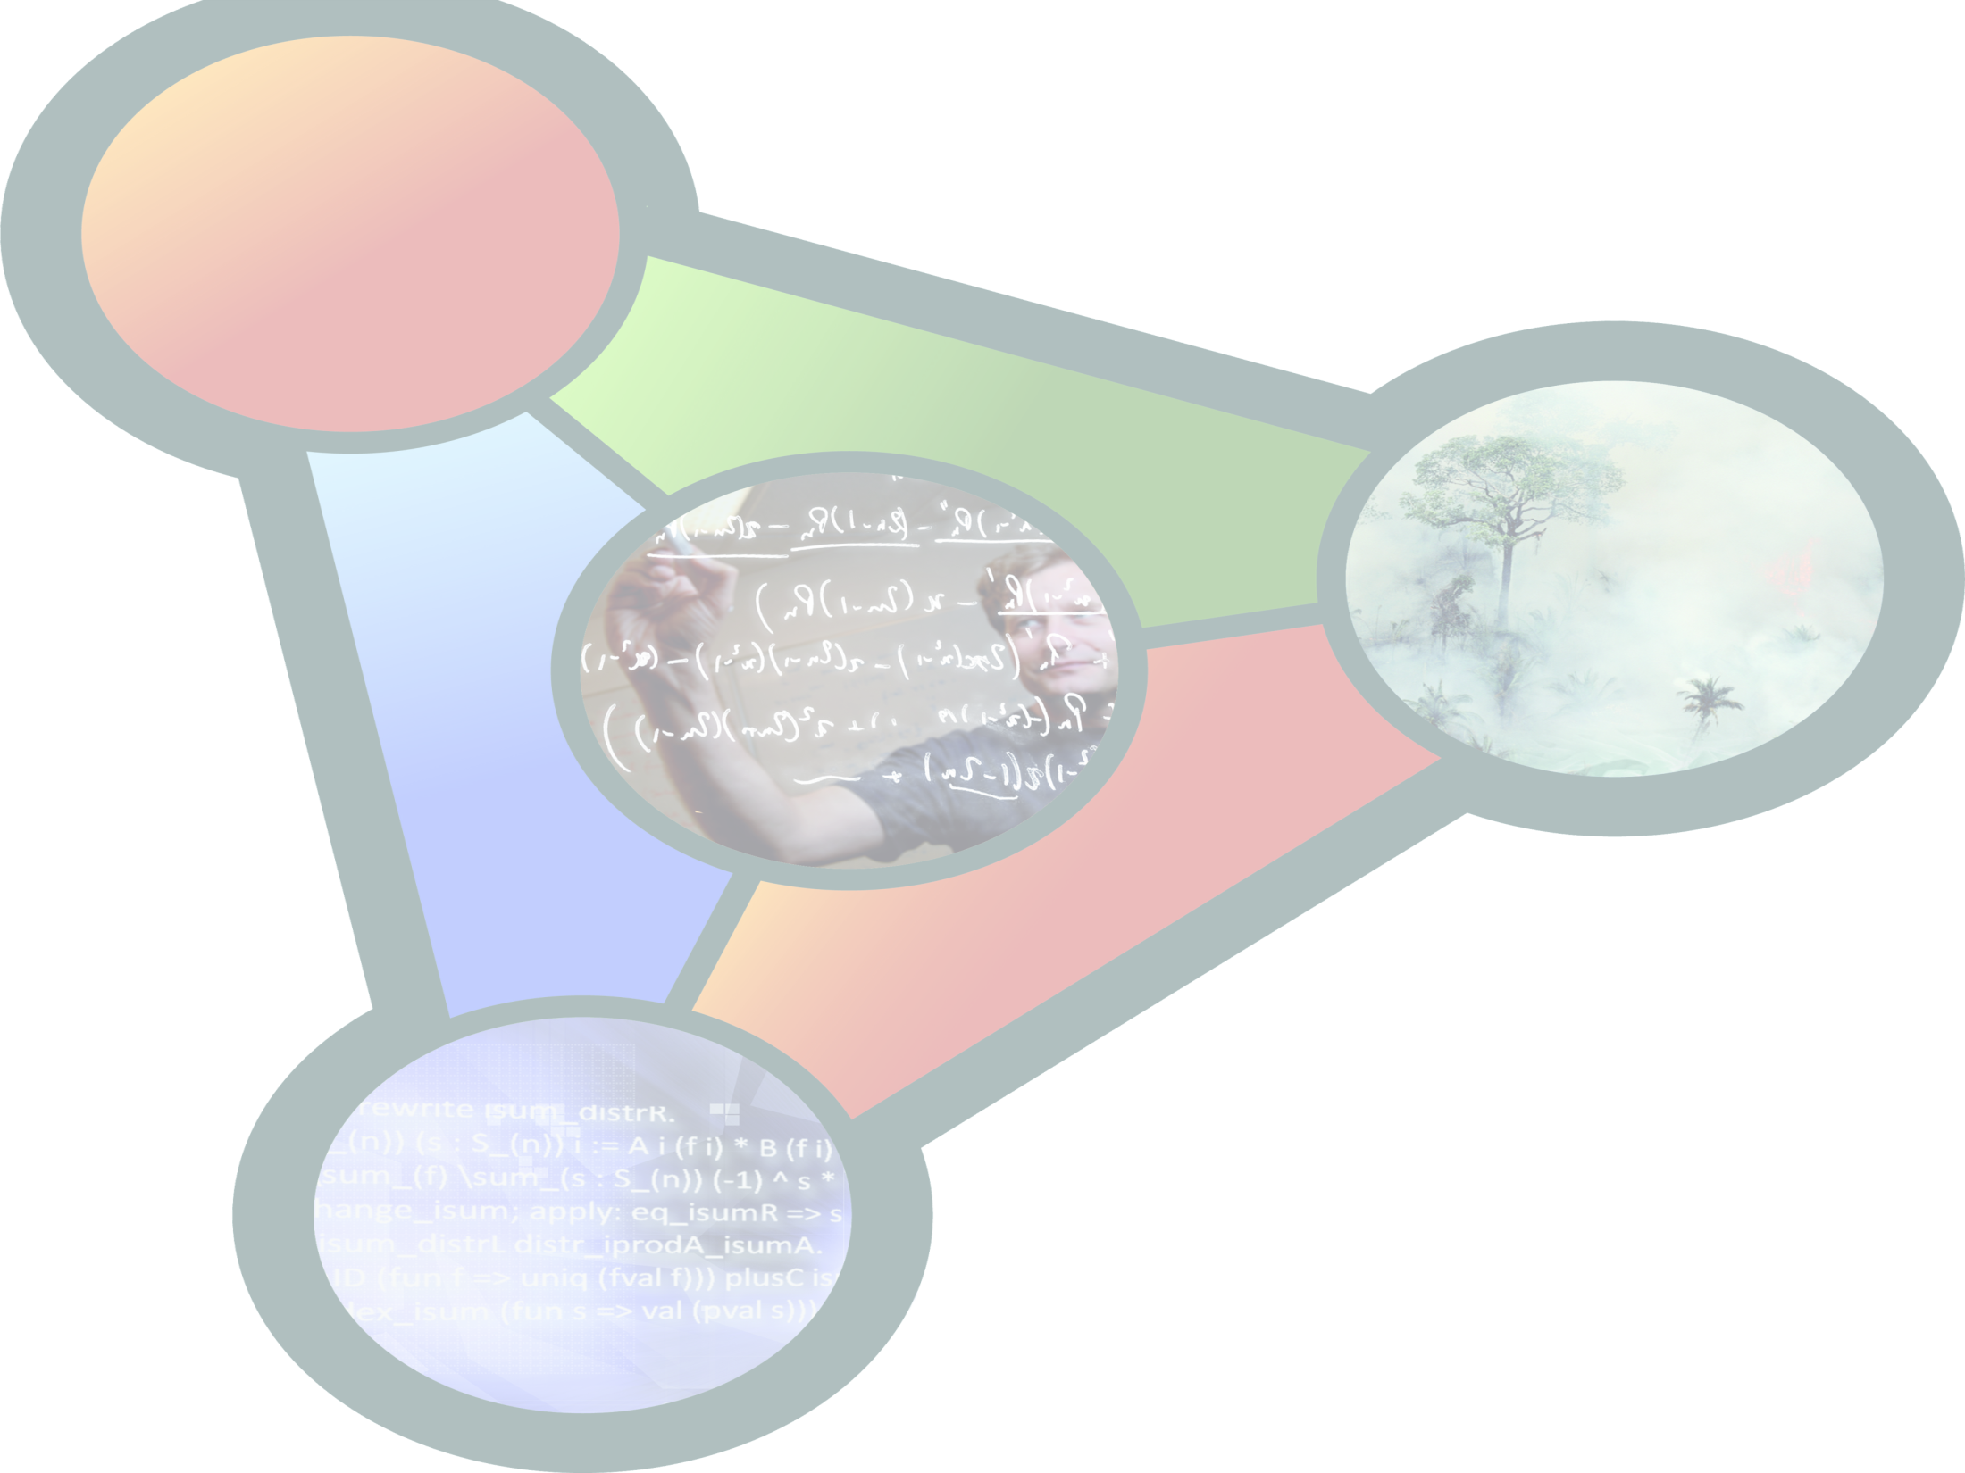
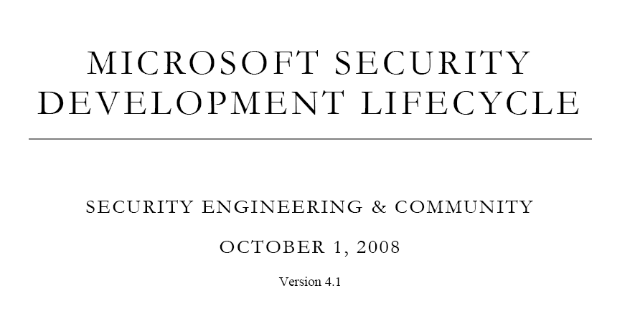
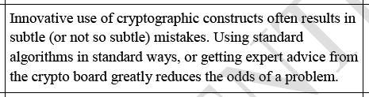
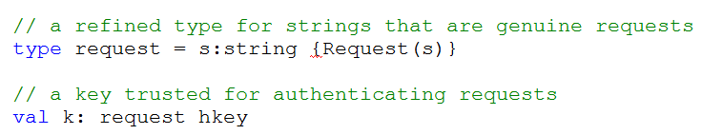
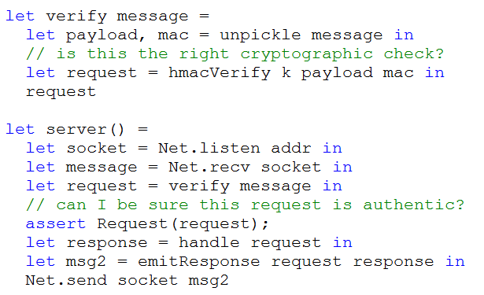

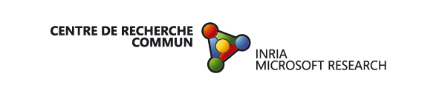
Crypto Verification Kit
Cryptographic Verification Kit
Our goal is a toolkit to verify reference implementations of standardized and custom cryptographic protocols
Application
Case Studies
WS-Security
1750 lines
fs2pv [MSRC’06]
CardSpace
1420 lines
fs2pv [MSRC’08]
TLS 1.0
2940 lines
fs2pv, fs2cv
[MSR-INRIA’08]
Multi-party
Sessions
2180 lines
f7 [MSR-INRIA’08]
Typed Interface
Protocol
Typed Interface
Crypto Library
Computational Crypto
Symbolic Crypto
Network Library
Poly-time Adversary
Active Adversary
Verification Tools for F#
Statically verify
security assertions
Different techniques,
cryptographic models
fsc
fs2cv
fs2pv
f7
Concrete runs
and interop tests
over .NET Runtime
Computational
crypto proof
using CryptoVerif
Symbolic proof
or attack trace
using ProVerif
Symbolic proof
by typing
using Z3
K Bhargavan, C Fournet, AD Gordon (MSR Cambridge), R Corin, P-M Deniélou, JJ Leifer, E Zalinescu (MSR-INRIA)

Slide 28
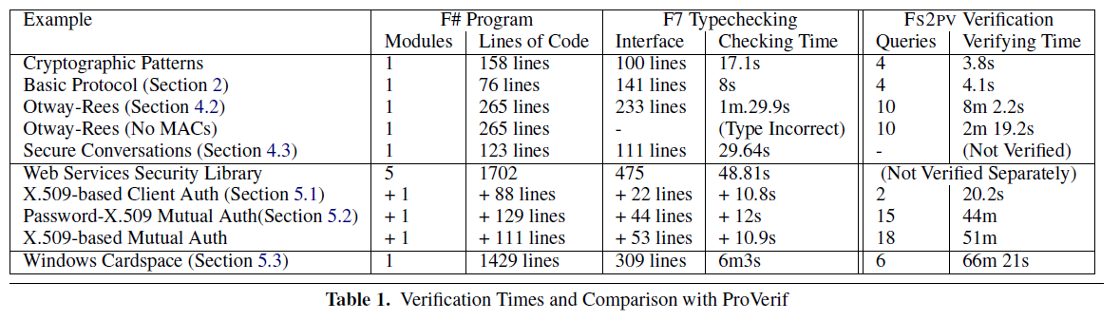
F7: Refinements for Security
Check out our site http://research.microsoft.com/cvk

Slide 29
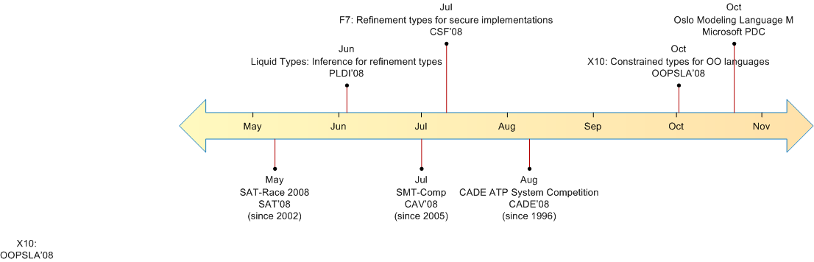
A Good Year for Refinements
Access control,
crypto protocols
Systems models
OO refinements, array bounds
Automatic inference for refinement types
Platform

Slide 30
Ideas to Take Away
Remember the riddle
  Q: How did the typechecker decide ?
  A: It didn’t. It didn’t even try. It asked an SMT solver.
Remember that boundaries are blurring
  Between types, predicates, policies, patterns, schemas
  Between typechecking and verification
Still, SMT solvers are incomplete, often amazingly so
  So dealing with typing errors remains a challenge
∀x. ∀y. x>y ⇒ x-y>0
http://research.microsoft.com/en-us/people/adg/part.aspx

Slide 31
Resources
The Microsoft Research SMT solver, Z3
http://research.microsoft.com/en-us/um/redmond/projects/z3/
Oslo and its modeling language, M
http://msdn.microsoft.com/oslo
Refinement types for security in F#
http://research.microsoft.com/f7
Liquid types (including online demo)
http://pho.ucsd.edu/liquid/
This lecture
http://research.microsoft.com/en-us/people/adg/part.aspx

Slide 32
The End

