Slide 1
IP Legal Training
July 2, 2009
John Mulgrew (jmulgrew)
+44 787 540 4481

Slide 2
Today’s Goals
Learn and refresh knowledge of IP laws and Microsoft guidelines and processes through real world scenarios
Informal Q&A → as we go!
Based on a day in the life of Rita Researcher

Slide 3
Today’s Roadmap
Why file patents?
How Microsoft uses its patents
Types of IPR
Patent BasicsNon-Disclosure Agreements
Collaborations
Questions

Slide 4


Slide 5
How we use our patents
Standards
Identify essential claims
License often under RAND or RAND-Z terms
Cross-License
10-30 representative patents
Outbound license or sale
Technology specific
Usually patent family and know-how
Litigation
Broad license for specified term
Defensive purpose
Counterclaim when possible
Encourages adoption of our technology
Allows collaboration between companies, reduces risk for both sides
Start up companies, SMEs, end brands, manufacturers
Support licensees of Microsoft IP
Often give non-commercial licenses for free

Slide 6










Microsoft’s Products Overview
Microsoft Mobile
Windows Embedded
Bill Gates
Chairman
Steve Ballmer
CEO
Microsoft
Dynamics
Xbox
Zune
Peripherals
Microsoft TV
Entertainment & Devices Division
Business Division
Office
System
MSN
Digital Advertising
Platform & Products Division
Windows Server
Windows OS

Slide 7
Microsoft’s R&D Investment
$9.0
$8.0
7.8
7.9
7.1
$7.0
6.6
6.5
6.3
6.2
$6.0
$ U.S. in Billions
$5.0
4.4
$4.0
3.8
$3.0
3.0
2.6
$2.0
1.9
1.3
$1.0
FY96
FY97
FY98
FY99
FY00
FY01
FY02
FY03
FY04
FY05 FY06E FY07 FY08E
Microsoft has reinvested 14%-20% of its
yearly revenue in Research & Development.

Slide 8
Annual Patent Trends
3060
3206
3004
3000
Issued
Filed
2500
2135
2000
1534
1556
1500
1238
1102
1234
1031
1000
784
640
664
579
511
539
500
384
453
360
446
478
268
314
46
92
170
0
FY95
FY96
FY97
FY98
FY99
FY00
FY01
FY02
FY03
FY04
FY05 FY06 FY07

Slide 9
The Breakthrough
Rita Researcher has just discovered a great new approach to solving an age-old problem, and has written code to implement her invention in a prototype. She wants to protect her discovery and her work to the fullest extent possible.
What are her options?
Would there be any difference if her prototype and invention were hardware?

Slide 10
Types of IPR – Compared
 | Protects | Rights | How Protection Arises
Patents | Inventions, ideas, designs, methods | Right to prevent others from making, using, or selling an invention | Filing an application and obtaining an issued patent
Copyrights | Expression, but not the idea itself | Exclusive right to copy, distribute perform, display, modify | Automatically, upon fixation in a tangible medium, but filing provides additional advantages
Trade Secrets | Confidential Information | Right to prevent others from using or disclosing confidential information | Reasonable measures to protect confidentiality (e.g., NDAs, security)
Trademarks | Protects against confusion of source of good or service (e.g., names, logos) | Exclusive right to use mark in connection with certain goods and services | Use (common law); filing application for trademark registration.

Slide 11
Patents – Legal Requirements
Your invention must be:
New
Has it ever been done before or completely described in a published document?
Non-Obvious
Would someone of ordinary skill in the technological field come up with this, even if not completely described before in one place?
Useful
What does the invention accomplish – does it accomplish what it’s intended to do?

Slide 12
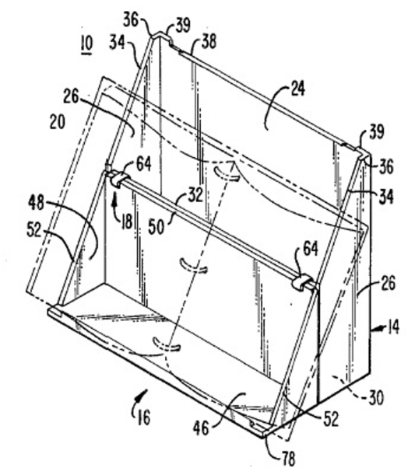
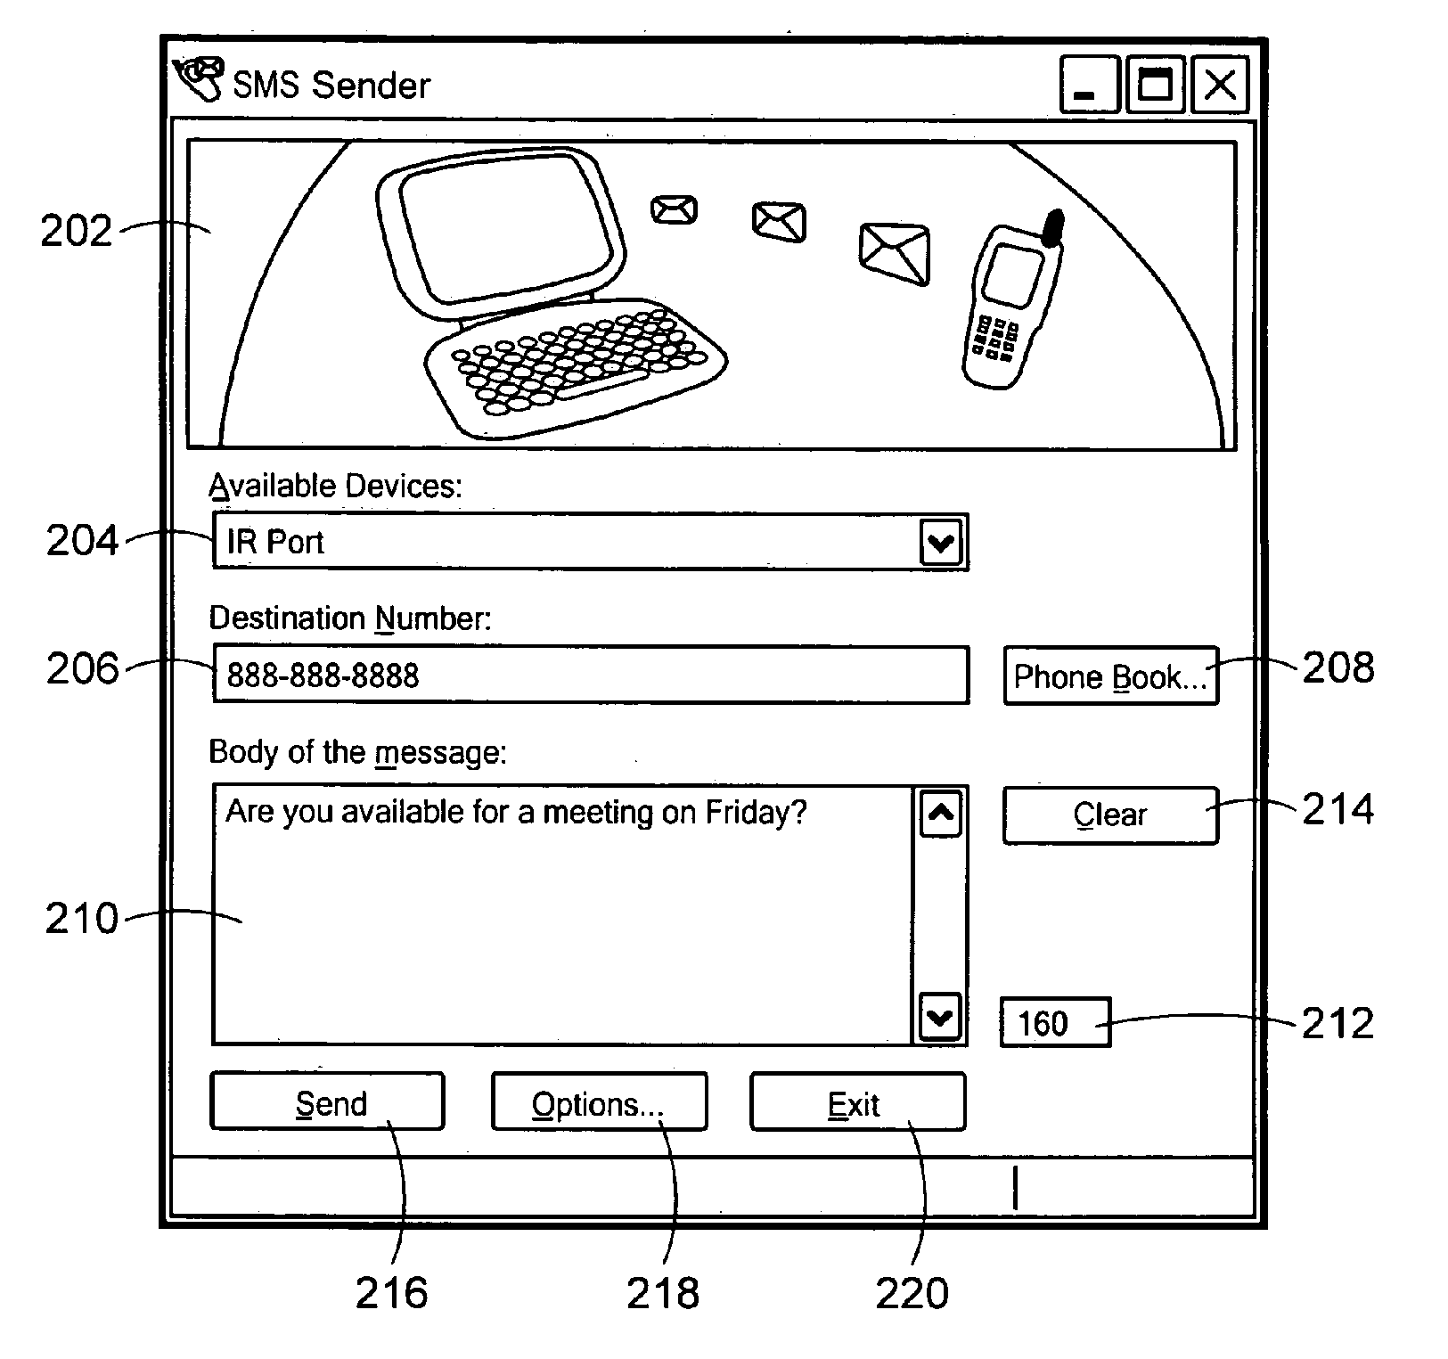
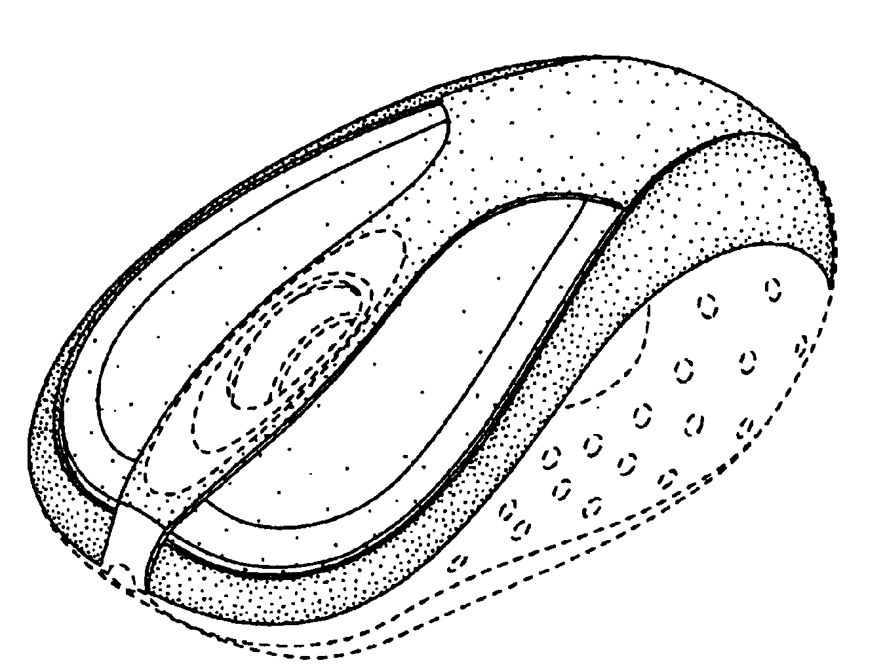
Which of these are patentable?

Slide 13

Brief History Of Patents At Microsoft
From humble beginnings…
1st patent application filed Aug 1983
SteveB is an inventor
But it’s on a book holder…
U.S. Patent granted May 1986
We pressed on…
100 U.S. patent applications filed in 1993
Filed 1500+ U.S. apps in FY03
Filed 2000+ U.S. apps in FY04
Filed 3000+ U.S. apps in FY05
Plan to file 3000 apps in FY06
To build a valuable asset
Over 5,000 issued U.S. patents
Over 13,100 pending U.S. applications
Over 1,700 issued Int’l patents
Over 15,700 pending Int’l patents

Slide 14
Components of a Patent Application
Specification
a written description of the invention with instructions on how to use it
Claims
defines the scope of what you claim to be the new and non-obvious part of your invention
Figures
optional, but useful to further explain the invention and how it works
Technical
Requirements
enablement and best mode

Slide 15
The Application Process at Microsoft
Invention
Disclosure Form
Asks basic questions about your invention
Disclosure
Meeting
1:1 meeting with drafting attorney
Application
Drafted
Review draft application
Asks for information relating to patentability
Used to prioritize among other inventions by LCA
Describe the problem space
Provide high level description of your invention
Block diagrams are helpful
Talk about details
Make sure the attorney can claim your invention
Discuss changes with drafting attorney if minor issues remain
Contact your LCA patent attorney if major problems persist
Contact your LCA patent attorney if you need help
Contact your LCA patent attorney if there are concerns

Slide 16
Microsoft’s Patent Process
Big Idea!
Work with your patent leader/LCA to prioritize ideas
Prepare Pre-disclosure Form for submission
Inventor Role
Work with your patent leader/LCA contact to prioritize ideas
Once approved, complete and submit the pre-disclosure form describing the invention
Meet with the outside counsel to draft application
Review drafts prepared by the outside counsel
Sign the paperwork
Review and answer questions
Review current state U.S. of technology
Disclosure Meeting With Patent Attorney
Prepare Patent Application and File with Patent Office
PTO Examination
Patent Issues

Slide 17
What Should We Patent?
Forward-looking Patents
Fundamental new technologies
New business models
New ways of doing things
5-10 year time frame
Not yet in that space
Not yet feasible
Breakthrough Inventions
“Elegant”
Enabling Technologies
New Architectures
Improvements on Existing Technologies
Better, Cheaper, Faster, More Reliable
Incremental

Slide 18
When Should We Patent?
File Early
Identify IP early in design phase
Formulate protection strategy
Be Strategic
Prioritize potential filings in alignment with business goals
Cover core technologies (protocols, formats)
Cover features with noticeable benefits to end users or developers
Cover features that are likely be copied by competitors
Plan
Design
Implement
Stabilize
Release
Project Def
Code
Beta Versions
Ship
Spec
B1
B2
B3
RC1
RTM
Best Time To File
1 Year to File for U.S. Patents
Potential Public Disclosure
Public Domain
Potential International Patent Rights Lost

Slide 19
Publish or Perish
Rita Researcher submits a paper for publication by the Hyper Tech Society, a pre-eminent organization in her field. The Hyper Tech Society has a confidentiality policy for its submissions but publishes accepted papers. A few weeks after her submission, she learns that her paper will be published in a week. She contacts her Patty Patents, her patent attorney, about filing a patent application on the technology disclosed in the paper.
Can Patty obtain patent protection for Rita’s invention? If so, where?

Slide 20
Public Disclosure and Patents
Publicly disclosing an invention before a patent is filed can kill patent rights, so disclosure date is very important
United States: 1-year grace period
Outside US: no grace period (strict novelty)
What constitutes a “public disclosure”?
E-mailing draft paper to peers
Public blog of research
External website
Disclosure may be OK if under NDA
Include your manager in making decisions to publish
Questions? Contact your LCA patent attorney

Slide 21
Rita’s Takeaways
Since the publisher has a confidentiality policy, Rita will not lose the ability to obtain international patent protection until her paper publishes (or earlier if there are other public disclosures).
Rita can help protect her patent rights by:
Confirming that the publisher has a written policy of confidentiality and understanding how long it lasts
Working with Patty Patents to file an application before submitting her paper
Rita will want to involve her team manager in decisions to forego patent rights
For more information and contacts, see: http://msrinfo/legal and http://lcaweb/patents
Roadmap

Slide 22
An Interesting Opportunity
A colleague of Rita Researcher at the University of Mulligatawny approaches Rita about collaborating in the area of human body networking. Rita decides to have an initial discussion with UM researchers while they are in Redmond on business. The UM researchers ask Rita to sign UM’s standard reciprocal Non-Disclosure Agreement (NDA) so they can “tell her about their cool, new technology.”
Should Rita sign the NDA?

Slide 23
Exchanges of Confidential Info
General Rule: Avoid signing a third party NDA
Can productive discussions take place without exchanging confidential information?
Preserve your research flexibility/avoid taint/avoid obligations for safeguarding third party information
If asked to engage in a confidential discussion, clear it with your team manager
Confirm an NDA / IEA isn’t already in place
Work with your LCA contact if you need IEA assistance
NOTE: code should not be released or received under just an NDA; you (and the code receiver) need a license

Slide 24
Rita’s Takeaways
Engaging in preliminary discussions with UM researchers is fine if:
Rita has discussed and received approval from her manager; and either
No confidential information will be shared; or
A suitable NDA is in place
As the level of collaboration deepens or becomes more extensive, Rita may consider whether she needs an additional IEA
Consider patentability issues early in this process
Roadmap

Slide 25
The Perfect Solution
Rita and UM decide that no confidential information will be exchanged – and thus no NDA is signed. After months of collaborating with her UM colleagues by telephone, e-mail and occasional face to face meetings, Rita and her UM colleagues together develop the perfect solution for an unsolved problem related to human body networking. Rita expects that this technology is one we’ll want to license out commercially or transfer to a product group, so she would like Patty to file patents to protect it.
Will Rita’s collaboration affect Microsoft’s commercialization opportunities?

Slide 26
Collaborations
Collaborations evolve from identifying problems into finding solutions
Result: joint inventorship
Before this evolution occurs – PAUSE
Check in again with your manager and LCA contact
Key is to ask: Do we want exclusive ownership of this IP? With potential tech transfer or commercial licensing, often the answer is “yes”.
If exclusive rights are desired, a contract is required
Preferred approach: Hire as consultant, VR, temp, or FTE
MS owns resulting IP
Beware of overlap with university work
Work with your admin and plan ahead to get contract before work starts
Alternative approach: Sponsored Research or CRA
Can be costly, slow, and result in limited rights

Slide 27
Rita’s Takeaways
Rita’s solution may be jointly owned by MS and UM
This diminishes MS’s interest in commercial licensing the technology (and may diminish product group interest)
It is less likely MS would patent this technology, and jointly-owned code will not likely be of commercial interest
Getting assignments from UM after the fact is often difficult and costly
Rita could have protected MS’s interests in the IP:
By contacting her manager to discuss IP protection before her collaboration evolved into identifying solutions
By hiring key UM researchers in as consultants, or else signing an appropriate collaboration agreement
Roadmap

Slide 28
Questions?

Slide 29
THANK YOU!!
John Mulgrew
+44 787 540 4481
http://my/sites/jmulgrew/default.aspx

