Slide 1

Scientific Computing on
MSR Summer School 2009 – Jurgen Van Gael

Slide 2
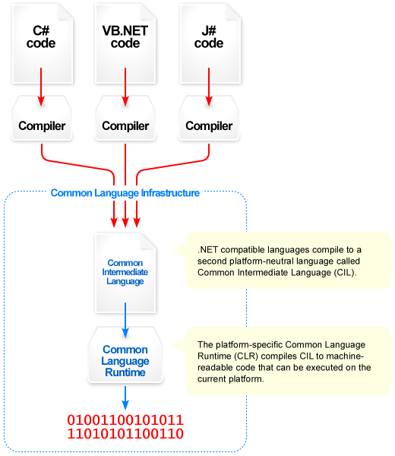
The .NET Platform
Supported Languages (From Wikipedia)
  C#
  F#
  Visual Basic.NET
  C++
  (Iron)Python
  (Iron)Ruby
  J#
  Jscript.NET
  Windows PowerShell
  (Iron)Scheme
  (Iron)Lisp
  Axum
  A#
  Boo
  M
  Oxygene
  Nemerle
  Phalanger
  P#

Slide 3
My Research Workflow
Data Preparation
Number Crunching
Postprocessing
Python Script
F# Script
Machine Learning: F#
Numerics: dnAnalytics
Matlab
Excel
LINQ Query

Slide 4

An Open Source Numerical Library for .NET
Object/Imperative API
Functional API
Intel MKL (C)
nVidia CUDA
Managed Core
dnAnalytics Library (C#)

Slide 5
Feature Set
Linear algebra classes with support for sparse matrices and vectors.
Dense and sparse solvers.
QR, LU, SVD, and Cholesky decomposition classes.
Probability distributions (Normal, Gamma + 20 more).
Random number generation (including Mersenne Twister MT19937).
Matrix IO classes that read and write matrices form/to Matlab, Matrix Market, and delimited files.
Complex and “special” math routines.
Descriptive Statistics, Histogram, and Pearson Correlation Coefficient.
Markov Chain Monte Carlo (Metropolis-Hastings, Slice Sampling, ...).
Visual Studio visual debuggers for matrices and vectors.
Functional (F#) interface.
Runs under Microsoft® Windows and platforms that support Mono.
Optional support for Intel®Math Kernel Library.
What about FFT, Interpolation, Integration ...?!?

Slide 6



Math.NET Numerics
Faster Bug Fixes
Larger Feature Set
Bigger Community
More Active Developers
More Platform
More Documentation

Slide 7
For You
User:
  Website: http://dnanalytics.codeplex.com/
  Blog: http://blog.dnanalytics.net/
  ... install Visual Studio 2008 and you’re good to go
Developer:
  Thousands of users = a real product
  Learn new tools (refactoring, unit testing, ...)
  Work with Microsoft: research & product groups

