Slide 1
Tools and Services for Data Intensive Research
Roger Barga
Nelson Araujo, Tim Chou, and Christophe Poulain
Advanced Research Tools and Services Group, Microsoft Research

Slide 2




Worldwide External Research Themes
Core Computer Science
Earth, Energy and Environment
Health & Wellbeing
Education & Scholarly Communications
Advanced Research Tools and Services

Slide 3
ARTS – Architecture Engagement Strategy
Engage with scientists and researchers to:
Understand requirements, across multiple projects;
Demonstrate prototypes and proofs of concept;
Develop software tools and technologies that support actual eScience projects (lighthouse applications) and release OSS;
Leverage this experience, try to transfer to new research project and communities, make it easy to deploy and use.
In rare cases, influence products still under development...

Slide 4

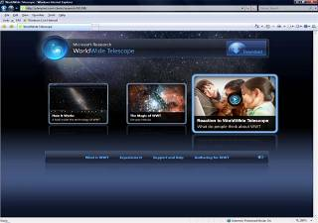
World Wide Telescope
Seamless social media virtual sky
Web application for science and education
Integration of data sets and one-click contextual access;
Easy access and use;
Over 2M unique users;
There have been 4,089,898 sessions for an average of 2.55 sessions per user;
The average number of new users that have installed and used WWT has been 3,773 per day.

Slide 5
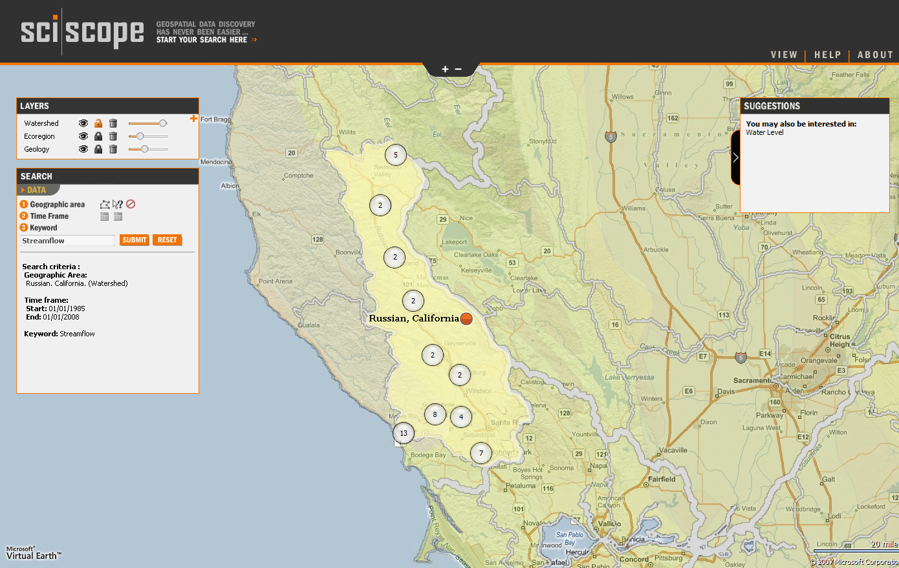
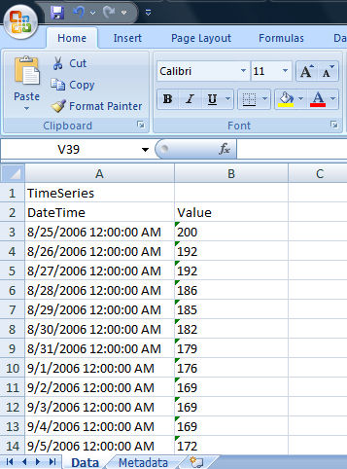

Automated download
+ Add to favorites
+ Download data

Slide 6
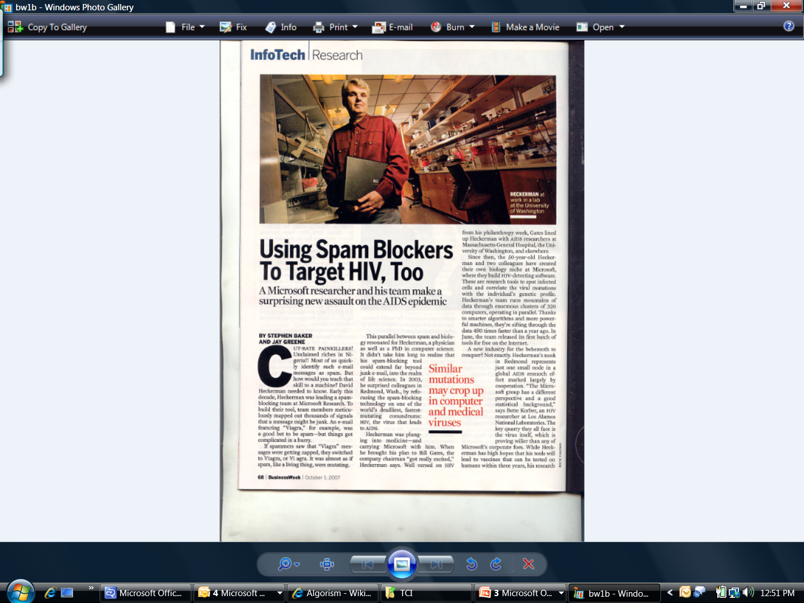
Discovered ‘decoy epitopes’ that could have predicted failure of Merck vaccine
Verified hypothesis on Merck data
Algorithms and medical results published in Science and Nature Medicine
MSR Computational Biology Tools published (source on CodePlex)

Slide 7

When someone wants to find information on their favorite musician by submitting an internet search, they unleash the power of several hundred processors operating over terabytes of data. Why then can’t a scientist seeking a cure for cancer invoke large amounts of computation over a terabyte-size database of DNA microarray data at the click of a button?
Randy Bryant (CMU) May 2007, with permission.

Slide 8
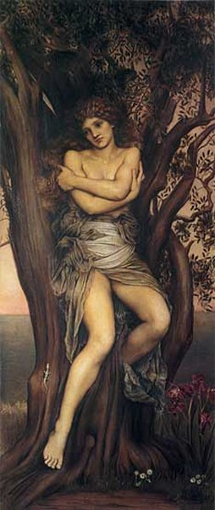
Microsoft’s Dryad
Continuously deployed since 2006
Running on >> 10⁴ machines
Sifting through > 10Pb data daily
Runs on clusters > 3000 machines
Handles jobs with > 10⁵ processes each
Used by >> 100 developers
Rich platform for data analysis
Microsoft Research, Silicon Valley
Michael Isard, Mihai Budiu, Yuan Yu, Andrew Birrell, Dennis Fetterly

Slide 9
Simple Programming Model
Terasort, well known benchmark, time to sort time 1 TB data [J. Gray 1985]
Sequential scan/disk = 4.6 hours
DryadLINQ provides simple but powerful programming model
Only few lines of code needed to implement Terasort
DryadDataContext ddc = new DryadDataContext(fileDir);
DryadTable<TeraRecord> records =
ddc.GetPartitionedTable<TeraRecord>(file);
var q = records.OrderBy(x => x);
q.ToDryadPartitionedTable(output);

Slide 10
Simple Programming Model
Terasort, well known benchmark, time to sort time 1 TB data [J. Gray 1985]
Sequential scan/disk = 4.6 hours
DryadLINQ provides simple but powerful programming model
Only few lines of code needed to implement Terasort
Benchmark effort from May 2008
DryadLINQ result: 349 seconds (5.8 min)
Cluster of 240 AMD64 (quad) machines, 920 disks
Code: 17 lines of LINQ

Slide 11
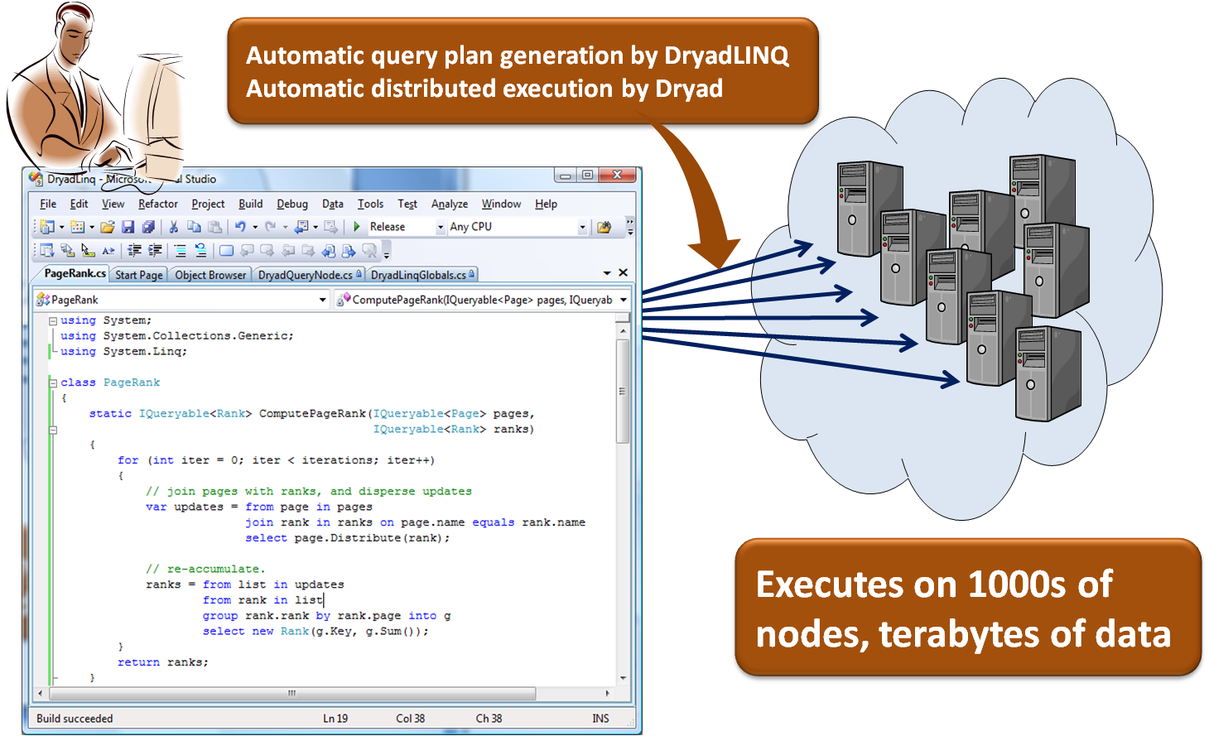
Dryad and DryadLINQ
Advanced Research Services and Tools (ARTS) team is working with the developers of Dryad (MSR-SV) to make the same software we use in our search labs available for data intensive research. We will also provide this same software, along with programming guides and tutorials, free of charge to universities for both academic research and education.

Slide 12


Programming at Scale
3000 node cluster ($2.5k - $4k/per node)
12,000 cores (36 x 10¹² cycles/sec)
48 terabytes of RAM
9 petabytes of persistent storage
But, very hard to utilize
Hard to program 12,000 cores
Something breaks every day
Challenge to deploy and manage

Slide 13

Challenges of Large Scale Computing
Scalability Adding load to a system should not cause outright failure but graceful decline.
Reliability Total system must support graceful decline in application performance rather than a full halt
Recoverability If nodes fail, their workload must be picked up by functioning units.
Consistency
Concurrent operations or partial internal failures should not cause externally visible nondeterminism.
Ability to Get Started Quickly Developers can use their existing skills in a familiar environment

Slide 14
Distributed Data-Parallel Computing
A radical approach to programming at scale
Nodes talk to each other as little as possible (shared nothing)
Programmer is not allowed to communicate between nodes
Data is spread throughout machines in advance, computation happens where it’s stored.
Master program divvies up tasks based on location of data, detects failures and restarts, load balances, etc…

Slide 15

LINQ
Microsoft’s Language INtegrated Query
Available in Visual Studio 2008
A set of operators to manipulate datasets in .NET
Support traditional relational operators
Select, Join, GroupBy, Aggregate, etc.
Data model
Data elements are strongly typed .NET objects
Much more expressive than SQL tables
Extremely extensible
Add new custom operators
Add new execution providers

Slide 16


LINQ Highlights
Where
Select
GroupBy
OrderBy
Aggregate
Join
Apply
Materialize

Slide 17
DryadLINQ Operators
LINQ operators
Where, Select, SelectMany, OrderBy, GroupBy, Join, GroupJoin, Aggregate, Distinct, Concat, Union, Intersect, Except, Count, Contains, Sum, Min, Max, Average, Any, All, Skip, SkipWhile, Take, TakeWhile, …
Operators introduced by DryadLINQ
HashPartition, RangePartition, Apply, Fork, Materialize

Slide 18
LINQ System Architecture
Local Machine
Execution Engine
LINQ-to-obj
PLINQ
LINQ-to-SQL
LINQ-to-WS
DryadLINQ
LINQ-to-Flickr
LINQ-to-XML
Your own…
.Net program
(C#, VB, F#, etc)
LINQ Provider
Query
Objects

Slide 19

Dryad Generalizes Unix Pipes
Unix Pipes: 1-D
grep | sed | sort | awk | perl
Dryad: 2-D, multi-machine, virtualized
grep¹⁰⁰⁰ | sed⁵⁰⁰ | sort¹⁰⁰⁰ | awk⁵⁰⁰ | perl⁵⁰

Slide 20
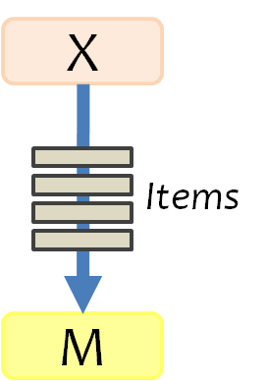
Dryad Job Structure
Channels
Input files
Stage
Output files
grep
sort
awk
sed
perl
grep
sort
sed
awk
grep
sort
Vertices (processes)
Channel is a finite streams of items
NTFS files (temporary)
TCP pipes (inter-machine)
Memory FIFOs (intra-machine)

Slide 21

Dryad System Architecture
data plane
job schedule
Files, TCP, FIFO, Network
V
V
V
NS
PD
PD
PD
Job manager
control plane
cluster

Slide 22

Dryad Job Staging
1. Build
7. Serialize vertices
2. Send .exe
Vertex Code
JM code
5. Generate graph
Cluster services
6. Initialize vertices
3. Start JM
8. Monitor vertex execution
4. Query cluster resources

Slide 23




Fault Tolerance

Slide 24
Dynamic Graph Rewriting
X[0]
X[1]
X[3]
X[2]
X’[2]
Slow vertex
Duplicate vertex
Completed vertices
Duplication Policy = f(running times, data volumes)

Slide 25
Dynamic Aggregation
S
S
S
S
S
S
T
static
S
S
S
S
S
S
# 1
# 2
# 1
# 3
# 3
# 2
rack #
A
A
A
# 1
# 2
# 3
dynamic
T

Slide 26
Example: Histogram
public static IQueryable<Pair> Histogram(
IQueryable<LineRecord> input, int k)
{
var words = input.SelectMany(x => x.line.Split(' '));
var groups = words.GroupBy(x => x);
var counts = groups.Select(x => new Pair(x.Key, x.Count()));
var ordered = counts.OrderByDescending(x => x.count);
var top = ordered.Take(k);
return top;
}
“A line of words of wisdom”
[“A”, “line”, “of”, “words”, “of”, “wisdom”]
[[“A”], [“line”], [“of”, “of”], [“words”], [“wisdom”]]
[ {“A”, 1}, {“line”, 1}, {“of”, 2}, {“words”, 1}, {“wisdom”, 1}]
[{“of”, 2}, {“A”, 1}, {“line”, 1}, {“words”, 1}, {“wisdom”, 1}]
[{“of”, 2}, {“A”, 1}, {“line”, 1}]

Slide 27
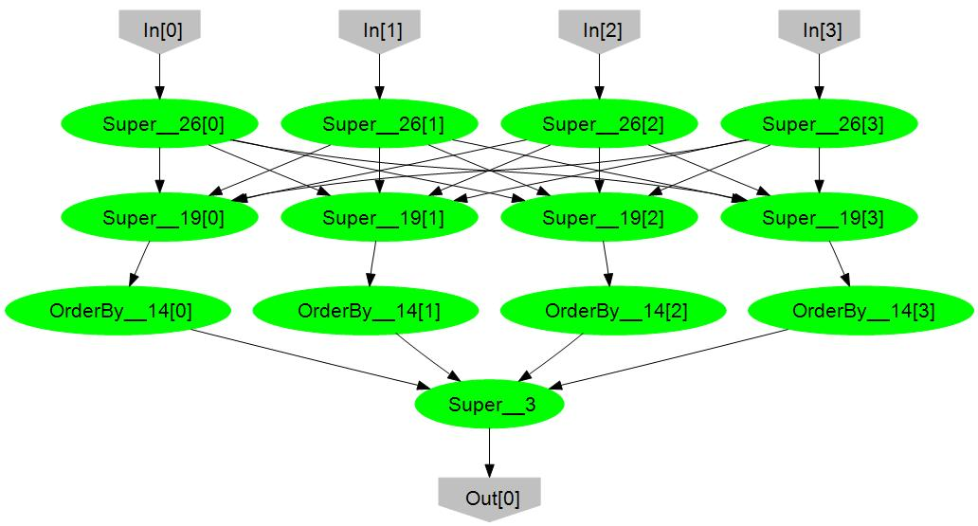
Histogram Plan
SelectMany
HashDistribute
Merge
GroupBy
Select
OrderByDescending Take
MergeSort
Take

Slide 28
Example: Word Count
Count word frequency in a set of documents:
var docs = new PartitionedTable<Doc>(“dfs://barga/docs”);
var words = docs.SelectMany(doc => doc.words);
var groups = words.GroupBy(word => word);
var counts = groups.Select(g => new WordCount(g.Key, g.Count()));
counts.ToTable(“dfs://barga/counts.txt”);
IN
SM
GB
S
OUT
metadata
doc =>
doc.words
word =>
word
g =>
new …
metadata

Slide 29
Distributed Execution of Word Count
LINQ expression
Dryad execution
IN
SM
DryadLINQ
GB
S
OUT

Slide 30
Execution Plan for Word Count
SM
SelectMany
Q
Sort
SM
pipelined
GB
GroupBy
GB
C
Count
(1)
S
D
Distribute
MS
Mergesort
GB
GroupBy
pipelined
Sum
Sum

Slide 31
Execution Plan for Word Count
SM
SM
SM
SM
Q
Q
Q
Q
SM
GB
GB
GB
GB
GB
C
C
C
C
(1)
(2)
S
D
D
D
D
MS
MS
MS
MS
GB
GB
GB
GB
Sum
Sum
Sum
Sum

Slide 32
Summary of DryadLINQ Internals
Distributed execution plan
Static optimizations: pipelining, eager aggregation, etc.
Dynamic optimizations: data-dependent partitioning, dynamic aggregation, etc.
Automatic code generation
Vertex code that runs on vertices
Channel serialization code
Callback code for runtime optimizations
Automatically distributed to cluster machines
Separate LINQ query from its local context
Distribute referenced objects to cluster machines
Distribute application DLLs to cluster machines

Slide 33
Dryad Job = Directed Acyclic Graph
Outputs
Processing
vertices
Channels
(file, pipe,
shared
memory)
Inputs

Slide 34
Dryad Scheduler is a State Machine
Static optimizer builds execution graph
Vertex can run anywhere once all its inputs are ready.
Dynamic optimizer mutates running graph
Distributes code, routes data;
Schedules processes on machines near data;
Adjusts available compute resources at each stage;
Automatically recovers computation, adjusts for overload
If A fails, run it again;
If A’s inputs are gone, run upstream vertices again (recursively);
If A is slow, run a copy elsewhere and use output from one that finishes first.
Masks failures in cluster and network;

Slide 35
Dryad in Context
Application
SQL
Sawzall
≈SQL
LINQ, SQL
Sawzall
Pig, Hive
DryadLINQ Scope
Parallel Databases
Language
Map-Reduce
Hadoop
Dryad
Execution
GFS BigTable
HDFS
S3
NTFS
Azure SQL Server
Storage

Slide 36
Dryad Map-Reduce
many similarities
Execution layer
Job = arbitrary DAG
Plug-in policies
Program=graph gen.
Complex ( features)
New (< 4 years)
Still growing
Internal (pending)
Exe + app. model
Map+sort+reduce
Few policies
Program=map+reduce
Simple
Mature (> 4 years)
Widely deployed
Hadoop

Slide 37
Combining Query Providers
Local Machine
Execution Engines
Scalability
.Net program
(C#, VB, F#, etc)
DryadLINQ
Cluster
Query
PLINQ
LINQ provider interface
Multi-core
LINQ-to-SQL
Objects
LINQ-to-Obj
Single-core

Slide 38
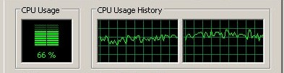



Combining with PLINQ
Query
DryadLINQ
subquery
PLINQ

Slide 39

Combining with LINQ-to-SQL
Query
DryadLINQ
Subquery
Subquery
Subquery
Subquery
Subquery
LINQ-to-SQL
LINQ-to-SQL

Slide 40
Sample applications written using DryadLINQ | Class
Distributed linear algebra | Numerical
Accelerated Page-Rank computation | Web graph
Privacy-preserving query language | Data mining
Expectation maximization for a mixture of Gaussians | Clustering
K-means | Clustering
Linear regression | Statistics
Probabilistic Index Maps | Image processing
Principal component analysis | Data mining
Probabilistic Latent Semantic Indexing | Data mining
Performance analysis and visualization | Debugging
Road network shortest-path preprocessing | Graph
Botnet detection | Data mining
Epitome computation | Image processing
Neural network training | Statistics
Parallel machine learning framework infer.net | Machine learning
Distributed query caching | Optimization
Image indexing | Image processing
Web indexing structure | Web graph

Slide 41
“What’s the point if I can’t have it?”
Glad you asked
We have offered Dryad+DryadLINQ to select academic partners (alpha release for evaluation purposes)
Broad academic/research release July 2009
Dryad and DryadLINQ (binary for now, source release in planning)
With tutorials, programming guides, sample codes, libraries, and a community site.
http://research.microsoft.com/en-us/collaboration/tools/dryad.aspx

Slide 42



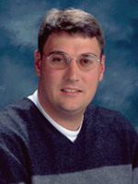


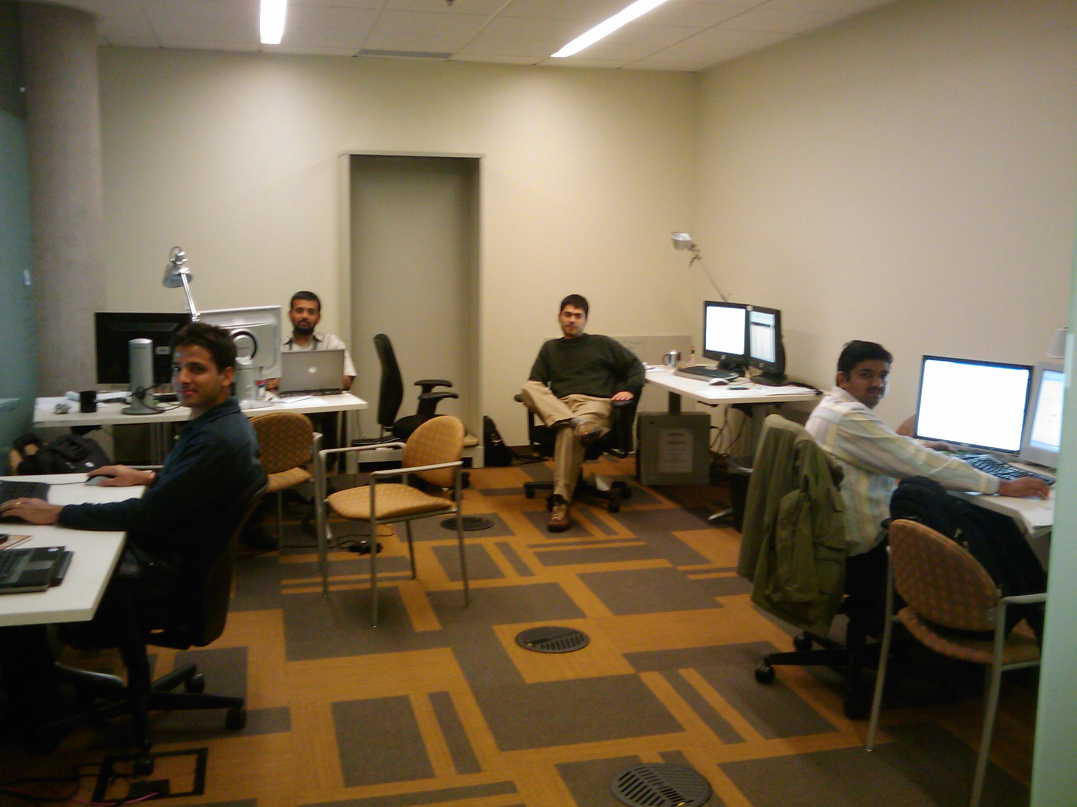


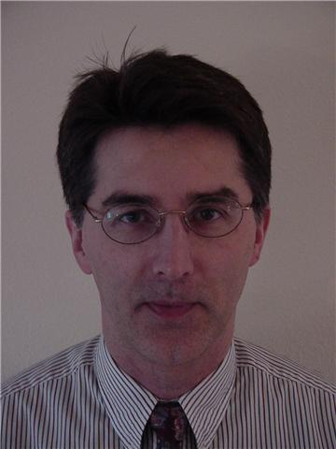
Acknowledgements
MSR-SV Dryad & DryadLINQ teams
Andrew Birrell, Mihai Budiu, Jon Currey, Dennis Fetterly, Michael Isard, and Yuan Yu
External Research team members
Nelson Araujo, Tim Chou, and Christophe Poulain
Pandu Rao, Ranjith Parakkunnath, and Rohit Parashar
Aditi Systems

Slide 43


© 2009 Microsoft Corporation. All rights reserved. Microsoft, Windows, Windows Vista and other product names are or may be registered trademarks and/or trademarks in the U.S. and/or other countries. The information herein is for informational purposes only and represents the current view of Microsoft Corporation as of the date of this presentation. Because Microsoft must respond to changing market conditions, it should not be interpreted to be a commitment on the part of Microsoft, and Microsoft cannot guarantee the accuracy of any information provided after the date of this presentation. MICROSOFT MAKES NO WARRANTIES, EXPRESS, IMPLIED OR STATUTORY, AS TO THE INFORMATION IN THIS PRESENTATION.

