Slide 1
























Systems & networking
MSR Cambridge
Tim Harris
2 July 2009

Slide 2
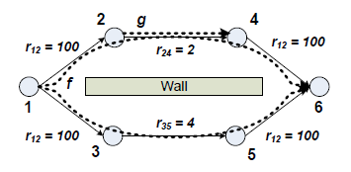
Multi-path wireless mesh routing

Slide 3
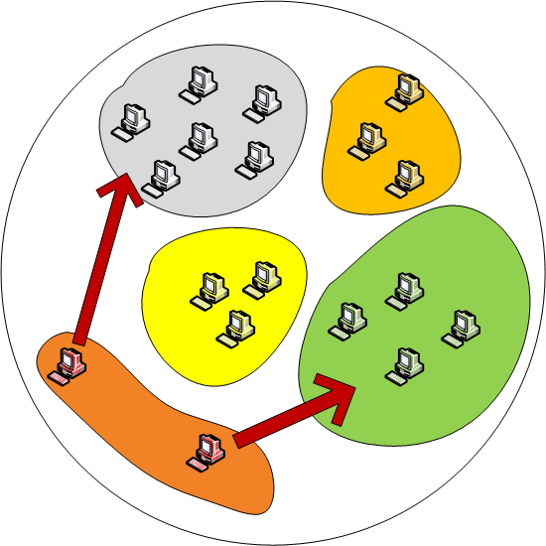
Epidemic-style information
distribution

Slide 4
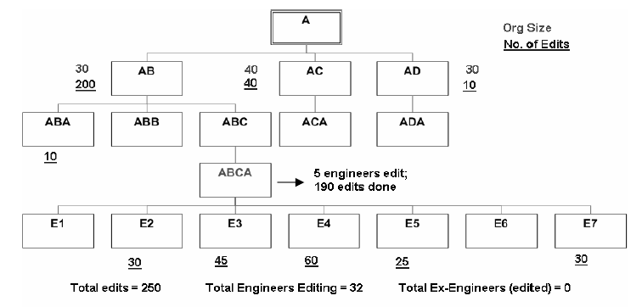
Development processes and failure prediction

Slide 5
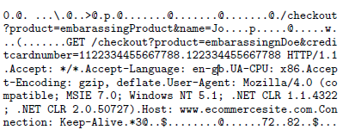
Better bug reporting with better privacy

Slide 6
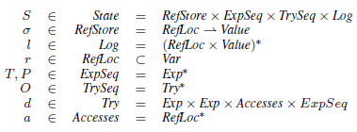
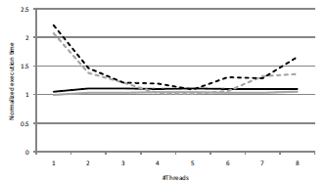
Multi-core programming, combining foundations and practice

Slide 7
Data-centre storage

Slide 8
WIT: lightweight defence against malicious inputs
What place for SSDs in enterprise storage?
Barrelfish: a sensible OS for multi-core hardware

Slide 9
Software is vulnerable
Unsafe languages are prone to memory errors
  many programs written in C/C++
Many attacks exploit memory errors
  buffer overflows, dangling pointers, double frees
Still a problem despite years of research
  half of all the vulnerabilities reported by CERT

Slide 10
Problems with previous solutions
Static analysis is great but insufficient
  finds defects before software ships
  but does not find all defects
Runtime solutions that are used
  have low overhead but low coverage
Many runtime solutions are not used
  high overhead
  changes to programs, runtime systems

Slide 11
WIT: write integrity testing
Static analysis extracts intended behavior
  computes set of objects each instruction can write
  computes set of functions each instruction can call
Check this behavior dynamically
  write integrity
    prevents writes to objects not in analysis set
  control-flow integrity
    prevents calls to functions not in analysis set

Slide 12
WIT advantages
Works with C/C++ programs with no changes
No changes to the language runtime required
High coverage
  prevents a large class of attacks
  only flags true memory errors
Has low overhead
  7% time overhead on CPU benchmarks
  13% space overhead on CPU benchmarks

Slide 13
Example vulnerable program
    char cgiCommand[1024];
    char cgiDir[1024];
    void ProcessCGIRequest(char* msg, int sz)
    {
    int i=0;
    while (i < sz) {
    cgiCommand[i] = msg[i];
    i++;
    }
    ExecuteRequest(cgiDir, cgiCommand);
    }
buffer overflow in this function allows the attacker to change cgiDir
non-control-data attack

Slide 14
Write safety analysis
Write is safe if it cannot violate write integrity
  writes to constant offsets from stack pointer
  writes to constant offset from data segment
  statically determined in-bounds indirect writes
Object is safe if all writes to object are safe
For unsafe objects and accesses...
char array[1024];
for (i = 0; i < 10; i++)
array[i] = 0; // safe write

Slide 15
Colouring with static analysis
WIT assigns colours to objects and writes
  each object has a single colour
  all writes to an object have the same colour
  write integrity
    ensure colors of write and its target match
Assigns colours to functions and indirect calls
  each function has a single colour
  all indirect calls to a function have the same colour
  control-flow integrity
    ensure colours of i-call and its target match

Slide 16




Colouring
Colouring uses points-to and write safety results
  start with points-to sets of unsafe pointers
  merge sets into equivalence class if they intersect
  assign distinct colour to each class
p1
p2
p3

Slide 17
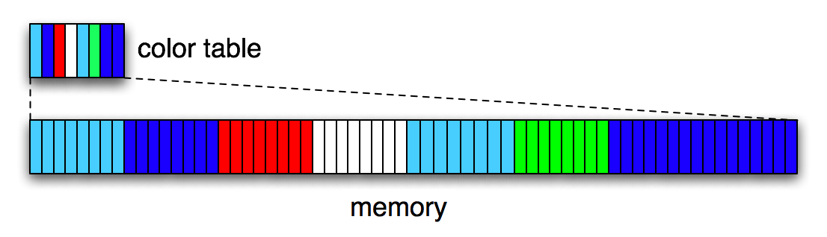
Colour table
Colour table is an array for efficient access
  1-byte colour for each 8-byte memory slot
  one colour per slot with alignment
  1/8th of address space reserved for table

Slide 18
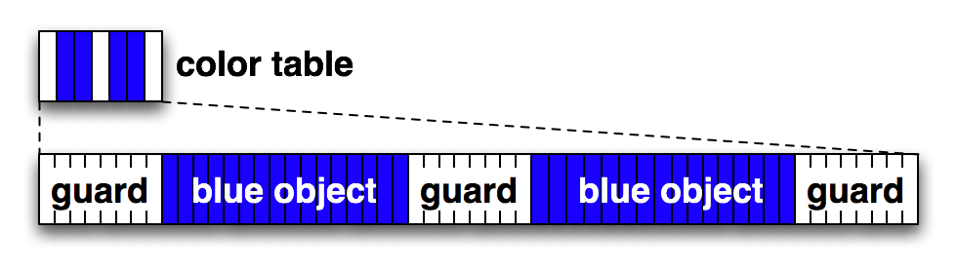
Inserting guards
WIT inserts guards around unsafe objects
  8-byte guards
  guard’s have distinct colour: 1 in heap, 0 elsewhere

Slide 19
Write checks
Safe writes are not instrumented
Insert instrumentation before unsafe writes
lea edx, [ecx] ; address of write target
shr edx, 3 ; colour table index → edx
cmp byte ptr [edx], 8 ; compare colours
je out ; allow write if equal
int 3 ; raise exception if different
out: mov byte ptr [ecx], ebx ; unsafe write

Slide 20
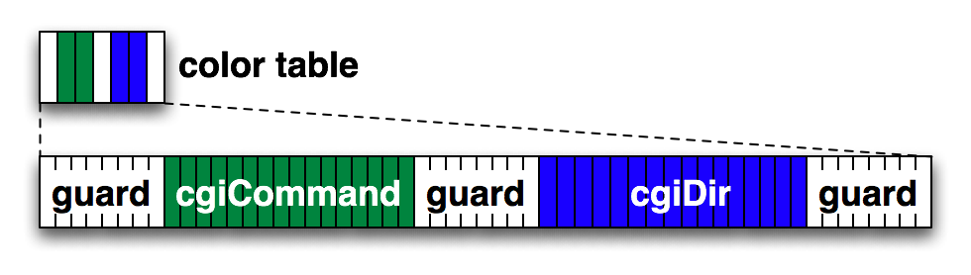
    char cgiCommand[1024]; {3}
    char cgiDir[1024]; {4}
    void ProcessCGIRequest(char* msg, int sz)
    {
    int i=0;
    while (i < sz) {
    cgiCommand[i] = msg[i];
    i++;
    }
    ExecuteRequest(cgiDir, cgiCommand);
    }
lea edx, [ecx]
shr edx, 3
cmp byte ptr [edx],3
je out
int 3
out:
mov byte ptr [ecx], ebx
attack detected, guard colour ≠ object colour
≠
attack detected even without guards – objects have different colours
≠

Slide 21
Evaluation
Implemented as a set of compiler plug-ins
  Using the Phoenix compiler framework
Evaluate:
  Runtime overhead on SPEC CPU,Olden benchmarks
  Memory overhead
  Ability to prevent attacks

Slide 22
Runtime overhead SPEC CPU

Slide 23
Memory overhead SPEC CPU

Slide 24
Ability to prevent attacks
WIT prevents all attacks in our benchmarks
  18 synthetic attacks from benchmark
    Guards sufficient for 17 attacks
  Real attacks
    SQL server, nullhttpd, stunnel, ghttpd, libpng

Slide 25
WIT: lightweight defence against malicious inputs
What place for SSDs in enterprise storage?
Barrelfish: a sensible OS for multi-core hardware

Slide 26
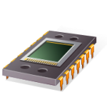
Solid-state drive (SSD)
Block storage interface
Flash Translation Layer (FTL)
Persistent
Random-access
NAND Flash memory
Low power

Slide 27
Enterprise storage is different
Laptop storage
Form factor
Single-request latency
Ruggedness
Battery life
Enterprise storage
Fault tolerance
Throughput
Capacity
Energy ($)

Slide 28
Replacing disks with SSDs
Match
performance
Disks
$$
Flash
$

Slide 29
Replacing disks with SSDs
Match
capacity
Disks
$$
Flash
$$$$$

Slide 30
Challenge
Given a workload
  Which device type, how many, 1 or 2 tiers?
We traced many real enterprise workloads
Benchmarked enterprise SSDs, disks
And built an automated provisioning tool
  Takes workload, device models
  And computes best configuration for workload

Slide 31
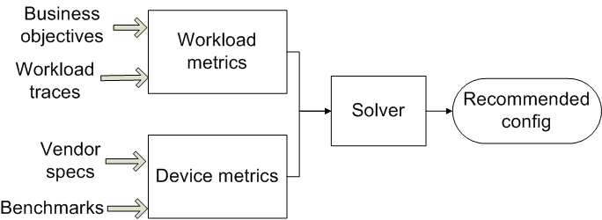
High-level design

Slide 32
Devices (2008)
Device | Price | Size | Sequential throughput | R’-access throughput
Seagate Cheetah 10K | $123 | 146 GB | 85 MB/s | 288 IOPS
Seagate Cheetah 15K | $172 | 146 GB | 88 MB/s | 384 IOPS
Memoright MR25.2 | $739 | 32 GB | 121 MB/s | 6450 IOPS
Intel X25-E (2009) | $415 | 32GB | 250 MB/s | 35000 IOPS
Seagate Momentus 7200 | $53 | 160 GB | 64 MB/s | 102 IOPS

Slide 33
Device metrics
Metric | Unit | Source
Price | $ | Retail
Capacity | GB | Vendor
Random-access read rate | IOPS | Measured
Random-access write rate | IOPS | Measured
Sequential read rate | MB/s | Measured
Sequential write rate | MB/s | Measured
Power | W | Vendor

Slide 34
Enterprise workload traces
Block-level I/O traces from production servers
  Exchange server (5000 users): 24 hr trace
  MSN back-end file store: 6 hr trace
  13 servers from small DC (MSRC)
    File servers, web server, web cache, etc.
    1 week trace
Below buffer cache, above RAID controller
15 servers, 49 volumes, 313 disks, 14 TB
  Volumes are RAID-1, RAID-10, or RAID-5

Slide 35
Workload metrics
Metric | Unit
Capacity | GB
Peak random-access read rate | IOPS
Peak random-access write rate | IOPS
Peak random-access I/O rate (reads+writes) | IOPS
Peak sequential read rate | MB/s
Peak sequential write rate | MB/s
Fault tolerance | Redundancy level

Slide 36
Model assumptions
First-order models
  Ok for provisioning → coarse-grained
  Not for detailed performance modelling
Open-loop traces
  I/O rate not limited by traced storage h/w
  Traced servers are well-provisioned with disks
  So bottleneck is elsewhere: assumption is ok

Slide 37
Single-tier solver
For each workload, device type
  Compute #devices needed in RAID array
    Throughput, capacity scaled linearly with #devices
  Must match every workload requirement
    “Most costly” workload metric determines #devices
  Add devices need for fault tolerance
  Compute total cost

Slide 38
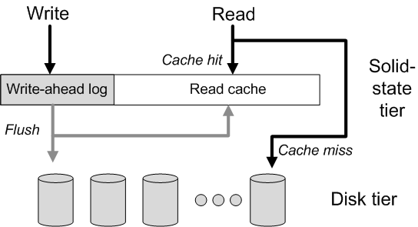
Two-tier model

Slide 39
Solving for two-tier model
Feed I/O trace to cache simulator
  Emits top-tier, bottom-tier trace → solver
Iterate over cache sizes, policies
  Write-back, write-through for logging
  LRU, LTR (long-term random) for caching
Inclusive cache model
  Can also model exclusive (partitioning)
  More complexity, negligible capacity savings

Slide 40
Single-tier results
Cheetah 10K best device for all workloads!
SSDs cost too much per GB
Capacity or read IOPS determines cost
  Not read MB/s, write MB/s, or write IOPS
  For SSDs, always capacity
  For disks, either capacity or read IOPS
Read IOPS vs. GB is the key tradeoff

Slide 41
Workload IOPS vs GB

Slide 42
SSD break-even point
When will SSDs beat disks?
  When IOPS dominates cost
Break even price point (SSD_{$/GB}) is when
  Cost of GB (SSD) = Cost of IOPS (disk)
Our tool also computes this point
  New SSD → compare its $/GB to break-even
  Then decide whether to buy it

Slide 43
Break-even point CDF

Slide 44
Break-even point CDF

Slide 45
Break-even point CDF

Slide 46
SSD as intermediate tier?
Read caching benefits few workloads
  Servers already cache in DRAM
  SSD tier doesn’t reduce disk tier provisioning
Persistent write-ahead log is useful
  A small log can improve write latency
  But does not reduce disk tier provisioning
  Because writes are not the limiting factor

Slide 47
Power and wear
SSDs use less power than Cheetahs
  But overall $ savings are small
  Cannot justify higher cost of SSD
Flash wear is not an issue
  SSDs have finite #write cycles
  But will last well beyond 5 years
    Workloads’ long-term write rate not that high
    You will upgrade before you wear device out

Slide 48
Conclusion
Capacity limits flash SSD in enterprise
  Not performance, not wear
Flash might never get cheap enough
  If all Si capacity moved to flash today, will only match 12% of HDD production
  There are more profitable uses of Si capacity
Need higher density/scale (PCM?)

Slide 49
WIT: lightweight defence against malicious inputs
What place for SSDs in enterprise storage?
Barrelfish: a sensible OS for multi-core hardware

Slide 50
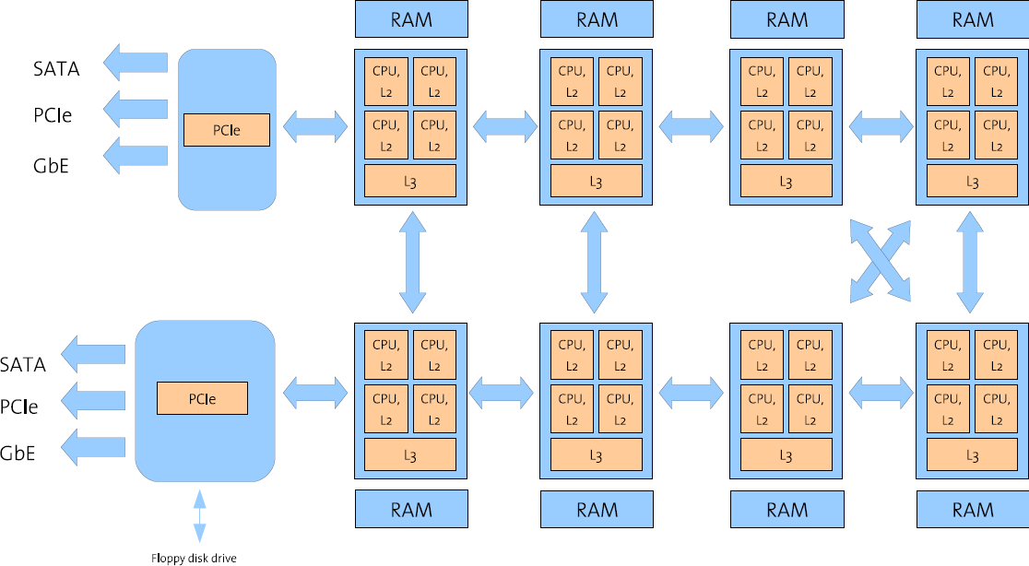
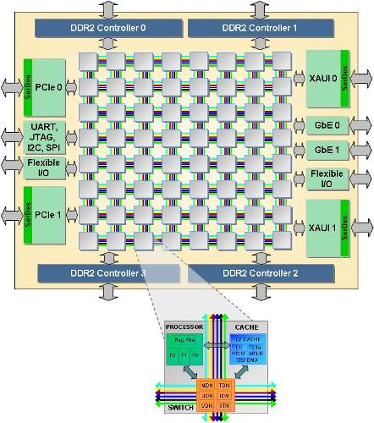
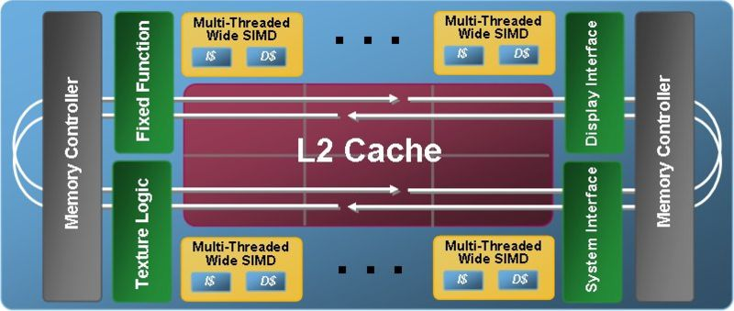
Don’t these look like networks to you?
Tilera TilePro64 CPU
AMD 8x4 hyper-transport system
Intel
Larrabee
32-core

Slide 51
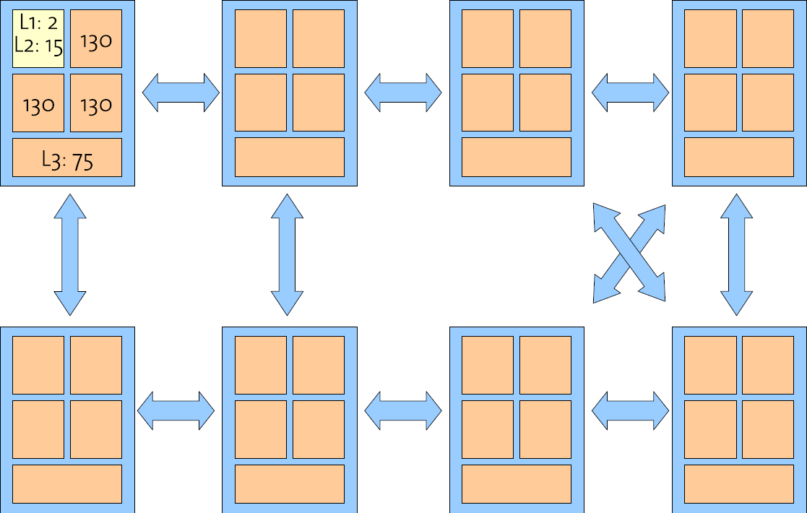
Communication latency

Slide 52
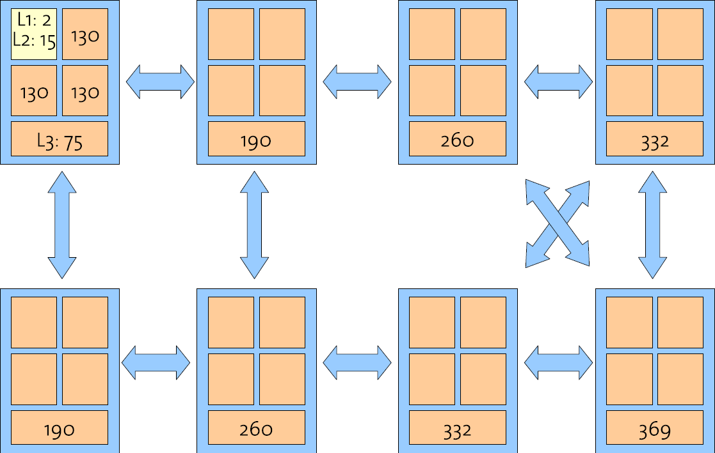
Communication latency

Slide 53
Node heterogeneity
Within a system:
  Programmable NICs
  GPUs
  FPGAs (in CPU sockets)
Architectural differences on a single die:
  Streaming instructions (SIMD, SSE, etc.)
  Virtualisation support, power management
  Mix of “large/sequential” & “small/concurrent” core sizes
Existing OS architectures have trouble accommodating
all this

Slide 54
Dynamic changes
Hot-plug of devices, memory, (cores?)
Power-management
Partial failure

Slide 55
What are the implications of building an OS as a
distributed system?
Extreme position: clean slate design
Fully explore ramifications
No regard for compatibility

Slide 56
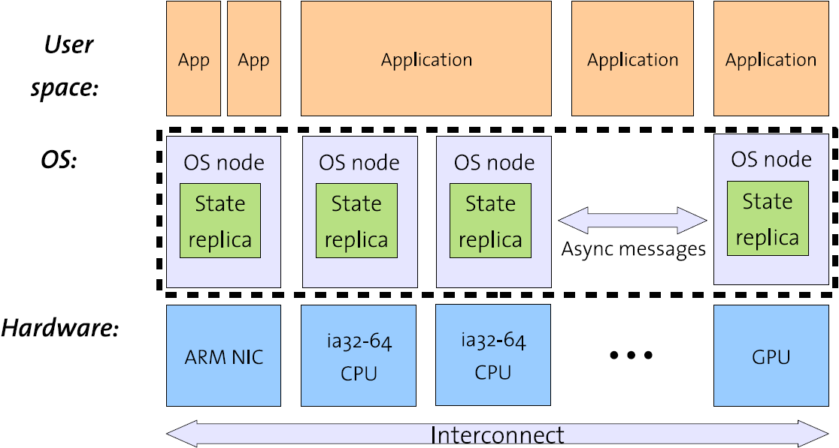
The multikernel architecture

Slide 57
Why message passing?
We can reason about it
Decouples system structure from inter-core communication mechanism
  Communication patterns explicitly expressed
  Naturally supports heterogeneous cores
  Naturally supports non-coherent interconnects (PCIe)
Better match for future hardware
  . . . cheap explicit message passing (e.g. TilePro64)
  . . . non-cache-coherence (e.g. Intel Polaris 80-core)

Slide 58
Message passing vs. shared memory
Access to remote shared data can form a blocking RPC
  Processor stalled while line is fetched or invalidated
  Limited by latency of interconnect round-trips
Performance scales with size of data (#cache lines)
By sending an explicit RPC (message), we:
  Send a compact high-level description of the operation
  Reduce the time spent blocked, waiting for the interconnect
Potential for more efficient use of interconnect bandwidth

Slide 59
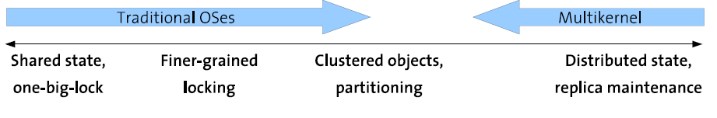
Sharing as an optimisation
Re-introduce shared memory as optimisation
  Hidden, local
  Only when faster, as decided at runtime
  Basic model remains split-phase messaging
But sharing/locking might be faster between some cores
  Hyperthreads, or cores with shared L2/3 cache

Slide 60
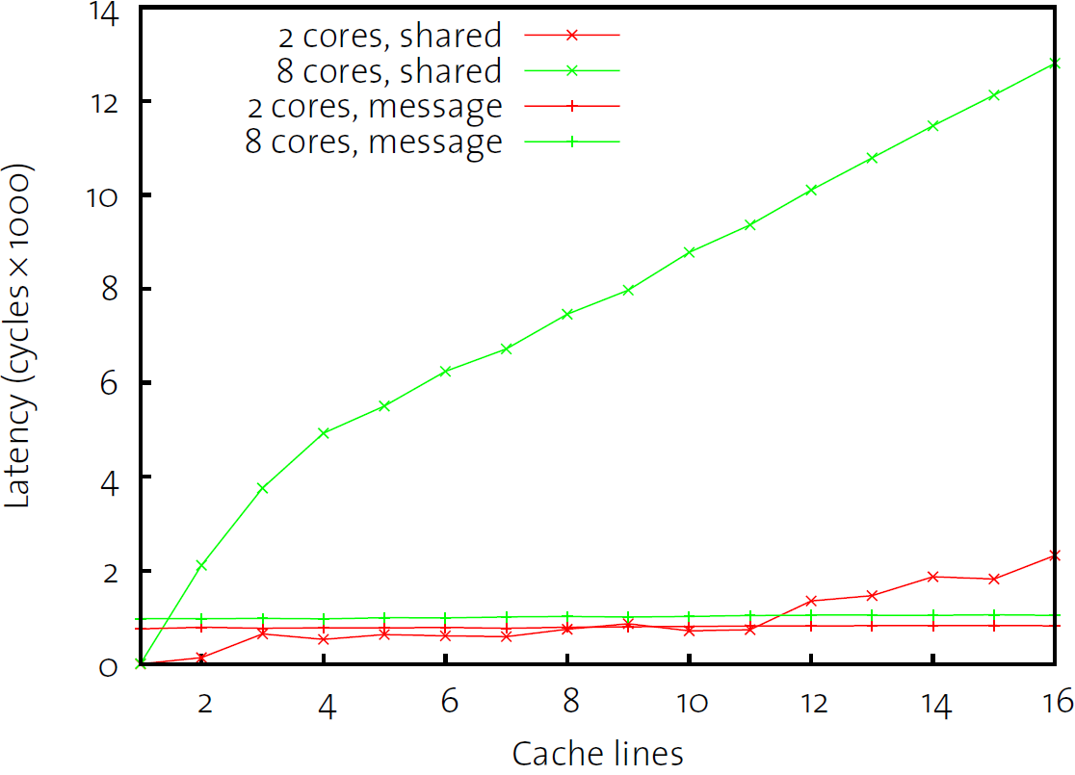
Message passing vs. shared memory: tradeoff
2 x 4-core Intel (shared bus)
Shared: clients modify shared array (no locking!)
Message: URPC to a single server

Slide 61
Replication
Given no sharing, what do we do with the state?
Some state naturally partitions
Other state must be replicated
Used as an optimisation in previous systems:
  Tornado, K42 clustered objects
  Linux read-only data, kernel text
We argue that replication should be the default

Slide 62
Consistency
How do we maintain consistency of replicated data?
Depends on consistency and ordering requirements, e.g.:
  TLBs (unmap) single-phase commit
  Memory reallocation (capabilities) two-phase commit
  Cores come and go (power management, hotplug) agreement

Slide 63
A concrete example: Unmap (TLB shootdown)
“Send a message to every core with a mapping, wait for all to be acknowledged”
Linux/Windows:
  1. Kernel sends IPIs
  2. Spins on shared acknowledgement count/event
Barrelfish:
  1. User request to local monitor domain
  2. Single-phase commit to remote cores
Possible worst-case for a multikernel
How to implement communication?

Slide 64
Three different Unmap message protocols...
Unicast
cache-lines
Broadcast
...
Read
...
...
Write
Multicast
More hyper-transport hops
...
...
Same package
(shared L3)
...

Slide 65
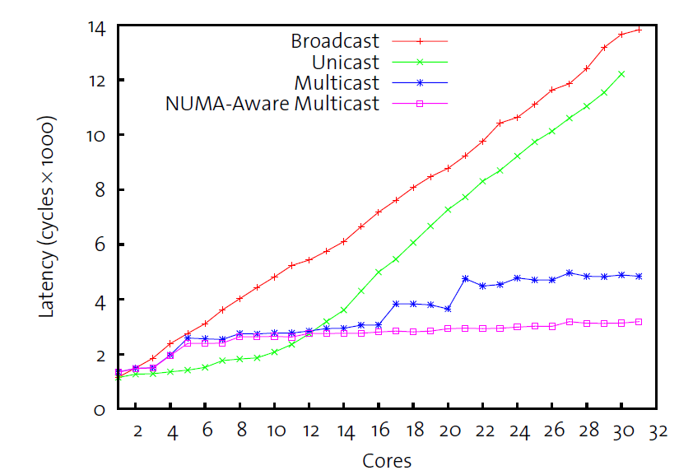
Choosing a message protocol on 8x4 AMD ...

Slide 66
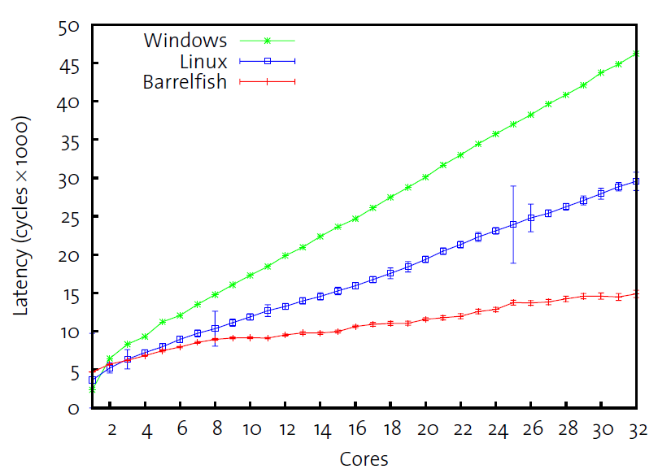
Total Unmap latency for various OSes

Slide 67
Heterogeneity
Message-based communication handles core heterogeneity
  Can specialise implementation and data structures at runtime
Doesn’t deal with other aspects
  What should run where?
  How should complex resources be allocated?
Our prototype uses constraint logic programming to perform online reasoning
System knowledge base stores rich, detailed representation of hardware performance

Slide 68
Current Status
Ongoing collaboration with ETH-Zurich
  Several keen PhD students working on a variety of aspects
Prototype multi-kernel OS implemented: Barrelfish
  Runs on emulated and real hardware
  Smallish set of drivers
  Can run web server, SQLite, slideshows, etc.
Position paper presented at HotOS
Full paper to appear at SOSP
Likely public code release soon

Slide 69
WIT: lightweight defence against malicious inputs
What place for SSDs in enterprise storage?
Barrelfish: a sensible OS for multi-core hardware
http://research.microsoft.com/camsys

