Slide 1

From Program Analysis Research to Industrial Programming Language Development
Andy Maule

Slide 2
Scenario
UCL coffee company™
Wholesale coffee traders

Slide 3
Sales application
Process orders
Add/update customers

Slide 4
Inventory application
Update stock details
Manage supplier info
Add/remove products

Slide 5
Database schema
Order
Product
∞
∞
∞
1
1
1
Customer
Supplier

Slide 6

Change
Supplier
Column: Address
Column: Country
Column: Street
Column: Town

Slide 7
Impacts?
INSERT INTO Suppliers (Name, Address) VALUES (?, ?)
Invalid Column Name Address
Missing required value Street
Missing required value Country
Missing required value Town

Slide 8

Estimate impact by hand
DB Refactoring book:
“knowledge built up over time… gut feeling…”
Manual inspection

Slide 9

Don’t change the database!
What will be affected?
What is the cost of this change?

Slide 10
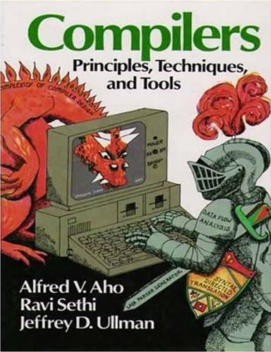
Automated analysis
App
DB
Dependences
Program analysis
Compilers

Slide 11
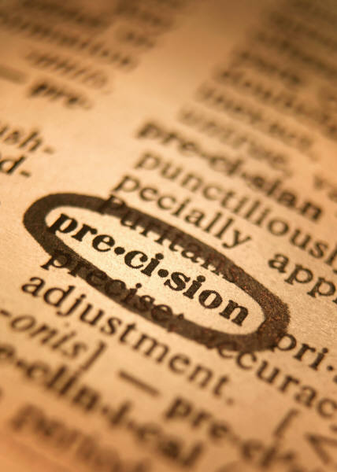
Precision
False positives
Need low false positives
Go through by hand

Slide 12
How much do low false positives cost
O(k^{n})
Analysis time
Size of analyzed program

Slide 13

Making it scale
Make algorithms more efficient
Reduce the size of the program

Slide 14
Overview

Slide 15
1. Program slicing
“… the parts of a program that (potentially)
affect the values computed at some point of interest”
Backward slice
(affect criteria)
Criteria
Forward slice
(affected by criteria)

Slide 16

Estimation using SUITE
Schema
Update
Impact
Tool
Environment

Slide 17
Does it work?
Version history
Predict effects
Compare to differences
…
App (v.234)
changes
App
(v.235)
…
Change | Predicted | True positives | False positives
1 | 5 warns | 2 | 3
2 | 4 warns | 0 | 4
3 | 4 warns | 0 | 4
4 | 4 warns | 0 | 4
5 | 1 err | 1 | 0
6 | 1 warn | 1 | 0
7 | 1 warn | 0 | 1
8 | None | 0 | 0

Slide 18
Does it scale?

Slide 19

Internship
Building tools is hard!
How is it done in the real world?
I got to find out

Slide 20
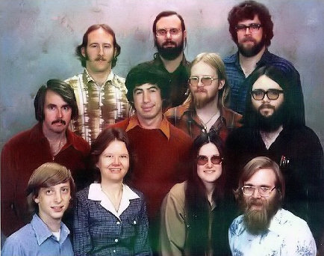
Now…
The M programming language
The Oslo project

Slide 21

What’s it like being a PhD in Industry?
At least 5 PhDs on my team
REALLY Smart people
REALLY interesting work
Lots of resources
Potentially big impact
Good pay ☺

Slide 22



The end…
andymaul@microsoft.com
Funded by
London Software Systems

