Slide 1
Austin Donnelly | July 2010

Slide 2
BIG DATA
Automated observations of the world

Slide 3
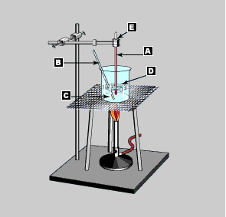

Slide 4
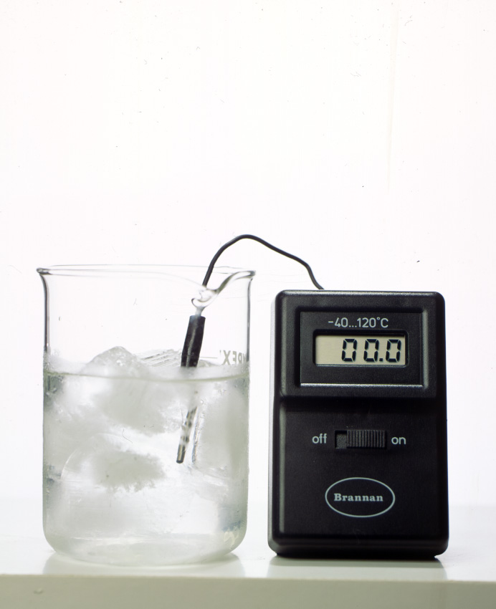
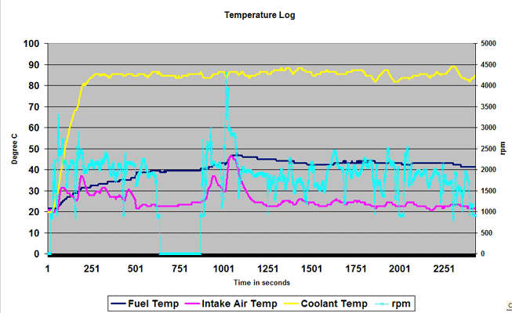

Slide 5
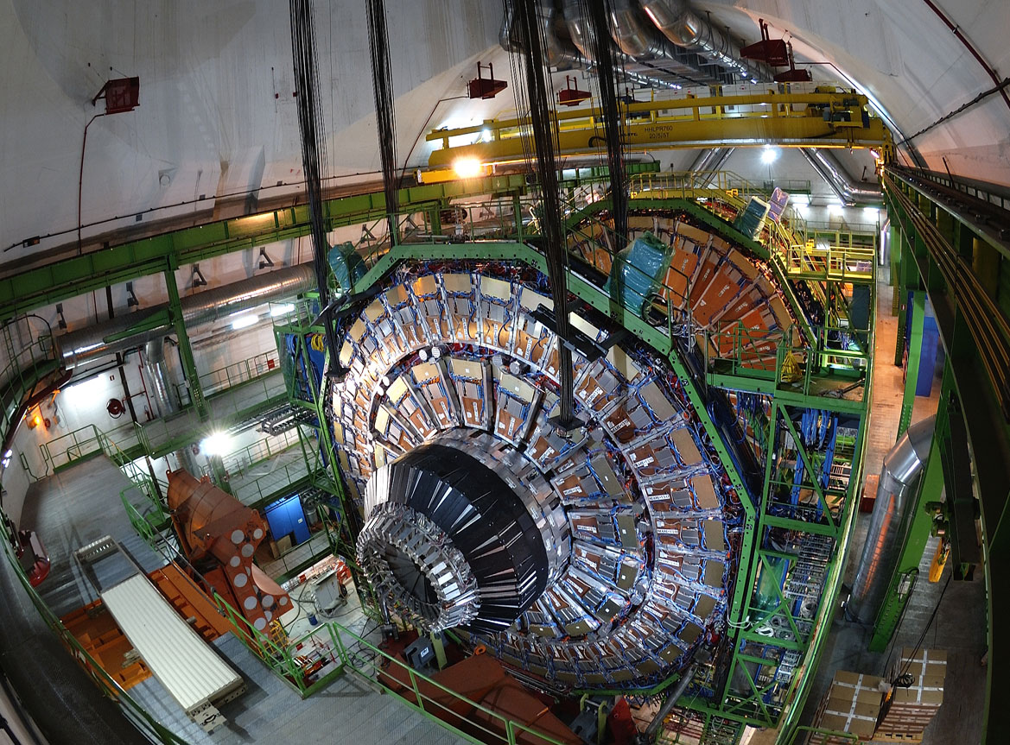
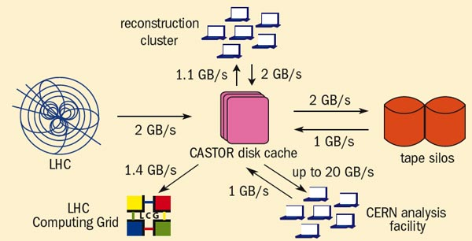
Notes:
http://www.psl.wisc.edu/projects/large/cms
Endcap for CMS (Compact Muon Solenoid), Large Hadron Collider
2million hair-like wires for capture, 310,000 channels of fast detectors
1GB/s in proton mode, 2GB/s heavy-ion mode: 15 petabytes/year
Data flow graphic:
http://cerncourier.com/cws/article/cern/31529

Slide 6
BIG SIMULATIONS
Machine-generated data

Slide 7
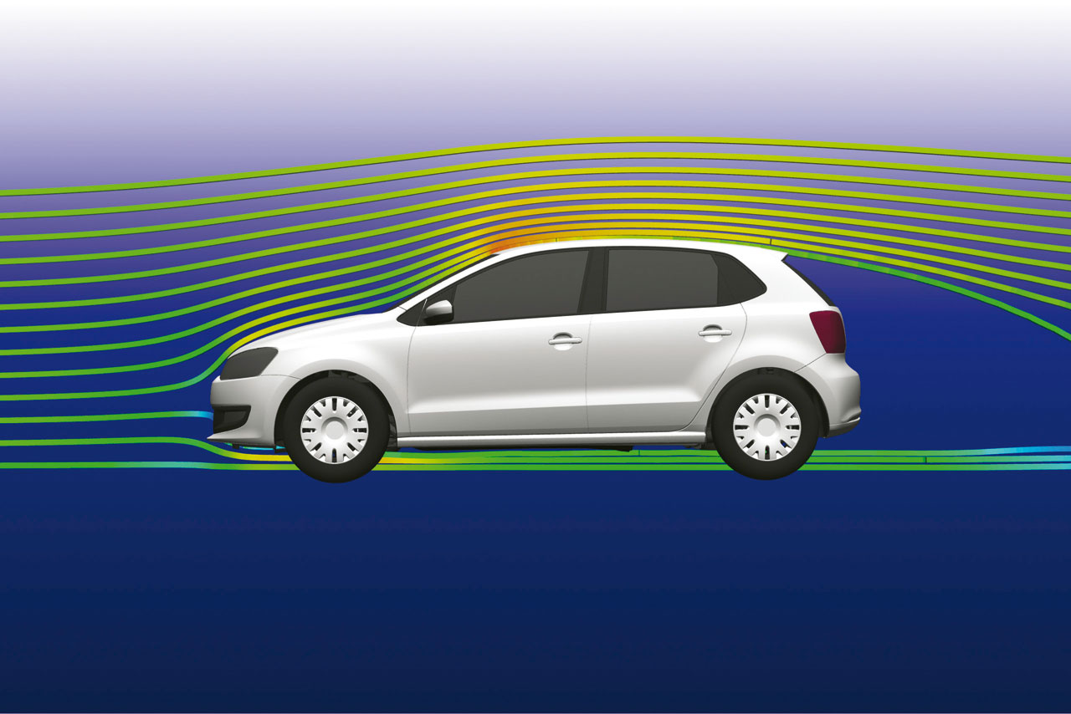
Notes:
New VM Polo wind tunnel airflow simulation

Slide 8

Simulations
Pool fire simulation, 2040 nodes on Sandia National Lab’s Red Storm supercomputer (from SC05)
Notes:
Pool fire simulation, 2040 nodes on Sandia National Lab’s Red Storm supercomputer, from SC05
http://www.sandia.gov/NNSA/ASC/pubs/sc05/prog_posters/Poster-Visualization-halfsize.pdf

Slide 9
Human MACHINES
The unwitting cyborg

Slide 10
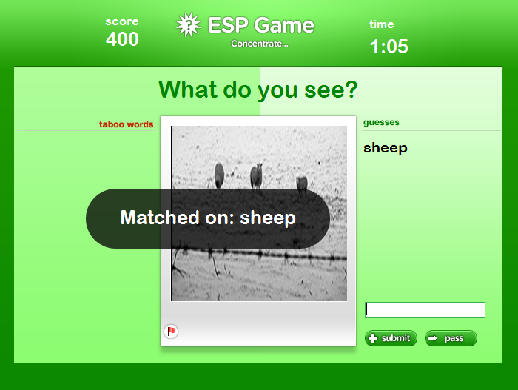
Notes:
Ahn and Dabbish 2004
Extension by MSFT: http://research.microsoft.com/apps/pubs/default.aspx?id=70638

Slide 11
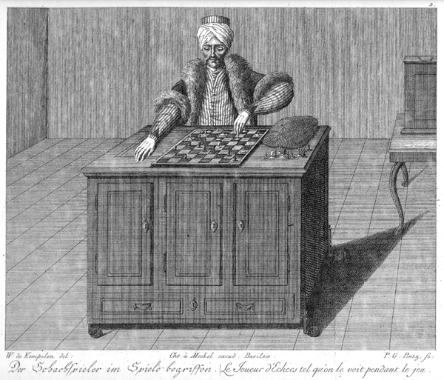
Notes:
1770 by Wolfgang von Kempelen
1820: unmasked by Londoner Robert Willis
1854: destroyed by fire

Slide 12
Cloud Computing Resources
What for?
  Statistical analysis
  Simulation
  Mechanical Turk / ESP Game
Where from?
  Departmental cluster
  Project based
  Windows Azure

Slide 13
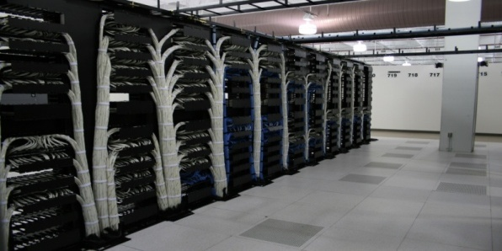
Windows Azure

Slide 14
Windows Azure
Key features:
  Scalable compute
  Scalable storage
  Pay-as-you-go: CPU, disk, network
  Higher-level API: PaaS

Slide 15



Cloud models
“SaaS”
“PaaS”
“IaaS”
Software as a Service
Platform as a Service
Infrastructure as a Service
consume it build on it migrate to it
Email
Application Development
Caching
CRM
Networking
Collaborative
Decision Support
Security
File
ERP
Web
Technical
Streaming
System Mgmt

Slide 16



Your Applications
Service
Bus
Workflow
Database
Analytics
Access
Control
…
Reporting
Data Sync
Compute
Storage
Manage
…

Slide 17
MANAGE

Slide 18


Declarative Services
Web Role
Worker Role
Web Role
Worker Role
Web Role
Worker Role
LB
Storage

Slide 19
Fabric Controller
Control VM
VM
VM
VM
WS08 Hypervisor
Control
_{Agent}
Service Roles
Out-of-band communication – hardware control
WS08
Load-balancers
In-band communication – software control
Node can be a VM or a physical machine
Switches
Highly-available
Fabric Controller

Slide 20
Hardware specs
Hardware: 64-bit Windows Server 2008
Choose from four different VM sizes:
  S: 1x 1.6GHz, medium IO, 1.75GB / 250GB
  M: 2x 1.6GHz, high IO, 3.5GB / 500 GB
  L: 4x 1.6GHz, high IO, 7GB / 1000 GB
  XL: 8x 1.6GHz, high IO, 14GB / 2000 GB

Slide 21
Storage
Blobs, Queues, Tables

Slide 22
Blobs
http://<Account>.blob.core.windows.net/<Container>/<BlobName>
Example:
  Account – sally
  Container – music
  BlobName – rock/rush/xanadu.mp3
  URL: http://sally.blob.core.windows.net/music/rock/rush/xanadu.mp3
Account
Container
Blob
IMG001.JPG
pictures
IMG002.JPG
sally
movies
MOV1.AVI

Slide 23
Blobs
Block Blob vs. Page Blob
Snapshots
Copy
xDrive
Geo-replication:
  Dublin, Amsterdam, Chicago, Texas, Singapore, Hong Kong
CDN: 18 global locations

Slide 24


RemoveMessage
GetMessage (Timeout)
Azure Queues
HTTP/1.1 200 OK
Transfer-Encoding: chunked
Content-Type: application/xml
Date: Tue, 09 Dec 2008 21:04:30 GMT
Server: Nephos Queue Service Version 1.0 Microsoft-HTTPAPI/2.0
﻿<?xml version="1.0" encoding="utf-8"?>
<QueueMessagesList>
<QueueMessage>
<MessageId>5974b586-0df3-4e2d-ad0c-18e3892bfca2</MessageId>
<InsertionTime>Mon, 22 Sep 2008 23:29:20 GMT</InsertionTime>
<ExpirationTime>Mon, 29 Sep 2008 23:29:20 GMT</ExpirationTime>
<PopReceipt>YzQ4Yzg1MDIGM0MDFiZDAwYzEw</PopReceipt>
<TimeNextVisible>Tue, 23 Sep 2008 05:29:20GMT</TimeNextVisible>
<MessageText>PHRlc3Q+dG...dGVzdD4=</MessageText>
</QueueMessage>
</QueueMessagesList>
PutMessage
Queue
Worker Role
Msg 1
Msg 2
Msg 2
Web Role
Msg 1
POST http://myaccount.queue.core.windows.net/myqueue/messages
DELETE
http://myaccount.queue.core.windows.net/myqueue/messages/messageid?popreceipt=YzQ4Yzg1MDIGM0MDFiZDAwYzEw
Msg 3
Msg 4
Worker Role
Worker Role
Msg 2

Slide 25
Tables
Simple entity store
Entity is a set of properties
  PartitionKey, RowKey, Timestamp are required
(PartitionKey, RowKey) defines the key
PartitionKey controls the scaling
  Designed for billions of rows
  PartitionKey controls locality
  RowKey provides uniqueness

Slide 26
Partitions
PartitionKey (Genre) | RowKey (Title) | Timestamp | ReleaseDate
Action | Fast & Furious | … | 2009
Action | The Bourne Ultimatum | … | 2007
… | … | … | …
Animation | Open Season 2 | … | 2009
Animation | The Ant Bully | … | 2006
… | … | … | …
Comedy | Office Space | … | 1999
… | … | … | …
SciFi | X-Men Origins: Wolverine | … | 2009
… | … | … | …
War | Defiance | … | 2008
PartitionKey (Genre) | RowKey (Title) | Timestamp | ReleaseDate
Action | Fast & Furious | … | 2009
Action | The Bourne Ultimatum | … | 2007
… | … | … | …
Animation | Open Season 2 | … | 2009
Animation | The Ant Bully | … | 2006
Server A
Table = Movies
[Action - Comedy)
Server A
Table = Movies
PartitionKey (Genre) | RowKey (Title) | Timestamp | ReleaseDate
Comedy | Office Space | … | 1999
… | … | … | …
SciFi | X-Men Origins: Wolverine | … | 2009
… | … | … | …
War | Defiance | … | 2008
Server B
Table = Movies
[Comedy- Western)

Slide 27
Tables
What tables don’t do
What tables can do


Not relational
Cheap


No Referential Integrity
Very Scalable


No Joins
Flexible


Limited Queries
Durable

No Group by

No Aggregations

No Transactions

Slide 28
Scalability targets
100TB storage per account (can ask for more)
Blobs:
  200GB max block-blob size
  1TB max page-blob size
Tables:
  max 255 properties, totalling 1MB
Queues:
  8KB messages, 1 week max age

Slide 29
TACTICS

Slide 30
HPC jobs
Use worker roles
  Good for parameter sweeps
  Increase the invisibility time (max 2hrs)
Maybe web-role as front-end

Slide 31
Interpreters
Python, Perl etc.
IronPython
Remember to upload runtime dlls
Think about security!

Slide 32
Data management
Blobs for large input files:
  upload may take a while, hopefully one-off
  http://blogs.msdn.com/b/windowsazurestorage/archive/2010/04/17/windows-azure-storage-explorers.aspx
Dump outputs to a blob
Reduce output to graphable size

Slide 33
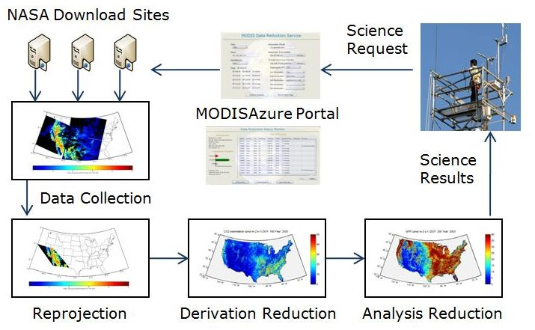
Azure MODIS

Slide 34
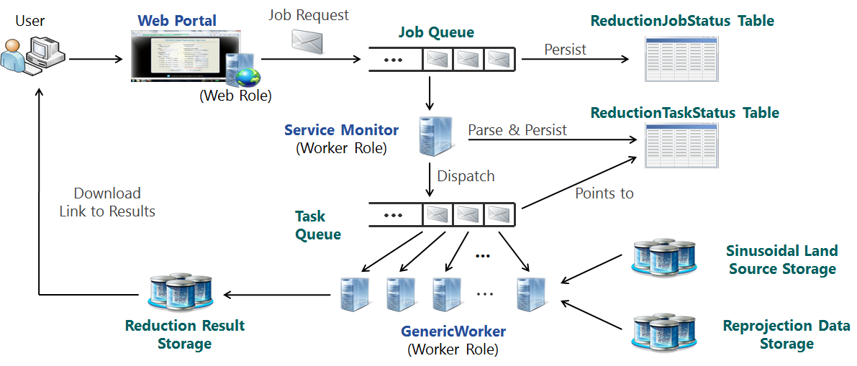
Azure MODIS implementation

Slide 35
Data ANALYSIS

Slide 36
Data curation
Where did your data come from?
How was it processed?
Do you have the original, master data?
Can you regenerate derived data?
  Keep the data
  Keep the code
  Use a revision control system

Slide 37
Accuracy vs. Precision
Accurate
Not accurate
X
X
X
X
X
Precise
X
X
X
X
X
X
X
X
Not precise
X
X
X
X
X
X
X

Slide 38
Common mistakes in eval 1/2
No goals
  Or biased goals (them vs. us)
Unsystematic approach
  Don’t just measure stuff at random
Analysis without understanding the problem
  Up to 40% of effort might be in defining problems
Incorrect metrics
  Right metric is not always the convenient one
Wrong workload
Wrong technique
  Measurement, simulation, emulation, analytics?
Missed parameter or factor
Bad experimental design
  Eg factors which interact not being varied sensibly together
Wrong level of detail
Notes:
From Jain pg 17

Slide 39
Common mistakes in eval 2/2
No analysis
  Measurement is not the endgame
  Bad analysis
  No sensitivity analysis
Ignoring errors
Outliers: let the wrong ones in
Assume no changes in the future
Ignore variability: mean is good enough
Too complex model
Bad presentation of results
Ignore social aspects
Omit assumptions and limitations

Slide 40
Steps for a good eval
State goals, define boundaries
Select metrics
List system and workload parameters
Select factors and their values
Select evaluation technique
Select workload
Design and run experiments
Analyse and interpret the data
Present results. Iterate if needed.

Slide 41





Books

Slide 42
THANKS!
http://www.azure.com/

