Slide 1
IP Legal Training
2 July 2010
Carole Boelitz (caroleb)
Mobile: +44 776 435 9689
Office: +44 1223 479 868
1
Notes:
1

Slide 2
Today’s Roadmap
2
Public Disclosures and Patent Filings
Publishing Research
Non-Disclosure Agreements
Collaborations
Copyright and other people’s stuff
Informal Q&A → as we go!
Notes:
2

Slide 3
Types of IPR – Compared
 | Protects | Rights | How Protection Arises
Patents | Inventions, ideas, designs, methods | Right to prevent others from making, using, or selling an invention | Filing an application and obtaining an issued patent
Copyrights | Expression, but not the idea itself | Exclusive right to copy, distribute perform, display, modify | Automatically, upon fixation in a tangible medium, but filing provides additional advantages
Trade Secrets | Confidential Information | Right to prevent others from using or disclosing confidential information | Reasonable measures to protect confidentiality (e.g., NDAs, security)
Trademarks | Protects against confusion of source of good or service (e.g., names, logos) | Exclusive right to use mark in connection with certain goods and services | Use (common law); filing application for trademark registration.
3
Notes:
3

Slide 4
Microsoft on IP
Best products and services
Competitive marketplace
IP framework to collaborate and compete
Real choice among differentiated products
Mutual respect for IP
4

Slide 5

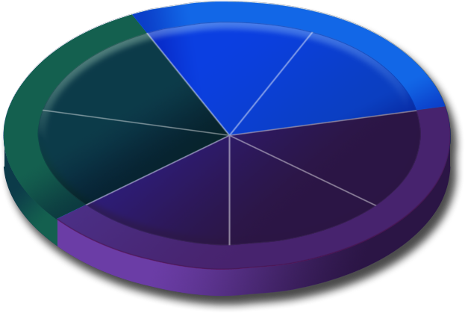







Microsoft’s Products Overview
Microsoft Mobile
Windows Embedded
Steve Ballmer
CEO
Microsoft
Dynamics
Xbox
Zune
Peripherals
Microsoft TV
Entertainment & Devices Division
Business Division
Office
System
MSN
Digital Advertising
Platform & Products Division
Windows Server
Windows OS
Notes:
5

Slide 6
Patent Industry Standards
6
Industry typically files 1 patent for every $1M in R&D
Microsoft in FY10 estimates about $10B R&D
  Patent budget for FY10: 2500 patent applications
  Microsoft typically invests 14-20% of its revenue in R&D

Slide 7
What Should We Patent?
Innovation Value
7
Forward-looking Patents
Fundamental new technologies
  New business models
  New ways of doing things
5-10 year time frame
Not yet in that space
Not yet feasible – Maturity/Ripeness
Breakthrough Inventions
“Elegant”
Enabling Technologies
New Architectures
Improvements on Existing Technologies
Better, Cheaper, Faster, More Reliable
Incremental

Slide 8
What Should We Patent?
Strategic Value
8
How are we going to use the technology?
  Product?
  Give away?
How easily could someone ‘design around’?
How easily could we detect a ‘copier’?

Slide 9
How we use our patents
Outbound license or sale
Identify essential claims
License often under RAND or RAND-Z terms
Litigation
Defensive purpose
Counterclaim when possible
Encourages adoption of our technology
Support licensees of Microsoft IP
Defensive Prior Art
Prevent others from obtaining patents
Public milestone of our own technology
Technology specific
Usually patent family and know-how
Start up companies, SMEs, end brands, manufacturers
Cross-License
10-30 representative patents
Broad license for specified term
Allows collaboration between companies, reduces risk for both sides
Standards
9
Notes:
9

Slide 10
The Breakthrough
Rita Researcher has just discovered a great new approach to solving an age-old problem, and has written code to implement in a prototype device with a UI. She wants to protect her discovery so that she can market it.
What are her options?
Would there be any difference if her prototype and invention were hardware?
Notes:
10

Slide 11
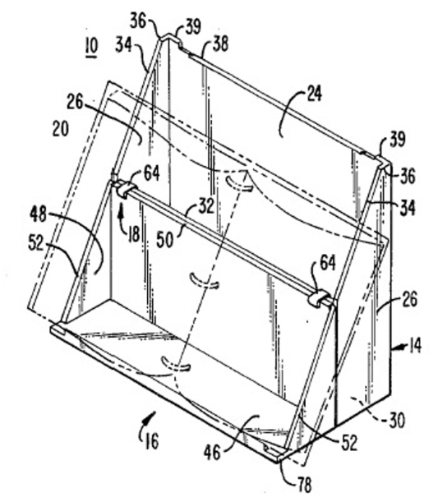
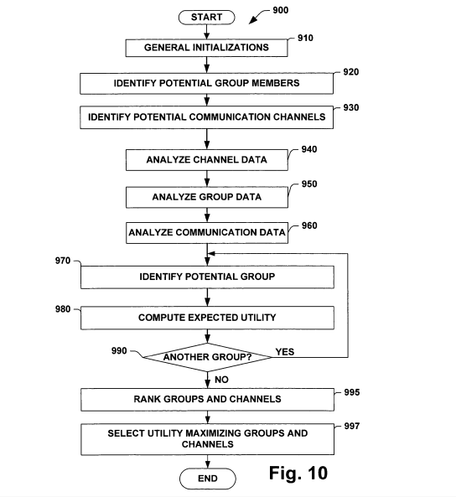
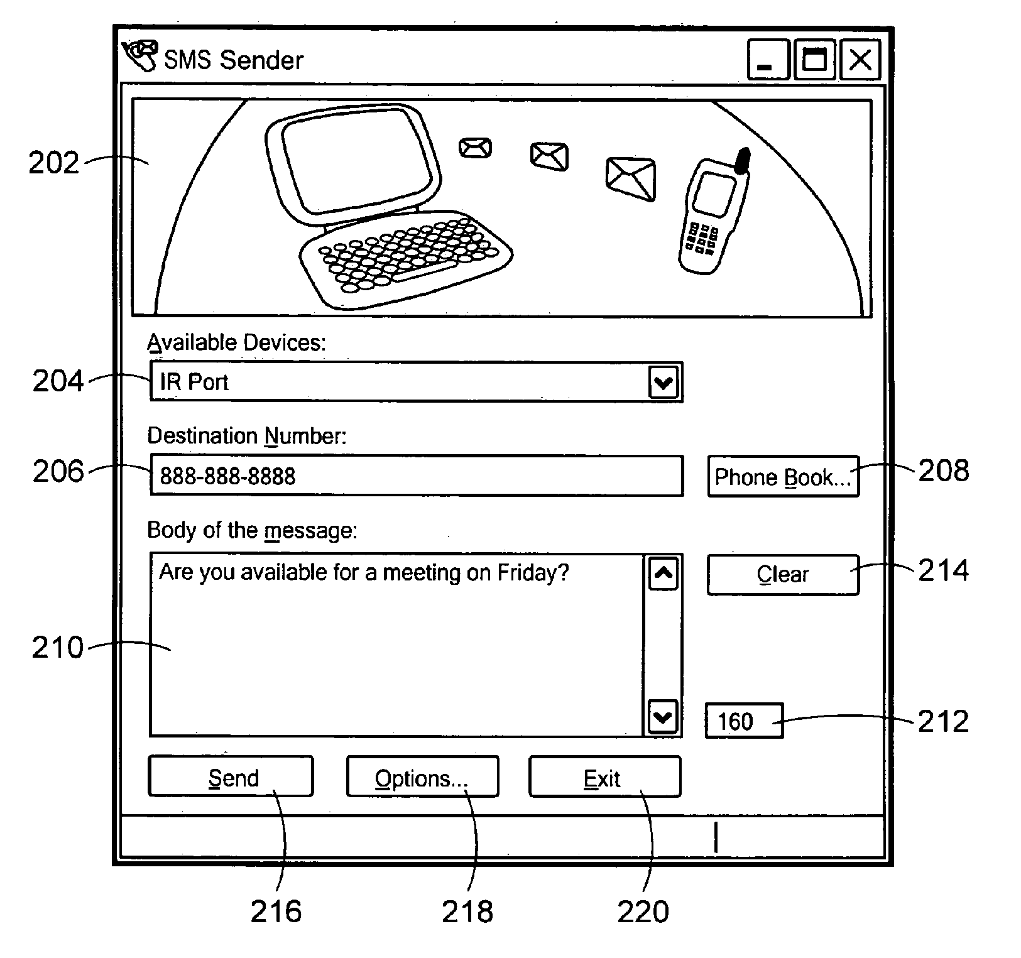
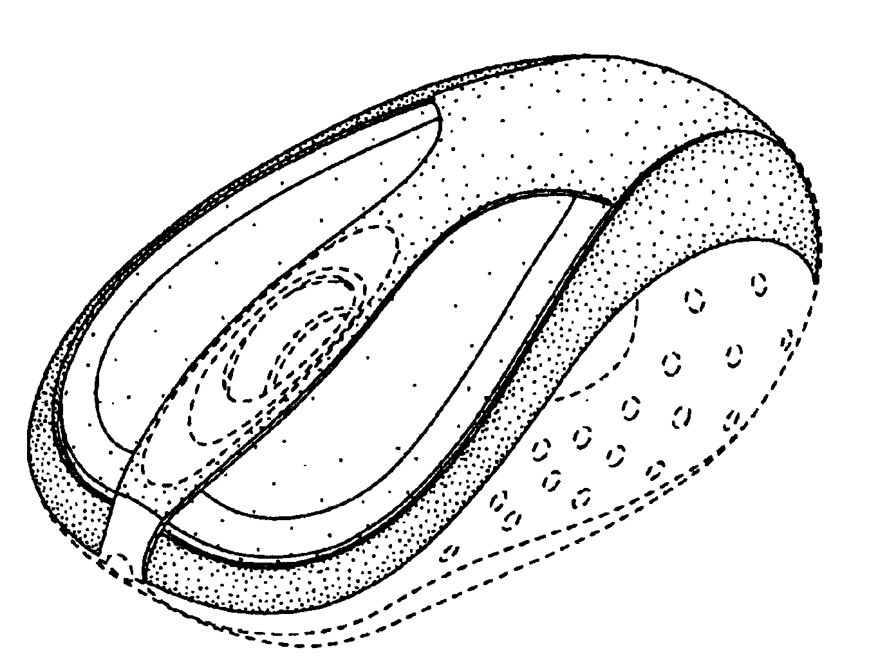
Which of these are patentable?
Notes:
11

Slide 12
Rita’s product
Code files
Code Functionality
UI
Device
Product/company name
Copyright
Utility Patent
Design and Utility Patent
Design and Utility Patent
Trademark
12

Slide 13
Patent Alternatives
Publication
Best used when invention has low right-to-exclude value
Trade Secret
Invention can be kept secret
13

Slide 14
Patentability in reality
It’s Not Enough Just To Be Different
New/
Novelty
Non-obvious/
Inventive Step
Multiple references
Tension with broadness
Useful/
Indust. applicability
14

Slide 15
Components of a Patent Application
Specification
a written description of the invention with instructions on how to use it
Claims
defines the scope of what you claim to be the new and non-obvious part of your invention
Figures
optional, but useful to further explain the invention and how it works
Technical
Requirements
enablement and best mode
15

Slide 16
The Application Process at Microsoft
Invention Disclosure Form
Disclosure
Meeting
1:1 meeting with drafting attorney
Application
Drafted
Review draft application
Describe the problem space
Block diagrams are helpful
Talk about details
Discuss changes with drafting attorney if minor issues remain
Update direction and priority of technology
Prosecution and Issuance
Are allowed claims valuable?
What
How
Alternatives
Advantages
Prior solutions
16

Slide 17
Publish or Perish
Rita Researcher submits a paper for publication by the Hyper Tech Society, a pre-eminent organization in her field. The Hyper Tech Society has a confidentiality policy for its submissions but publishes accepted papers. A few weeks after her submission, she learns that her paper will be published in a week. She contacts her Patty Patents, her patent attorney, about filing a patent application on the technology disclosed in the paper.
Can Patty obtain patent protection for Rita’s invention? If so, where?
Notes:
17

Slide 18
Public Disclosure and Patents
Can destroy patent rights
United States: 1-year grace period
Outside US: no grace period (strict novelty)
What is “public disclosure”?
E-mailing draft paper to peers
Public blog of research
External website
NDA?
Notes:
18

Slide 19
When Should We Patent?
File Early
Identify IP early in design phase
Formulate protection strategy
Plan
Design
Implement
Stabilize
Release
Project Def
Code
Beta Versions
Ship
Spec
B1
B2
B3
RC1
RTM
Best Time
To File
1 Year to File for
U.S. Patents
Potential Public
Disclosure
Public Domain
Potential International
Patent Rights Lost
19

Slide 20
Exchanges of Confidential Info
Can productive discussions take place without exchanging confidential information?
NDAs do NOT cover code
NDA
Obligations
Appearances of impropriety
20

Slide 21
Collaborations
Build Relationship
Identify Problems
Solve problems
NDA
AGREEMENT
21

Slide 22
Collaboration Options
Do we want exclusive ownership of this IP?
If Yes - get contract
Hire as consultant, Visiting Researcher, Intern, temp, or employee
MS owns resulting IP
Beware of overlap with Uni work
Plan ahead to get contract before work starts
Sponsored or Collaborative Research Agreement
Can be slow
Limited rights
22

Slide 23
Copyright
Demo/Events
Images – ©and PII
Publications
BUG your code and web sites
Media
Training set (data)
Code
Libraries
23

Slide 24
24
Questions?

Slide 25
Carole Boelitz
+44 776 435 9689
+44 1223 479 868
25
THANK YOU!!

