Slide 1
Cloud Computing for Research
Fabrizio Gagliardi
Microsoft Research

Slide 2
Introduction
Happy to be given the chance of addressing so many smart and young scientists
My talk is not about computer science, but about computing technology which could enable a new and better way of supporting computational science
I will also cover recent experience in attracting EU funding to support new experimental computing initiative in this field

Slide 3
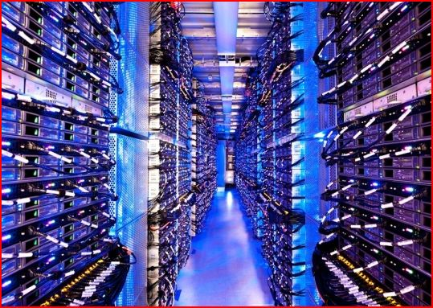
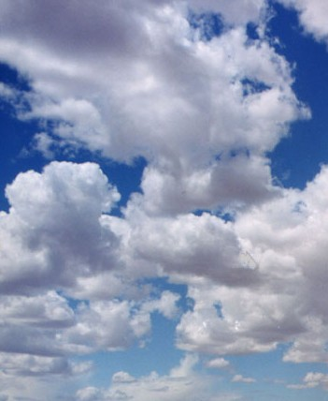
The Cloud
A model of computation and data storage based on “pay as you go” access to “unlimited” remote data center capabilities
A cloud infrastructure provides a framework to manage scalable, reliable, on-demand access to applications
A cloud is the “invisible” backend to many of our mobile applications
Historical roots in today’s Internet apps
    Search, email, social networks
    File storage

Slide 4
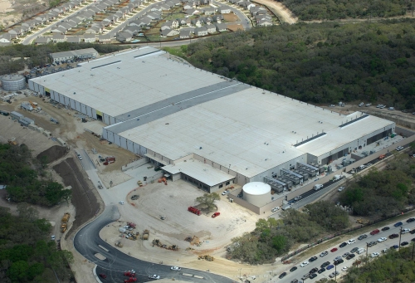
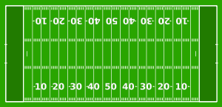

The Cloud is built on massive data centers
Range in size from “edge” facilities to megascale.
Economies of scale
  Approximate costs for a small size center (1K servers) and a larger, 100K server center.
Technology | Cost in small-sized Data Center | Cost in Large Data Center | Ratio
Network | $95 per Mbps/ Month | $13 per Mbps/ month | 7.1
Storage | $2.20 per GB/ Month | $0.40 per GB/ month | 5.7
Administration | ~140 servers/ Administrator | >1000 Servers/ Administrator | 7.1
Each data center is
11.5 times
the size of a football field

Slide 5
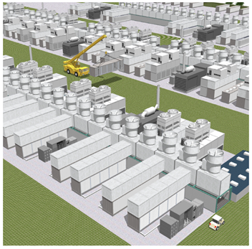
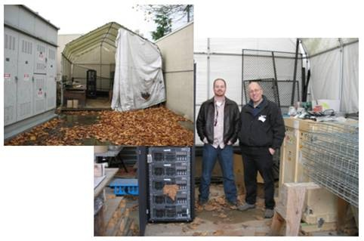
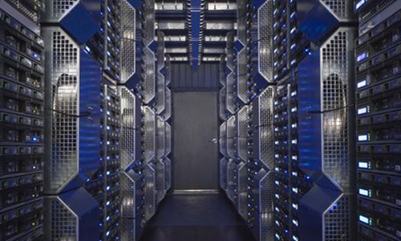
Microsoft Advances in DC Deployment
Conquering complexity.
  Building racks of servers & complex cooling systems all separately is not efficient
  Package and deploy into bigger units
http://www.microsoft.com/showcase/en/us/details/36db4da6-8777-431e-aefb-316ccbb63e4e

Slide 6
DCs vs Grids, Clusters and Supercomputer Apps
Supercomputers
    High parallel, tightly synchronized MPI simulations
Clusters
    Gross grain parallelism, single administrative domains
Grids
    Job parallelism, throughput computing, heterogeneous administrative domains
Cloud
    Scalable, parallel, resilient web services
HPC Supercomputer
Data Center based Cloud
Internet
MPI communication
Map Reduce Data Parallel

Slide 7
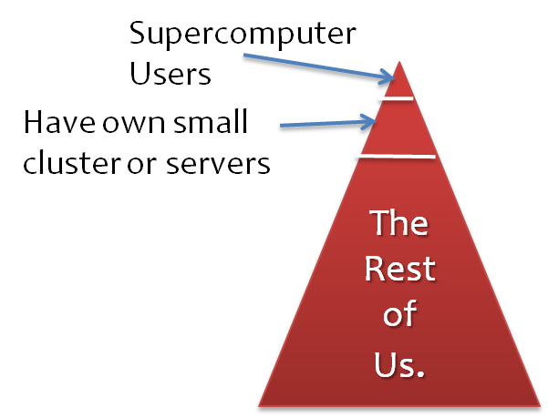
Changing the way we do research
The Rest of Us
    Use laptops
    Got data, now what?
    And it is really is about data, not the FLOPS…
      Our data collections are not as big as we wished
      When data collection does grow large, not able to analyze
    Tools are limited, must dedicate resources to build analysis tools
Paradigm shifts for research
    The ability to marshal needed resources on demand
      Without caring or knowing how it gets done…
    Funding agencies can request grantees to archive research data in common public repositories
    The cloud can support very large numbers of users or communities in a flexible way

Slide 8
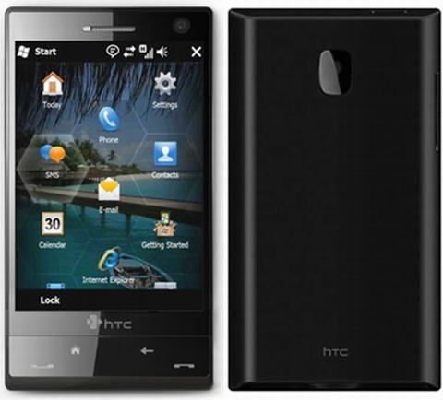
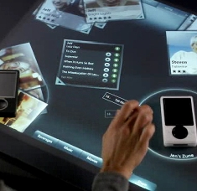
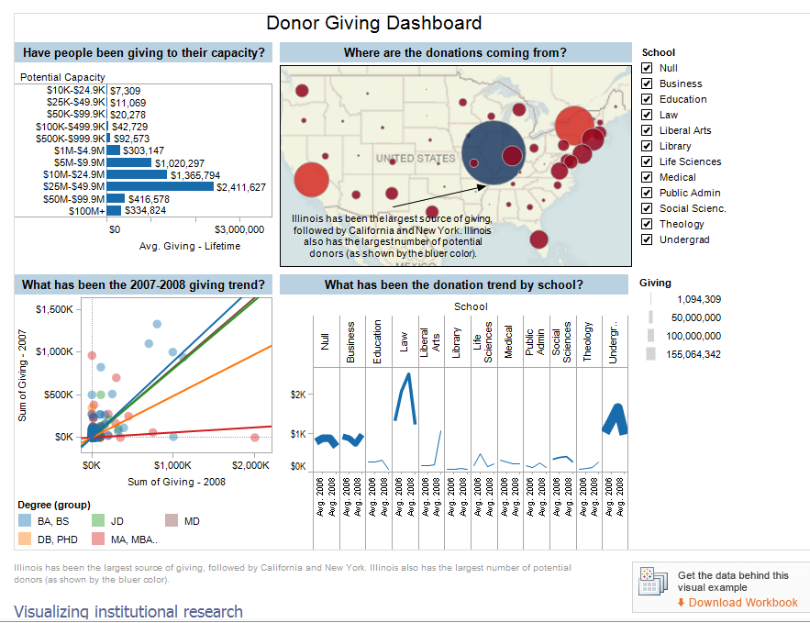


Focus Client + Cloud for Research
Seamless interaction
  Cloud is the lens that magnifies the power of desktop
  Persist and share data from client in the cloud
  Analyze data initially captured in client tools, such as Excel
    Analysis as a service (think SQL, Map-Reduce, R/MatLab)
    Data visualization generated in the cloud, display on client
    Provenance, collaboration, other ‘core’ services…

Slide 9
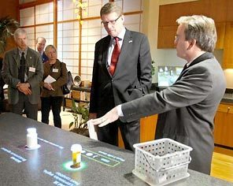
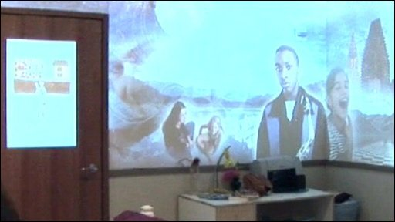
The Clients+Cloud Platform
At one time the “client” was a PC + browser
Now:
    The Phone
    The laptop/tablet
    The TV/Surface/Media wall
And the future:
    The instrumented room
    Aware and active surfaces
    Voice and gesture recognition
    Knowledge of where we are
    Knowledge of our health

Slide 10

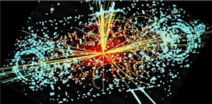
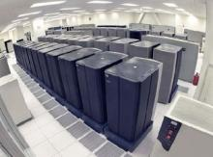

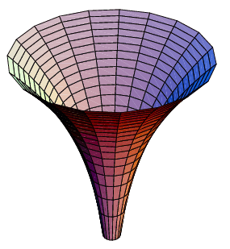
The Future: an Explosion of Data
Experiments
Simulations
Archives
Literature
Instruments
The Challenge:
Enable Discovery.
Deliver the capability to mine,
search and analyze this data
in near real time.
Enhance our Lives
Participate in our own health
care. Augment experience
with deeper understanding.
Petabytes
Doubling every
2 years

Slide 11
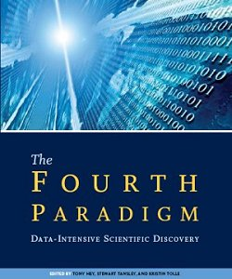
Changing Nature of Discovery
Complex models
  Multidisciplinary interactions
  Wide temporal and spatial scales
Large multidisciplinary data
  Real-time steams
  Structured and unstructured
Distributed communities
  Virtual organizations
  Socialization and management
Diverse expectations
  Client-centric and infrastructure-centric
http://research.microsoft.com/en-us/collaboration/fourthparadigm/

Slide 12
The Cloud Landscape
Infrastructure as a Service (IaaS)
    Provide a data center and a way to host client VMs and data.
Platform as a Service (PaaS)
    Provide a programming environment to build a cloud application
    The cloud deploys and manages the app for the client
Software as a Service (SaaS)
    Delivery of software from the cloud to the desktop

Slide 13
Some examples based on MSR ongoing Cloud Research Engagements

Slide 14
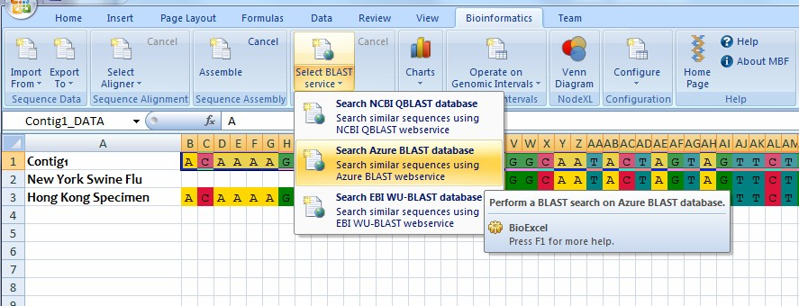

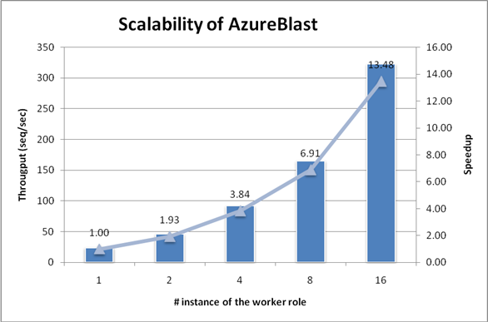
AzureBLAST*
Seamless Experience
Evaluate data and invoke computational models from Excel.
Computationally heavy analysis done close to large database of curated data.
Scalable for large, surge computationally heavy analysis.
Test local, run on the cloud.
selects DBs and
input sequence
Web Role
Input Splitter
Worker Role
BLAST
Execution
Worker
Role #1
BLAST
Execution
Worker
Role #n
….
Azure Blob Storage
*The Basic Local Alignment Search Tool (BLAST) finds regions of local similarity between sequences. The program compares nucleotide or protein sequences to sequence databases
BLAST DB
Configuration
Genome
DB 1
Genome
DB K
Combiner
Worker Role

Slide 15
Making Excel the user interface to the cloud

Slide 16
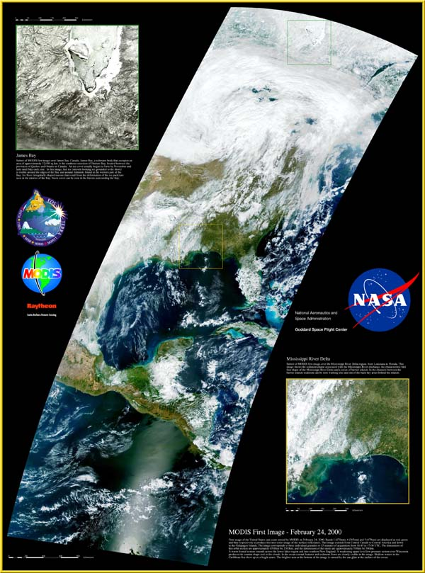
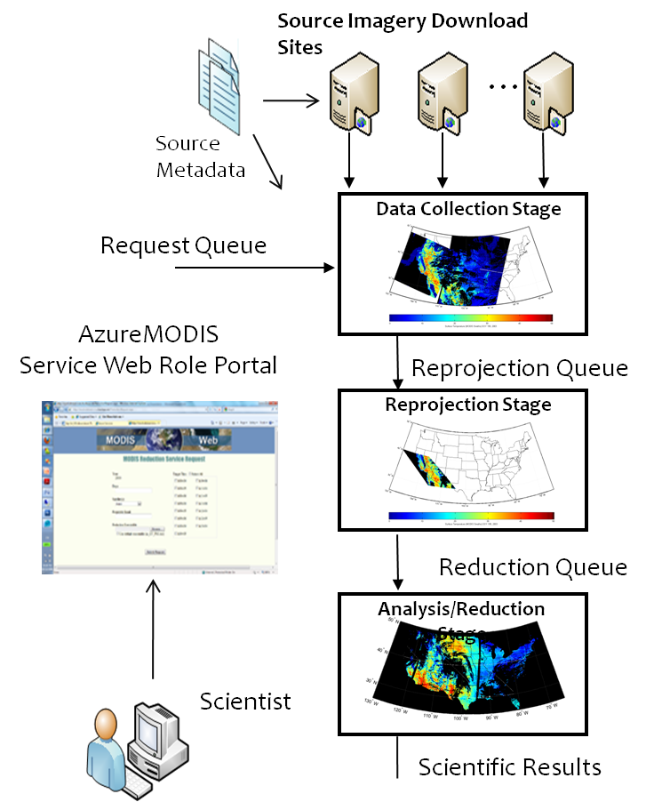
AzureMODIS – Azure Service for Remote Sensing Geoscience
5 TB (~600K files) upload of 9 different imagery products from 15 different locations (~6 days of download)
4 TB reprojected harmonized imagery ~35000 cpu hours
50 GB reduced science variable results ~18000 cpu hours (~14 hour download)
50 GB additional reduced science analysis results ~18000 cpu hours (~14 hour download)

Slide 17
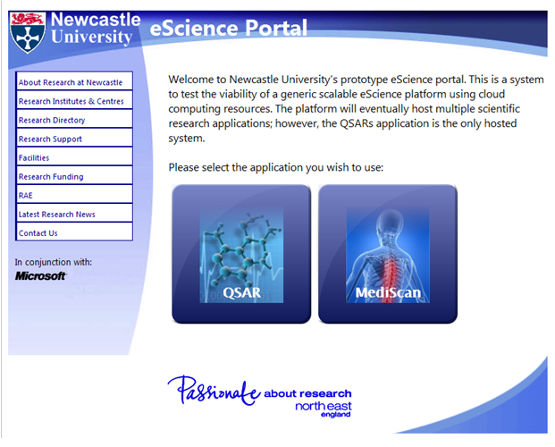
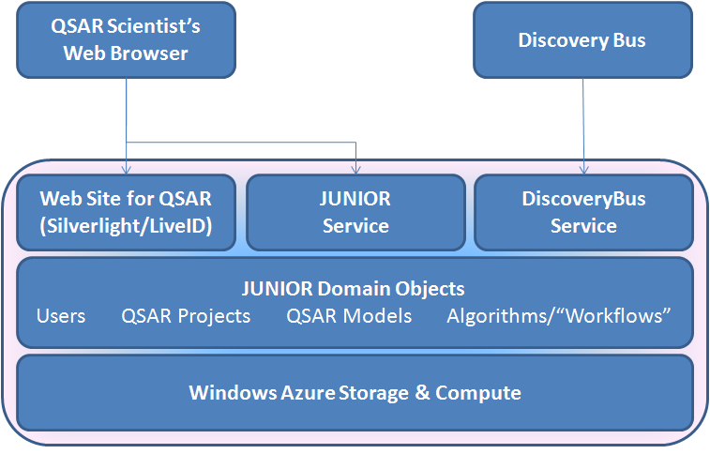
Project JUNIOR
Newcastle University, UK -Paul Watson
  Investigating applicability of
  commercial clouds for scientific research
  Build a working prototype for use-cases
  in chemo-informatics
  Uses Microsoft technologies to build science-related services (Windows Azure, Silverlight…)
  Exploits Azure and Amazon Clouds
Built initial proof-of-concept
  Silverlight UI for basic Quantitative Structure-
  Analysis Relationship (QSAR) modeling
  Demonstrated ability to scale QSAR computations
  in Windows Azure

Slide 18
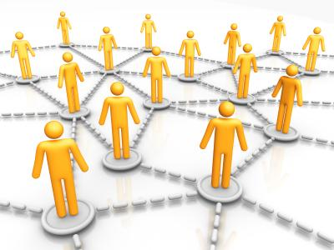
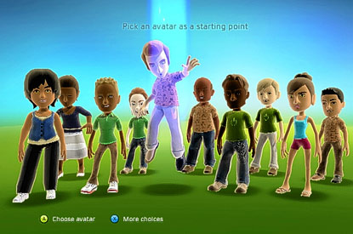
Dynamic shared state
multiplayer games, virtual worlds, social networks
    New modalities of collaboration

Slide 19
Reaching Out: Azure Research Engagement project
In the U.S.
  Memorandum of Understanding with the National Science Foundation
    Provide a substantial Azure resource as a donation to NSF
    NSF will provide funding to researchers to use this resource
  In Europe
    We interested in direct engagement with the thought leaders in the U.K., France and Germany
    EC engagements where possible (VENUS-C to start off)
  In both we provide our engagement team
    We provide workshops, tutorials, best practices and shared services, learn from this community, shape policy…
  In Asia
    We wish to explore possibilities

Slide 20
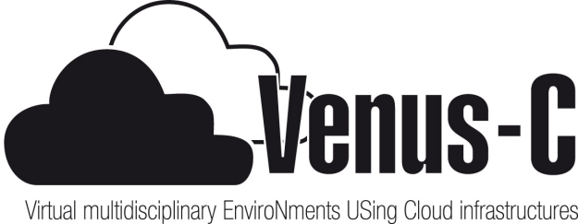
VENUS-C
Virtual multidisciplinary EnviroNments
USing Cloud infrastructures
Funding Scheme: Combination of Collaborative Project and Coordination and Support Action: Integrated Infrastructure Initiative (I3)
Program Topic: INFRA-2010-2 1.2.1. Distributed Computing Infrastructures

Slide 21
Consortium
1 (co) | Engineering Ingegneria Informatica S.p.a. | ENG | IT
2 | European Microsoft Innovation Centre | EMIC | DE
3 | European Charter of Open Grid Forum | OGF.eeig | UK
4 | Barcelona Supercomputing Center – Centro Nacional de Supercomputación | BSC-CNS | ES
5 | Universidad Politecnica de Valencia | UPV | ES
6 | Kungliga Tekniska Hoegskolan | KTH | SE
7 | University of the Aegean | AEG | GR
8 | Technion | TECH | IL
9 | Centre for Computational and Systems Biology | CoSBi | IT
10 | University of Newcastle | NCL | UK
11 | Consiglio Nazionale delle Ricerche | CNR | IT
12 | Collaboratorio | COLB | IT

Slide 22
Goals
1. Create a platform that enables user applications to leverage cloud computing principles and benefits
2. Leverage the state of the art to early adopters quickly, incrementally enable interop with existing DCI and push the state of the art where needed
3. Create a sustainable infrastructure that enables cloud computing paradigms for the user communities inside the project, the ones from the open-call for applications, as well as others

Slide 23
Supporting multiple basic research disciplines
Biomedicine: Integrating widely used tools for Bioinformatics (UPV), System Biology (CosBI) and Drug Discovery (NCL) into the VENUS-C infrastructure
Civil Protection and Emergency: Early fire risk detection (AEG), through an application that will run models on the VENUS-C infrastructure, based on multiple data sources.
Civil Engineering: Support complex computing tasks on Building Information Management for green constructions (provided by COLB) and dynamic building structure analysis (provided by UPV).
D4Science: Integrating computing through VENUS-C on data repositories (CNR). In particular focus will be on Marine Biodiversity through Aquamaps.

Slide 24
Open Call for 20 e-Science Applications
20K€ funding each (in addition to Azure Compute , Storage and Network Resources)
-> porting applications to the cloud
-> education and traning
-> scalability tests

Slide 25
Thanks for your attention

