Slide 1

Infer.NET and probabilistic programming
John Winn 30th June 2010

Slide 2
How can I write smart software?
How can I do smart data analysis?

Slide 3
Why probabilistic programming?
Old approach
Define model
Choose inference method
Derive algorithm by hand
Implement algorithm (e.g. Matlab)
Revise model/method
Re-implement algorithm (e.g. C++/C#)

Slide 4
Why probabilistic programming?
Old approach
New approach
Define model
Define model
Choose inference method
Write model as probabilistic program
Derive algorithm by hand
Implement algorithm (e.g. Matlab)
Apply inference engine
Revise model/method
Revise model/ engine settings
Re-implement algorithm (e.g. C++/C#)
Notes:
These stages are very time consuming!

Slide 5
Code size & complexity
Ordinary program
Probabilistic program
with Infer.NET
20-30 lines of ‘simulation’ code
Hours, not months!
100s-1000s of lines of code
Notes:
How can we implement reasoning backwards?
In a normal language it can take thousands of lines of code to achieve this.
However, with Infer.NET we can use a probabilistic program to solve the same problem in 20 or 30 lines of code. Much faster to develop, test and easier to debug!
The reason it is so much more compact, is that with Infer.NET you just describe the forward process and you get reasoning backwards and probabilities for free.

Slide 6


Examples of using Infer.NET
Medical research
Electronic health records
New understanding of the causes of asthma
Clinical simulation of asthma
Social network understanding
Network and music tastes
Recommended songs
Simulation of sharing of musical tastes between friends
Notes:
This show the great diversity of potential applications.

Slide 7
What is a probabilistic program?
Very much like an ordinary program, except:
Variables can have uncertain (random) values
Functions of random variables can be constrained to have particular results.
Programs are executed using an inference engine
Let’s see an example…
Notes:
MOTIVATION: new representation language, drive new inference algorithms.
Related work: limited inference algorithms, limited language e.g. discrete variables only, do not separate framework + language, not based on an existing language.

Slide 8

A Simple Probabilistic Program
I toss two fair coins
What is the probability both are heads?
Notes:
The purpose of this example is to
Introduce concepts
See how Infer.NET works
We will move to a real application later. You will need to understand this to understand the later application
First SLOW way, then FAST way
What is the probability both are heads? Ask the audience

Slide 9
C# 'Probabilistic' Program
bool firstCoin =
random.NextDouble()>0.5;
bool secondCoin =
random.NextDouble()>0.5;
bool bothHeads =
firstCoin & secondCoin;
T
F
T
T
…
F
T
T
F
…
F
F
T
F
…
Notes:
We’ll start in plain C#. We are using .NET random methods to simulate the randomness of the coins where true is heads and false is tails.
What happens when we run this?
Walk through the animation

Slide 10
After a Very Large Number of Runs…
T
~50%
bool firstCoin =
random.NextDouble()>0.5;
bool secondCoin =
random.NextDouble()>0.5;
bool bothHeads =
firstCoin & secondCoin;
F
~50%
T
~50%
F
~50%
T
~25%
F
~75%
Notes:
… we get approximately the right answer

Slide 11
Reasoning Backwards
Suppose I did not get two heads
What is the probability the first coin was heads?
Notes:
For example, I may have got no heads or 1 head, but not 2 heads.
Anyone know the answer?

Slide 12
Probabilistic Program
bool firstCoin =
random.NextDouble()>0.5;
bool secondCoin =
random.NextDouble()>0.5;
bool bothHeads =
firstCoin & secondCoin;
T
F
T
T
…
F
T
T
F
…
F
F
T
F
…
We observe that bothHeads is
F
Notes:
How can we use our C# program to answer this question
Answer – we keep only the runs which match our observations
So here are 4 runs – only three match the observation

Slide 13
After a Very Large Number of Runs…
T
~33%
bool firstCoin =
random.NextDouble()>0.5;
bool secondCoin =
random.NextDouble()>0.5;
bool bothHeads =
firstCoin & secondCoin;
F
~67%
T
~33%
F
~67%
T
~0%
F
~100%
Notes:
… we get approximately the right answer

Slide 14
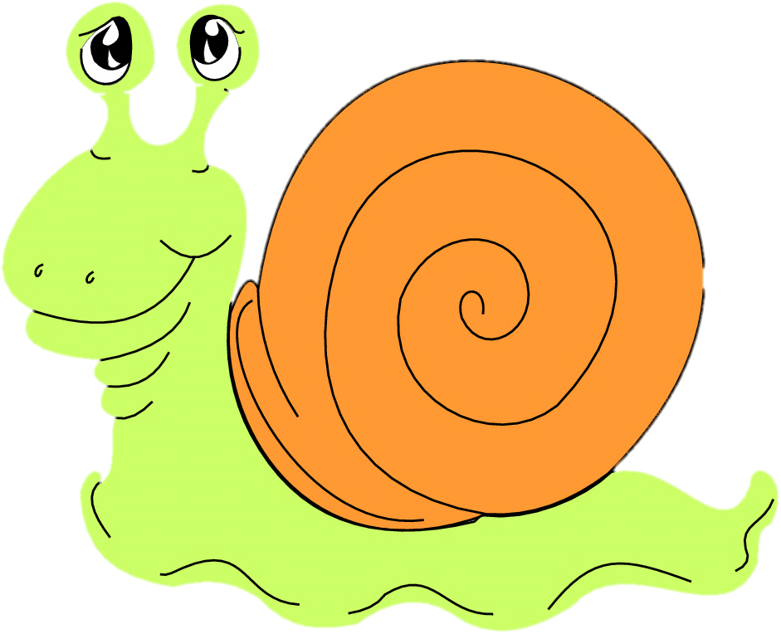
Multiple Runs Are Very Inefficient
Illustrates how a prob. program works
But we want to reason about complex situations with 1000s of variables e.g. observing 20 binary variables needs ~2²⁰ million runs
Is there a practical approach?
Infer.NET
Notes:
We have seen how you can use large numbers of runs in C# to answer simple questions about coins
In reality we want to…(as it says on the slide)
The method we have seen does not scale

Slide 15


Random Variables in Infer.NET
T
var firstCoin =
Variable.Bernoulli(0.5);
var secondCoin =
Variable.Bernoulli(0.5);
var bothHeads =
firstCoin & secondCoin;
50%
T
50%
F
25%
Notes:
We now take our C# program and write in Infer.NET. Infer.NET is a .NET library
Instead of working with multiple runs, Infer.NET works with probability distributions.
The name for a probability distribution which has some probability of being true or false is Bernoulli (named after Jacob Bernoulli who was the uncle of Daniel Bernoulli who discovered the principle of what keeps an airplane up in the air.)
Now firstCoin 50% true and 50% false – it has a distribution over the values true and false – we call a variable which has a distribution over a finite or infinite number of values a ‘random variable’.
CLICK CLICK
Operations on random variables yield other random variables
CLICK

Slide 16
Getting the Distribution of ‘bothHeads’
var engine = new InferenceEngine();
Bernoulli result =
engine.Infer<Bernoulli>(bothHeads);
double probTrue = result.GetProbTrue();
// ‘probTrue’ is now exactly 0.25
Notes:
We know the distributions for firstCoin and secondCoin. We would like to be able to get at the distribution for bothHeads .
This process is called inference, and is achieved in Infer.NET using an inference engine. Infer.NET uses some serious heavyweight technology to get at these distributions without having to do multiple runs.
Running inference on a random variable (in this case bothHeads) returns a distribution, in this case a Bernoulli distribution. And we can recover the probability of being true from this distribution.
Unlike the C# example, this is an exact answer.

Slide 17
Adding an Observation
We observe that bothHeads is
F
bothHeads.ObservedValue = false;
Bernoulli firstDist =
engine.Infer<Bernoulli>(firstCoin);
double newProb = firstDist.GetProbTrue();
// ‘newProb’ is now exactly 0.333…
Notes:
Now, what about backward reasoning. We can tell Infer.NET about observations through the ‘Observed’ property on the variable. This changes the distributions for other variables but it places a constraint on the variable and therefore rules out some of the options for the other variables.
Setting bothHeads to be observed as false, we can now ask questions about firstCoin by running inference again.

Slide 18
How Infer.NET Works
Bernoulli(0.5)
Bernoulli(0.5)
firstCoin
secondCoin
&
Normal execution
bothHeads
Backwards messages
Observe
F
Notes:
Ordinary programs run forward
Infer.NET can run both backwards and forwards which allows reasoning backwards…
… and the messages that are passed are distributions not values.

Slide 19
Almost Done with the Coins!
For ‘tossing a coin’ think:
Switching on a gene
Clicking on a link
Having a disease…
Want to learn the probability of these events
Like having a biased coin
Notes:
One more thing to cover before example application
Tie back to examples at the start
Suppose we want to learn probability of clicking?
… it’s like having a biased coin
“This is important because…”

Slide 20
Biased Coins
Probability of heads (p)
10%
50%
90%
T
T
T
F
T
T
F
F
T
F
F
T
F
T
F
F
F
T
Notes:
So far we have assumed the coins are fair.
Now suppose we have a coin where we don’t know if it fair. We will now look at SEQUENCES of coin tosses.
If it was actually fair, we would expect to see a sequence of observations like this …
CLICK CLICK…
If it was biased towards tails, so that there’s only a 10% chance of heads, we would get …
If it was biased towards heads, so that there’s a 90% chance of heads, we would get …

Slide 21
Reasoning Backwards
Beta distributions
10%
50%
90%
T
T
T
F
T
T
F
F
T
F
F
T
F
T
F
F
F
T
Notes:
But we have to be careful. If we have a coin of unknown bias, and we happen to get this middle sequence, we can’t be sure that it’s a fair coin – all we can say is that it is more likely to be close to 50% chance of heads.
CLICK
… as shown by this curve.
Similarly if we get the sequence on the left, we can’t be sure that the probability of heads is 10%– all we can say is more likely to shift towards the tails end of the scale…
CLICK
… as shown by this curve
Etc
These curves are distributions over the probability of heads (the bias). We call them Beta distributions.

Slide 22
Reasoning Backwards
// a flat Beta distribution var p = Variable.Beta(1,1);
var toss1 = Variable.Bernoulli(p); toss1.ObservedValue = false;
var toss2 = Variable.Bernoulli(p);
toss2.ObservedValue = true;
Beta result = engine.Infer<Beta>(p);
// gives a Beta curve like the ones // on the last slide
F
T
…
…
Notes:
… and because the are distributions, we can reason about them using Infer.NET
So you have seen how to reason backwards from data about events (like coin tosses) and also about quantities (like the coin bias).
Now I will hand over to John Guiver who will show how we can use these abilities in a real application.

Slide 23
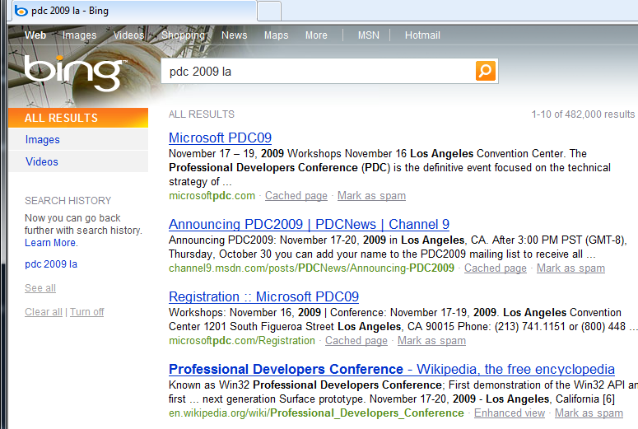

Some Infer.NET Scenarios
Search Log Analysis
Musical Tastes
Understanding intent
Understanding social structures
Patterns of email/meetings
User presence (free/busy)
Assessing user skills/expertise
Collaborative filtering
Smart contact management
Paper Reviewing
Movies, music, apps, photos…
Adaptive user interfaces
Exploiting explicit/ implicit feedback
Personalised search
Telemetry/log analysis
Reject
Accept

Slide 24

Search Log Analysis
[Guo et al., WWW Conf. 2009]
Notes:
Disclaimer – not used in Bing in the manner presented here. However, a similar model is used by Bing to evaluate new ranking algorithms.
The first example I want to look at to an analysis of a search engine log. This is a nice example to start with because it uses exactly the same probabilistic program elements as John’s hello world example. So let’s start with a user issuing a query, for example ‘pdc 2009 la’, and hit enter.

Slide 25

The Click Log
Click Log
1
2
3
4
T
F
T
F
Notes:
The user then gets presented with a page of results, and the user interacts with the results. So, for example, our user may click on the first item, examine the document, navigate back to the results page, skip over the second item, skip on the third, and then close the results page. These clicks and non-clicks are stored in a click log associated with the query and results page. What we would like to do is reason backwards and learn about the quality of the results page.
This analysis could equally well apply to a web app where you want to learn about how users navigated through the app, and how you can make it easier for them.

Slide 26





Imagine One User and One Query
Examine
Let’s look at the page …
… and see if it’s useful
Let’s look at the next result …
… and see if it’s worth clicking on
Aaargh!
That looks promising … … let’s click
appeal
It’s relevant!
Done!
N
Y
Click?
Next?
Y
N
View
relevance
N
Y
Relevant?
Next?
Y
N
Y
Next?
var click = Variable.Bernoulli (appeal[d]);
var next = Variable.Bernoulli (0.2);
var doNext = Variable.Bernoulli (0.9);
N
var isRel = Variable.Bernoulli (relevance[d]);
Notes:
So how do we write this probabilistic program? Well first we have to have some understanding of how a user interacts with a search engine, and makes some assumptions based on that understanding. Our program assumes that the user looks through the items on the results page in order, and reads the summary snippet to determine whether to click on a link
Here is a flowchart for our probabilistic program, and here is our user. We’re going to look at this from the point of view of the user.
Let’s imaging what goes through the user’s mind. From our assumptions, he starts off by examining the first item in the list.
CLICK
At this point the user needs to decide whether to click on the hyperlink or not. We imagine the user looking at the summary text, and we hypothesise that the summary has a certain appeal with respect to the query. There will be a proportion of people finding the summary appealing – that proportion is given by the unknown appeal variable.
CLICK
This appeal is like the bias in the coin in our earlier example – the greater the appeal, the more likely the user is to click. But the click is still a random event – however appealing the summary is, the user still may not click on it. So let’s imagine a biased ‘appeal’ coin is flipped at this point – here’s the C# code at bottom right
CLICK
… and in this case he’s decided to click
At this point the user is viewing the document…
CLICK
… and is assessing whether the document is relevant or not. As with appeal, relevance is also like the bias of a coin.
CLICK
The document will have some level of relevance with respect to the query. Some proportion of users will find the document relevant with respect to the query. This relevance is again like a bias for an ‘is relevant’ coin.
So let’s flip it…
CLICK
In this case the relevance coin comes up tails - our user is not happy. Now our user makes another decision – whether to go and examine the next item on the results list. As the previous document was not relevant for the needs of our user, he is more likely to press on to the next item.
CLICK Again this is like flipping a biased coin (in this case we have fixed the bias to 0.9 the C# code fragment)
CLICK
In this case our user has chosen to examine the next document
CLICK
And now we go through our sequence again for the document in the second position
We flip our appeal coin
CLICK
It comes out heads so we examine the document CLICK CLICK, we flip the relevance coin, CLICK and in this case our user is happy, we flip the coin which says whether we look at the next document, CLICK , which in this case is FALSE, CLICK and so we exit.
So we have described a fairly involved probabilistic program of a user interacting with a search engine by sequence of flipping biased coins

Slide 27
Infer.NET code snippet
// Is user examining this item?
examine[d] =
examine[d - 1] & (((!click[d - 1]) & nextIfNotClick) | (click[d - 1] & nextIfClick));
// Whether the user clicks/finds relevant
click[d] =
examine[d] & Variable.Bernoulli(appeal[d]);
isRelevant[d] =
click[d] & Variable.Bernoulli(relevance[d]);
Notes:
Here is more of the Infer.NET code for this example. The variables we are interested in such as the underlying appeal and underlying relevance of a document at a particular position, whether the document was examined, and whether it was clicked on, and whether it was considered relevant by this user are all random variables to be inferred.
The first statement is a random variable which represents whether a document was examined. The logic embodied in this statement embodies all the different paths through the flow chart to arrive back at the top again. The second and third statements show the coin flips based on the underlying appeal and relevance.

Slide 28
Attaching data
Click Log
T
T
F
T
T
F
F
F
F
T
F
F
F
F
T
T
for (int d = 0; d < nRanks; d++)
click[d].ObservedValue = user.clicks[d];
Notes:
If we want to reason backwards we need to add observations to our models. These come from the click log

Slide 29
Search Log Analysis
demo
Notes:
Comments on the code. Control statements are interesting. Code in both the if and the else are executed with some probability.
We look at the following scenarios
TF - Appealing and relevant
TT – appealing and not relevant
FT – not appealing - cannot infer relevance

Slide 30
Standard models supported
Clustering
Classification (linear/non-linear/multi-class)
Logistic regression
Factor analysis/PCA/ICA
Discrete Bayesian networks
Ranking models
Hidden Markov Models
Sparse models (e.g. classifiers, PCA)
Hierarchical models

Slide 31
Custom models supported
Standard models
More complex models →
Solvable using built-in components
Solvable using custom components
Solvable in parts
Custom method
Open research
Custom components can be used as a distribution channel for ML research.

Slide 32
Shared Music Tastes
[Dietz, NIPS Topic Model workshop 2009]
Aim: analyse playlists to understand shared tastes within the social network.
Learn which friends are more influential in propagating musical tastes
Learn underlying taste profiles across artists/songs
Learn shared tastes between two individuals
Clique within social network $⇏$ Shared Taste

Slide 33
Learning Shared Tastes
Alternative
Jam Band
Misc.
R&B/Pop
Rock

Slide 34
Probabilistic Program (one user)
var F = new Range(NumF); // Friends
var P = new Range(NumP); // Playlist
var T = new Range(NumT); // Tastes
using (Variable.ForEach(P)) {
// Explain playlist by choosing a friend … var friend = Variable.Discrete(F,UProb);
using (Variable.Switch(friend)) {
// … choosing a taste for that friend … var taste = Variable.Discrete(T,FProbs[friend])
using (Variable.Switch(taste))
// … and choosing a song for that taste PlayList[P] = Variable.Discrete(TProbs[taste]); }
}
}
Notes:
This is the probabilistic program for one user

Slide 35
Shared Music Tastes
demo
Notes:
Comments on the code. Control statements are interesting. Code in both the if and the else are executed with some probability.
We look at the following scenarios
TF - Appealing and relevant
TT – appealing and not relevant
FT – not appealing - cannot infer relevance

Slide 36

How Good Are You at Halo?
Xbox Live
12 million players
2 million matches per day
2 billion hours of gameplay
The Challenge
Tracking how good each player is to match players of similar skill.
TrueSkill™
Months of work, 100s of lines of code
Gamertag | Score
Sully | 25
SniperEye | 22
DrSlowPlay | 17
Old Estimates of Players’ Skills
New Estimates of Players’ Skills
Notes:
Observe performance – who wins, who loses, infer player skills
A free-for-all three player game
Score is number of kills
Original TrueSkill™ inference algorithm was created by Ralf Herbrich and Thore Graepel of Microsoft Research, Cambridge.

Slide 37
Inferring Skills
Game Outcome
SniperEye
1st Place
2nd Place
3rd Place
DrSlowPlay
Belief in Skill Level
Sully
0
10
20
30
40
50
Skill Level
Notes:
Skill is stored as random variable satisfying a Gaussian distribution. Both mean and variance are maintained for each player.
The more games that are played, the more certain we are of skill. Sully has wide uncertainty – probably a newish player. SniperEye has narrow uncertainty – will have played a lot of games. Sully beats both players – his skill quickly gets promoted, but is still quite uncertain. Dr Slowplay and SniperEye move down, but not so much, as their skill is more tested with time.

Slide 38
Probabilistic Program
// Gaussian random variables for skills
var skill1 = Variable.Gaussian(oldMean1, oldStdDev1);
var skill2 = Variable.Gaussian(oldMean2, oldStdDev2);
var skill3 = Variable.Gaussian(oldMean3, oldStdDev3);
// Players’ performances are centred around their skills
var perf1 = Variable.Gaussian(skill1, beta);
var perf2 = Variable.Gaussian(skill2, beta);
var perf3 = Variable.Gaussian(skill3, beta);
// Outcomes
Variable.ConstrainPositive(perf1 – perf2);
Variable.ConstrainPositive(perf2 - perf3);
// Now we update the players’ skills
var newSkill1 = engine.Infer<Gaussian>(skill1);
var newSkill2 = engine.Infer<Gaussian>(skill2);
var newSkill3 = engine.Infer<Gaussian>(skill3);
Notes:
This is a simplified version of the Xbox ranking system used to rate players so as to bring together evenly matched players or teams. Performances are randomly distributed around their skill levels
The probabilistic program is relatively easy. The inference is hard – several months work to code from scratch. With Infer.NET, can just concentrate on the probabilistic program.

Slide 39

Reviewer Calibration Problem
[SIGKDD Explorations ‘09]
Weak Accept
Strong Reject
Weak Reject
Accept
Reviewers
Weak Accept
Submissions
Weak Accept
Weak Accept
Aim: infer calibrated score
Notes:
Perennial problem for conferences
Which submissions to accept/reject
Variable quality reviews. Each reviewer (judge) reviews a variable number of submissions. They may or may not be knowledgeable about the area. The reviews are of variable quality. Each reviewer gives a rating to a submission, and an assessment of their expertise in the subject matter.
Some ‘good’ reviewers give accurate reviews and are realistic about their expertise; some reviewers give variable quality reviews and may be unrealistic about their expertise. Some may have a tendency to give the same rating for each submission.
Would like to infer true ratings and qualities of reviews to provide advice for committee

Slide 40
Reviewer Calibration Code
// Precision associated with each expertise level
Expertise[e] = Variable.Gamma(expMean,expVar)).ForEach(e);
// Calibrated score – one per submission
Quality[s] = Variable.Gaussian(qualMean,qualPrec).ForEach(s);
// Review score – one per review
Score[r] = Variable.Gaussian(Quality[sOf[r]],Expertise[eOf[r]]);
// Accuracy of judge
Accuracy[j] = Variable.Gamma(judgeMean,judgeVar).ForEach(j);
// Score thresholds per judge
Threshold[t][j] = Variable.Gaussian(NomThresh[t], Accuracy[j]);
// Bool observations (derived from rating)
Observation[t][r] = Score[r] > Threshold[t][jOf[r]];
Notes:
This is the probabilistic program for one user

Slide 41
Results for KDD 2009 (Anonymised)
Highest score: paper #319
Overtakes #99 which had best possible reviews
#99 had 3 ‘strong accept’, #319 had 1 ‘strong accept’ and 2 ‘accept’ but #319 reviewers less likely overall to give ‘strong accepts’
Most certain score: paper #94
Had 5 reviews which, exceptionally, all recommend weak accept
Least certain score: paper #533
Had ‘weak reject’, ‘weak accept’, and ‘strong accept’.
Most generous reviewer: reviewer #61
Lowest threshold for top rank
Gave 5 strong accepts
Self-assessed expertise corresponds to learned precision:
Informed Outsider: 1.22
Knowledgeable: 1.35
Expert: 1.59

Slide 42
Other Infer.NET Research Projects
Program verification (Merlin – ACM Sigplan ‘09)
Movie recommendation (MatchBox – WWW ‘09)
Data form entry checking (Usher – ICTD ‘09)
Gene expression analysis (RECOMB 2008)
Click prediction (SIGIR Workshop 2008)
Understanding causes of asthma (AJRCCM 2010)
Extracting plots of novels
… and many more
Notes:
This show the great diversity of potential applications.

Slide 43
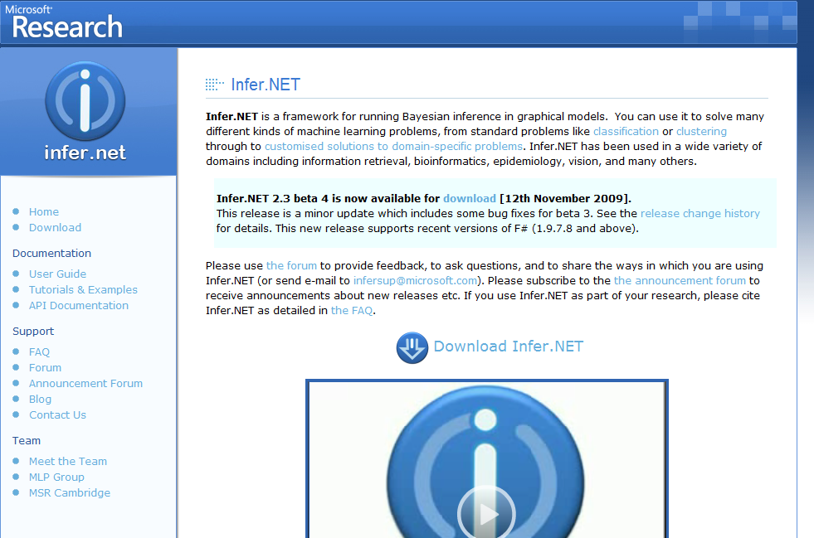
http://research.microsoft.com/infernet
Notes:
You can try out Infer.NET as a free download. The site provides tutorials, examples, documentation, and an active community forum.
Currently this is research code only – but please do try it out and play around with it.

Slide 44
If you use Infer.NET in your research, please keep us in the loop! Use the forums or email: infersup@microsoft.com

Slide 45
Thanks!
Questions?

