Slide 1


2015 Microsoft Indoor Localization Competition
Dimitrios Lymberopoulos (Microsoft Research)
Jie Liu (Microsoft Research)
Xue Yang (Intel)
Niki Trigoni (University of Oxford)
Anthony Rowe (CMU)
Ayman Naguib (Qualcomm)

Slide 2
Background
48 systems from 44 teams submitted abstracts
28 systems showed up
23 systems actually evaluated
Academia, Industry
Two categories
Infrastructure-free (7 teams)
No hardware deployment
Conference venue WiFi and phone sensors
Infrastructure-based( 16 teams)
Custom hardware deployment

Slide 3
Evaluation Process
2-day event
Day 1: Monday
Teams were given 7 hours to setup and calibrate their systems
Day 2: Tuesday
Each team was asked to provide the coordinates of 20 test points
Test points’ coordinates were manually measured using laser range finders
Evaluation Metric
Average localization error across the 20 test points

Slide 4
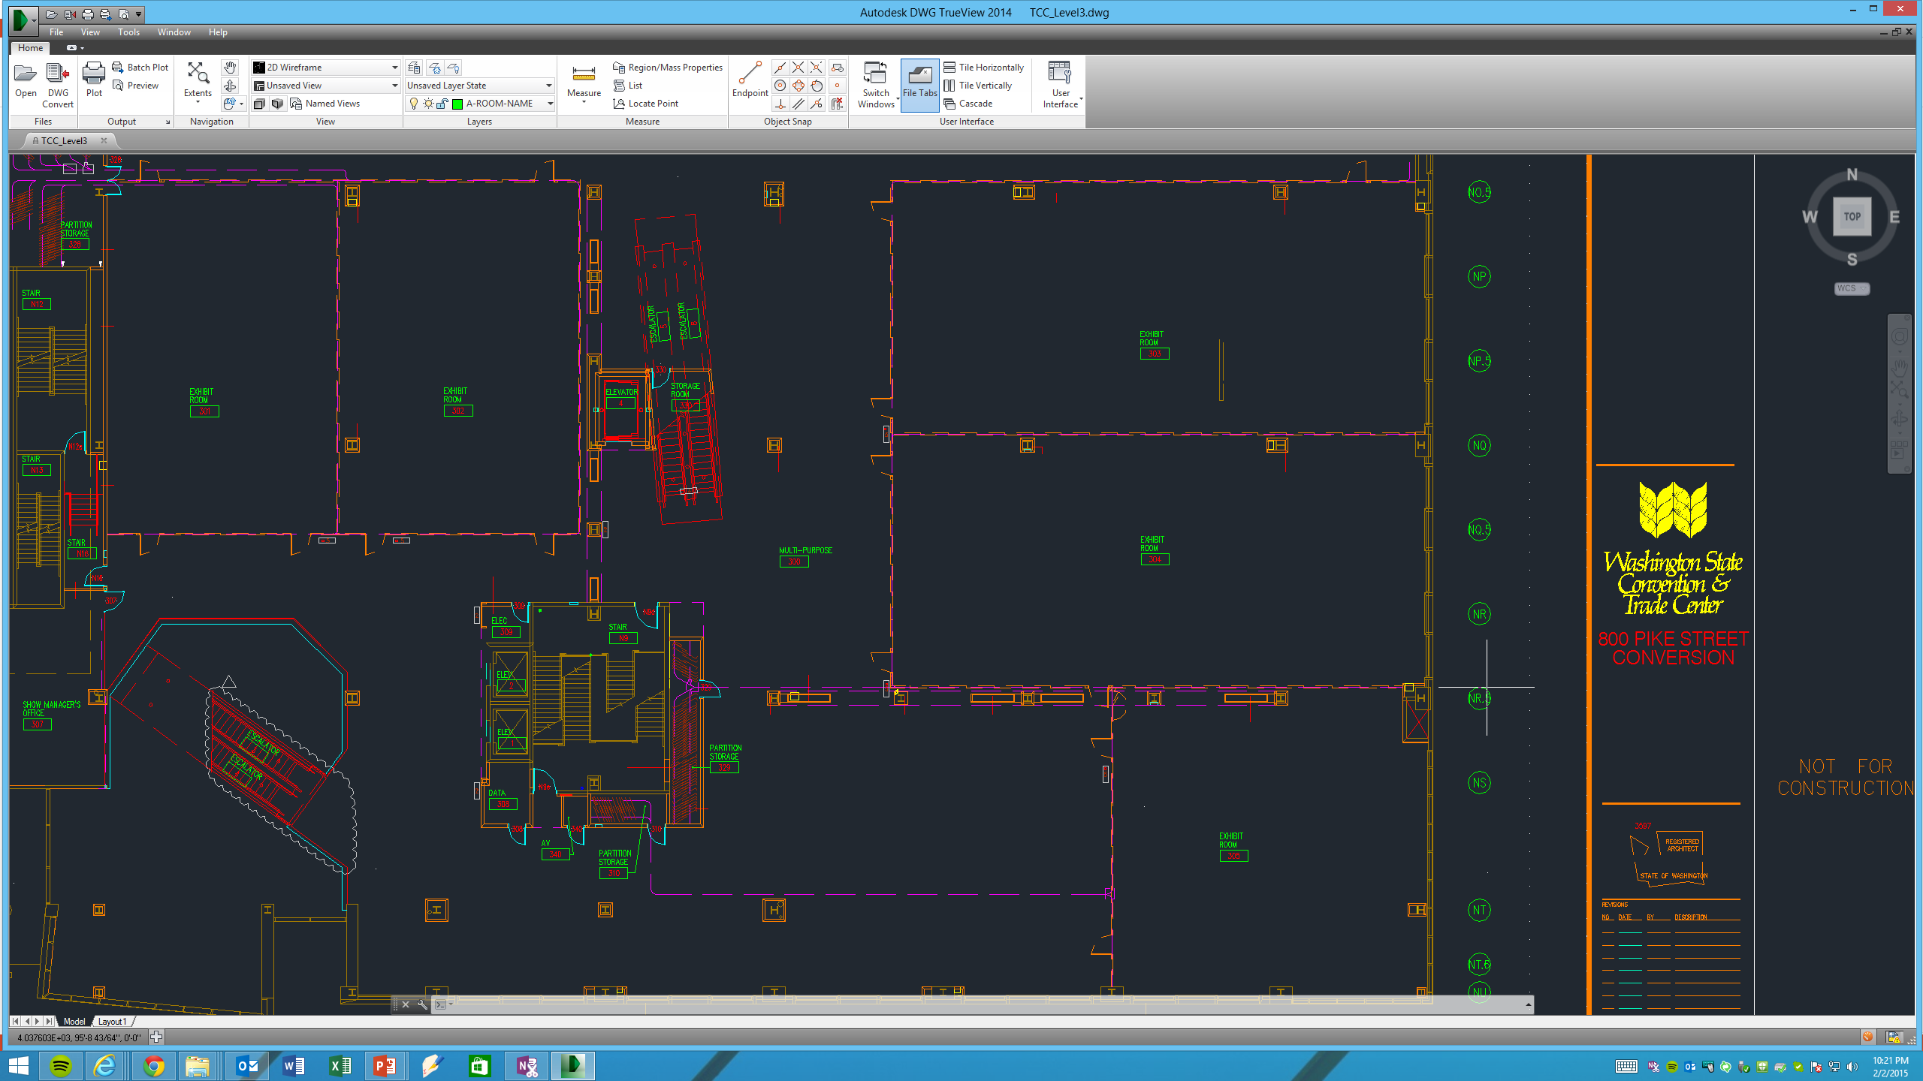
2000m² Evaluation Area
Y Axis
Origin Point
(0,0)
X Axis

Slide 5
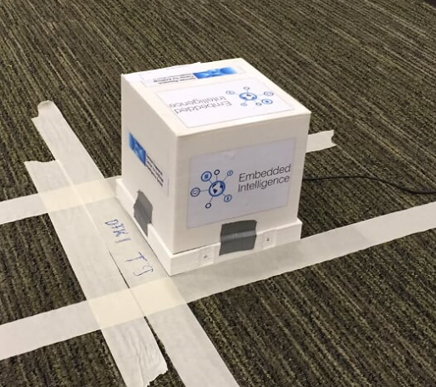
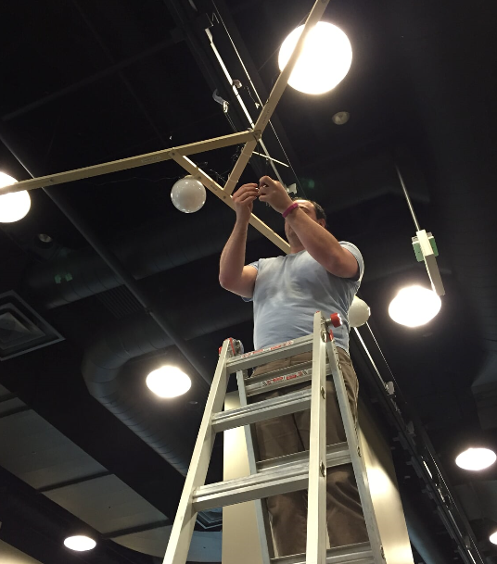
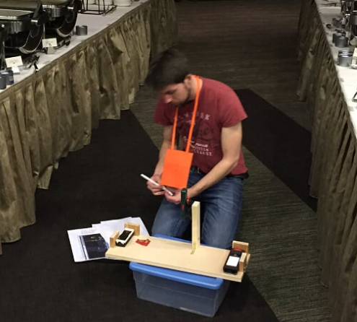
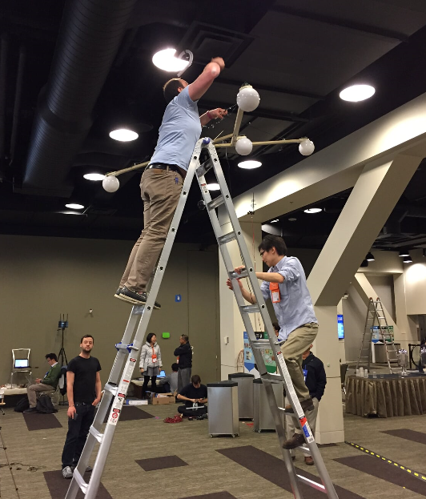
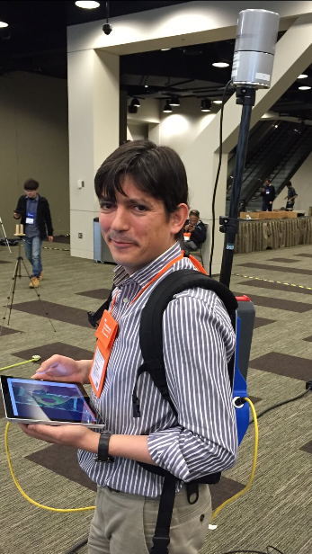
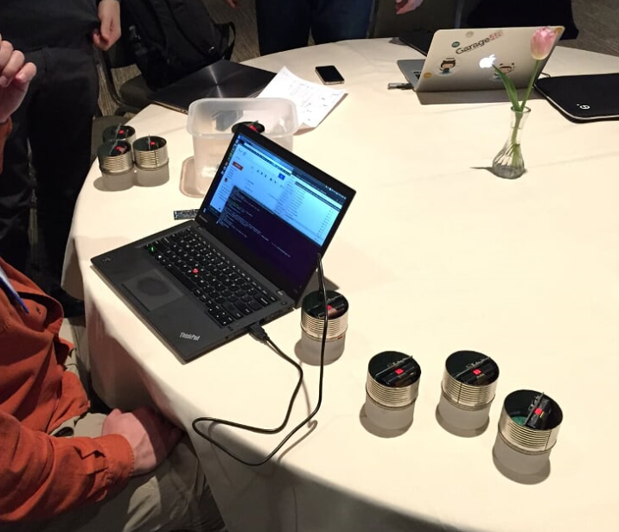
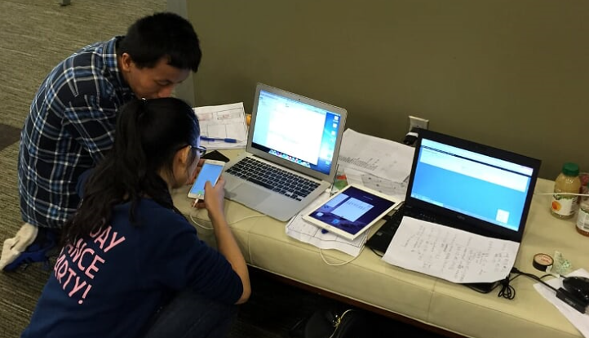
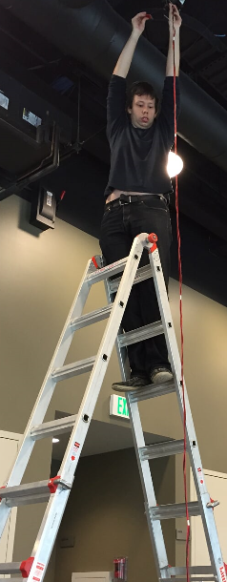
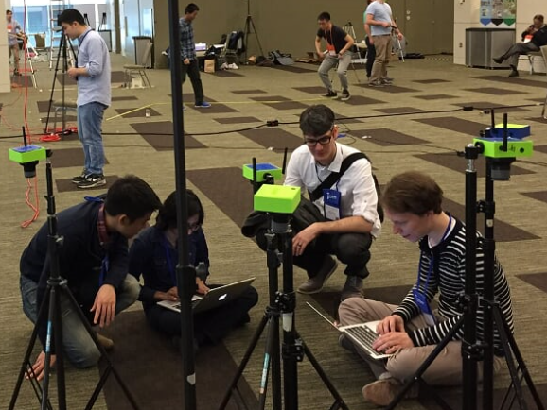
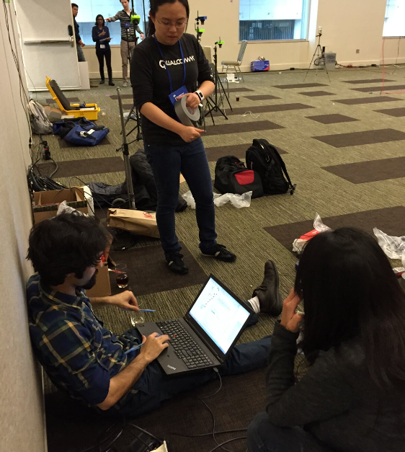
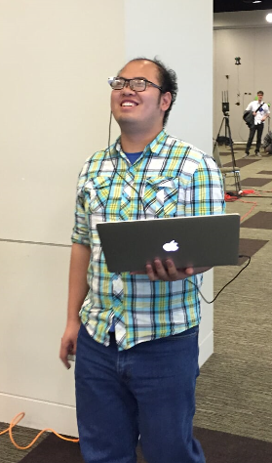
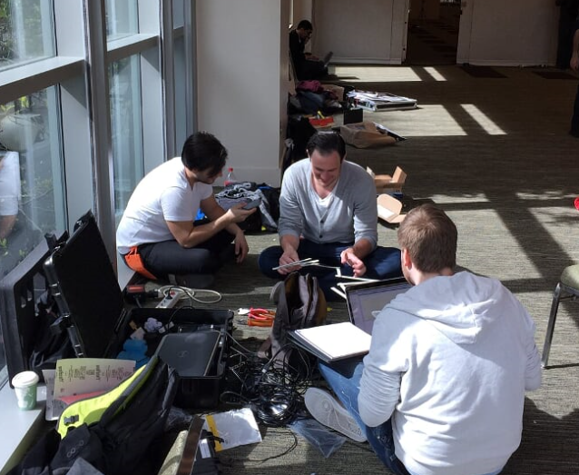
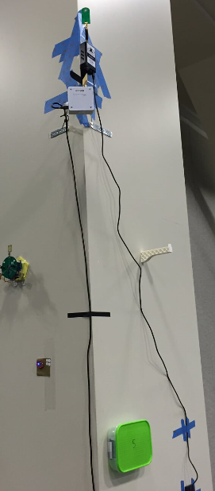
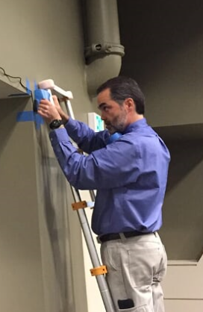
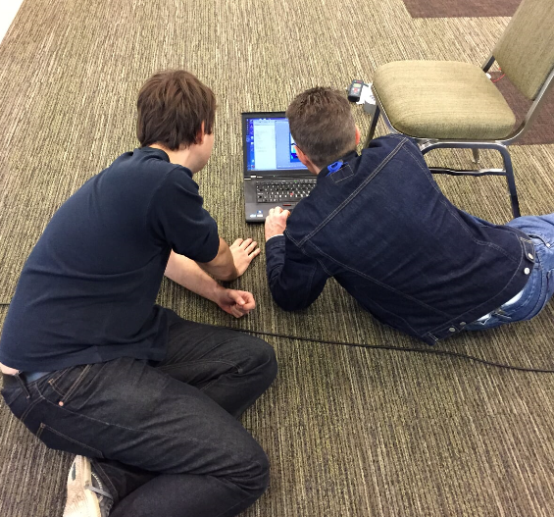
Fun Times…

Slide 6
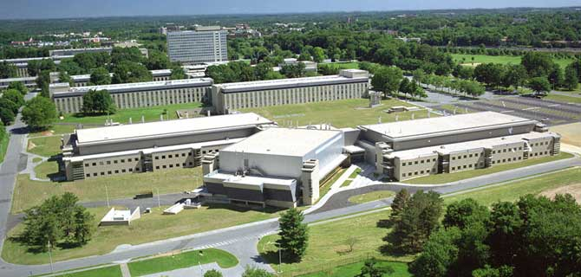
Towards a standardized evaluation of indoor location technologies
Multi-institutional effort
NIST, TU Berlin, and iMinds at University of Ghent
Goal: create a large repository of labeled indoor location data traces
5 buildings on the NIST campus in Gaithersburg, MD
1800 test points
More than 30000m²
Data Collection
September – December 2015
Available through a web service
Ideas/Feedback/Suggestions
Nader Moayeri (nader.moyaeri@nist.gov)

Slide 7
Official Results
infrastructure-free
industry

Slide 8
Infrastructure Free
Infrastructure Based
1st
STeAM: Sensor Tracking and Mapping
Sanchez et al.
(Institute for Transuranium Elements)
ALPS: An Ultrasonic Localization System
Lazik et al.
(CMU)
$1000
0.2m error
0.31m error
2nd
SPIRIT Navigation
Berkovich et al.
(SPIRIT Navigation)
Time Domain
Dewberry et al.
(Time Domain)
$600
1.9m error
0.39m error
2.6m error
3rd
Precise Indoor Location
D. Elias et al.
(Fraunhofer Portugal Research Center)
Exploring State of the Art Commercial Localization
Campbell et al.
(Univ. of Michigan)
$400
0.6m error

Slide 9
Point-Level View

