Slide 1
Time Domain Indoor Navigation using Ultra Wideband
Brandon Dewberry & Mike Einhorn Time Domain Huntsville, Alabama, USA www.timedomain.com
Notes:
Hi, I’m Brandon Dewberry, CTO of Time Domain
My colleague Mike Einhorn and I demonstrated an Indoor Navigation System using Ultra Wideband ranging radios

Slide 2
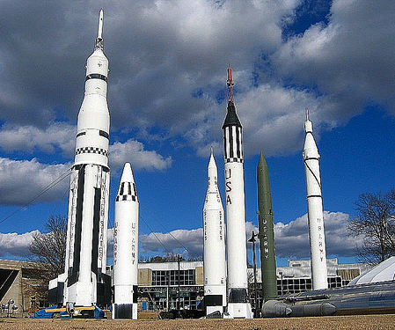
Time Domain – Company Overview
“One Stop Shop” for UWB Precise Ranging/Tracking and Radar
Privately owned small business
~20 employees >14 years average UWB experience
~100 patents
Based in Huntsville, AL (“Rocket City”)
Notes:
2
TD aims to be a One stop shop for UWB ranging/radar
We are solving real world problems for heavy industrial/military - mobile ad hoc outdoor environments
Expanding our product offerings with new hardware and new software, enabling us to better address _indoor_ navigation
Briefly discuss where we’ve been, the Indoor Nav Architecture, and
Hopefully leave some time to describe why UWB is so awesome for this.
2

Slide 3
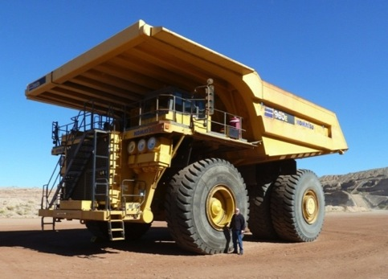
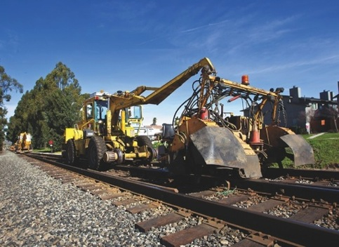
Heavy Industry Safety, Collision Avoidance, Logistics
Notes:
Briefly – big, expensive stuff near other big expensive stuff. Need 6-sigma reliability. GPS sometimes blunders. Reliable point-to-point distance needed.
We typically focus on radio and firmware (network) mods while our partners develop application layer and integration.

Slide 4
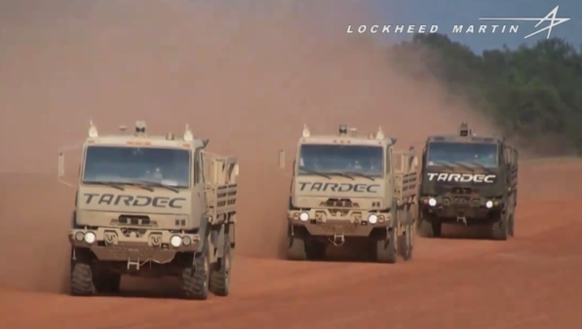
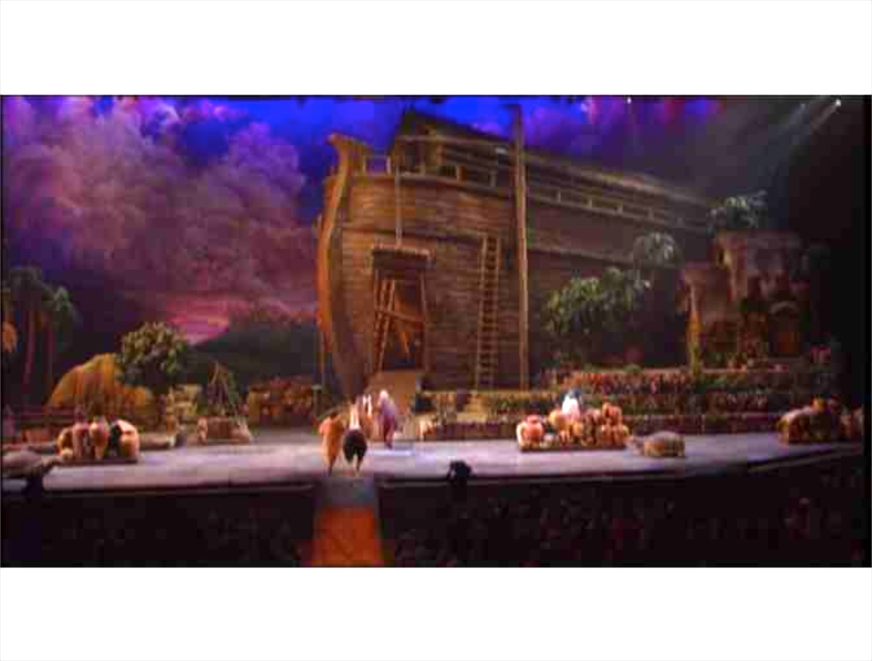
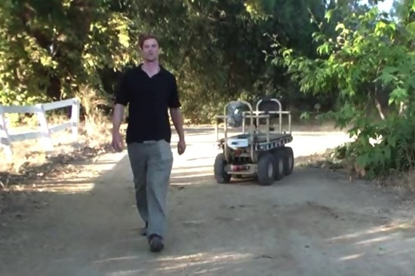
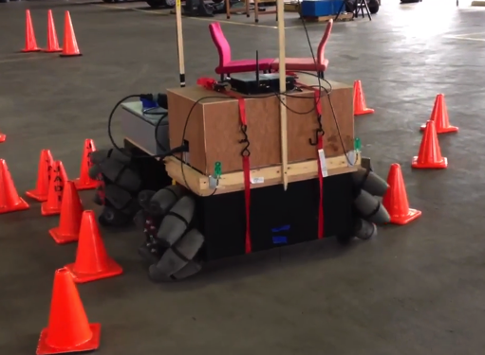
Machine Guidance & Following Behaviors
Notes:
Supply special hardware to Army for automatic convoy system which blends UWB with GPS, LiDAR, IR cameras.
A simpler form of this “FollowMe” is used on “mule” sized ground robots. Mostly this is UWB for range and bearing, and LiDAR for collision avoidance.
Our radios have been in use 3 shows a day, 7 days a week for automatic prop changeout for various Sight and Sound productions for the past 3 years.

Slide 5
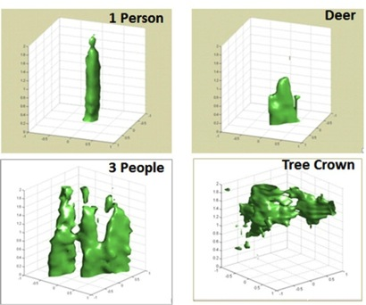
UWB Radar Mesh
Notes:
Quickly show another use for pulsed radio –
US Navy Mesh radar system. This is a top down view of a munitions bunker.
Radar scans from all poles are mapped to pixel grid. The resulting image has about 7cm resolution – enough to discriminate and have high confidence warnings.

Slide 6
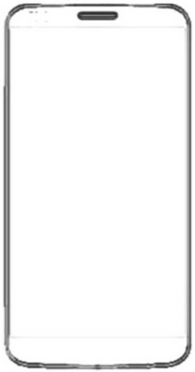
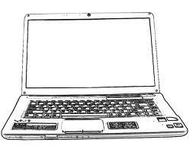

Indoor Navigation
ELR
ELL
X: 24.346
Y: 4.208
NavNet
RangeNet (MAC)
USB ETH SPI UART
Ranging and Communications
UWB PHY
Notes:
So we came to CPS Week and the Challenge with lots of experience.
We also decided to participate for early pre-introduction of a new product line using DecaWave’s UWB chip.
When we evaluated this chip we realized this is our chance to enable smaller, lower-power, lower-cost markets.
We will also grow our own high-precision UWB PHY and continue to aim it at markets where high precision and reliability are paramount.
For Indoor Personal Localization we ported our firmware layers to a new radio module with the DW PHY.
First, note all radios are identical. The anchors “beacon” their name and location, while the mobile collects the anchors in a database and optimally targets range requests.
The RangeNet Media Access Control layer coordinates when the mobile transmits. This is simple until there’s more than one mobile.
The NavNet layer chooses anchors and, with anchor locations solve for postion. For this we used a EKF solver with constant 2D height for the mobile but with anchors at surveyed heights.
This radio offers the host access to any of these layers through many interfacing options.

Slide 7
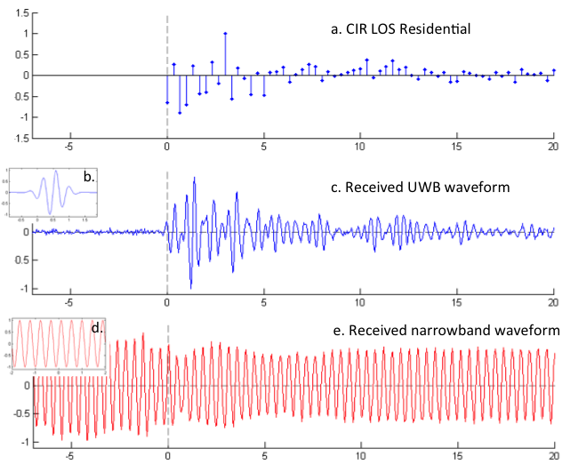
Why UWB?
Notes:
Quickly – why UWB?
If the goal is measuring “when” the signal arrives, then there’s nothing quite like a pulse basis.
Here you see a radio Impulse response signature – if you could send impulses then you could measure TOA with infinite precision.
The best we’ve been able to do is a ~1ns wide pulse. So the TOA error is fundamentally limited to whether you receive the first path pulse, and how fast it rises from the noise floor.
It is hard to measure arrival time on conventional radios, with carrier, because earlier cycles combine with the start of the bit change.

Slide 8
Two-Way Ranging
Requester
Responder
Notes:
A TWR conversation measures TOA twice – once Requester to Responder, and again Responder to Requester.
At the end of this conversation the Requester can measure the delta time, subtract the (well known) responder delay, and compute distance as dT*c/2
The radio configuration we used take about 10ms for a full conversation and can go over 100m in LOS conditions.
The pulse stength and shape is inspected by the link layer to characterize the channel and estimate the error in the associated range measurement.
The localizer chooses the best anchor(s) for minimizing both range error and geometric localization error based on these metrics.

Slide 9
Time Domain
Invent
Something
New
Notes:
So now I hope you understand why UWB is awesome, especially for indoor localization.
But we’ve barely scratched the surface. Our mission is actually to enable innovators like youselves, at whatever level of abstraction you need, to Invent Something New with UWB.

