Slide 1
PolyPoint: Accurate 802.15.4a Indoor Localization
Benjamin Kempke, Brad Campbell, Pat Pannuto,
Ye-Sheng Kuo, and Prabal Dutta
University of Michigan
2015 Microsoft Indoor Localization Competition – April 15, 2015

Slide 2
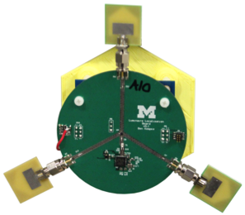
PolyPoint: Localization via Trilateration
(x₂,y₂,z₂)
(x₃,y₃,z₃)
(x₁,y₁,z₁)

Slide 3
PolyPoint: Localization via Trilateration
Tag

Slide 4
PolyPoint: Localization via Trilateration
Tag

Slide 5
PolyPoint: Localization via Trilateration
Tag

Slide 6
PolyPoint: Localization via Trilateration
Tag

Slide 7

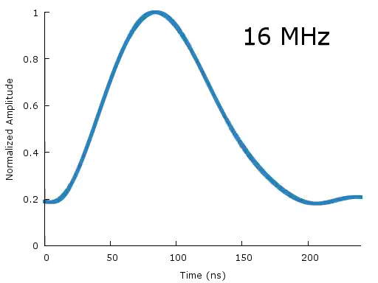
PolyPoint Node Hardware
802.15.4a UWB Transceiver
Timed TX
RX Timestamps
UWB: fine-granularity characterization of the multipath environment
Decawave DW1000
RF Switch
3 UWB antennas
Atum (Cortex M3)

Slide 8
PolyPoint Node Hardware
Enables antenna diversity
Decawave DW1000
RF Switch
3 UWB antennas
Atum (Cortex M3)

Slide 9
PolyPoint Node Hardware
Enables antenna polarization diversity
Decawave DW1000
RF Switch
3 UWB antennas
Atum (Cortex M3)

Slide 10
PolyPoint Node Hardware
Runs the Contiki embedded OS
Schedules ranging operations
Calculates range estimates
Decawave DW1000
RF Switch
3 UWB antennas
Atum (Cortex M3)

Slide 11
PolyPoint Node Hardware
Offloads ranging measurements for trilateration processing
Decawave DW1000
RF Switch
3 UWB antennas
Atum (Cortex M3)
USB

Slide 12
Ranging using Timestamps: Time-of-Flight Ranging
Clock Offset Compensation:
Time-of-Flight Calculation:
Range Calculation:

Slide 13
Estimating Actual Range from Multiple Time-of-Flight Measurements
Ranging operations repeated 27 times
Every combination of:
3 antennas @ the tag
3 antennas @ the anchor
3 UWB channels
Best estimate of range: 10th percentile

Slide 14
Trilateration: From Range to Position
Choose the three closest anchors
Perform trilateration using the Non-linear Least Squares Method
Minimize the function:
Where:

Slide 15
PolyPoint Demonstrates Accurate Indoor Localization Using Inexpensive, Commercially-Available Hardware
Ranging operations performed using timestamps provided by the DW1000
27 successive range measurements between the tag and each anchor
Antenna diversity avoids large ranging errors due to polarization mismatch
Frequency diversity avoids frequency-selective effects
Tag location derived using minimum least squares trilateration
Benjamin Kempke
University of Michigan
bpkempke@umich.edu
PolyPoint: http://www.github.com/lab11/polypoint

