Slide 1
Cloud-Offloaded GPS
Jie Liu
Microsoft Research
Redmond, WA 98052
Jie.liu@microsoft.com
Mobile Location Sensing Tutorial at MobiSys 2013

Slide 2

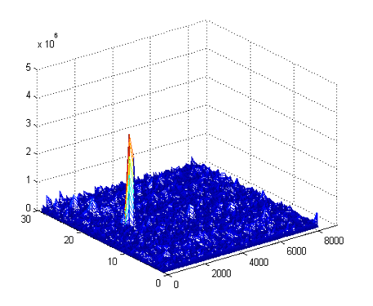
GPS Receiving
in the
cloud!
Baseband
Time stamp
Acquisition
Tracking
Decoding
Least
Square
(lat, lon)
Ephemeris
SV IDs
Code Phases
Code Phases
Doppler
1 ms data (4kB)
Intense
computation
Every ms
continuous
Time stamp: 6s
Ephemeris: 30s
~10ms
300 bits (10 words)
TLM
HOW
Clock corrections and SV health
6
TLM
HOW
Ephemeris parameters
12
TLM
HOW
Ephemeris parameters
Time (sec)
18
TLM
HOW
Almanac, ionospheric model, dUTC
24
TLM
HOW
Almanac
30
preamble
Time of week

Slide 3

Coarse Time Navigation
Time of flight has two parts
  Fractional part – code phase
  Integer part (# of ms, NMS)
Nearby locations have the same NMS.
A reference location and a coarse time remove the need for timestamp decoding.
NMS （~60ms)
NMS
code phase
~100km
time of flight (ms) = code phase + # of ms (NMS)
fraction
integer

Slide 4
Course Time Error vs Common Bias
Common bias causes same error in all distance measurements

Slide 5
Course Time Error vs Common Bias
Common bias causes same error in all distance measurements
Course time errors are different for each measurement.

Slide 6
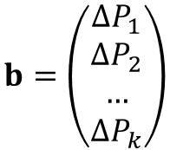
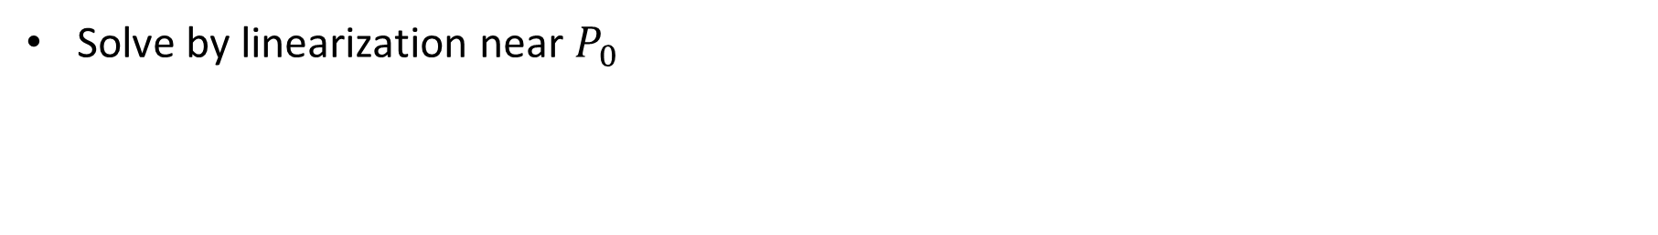

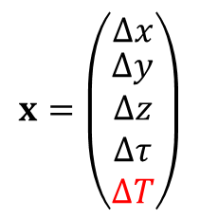
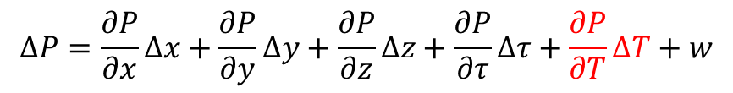
New Observation Equations
$$P_{i}=\sqrt{{\left(x_{i}+v_{xi}∆T−x\right)}^{2}+{\left(y_{i}+v_{yi}∆T−y\right)}^{2}+{\left(z_{i}+v_{zi}∆T−z\right)}^{2}}+c⋅τ$$
$$∆P=\frac{∂P}{∂x}∆x+\frac{∂P}{∂y}∆y+\frac{∂P}{∂z}∆z+\frac{∂P}{∂τ}∆τ+\frac{∂P}{∂T}∆T+w$$
Solve by linearization near $P_{0}$
$$A=\left[ \begin{matrix}\frac{\left(x_{0}−x_{1}\right)}{ρ} & \frac{\left(y_{0}−y_{1}\right)}{ρ} \\ \frac{\left(x_{0}−x_{2}\right)}{ρ} & \frac{\left(y_{0}−y_{2}\right)}{ρ} \\ … & … \\ \frac{\left(x_{0}−x_{k}\right)}{ρ} & \frac{\left(y_{0}−y_{k}\right)}{ρ}\end{matrix} \begin{matrix}\frac{\left(z_{0}−z_{1}\right)}{ρ} & c \\ \frac{\left(z_{0}−z_{2}\right)}{ρ} & c \\ … & … \\ \frac{\left(z_{0}−z_{k}\right)}{ρ} & c\end{matrix}\begin{matrix} & \begin{aligned}−v_{1}↓e \\ \end{aligned} \\ & \begin{aligned}−v_{2}↓e \\ \end{aligned} \\ & … \\ & \begin{aligned}−v_{k}↓e \\ \end{aligned}\end{matrix}\right]$$
$$b=\left(\begin{aligned}∆P_{1} \\ ∆P_{2} \\ … \\ ∆P_{k}\end{aligned}\right)$$
$$x=\left(\begin{matrix}∆x \\ \begin{aligned}∆y \\ ∆z \\ ∆τ \\ ∆T\end{aligned}\end{matrix}\right)$$
Need 5+ satellites

Slide 7
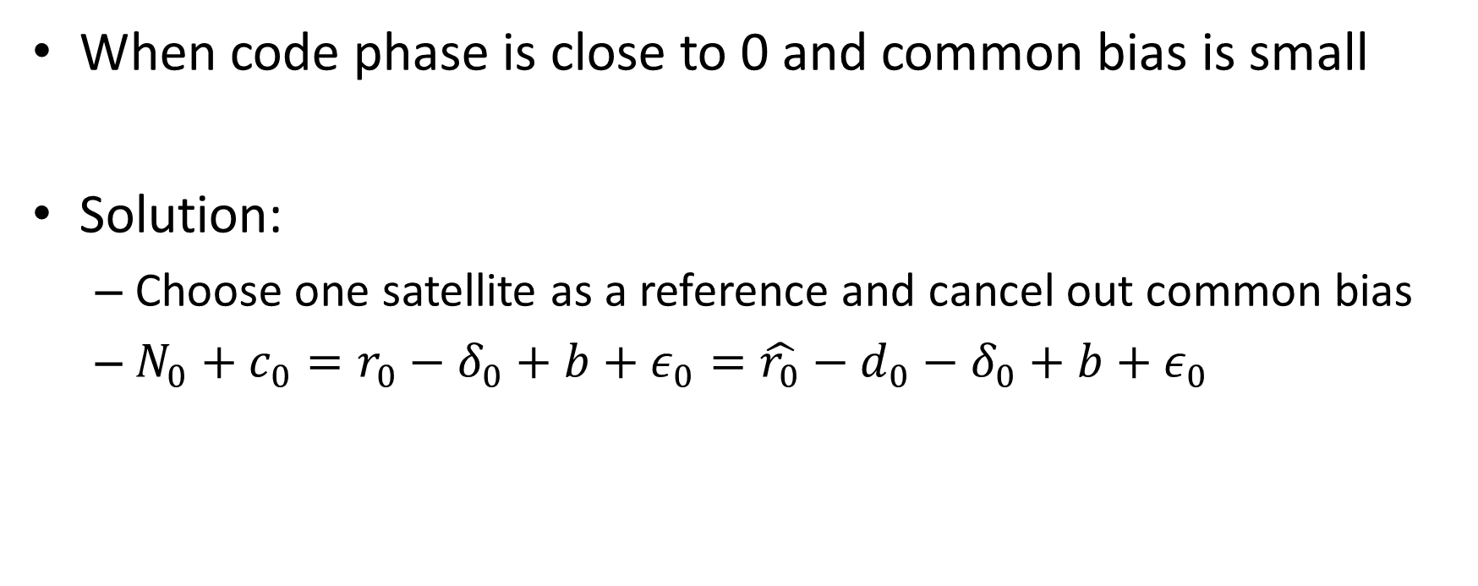
Solve Integer Roll Over Problem
When code phase is close to 0 and common bias is small
Solution:
  Choose one satellite as a reference and cancel out common bias
  $N_{0}+c_{0}=r_{0}−δ_{0}+b+ε_{0}=\hat{r_{0}}−d_{0}−δ_{0}+b+ε_{0}$
ms
Nms
from ref loc
Common
bias
Estimated
prop time
Code
phase
Real
prop
time
satellite
clock
error
Estimation error
noise

Slide 8
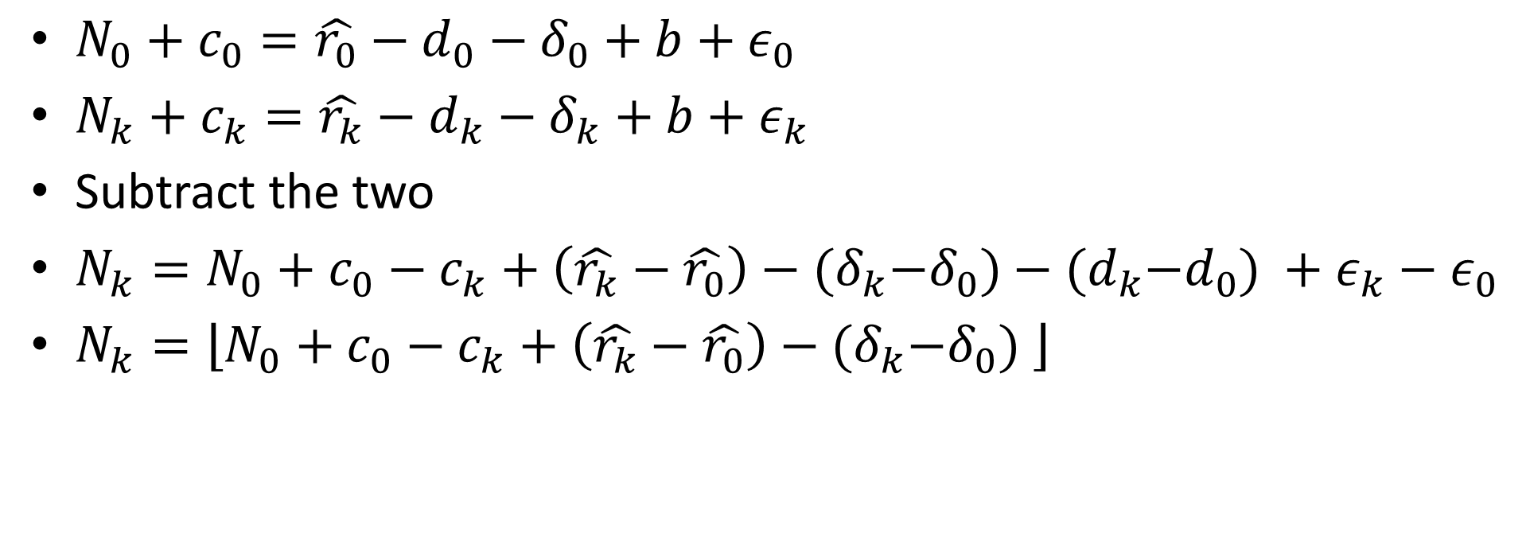
Solve Integer Roll Over Problem
$N_{0}+c_{0}=\hat{r_{0}}−d_{0}−δ_{0}+b+ε_{0}$
$N_{k}+c_{k}=\hat{r_{k}}−d_{k}−δ_{k}+b+ε_{k}$
Subtract the two
$N_{k}=N_{0}+{c_{0}−c}_{k}+\left(\hat{r_{k}}−\hat{r_{0}}\right)−{(δ}_{k}−δ_{0})−{(d}_{k}−d_{0}) +ε_{k}−ε_{0}$
$N_{k}=\left\lfloor N_{0}+{c_{0}−c}_{k}+\left(\hat{r_{k}}−\hat{r_{0}}\right)−{(δ}_{k}−δ_{0}) \right\rfloor$
Assume < 0.5ms
Round down

Slide 9
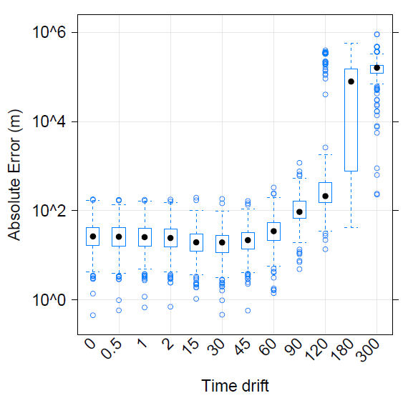
Time Drift Evaluation
(s)

Slide 10
Online Ephemeris
Broadcast Ephemeris (RINEX)
http://igscb.jpl.nasa.gov/components/dcnav/cddis_data_daily_yyn.html
National Geodetic Survey (NGS):http://www.ngs.noaa.gov/orbits/
  Ultra-rapid (iguWWWWD.sp3)
  6-hour latency
  Rapid (igrWWWWD.sp3)
  13-hour latency
  Final (igsWWWWD.sp3)
  12 to 14 day latency

Slide 11
SP3 Files
For full specification http://www.ngs.noaa.gov/orbits/SP3_format.html
GPS Time, every 15 minutes
position (km)
* 2013 6 20 0 0 0.00000000
P 1 15833.341744 0.164576 21320.746257 39.638737
V 1 8522.699138 25731.050460 -6232.897765 0.046098
P 2 -13705.126878 -21928.324527 -6915.898362 437.855352
V 2 -401.124411 -9435.761633 29274.903151 0.017941
P 3 21932.968373 9793.907906 -12084.896943 222.312056
V 3 -14624.350974 2137.876854 -25721.177094 0.048538
clock correction (μs)
clock drift (10⁻⁴ μs/s)
velocity (km/s)

Slide 12
Without Reference Location?

Slide 13
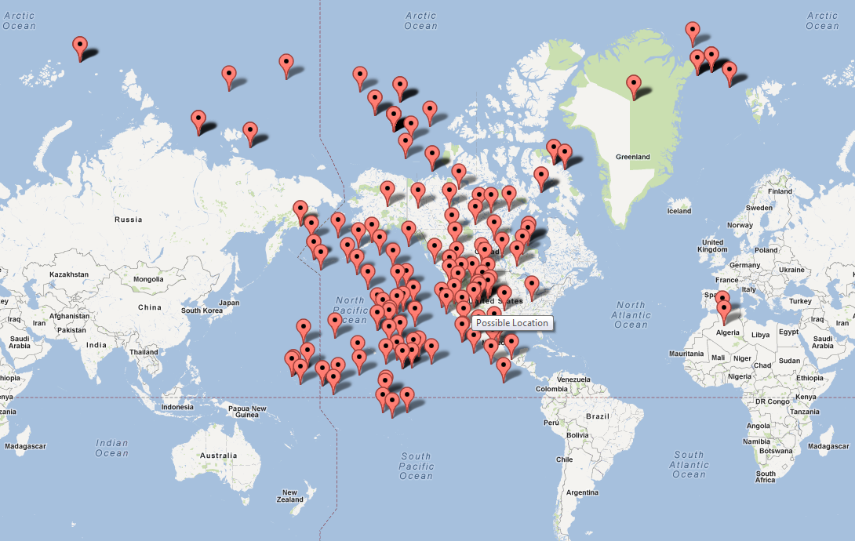

Disambiguating Reference Locations
Conjecture: Least square may not converge

Slide 14
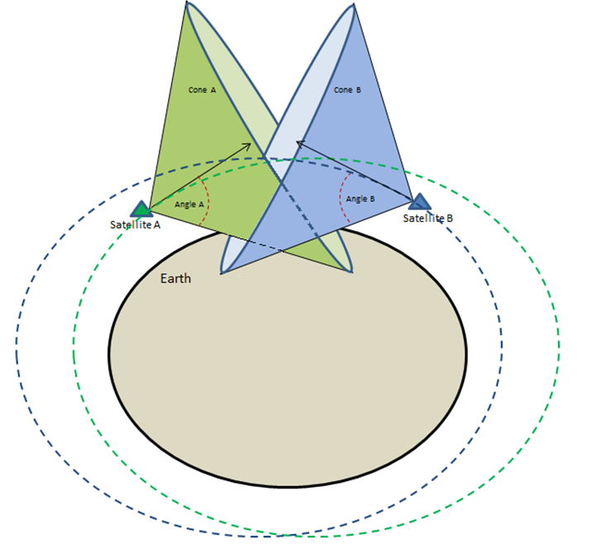
Disambiguating Reference Locations
Use Doppler shifts
Similar observation
equations can be derived
Receiver Location at cone intersection(s) on the Earth’s surface
Doppler uncertainty results in wider intersection region

Slide 15
Disambiguating Reference Locations
The 3rd dimension:
  Use elevation data from cloud services, e.g. USGS Elevation API: http://www.programmableweb.com/api/usgs-elevation-query-service
S1
S2
C
B
D
I
E
H
A
F
G

Slide 16


Cloud-Offloaded GPS Design
Device
Timestamp
Doppler
AOA
Intersection
Ref. Locations
Acquisition
SV speed
Coarse Time Navigation
NASA/NGA Orbit DB
(lat, lon, alt)
SV IDs
Ephemeris
Time stamp
Code Phases
Cloud
Device (a set of 2ms GPS signals)
Raw GPS signals (16MHz sampling rate, 2 bit/sample, 2ms)
“reasonable” time stamp

Slide 17
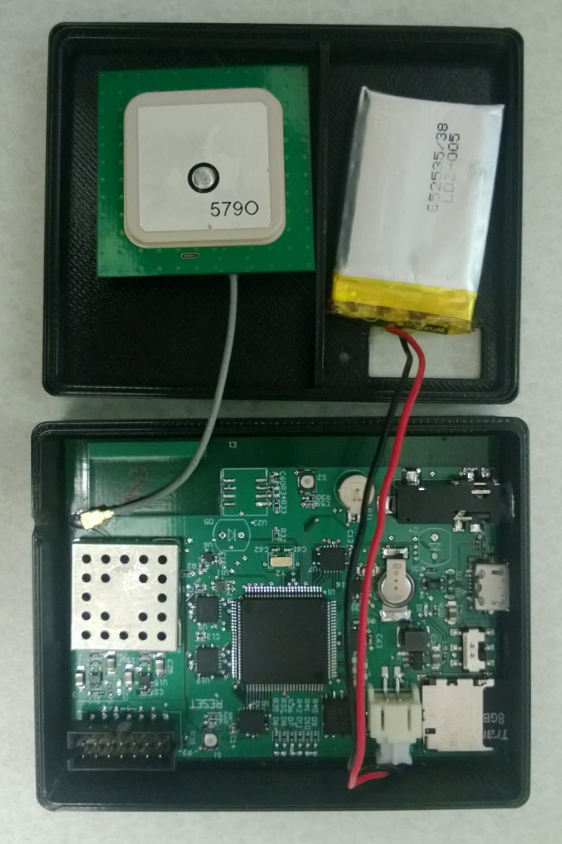
CLEON Prototype
Max 2769 GPS receiver
MSP430F5338 μC, 12MHz
Serial to parallel + DMA
Rechargeable battery
Battery-backed up real-time clock
microSD card

Slide 18
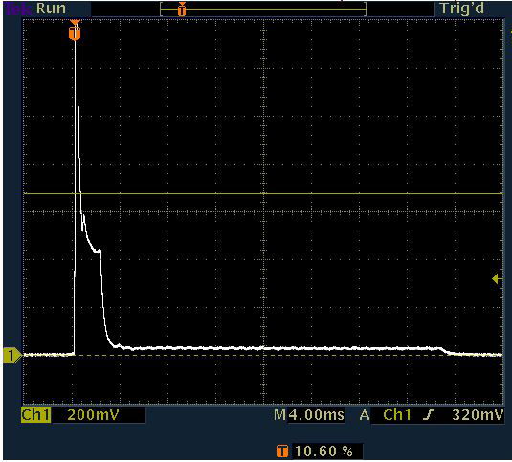
Device Energy Performance: (flash chip)
action | Current(mA) | Duration (ms)
GPS sampling | 42 | 2.2
Flash writing | 1.5 | 28.8
Total (2ms) | 4.37 | 31
5x 2ms GPS sample: ~2mJ
1 A-GPS sample in phone: ~2J
In theory, 2AA batteries (2Ah) can last for 1.5 years with continuous GPS sampling (1Hz).
GPS
sampling
Save to flash

Slide 19
Low Energy Assisted Positioning Cloud Service
https://msr-leap.cloudapp.net/LEAP.svc
Client ID, data
NGA/
NASA
Web
Role
Eph.
Worker
Queue
LEAP
Workers
Ephemeris
table
Req. ID
Client ID, Req. ID
Web
Role
SQL
Azure
Location
Azure Cloud

Slide 20
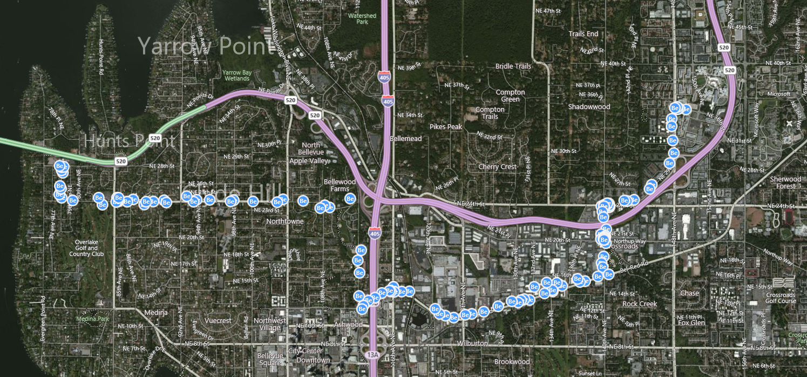
Web Services Demo

Slide 21
Source of Errors
Visible Satellites
Multi-path effect
Ephemeris accuracy
Time stamping accuracy

Slide 22
Accuracy Evaluation
~1500 set of traces, 10~60s long each (~50GB)
Taken from both northern and southern hemisphere (US, Brazil, Korea).
chunk
gap
# of Chunks | Chunk Length (ms) | Gap Length (ms)
1 | {2, 4, 6, 8, 10} | 0
{1, 2, 3, 4, 5} | 2 | 50
5 | 2 | {0, 10, 50, 100}
…
sampling
idle

Slide 23
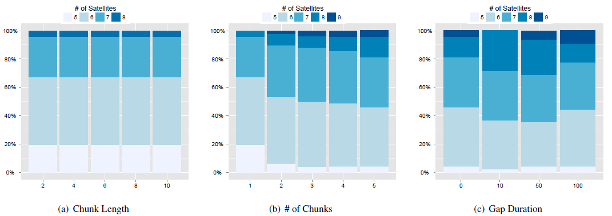
Number of Acquired SVs

Slide 24
Accuracy Evaluation
2ms, 3~5chunks, 50ms gaps
16X oversampling (2ms == 8KB)
Min | Median | Mean | Max | StdDev
0.06 | 11.85 | 20 | 725.08 | 33.65

Slide 25
Number of acquired satellites

Slide 26
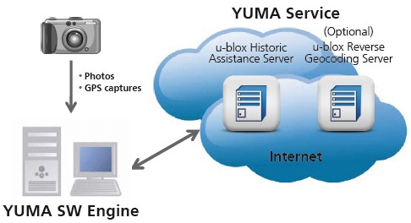
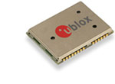
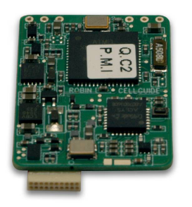
Other GPS Snapshot Platforms
U-Blox YUMA (Switzerland)
  200ms capture
PathTrack FastLoc (UK)
  150ms capture
Cell-Guide Robin (Israel)
  >64ms capture

Slide 27
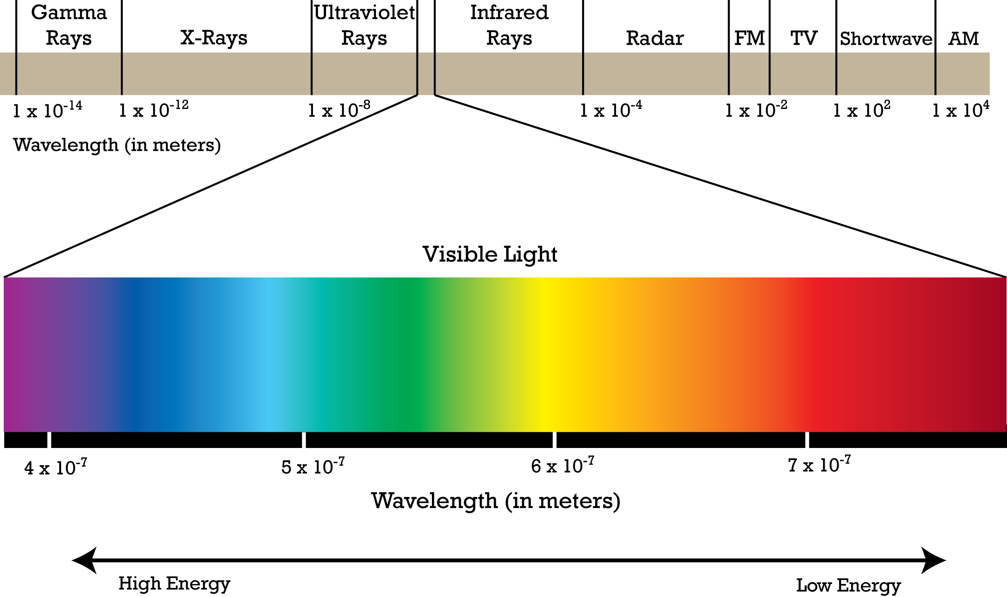
A Spectrum of GPS Solutions
 |  |  |  |  | Self-contained GPS
Example |  |  |  |  | Car GPS
Acquisition |  |  |  |  | On device
Time Stamp |  |  |  |  | From satellites
Ephemeris |  |  |  |  | From satellites
Location Calc. |  |  |  |  | On device
Network Usage |  |  |  |  | None
Accuracy |  |  |  |  | 10m
Latency |  |  |  |  | ~30sec
Device Energy Consumption |  |  |  |  | ~10J
* Assume: 50mW GPS power and 1s acquisition latency; 50mW AP low and 1W AP high utilizations.

Slide 28
A Spectrum of GPS Solutions
 |  |  |  | Precise-Time AGPS | Self-contained GPS
Example |  |  |  | Phone GPS today | Car GPS
Acquisition |  |  |  | On device | On device
Time Stamp |  |  |  | From satellites | From satellites
Ephemeris |  |  |  | From server | From satellites
Location Calc. |  |  |  | On device | On device
Network Usage |  |  |  | Ephemeris updates (1/6hrs) | None
Accuracy |  |  |  | 10m | 10m
Latency |  |  |  | ~6sec | ~30sec
Device Energy Consumption |  |  |  | ~2J | ~10J
* Assume: 50mW GPS power and 1s acquisition latency; 50mW AP low and 1W AP high utilizations.

Slide 29
A Spectrum of GPS Solutions
 | Full Cloud Offloaded GPS |  |  | Precise-Time AGPS | Self-contained GPS
Example | Sensors, wearable |  |  | Phone GPS today | Car GPS
Acquisition | In cloud |  |  | On device | On device
Time Stamp | From device |  |  | From satellites | From satellites
Ephemeris | In cloud |  |  | From server | From satellites
Location Calc. | In cloud |  |  | On device | On device
Network Usage | Bulk or None |  |  | Ephemeris updates (1/6hrs) | None
Accuracy | 30m |  |  | 10m | 10m
Latency | Offline |  |  | ~6sec | ~30sec
Device Energy Consumption | ~2mJ |  |  | ~2J | ~10J
* Assume: 50mW GPS power and 1s acquisition latency; 50mW AP low and 1W AP high utilizations.

Slide 30
A Spectrum of GPS Solutions
 | Full Cloud Offloaded GPS | Half Cloud Offloaded GPS |  | Precise-Time AGPS | Self-contained GPS
Example | Sensors, wearable | Mobile (logging) |  | Phone GPS today | Car GPS
Acquisition | In cloud | On device |  | On device | On device
Time Stamp | From device | From device |  | From satellites | From satellites
Ephemeris | In cloud | In cloud |  | From server | From satellites
Location Calc. | In cloud | In cloud |  | On device | On device
Network Usage | Bulk or None | Bulk or real-time |  | Ephemeris updates (1/6hrs) | None
Accuracy | 30m | 30m |  | 10m | 10m
Latency | Offline | Offline or <1s* |  | ~6sec | ~30sec
Device Energy Consumption | ~2mJ | ~100mJ (logging)* 1~2J (real-time)^ |  | ~2J | ~10J
Assume 1s acquisition at 50mW

Slide 31
A Spectrum of GPS Solutions
 | Full Cloud Offloaded GPS | Half Cloud Offloaded GPS | Coarse-Time AGPS | Precise-Time AGPS | Self-contained GPS
Example | Sensors, wearable | Mobile (logging) | Mobile (real-time) | Phone GPS today | Car GPS
Acquisition | In cloud | On device | On device | On device | On device
Time Stamp | From device | From device | From device | From satellites | From satellites
Ephemeris | In cloud | In cloud | From server | From server | From satellites
Location Calc. | In cloud | In cloud | On device | On device | On device
Network Usage | Bulk or None | Bulk or real-time | Ephemeris updates (1/6hrs) | Ephemeris updates (1/6hrs) | None
Accuracy | 30m | 30m | 30m | 10m | 10m
Latency | Offline | Offline or <1s* | <1.2s * | ~6sec | ~30sec
Device Energy Consumption | ~2mJ | <100mJ (logging)* 1~2J (real-time)^ | <250mJ* | ~2J | ~10J
15ms on Surface Pro
Assume 10x slow down on phones

Slide 32
A Spectrum of GPS Solutions
 | Full Cloud Offloaded GPS | Half Cloud Offloaded GPS | Coarse-Time AGPS | Precise-Time AGPS | Self-contained GPS
Example | Sensors, wearable | Mobile (logging) | Mobile (real-time) | Phone GPS today | Car GPS
Acquisition | In cloud | On device | On device | On device | On device
Time Stamp | From device | From device | From device | From satellites | From satellites
Ephemeris | In cloud | In cloud | From server | From server | From satellites
Location Calc. | In cloud | In cloud | On device | On device | On device
Network Usage | Bulk or None | Bulk or real-time | Ephemeris updates (1/6hrs) | Ephemeris updates (1/6hrs) | None
Accuracy | 30m | 30m | 30m | 10m | 10m
Latency | Offline | Offline or <1s* | <1.2s* | ~6sec | ~30sec
Device Energy Consumption | ~2mJ | <100mJ (logging)* 1~2J (real-time)^ | <250mJ* | ~2J | ~10J

Slide 33
CO-GPS Demo

