Slide 1
GPS Fundamentals
Jie Liu
Microsoft Research
Redmond, WA 98052
Jie.liu@microsoft.com
Mobile Location Sensing Tutorial at MobiSys 2013

Slide 2
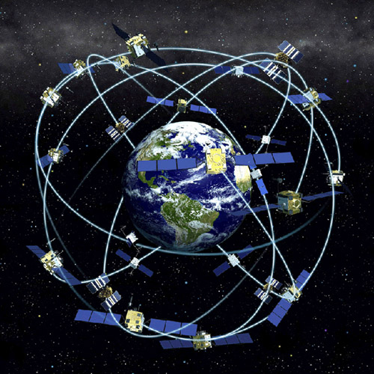
GPS Basics
32 Satellites (SVs)
Ground management stations
Time synced to nanosecond level
Estimate trajectories for each SV
Transmit time and trajectory parameters (Ephemeris) periodically
Receiver estimates its location by:
time of flight (pseudorange) from each visible satellite
SV locations at time when signals left SVs.

Slide 3
GPS Data Packets @50bps
300 bits (10 words)
TLM
HOW
Clock corrections and SV health
6
TLM
HOW
Ephemeris parameters
12
TLM
HOW
Ephemeris parameters
Time (sec)
18
TLM
HOW
Almanac, ionospheric model, dUTC
24
TLM
HOW
Almanac
30
preamble
Time of week

Slide 4
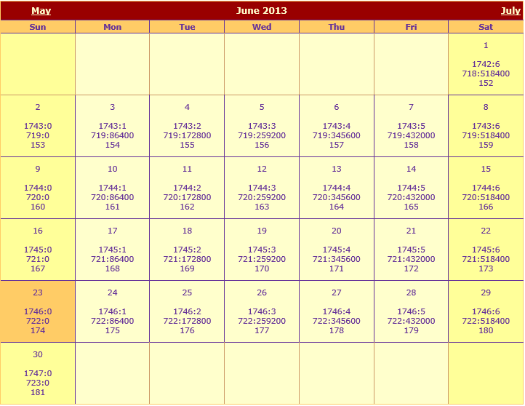
GPS Time
GPS Time is a uniformly counting time scale beginning at the 1/5/1980 to 1/6/1980 midnight. January 6, 1980 is a Sunday.
GPS Time counts in weeks and seconds of a week from this instant. The weeks begin at the Saturday/Sunday transition. This is week 1746.
The days of the week are numbered, with Sunday being 0, 1 Monday, etc.
There are no "leap seconds" in this time system. Currently, GPS is ahead of UTC by 15 SECONDS.

Slide 5
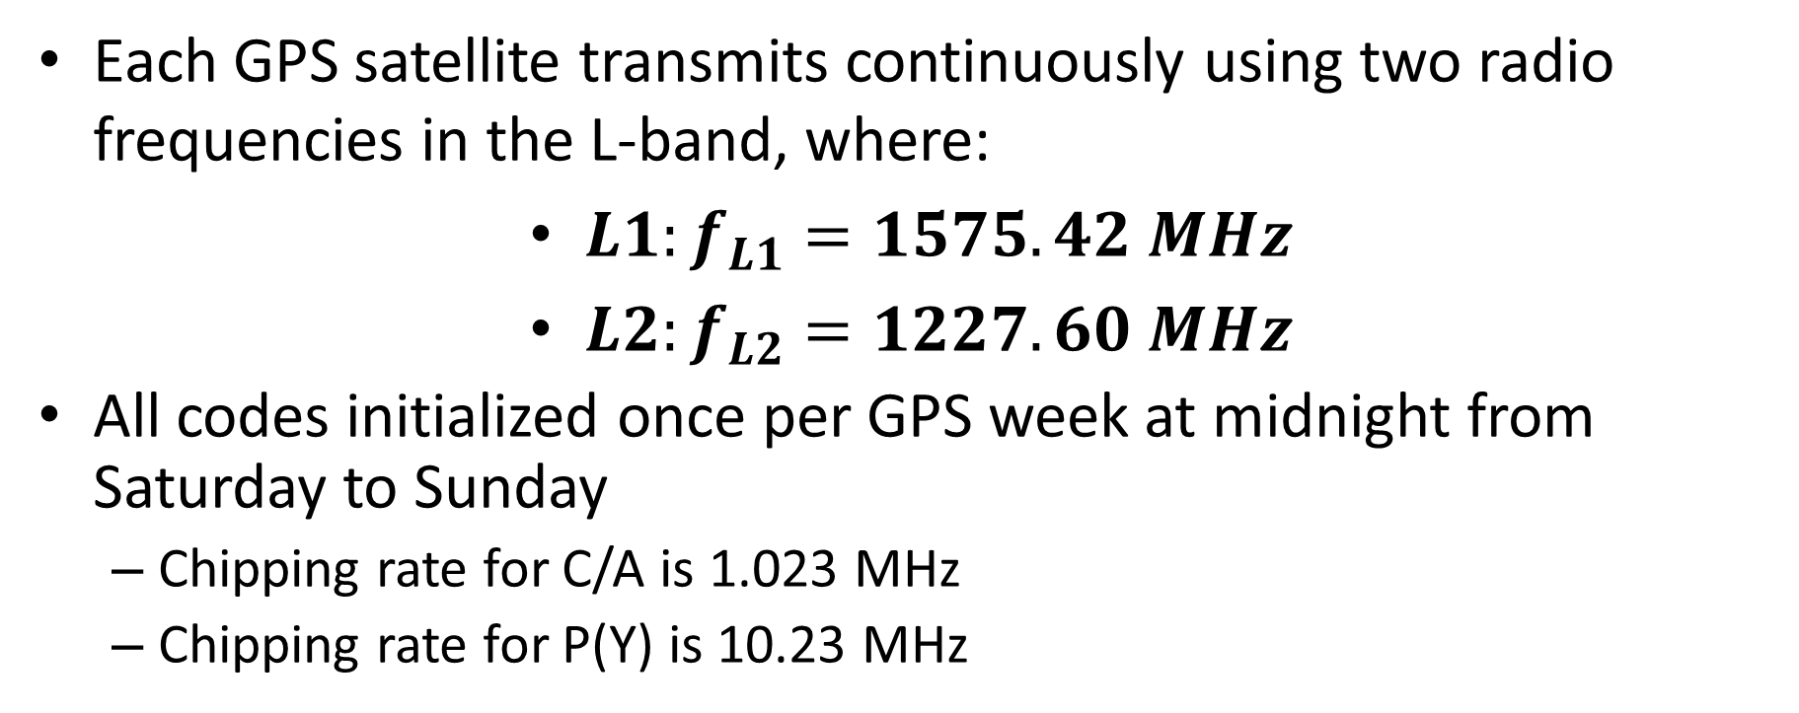
Gps signal structure
Each GPS satellite transmits continuously using two radio frequencies in the L-band, where:
$L1:f_{L1}=1575.42 MHz$
$L2:f_{L2}=1227.60 MHz$
All codes initialized once per GPS week at midnight from Saturday to Sunday
Chipping rate for C/A is 1.023 MHz
Chipping rate for P(Y) is 10.23 MHz

Slide 6
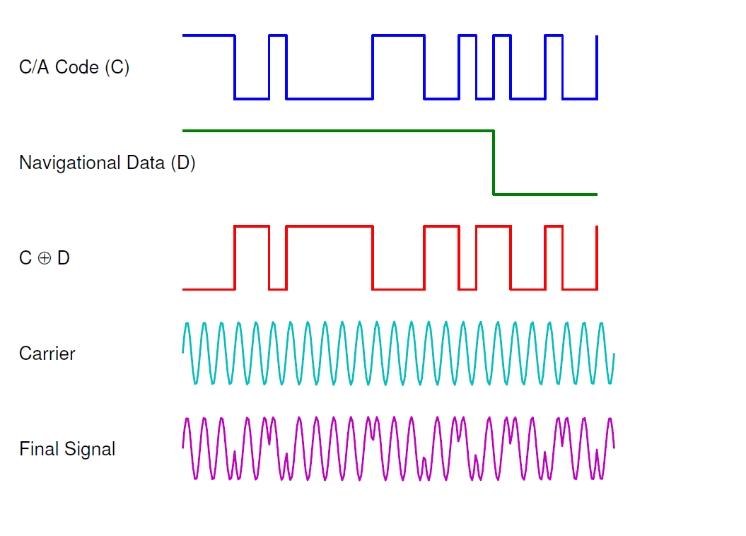

GPS Signals Modulation
Using CDMA, satellite k sends signal:
$$s_{L1}^{(k)}\left(t\right)=\sqrt{2P_{tmt}}{∙x}^{(k)}\left(t\right){∙D}^{(k)}\left(t\right)∙cos(2πf_{L1}t+θ_{tmt})$$
Received signal: $r_{L1}^{(k)}\left(t\right)=\sqrt{2P_{rcv}}x^{(k)}\left(t−τ^{(k)}\right)D^{(k)}\left(t−τ^{(k)}\right)\cos\left(2π\left(f_{L1}+f_{D}\right)t+θ_{rcv}\right)+n^{(k)}(t)$
1023 kbps repeats every 1ms
C/A: Coarse/Acquisition

Slide 7

GPS Signals Modulation
Using CDMA, satellites send the signal:
$$s_{L1}^{(k)}\left(t\right)=\sqrt{2P_{tmt}}{∙x}^{(k)}\left(t\right){∙D}^{(k)}\left(t\right)∙cos(2πf_{L1}t+θ_{tmt})$$
Received signal: $r_{L1}^{(k)}\left(t\right)=\sqrt{2P_{rcv}}x^{(k)}\left(t−τ^{(k)}\right)D^{(k)}\left(t−τ^{(k)}\right)\cos\left(2π\left(f_{L1}+f_{D}\right)t+θ_{rcv}\right)+n^{(k)}(t)$
1023 kbps repeats every 1ms
50 bps
1.575GHz

Slide 8
GPS Signals Modulation
Using CDMA, satellites send the signal:
$$s_{L1}^{(k)}\left(t\right)=\sqrt{2P_{tmt}}{∙x}^{(k)}\left(t\right){∙D}^{(k)}\left(t\right)∙cos(2πf_{L1}t+θ_{tmt})$$
Received signal: $r_{L1}^{(k)}\left(t\right)=\sqrt{2P_{rcv}}x^{(k)}\left(t−τ^{(k)}\right)D^{(k)}\left(t−τ^{(k)}\right)\cos\left(2π\left(f_{L1}+f_{D}\right)t+θ_{rcv}\right)+n^{(k)}(t)$
1023 kbps repeats every 1ms
50 bps
1.575GHz
DSSS

Slide 9
GPS Signals Modulation
Using CDMA, satellites send the signal:
$$s_{L1}^{(k)}\left(t\right)=\sqrt{2P_{tmt}}{∙x}^{(k)}\left(t\right){∙D}^{(k)}\left(t\right)∙cos(2πf_{L1}t+θ_{tmt})$$
Received signal: $r_{L1}^{(k)}\left(t\right)=\sqrt{2P_{rcv}}x^{(k)}\left(t−τ^{(k)}\right)D^{(k)}\left(t−τ^{(k)}\right)\cos\left(2π\left(f_{L1}+f_{D}\right)t+θ_{rcv}\right)+n^{(k)}(t)$
1023 kbps repeats every 1ms
50 bps
1.575GHz
DSSS, 280~460W

Slide 10
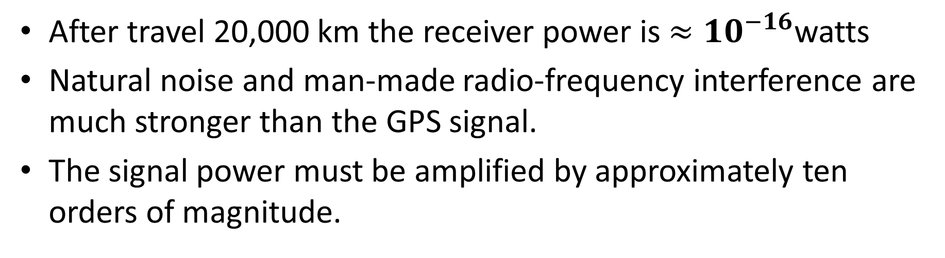
Received Signal
$$r_{L1}^{(k)}\left(t\right)=\sqrt{2P_{rcv}}x^{(k)}\left(t−τ^{(k)}\right)D^{(k)}\left(t−τ^{(k)}\right)\cos\left(2π\left(f_{L1}+f_{D}\right)t+θ_{rcv}\right)+n^{(k)}(t)$$
After travel 20,000 km the receiver power is $≈{10}^{−16}$watts
Natural noise and man-made radio-frequency interference are much stronger than the GPS signal.
The signal power must be amplified by approximately ten orders of magnitude.

Slide 11
GPS Receiver
Antenna
Burnout protection
Bandpass filter
Low-noise amplifier
Amplifiers
Down converters
Bandpass filters
A/D
Satellite #1
Acquisition
Tracking
Data Dem.
Application-Specific processing
.
.
Estimation of:
Position
Velocity
Time
Analog signals
Digital signals

Slide 12
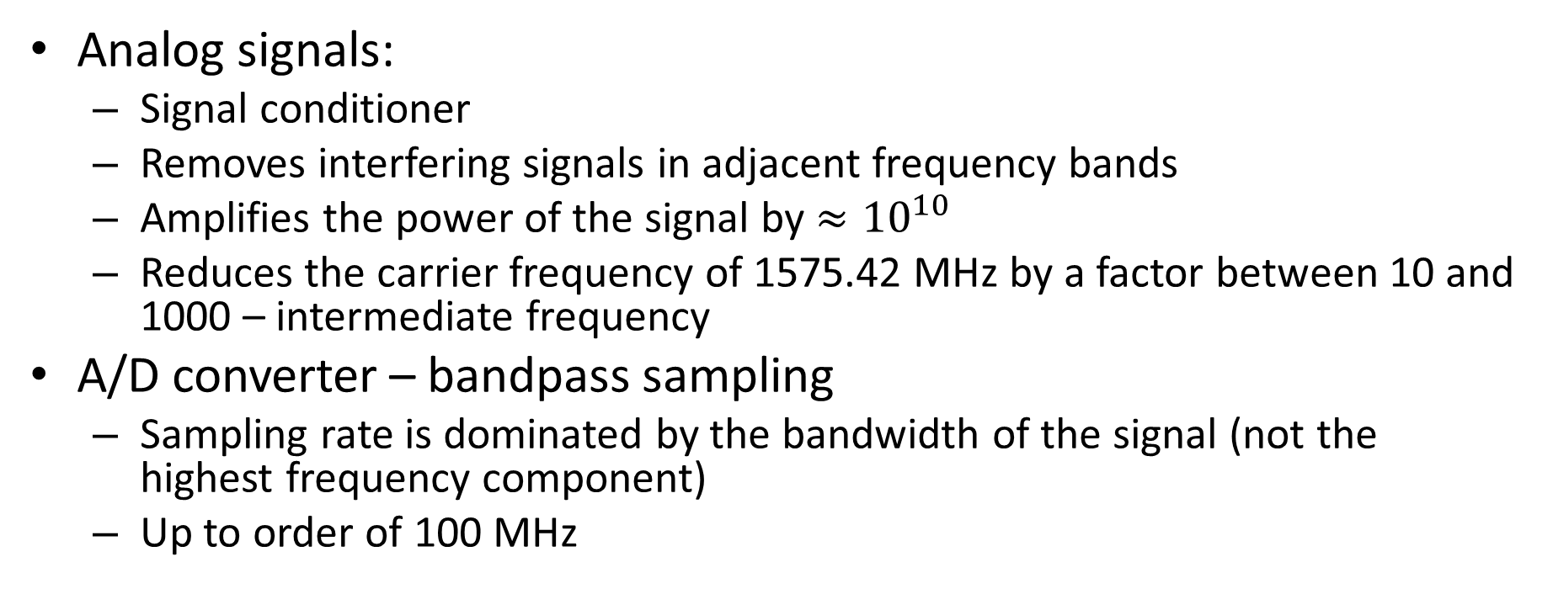
GPS Receiver Signal Processing
Analog signals:
Signal conditioner
Removes interfering signals in adjacent frequency bands
Amplifies the power of the signal by $≈{10}^{10}$
Reduces the carrier frequency of 1575.42 MHz by a factor between 10 and 1000 – intermediate frequency
A/D converter – bandpass sampling
Sampling rate is dominated by the bandwidth of the signal (not the highest frequency component)
Up to order of 100 MHz

Slide 13
GPS Receiver Signal Processing
Digital signals:
Doppler removal
Correlators
Delay lock loop filter
Phase lock loop filter
Data demodulation
Application specific processing
Figure courtesy: F. Van Diggelen “A-GPS”

Slide 14
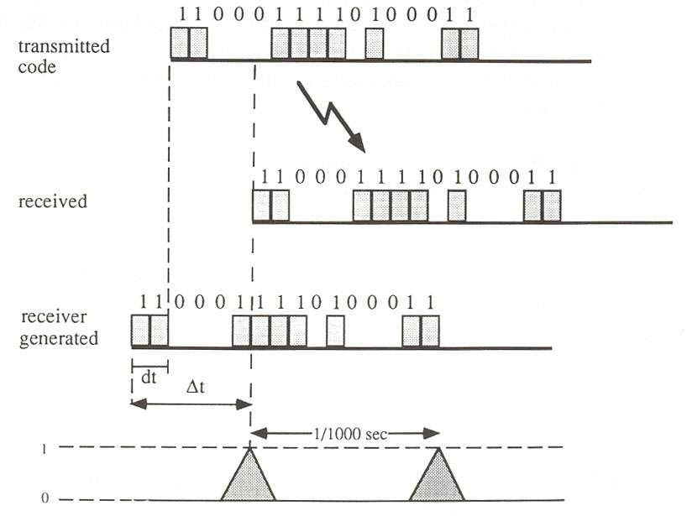
Auto-Correlation
Correlation peaks, every millisecond.

Slide 15
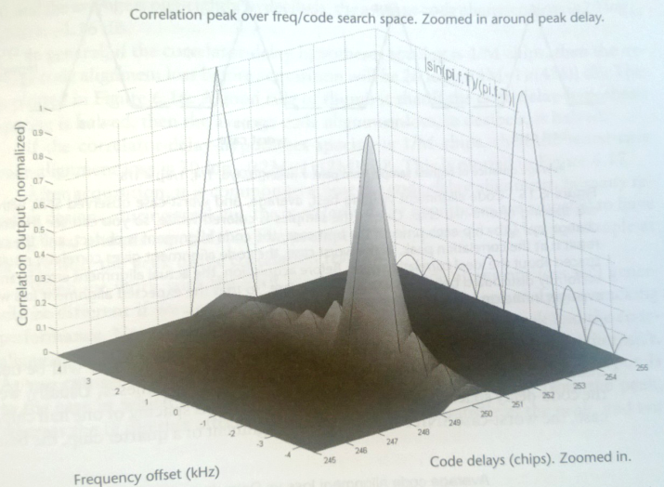
Doppler Shifts
A rising GPS satellite can move at up to 800m/s towards a receiver, causing a frequency shift of L1*800/c = 4.2kHz, where c is the speed of light.
Simulated acquisition with no noise.
Figure courtesy: F. Van Diggelen “A-GPS”

Slide 16
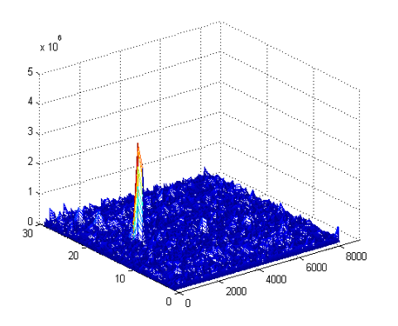
Acquisition Result
Doppler bins (500Hz)
Code phases

Slide 17
Tracking
Doppler bins
Continuous local peak adjustment based on acquisition results
.
.
.
. . . . . .
Code phase

Slide 18

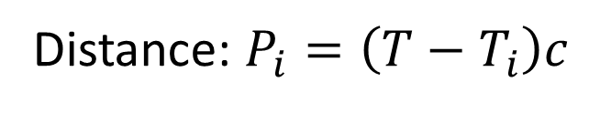
Pseudorange Estimation
t₁
TLM
HOW
Ephemeris
s₁
t₂
TLM
HOW
Ephemeris
s₂
NMS （~70ms)
t₃
TLM
HOW
Ephemeris
code phase
s₃
t₄
Distance: $P_{i}=\left(T−T_{i}\right)c$
TLM
HOW
Ephemeris
s₄
Receiving time
Time signal left satellite i
T

Slide 19
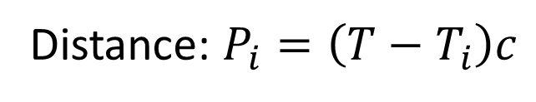
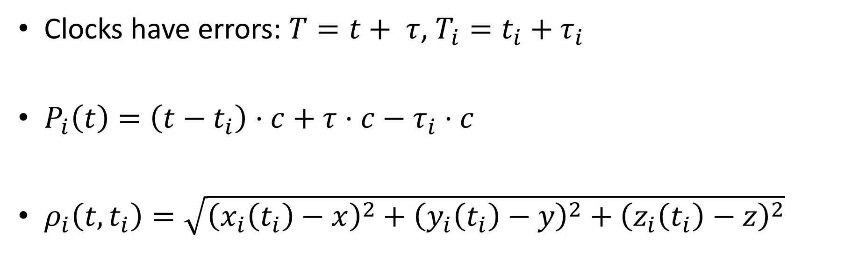
Distance Estimation
Distance: $P_{i}=\left(T−T_{i}\right)c$
Absolute time
Clocks have errors: $T=t+ τ$, $T_{i}=t_{i}+τ_{i}$
$P_{i}\left(t\right)=\left(t−t_{i}\right)⋅c+τ⋅c−τ_{i}⋅c$
$ρ_{i}\left(t, t_{i}\right)=\sqrt{{\left(x_{i}\left(t_{i}\right)−x\right)}^{2}+{\left(y_{i}\left(t_{i}\right)−y\right)}^{2}+{\left(z_{i}\left(t_{i}\right)−z\right)}^{2}}$
Local drift: common bias
Satellite drift: sent in message
Real distance
Important to use satellite position at transmit time. Satellites can move up to 60m during propagation time.

Slide 20
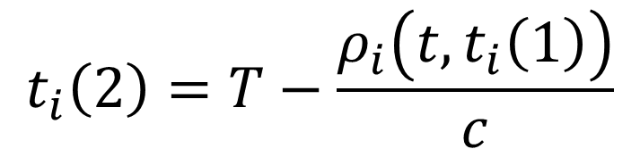
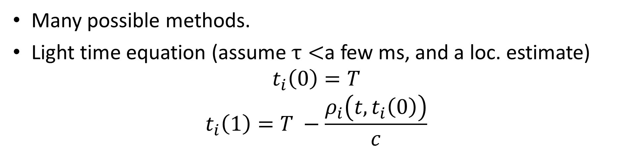
Find Transmission Time
Many possible methods.
Light time equation (assume $τ<$a few ms, and a loc. estimate)
$$t_{i}\left(0\right)=T$$
$$t_{i}\left(1\right)=T −\frac{ρ_{i}\left(t, t_{i}\left(0\right)\right)}{c}$$
$$t_{i}\left(2\right)=T−\frac{ρ_{i}\left(t, t_{i}\left(1\right)\right)}{c}$$
…

Slide 21

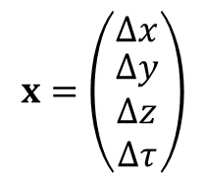
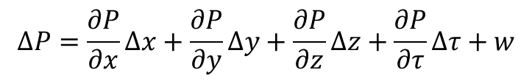

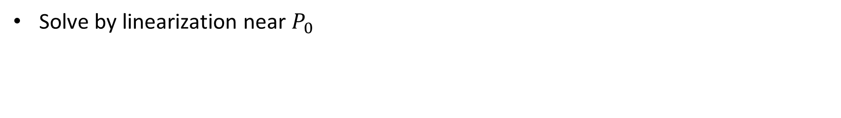
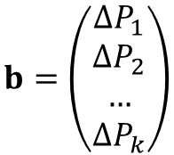
Observation Equations
$$P_{i}=\sqrt{{\left(x_{i}−x\right)}^{2}+{\left(y_{i}−y\right)}^{2}+{\left(z_{i}−z\right)}^{2}}+c⋅τ$$
$$∆P=\frac{∂P}{∂x}∆x+\frac{∂P}{∂y}∆y+\frac{∂P}{∂z}∆z+\frac{∂P}{∂τ}∆τ+w$$
Solve by linearization near $P_{0}$
$$A=\left[ \begin{matrix}\frac{\left(x_{0}−x_{1}\right)}{ρ} & \frac{\left(y_{0}−y_{1}\right)}{ρ} \\ \frac{\left(x_{0}−x_{2}\right)}{ρ} & \frac{\left(y_{0}−y_{2}\right)}{ρ} \\ … & … \\ \frac{\left(x_{0}−x_{k}\right)}{ρ} & \frac{\left(y_{0}−y_{k}\right)}{ρ}\end{matrix} \begin{matrix}\frac{\left(z_{0}−z_{1}\right)}{ρ} & c \\ \frac{\left(z_{0}−z_{2}\right)}{ρ} & c \\ … & … \\ \frac{\left(z_{0}−z_{k}\right)}{ρ} & c\end{matrix}\right]$$
$$x=\left(\begin{matrix}∆x \\ \begin{aligned}∆y \\ ∆z \\ ∆τ\end{aligned}\end{matrix}\right)$$
$$b=\left(\begin{aligned}∆P_{1} \\ ∆P_{2} \\ … \\ ∆P_{k}\end{aligned}\right)$$
Observation Equations:
$$Ax=b$$

Slide 22
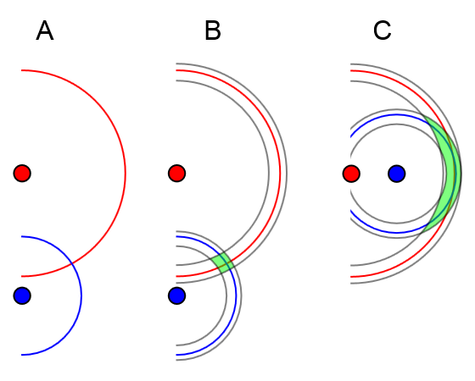


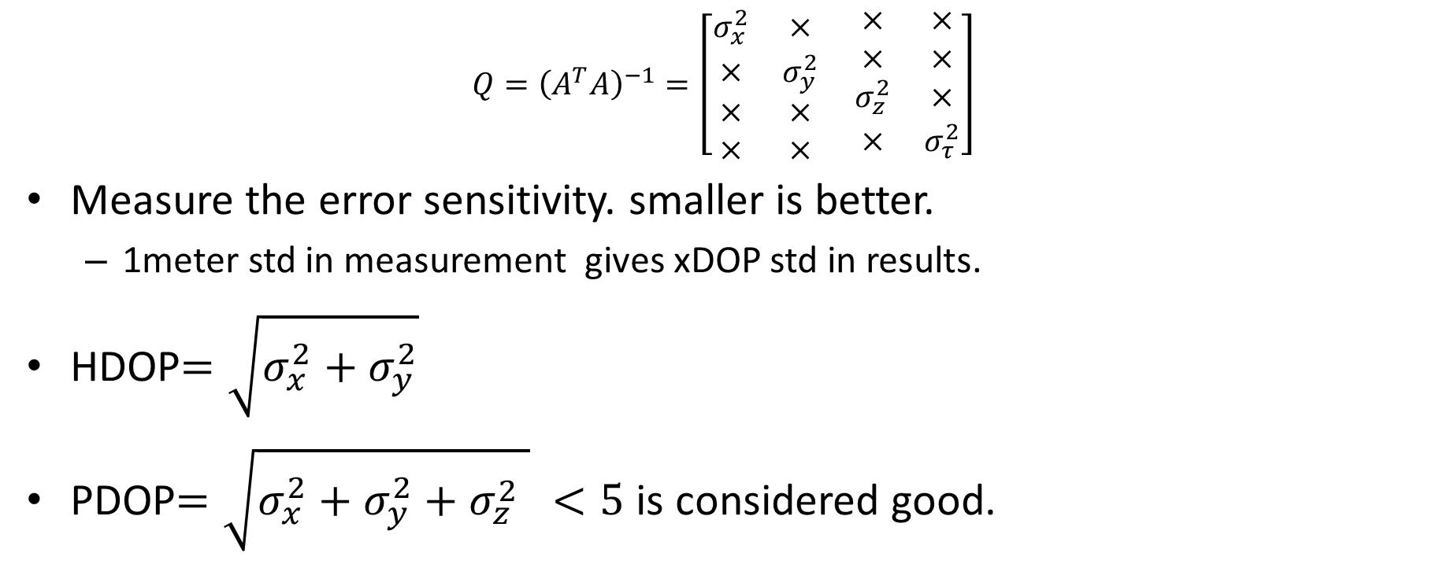
Dilution of Precision
$$Q={\left(A^{T}A\right)}^{−1}=\left[\begin{matrix}σ_{x}^{2} & × \\ × & σ_{y}^{2} \\ × & × \\ × & ×\end{matrix} \begin{matrix}× & × \\ × & × \\ σ_{z}^{2} & × \\ × & σ_{τ}^{2}\end{matrix}\right]$$
Measure the error sensitivity. smaller is better.
1meter std in measurement gives xDOP std in results.
HDOP$=\sqrt{σ_{x}^{2}+σ_{y}^{2}}$
PDOP$=\sqrt{σ_{x}^{2}+σ_{y}^{2}+σ_{z}^{2} } <5$ is considered good.
$$Ax=b$$
$$\hat{x}={\left(A^{T}A\right)}^{−1}A^{T}b$$

Slide 23
A-GPS
Two types:
Mobile Station Assisted AGPS
Mobile Station Based AGPS
Cloud send assisted information to mobile devices
Ephemeris (typically valid for 6 hours)
Visible satellites at any given time
Doppler for each satellite at any given time

Slide 24
Android Low Level GPS Log
+++++++++++ starting ++++ 1362715901273
GPSSC:STARTED:1362715901296
1524:NMEA:1362715902:$GPGSA,A,1,,,,,,,,,,,,,,,*1E
…
10790:SATs:1,31.0,93.0,44.0:8,27.0,354.0,59.0:11,27.0,63.0,41.5:17,30.0,237.0,39.0
10826:NMEA:1362715912:$GPGSV,1,1,04,08,59,354,26,17,39,237,30,01,44,093,30,11,41,063,26*7A
…
15884:SATs:1,24.0,133.5,47.0:8,29.0,294.0,73.0:11,27.0,100.5,59.5:15,22.0,331.5,0.0:17,25.0,235.5,16.0:19,21.0,48.0,31.0:26,30.0,301.5,18.5:28,25.0,303.0,42.0
15888:NMEA:1362715917:$GPGSV,2,1,08,08,73,294,28,17,16,235,24,01,47,133,21,11,59,100,26*71
15889:NMEA:1362715917:$GPGSV,2,2,08,19,31,048,20,26,18,301,29,15,00,331,21,28,42,303,24*7D
15952:NMEA:1362715917:$GPGGA,041158.427,4738.283017,N,12207.949706,W,1,08,1.0,133.4,M,-17.2,M,,*67
15954:NMEA:1362715917:$GPRMC,041158.427,A,4738.283017,N,12207.949706,W,2.5,107.4,080313,,,A*7C
15957:GPSSC: 1st fix in:15938
gpsListener: received location (-122.132495,47.638050) accuracy: 5.000000
15964:GPSSC:STOPPED
---------- stopping ----------

Slide 25
NMEA Sentences: $GPGSV
GPS Satellites in view
15888:NMEA:1362715917:$GPGSV,2,1,08,08,73,294,28,17,16,235,24,01,47,133,21,11,59,100,26*71
15889:NMEA:1362715917:$GPGSV,2,2,08,19,31,048,20,26,18,301,29,15,00,331,21,28,42,303,24*7D
1 = Total number of messages of this type in this cycle 2 = Message number 3 = Total number of SVs in view 4 = SV PRN number 5 = Elevation in degrees, 90 maximum 6 = Azimuth, degrees from true north, 000 to 359 7 = SNR, 00-99 dB (null when not tracking)
Repeat
Azimuth angle
Elevation angle

Slide 26
NMEA Sentences : $GPGGA
15952:NMEA:1362715917:$GPGGA,041158.427,4738.283017,N,12207.949706,W,1,08,1.0,133.4,M,-17.2,M,,*67
Name | Example Data | Description
Sentence Identifier | $GPGGA | Global Positioning System Fix Data
Time | 041158.427 | 04:11:58.427
Latitude | 4738.283017,N | 47d 38. 283017' N
Longitude | 12207.949706,W | 122d 07.949706' W
Fix Quality: 0 = Invalid; 1 = GPS fix; 2 = DGPS fix | 1 | Data is from a GPS fix
Number of Satellites | 08 | 8 Satellites are in view
Horizontal Dilution of Precision (HDOP) | 1.0 | Relative accuracy of horizontal position
Altitude | 133.4, M | 133.4 meters above mean sea level
Height of geoid above WGS84 ellipsoid | -17.2, M | -17.2 meters
Time since last DGPS update | blank | No last update
DGPS reference station id | blank | No station id
Checksum | *75 | Used by program to check for transmission errors

Slide 27
Summary
Baseband
Time stamp
Acquisition
Tracking
Decoding
Least Square
(lat, lon)
Ephemeris
SV IDs
Code Phases
Code Phases
Doppler
1 ms data (4kB)
Intense computation
Every ms continuous
Time stamp: 6s
Ephemeris: 30s
~10ms
AP
300 bits (10 words)
TLM
HOW
Clock corrections and SV health
6
TLM
HOW
Ephemeris parameters
12
TLM
HOW
Ephemeris parameters
Time (sec)
18
TLM
HOW
Almanac, ionospheric model, dUTC
24
TLM
HOW
Almanac
30
preamble
Time of week

Slide 28
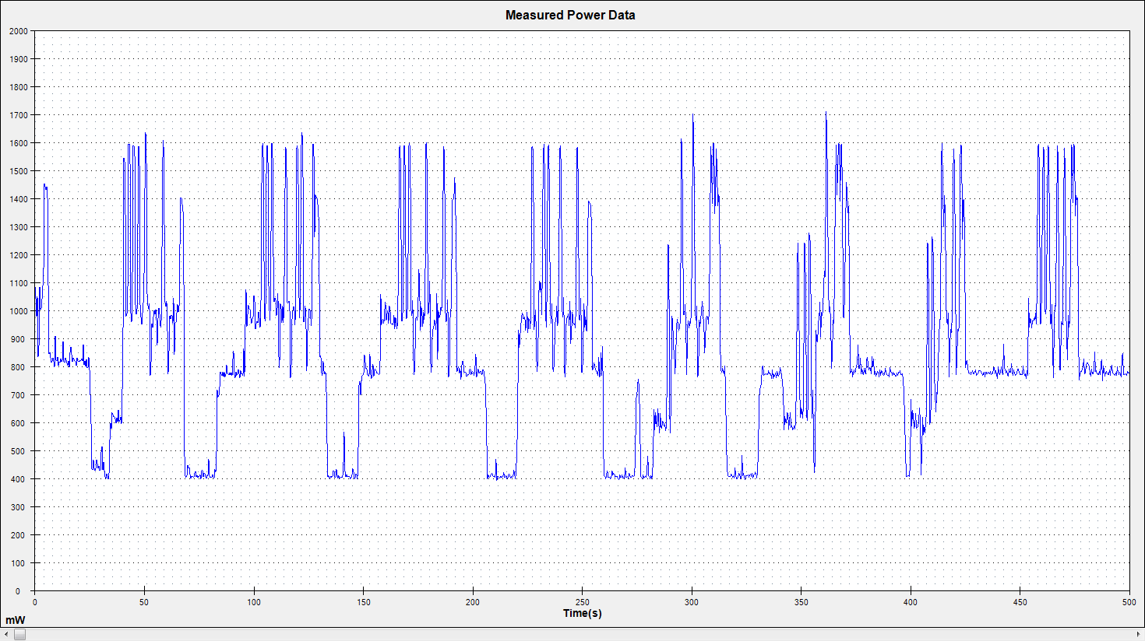



GPS Power Consumption (Succeeded)
Position Calculation $≈1200mw$
Tracking $≈700mw$
Acquisition $≈400mw$

Slide 29
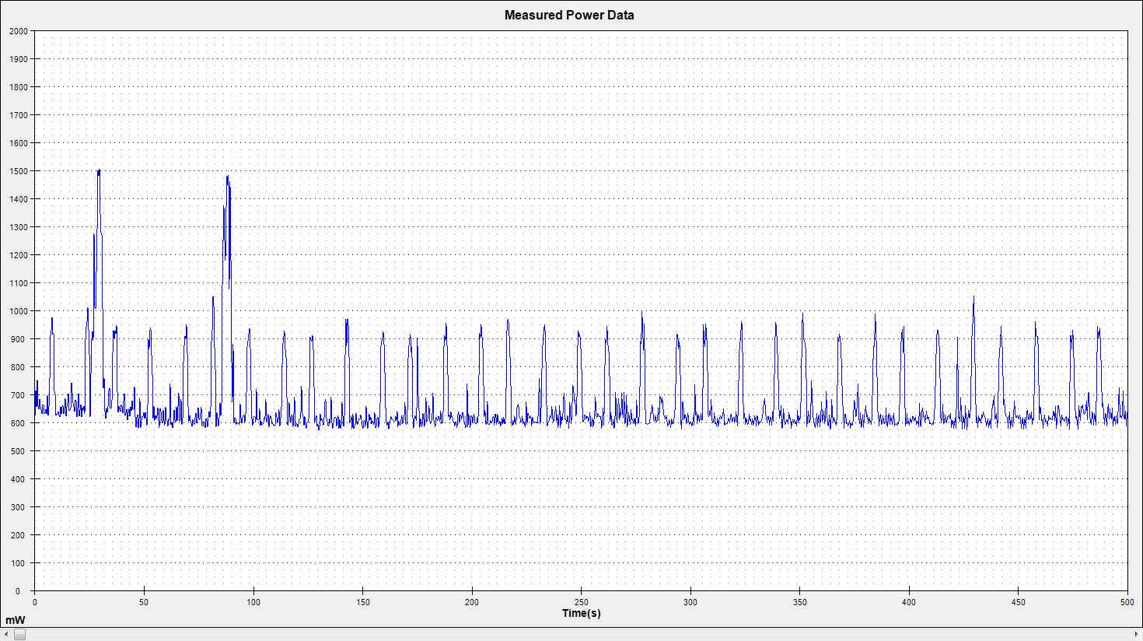

GPS Power Consumption (Failed)
Acquisition $≈400mw$

