Slide 1
Mobile Location Sensing Tutorial
Jie Liu, Dimitrios Lymberopoulos, Bodhi Priyantha, Jacky Shen
Microsoft Research

Slide 2
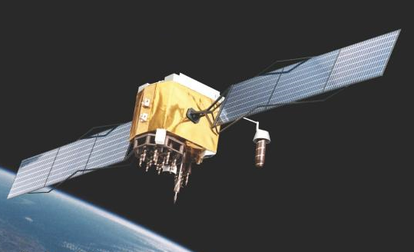
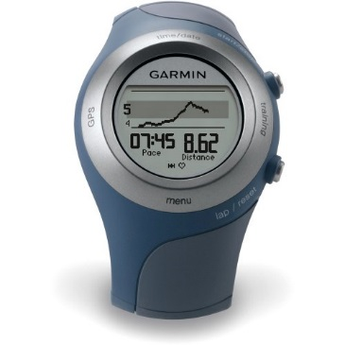

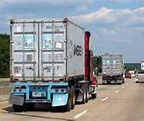
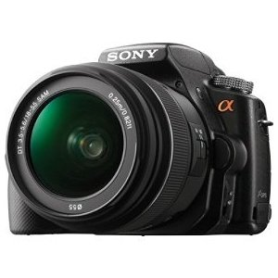


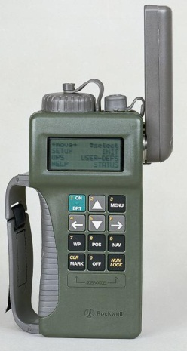
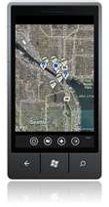
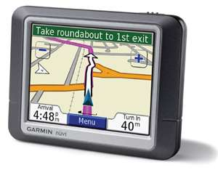
The BC and AD of Location Sensing
Scientific Discovery
Photo tagging
Asset Tracking
Healthcare
June 23, 1977
‘80
‘90
‘00
‘10

Slide 3






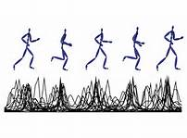

And A Lot More Sensors
FM
GSM
Multiple Radios
Audio
Camera
Motion
Cloud Connectivity

Slide 4
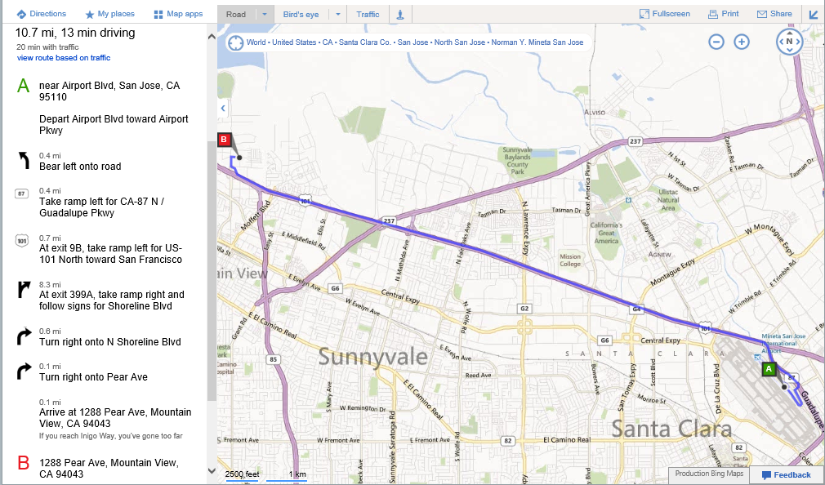
Killer App: Navigation

Slide 5
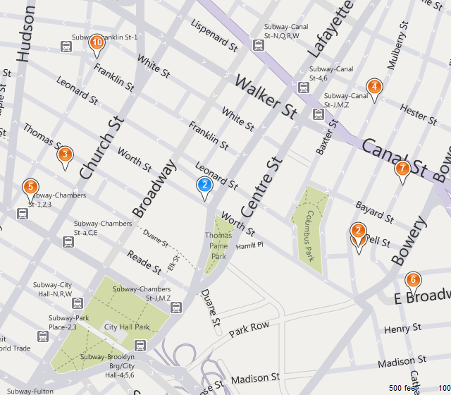
Local Search As An Example
Context | Service Example
Current Location | Local business and directions

Slide 6
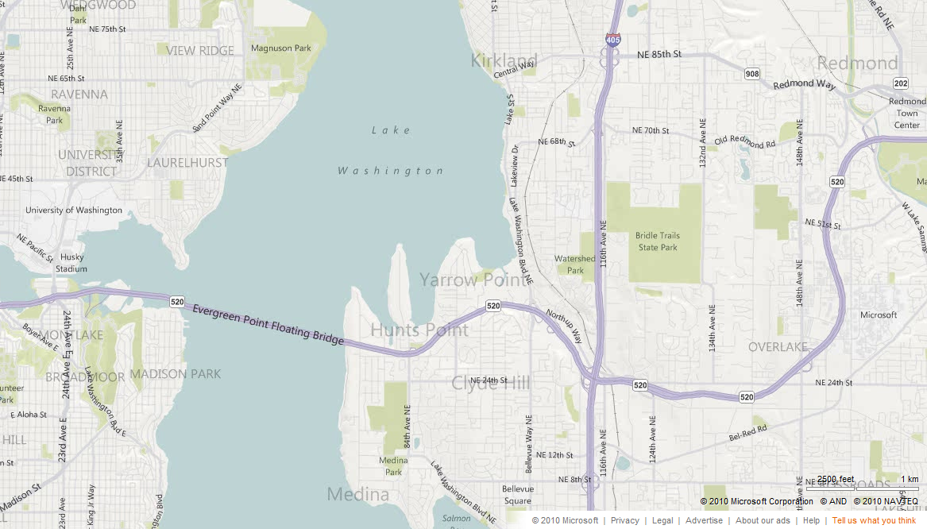
Local Search As An Example
Context | Service Example
Current Location | Local business and directions
+ Time Tracks | Businesses in driving direction
time

Slide 7
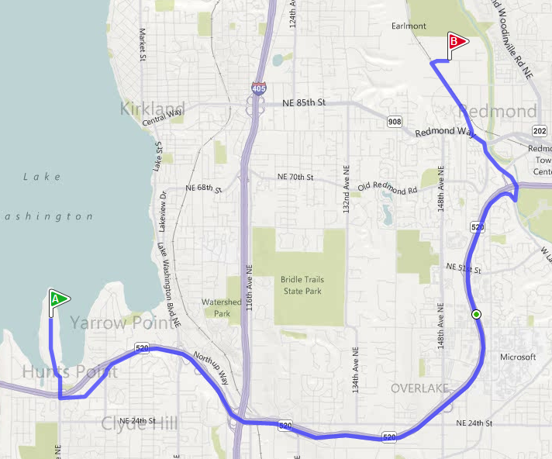
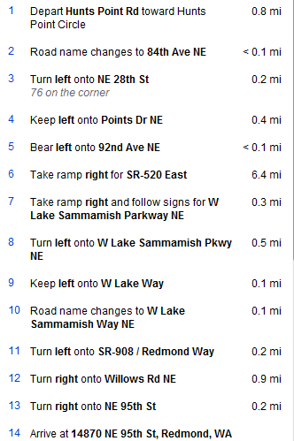
Local Search As An Example
Context | Service Example
Current Location | Local business and directions
+ Time Tracks | Businesses in driving direction
+ History | Personalized directions
frequency
time
≈ Take 520 East
Notes:
This is from Steve Ballmer’s house to a Redmond comcast office where people return their set-top boxes.

Slide 8
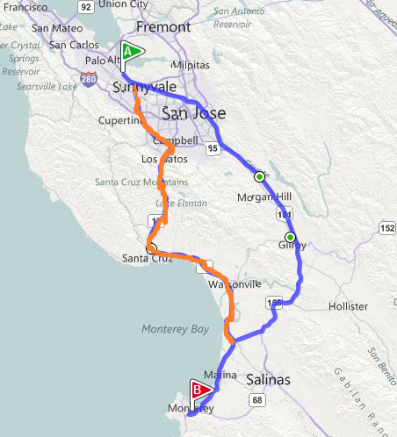
Local Search As An Example
Context | Service Example
Current Location | Local business and directions
+ Time Tracks | Businesses in driving direction
+ History | Personalized directions
+ Community | Tourist recommendation
frequency
time
Community
35% people pick the scenic route

Slide 9
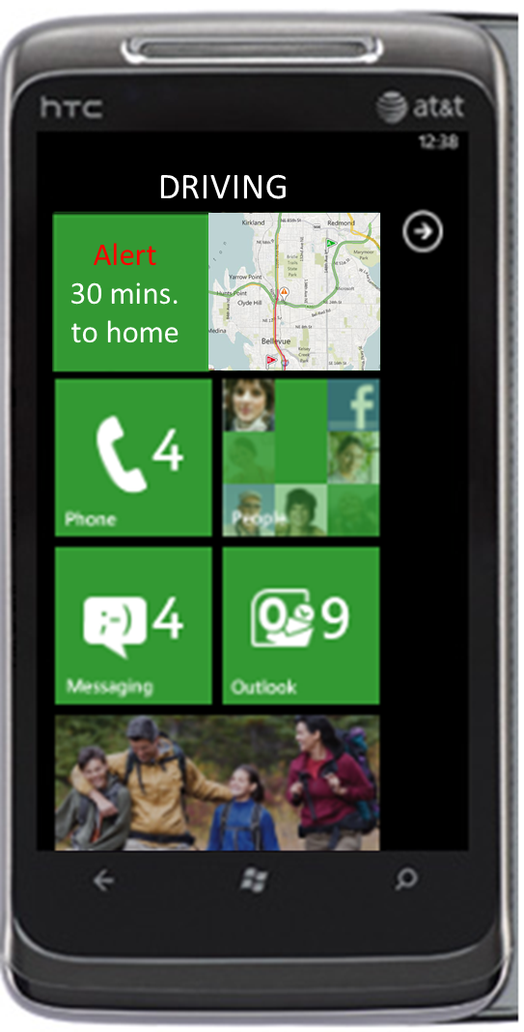
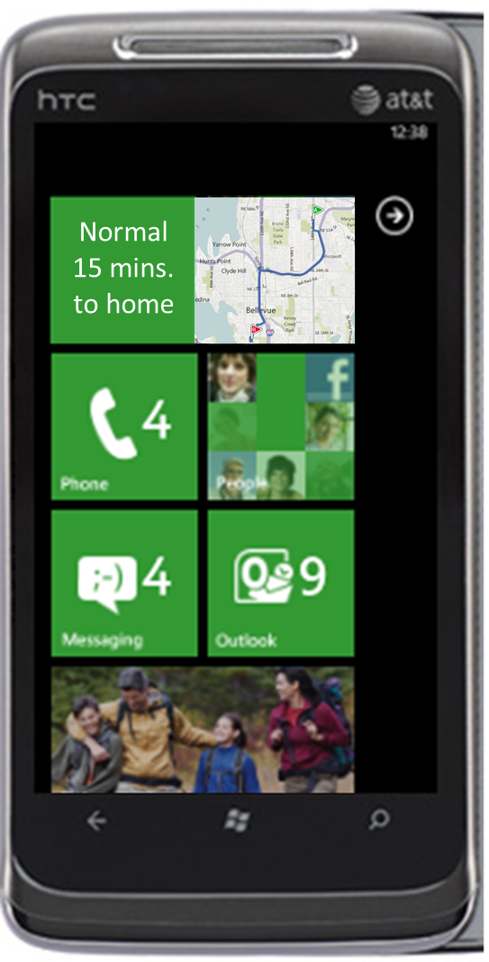
Local Search As An Example
Context | Service Example
Current Location | Local business and directions
Tracks | Businesses in driving direction
+ History | Personalized directions
+ Community | Tourist recommendation
+ Push | alerts, triggers, reminders
frequency
time
Community
Alert: Bad Traffic Consider Alternate route
Commute title appears
automatically when I am about to leave office.
Notes:
Ranking and filtering

Slide 10
Location-Based Services in Mobile Devices
Service | Expected Accuracy | Expected Latency | Require Network
Turn-by-turn navigation | <10m | <1s | Yes (initially and for route computing)
Static geo-fencing (e.g. offers) | < 30m (City block) | 1min (walking) 10s (driving) | May not
Dynamic geo-fencing (e.g. friend finder) | < 30m (City block) | 1min | Yes
logging (jogging, biking, places) | <30m depends | Delay tolerant | No
App with maps (zoom in) | <10m | Few seconds | Yes
photo tagging | <10m | Delay tolerant | No
One time LBS (search, ad, traffic, news, weather, checkin, bus, etc.) | <30m (City block) | Few seconds | Yes

Slide 11
Fundamental Tradeoffs
Energy vs Accuracy
Real-time vs Offline
Single Location vs Tracking

Slide 12
In this tutorial, we will cover
Fundamentals of location sensing
  multilateration, triangulation, intersections, signatures
Distance/Angle measurements
GPS and Cloud-Offloaded GPS
Signature-based location sensing
Continuous location (trajectory) sensing
Energy efficient location sensing
Point Locations

Slide 13
Tutorial Outline
9:00AM: Dimitrios Lymberopoulos
Introduction: Mobile Location and Location-Based Services
9:15AM: Bodhi Priyantha
Location Sensing Fundamentals
10:15AM: Break
10:45AM: Jie Liu (remote)
GPS
GPS Principle
Cloud Offloaded GPS: device & service
12:30PM: Lunch
14:00PM: Dimitrios Lymberopoulos
Signature-Based approaches: such as using WiFi, FM, GSM, magnetic field, and sound signals
15:30PM: Break
16:00PM: Jacky Shen
Mobile Location Tracking
Map-based tracking
Inertial navigation + landmarks
17:30PM: Concluding Remarks

