Slide 1
An Overview of the Global Policy and Regulatory Landscape – Creating Opportunities for Alternative forms of Spectrum Access
For more information contact spectrumpolicy@microsoft.com

Slide 2
How Do You Globally Scale Regulatory Change?

Slide 3
It’s Complicated . . .
Actions…
Database, Device and Other Prototypes
Empowering Champions in
Government, Academia, and Industry
Standards Engagements
Technical, Economic
and Legal Whitepapers
Move The Rocks…
Entrenched Incumbent Operators
New Entrant Caution
Developing Alliances with Companies, Academics & Regulators
Regulator Inertia
To Achieve…
Strategically Located and Scoped
Proof of Concept Pilot Projects
Vendor (OEM) Resistance
Global Regulations Allowing Various Forms of Spectrum Sharing
Legal and Regulatory Submissions
Technical Challenges

Slide 4
Proof of Concept Pilot Projects

Slide 5

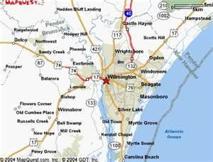














15 Years: From Concept to Commercialization
4
Commercial Deployments
Volume devices
Rural broadband
Campus networking
Smaller form factors
Standards-based
devices
3
Commercial Pilots
Device & database certification
Use case experimentation
Vertical industries
2
Regulatory Trials
Technology feasibility
Prototype devices
Field test & measurements
1
R&D
Basic research
Lab trials
Notes:
TV White Space development has made tremendous progress from concept to commercialization over the past decade.
The U.S. FCC, UK’s Ofcom, and Singapore’s Infocomm Development Authority have all shown tremendous leadership in exploring the potential of new models of allocation and regulation. Each of these agencies has been a leader in developing new ways of thinking about spectrum, and each is moving forward to enable new forms of access.
In the U.S., completion of the database rules, and rules ensuring interference protection for licensed services, enabled the first commercial whitespaces network to lunch in Wilmington, North Carolina last January and two database and device vendors now have approved offerings available. Other device and database vendors are preparing for FCC certification.
Now the stage is set for commercial deployment and real business models to emerge in the U.S. where all enabling law and regulation has now been concluded. I hope that other countries will follow that lead this year.

Slide 6

MSFT Supported Pilot Projects: Current Snapshot
Scotland
Bhutan
Taiwan
Philippines
Ghana
Kenya
Singapore
Tanzania
Indonesia
Projects (12)
Namibia
Uruguay
South Africa
67 K-12 Schools Being Connected
36,000 K-12 Students Being Connected
6 University Campuses Being Connected
38,500 University Students Getting MSFT Devices & Services
176,000 Population Under Coverage

Slide 7
Identification of Shared Goals
Relevant
Content
Healthcare
Education
E-Government
Small Business
Energy & Environment
Disaster Prepared-ness & Recovery
Services & Applications
Low-Cost Internet Access
Smart Devices

Slide 8
Africa Affordable Access Projects
Cloud-Based Services
Low-Cost Internet Access
Smart Devices
Healthcare
Education
E-Government
Small Business
Energy & Environment
Test License
Commer-cial
Kenya
√
√
√
√
√
√
√
√
MSFT
Tanzania
√
√
√
√
√
Uhuru
√
Ghana
√
√
√
Spectra
Namibia
√
√
√
√
MDB
Botswana
√
√
√
√
BIH
√
South Africa
√
√
√
√
CSIR

Slide 9

Mawingu Project
Collaboration between Kenya’s Ministry of Information and Communications, Microsoft, and Mawingu Networks.
Pilot delivering low-cost wireless broadband access to previously unserved locations near Nanyuki.
First deployment of solar-powered based stations together with TVWS to deliver high-speed Internet access to areas currently lacking even basic electricity. Base stations allow end-users to charge devices.
To maximize coverage and bandwidth, while keeping costs to a minimum, the Mawingu network relies on a combination of “license-exempt” wireless technologies, including Wi-Fi and TVWS.

Slide 10

Mawingu Business Model Overview
Paid access for govt. customers. Free access to schools/clinics. Devices, services, and training funded through donors, etc.
Free “Walled Garden” access and charging at commercial rates for Mawingu members. Transacted through Mawingu agents.
Metered BB Internet access and charging at commercial rates for Mawingu members. Transacted through Mawingu agents.
Education
Government Services
Healthcare
Agriculture

Slide 11
Regulatory Status

Slide 12
Overall Landscape – the Chicken and Egg Dilemma
Very few governments and regulators are willing to implement new spectrum sharing regimes without development of technology standards and evidence of (or commitments for) major investments from major infrastructure vendors, device manufacturers, silicon vendors, component manufacturers, and network operators.
  Government needs to be shown public policy benefits.
Very few companies are willing to make investments in new spectrum sharing technologies (including development standards) in the absence of a supportive and stable regulatory environment – ideally one that is globally harmonized.
  Industry needs to be shown a market.

Slide 13
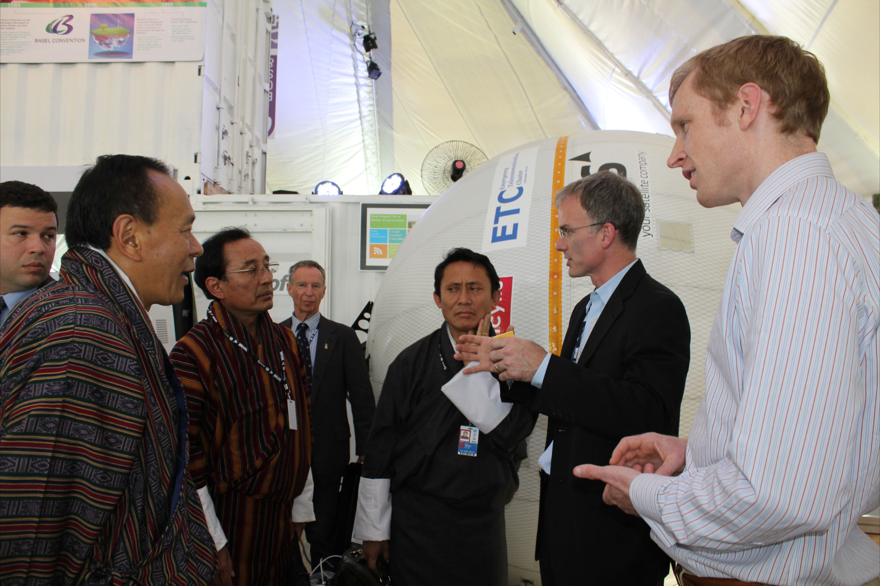
International Telecommunications Union
National regulators can begin allowing software defined radio and cognitive radio systems, hence dynamic spectrum access, without any change to the ITU radio regulations.
- World Radiocommunications Conference 2012
The ITU resolves to compile case studies and best practices regarding national use of DSA.
- World Telecommunications Development Conference 2014
Notes:
“The ITU World Radiocommunication Conference of 2012 concluded that the current international regulatory framework can accommodate software defined radio and cognitive radio systems, hence dynamic spectrum access, without being changed. The development of systems implementing this concept, such as TV white spaces, is therefore essentially in the hands of national regulators in each country.” Francois Rancy

Slide 14
Snapshot of Select Countries
United States: Remains the global leader in allowing new forms of spectrum sharing.
  FCC TV White Space regulations are in place (impacted by 600 MHz proceeding)
  FCC Proposal to allow dynamic access to 3.5 GHz to 3.7 GHz spectrum (shared access system)
  FCC Proposal to expand dynamic access to 5 GHz frequencies (DFS and databases)
  FCC & NTIA proposal for a model city for demonstrating spectrum sharing technologies (comments due 8/2014)
United Kingdom: Ofcom continues on a slow march to implementing license-exempt access to the TV white spaces. Implementation by MY15.
Singapore: IDA appears ready to enable license-exempt access to 180 MHz of TV White Spaces spectrum. Approved regulatory framework by YE14.
Canada: Industry Canada intend to adopt TV white space regulations modeled on the FCC’s rules. Approved regulatory framework by YE14.
European Commission: RSPG opinion on licensed shared access – up to NRAs.
France: ARCEP has launched a proceeding on unlicensed (free) access to spectrum (comments due 10/15/14).

Slide 15
Developing Alliances

Slide 16

A global, cross-industry alliance focused on increasing dynamic access to unused radio frequencies

Slide 17
DSA Goals
Close the Digital Divide
  Support technical, regulatory, and business model innovations that make wireless broadband access more affordable for people around the world
Enabling the Internet of Things
  Support spectrum policies that can enable the burgeoning Internet of Things
  Increasing efficiency and improving quality of life
Alleviating the “Spectrum Crunch”
  Support changing regulatory policies that create artificial spectrum scarcity
  Replace them with policies that will increase available bandwidth, reduce costs, and increase consumer choice

Slide 18
The DSA supports the following policies to create an appropriate legal and regulatory framework to foster dynamic access to spectrum:
  Gaining a better understanding of spectrum use around the globe
  Regulations that do not favor one radio access technology over the other and allow for the co-existence of a variety of technology platforms
  Making unused spectrum available for dynamic spectrum access in licensed, license-exempt (unlicensed) and lightly licensed spectrum bands
  Supporting dynamic spectrum access across a variety of complementary spectrum bands
  Promoting the use of geolocation databases and other interference protection mechanisms
  Supporting global harmonization of dynamic access to unused spectrum
  Encouraging long-term efforts to develop regulations making dynamic spectrum access the default mode of access to radio spectrum, with technical rules that address legitimate interference concerns

Slide 19


































Current Members

Slide 20


For more information go to http://research.microsoft.com/en-us/projects/spectrum/ or
Contact spectrumpolicy@microsoft.com
© 2012 Microsoft Corporation. All rights reserved. Microsoft, Windows, Windows Vista and other product names are or may be registered trademarks and/or trademarks in the U.S. and/or other countries.
The information herein is for informational purposes only and represents the current view of Microsoft Corporation as of the date of this presentation. Because Microsoft must respond to changing market conditions,
it should not be interpreted to be a commitment on the part of Microsoft, and Microsoft cannot guarantee the accuracy of any information provided after the date of this presentation.
MICROSOFT MAKES NO WARRANTIES, EXPRESS, IMPLIED OR STATUTORY, AS TO THE INFORMATION IN THIS PRESENTATION.

Slide 21
Backup References

Slide 22
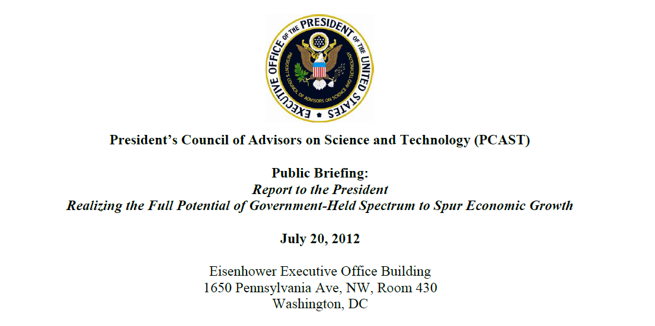
http://www.whitehouse.gov/sites/default/files/microsites/ostp/pcast_spectrum_report_final_july_20_2012.pdf

Slide 23
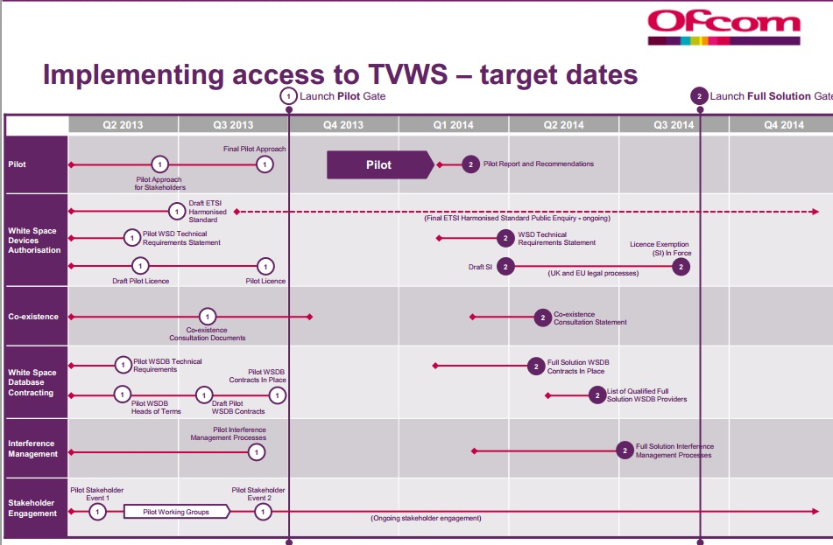

Slide 24
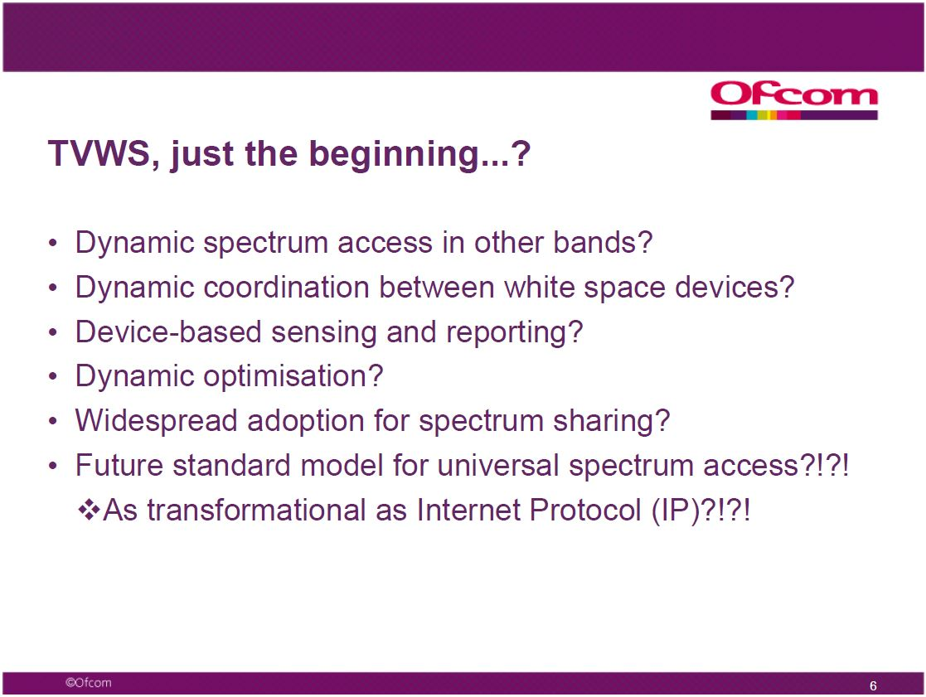
Ofcom plans…

Slide 25

Industry Canada’s White Space Implementation Plan
Major Milestones
Q4 2012
Q4 2013
Q4 2014
Database
Approval
Device
Certification
Consultation
&
Decision
Technical
&
Operational Rules
Deployment
We are Here

Slide 26
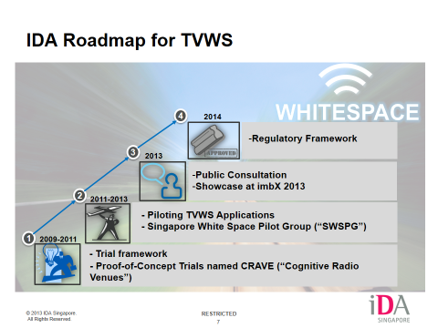

Slide 27
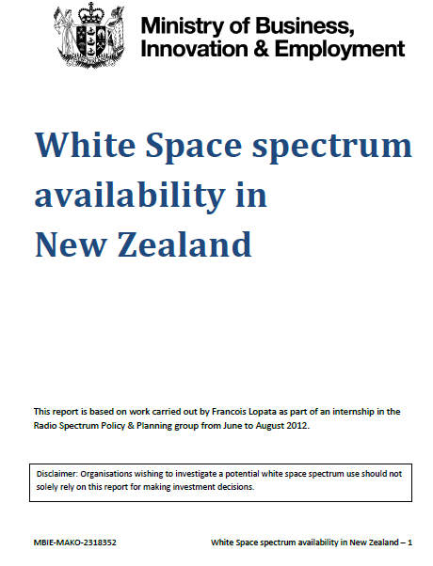
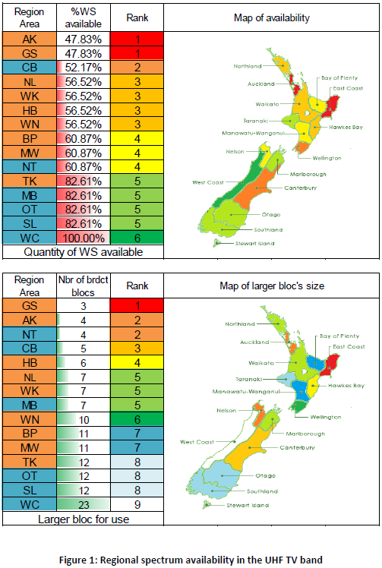
TV White Space Availability in New Zealand
Conclusion:
At the time of this study, there was a minimum of 2x16 MHz
And 2x24 MHz of contiguous white space spectrum available
In the North Island and South Island, respectively.

Slide 28
