Slide 1

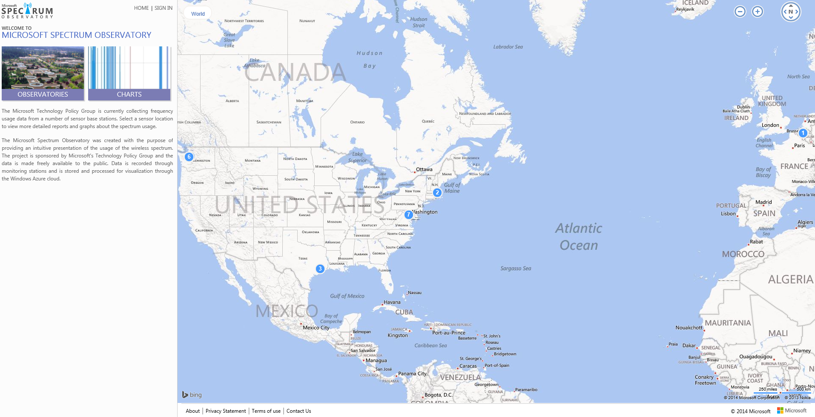
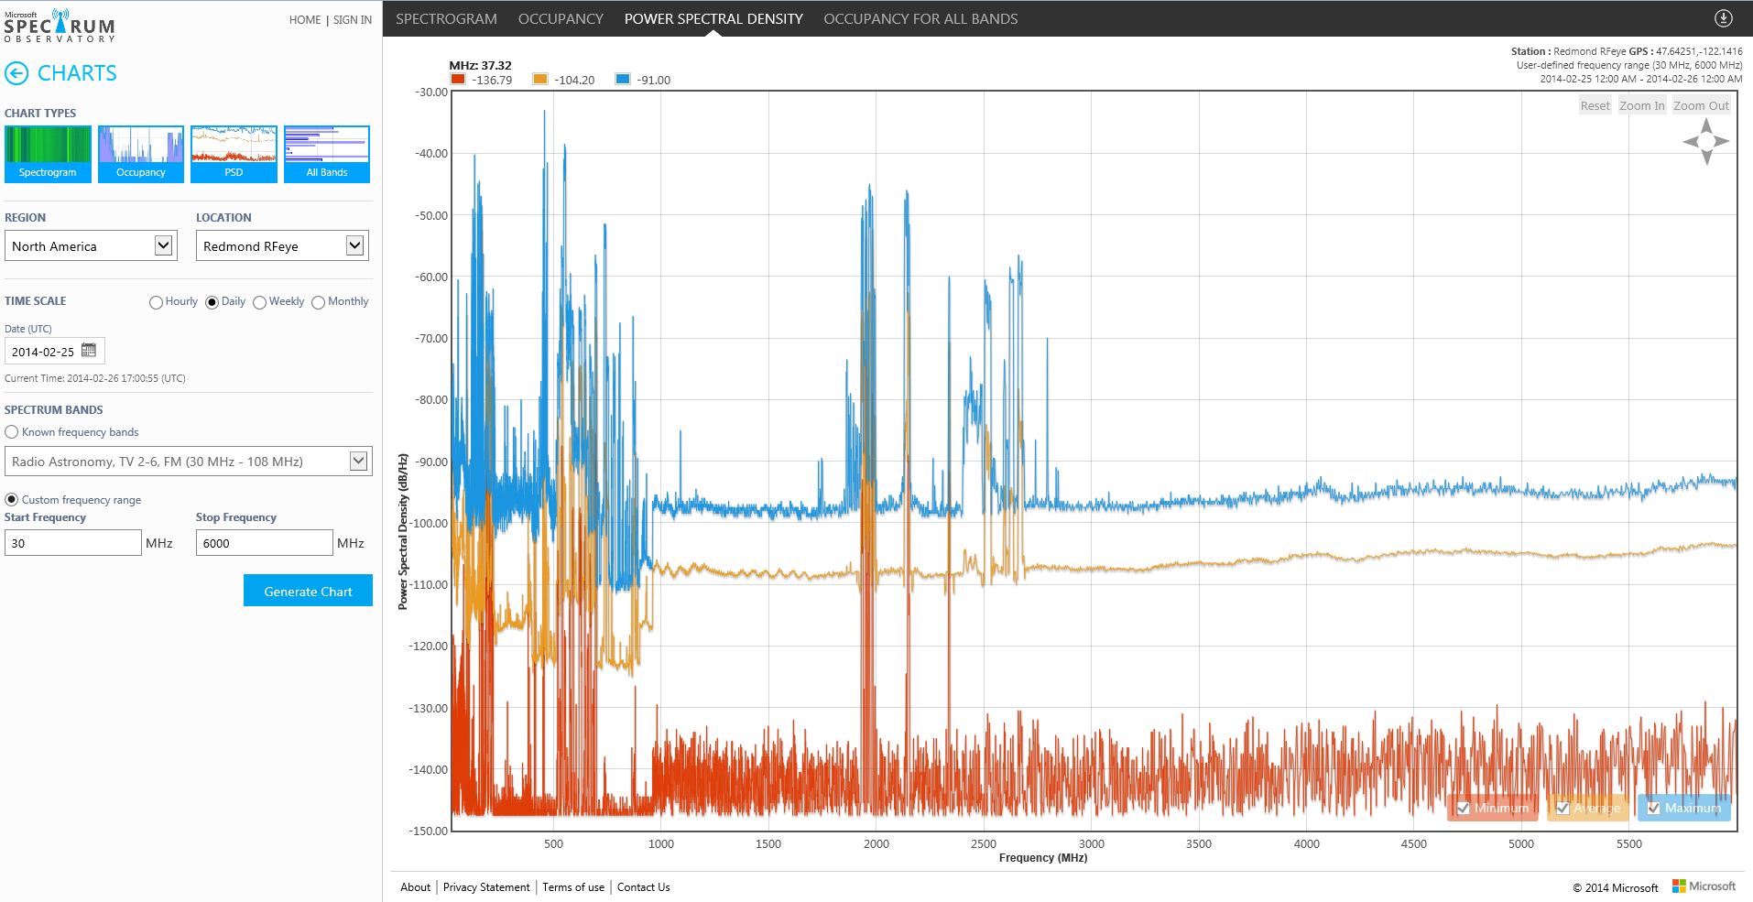
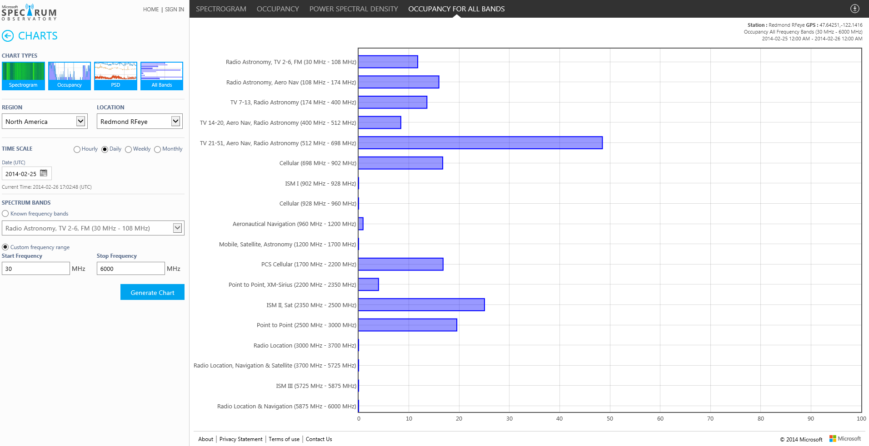
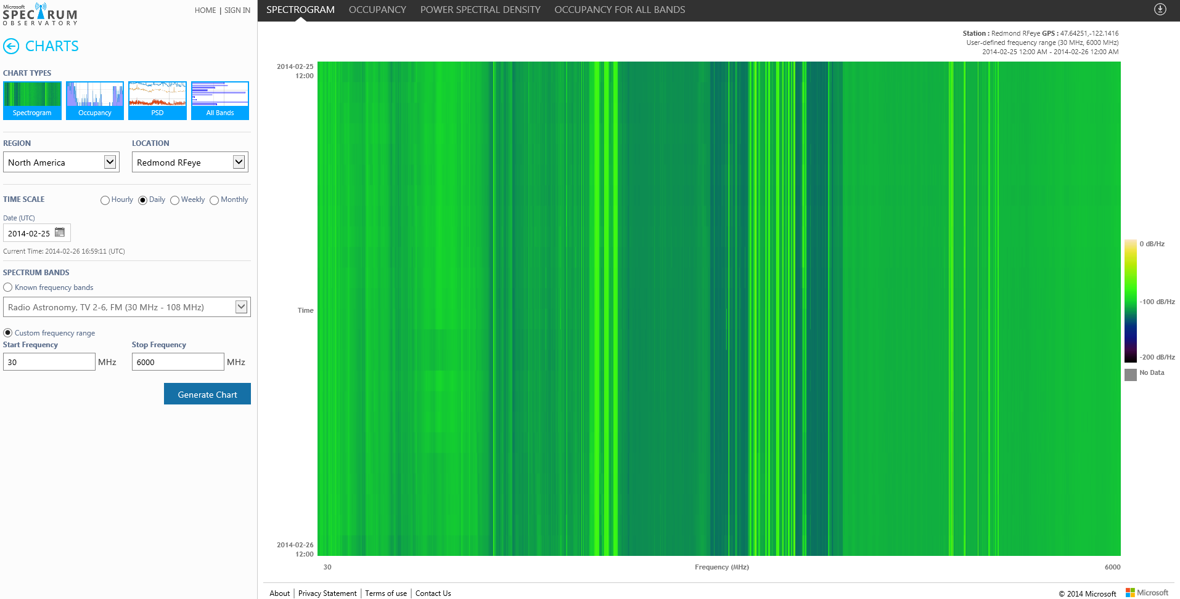
http://observatory.microsoftspectrum.com
Created to provide an intuitive presentation of the usage of the wireless spectrum. The project is sponsored by Microsoft's Technology Policy Group and the data is made freely available to the public. Data is recorded through monitoring stations and is stored and processed for visualization through the Windows Azure cloud.

Slide 2




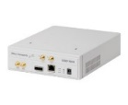
Our Goals
A global spectrum-monitoring platform:
Provides evidence (hard data) of the spectrum usage
Aids in policy and regulation decisions
Helps DSA systems
Users
<$5,000
Large Scale
Distributed to world-wide research orgs
Low Cost
Suitable for large deployment

Slide 3
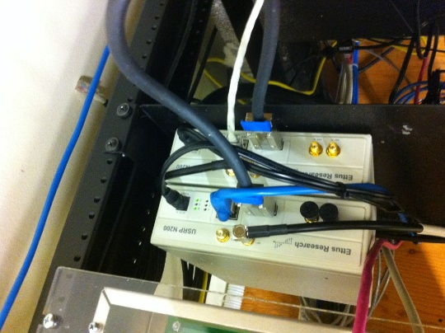
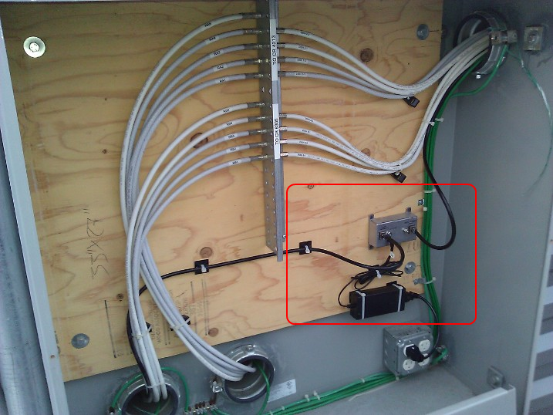
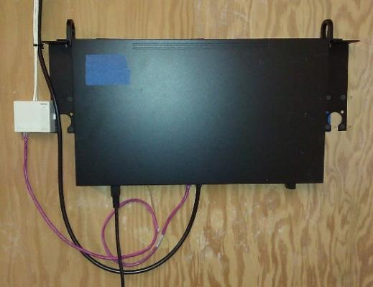
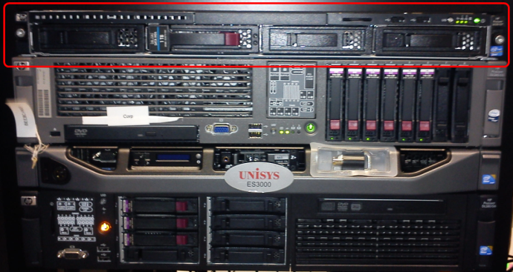
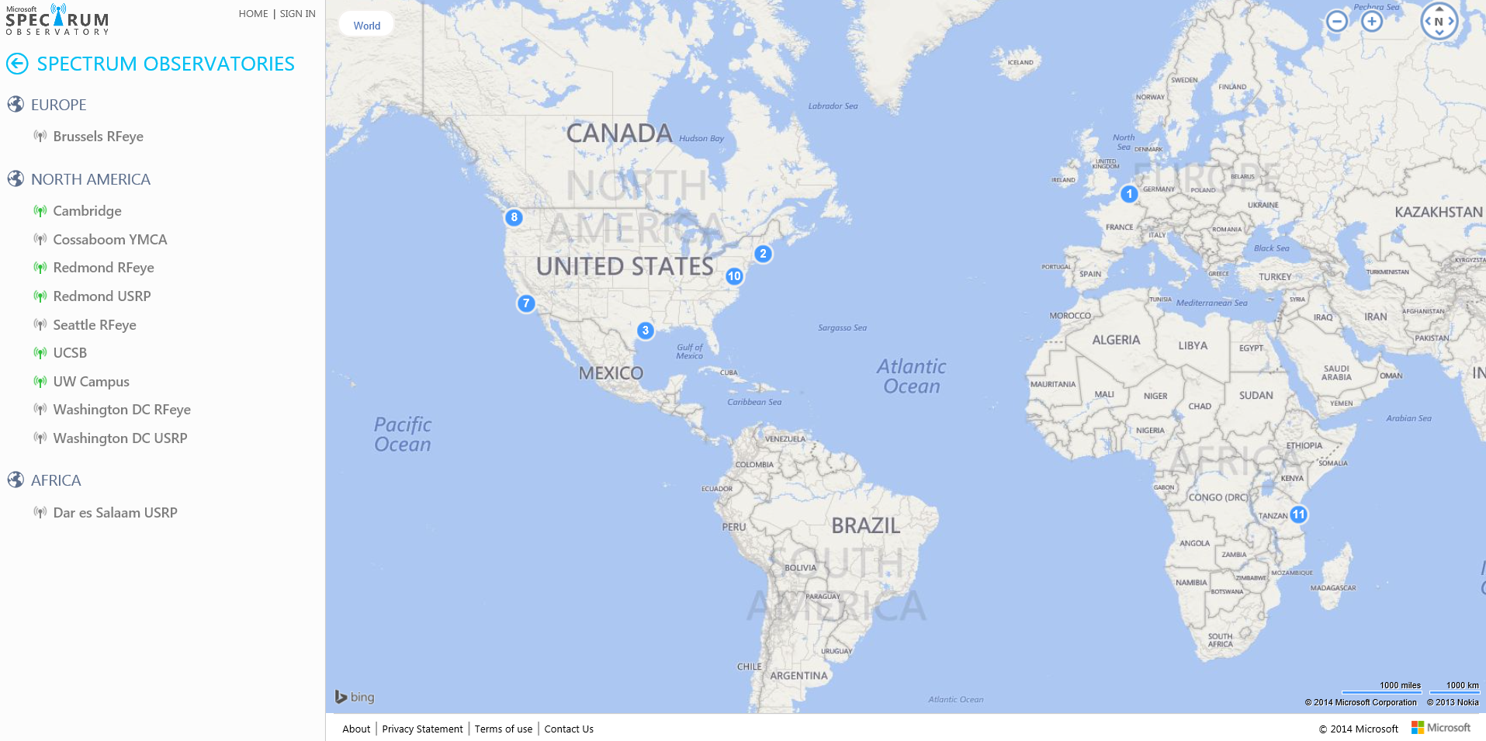
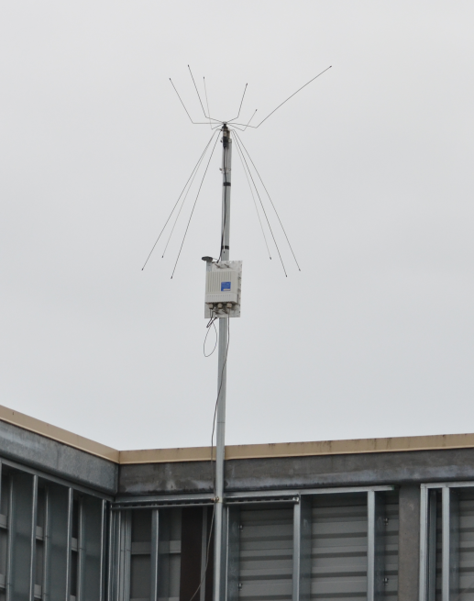
Current Station Locations

Slide 4
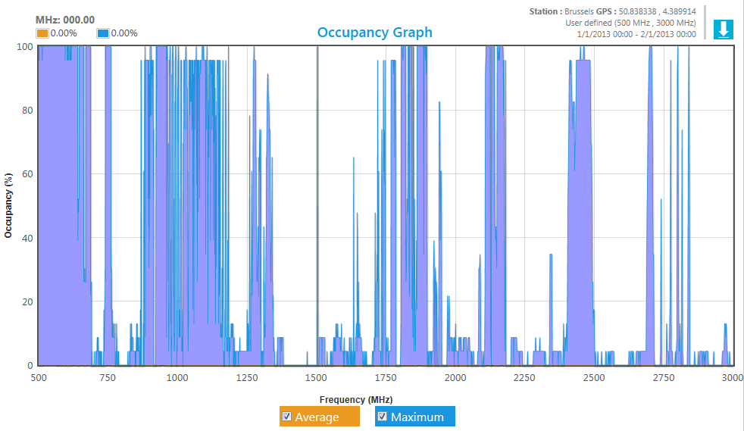
General Findings
Overall low total occupancy, time and location important, band specific

Slide 5
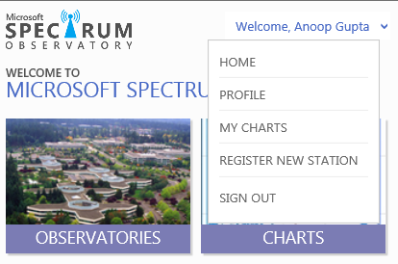
Adding New Stations
Go to http://observatory.microsoftspectrum.com
Sign in to the site (registration is required to register a new station)
Click on the “Register New Station” button under where the sign in button was:
Hardware requirements, setup instructions, and links to monitoring software are displayed
Enter the information for the station (point of contact, location…)
Station will be approved by a Microsoft admin, and a station ID will be assigned

Slide 6
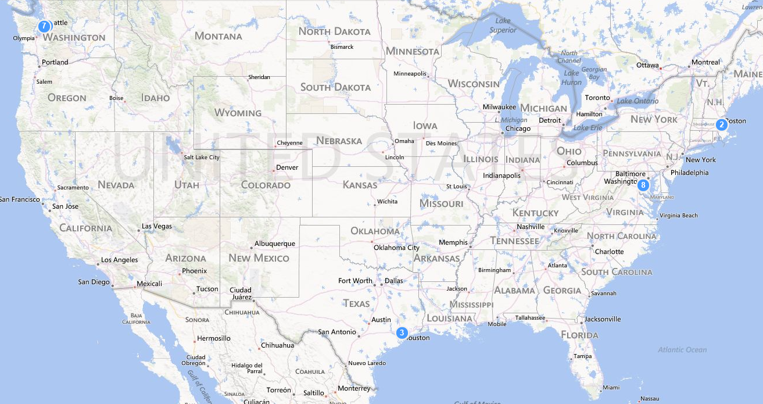


Openness and Collaboration
Working with university partners
University of Washington
MIT
Rice
UCSB
Released under Apache 2.0 OSS license on CodePlex: https://spectrumobservatory.codeplex.com/
Full access to the all uploaded data available upon request. E-mail spectrum_obs@microsoft.com

Slide 7



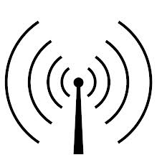

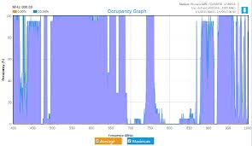
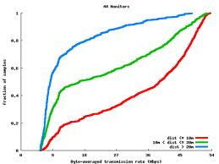

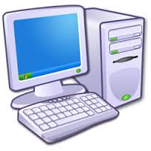
System Overview
Outdoor Antenna
Researchers
Visualize
Policy Makers
DSA Users
• Real-time/History Occupancy
Signal Splitter
Cmd
• User Signal Feature
Cloud & Storage
• Other Information…
Processed Data
Backwards
Control
End User
USRP1(SBX)
400-4400MHz
USRP2(WBX)
50-2200MHz
Feature Vector Extraction
Smart Scheduling / Scanning
Custom Device Support
Data
Per USRP:
- Sampling Rate: 50 MS/s
- Instant BW: 40MHz
Control
Radio Frontend
Local Process & Control

Slide 8
Scanner
Outdoor Antenna
Signal Splitter
USRP1(SBX)
400-4400MHz
USRP2(WBX)
50-2200MHz
Per USRP:
- Sampling Rate: 50 MS/s
- Instant BW: 40MHz
Radio Frontend

Slide 9
Scanner Configuration
Simple XML config file
<UsrpSequentialScanner cpuFormat = "fc64" fftAlgorithm = "n“ fullScale = "0“ minutesOfDataPerScanFile = "60" otwFormat = "sc16" peak = "0" rxRate = "25000000" samplesPerScan = "1024" multiThreadFft = "false" scanDirectory = "c:\spectrumdata\scan" secondsOfDataPerSample = "60" singleScan = "false" tuneSleep = "0" decibelShift = "0“ numberOfSampleBlocksToThrowAway = "0" numberOfSampleBlocksPerScan="1" scanOverlap="0" commChannel="serial" communicationsChannelLocks="false"
>
<Devices>
<add antenna = "RX2" clockSource = "internal" gain = "38" address="F49911" name="B200“ startFrequency= "70000000" stopFrequency= "5995000000" timeSource = "none" scanPattern = "StandardScan"/>
</Devices>
</UsrpSequentialScanner>

Slide 10
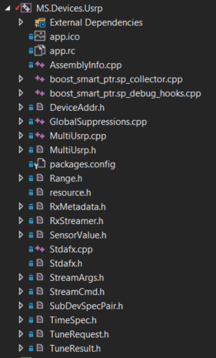
Adding a New RF Sensor
Repeatable pattern to support various sensors
Step 1
MS.Devices.USRP
C# interop to sensor

Slide 11
Adding a New RF Sensor (contd)
Step 2
MS.Scanning.Scanners
Configuration of sensor via XML config
Implement algorithm specific to sensor for scanning

Slide 12
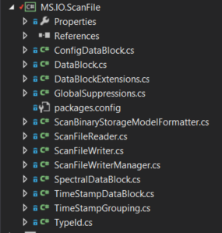
Adding a New RF Sensor (contd)
Step 3
MS.IO.ScanFile
Output into standard file format

Slide 13
System Overview
Outdoor Antenna
Signal Splitter
USRP1(SBX)
400-4400MHz
USRP2(WBX)
50-2200MHz
Feature Vector Extraction
Smart Scheduling / Scanning
Custom Device Support
MIMO Cable
Data
Per USRP:
- Sampling Rate: 50 MS/s
- Instant BW: 40MHz
Control
Radio Frontend
Local Process & Control

Slide 14
New Feature Vectors (scanner side)
Single extensible file format (ScanFile)
Time
Config
Spectral Data
Moving to storing everything in this format for all raw data

Slide 15
System Overview
Outdoor Antenna
Signal Splitter
Cloud & Storage
Processed Data
Backwards
Control
USRP1(SBX)
400-4400MHz
USRP2(WBX)
50-2200MHz
Feature Matching
Smart Scheduling
Custom Device Support
MIMO Cable
Data
Per USRP:
- Sampling Rate: 50 MS/s
- Instant BW: 40MHz
Control
Radio Frontend
Local Process & Control

Slide 17
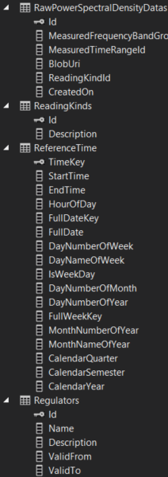
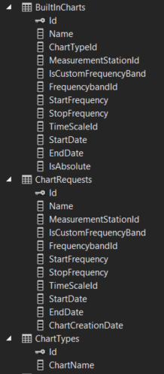
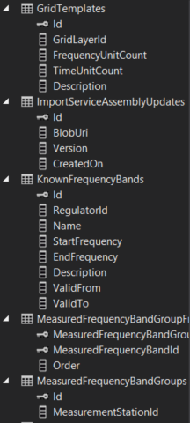
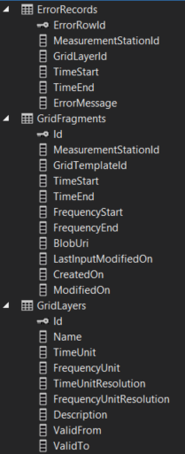
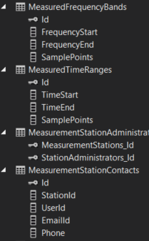
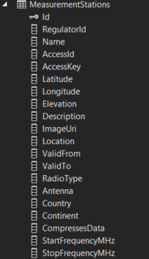
Metadata Storage
SQL Tables

Slide 18
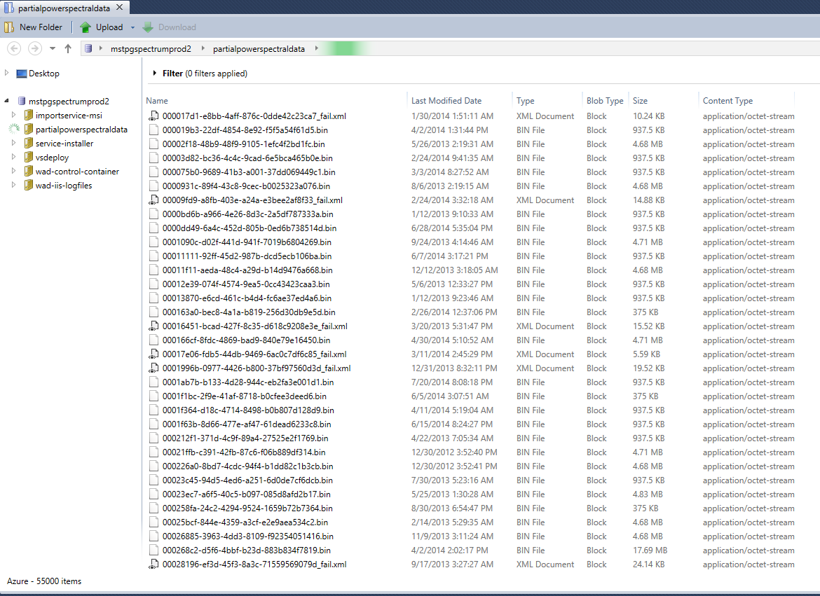
Raw Data Storage
Raw and Aggregated Azure blobs

