Slide 1
NTIA Spectrum Monitoring
Current Project Status
6 August, 2014
Mike Cotton (NTIA Boulder)
for
Microsoft Spectrum Observatory Think Tank Meeting
(Redmond, WA)

Slide 2
Outline
Background
Project Goals, Plan, and Deliverables
Sensor Design(s)
Data Transfer Specification
Measured Spectrum Occupancy Database (MSOD)
Q&A

Slide 3
Background
ISART 2010 and 2011
Measure of 3.5 GHz band near San Diego (June 2012)
Present Data at ISART 2012 → Proposed SOW
NTIA Spectrum Monitoring Initiative with NOI – Did not pass in Dec 2013 Congressional Budget
NTIA-Funded FY14/15 Spectrum Monitoring Program (Started March 2014)

Slide 4
Project Goals
To determine benefits of automated and continuous spectrum measurements to better analyze actual spectrum usage.
To evaluate whether a more comprehensive monitoring program would create additional opportunities for more efficient spectrum access through, for example, increased and more dynamic sharing.

Slide 5
FY14 Project Plan
Design and implement a Measured Spectrum Occupancy Database (MSOD)
Assess RF performance and programmability of available mid-, low-, and ultralow-grade COTS sensors
Design prototype radar sensor
Design prototype comm sensor
Demonstrate end-to-end functionality with data from remote sensors made available to authorized users via MSOD over the internet

Slide 6
FY15 Project Plan
Deploy 10 x 3.5 GHz Sensors at Coastlines of U.S. Littoral Waters
  - AND/OR –
Setup a Monitoring Network for the Spectrum Test City
MSOD

Slide 7



NTIA Spectrum
Monitoring Network
Authorized Users
RF
C
M
F
Sensor 1
RF
C
M
F
IP Internet
Sensor 2
IP Network
RF
C
M
F
Sensor 3
RF
C
M
F
Sensor 4
NTIA/ITS Boulder
M
F
RF
C
M
F
Modem/Firewall
and Data Staging Station
Sensor N
Measured Spectrum Occupancy Database (MSOD)

Slide 8
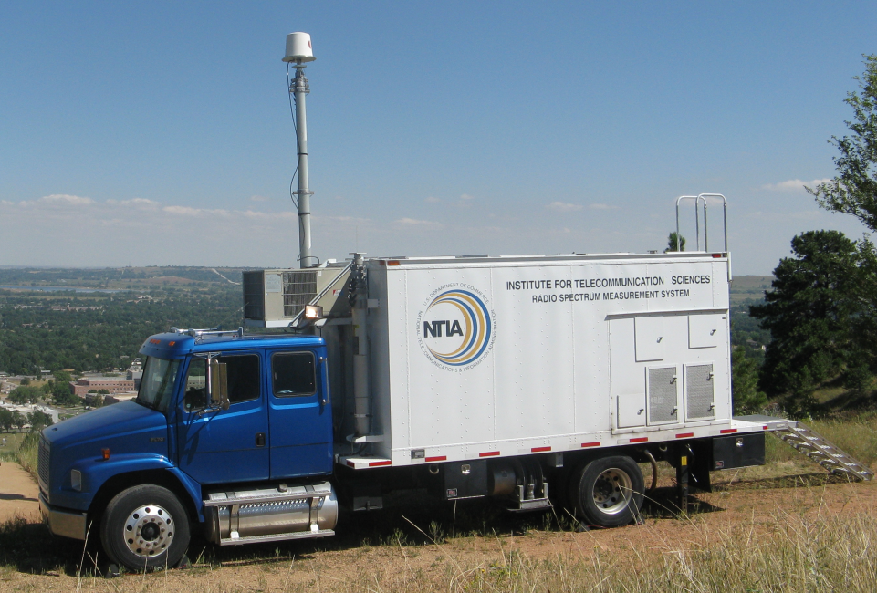
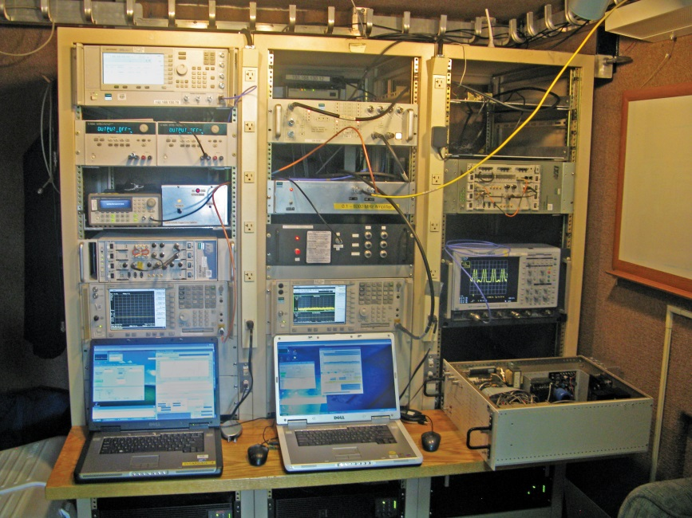

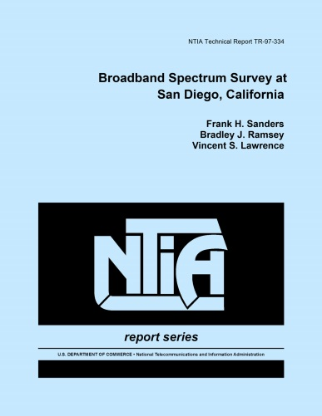
Sensor Design(s)
Starting Point - Broadband Surveys

Slide 9
Sensor Design(s)
Development Tasks
Create cost/capability matrix of high-, mid-, low-, and ultralow-grade COTS sensors
Limit scope of sensor design to a frequency/service proximity and design to appropriate requirements
Replace spectrum analyzer with appropriate COTS sensor
Implement remote control and data backhaul

Slide 10



Sensor Design(s)
General Architecture
IP Network
Example Site Requirements for 3.5 GHz Sensor:
180⁰ Filed of View of Ocean/Gulf
AC Power: (1 A)
Shelter: Driver, COTS sensor, and modem are not weatherproof
Access to Outside to run 30’ RF and Ethernet cables
Structure outside shelter for mounting antenna and preselector
Preselector
Modem
COTS Sensor
Driver

Slide 11
Sensor Design(s)
Requirements
Appropriate antenna parameters for the band/service to be monitored, e.g., frequency range, polarization, pattern, &c
Preselector requirements:
  Cost less than chosen COTS sensor
  Weatherproof
  Perform local calibration/self-check
  Achieve adequate sensitivity and avoid non linear behavior (e.g., due to strong out-of-band emissions)
Driver/COTS sensor requirements:
  Execute scheduled measurements with appropriate sampling (e.g., timing, frequency, and bandwidth)
  Provide indication of “SIGNAL IS TOO STRONG”
  Achieve reasonable amplitude accuracy, e.g, +- 1 dB
  Process data to (1) Implement optimal detection, (2) Remove systematic sensor-specific gains/losses, and (3) Format according to data transfer specification
  Store data locally and move to data staging server when network is available

Slide 12
Common Transfer Specification
{
"Ver": "1.0.11",
"Type": "Sys",
"SensorID": "Norfolk",
"SensorKey": "123456789",
"t": 1406659994,
"Antenna": {
"Model": "Alpha AW3232/Sector/Slant",
"fLow": 3300000000,
"fHigh": 3800000000,
"g": 15,
"bwH": 120,
"bwV": 7,
"AZ": 0,
"EL": 0,
"Pol": "Slant",
"XSD": 13,
"VSWR": -1,
"lCable": 2
},
"Preselector": {
"fLowPassBPF": 3430000000,
"fHighPassBPF": 3674000000,
"fLowStopBPF": 3390000000,
"fHighStopBPF": 3710000000,
"fnLNA": 1.34,
"gLNA": 43.29,
"pMaxLNA": 27.29,
"enrND": 14.34
},
"COTSsensor": {
"Model": "Agilent E4440A",
"fLow": 3,
"fHigh": 2.65e+10,
"fn": 22,
"pMax": 0
},
{
"Ver": "1.0.11",
"Type": "Data",
"SensorID": "Norfolk",
"SensorKey": "123456789",
"t": 1406659994,
"Sys2Detect": "Radar - SPN43",
"Sensitivity": "Medium",
"mType": "Swept-frequency",
"t1": 1406659994,
"a": 1,
"nM": 1,
"Ta": 0,
"OL": 0,
"wnI": -106.8202532,
"Comment": "System installed at…",
"Processed": "False",
"DataType": "ASCII",
"ByteOrder": "Network",
"Compression": "None",
"mPar": {
"RBW": 1000000,
"fStart": 3450500000,
"fStop": 3649500000,
"n": 200,
"td": 5,
"Det": "Positive",
"Atten": 18,
"VBW": 50000000
}
}
[-47.56900024,-43.05500031,-40.02500153,-43.14799881,-48.80799866, …]
JSON format with version control, two-factor authentication, and time stamp
Sys messages (blue) describe sensor hardware and can contain cal data
Loc messages (red) describe sensor location
Data Messages (green) contain data and data description
{
"Ver": "1.0.11",
"Type": "Loc",
"SensorID": "Norfolk",
"SensorKey": "123456789",
"t": 1406659994,
"Mobility": "Stationary",
"Lat": XX.XX,
"Lon": -XX.XX,
"Alt": XX,
"TimeZone": "America/New_York"
}

Slide 13
Applications for Spectrum Monitoring
Informing Spectrum Policy - Historical amplitude data, course metrics (e.g., daily mean band occupancy), confidence limits
Coordinating Spectrum Usage – Low latency amplitude data, temporal statistics of channel usage (e.g., mean renewal time)
Enforcement – Low latency amplitude and phase data, Location/direction finding

Slide 14
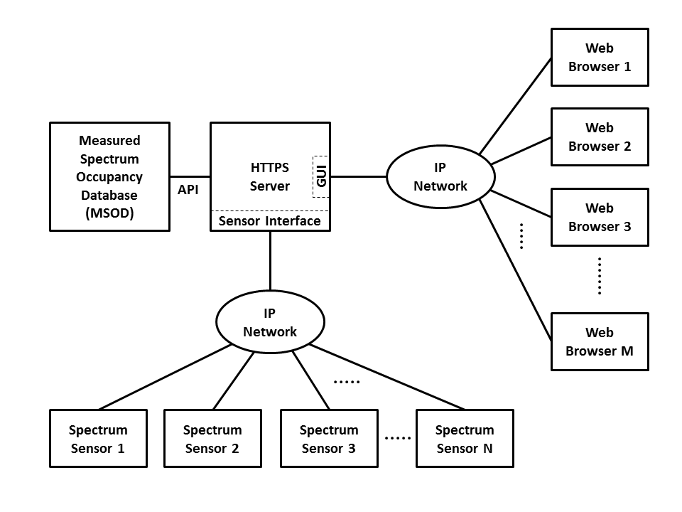
Architecture Diagram

Slide 15
MSOD Parameters
Layer | Category/Metric | ITS/ITL MSOD
Data Collection | Time Resolution | 1 millisecond
 | Frequency Range | Target band(s) specified in advance
 | Latency | Acquisition mode: 10 s Streaming mode: <1 s
 | Calibration Data | Accepted
Data Presentation | Charts | Spectrogram with zoom
 |  | Mean Band Occupancy over long time ranges
 |  | Power vs time
 |  | Power vs frequency
 | Time Scale | Week(s), day, 10 s

Slide 16
Contact Information and References
Michael Cotton
mcotton@its.bldrdoc.gov
303-497-7346
NOI Comments on NTIA Spectrum Monitoring Pilot Program
Cotton and Dalke, “Spectrum Occupancy Measurements of the 3550-3650 MHz Maritime Radar Band Near San Diego,” NTIA Report TR-14-500, Jan 2014.
Sanders, Ramsey, and Lawrence, “Broadband Spectrum Survey at San Diego, CA,” NTIA Report TR-97-334, Dec 1996.

Slide 17
NOI Collaboration Tasks
Consult with Federal agencies to determine technical parameters and sensitivity of data.
Consult with OSM to prioritize frequency bands, sensor locations, coverage criteria, and monitoring requirements.
Enable private sector and spectrum managers to deploy data collection/dissemination systems.
Make available criteria, requirements, parameters, designs, interfaces, software, data sets and other information in each phase of the project.
Make available data for spectrum community to investigate feasibility of new spectrum access schemes.
Seek recommendations on whether to continue and expand the program.

